Slide 1
Hydrogen:
Getting the Green Light,
Driving Europe's Green Recovery
1 July 2020
Place image in this area.

Slide 2
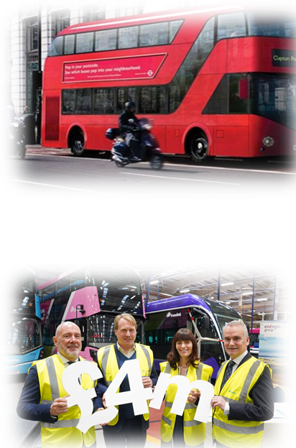
Background
Over the last 4 years NI has been successful in securing funding for the development of Renewable generate Hydrogen supplying Fuel Cell Buses in Belfast, these included
A €9.3m EU project, GENCOMM (GENerating energy secure COMMunities); led by Belfast Met is a Hydrogen Storage from renewable energy project designed to develop a new model to increase generated electricity from renewable sources and deliver energy security. This includes a 500kW Electrolyser installed on a Wind Farm in NI
£4m grant for the supply of 3 Double Deck Buses and Hydrogen Refueling Station in Belfast from OLEV led by Energia and Translink
In a renewable future NI has to address the big 3 energy users of: Electricity, Heat and Transportation fuel.
This will require the rapid deployment of Electrolysers, Anaerobic Digestion Plant and Electric/Fuel Cell Vehicles together with the technicians to install and maintain them
Hydrogen: Getting the Green Light, Driving Europe’s Green Recovery

Slide 3
The hydrogen economy
The hydrogen economy is the use of hydrogen as a low carbon fuel, particularly for heating, hydrogen vehicles, seasonal energy storage and long distance transport of energy.
The hydrogen economy is proposed as part of the future low-carbon economy. In order to phase out fossil fuels and limit global warming, hydrogen is being considered as its combustion only releases clean water, and no CO2 to the atmosphere
The Hydrogen is produced from Electrolysers that can be connected directed to the renewable generator (wind and solar) making the fuel 100% carbon free
Hydrogen can be used for electricity generation through fuel cells, in vehicles (passenger, commercial and HGV as well as trains), and in boilers and burners for heating and cooking.
Hydrogen: Getting the Green Light, Driving Europe’s Green Recovery

Slide 4
Hydrogen: Getting the Green Light, Driving Europe’s Green Recovery

Slide 5
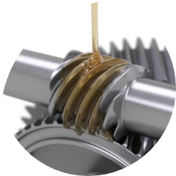
Delivering an Industry Led Approach
Essential there is a strong local energy policy and associated implementation strategy that is linked to the UK Industrial Strategy (Energy Revolution Theme – energy, water, transport, circular economy and ICT) and the Zero Carbon 2050 strategy.
We need to have a simple pathway with very clearly defined goals and funding to meet the needs of the economy
This will act as a driver for the Knowledge Economy through industry led R&D, creation of High Value jobs, and potential for investment in manufacturing of hydrogen storage tanks, mobile refill units, electrolyser’s and expansion for renewable energy and storage etc.
Hydrogen will provide energy security and system resilience for the heat, power and transport markets.
Hydrogen: Getting the Green Light, Driving Europe’s Green Recovery

Slide 6
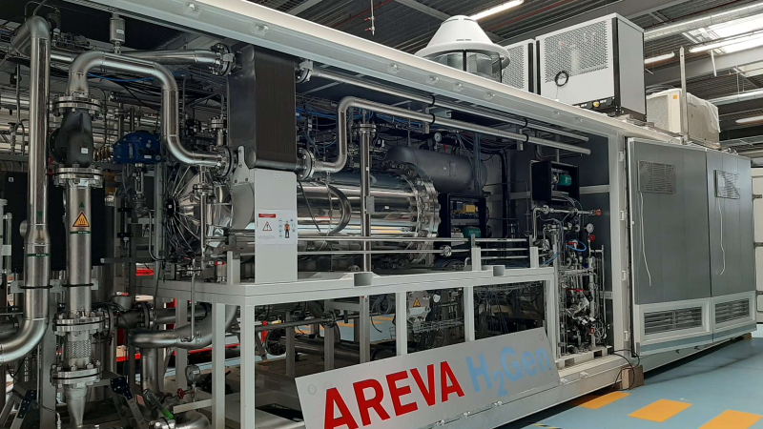
Electrolyser – Requiring High Value Skills and Knowledge
Hydrogen: Getting the Green Light, Driving Europe’s Green Recovery

Slide 7
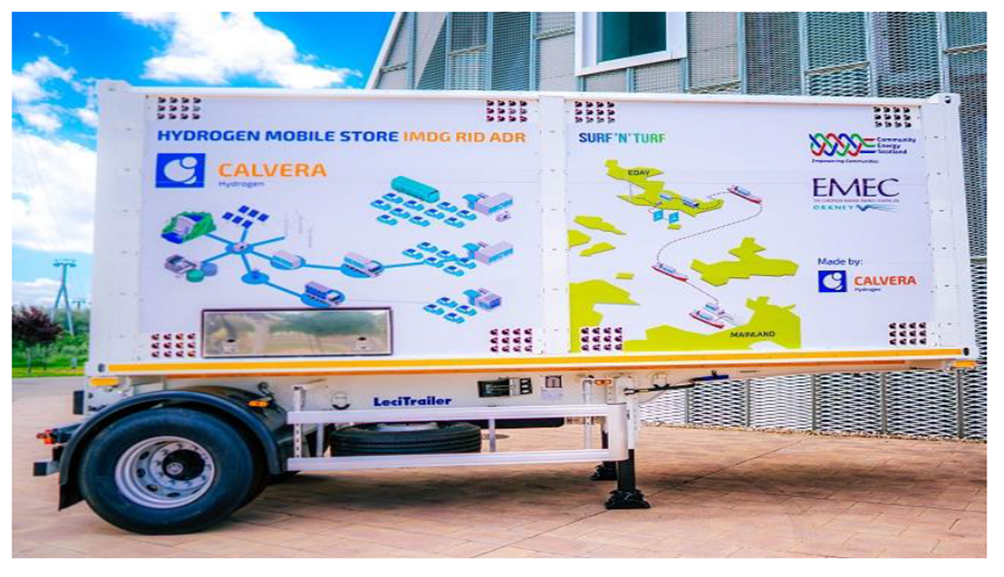
Utilising the existing fuel transport and delivery network
Hydrogen: Getting the Green Light, Driving Europe’s Green Recovery

Slide 8
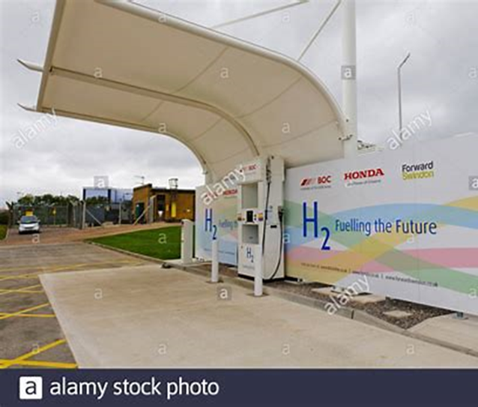
Hydrogen Refuelling Station
Delivering 3 Hydrogen Double Deck Busses to Belfast
Northern Ireland is the only region in the United Kingdom, and Belfast the only capital city, which does not have a hydrogen refuelling station
The project will deliver a 350 bar hydrogen refuelling station in Belfast, owned and operated by Energia, thereby significantly expanding the reach of the UK’s hydrogen refuelling station network. It will supply this station with 100% sustainably produced hydrogen from an electrolysis system co-located at, and supplied by, an existing windfarm .
Translink, the province’s public transport operator, will own and operate 3 locally manufactured, high capacity hydrogen double decker buses from Wrightbus on the road to provide a base demand for hydrogen to allow an initial business case to be developed.
Hydrogen: Getting the Green Light, Driving Europe’s Green Recovery

Slide 9
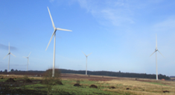
Renewable Hydrogen Delivering
Electricity - NI Electricity System is currently supplied by 40% renewable aiming by 2050 to be 100% renewable. This will be delivered by a mix of On/Off Shore Wind, Marine Tidal and Solar development all using excess energy to deliver green hydrogen
Heat – Our Gas Network is supplied by fossil fuels, to deliver 100% renewable by 2050 will require a ramping up our AD Gas plants and Renewable Hydrogen
Transport is currently supply by 2% renewable energy; to achieve 100% renewable again will require a steep increase in Electric Vehicles (Charge points) and Hydrogen Fuel Cell HGV’s
Hydrogen: Getting the Green Light, Driving Europe’s Green Recovery

