Slide 1
Informing and enabling communities –
The Community Hydrogen Forum (CH2F)
1 July 2020
Place image in this area.

Slide 2
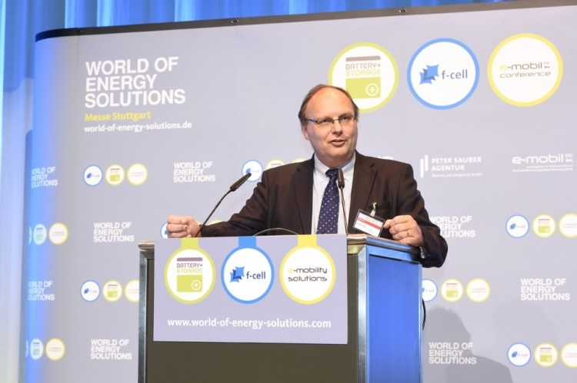
Introduction
Do renewables spark joy?
Hydrogen’s role and record
Learn, enhance, improve…
The Community Hydrogen Forum
How CH2F can help you
Where to find us
Hydrogen: Getting the Green Light, Driving Europe’s Green Recovery

Slide 3
Renewables: Do they spark joy?
Many recent initiatives to change energy policy have been led by the efforts of individuals and pressure from communities
Renewables are now at the forefront of EU policy
Individuals are educating themselves on actions which could be taken to avoid climate change
Communities are developing projects to supply energy locally to enable greater sourcing control
They rapidly recognise that energy needs are wider than just electrical power
Hydrogen: Getting the Green Light, Driving Europe’s Green Recovery

Slide 4
Sustainability enabled by hydrogen
Hydrogen offers community projects greater flexibility on how to use their renewable energy
It enables energy storage and opens decarbonisation of heat and additional mobility options
Coupling these other sectors to renewables allows expansion of renewable investment
The integration of hydrogen production and use in the energy value chain is now possible – increasing reduction in carbon emissions…
Hydrogen enhances a community’s energy transition potential
Hydrogen: Getting the Green Light, Driving Europe’s Green Recovery

Slide 5
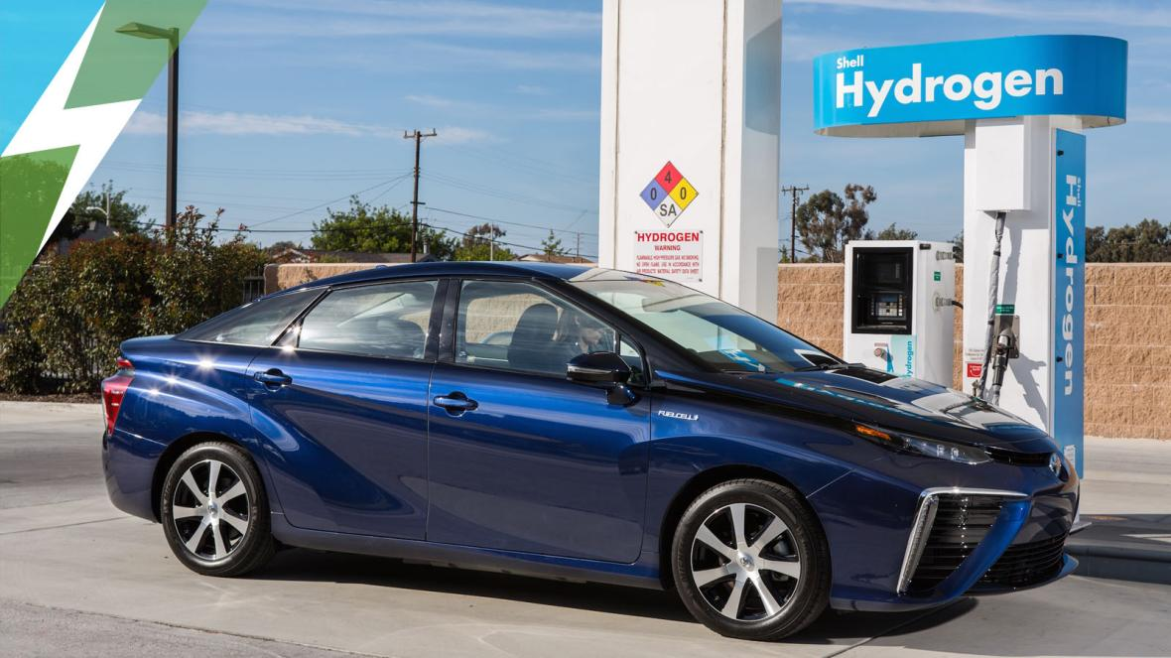
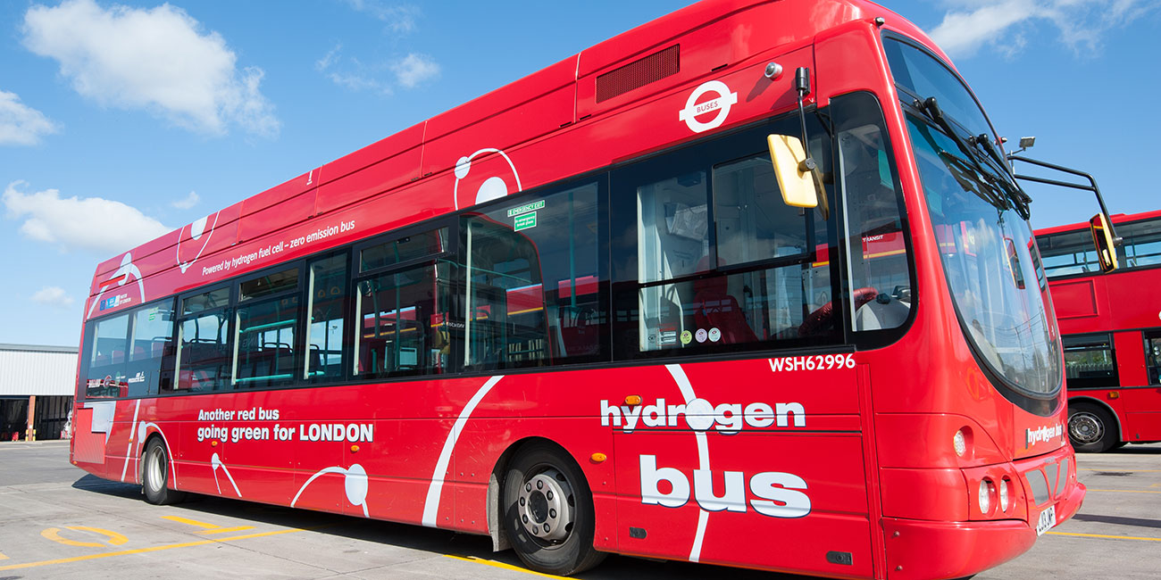
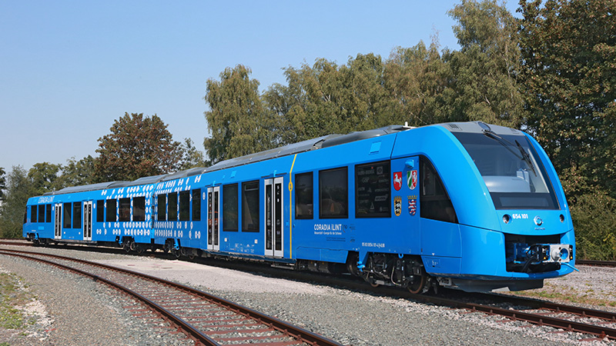
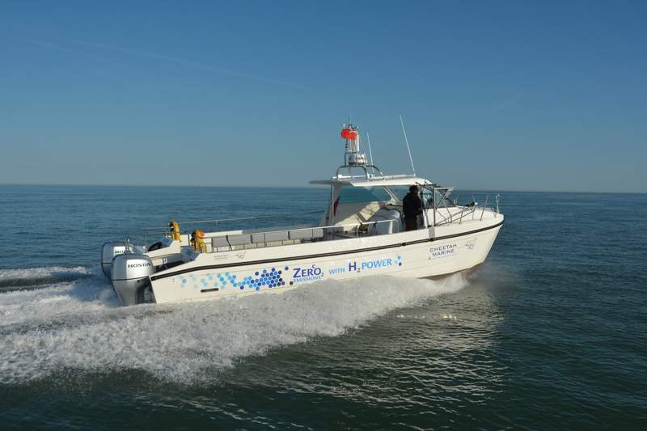
Tried, tested and available…
This integration of renewables with hydrogen has been used in many projects to date all over the globe
The technology is proven commercially or is at a high TLR level, ready to be deployed for projects
An example of the equipment and knowhow available:
Full integration with renewable energies
Electrolysers
Compressors
Lightweight storage
Refuelling stations
Hydrogen cars, buses, trucks, trains and boats
Hydrogen ready boilers
Hydrogen: Getting the Green Light, Driving Europe’s Green Recovery

Slide 6
Learn, enhance, improve….
In order to progress to reach current climate goals, co-operation is a must
The ideas used in projects currently being deployed can be used as inspiration for other local communities
Follow-on and replication projects will increase hydrogen knowhow and penetration
Integration of such projects leads to regional and national change
Knowledge and experience sharing is key to creating successful hydrogen communities
Hydrogen: Getting the Green Light, Driving Europe’s Green Recovery

Slide 7
The Community Hydrogen Forum
Where hydrogen experts and communities come together…
Hydrogen: Getting the Green Light, Driving Europe’s Green Recovery

Slide 8
Goal 1
Raise community hydrogen awareness
Goal 5
Goal 2
Aid the development of long term H2 strategies
Hydrogen Discussion Forum – Sharing information; experiences and best practice
Goal 4
Goal 3
Decision Support Tool to assist in the evaluation of H2 technologies.
Up to date Hydrogen Information
Hydrogen: Getting the Green Light, Driving Europe’s Green Recovery
Aid the development of long term hydrogen strategies

Slide 9
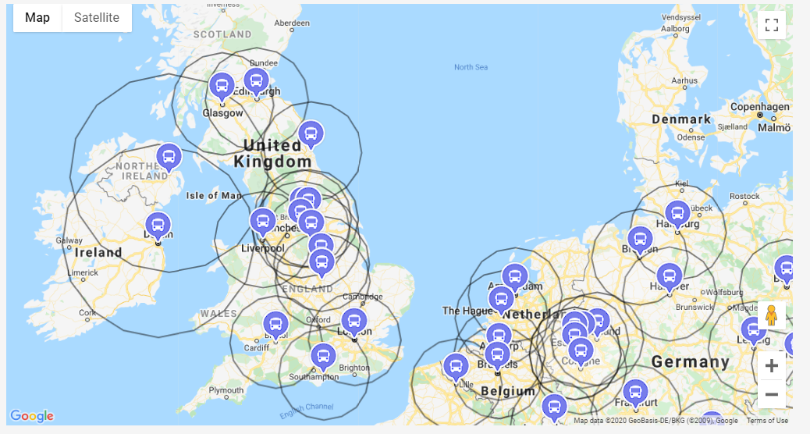
A developing resource….
Case Studies
Decision Support Tool
Latest News
Hydrogen: Getting the Green Light, Driving Europe’s Green Recovery

Slide 10
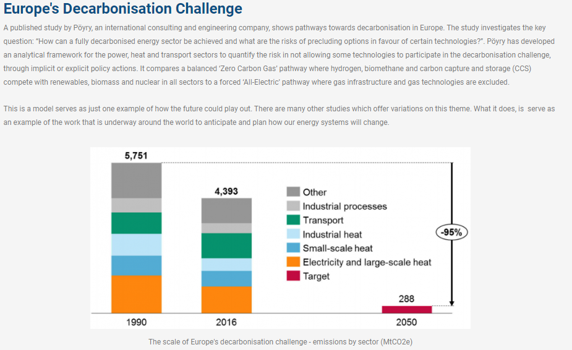
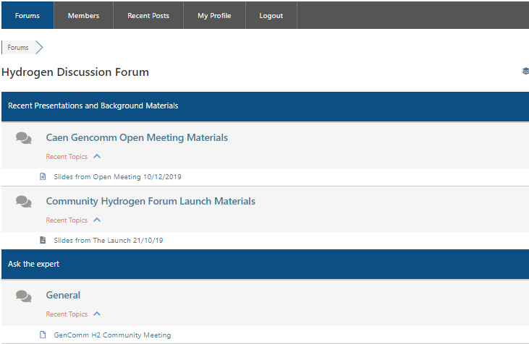
Key features at your fingertips…
Hydrogen Insights
Hydrogen introductory materials
Written by academics and leading hydrogen sector members
Hydrogen Discussion Forum
Register on Communityh2.eu
Ask your questions in the Hydrogen Discussion Forum
Get answers from like-minded communities and our pool of experts.
Hydrogen: Getting the Green Light, Driving Europe’s Green Recovery

Slide 11
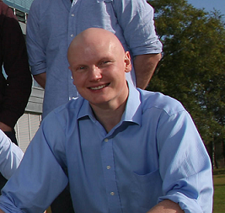
More information…
Ian Williamson
CEO, HyEnergy Consultancy
President, European Hydrogen Association
Tel: +44 7899 941422
E-mail: ian.Williamson@hy-energy.co.uk
Dr. Rory Monaghan
Lecturer of Mechanical Engineering, College of Engineering and Informatics National University of Ireland Galway
Tel: +353 (0)91 494256
E-mail: rory.monaghan@nuigalway.ie
Hydrogen: Getting the Green Light, Driving Europe’s Green Recovery

