Slide 1
Hydrogen:
Getting the Green Light,
Driving Europe's Green Recovery
1 July 2020
Place image in this area.

Slide 2
AGENDA
10:00 - Introduction
Hydrogen the catalyst for generating energy secure communities
Paul McCormack Belfast Met
10:20 - Optimising H2-based energy models – using Decision Support Tools
Dr Rory Monaghan NUIG
10:40 - Informing and enabling communities - Community Hydrogen Forum CH2F
Ian Williamson HyEnergy
11:00 - The mobility capacity of Hydrogen - Wind to green H2
Mark Welsh Energia
11:20 - H2 the catalyst for economic growth – Marine H2 Mobility
Iain Percy Artemis Technologies
11:40 - Q&A session
Hydrogen: Getting the Green Light, Driving Europe’s Green Recovery

Slide 3
Maíread McGuinness First Vice President of the European Commission
Hydrogen: Getting the Green Light, Driving Europe’s Green Recovery

Slide 4
GenComm Animation
Hydrogen: Getting the Green Light, Driving Europe’s Green Recovery

Slide 5
Challenges - Poll
Which of these challenges pose the greatest barrier to Hydrogen getting the green light?
1. Cost
2. Government funding/subsidies
3. Legal barriers
4. Technical challenges
5. Public perception/safety
6. Supply chain and Co-ordination
7. Other?
Notes:
hydrogen is a ‘game changing’ technology with extensive applications across transport, stationary power and beyond. Hydrogen, as an energy carrier, and as an enabling technology, will be critical in the delivery of a clean energy future.
As an energy carrier, hydrogen can play a significant role in energy security, carbon reduction and economic growth. It will be the crucial element of any future energy system.

Slide 6
SMARTH2
The world is changed by your example, not by your opinion
Paulo Coelho
We are on the cusp of a new industrial revolution. Where growth will be driven by;
interaction between rapid technological innovation,
sustainable infrastructure investment
increased resource productivity.

Slide 7
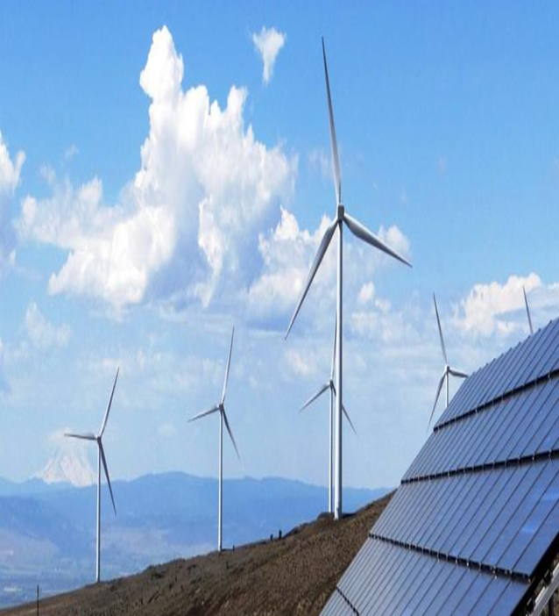
GenComm Focus
GENCOMM – GENerating energy secure COMMunities. Smart Hydrogen -Integrated renewable energy, generation & storage To develop a new model for exploiting remotely generated electricity from renewable sources to provide energy security for remote communities.
GenComm project focuses on increasing the uptake of the local renewable sources by communities, mostly peripheral, in the NWE region, by implementing an energy model that relies on hydrogen as an energy carrier and is utilised to supply the main forms of energy demand: electricity, heating and transportation fuels.
Notes:
hydrogen is a ‘game changing’ technology with extensive applications across transport, stationary power and beyond. Hydrogen, as an energy carrier, and as an enabling technology, will be critical in the delivery of a clean energy future.
As an energy carrier, hydrogen can play a significant role in energy security, carbon reduction and economic growth. It will be the crucial element of any future energy system.

Slide 8
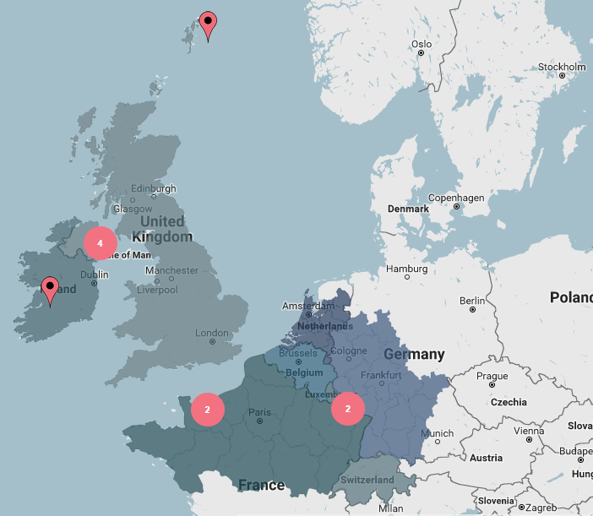
GenComm Partners
Belfast Metropolitan College Viridian Energy Supply Limited | United Kingdom United Kingdom
HyEnergy | United Kingdom
Pure Energy Centre | United Kingdom
National University of Ireland Galway | Ireland
IZES gGmbH | Germany
ENSICAEN | France
INSA Rouen Normandie | France
TK Renewables | United Kingdom
BURN Joint Research Group, Vrije Universiteit Brussel | Belgium

Slide 9
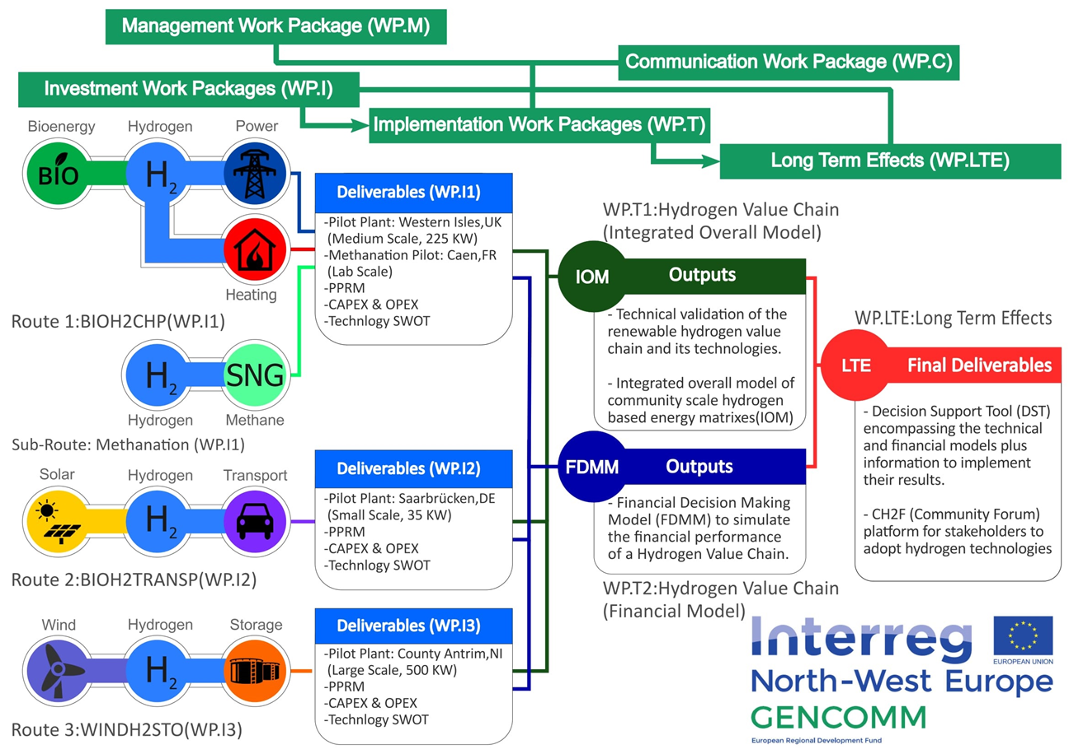
GenComm Value Chain
Notes:
Rural and isolated communities in NWE face unique energy issues related to efficiency, reliability and sustainability. This is commonly due to dependency on external and fossil fuel energy supply, low electricity grid capacity and limited or no connection to wider grids. As a result these communities have higher than average carbon emissions and are more vulnerable to fluctuating fuel prices.

Slide 10
SMART H2
Smart Hydrogen creating a hydrogen value chain that is optimal in technical performance and financial revenues.
SMARTH2 sector coupling renewables -transport, industry & heat
Involving entire supply chain and end users
Versatile energy carrier for efficient renewable energy storage, transmission and utilisation.

Slide 11
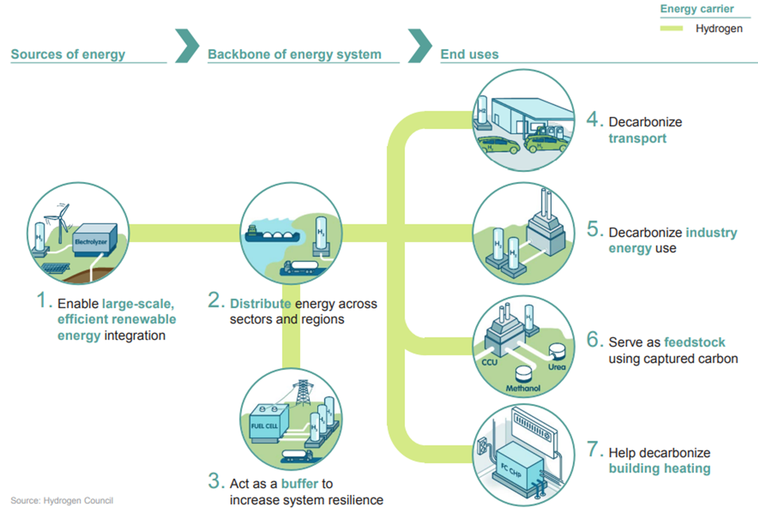
Renewable Power to X - P2X
Green Hydrogen
Power to Mobility P2TM
Power to Industry P2I
Power to Heat P2H
Power to Gas Grid Injection P2G
Notes:
Renewable energy sources continue to increase their share of installed capacity worldwide. Their integration, in conjunction with increased energy efficiency and other low-carbon technologies, constitutes the best opportunity to achieve energy sustainability.
Renewable energy sources also constitute the best option to avert the risks that conventional non-renewable sources pose to health, geopolitics, the economy and the environment. In accordance with their commitment to the Paris Agreement of 2015,
The concept “Power to X” (P2X) refers to energy conversion technologies that allow for the decoupling of power production plants from the electrical market to use their product in other sectors (such as transport, heating and chemicals). P2X is particularly relevant for renewable power technologies as they face a series of challenges to increase their participation in the current energy matrix. These challenges hinder the uptake of renewable energy technologies hence delaying, the current transition to a sustainable energy sector and decelerating the effort to reduce GHG emissions from this sector. The project is aimed to create a roadmap in which investors from existing and future renewable power plants can identify, techno-economically analyse and project the inclusion of a fitting P2X technology to their infrastructure.

Slide 12
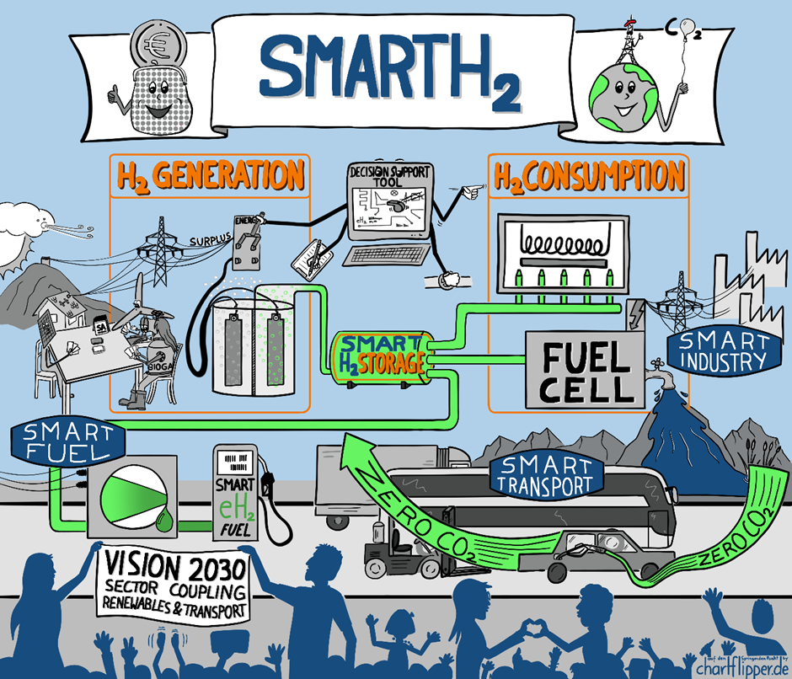
Fuelling the Just Transition – The Role of Non-Carbon Energy

Slide 13
Key Take Aways
We can change the current dominant economic paradigm where energy production is a secondary product of the economy and instead make it a primary driver of the economy
?
?
?
Polls at the end

Slide 14
Speakers
Hydrogen: Getting the Green Light, Driving Europe’s Green Recovery

Slide 15
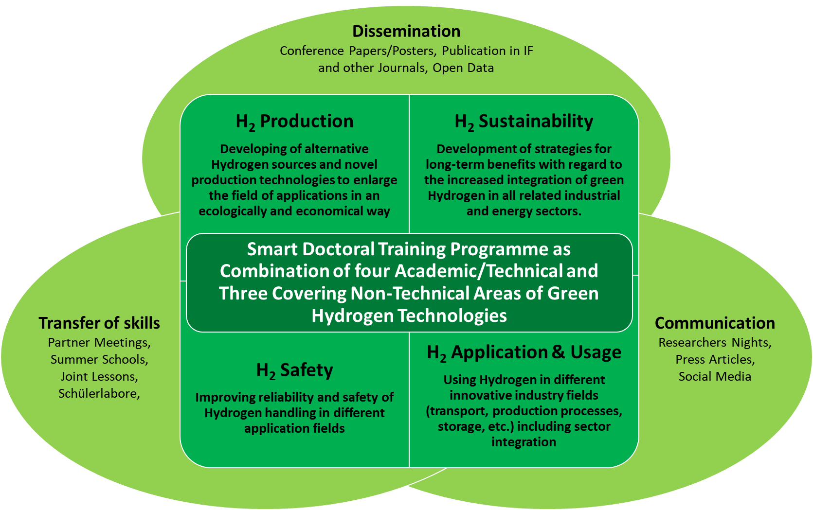
Webinar Series HAZEL
Hydrogen enAbled Zero Emissions suppLy chains

Slide 16
Webinar conclusion
In order to achieve successful energy transition to renewables in Europe we must look to achieving full commercial opportunity for renewable energy. In order to achieve this we have to ensure commercial flexibility in sector coupling renewable energy. The use of SMART H2 as an energy carrier to achieve this goal is crucial.
Part of the wider European energy solution demonstrating Green H2 in the P2X equation
Helping shape the energy future and leading the new energy revolution.
Exploring the versatility of hydrogen as an energy vector
Demonstrating how Hydrogen can play important role to increase energy security and resilience in renewable-rich, energy-remote communities.

Slide 17
In Conclusion
GenComm is part of the wider NWE energy solution
We are all part of the new energy revolution
We are helping shape the energy future

