Slide 1
Optimising H₂-based Energy Models – using Decision Support Tools
Dr Rory Monaghan
School of Engineering, National University of Ireland Galway (NUI Galway)
Ryan Institute for Marine, Environment and Energy Research, NUI Galway
MaREI, the SFI Research Centre for Energy, Climate and Marine
Hydrogen: Getting the green light, Driving Europe’s green recovery
1 July 2020

Slide 2
Why hydrogen?
Chickens and eggs
A decision support tool for hydrogen investments
Hydrogen value chain case studies
Outlook

Slide 3
Why are we Talking about Renewable Hydrogen?
Hydrogen can close half of the gap between current EU 2050 plans and 2DS GHG emissions
Image: Hydrogen Roadmap Europe, FCHJU, 2019

Slide 4
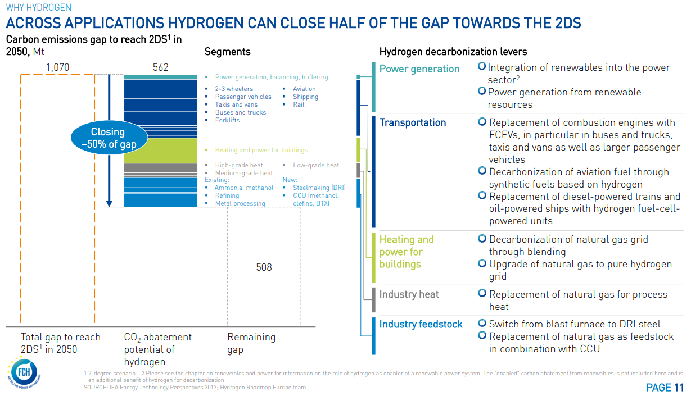
From: Hydrogen Roadmap Europe, FCHJU, 2019

Slide 5
Chickens, Eggs & Hydrogen
Awareness is growing of the benefits of hydrogen but how can investors and communities understand sector integration and the opportunities?
Who invests first?
“I want to produce renewable hydrogen but who would buy it?”
“I want to run fuel cell buses but who sells renewable hydrogen?”

Slide 6
The Missing Links: Community Hydrogen Forum & Decision Support Tool
Decision Support Tool
Curtailed renewable energy sources
Hydrogen could make sense for my community, organisation or company.
But how do I make it happen?
How do I find a hydrogen source or market?
Energy demands
Where can I learn about hydrogen opportunities?
How do I take the next steps?
How do I connect with others across Europe?
Industry
Wind Energy
Mobility
Solar Energy
AD Plant
Stationary Energy

Slide 7
Decision Support Tool
Annual energy demands for big city bus fleets
Hydrogen energy equivalent
Supports NWE stakeholders to evaluate the potential of hydrogen in:
Sustainable community development
Decarbonisation
Energy security
Achieves this by demonstrating the role of hydrogen produced at onshore wind farms in decarbonising public bus fleets in large cities across the region
Will later be expanded to include solar and bioenergy
Visualised in an online interactive map of NWE
Total hydrogen demand

Slide 8
Decision Support Tool
Annual energy demands for big city bus fleets
Hydrogen energy equivalent
Supports NWE stakeholders to evaluate the potential of hydrogen in:
Sustainable community development
Decarbonisation
Energy security
Achieves this by demonstrating the role of hydrogen produced at onshore wind farms in decarbonising public bus fleets in large cities across the region
Will later be expanded to include solar and bioenergy
Visualised in an online interactive map of NWE
Total hydrogen demand
Total hydrogen supply
Optimal electrolyser size at every wind farm
Available curtailed wind at every wind farm

Slide 9
Decision Support Tool
Annual energy demands for big city bus fleets
Hydrogen energy equivalent
Supports NWE stakeholders to evaluate the potential of hydrogen in:
Sustainable community development
Decarbonisation
Energy security
Achieves this by demonstrating the role of hydrogen produced at onshore wind farms in decarbonising public bus fleets in large cities across the region
Will later be expanded to include solar and bioenergy
Visualised in an online interactive map of NWE
Total hydrogen demand
Big city locations
Hydrogen supply chain
Wind farm locations
37 cities across North West Europe
4,252 wind farms across North West Europe
Total hydrogen supply
Optimal electrolyser size at every wind farm
Available curtailed wind at every wind farm

Slide 10
Decision Support Tool
Annual energy demands for big city bus fleets
Hydrogen energy equivalent
Supports NWE stakeholders to evaluate the potential of hydrogen in:
Sustainable community development
Decarbonisation
Energy security
Achieves this by demonstrating the role of hydrogen produced at onshore wind farms in decarbonising public bus fleets in large cities across the region
Will later be expanded to include solar and bioenergy
Visualised in an online interactive map of NWE
Total hydrogen demand
Big city locations
Hydrogen supply chain
Wind farm locations
37 cities across North West Europe
4,252 wind farms across North West Europe
Total hydrogen supply
Optimal electrolyser size at every wind farm
Available curtailed wind at every wind farm
“Top up” power needed from wind farm & grid for 24/7 operation

Slide 11
The Decision Support Tool How it works
Input from users
Techno-economic parameters
Technical model
Economic model
Transport model

Slide 12
The Decision Support Tool How it works
Input from users
wind curtailment, $\text{E}\text{DD}$ (%)
capacity factor, $\text{CF}\text{WF}$ (%)
wind farm capacity, $\text{CP}\text{WF}$ (MW)
Wind curtailment volume (MWh)
Techno-economic parameters
Technical model
Hydrogen production (kg/y)
Optimum electrolyser size (MW)
Required water (kg/y)
Required electricity from the grid (MWh)
Economic model
Transport model

Slide 13
The Decision Support Tool How it works
Input from users
wind curtailment, $\text{E}\text{DD}$ (%)
capacity factor, $\text{CF}\text{WF}$ (%)
wind farm capacity, $\text{CP}\text{WF}$ (MW)
Wind curtailment volume (MWh)
Techno-economic parameters
Technical model
Hydrogen production (kg/y)
Optimum electrolyser size (MW)
Required water (kg/y)
Required electricity from the grid (MWh)
Economic model
Transport model
CAPEX ($€$)
Fixed OPEX ($€$)
Variable OPEX ($€$)
Travel cost ($€$)
Location & routes by GIS
Operating cost relative to diesel (excl. transport)
Full operating cost relative to diesel

Slide 14
Hydrogen Value Chain Case Studies
Local – Galway bus pilot
Regional-National – Decarbonisation of Irish city bus fleets
Multinational – Decarbonisation of European city bus fleets
Gas grid injection – Decarbonisation of heat

Slide 15
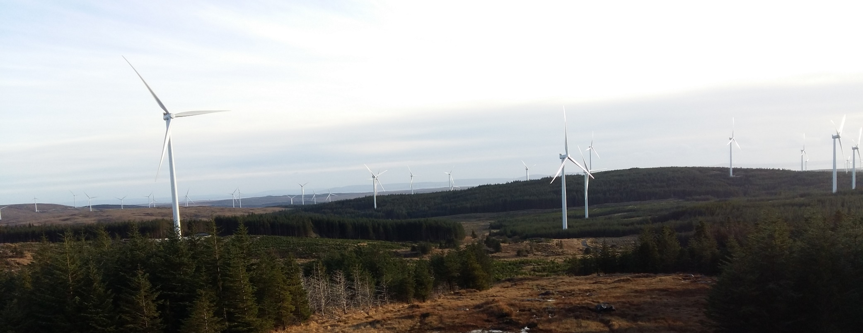
Case Study – Galway, IE
Local Hydrogen Supply Chain
“Can we use wasted wind energy from Ireland’s largest wind farm to produce hydrogen to fuel 5 buses in Galway?”
Galway Wind Park, 174 MW

Slide 16
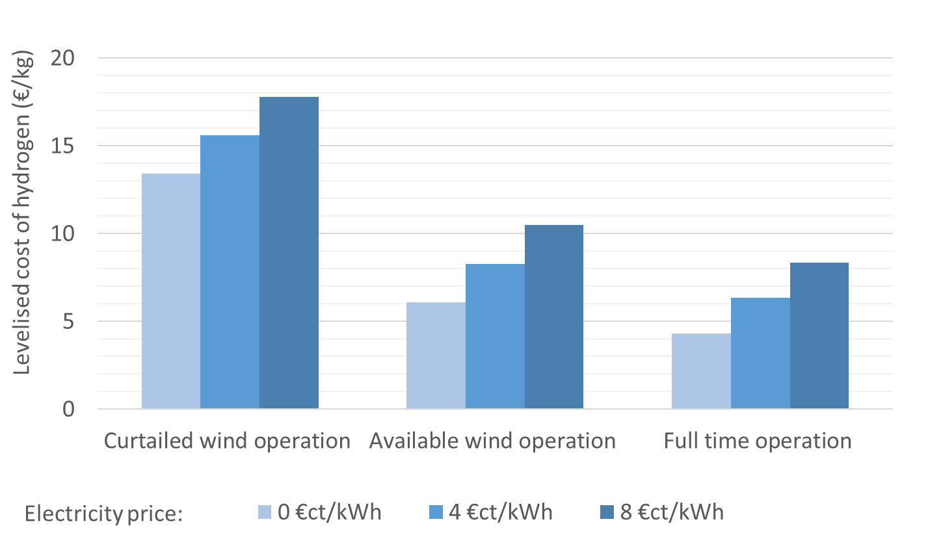
Case Study – Galway, IE
Local Hydrogen Supply Chain

Slide 17
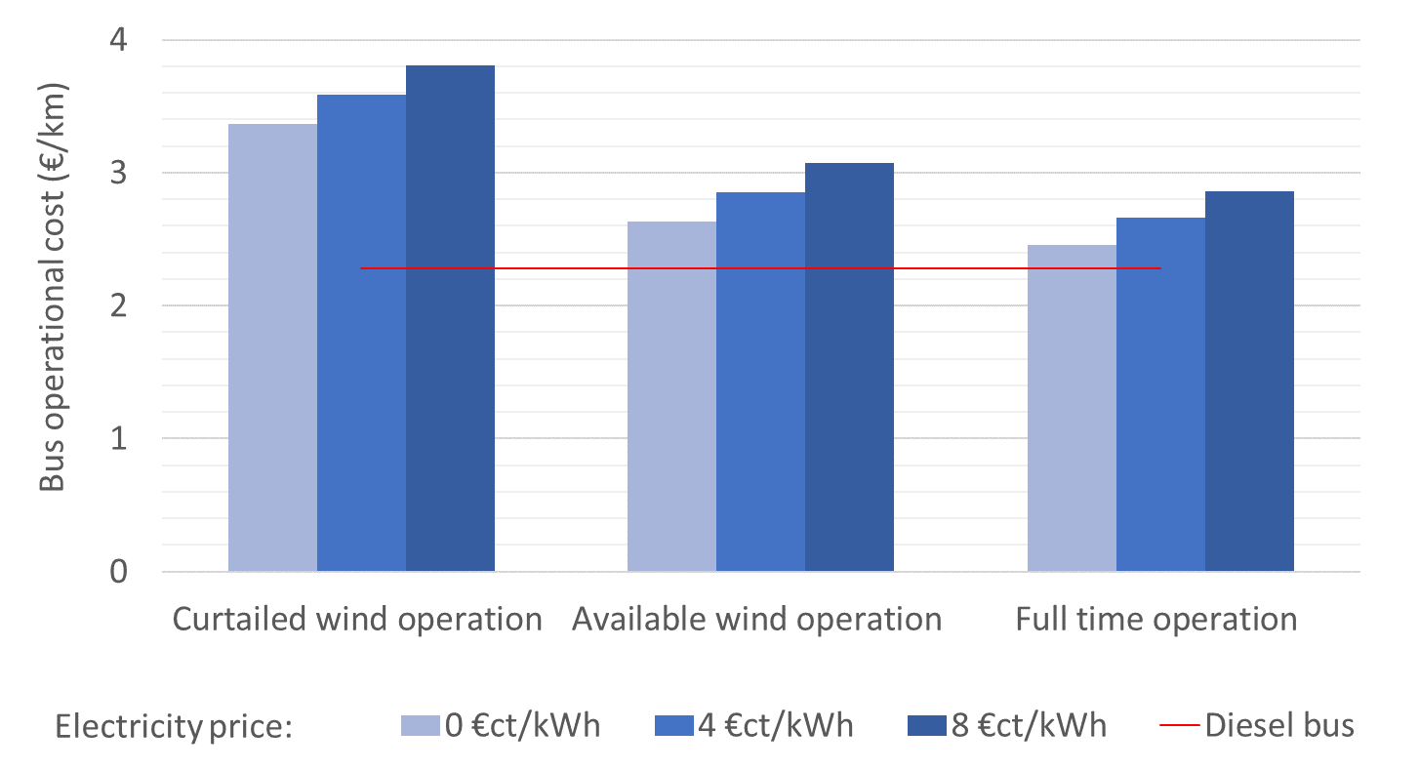
Case Study – Galway, IE
Local Hydrogen Supply Chain

Slide 18
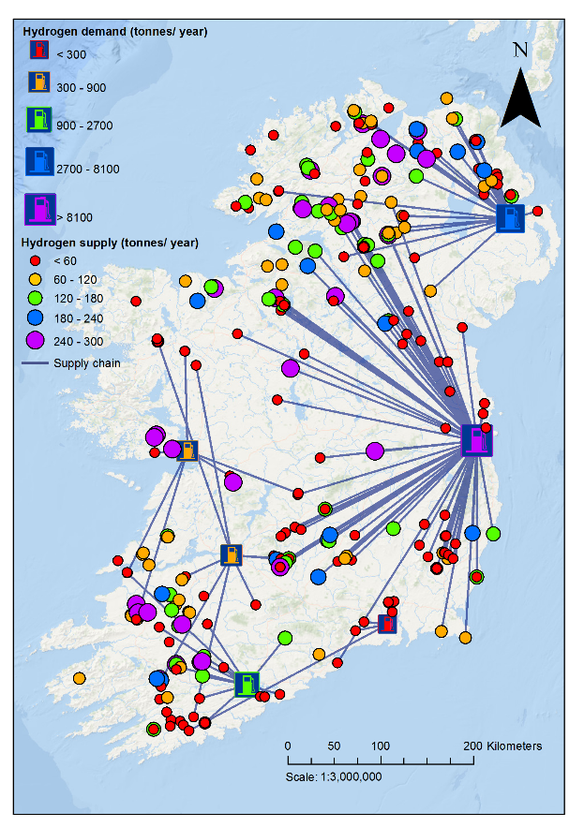
Case Study - Ireland
Regional-National Hydrogen Supply Chain
2017 costs
Levelised cost of delivered hydrogen
Wind-solar H₂ supply chain to city bus networks
100% demand coverage

Slide 19
Case Study - Ireland
Regional-National Hydrogen Supply Chain
2017 costs
2030 costs
Levelised cost of delivered hydrogen
Wind-solar H₂ supply chain to city bus networks
100% demand coverage

Slide 20
Case Study - Ireland
Regional-National Hydrogen Supply Chain
2017 costs
2030 costs
Levelised cost of delivered hydrogen
By 2030, renewable hydrogen will be competitive with diesel at any CO₂ price
2017 costs
2030 costs
Wind-solar H₂ supply chain to city bus networks
100% demand coverage
Levelised bus operational costs

Slide 21
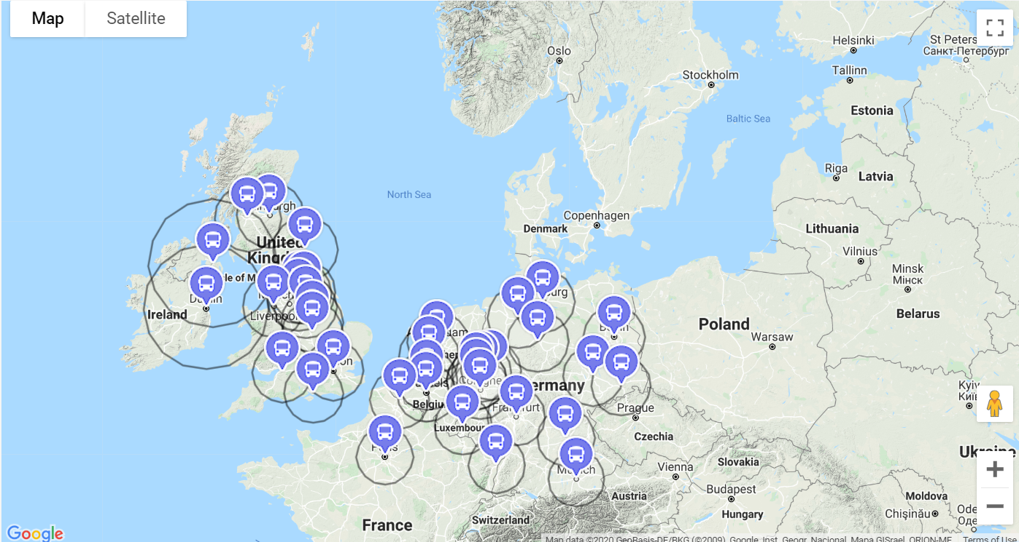
Online DST – Northwest Europe
Multinational Hydrogen Supply Chain
User-friendly wind-H₂ supply chain costings for northwest Europe’s 40 largest cities
http://communityh2.eu/dst/

Slide 22
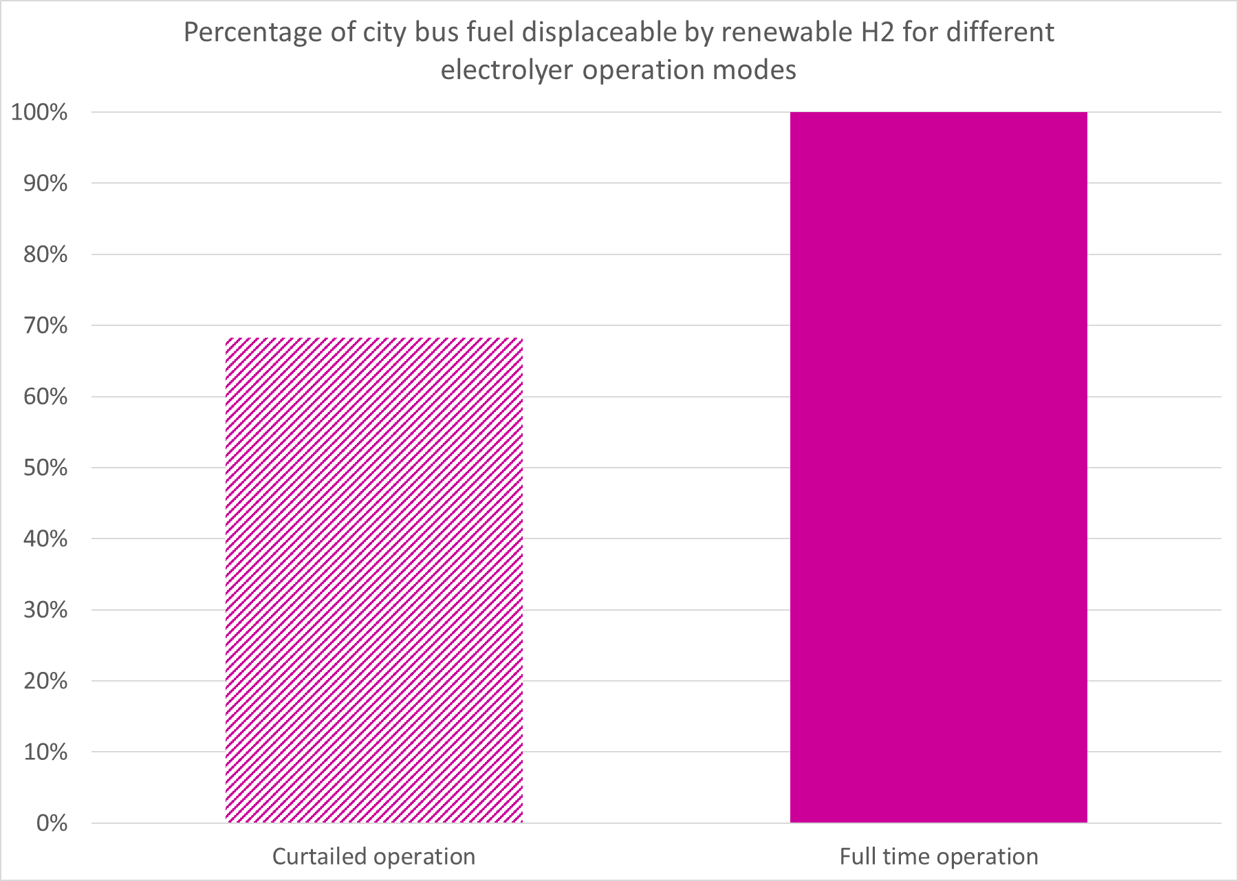
Online DST – Northwest Europe
Multinational Hydrogen Supply Chain
User-friendly wind-H₂ supply chain costings for northwest Europe’s 40 largest cities
Hydrogen would displace 70% of Dublin bus fleet fuel use with curtailed operation of the electrolyser, or 100% with full time operation
http://communityh2.eu/dst/

Slide 23
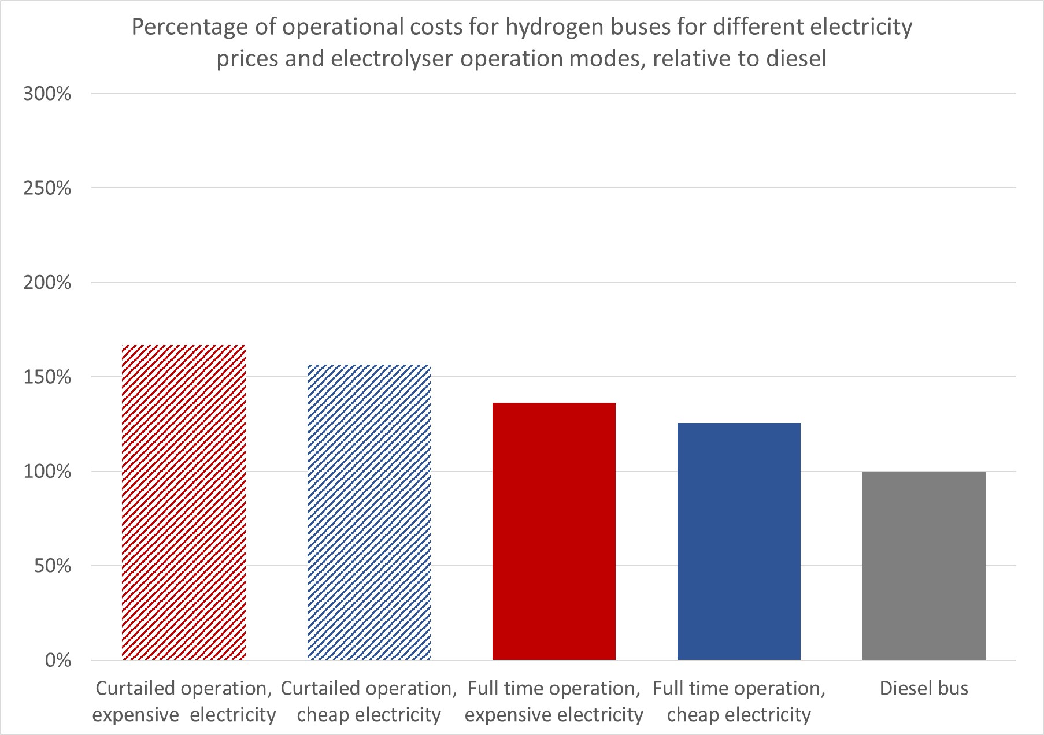
Online DST – Northwest Europe
Multinational Hydrogen Supply Chain
User-friendly wind-H₂ supply chain costings for northwest Europe’s 40 largest cities
A Dublin fuel cell bus could operate with costs from 26% higher than diesel (full time electrolyser operation, cheap electricity) to 67% higher (curtailed operation, expensive electricity)
http://communityh2.eu/dst/

Slide 24
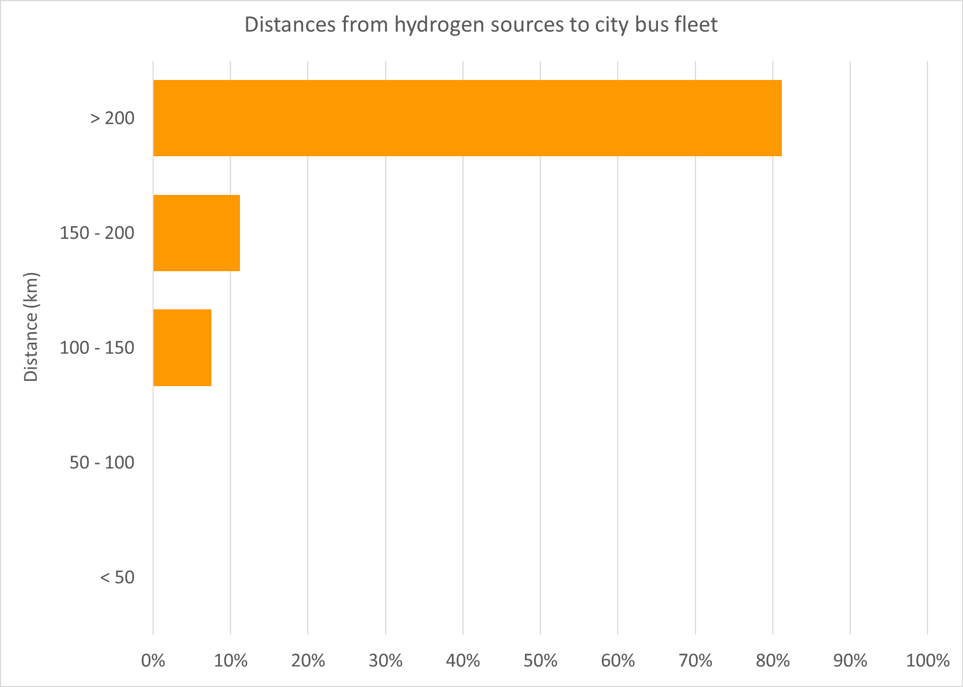
Online DST – Northwest Europe
Multinational Hydrogen Supply Chain
User-friendly wind-H₂ supply chain costings for northwest Europe’s 40 largest cities
Over 80% of the hydrogen available to fuel the Dublin bus fleet must be transported over 200 km (from the west coast) but the wind resource makes it worthwhile
http://communityh2.eu/dst/
The DST can inform potential hydrogen suppliers and users where they can make the greatest impact and how much it could cost

Slide 25
Gas grid injection supply chain
Gunawan, T.A.; Singlitico, A.; Blount, P.; Burchill, J.; Carton, J.G.; Monaghan, R.F.D. At What Cost Can Renewable Hydrogen Offset Fossil Fuel Use in Ireland’s Gas Network? Energies 2020, 13, 1798. Full paper: https://www.mdpi.com/1996-1073/13/7/1798
Curtailed wind, high price
Available wind, high price
Full capacity, high price
Levelised cost (2030) of hydrogen delivered to gas grid

Slide 26
Gas grid injection supply chain
Gunawan, T.A.; Singlitico, A.; Blount, P.; Burchill, J.; Carton, J.G.; Monaghan, R.F.D. At What Cost Can Renewable Hydrogen Offset Fossil Fuel Use in Ireland’s Gas Network? Energies 2020, 13, 1798. Full paper: https://www.mdpi.com/1996-1073/13/7/1798
Curtailed wind, low price
Available wind, low price
Full capacity, low price
Levelised cost (2030) of hydrogen delivered to gas grid

Slide 27
Key messages
Renewable hydrogen suppliers and consumers need to understand each other before investing.
The Community Hydrogen Forum aims to facilitate this.
The Hydrogen Decision Support Tool guides northwest Europe stakeholders through the first steps of appreciating their opportunities.
Current DST focus is wind-hydrogen-bus but new features will include solar, gas grid injection and industrial heat.
Join us at http://communityh2.eu/

