Slide 1
Hydrogen:
Getting the Green Light,
Driving Europe's Green Recovery
1 July 2020
Place image in this area.

Slide 2
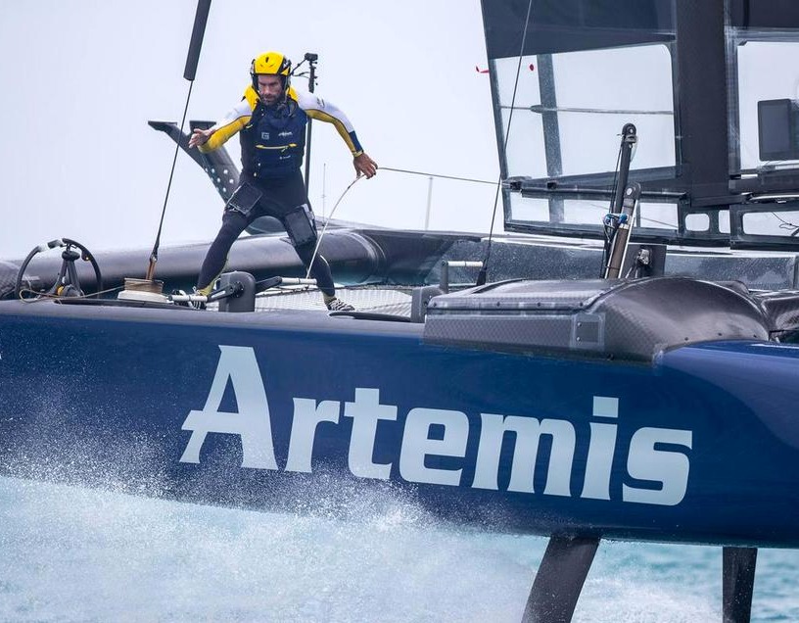
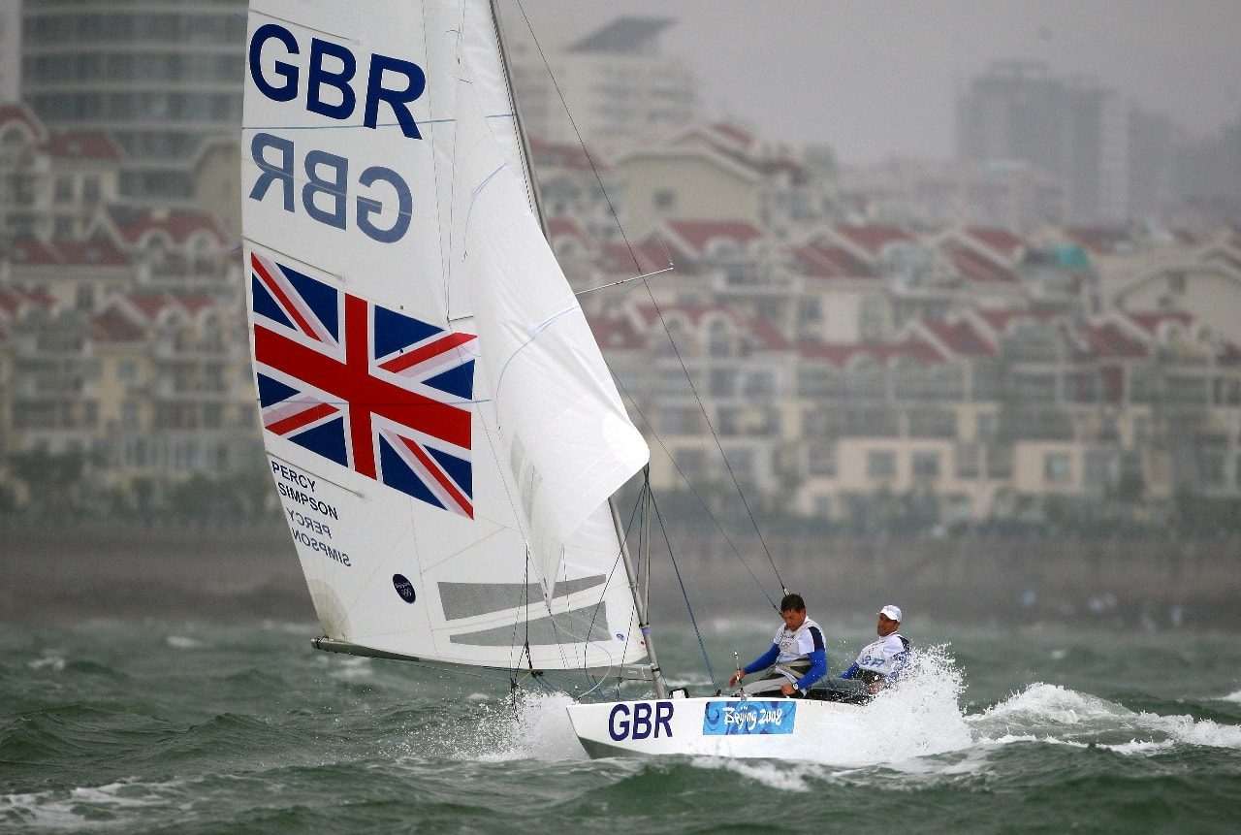
My Background
Three time Olympic medallist and double Olympic champion
Veteran of four America’s Cup challenges, Team Manager of Artemis Racing during the 2017 America’s Cup in Bermuda.
Founded Artemis Technologies in 2017, with a mission to see how our America’s Cup technology could play a part in the decarbonisation of the maritime industry.
Hydrogen: Getting the Green Light, Driving Europe’s Green Recovery

Slide 3
Artemis Technologies
A spin off from the successful Artemis Racing America’s Cup team.
Founded to commercialise the hydrofoil, computer simulation tools, and wing-sail intellectual property developed by the team over the last seven years.
The company provides engineering services to high-performance and commercial clients, as well as developing unique products, like the world’s most advanced maritime simulators.
Hydrogen: Getting the Green Light, Driving Europe’s Green Recovery

Slide 4
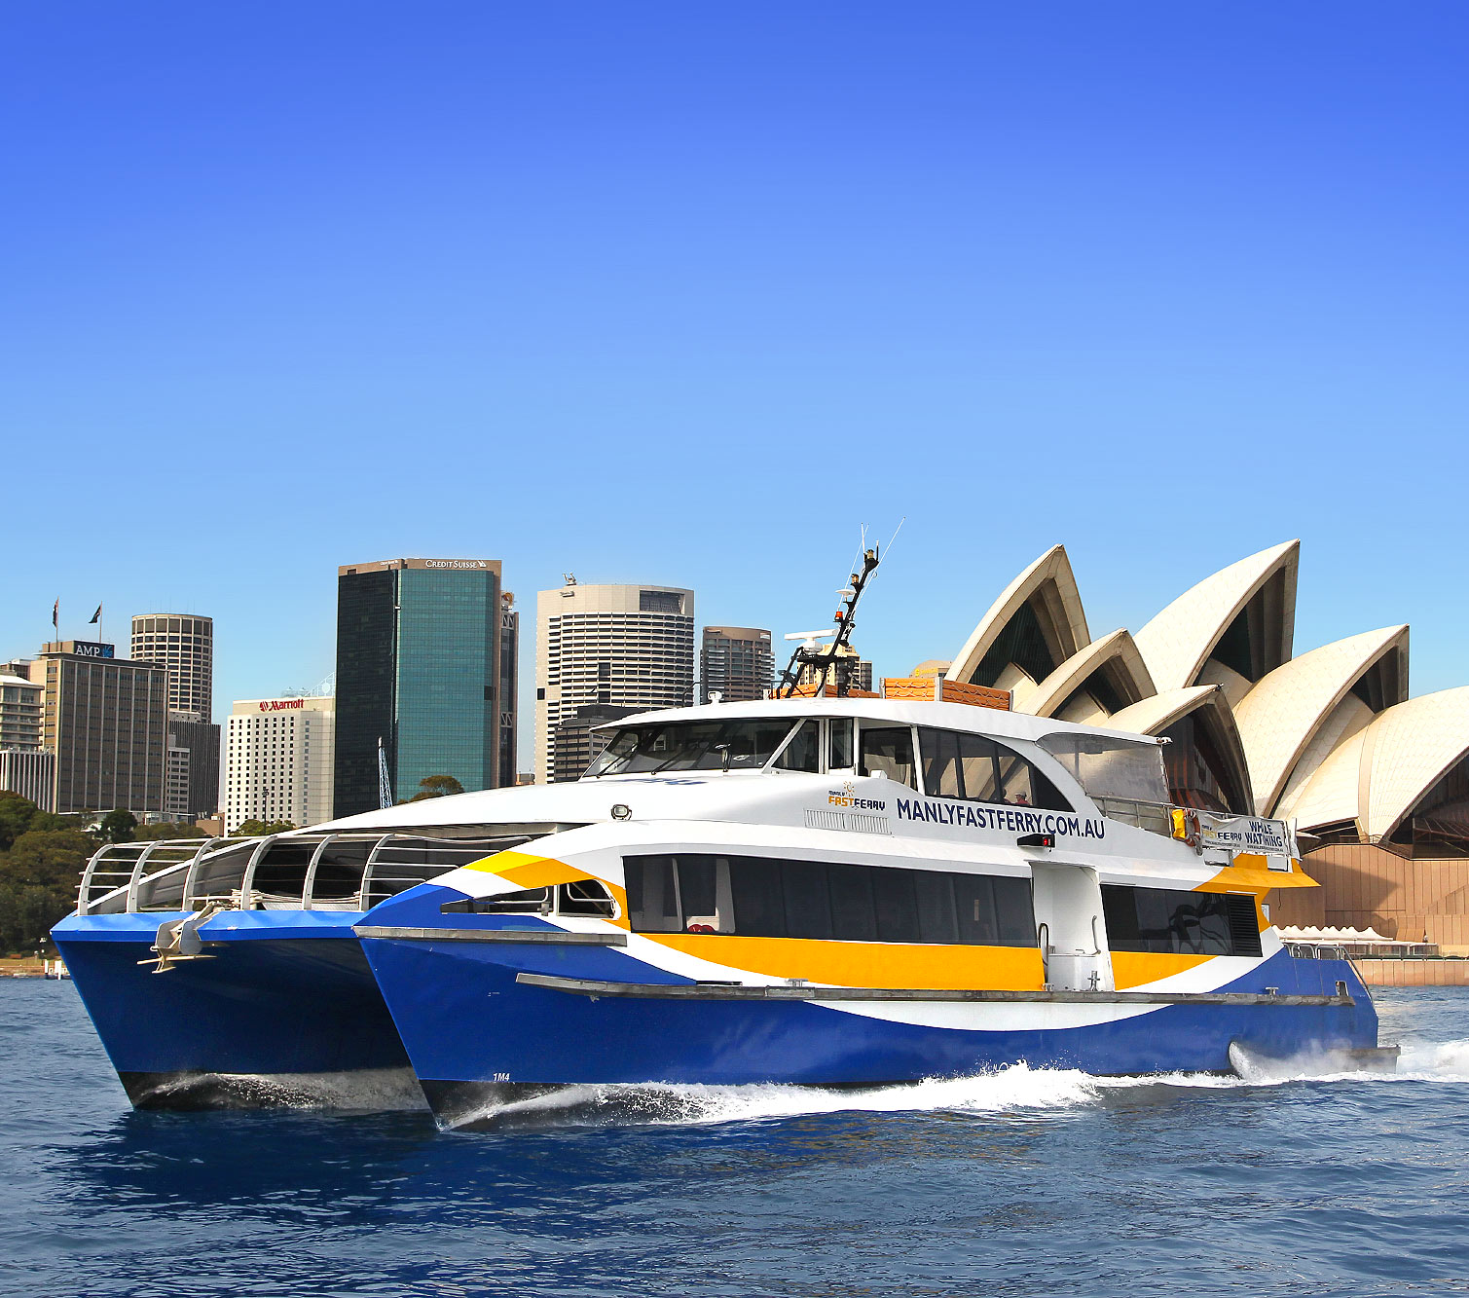
Maritime in 2020
The global maritime transport sector is a major source of greenhouse gas emissions. It accounts for 15% of nitrogen oxides (NOX), 13% of sulphur oxides (SOx), and 3% of carbon dioxide (CO2) emissions annually.
Under new UN & Government regulation, the maritime sector must reduce its emissions by 50% by 2050 through embracing new disruptive technologies.
However, most operators continue to use ageing and inefficient technology, due to no viable zero-emissions solution in the market, with only marginal environmental gains being achieved.
Hydrogen: Getting the Green Light, Driving Europe’s Green Recovery

Slide 5
PLAY CONSORTIUM VIDEO - https://www.youtube.com/watch?v=l4cFXz3CAVQ&t=9s
Hydrogen: Getting the Green Light, Driving Europe’s Green Recovery

Slide 6
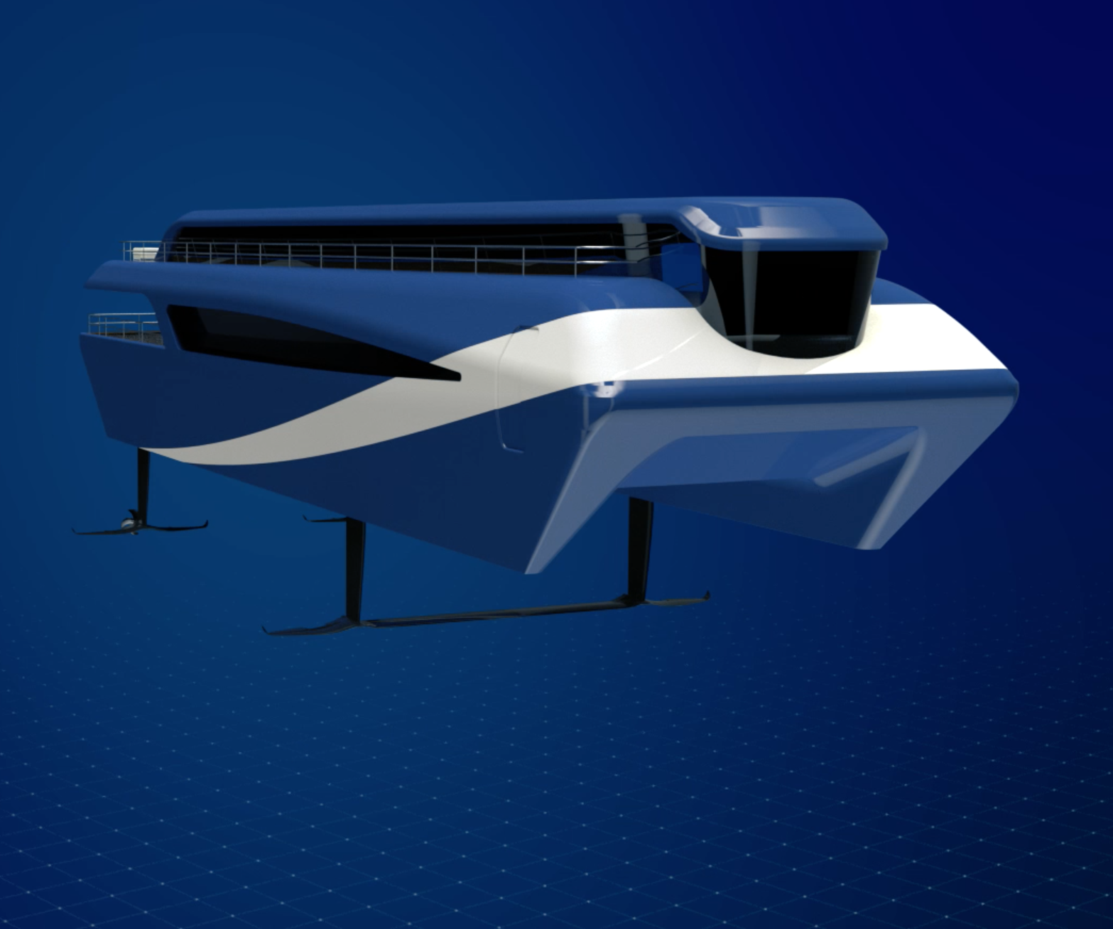
Speed vs
Range
Hydrogen: Getting the Green Light, Driving Europe’s Green Recovery

Slide 7
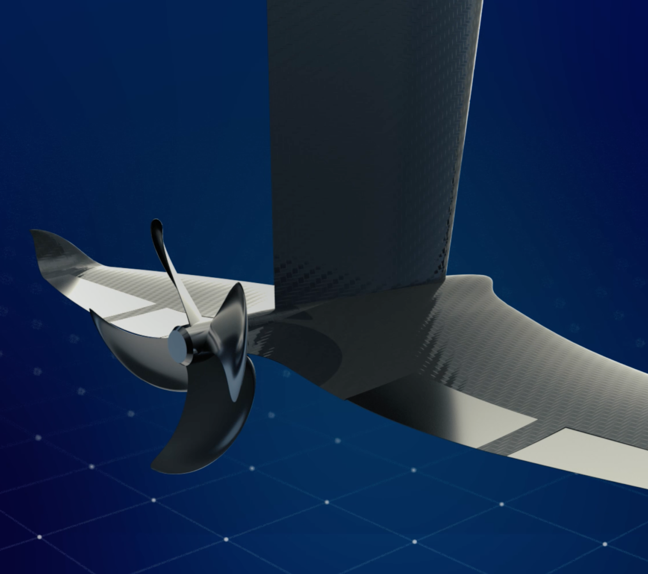
eFoiler Propulsion System
The integration of a high power density electric drivetrain into an autonomously controlled hydrofoil.
A combination of America’s Cup, aerospace, and motorsport technologies.
Vessels fly over the water providing up to 90% fuel savings compared to modern high speed vessels, through a combination of drag reduction and engine efficiency.
Hydrogen: Getting the Green Light, Driving Europe’s Green Recovery

Slide 8
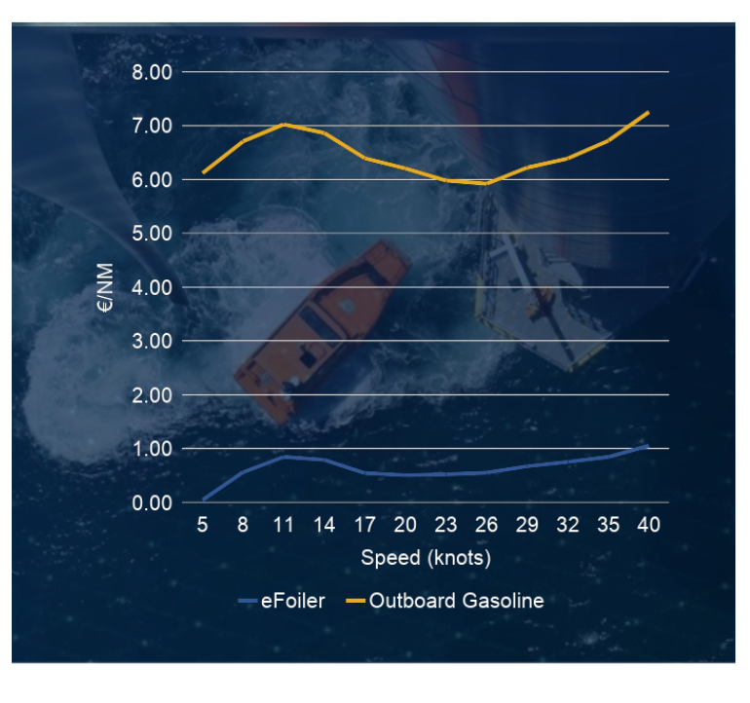
Fuel Efficiency Case Study
Standard fuel costs provided by Tuco Marine Group, and the eFoiler data generated from the Artemis Technologies eSim Tool Chain.
Hydrogen: Getting the Green Light, Driving Europe’s Green Recovery

Slide 9
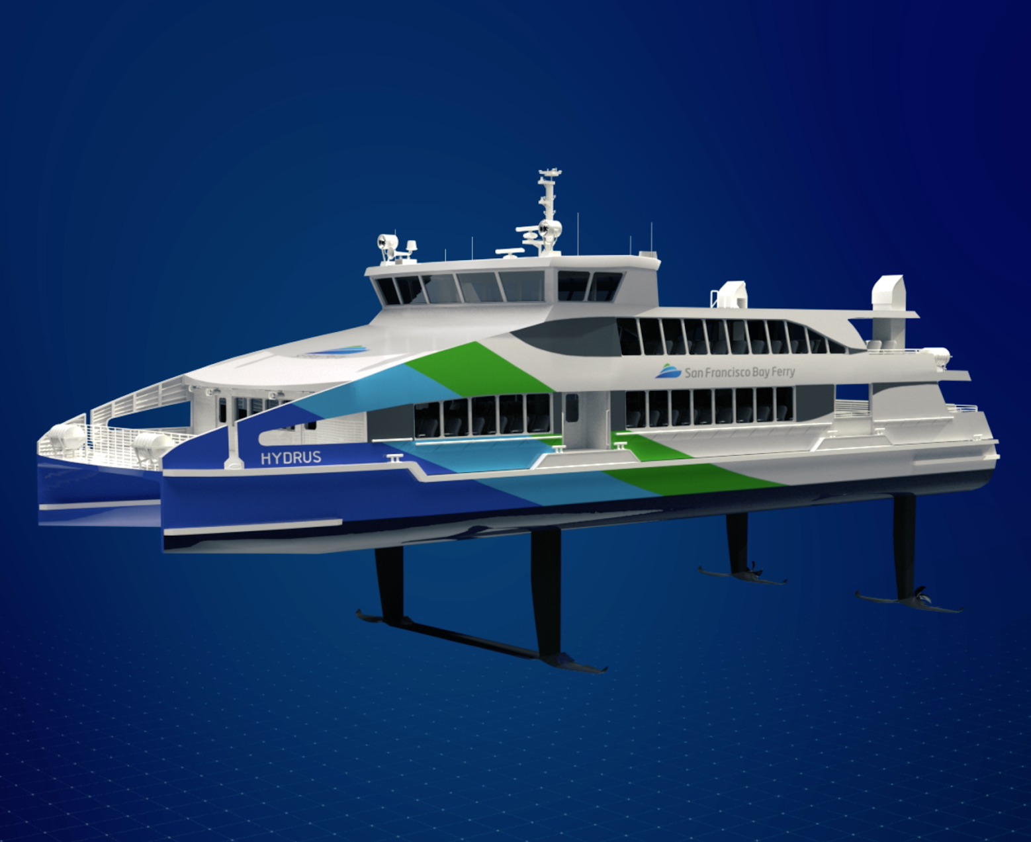
New Builds & Retrofits
Our eSim capability makes the eFoiler a modular system, from propeller to user interface, that can be installed on new build vessels or retrofitted onto operational vessels.
Hydrogen: Getting the Green Light, Driving Europe’s Green Recovery

Slide 10
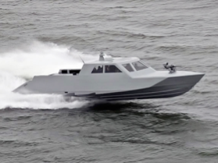
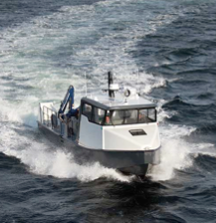
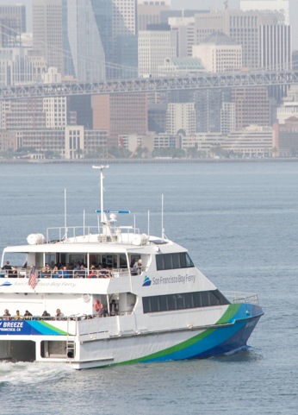
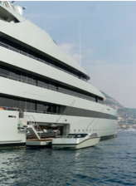
Use Cases
Security
Passenger Ferry & Water Taxi
Workboat
Leisure
Hydrogen: Getting the Green Light, Driving Europe’s Green Recovery

Slide 11
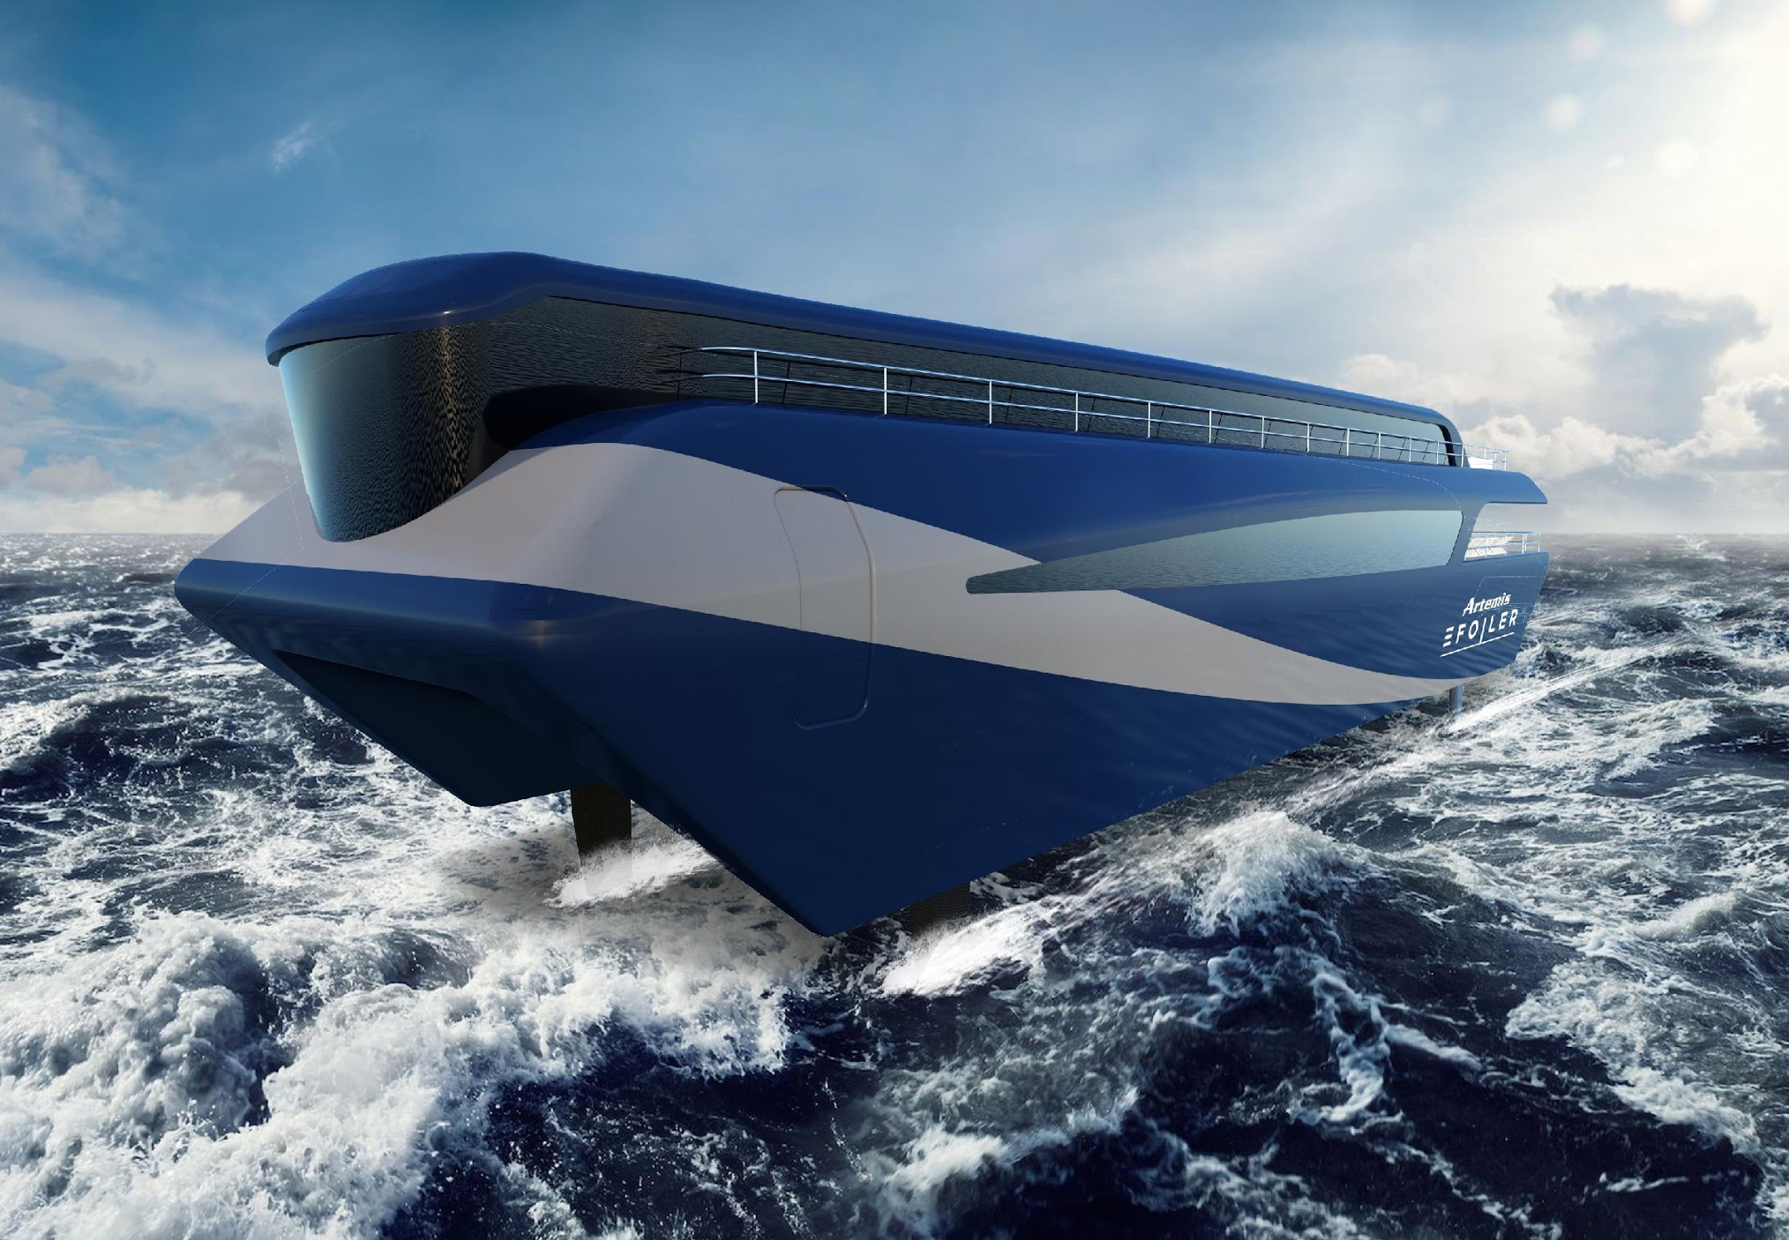
Hydrogen Extended Range
Hydrogen: Getting the Green Light, Driving Europe’s Green Recovery
Notes:
Limited range with batteries

Slide 12
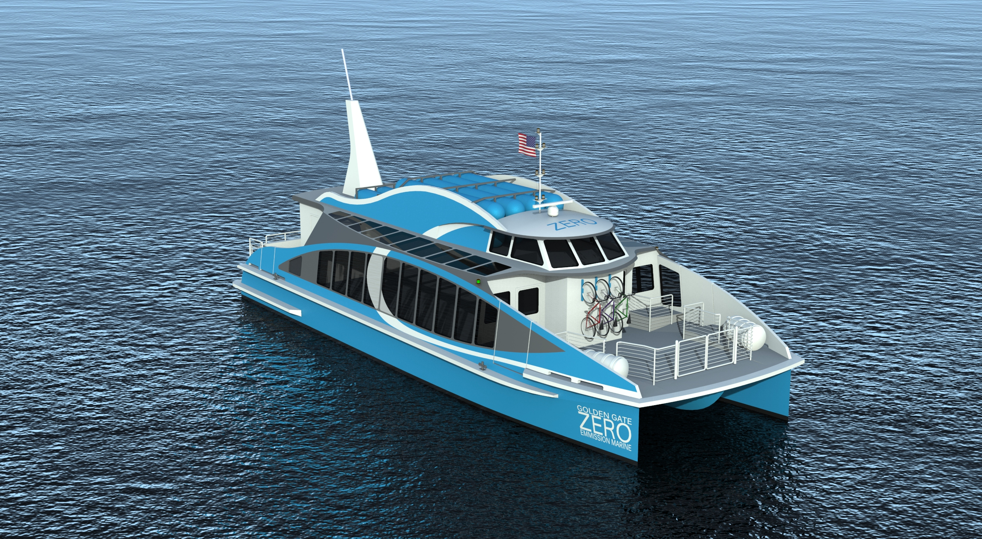
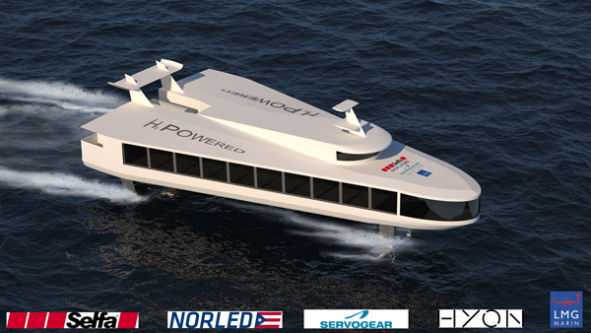
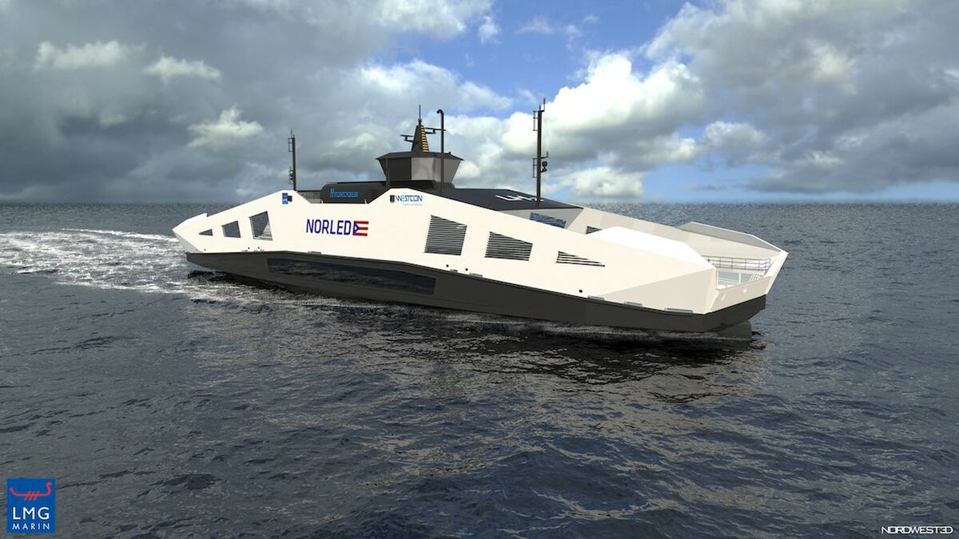
Hydrogen Marine Projects
Golden Gate Zero Emission Marine Hydrogen Ferry
Zeff Hydrofoiling Hydrogen Ferry Concept
Norled Hydrogen Ferry
Hydrogen: Getting the Green Light, Driving Europe’s Green Recovery

Slide 13
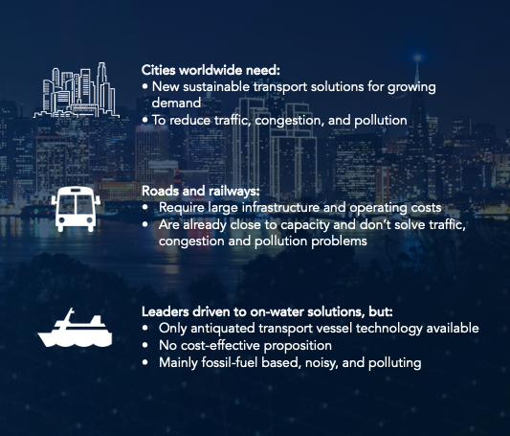
Waterways in major cities are a source of untapped potential.
Hydrogen: Getting the Green Light, Driving Europe’s Green Recovery

