Slide 1
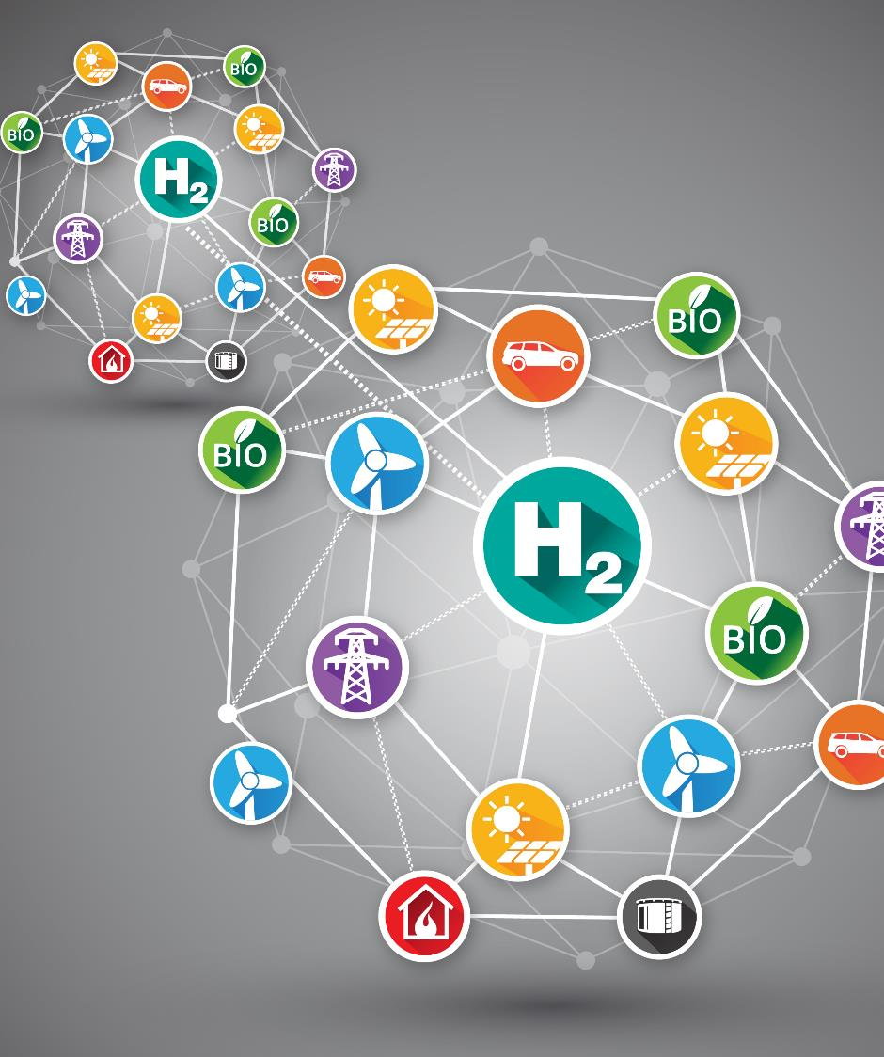


HAZEL Webinar 1:
Industrial Sector Coupling using a Connected eH2 cycle
22nd September 2020
Place image in this area.

Slide 2


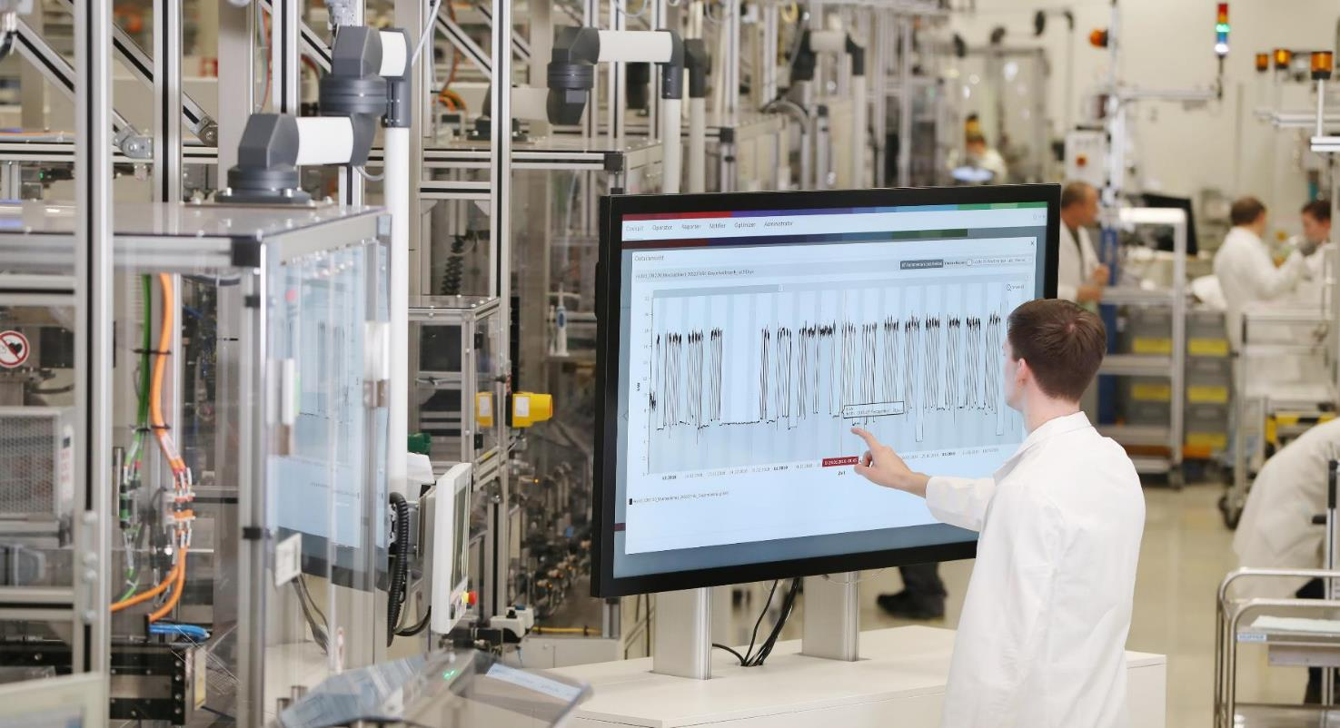


Industrial Sector-Coupling using a
Connected eH2-Cycle
Dr. rer.nat. Frank Kruchten
HAZEL Webinar 1: Industrial Sector Coupling using a Connected eH2 cycle

Slide 3

The world
is changing.
HAZEL Webinar 1: Industrial Sector Coupling using a Connected eH2 cycle

Slide 4

1. Increasing
population
In 2050 there will be 10 billion people living on earth.
HAZEL Webinar 1: Industrial Sector Coupling using a Connected eH2 cycle

Slide 5

2. Urbanization
Around 60% of the world population is living in cities.
HAZEL Webinar 1: Industrial Sector Coupling using a Connected eH2 cycle

Slide 6

3. Climate Change
The top 20 of the warmest years since recording can be found in the periode since 1990.
HAZEL Webinar 1: Industrial Sector Coupling using a Connected eH2 cycle

Slide 7

Impact
HAZEL Webinar 1: Industrial Sector Coupling using a Connected eH2 cycle

Slide 8


Sustainability Initiative
From the start 2020 Bosch is
CO2-neutral - worldwide
Bosch embraces the value
"Responsibility and Sustainability“
more strongly .
11
Intern | C/CGC-IC | 05.2019
© Robert Bosch GmbH 2019. Alle Rechte vorbehalten, auch bzgl. jeder Verfügung, Verwertung, Reproduktion, Bearbeitung, Weitergabe sowie für den Fall von Schutzrechtsanmeldungen.
HAZEL Webinar 1: Industrial Sector Coupling using a Connected eH2 cycle

Slide 9

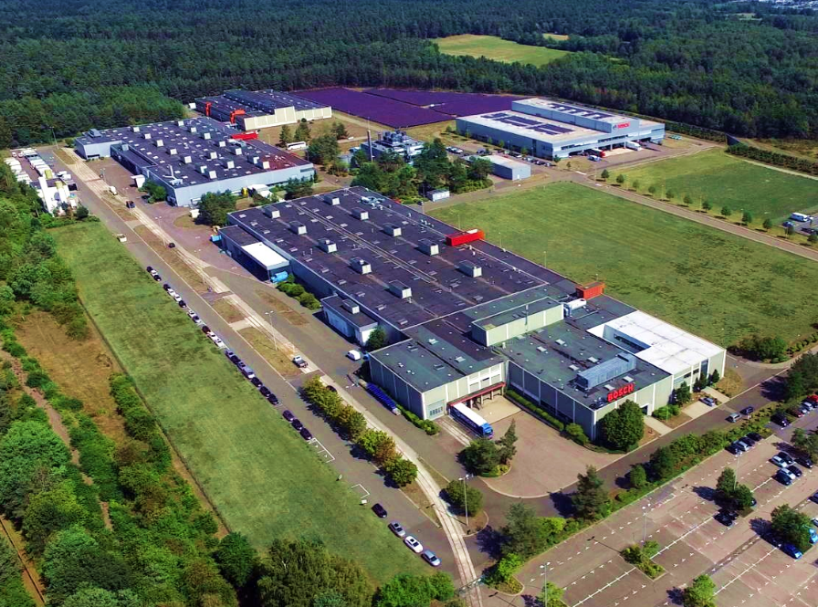
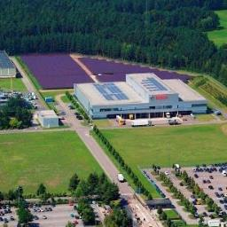
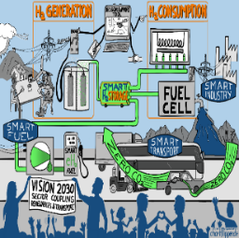
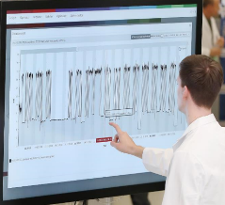
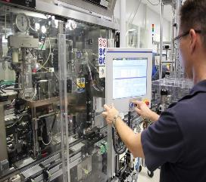
What Homburg
stands for?
Efficient and flexible consumption
optimized power generation
for own consumption
Linking-up all components
by the Energy Platform
storage and sector-coupling i.e. by the connected eH2 cycle
regenerative power generation
Connected eH2 cylce
Energy Platform
Reduction of consumption
by increasing efficiency and flexibility
11
Internal | C/CGC-IC | 5/2019
© Robert Bosch GmbH 2019. All rights reserved, also regarding any disposal, exploitation, reproduction, editing, distribution, as well as in the event of applications for industrial property rights.
HAZEL Webinar 1: Industrial Sector Coupling using a Connected eH2 cycle

Slide 10
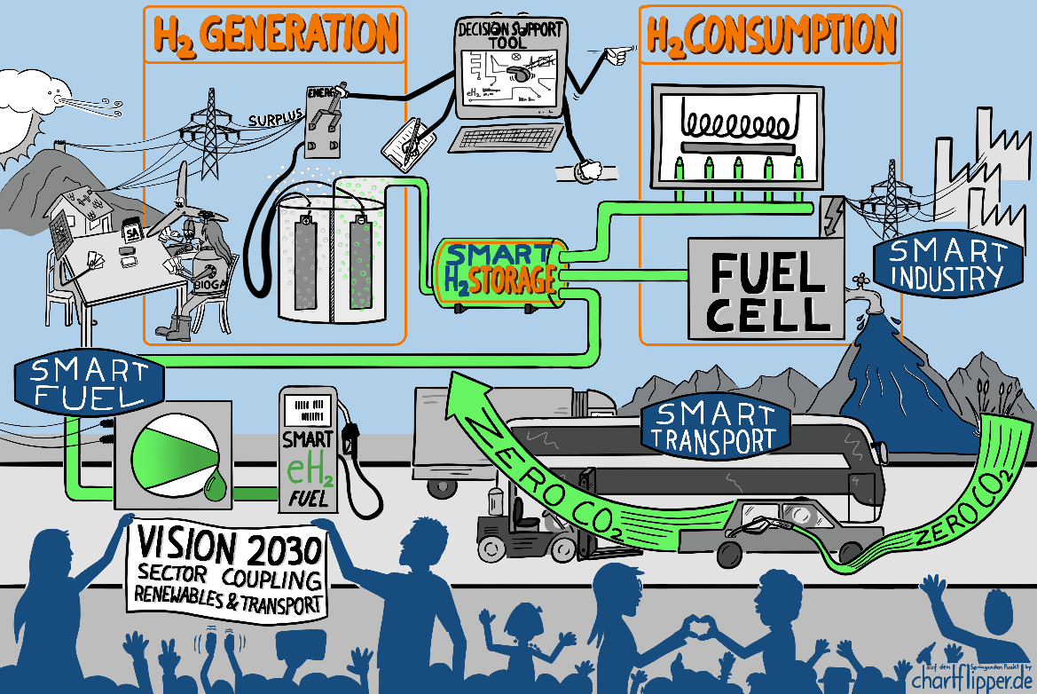
Connected
eH₂-Cycle
HAZEL Webinar 1: Industrial Sector Coupling using a Connected eH2 cycle

Slide 11



installed infrastructure
Connected eH₂-Cycle
photovoltaic
industrial
process
H₂ storage
smart control
SOFC
Bosch Energy Platform
power / heat
generation
HAZEL Webinar 1: Industrial Sector Coupling using a Connected eH2 cycle

Slide 12



expansion until 2021
Connected eH₂-Cycle
generation
green H₂
photovoltaic
industrial
process
electrolyser
H₂ storage
compressor
smart control
filling station
SOFC
Bosch Energy Platform
power / heat
generation
HAZEL Webinar 1: Industrial Sector Coupling using a Connected eH2 cycle

Slide 13






expansion until 2023
  Connected eH2-Cycle
generation
green H₂
photovoltaic
industrial
process
electrolyser
mobility
H₂ storage
compressor
smart control
filling station
SOFC
mobile H₂-refueler
Bosch Energy Platform
power / heat
generation
HAZEL Webinar 1: Industrial Sector Coupling using a Connected eH2 cycle

Slide 14
Target Values
Solid Oxide Fuel Cell
Almost emission-free:
No nitrogen oxides
No particles
>60%
Electrical efficiency (AC)
Very low noise
No vibrations
>85%
Overall efficiency
Efficiency
Scalability up to several MW_{el}
Resilience
Profitability
10 kW_{el}
AC power nominal load
CO2 reduction
Capable to run on:
Hydrogen (H2)
Biogas/Ecogas
Natural Gas
& all combinations of above
> 3 kW_{th}
Thermal output
Extended & rapid
Power modulation
HAZEL Webinar 1: Industrial Sector Coupling using a Connected eH2 cycle

Slide 15
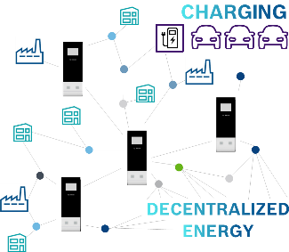
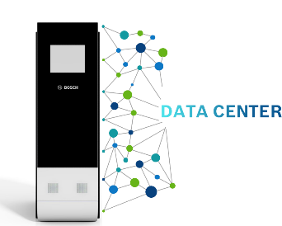
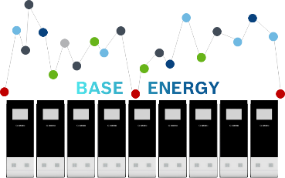
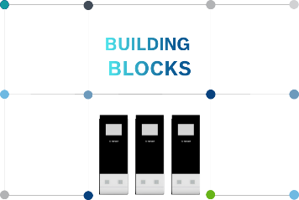
SOFC – Use Cases (Selection)
Various Application Opportunities
Growing on Demand
Preventing overcapacities and downtimes of power stations by using a decentralized energy system
Combined Heat and Power
Providing precious electricity with 60 % AC efficiency and additional thermal power
Unlimited Scalability
Being able to install plug and play solutions worldwide only requires availability of natural gas or if available Hydrogen
Cost Competitive
Technical benefits come with cost competitiveness to alternative solutions
HAZEL Webinar 1: Industrial Sector Coupling using a Connected eH2 cycle

Slide 16
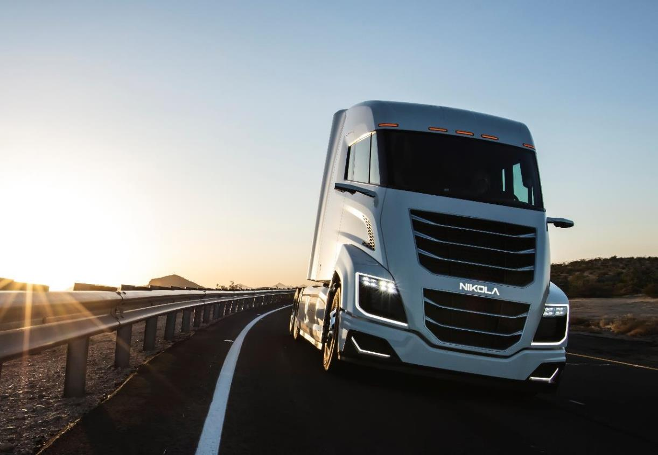

The
fuel cell
is on its way
HAZEL Webinar 1: Industrial Sector Coupling using a Connected eH2 cycle

Slide 17
Fuel Cell Electric Vehicles - Motivation
Commercial Vehicles
Driving Range
1000 km
Diesel
Weight- and space optimized e-mobility
with potential for attractive TCO-case
Fuel Cell Electric Vehicles
(FCEV)
FCEV might be the only viable option for HD long-haul
e-mobility
In many use-cases and based on attractive Hydrogen costs
FCEV will be able to offer attractive Total-Cost-of-Ownership
Gasoline
500 km
Passenger Cars
Battery
Electric Vehicle (BEV)
Attractive UX-factors in long-distance use cases
FCEV can provide an ultimate solution for zero tail-pipe
emissions in all applications for long distance uses cases
FCEV can remove range anxiety barrier in e-mobility applications
  refueling time in 3 min
  driving range above 500 km
Plug-in-Hybrid
(PHEV, pure electric)
Vehicle segments
HAZEL Webinar 1: Industrial Sector Coupling using a Connected eH2 cycle

Slide 18
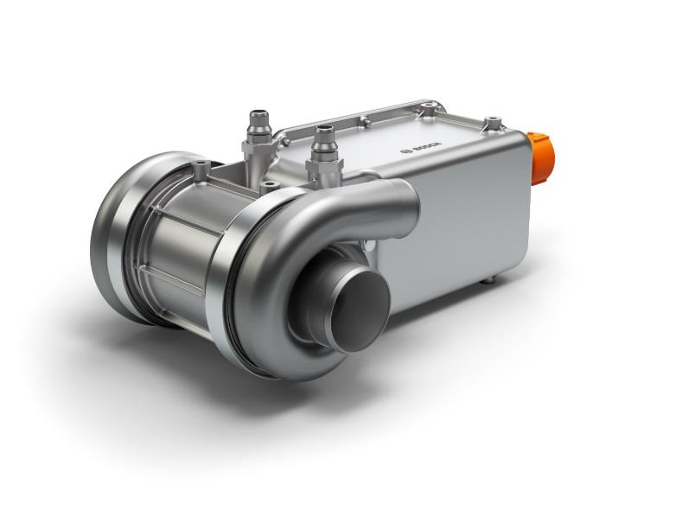
components for mobile fuel cell systems
Sector-Coupling in industrial environment
Electric air compressor (EAC)
The air compressor is required to
supply the fuel cell with oxygen.
HAZEL Webinar 1: Industrial Sector Coupling using a Connected eH2 cycle

Slide 19
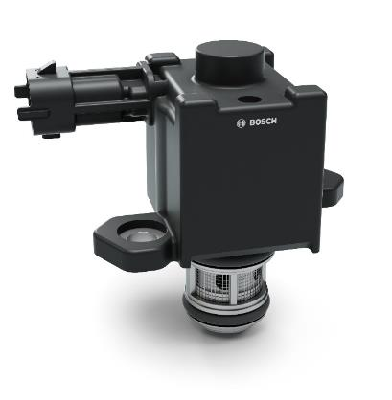
Sector-Coupling in industrial environment
components for mobile fuel cell systems
Hydrogen gas injector (HGI)
The gas injector provides
the correct amount of hydrogen.
HAZEL Webinar 1: Industrial Sector Coupling using a Connected eH2 cycle

Slide 20
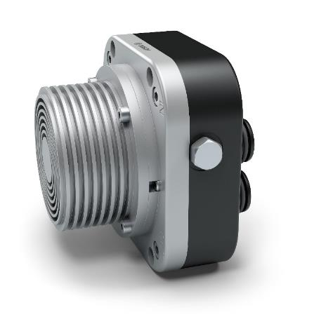
Sector-Coupling in industrial environment
components for mobile fuel cell systems
Anode recirculation blower (ARB)
The recirculation blower returns the
surplus hydrogen back into the system cycle
HAZEL Webinar 1: Industrial Sector Coupling using a Connected eH2 cycle

Slide 21


Our target 2020
HAZEL Webinar 1: Industrial Sector Coupling using a Connected eH2 cycle

