Slide 1
HAZEL Industrial Sector Coupling using a Connected eH2 Cycle "Hydrogen Scale-Up: Where, When & How“

Slide 2
The Association for Energy, Mobility, Industry & Community
Dr James Carton, Chair of Hydrogen Ireland
& Assistant Professor at Dublin City University
@IrelandHydrogen

Slide 3
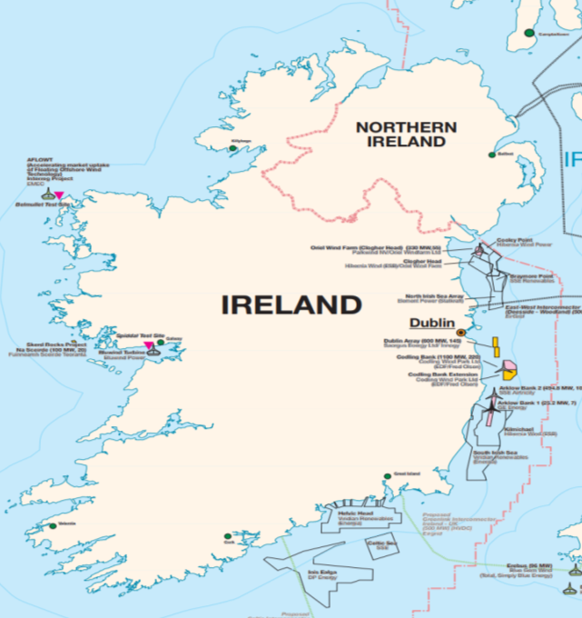
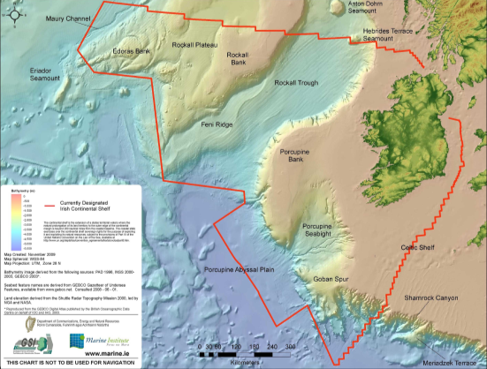
Can Hydrogen save the gas industry….?
wind
Technically exploitable wind capacity start at 50 GW
These numbers dwarf Irish electricity demand…
Long-term, high-capacity storage will be needed, as will the infrastructure to transmit these enormous quantities of energy.
4 GW of offshore
East & South
Capacity factors >45%

Slide 4
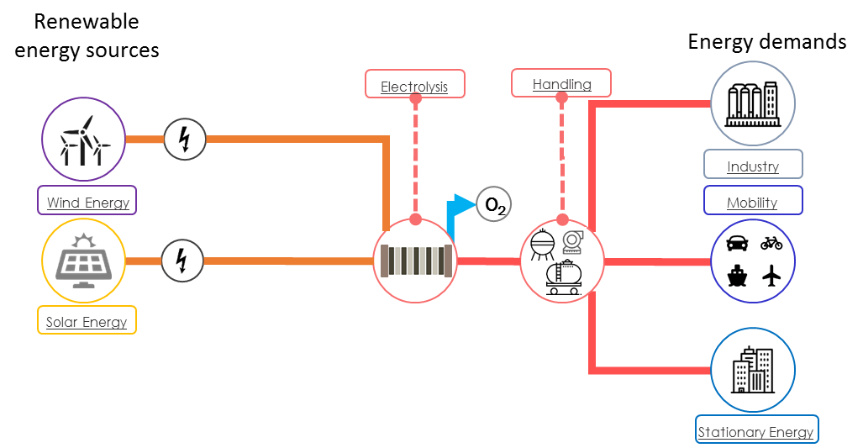
Power-to-X & Hydrogen
Hydrogen
Energy storage to decarbonise all sectors!

Slide 5
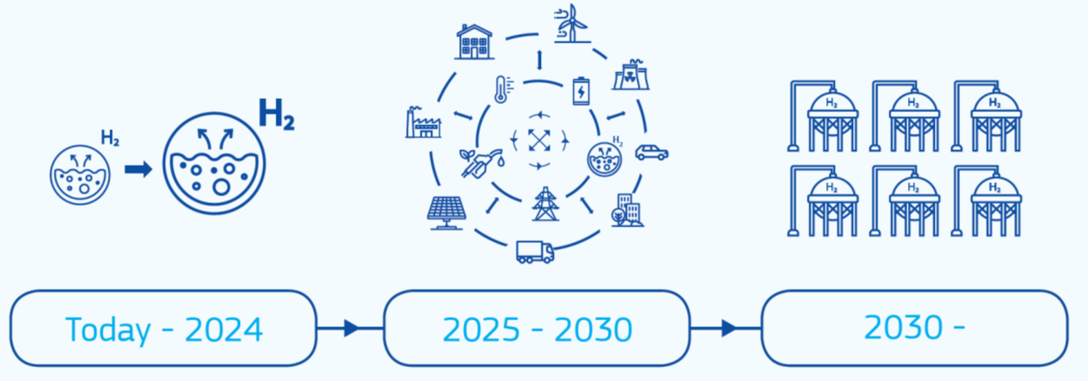
EU's Hydrogen Strategy
“Hydrogen can be used as a feedstock, a fuel or an energy carrier and storage, and has many possible applications across industry, transport, power and buildings sectors….. an important part of the solution to meet the 2050 climate neutrality goal of the European Green Deal.” EU Commission
Renewable hydrogen is the focus of the strategy
6 Gigawatt of renewable hydrogen electrolysers in the EU by 2024
40 Gigawatt of renewable hydrogen electrolysers by 2030
EU Green Deal to reduce 55% GHG reductions by 2030

Slide 6
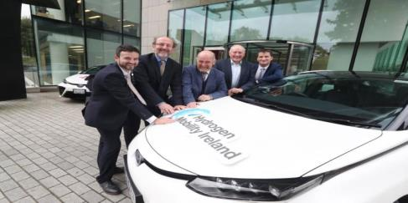
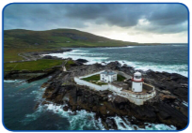
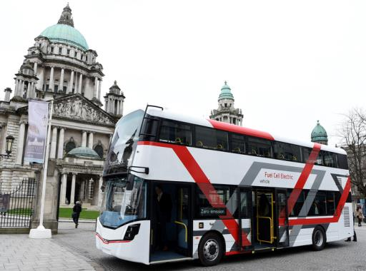
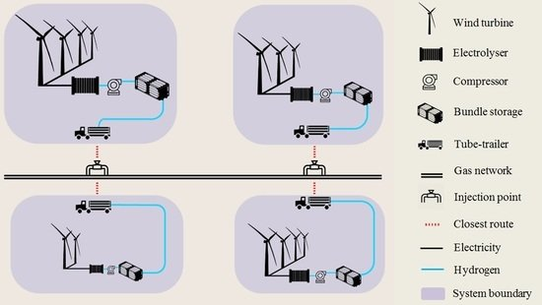
Hydrogen Activities - Ireland
Valentia Island &
Community Ambitions

Slide 7
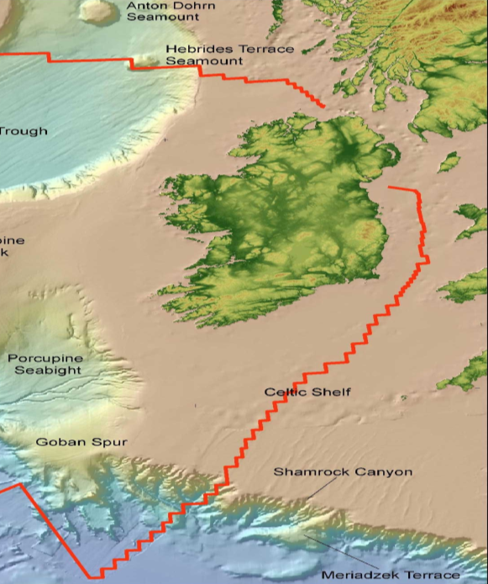
Ireland's Role in the EU's Hydrogen Strategy
Irish Factors:
Small country and population disconnected from Europe
Captive, flexible Market - Transport, Industry, Heating, Power
Renewable Resources
Wind Onshore & Offshore
Renewable Electricity Integration Experience
DSM, Integration, flexibility, workforce, knowledge
Capability of Wind Onshore &Offshore to Scale beyond demand
Energy Export in the form of Green Hydrogen
Lack of Fossil Resources or Fossil fuel economy/ Energy Security
No easy fix with fossil fuels, ensures Ireland goes renewables
NO industrial scale SMR (Steam Methane Reforming)
Ensures Ireland goes green hydrogen with renewables and not blue
Suitable Carbon Capture & Storage Sites
No easy fix with fossil fuels, or distraction, ensures Ireland goes green hydrogen with renewables and not blue
Modern Gas Network
Can carry blends of hydrogen or 100% hydrogen
H₂

Slide 8
Final Remarks
Zero Emissions are good for Climate & Health & Economy!
What we build today will still be here in 20years – end fossil fuel emissions/subsidies
We need to use our resources – ocean, wind, solar, pipes, cables, rail, people, etc
We need to update & diversify our energy markets – Storage, DSM, Auctions, etc
Clean Renewables & Green Hydrogen work - The technology is mature
Green Hydrogen Policy, Regulation & Roadmap Required
Green Hydrogen Deployment needed at scale
Education! The voice of people matter! Listen to Communities!

Slide 9
The Association for Energy, Mobility, Industry & Community
info@hydrogenireland.org
#IrelandHydrogen
Thank You.

