Slide 2
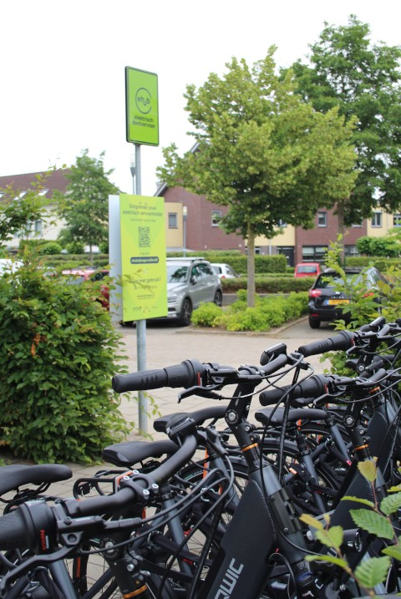
Visual identity eHUBS
Identification
Striking ‘landmark’ is the basis of the eHUB. Landmark is stronger when it is part of a regional, national of international network.
Visible from a distance. Support the sense of place (cfr. Pavlov-effect).
Facilitator for local shared mobility.

Slide 3
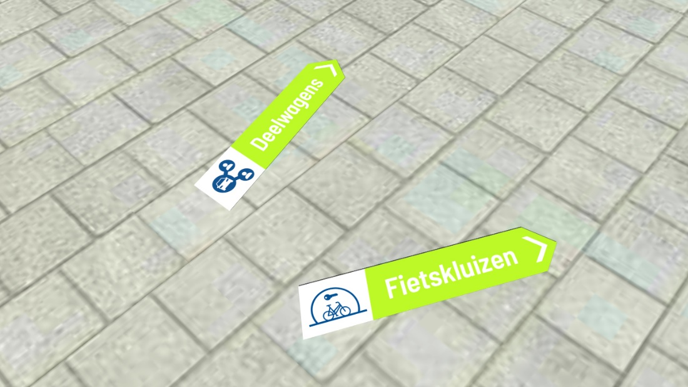
Visual identity eHUBS
Navigation
All elements help to support the end user to find all the different services at an eHUB.
Floor plans.

Slide 4
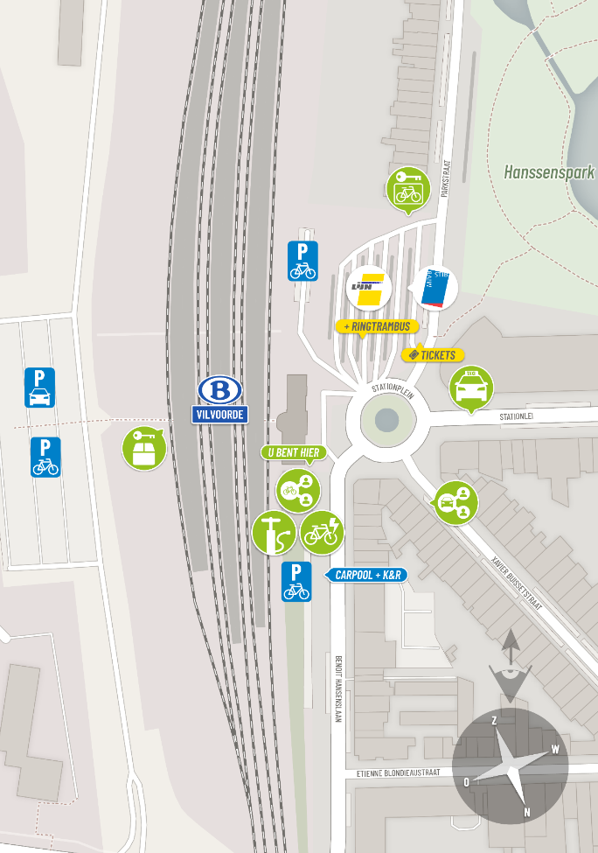
Visual identity eHUBS
Orientation
Maps support the end user to locate himself at the hub and find different services in the neigborhood.
Information on what is not directly visible.

Slide 5
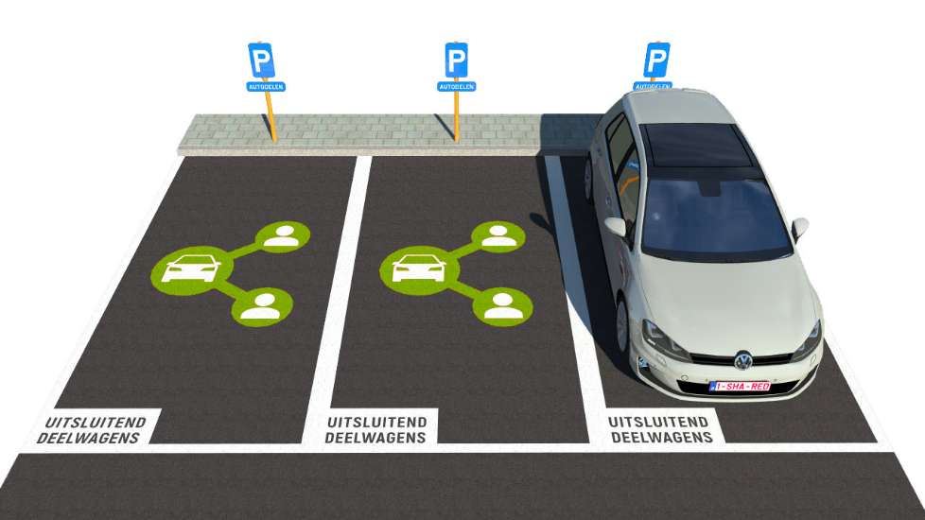
Visual identity eHUBS
Instruction
Elements (signs, markers…) that indicate the mode.
Information for the different services at the eHUB (what is an eHUB, how to book a car/bike?,…)

