Slide 1



HAZEL Webinar 2:
Hydrogen Sustainability - H2 DXNET - Hydrogen injection into natural gas distribution networks
6th October 2020
Place image in this area.

Slide 2
Decentralized hydrogen production from green methane –
The Reformer Steam Iron Cycle (RESC)
Sebastian Bock, Karin Malli, Michael Lammer and Viktor Hacker
Institute of Chemical Engineering and Environmental Technology
Graz University of Technology, Austria
HAZEL Webinar 2: Hydrogen Sustainability - H2 DXNET - Hydrogen injection into natural gas distribution networks

Slide 3
Outline
Introduction
High-purity hydrogen from biogas
Decentralized PEMFC-grade hydrogen
On-Site hydrogen with Negative Emissions
Sequestration of pure CO₂
100 bar hydrogen release
Pre-pressurized H₂ release
Conclusion and Outlook
HAZEL Webinar 2: Hydrogen Sustainability - H2 DXNET - Hydrogen injection into natural gas distribution networks

Slide 4
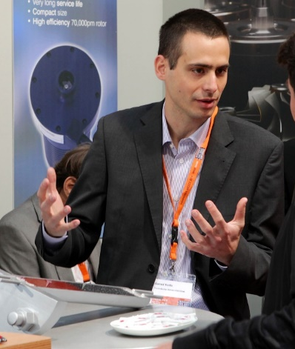
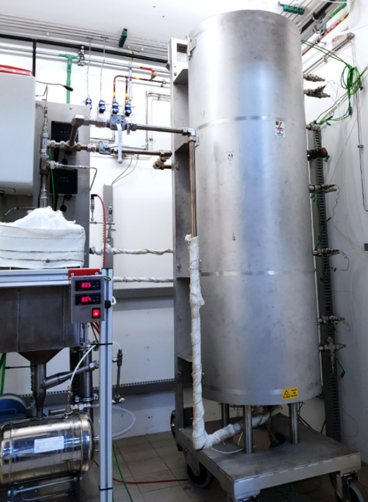
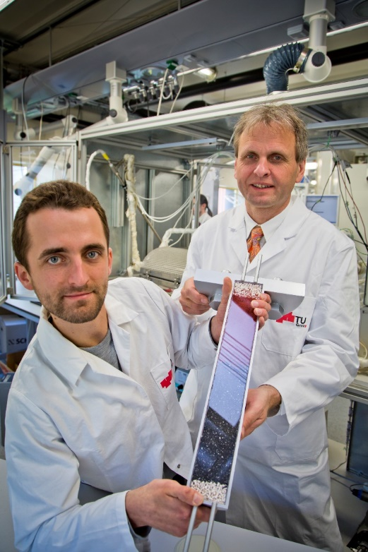
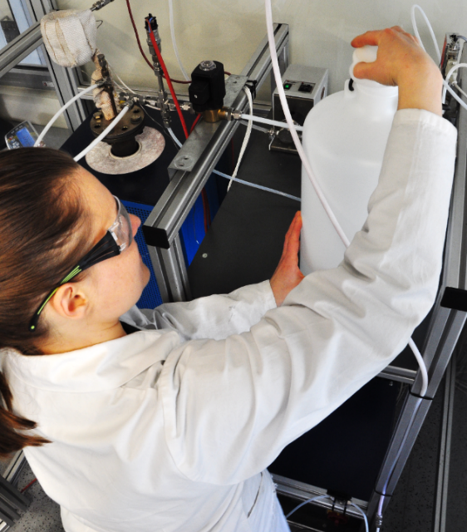
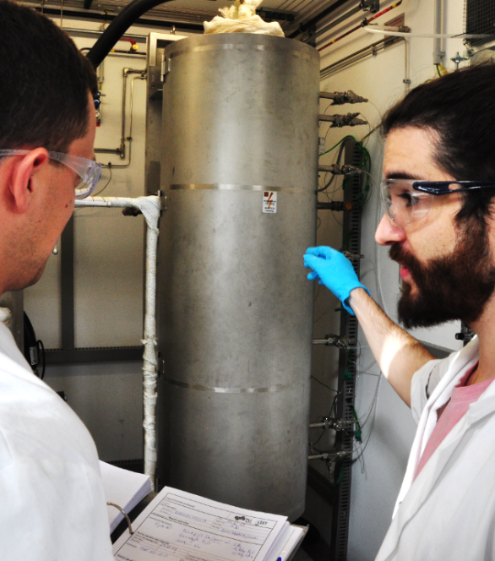
The Reformer Steam Iron Cycle (RESC)
2000 2010 2020 2023
Publication of RESC
by Viktor Hacker
0.5 kW lab reactor
H₂ from
real producer
biogas
10 kW lab reactor
Fundamental research
Foto: © TU Graz
Foto: © Lammer / TU Graz
Foto: © Bock / TU Graz
Foto: © Lunghammer / TU Graz
Foto: © Lammer / TU Graz
HAZEL Webinar 2: Hydrogen Sustainability - H2 DXNET - Hydrogen injection into natural gas distribution networks

Slide 5
Introduction
Motivation and challenges
Hydrogen from locally available resources
Decentralized hydrogen generation is environmentally friendly
Regional feedstock utilization
Efficient and cost-effective conversion
Stringent restrictions on hydrogen quality for low-temperature PEM-FC
HAZEL Webinar 2: Hydrogen Sustainability - H2 DXNET - Hydrogen injection into natural gas distribution networks

Slide 6
Introduction
RESC process as hydrogen production pathway
HAZEL Webinar 2: Hydrogen Sustainability - H2 DXNET - Hydrogen injection into natural gas distribution networks

Slide 7
Outline
Introduction
High-purity hydrogen from biogas
Decentralized PEMFC-grade hydrogen
On-Site hydrogen with Negative Emissions
Sequestration of pure CO₂
100 bar hydrogen release
Pre-pressurized H₂ release
Conclusion and Outlook
HAZEL Webinar 2: Hydrogen Sustainability - H2 DXNET - Hydrogen injection into natural gas distribution networks

Slide 8
Introduction
RESC process as hydrogen production pathway
HYDROGEN
HAZEL Webinar 2: Hydrogen Sustainability - H2 DXNET - Hydrogen injection into natural gas distribution networks

Slide 9
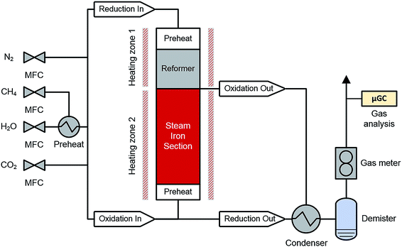

Advances in 10 kW lab system
Lab demonstration system
Reproduced from: Bock et al., 2019, DOI:10.1039/C9RA03123E
Published by The Royal Society of Chemistry under CC BY 3.0
HAZEL Webinar 2: Hydrogen Sustainability - H2 DXNET - Hydrogen injection into natural gas distribution networks

Slide 10
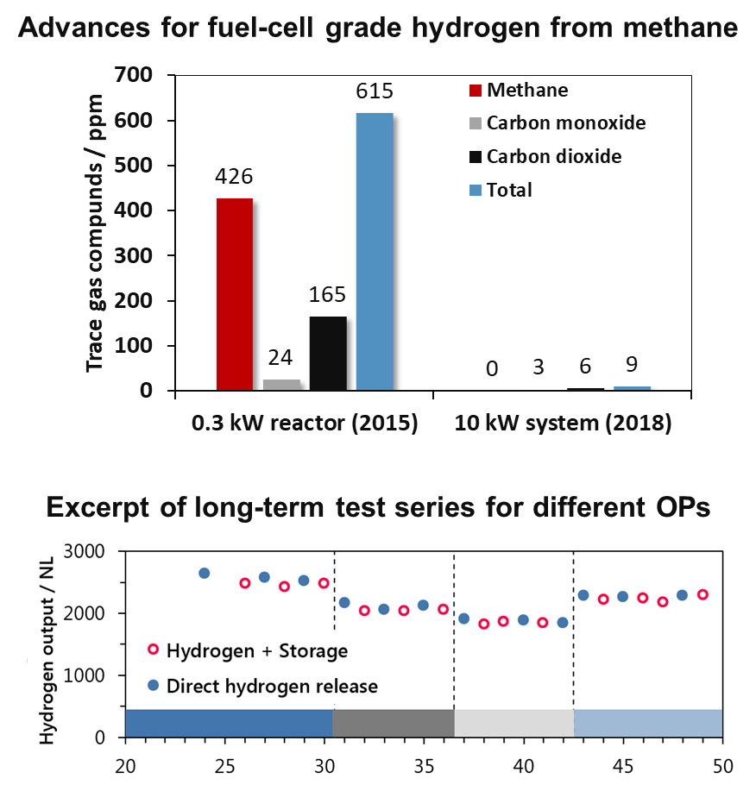
Advances in 10 kW lab system
Hydrogen storage and long-term experience
1000 hours time-on-stream,
over one year of discontinuous operation
Loss-free energy storage
with an energy density equal to 700 bar PH₂
Up to 65% feedstock utilization
for high-purity H₂ - 99.999%
On-time hydrogen generation
e.g. for decentralized systems
HAZEL Webinar 2: Hydrogen Sustainability - H2 DXNET - Hydrogen injection into natural gas distribution networks

Slide 11
Outline
Introduction
High-purity hydrogen from biogas
Decentralized PEMFC-grade hydrogen
On-Site hydrogen with Negative Emissions
Sequestration of pure CO₂
100 bar hydrogen release
Pre-pressurized H₂ release
Conclusion and Outlook
HAZEL Webinar 2: Hydrogen Sustainability - H2 DXNET - Hydrogen injection into natural gas distribution networks

Slide 12
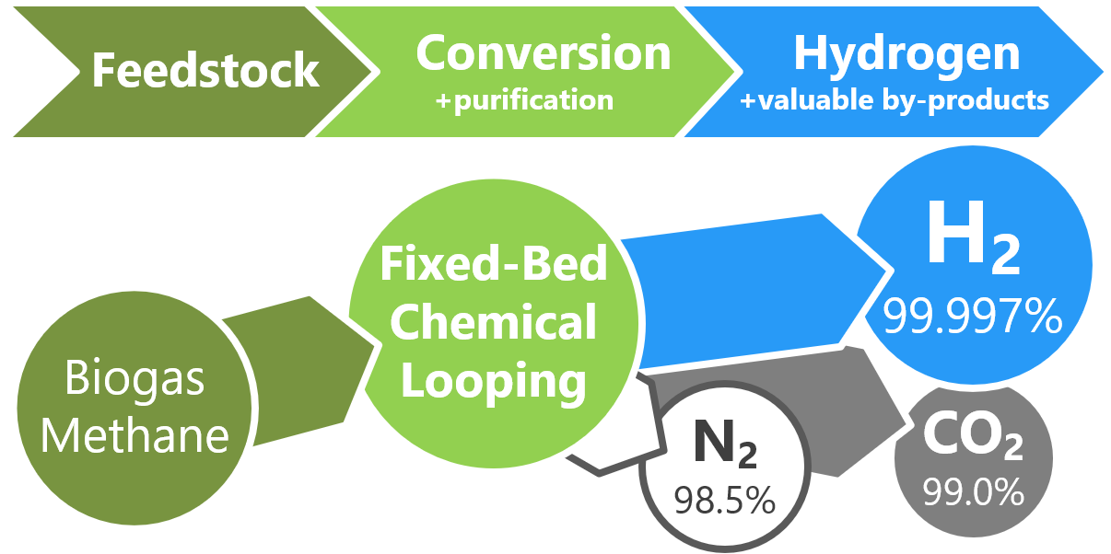
Pure hydrogen, carbon dioxide and nitrogen sequestration from biogas feed
Reproduced from: Bock et al., 2020, DOI: 10.1039/C9SE00980A
Published by The Royal Society of Chemistry under CC BY 3.0
HAZEL Webinar 2: Hydrogen Sustainability - H2 DXNET - Hydrogen injection into natural gas distribution networks

Slide 13
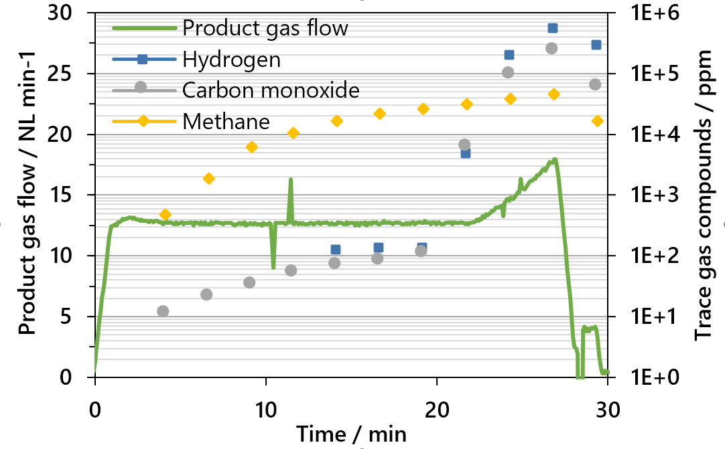
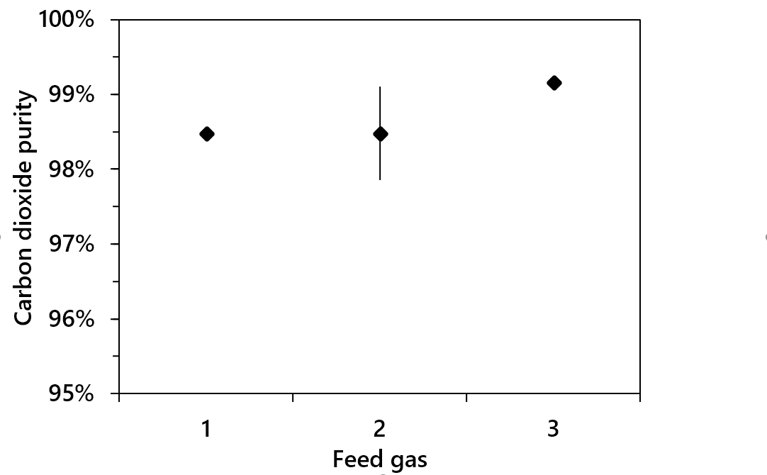
Pure hydrogen, carbon dioxide and nitrogen sequestration from biogas feed
1: Methane, O/R ratio 1.2
2: Biogas, 25% CO₂, O/R ratio 1.2
3: Biogas, 25% CO₂, O/R ratio 1.6
Adapted from: Bock et al., 2020, DOI: 10.1039/C9SE00980A
Published by The Royal Society of Chemistry under CC BY 3.0
HAZEL Webinar 2: Hydrogen Sustainability - H2 DXNET - Hydrogen injection into natural gas distribution networks

Slide 14
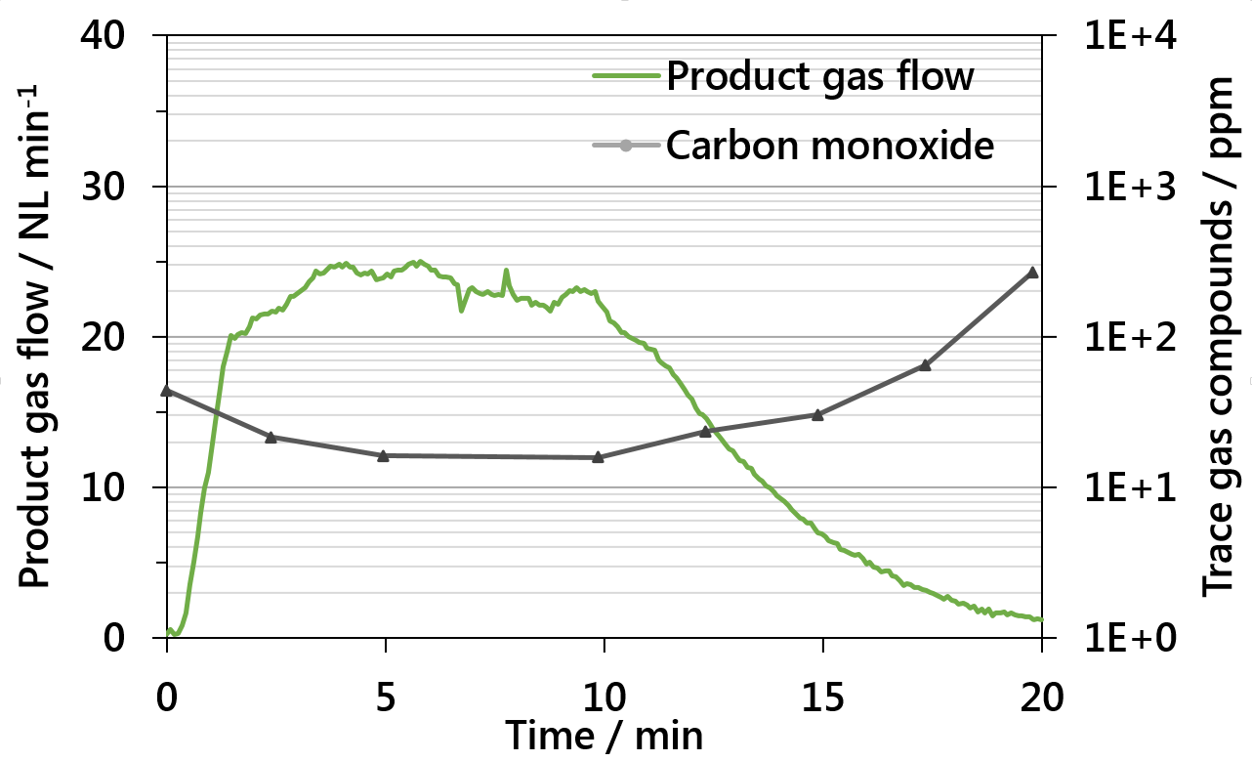
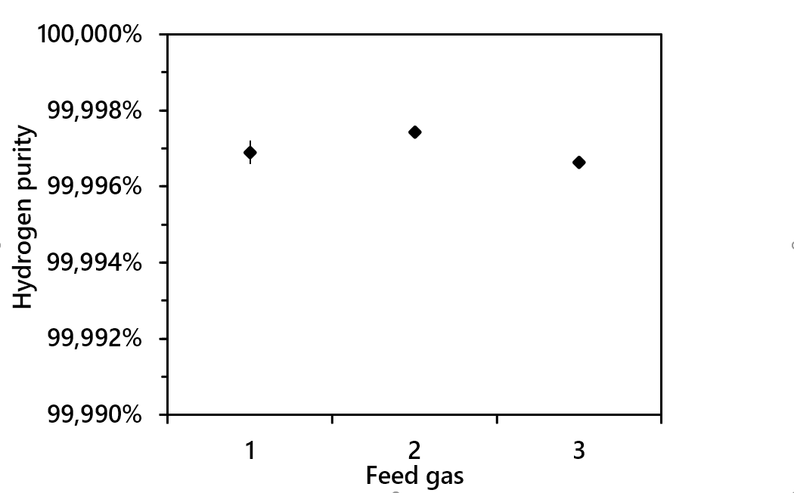
Pure hydrogen, carbon dioxide and nitrogen sequestration from biogas feed
1: Methane, O/R ratio 1.2
2: Biogas, 25% CO₂, O/R ratio 1.2
3: Biogas, 25% CO₂, O/R ratio 1.6
Adapted from: Bock et al., 2020, DOI: 10.1039/C9SE00980A
Published by The Royal Society of Chemistry under CC BY 3.0
HAZEL Webinar 2: Hydrogen Sustainability - H2 DXNET - Hydrogen injection into natural gas distribution networks

Slide 15
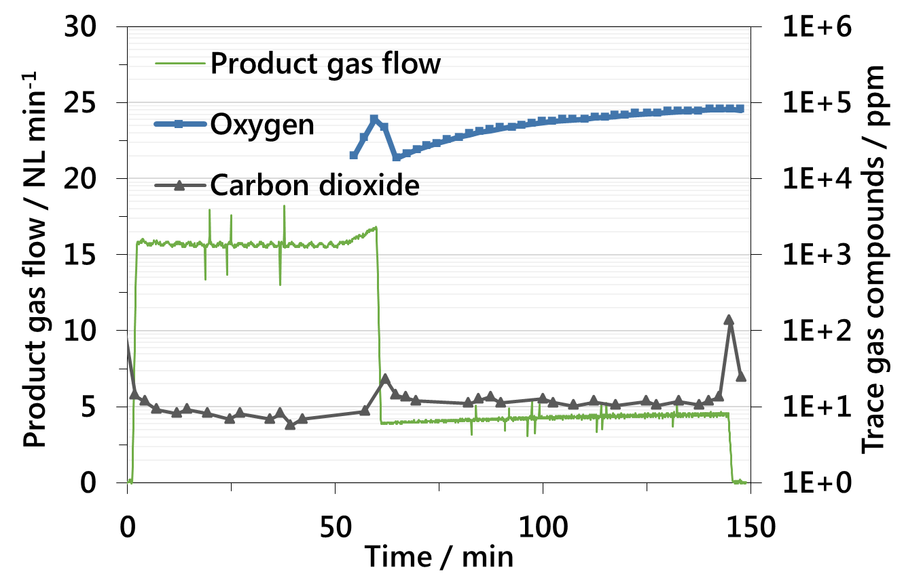
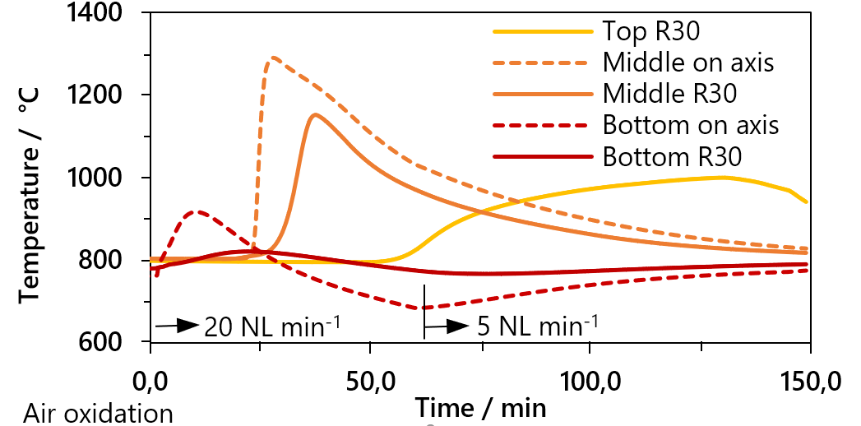
Pure hydrogen, carbon dioxide and nitrogen sequestration from biogas feed
Adapted from: Bock et al., 2020, DOI: 10.1039/C9SE00980A
Published by The Royal Society of Chemistry under CC BY 3.0
HAZEL Webinar 2: Hydrogen Sustainability - H2 DXNET - Hydrogen injection into natural gas distribution networks

Slide 16
Outline
Introduction
High-purity hydrogen from biogas
Decentralized PEMFC-grade hydrogen
On-Site hydrogen with Negative Emissions
Sequestration of pure CO₂
100 bar hydrogen release
Pre-pressurized H₂ release
Conclusion and Outlook
HAZEL Webinar 2: Hydrogen Sustainability - H2 DXNET - Hydrogen injection into natural gas distribution networks

Slide 17
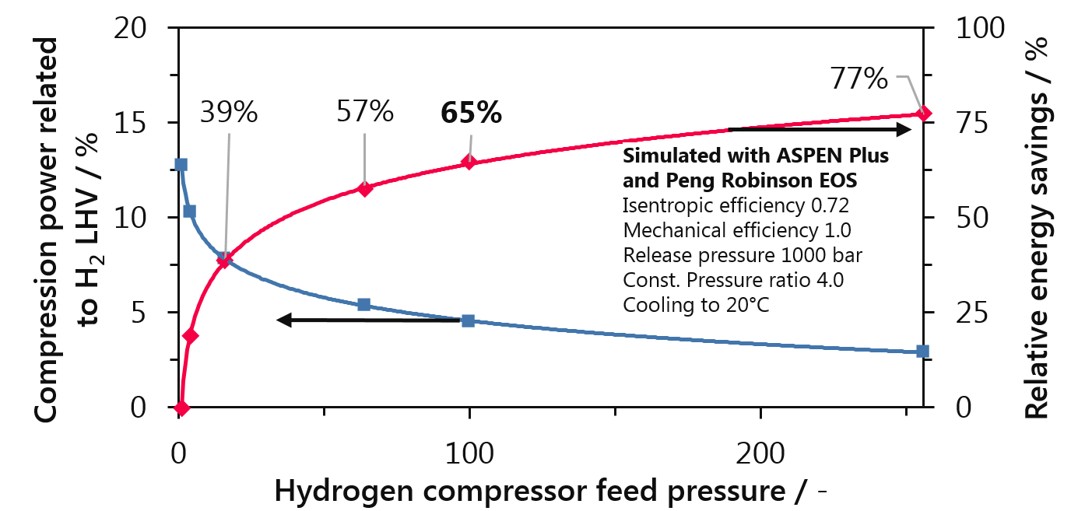
100 bar high-pressure hydrogen
Pre-pressurized H₂ release
System-integrated 100 bar pre-pressurized release
by liquid feed water compression
Significant energy savings for 1000 bar allocation
Reprinted from: Zacharias et al., 2019, Int. J Hydrogen Energy, DOI:10.1016/j.ijhydene.2019.01.257 under CC BY-NC-ND 4.0
HAZEL Webinar 2: Hydrogen Sustainability - H2 DXNET - Hydrogen injection into natural gas distribution networks

Slide 18
Outline
Introduction
High-purity hydrogen from biogas
Decentralized PEMFC-grade hydrogen
On-Site hydrogen with Negative Emissions
Sequestration of pure CO₂
100 bar hydrogen release
Pre-pressurized H₂ release
Conclusion and Outlook
HAZEL Webinar 2: Hydrogen Sustainability - H2 DXNET - Hydrogen injection into natural gas distribution networks

Slide 19
Conclusion
Decentralized PEM-FC grade hydrogen from renewable resources
  Excellent gas purity (99.999%)
  Feedstock utilization up to 65%
  Zero- or negative carbon dioxide emissions with CCS/CCU
  Loss-free energy storage for peak coverage
  On-demand hydrogen
Pre-pressurized release at 100 bar
HAZEL Webinar 2: Hydrogen Sustainability - H2 DXNET - Hydrogen injection into natural gas distribution networks

Slide 20
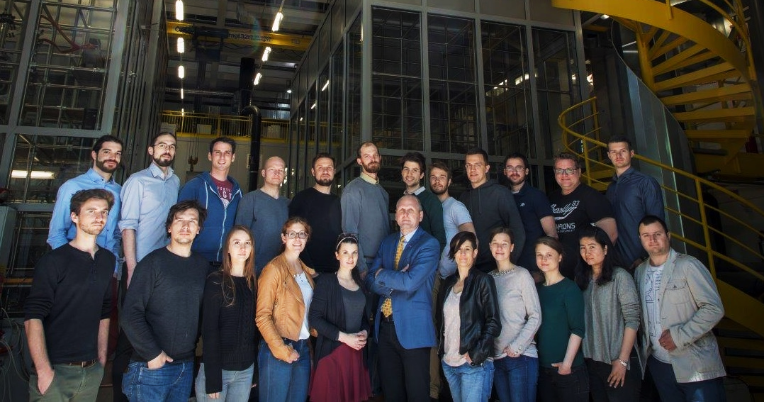





Acknowledgements
The project Bio-LOOP is funded by the Austrian Federal Ministry for Climate Action, Environment, Energy, Mobility, Innovation and Technology (BMK) and the Austrian Research Promotion Agency (FFG). It is supported by the COMET-Module and BEST - Bioenergy and Sustainable Technologies GmbH.
The financial support of the project Biogas2H2 by the Austrian Klima- and Energiefonds through the Energy Research Program 2015 is gratefully acknowledged.
Funding organizations
HAZEL Webinar 2: Hydrogen Sustainability - H2 DXNET - Hydrogen injection into natural gas distribution networks

Slide 21







One-Stop-Shop
H₂ Center
Project H₂GreenTECH
Strengthening crossborder R&I capacities in advanced hydrogen technologies by developing synergies between enterprises, R&D centers and higher education
Duration: 01.03.2020 – 31.08.2022
Project budget: 584.500,00 EUR
Better access and use of research infrastructure
Build-up of competences of enterprises, R&D centres and higher education
Development of the cross border Roadmap
interest groups SME, NGOs
national public authority
higher education & research
HAZEL Webinar 2: Hydrogen Sustainability - H2 DXNET - Hydrogen injection into natural gas distribution networks

Slide 22

Contact
Working Group Fuel Cell and Hydrogen Systems
Institute of Chemical Engineering & Environmental Technology
Graz University of Technology, Austria
Open Access: R. Zacharias, S. Bock, V. Hacker, The impact of manufacturing methods on the performance of pelletized, iron-based oxygen carriers for fixed bed chemical looping hydrogen in long term operation, Fuel Process. Technol. 208 (2020) 106487. https://www.doi.org/10.1016/j.fuproc.2020.106487
Open Access: S. Bock, R. Zacharias, V. Hacker, Co-production of pure hydrogen, carbon dioxide and nitrogen in a 10 kW fixed-bed chemical looping system, Sustain. Energy Fuels. 4 (2020) 1417–1426. https://doi.org/10.1039/C9SE00980A
Open Access: Bock, S., Zacharias, R., & Hacker, V. (2019). Experimental study on high-purity hydrogen generation from synthetic biogas in a 10 kW fixed-bed chemical looping system. RSC Advances, 9(41), 23686–23695. https://doi.org/10.1039/C9RA03123E
Open Access: Zacharias, R., Visentin, S., Bock, S., & Hacker, V. (2019). High-pressure hydrogen production with inherent sequestration of a pure carbon dioxide stream via fixed bed chemical looping. International Journal of Hydrogen Energy, 44(16), 7943–7957. https://doi.org/10.1016/j.ijhydene.2019.01.257
Open Access: Nestl, S., Voitic, G., Zacharias, R., Bock, S., & Hacker, V. (2018). High-Purity Hydrogen Production with the Reformer Steam Iron Cycle. Energy Technology, 6(3), 563–569. https://doi.org/10.1002/ente.201700576
Open Access: Voitic, G., Hacker, V., (2016). Recent advancements in chemical looping water splitting for the production of hydrogen. RSC Advances, 6(100), 98267–98296. https://doi.org/10.1039/C6RA21180A
Open Access: Voitic, G., Nestl, S., Malli, K., Wagner, J., Bitschnau, B., Mautner, F. A., & Hacker, V. (2016). High purity pressurised hydrogen production from syngas by the steam-iron process. RSC Advances, 6(58), 53533–53541. https://doi.org/10.1039/c6ra06134f
HAZEL Webinar 2: Hydrogen Sustainability - H2 DXNET - Hydrogen injection into natural gas distribution networks

