Slide 1
HAZEL Webinar 2:
Hydrogen Sustainability - H2 DXNET – Gas Grid Injection – The Challenges
6th October 2020
Place image in this area.

Slide 2
Natural Gas in Ireland¹
54% of electricity is generated using Natural Gas
22% of residential energy demand is met directly by Natural Gas
30% of final industry energy demand is met directly by Natural Gas
Ireland Share of Total Primary Energy Requirement (TPER) 2018 by Fuel source
31% of Ireland’s energy requirement is met by Natural Gas
9
Source: Sustainable Energy Authority of Ireland (SEAI) Energy in Ireland 2019 Report.
Notes:
Hello, my name is James Burchill - currently I am Head of Asset operations at Gas networks Ireland. - For those who will be unfamiliar with Gas networks Ireland, we are the State owned utility responsible for the transportation of Natural gas in Ireland.
We manage the Gas Transmission and Distribution system in the republic of Ireland and we also operate and Assets in Scotland, Northern Ireland and the Isle of Man.
In the slide above : you can see the role Natural gas plays in meeting the energy needs of the country,-- with 54% of electricity on average being generated by Natural Gas -- that of course is an average figure , there are times particularly in calmer conditions this can reach as high as 80% or more
Secondly you can also see that Natural gas’s importantance to Industry and to meeting the domestic heat load.
While the title of this presentation is Hydrogen injection in to gas grids a Challenge- I think it could as you can see in the slide it could also be a called an opportunity. Next Slide

Slide 3
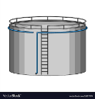
Hydrogen Landscape – Where are we?
Biomethane
Steam Methane Reforming
Carbon Storage
CO₂
Negative Emissions
Power Generation
Blue
Natural Gas
H₂
Industry
Wind
Storage
Network
Transport
Electrolysis
Green
Heat
Solar
Notes:
SO ,as Important as Natural Gas is to our economy - We absolutely recognise that we must as a transporter need to de carbonise the grid. And Just as other system operators across Europe have done, gas networks Ireland has set out its road map to do so in our vision 2050 document.
One of key enablers on that pathway is the Introduction of Hydrogen on to the grid.
As you can see in the diagram the Gas Grid will be instrumental in providing that vital link between production and end users. In addition to being the most effect way of transporting Hydrogen the Grid also has the huge advantage of being able to provide long energy storage.
Currently the grid has a store 621 Gwhs of energy
So - while the introduction of Hydrogens poses many challenges, -- it also provide for great opportunities for Producers and Shippers as the Grid offers the opportunity to not only to displace the current role of natural gas heat generation but also to offers to potential to gain a share of the 48% of primary energy demand currently held by Oil predominantly in the transport sector.
I note that during the week that The first Hydrogen powered train made it is Maiden voyage on the UK Rail network. Next slide

Slide 4
GNI Pathway to Enabling Hydrogen
Test Facility
GNI is working on a hydrogen blend test facility to assess the implications of hydrogen blends on an isolated section of gas network and appliances. This off network facility will demonstrate that different blends of hydrogen can be transported safely, effectively and flexibly in the existing network
.
Safety Review
Safety is a very important aspect of the development of hydrogen. A safety case material change impact assessment will need to be scoped and advanced during the timeframe of these preliminary projects.
Technical
A materials checklist and requirements for assessment by asset class will need to be drawn up. Consideration will need to be given to assessing steel pipes compatibility, PE pipes, metering, compressors, odorant and SCADA.
Standards and Training
A review of standards at National and European level must be carried out. Existing standards will need to be updated and there may be a need for new standards.
Identification of training requirements per role will need to be carried out and aligned to Technical Competency Framework.
Arrangements
Commercial and regulatory arrangements/models for the facilitation of hydrogen injection need to be considered.
Notes:
To safely introduce Hydrogen in to the Existing grid requires the coordination of a great numbers of activities.
One of the very first things we recognised is that if we are to go on this journey - we need to get our hands dirty so to speak and get a feel for and hydrogen and hydrogens blends and how they behave in the exiting network
To than end we are currently finalising the construction or a Small scale Test facility in our campus in Citywest. This facility will replicate the existing Distribution networks and typical downstream appliances found in homes .
Key to allow us to transport H2 at any concentration is the acceptance by the regulatory authorities of a Safety Case - . We must prove that the transportation of the H2 or Blends are ALARP as low as reasonable practicable.
To achieve this requires a deep knowledge and understanding of the technical challenges associated with H2 from both a material and gas characteristics perspective.
This is not a journey we can undertake on our own, we will need to rely on experts from many areas, but also to build on work which is ongoing across Europe and on the development of technical standards and specifications in this area.
And finally we must put in place the market arrangements to allow Shippers transport gas in a fair and equitably way

Slide 5
Hydrogen Injection Roadmap – Existing Network – Transmission Network
European studies suggest the Transmission Network is compatible with 2% Blend of Hydrogen.
What is the optimal blend of H2 to Nat gas? How do we control flow and pressure to maintain blend consistency?
Greater studies are required to understand the performance of transmission infrastructure in the blends greater than that of 2% of pure hydrogen.
Validation of TX Material Steel Grades X42 to X65 Pressure Reduction Stations: Materials, Filters, Regulators, etc. Fiscal Metering
Notes:
So I am going to look at some of the technical practicalities around injection of H2 in to a networks, and I have to say at the outset that this is the commencement of a journey. All across Europe and the world grid operators are try in to get to grips these issues. In the UK National Grid are hoping to construct a replica of their transmission network at their site in Spadadam near Newcastle.
On the positive side we know that Hydrogen pipelines can be constructed and they do exist.
What we need to establish is, if current Nat gas infrastructure can be adopted to transport H2 and that is can be as safe as the existing network.
Currently all the evidence coming from Europe, particularly from work undertaken by Marcogaz suggest that H2 at low concentrations - 2% or so does not pose a problem for High pressure steel transmission mains.
This leads to the question of Blend v’s pure H2.
Where I think we are going with this- and this only my opinion: there two scenarios likely to happen initially before we see a fully built out hydrogen grid –
Certainly we are going to see H2 production particularly from wind sources look to inject locally. This is already becoming apparent.
A Second possibility and one envisaged in the UK is large scale production via SMR which will feed a local industrial cluster with pure H2 but will again inject the excess in to the local grid.
Either way it is clear as a transporter we need to be prepared for some period where blends of Hydrogen Natural Gas and Biogas exist on or with in parts of the Grid. This of course begs the question as to what is the optimal blend , at the moment the consensus seems to be landing on 20% or so - this is based on downstream appliances.
So What we as transporters need to understand is the effect of a 20% blend and then ultimately pure h2 has on Steel pipelines particularly some of the older grades and in particular the area of hydrogen embrittlement.
Another area of particular interest is pressure reduction, as many of you know Natural gas cools upon expansion by the joules Thompson effect, this happens in pressure reduction stations and we need to reheat the gas following this drop in pressure . Hydrogen on the other hand dose not experience such an effect. As operators we are very anxious to understand can blends of H2 and Nat Gas be accommodated within the parameters of the existing infrastructure.

Slide 6
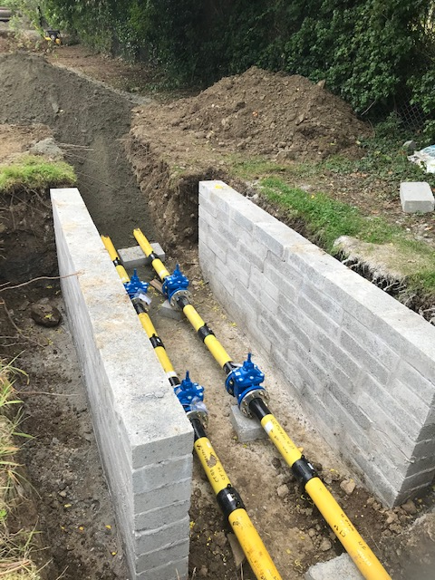
Hydrogen Injection Roadmap – Existing Network – Distribution
Polyethylene distribution pipework is compatible with hydrogen.
Further studies are required to fully understand the safety aspects of hydrogen particularly in leakage events.
We also need to fully understand the performance of fitting a 4mbar and 65mbar into the typical pressures within the gas network.
HAZEL Webinar 2: Hydrogen Sustainability - H2 DXNET - Hydrogen injection into natural gas distribution networks
Notes:
If we move then to the Distribution network: that is the lower pressure grid which supplies the vast majority of end users. The picture here is very encouraging, Ireland has the most modern network in Europe having an almost entirely Polyethylene network. So we do not, as other jurisdictions need to deal with legacy Cast iron , Asbestos or other materials which were used in former times.
Thus far all the research and studies indicate that Polyethylene is fully compatible with the transportation of Hydrogen.
Never-the-less we do need to understand and number of issues not least of which is to safely manage leakage events on the network, so for example what is the profile of gas dispersal in the event third party dig in to a pipe ? Where can we safely position our crews so they can repair the damage ? what are the exclusion zones for the general public ?
In our test facility shown under construction above the valveinng arrangement, will allow us to insert pipes and fittings with a known defect and compare the results between H2 and H2Blends with Natural gas. To see how for example leakage rates differ.
Finally the other subject which there is a lot of research in and we will also need to investigate is the area of metering. We absolutely need to ensure that customers are correctly billed for the energy they receive.
Which leads then to another subject for consideration that is - market arrangements

Slide 7
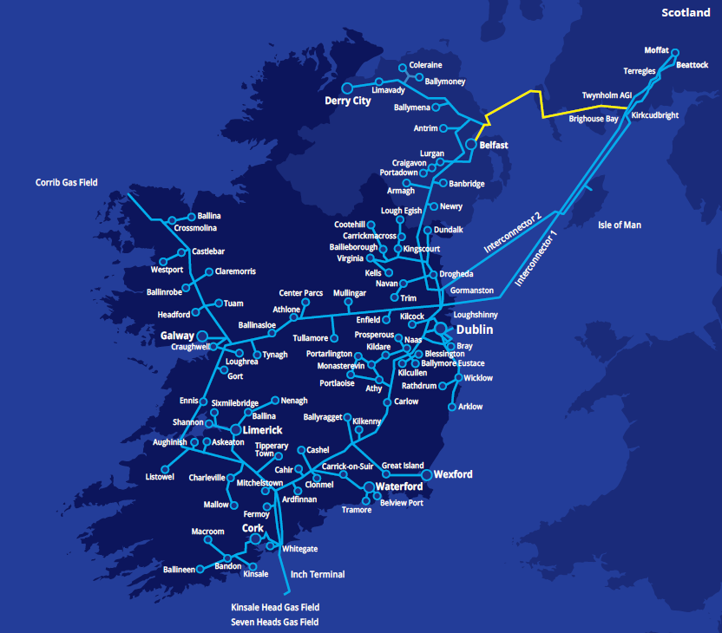
Hydrogen Injection Roadmap – Existing Network – Commercial/ Shippers Considerations
What are the commercial terms for injection? - Extensive modification of the code of operations will be required.
How to Managing Capacity ? - How to manage constrains
- H₂ Quality Control
Management of Storage and Injection Equipment?
Notes:
In the slide I have some of the open question that any market arrangements will need to address.
In the current market - shippers nominate the daily quantity of gas they want to bring on to the grid and they need to balance that by the end of the day.
These arrangements work well because, there are no practical constraints on the availability of Natural gas and secondly natural gas is essentially homogeneous so the source –be it the North Sea or Corrib or Bio Methane is interchangeable - it is still the one molecule,
I know I am talking in general terms here but currently all gas coming on to the network needs to conform to a relatively narrow band of physical parameters.
The challenges then will come about in managing a gas with difference parameters such a blends of Nat Gas H2 key is how question is how do we maintain that a blend is uniform on the network or part of the network but also managing the very real commercial requirements of producers to bring their product to end-users.
Certainly the solution will be storage and in all likelyhood greater control systems will be needed to manage the blends across the networks. To ensure that capacity is managed optimally and that quality is maintained.
These are issues the industry at large will need to put rules in place via the code of operations to manage.

Slide 8
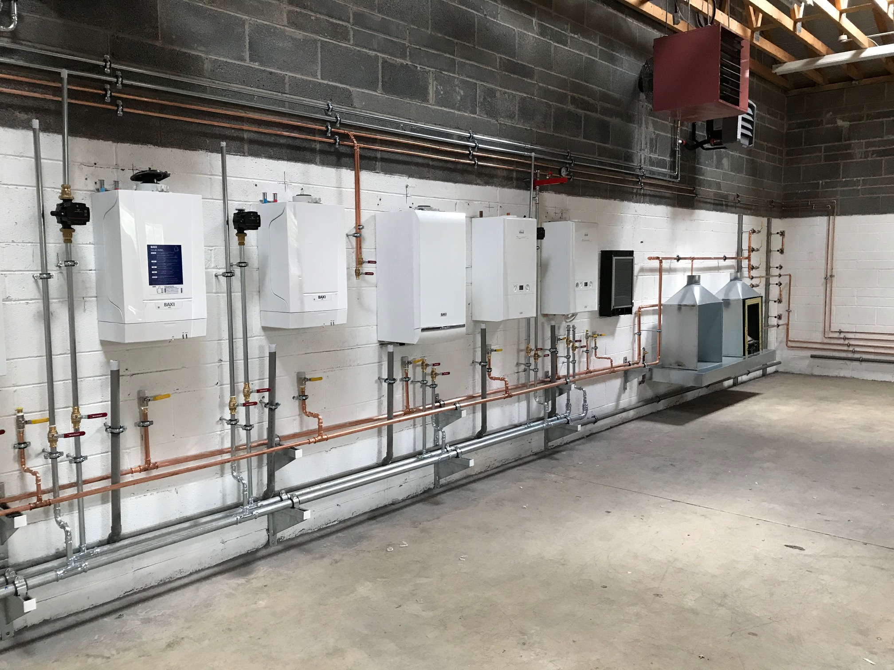
Downstream Appliances
1
Restricted or reduced pressure impact on devices.
2
Flue Gas Analysis - Blended hydrogen will increase water vapour and potentially the formation Carbon Monoxide (CO).
3
Heat output/ Calorific value and Wobbe index.
4
Flammability limits – to determine the LEL and UEL.
5
Appliance flame picture – determine the effect which hydrogen addition will have on the visibility of the natural gas flame.
HAZEL Webinar 2: Hydrogen Sustainability - H2 DXNET - Hydrogen injection into natural gas distribution networks
Notes:
Finally in this section I’d like to briefly look at downstream of the networks briefly. While domestic appliances designed and built after 1996 are theoretically capable of taking blends of 25% or so H2. In our test facility we are going to look the actual performance of these domestic appliances with varying blends of H2 to Nat Gas , such as the effect of pressure fluctuations subsequently leading to incomplete combustion and increased Water vapour and CO
Calorific value and metering accuracy
flame picture amongst many other areas.
We have also managed to acquire soon pre 1996 appliance and we will also be looking at their performance.
We are almost ready to get in to these areas of research with Academic partners unfortunately the Covid situation has slowed things up. But hopefully we will be up and running before long.

Slide 9
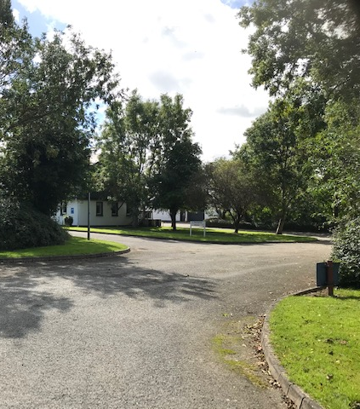
As set out in our Vision 2050 document, we see hydrogen as one of the key enablers in decarbonising the Gas Network.
As our first time on this journey, we are currently developing a small Innovation Facility in our Citywest Campus in Dublin in order to explore the impact of hydrogen in the network.
HAZEL Webinar 2: Hydrogen Sustainability - H2 DXNET - Hydrogen injection into natural gas distribution networks
Notes:
So that concludes my short overview of some the challenges of bringing H2 on the gas grid . It was by no mean comprehensive it is merely scratching the surface. I hope you found it informative and I’d like to thank you for listening,

