Slide 1
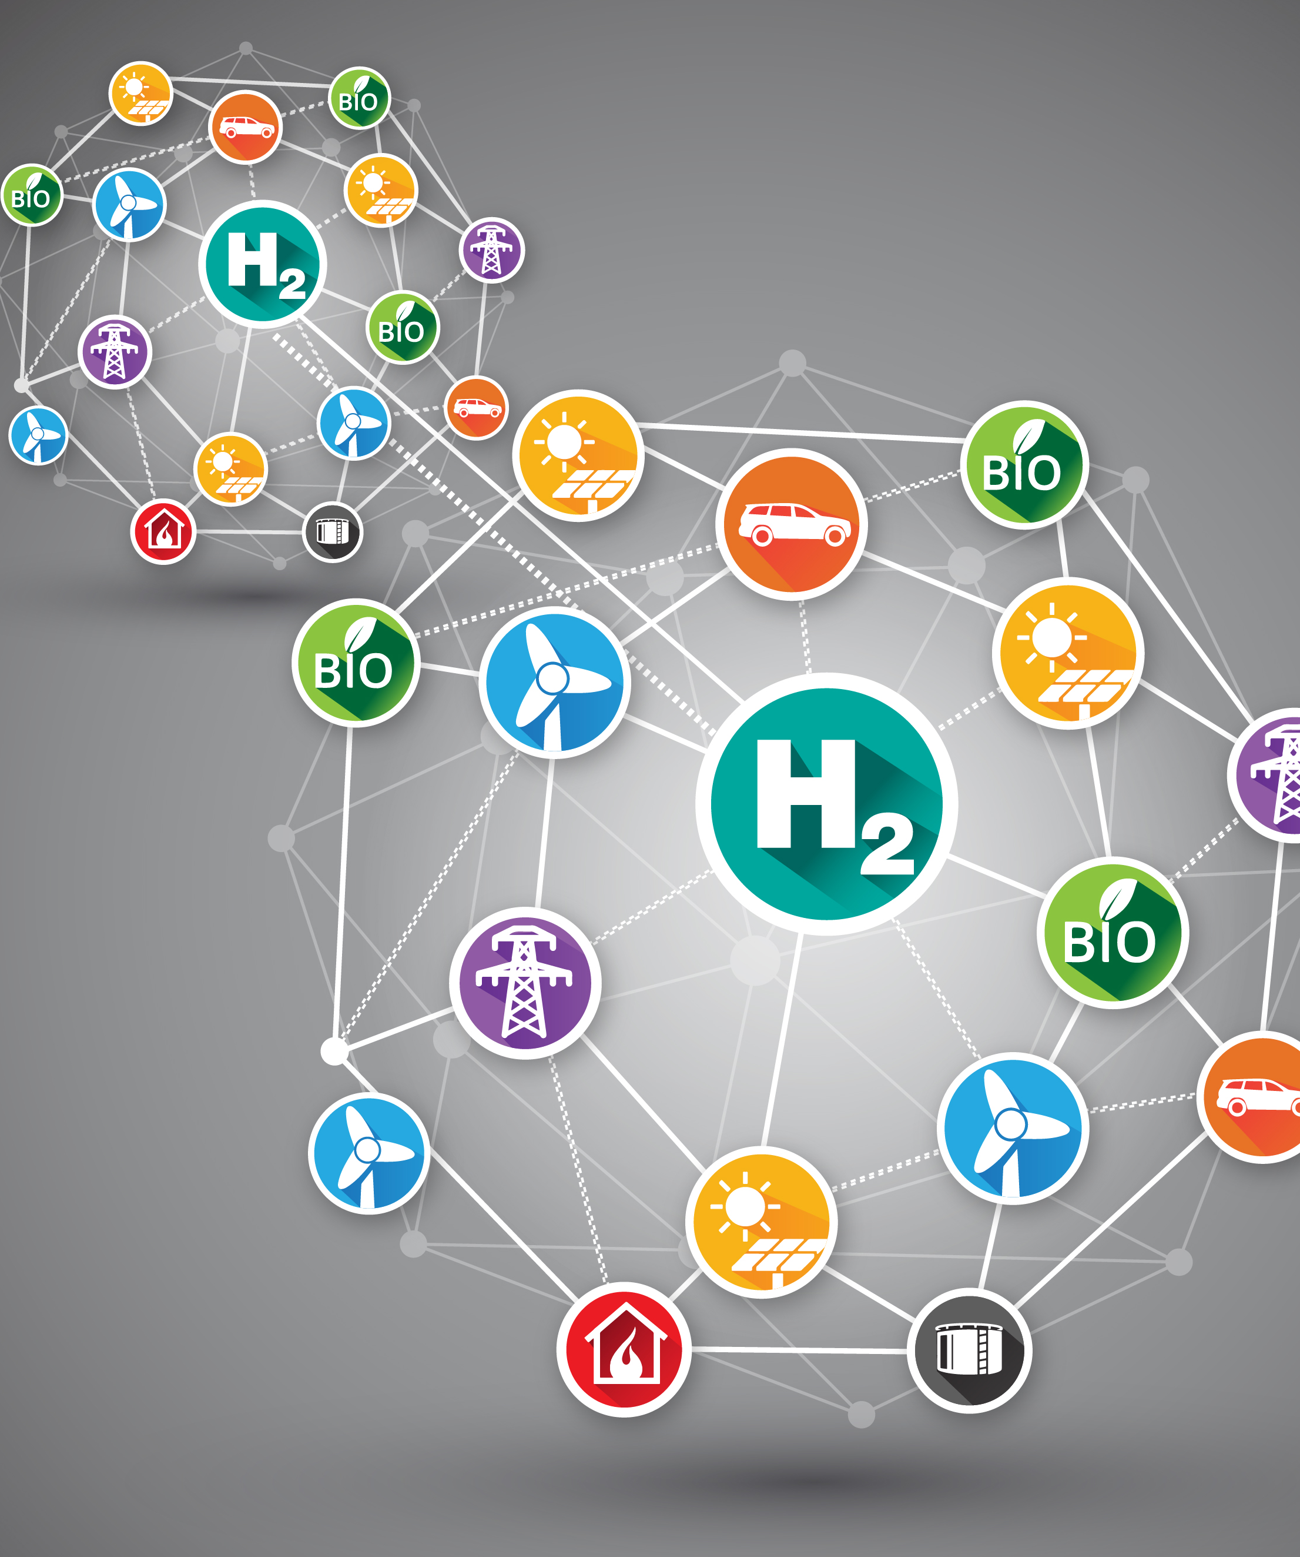


HAZEL Webinar 2:
Hydrogen Sustainability - H2 DXNET - Hydrogen injection into natural gas distribution networks
6th October 2020
Place image in this area.

Slide 2
Prospects and conditions for carbon-neutral steel production at Dillinger & Saarstahl by 2050
Helmut Lachmund

Slide 3
Renewables are several times more material intensive
Source: https://www.estep.eu/assets/SRA-Update-2017Final.pdf
Notes:
The energy transition and climate protection cannot be achieved without steel.
This slide shows as an example that the steel demand per installed MW is several times higher for renewable energies than for conventional power plants.

Slide 4
Steel industry and climate protection
Innovative steels save six times as much CO₂ than their production causes
Efficiency fossil fuel power plants
Wind turbines
Weight reduction car
Power-heat coupling
Other renewable energies
Efficient transformers
Efficient electric motors
Weight reduction trucks
Source: https://www.stahl-online.de/wp-content/uploads/2018/03/StahlNachhaltigkeit_2017_web_FINAL.pdf
Notes:
In addition, the results of this study show that innovative steels save six times as much carbon dioxide in their areas of application as they generate in their production.
This also applies to megatrends: whether e-mobility, green energy, lightweight construction or saving resources - without steel it is not possible.

Slide 5
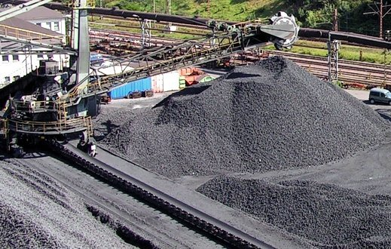

Dillinger & Saarstahl are committed to the Paris climate goals!
„We have a plan to realize these goals, but we have to convince politics of our ideas.“
Today
~2035: – 40% CO₂
2050: CO₂-neutral
Optimize
BF-Route
electricity from renewable energy sources
…
Bridge technology
green hydrogen
§
Technologically, transformation is possible, but it costs billions!
concrete technological scenarios for action
technologically and metallurgically assessed
Cost effectiveness evaluated
Political & social support is necessary!
fair conditions of competition
Reliable framework conditions
Development of necessary infrastructures
Support CAPEX & OPEX
Notes:
Dillinger & Saarstahl are committed to the Paris climate goals! The master plan for meeting the ambitious climate targets of the Paris Convention is ambitious. However, there is a lack of elementary framework conditions for the long-term investment decisions linked to the conversion to climate-neutral production: Green energy - in sufficient quantities and at competitive prices -, fair global competition and predictable subsidies.
Dillinger and Saarstahl are nevertheless convinced that, with the appropriate political framework and the necessary support, the green transformation of Saarstahl's and Dillinger's plants will be a success.

Slide 6
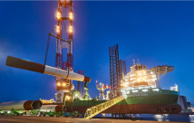
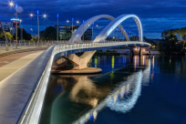
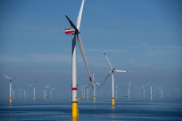
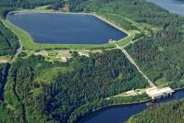
Dillinger & Saarstahl
We enable the climate change!
„We align our product portfolio especially focused on megatrends like sustainability!“
Offshore Wind (innovative steels for Offshore wind foundations)
Hydraulic steel structures (e.g. Hydroelectric power plants)
Steel construction (high-strength steels for a efficient raw material usage & lean designs)
Construction machines (high-strength and wear resistant steels)
Notes:
The innovative steels from Dillinger and Saarstahl are already enabling the climate change.
Dillinger & Saarstahl align their product portfolio especially focused on megatrends like sustainability!

Slide 7
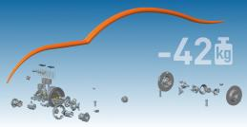
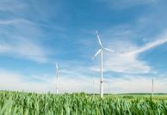
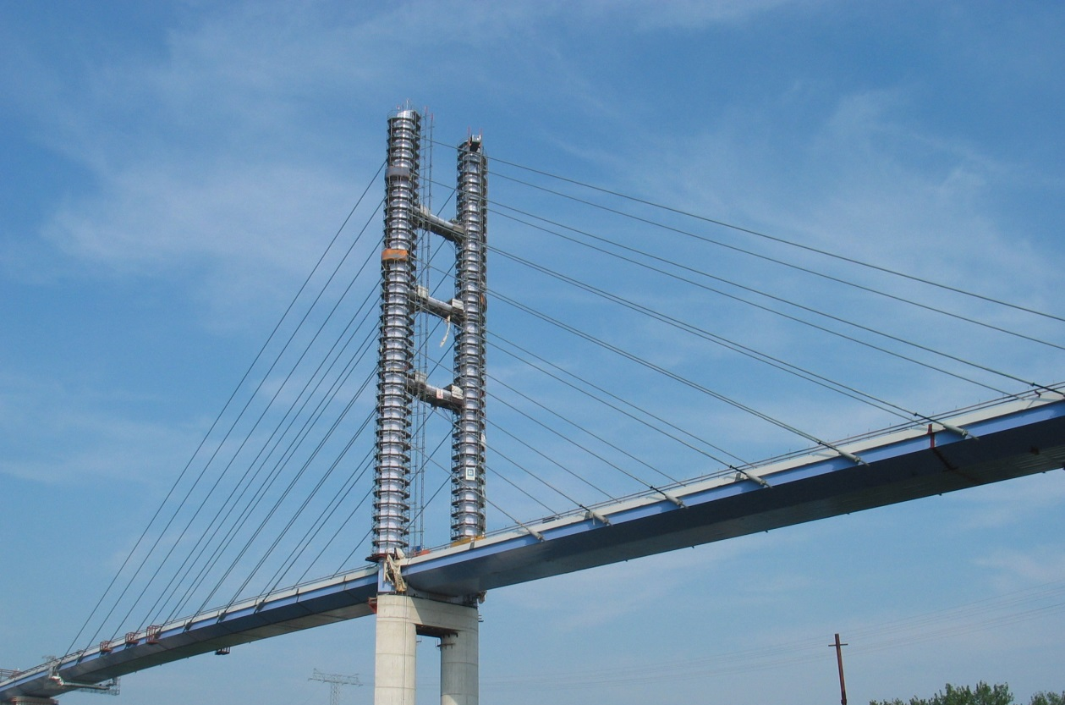
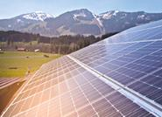
Dillinger & Saarstahl
We enable the climate change!
„We align our product portfolio especially focused on megatrends like sustainability!“
Automotive industry (innovative steels for lightweight design and for efficient solutions in engines, gears and e-mobility)
Construction sector and windpower (High-strength steels for ambitious infrastructure projects (e.g. Bridge and rail constructions or efficient development of the power supply system)
Photovoltaics (Saw wire for the production of solar panels)
Notes:
Here, high-performance steels from Dillinger and Saarstahl play a leading role worldwide: Twenty percent of the products of the two major Saarland steel companies are already indispensable today in the future-oriented sectors of the energy and mobility transition.

Slide 8
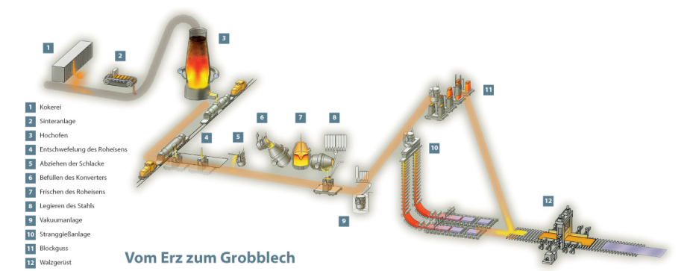
Decarbonization can only be achieved in a stepwise and long term transformation process.
Change to CO₂-neutral technology will result in massive impacts in the integrated steel plant
chain of production
coking plant sinter plant
blast furnace
steel mill
rolling mill
Effects on the entire production chain:
Complete technology change for production units 1-8
Adjustment actions for the following aggregates 9-12
Notes:
This scetch illustrates the current carbon based production process of the integrated steelplant in the Saarland.
Starting with the cking and sinter plant the raw materials are prepared to their charge into the blast furnaces where the hot metal for the LD steel plants is produced. The hot metal enters the primary steelmaking in the BOF followed by the secondary metallurgical treatment before it is casted and subsequently hot rolled.
Change to climate-neutral technology will result in massive impacts in the integrated steel plant.

Slide 9




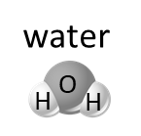





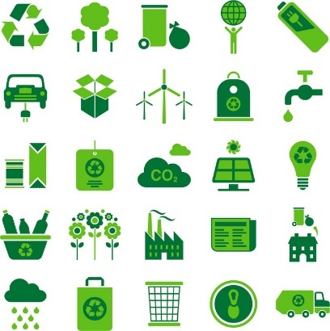
Primary Steelmaking is using an energy source to generate Iron Reducing agents while producing all kind of by-products
Energy source
Iron reducing agent
Output
steel
electricity
electrons
Fe₂
emissions
natural gas
CO₂
hydrogen
stored
CO₂
coal
bio-chemicals
carbon
biomass & plastics
electricity
Notes:
Since iron occurs in nature only as an oxide, it must be reduced for steel production. Primary Steelmaking is using an energy source to generate Iron Reducing agents while producing steel and all kind of by-products.

Slide 10
Today coal and natural gas are the primary energy pathways for producing primary steel
Energy source
Iron reducing agent
Output
steel
electricity
electrons
Fe₂
emissions
natural gas
CO₂
DRI (5%)
hydrogen
stored
CO₂
coal
BF Route (95%)
bio-chemicals
carbon
biomass & plastics
electricity
Notes:
Today, the blast furnace process accounts for 95% of the world's iron ore reduction. The rest is produced by the route of direct reduction. While coal is the energy source in the blast furnace process, natural gas is used in the direct reduction process. Here only half of the greenhouse gas carbon dioxide is produced, since the natural gas is split into the two reducing gases hydrogen and carbon monoxide. In contrast to the blast furnace process, however, direct reduction does not produce a liquid product but a solid sponge iron, which requires additional electrical energy for melting.

Slide 11
In the future Primary Steelmaking is using an energy source to generate Iron Reducing agents without CO₂ emissions
Energy source
Iron reducing agent
Output
steel
electricity
electrons
Fe₂
emissions
natural gas
hydrogen
stored
CO₂
bio-chemicals
carbon
biomass & plastics
electricity
Notes:
If there is sufficient renewable energy available in the future, the steel industry will move towards direct carbon avoidance. The green hydrogen can be used as the only reducing agent or in combination with the use of biomass and plastics the green hydrogen can also be used to produce bio-chemicals.

Slide 12
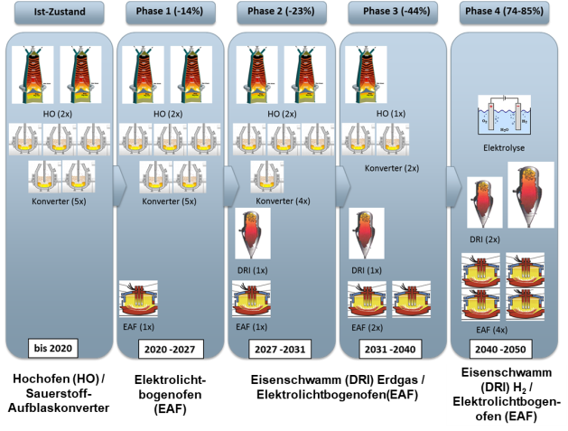
Decarbonization of the steel industry
„DILCOS“ study shows a long-term transformation process
towards CO₂-neutral steel production
Dillinger & Saarstahl worked on decarbonization ideas since years
DILCOS-Study finished in 2016
Stepwise insallation of new units
Theoretical and location-independent
Conclusion:
Concerns on infrastructure conditions and massive economic burdens !!!
Blast furnace (BF) / Basic oxygen furnace (BOF)
Electric arc furnace
(EAF)
DRI (natural gas) / Electric arc furnace (EAF)
DRI (Hydrogen) / Electric arc furnace (EAF)
Notes:
For more than 15 years, Dillinger and Saarstahl conducted intensive research into processes for low carbon steel production. A milestone was set in 2016 with the company's own study, Dillinger Low CO2 Steelmaking (DILCOS), which was carried out in cooperation with plant engineering companies. This broad-based study analysed the CO2 savings potential of existing steelmaking processes. Its findings formed the basis for the roadmap currently being pursued for the successive replacement of the blast furnace-converter route by electric arc furnaces with a direct reduction route - in the first step by natural gas, in the final stage by hydrogen.Translated with www.DeepL.com/Translator (free version)

Slide 13
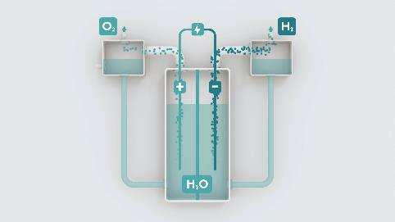
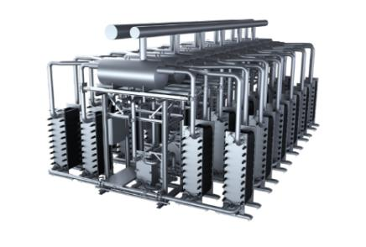
Sufficient supply of raw materials at the site must be guaranteed
Scenario: „Hydrogen route “
Ensuring the hydrogen supply for DRI/HBI generation on site
Construction of hydrogen pipelines required
In addition, the power supply must be guaranteed.
Source: voestalpine.com
In numbers:
Scenario 4 million t/a DRI/HBI on site
Quantity of hydrogen required for this:
~350,000 m³/h
Equivalent to ~92 times the capacity of the planned H₂ hub in Fenne
Source: siemens.com
Siemens SILYZER 300
Kapazität im H₂ Hub Fenne: 3800 Nm³/h
Notes:
For carbon-neutral steel production, a stable hydrogen supply must also be guaranteed at the site.This can be achieved either by building hydrogen pipelinesor the necessary supply of renewable energy.The production of 4 million tonnes of DRI per year at the site will require a hydrogen volume of 350,000 m³/h, which is approximately 92 times the capacity of the planned H2 Hub in Fenne, which was already presented by H. Sacca in the first HAZEL webinar.

Slide 14
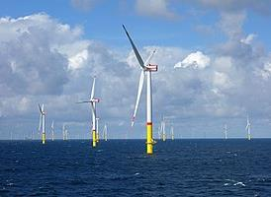
Stable and sufficient supply of renewable electricity on site
„Stable “ means that a continuous supply (24-7-365) must be ensured
i.e. research activities and investments in storage, transport and infrastructure
technologies are necessary
„sufficient “ means that an additional demand for electricity must be available
for steel production
Capacity and networks need to be expanded, because besides the steel industry there are other energy-intensive industries, e-mobility, ... which need to be supplied
In numbers:
~3 TWh/a for 4 EAF in Saarland (5.2 million t/a electrical steel production)
  Equivalent to 2 wind farms of the size of Arkona
  For total German steel production by EAF: approx. 17 wind farms*
~13 TWh/a additionally for DRI/HBI production with hydrogen in Saarland
  Equivalent to 8.5 wind farms the size of Arkona
Wind farm Arkona
Capacity: 385 MW
*Source: WV Stahl
Notes:
A stable supply of carbon free electricity at the site means that a continuous supply (24-7-365) must be ensured.Sufficient supply means that an additional demand for electricity for steel production must be availableIn figures this means~3 TWh/a for 4 EAFs in Saarland (5.2 million t/a of electrical steel production) Equivalent to 2 wind farms of the size of ArkonaFor total German steel production by EAF: approx. 17 wind farms ~13 TWh/a additionally for DRI/HBI production with hydrogen in SaarlandEquivalent to 8.5 wind farms the size of ArkonaTranslated with www.DeepL.com/Translator (free version)

Slide 15
CAPEX & OPEX support for the transition of steel production
High investments made in efficient integrated steel plant; loss of value due to transition to new route
Significant investment in new technology required
Hydrogen-based DRI/HBI: lack of industrial scale and not yet competitive;
high OPEX not feasible in international competition
Competitive energy prices are essential
Complete transition to the hydrogen route:
almost a doubling of production costs
High investments / complete restructuring of production
Estimation of climate protection costs for German industry:
Investments of ~230 billion € to reduce CO₂ emissions by 95% by 2050
(Source: Bosten Consulting Group)
Notes:
The transition of steel production requires significant investment in new technologies.
Hydrogen-based DRI/HBI production currently lacks an industrial scale and is not competitive under the current constraints.
The almost doubling of production costs is not practicable in international competition.
Competitive energy prices are therefore essential.

Slide 16
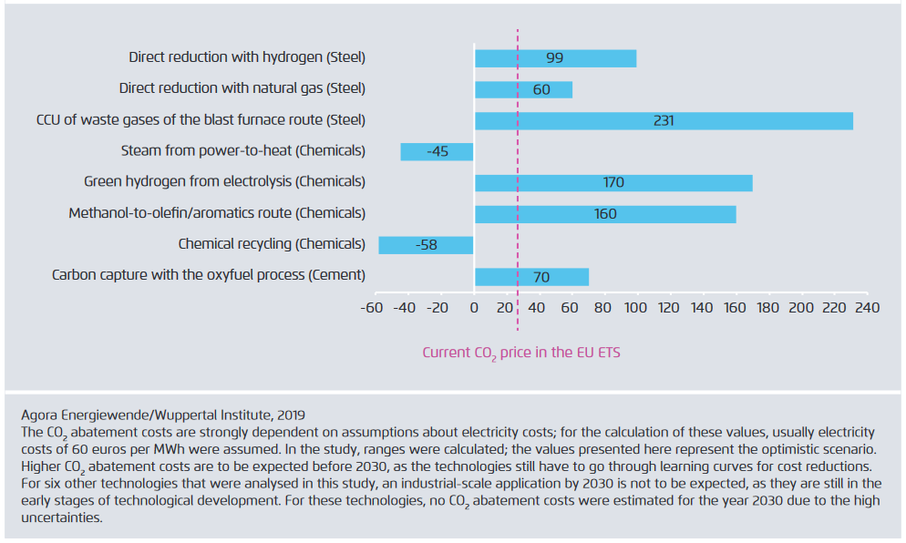
Estimated CO₂ abatement costs of selected key technologies versus today's conventional reference process for 2030
https://www.agora-energiewende.de/fileadmin2/Projekte/2018/Dekarbonisierung_Industrie/168_A-EW_Climate-neutral-ndustry_EN_ExecSum_WEB.pdf

