Slide 1
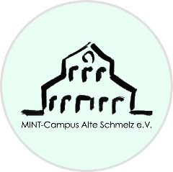
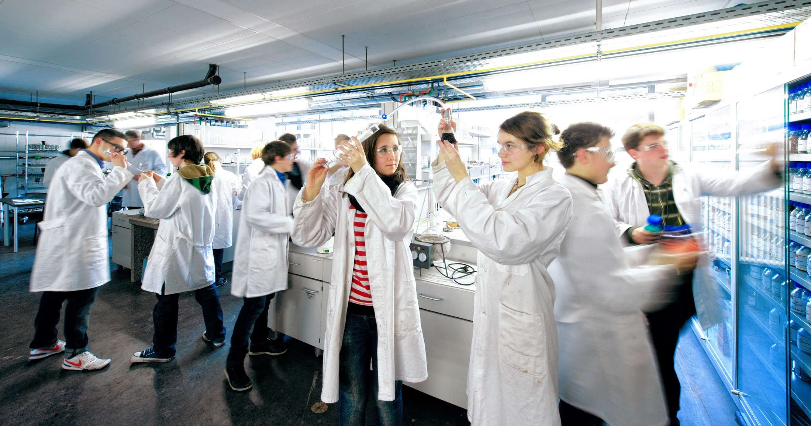
Hydrogen and STEM Sustainability Education in Saarland´s Schülerlabors
Rolf Hempelmann Transfercentre Sustainable Electrochemistry and Chemistry-Schülerlabor NanoBioLab @ Saarland University
Schülerforschungs- & -technikzentrum SFTZ @ MINT-Campus Alte Schmelz e.V., Sankt Ingbert

Slide 2
Definition of „Schülerlabor“
provide well-equipped laboratories
provide authentic surroundings and thus professional orientation
allow young people to perform experiments hands-on, by themselves
have a regular periodical offer of practical courses.

Slide 3
Tell me and I will forget, show me and I may remember; let me do it and I will understand.
Konfuzius 2500 years ago

Slide 4
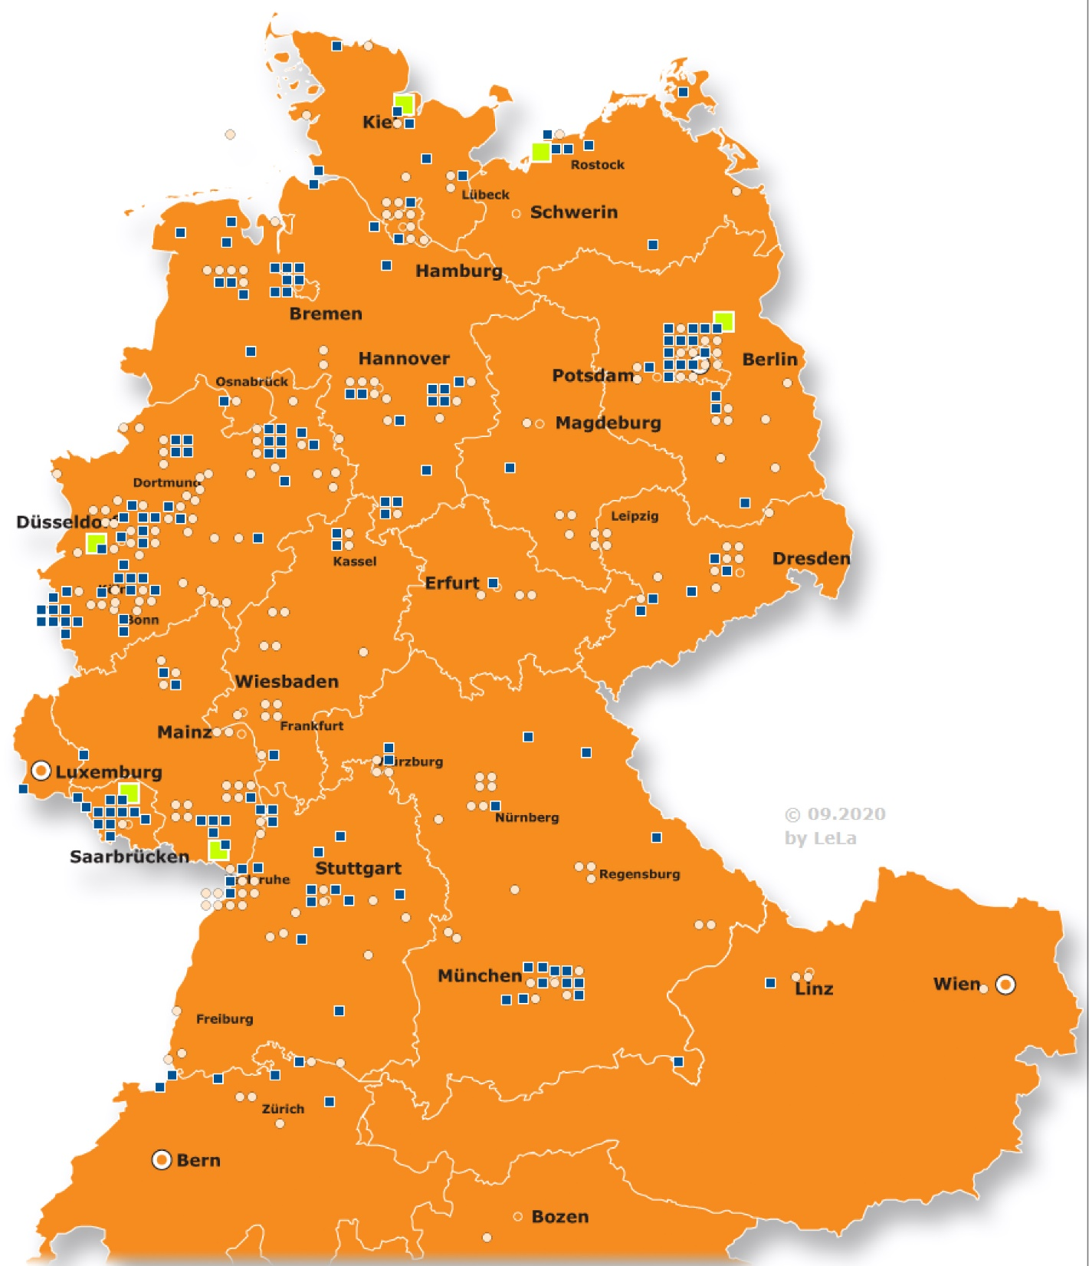
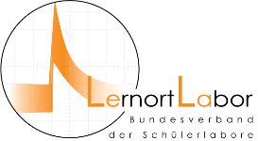
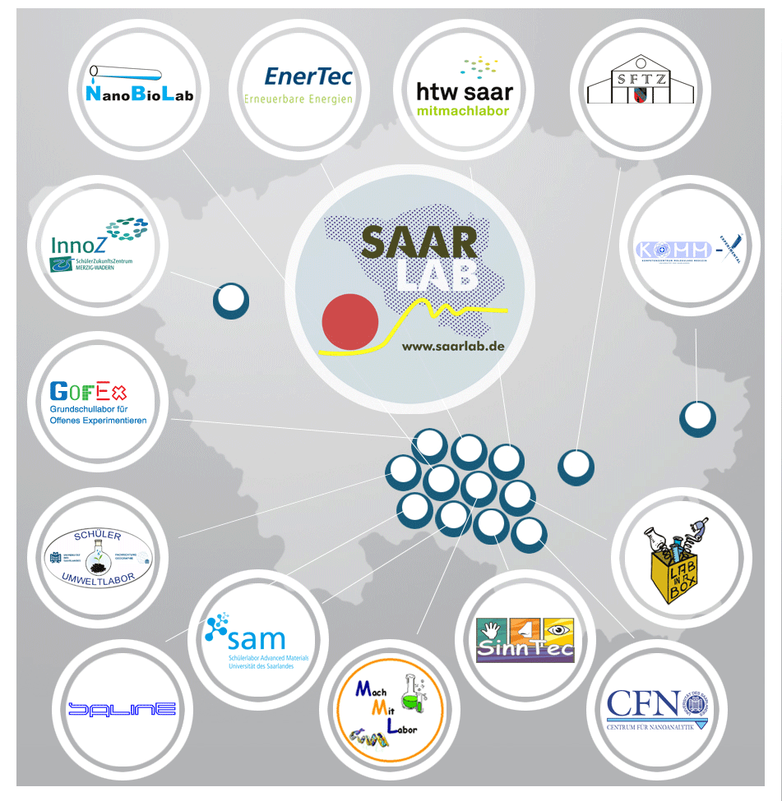
since more than 25 years in German speaking regions,
more than 370 SLs by now
Operating institutions:
Universities 49 %
Private Clubs 12 %
Research Centers: 11 %
Industrial Enterprices: 10 %
Others: 18 %

Slide 5
Sustainable Development
„ Sustainable development is a development that satisfies the present generation's needs without jeopardizing the possibilities for future generations to meet their own needs.“ from the Brundtland-Report of the United Nations „Our Common Future“ from 1987,
important political goal of our society today
Sustainability
economy
ecology
social issue
3-columns concept of Sustainable Development
Notes:
Vieles genannt, aber im wesentlichen nur Ökonomie und Ökologie
Wichtig ist dabei auch, dass das Soziale nicht vergessen wird.
Nicht nur jetzt, sondern auch noch für die weiteren Generationen verantwortlich!
----- Besprechungsnotizen (26.09.14 08:15) -----
Was kann das jetzt aber für die Chemie bedeuten?

Slide 6
Sustainable Development
Prerequisite for successful implementation:
Bildung
less precise: Education
→ Education for Sustainable Development (ESD)
Additionally urgently needed: R & D in the field of Sustainability
and concomitantly: STEM Sustainability Education (STEM-SE)
Notes:
Vieles genannt, aber im wesentlichen nur Ökonomie und Ökologie
Wichtig ist dabei auch, dass das Soziale nicht vergessen wird.
Nicht nur jetzt, sondern auch noch für die weiteren Generationen verantwortlich!
----- Besprechungsnotizen (26.09.14 08:15) -----
Was kann das jetzt aber für die Chemie bedeuten?

Slide 7
STEM Sustainability Education (MINT-Nachhaltigkeitsbildung)
Definition:
STEM Sustainability Education provides interdisciplinary knowledge on environmental issues in the fields of Mathematics, Computer Science, Natural Science and Technology. It promotes environmental awareness and sustainable attitudes.
Schülerlabors are particularly suitable for providing children with STEM Sustainability Education and to bring, - with the school students as multipliers -, STEM Sustainability Bildung into our society.
(LernortLabor 2018)
STEM Sustainability Education
Scientific Literacy
Technology Acceptance
Environmental Education
ESD
SchülerLabors + School
STEM-SE is Transformative Education

Slide 8
efficient dissemination of research achievements
Important technological achievements occur in increasingly shorter time intervals, with essential impact on the day-to-day life of the youth (and of all of us).
Progress in science and technology does not wait, until it eventually makes it into the official school curricula, i.e. into the formal sector of education
Schülerlabors as non-formal educational institutions act as bridge between research and school:

Slide 9
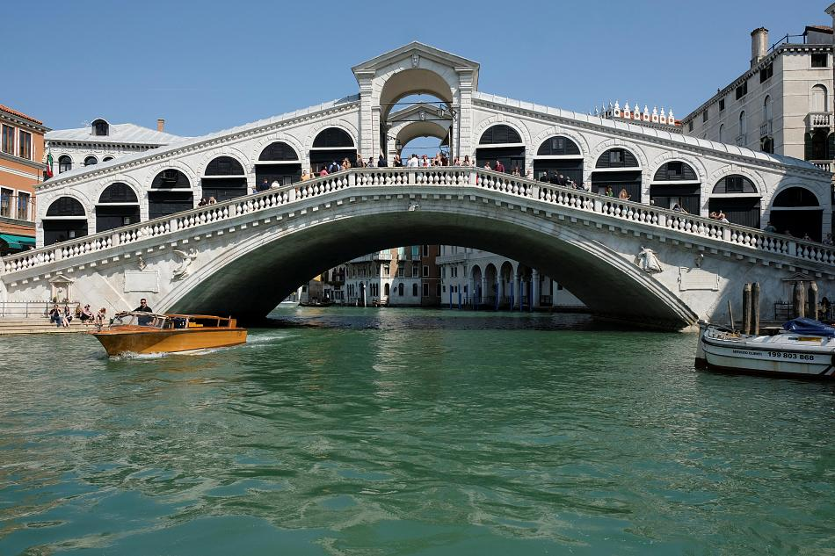
efficient dissemination of research achievements
front of science
Schülerlabor
university
school
subject-specific didactics
Schülerlabors are locations of educational freedom: here new things can just be tried or can systematically be probed

Slide 10
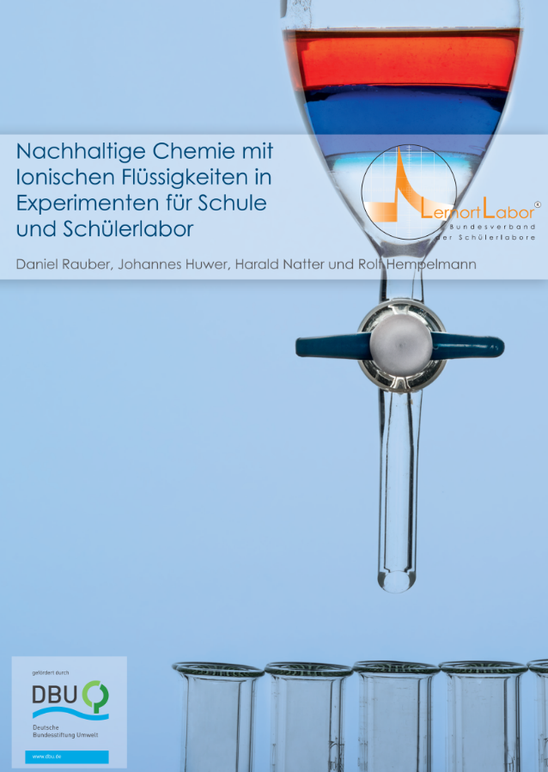
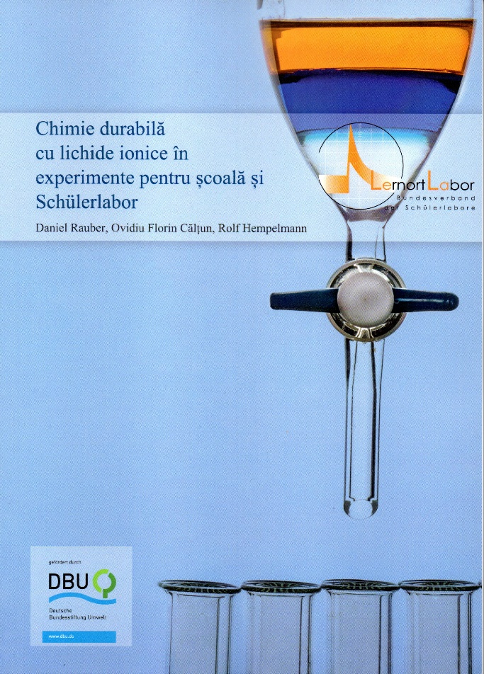
Ionic Liquids: new class of materials
industrial process
up-scaling (pilot scale)
down-scaling to the school
School experiments with Ionic Liquids
Dual carbon lithium ion battery
Supercapacitors
Ionic Liquids as electrolytes in dye-sensitized solar cells
Processing of cellulose
Urban Mining: recuperation of rare earth Neodymium from electronic garbage
Book in German Language: Nachhaltige Chemie mit Ionischen Flüssigkeiten
in Experimenten für Schule und Schülerlabor
Translations in the Korean, Greek and English languages are in progress now

Slide 11
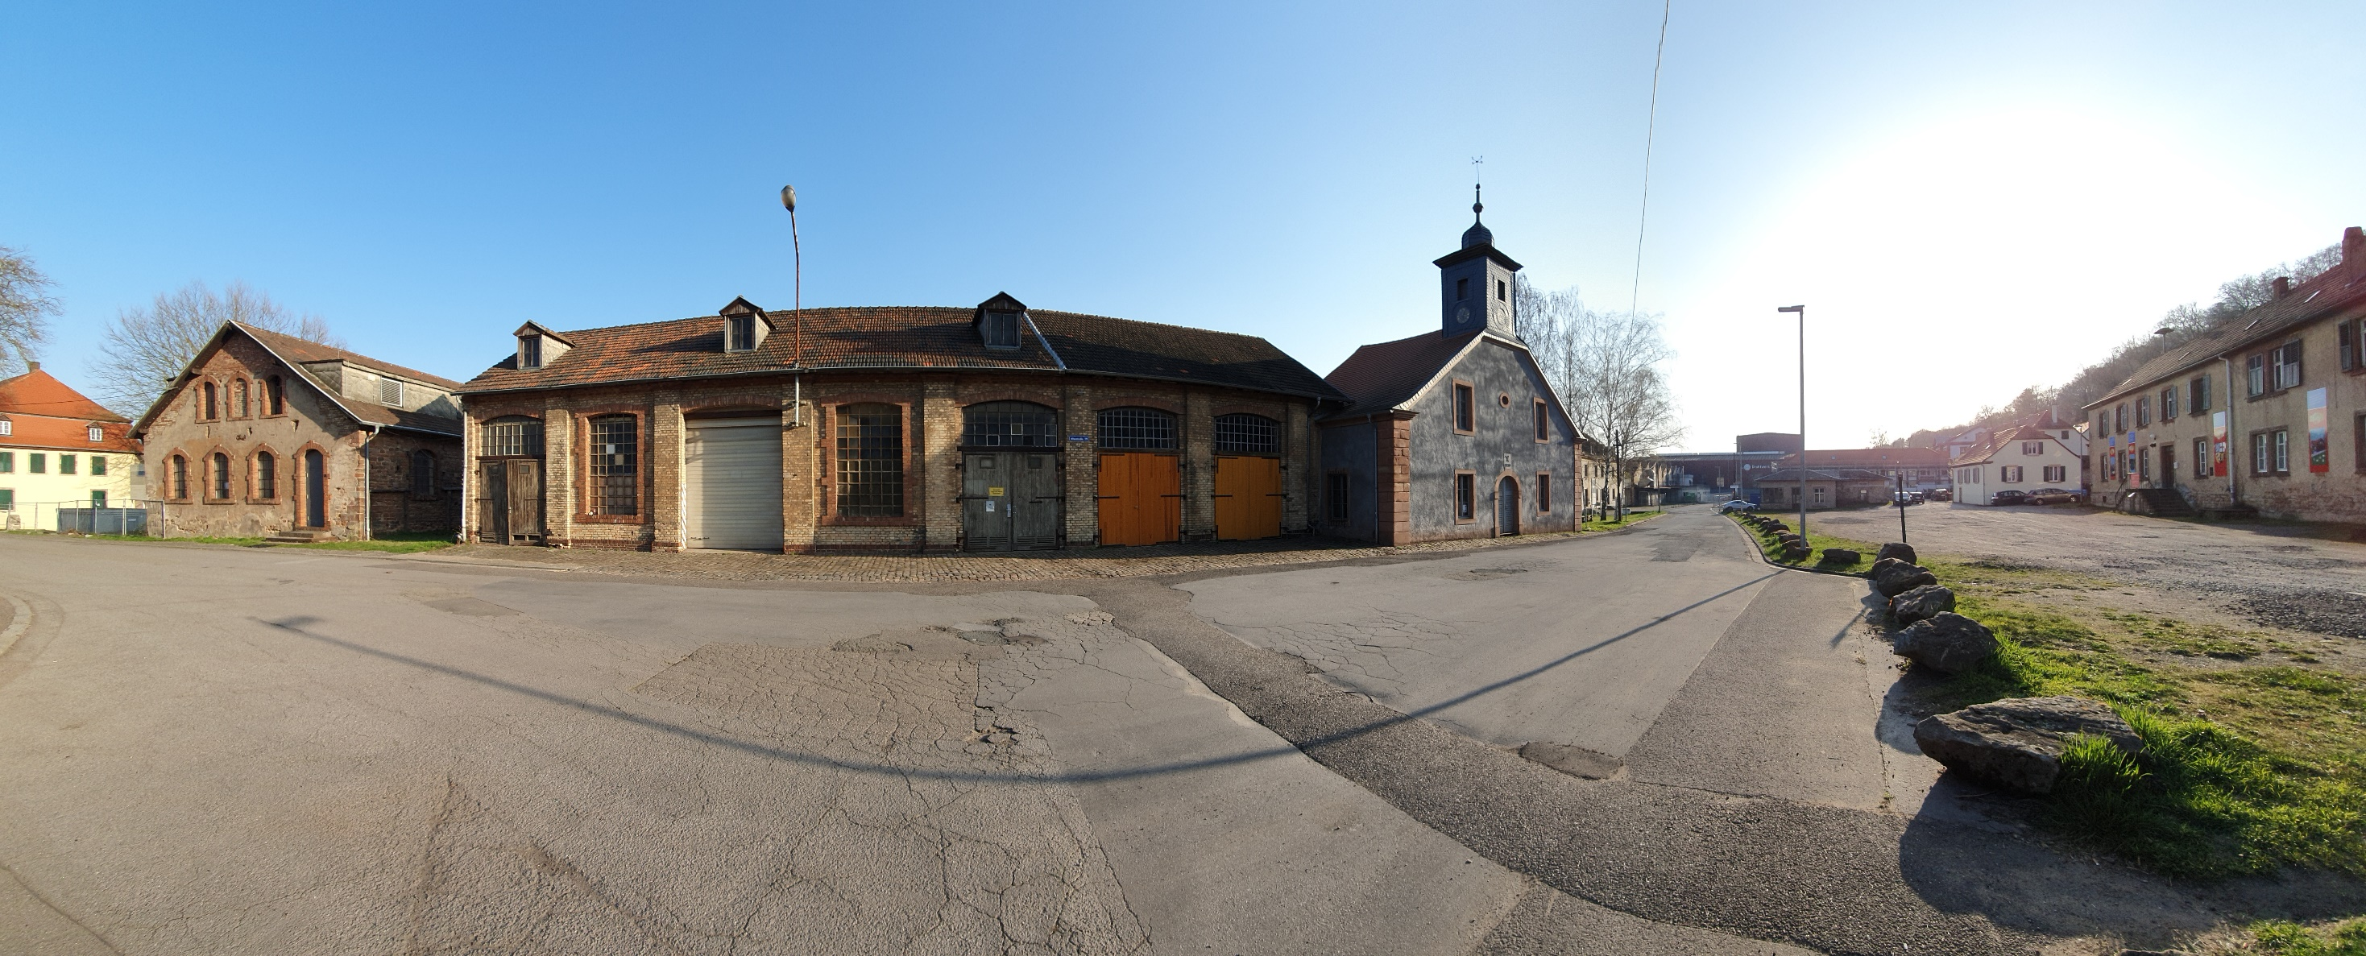
Industrial Monument Alte Schmelz (former iron factory) → MINT-Campus Alte Schmelz St. Ingbert, Conversion of the laboratory building of the former ironworks into a Student Research and Technology Center

Slide 12
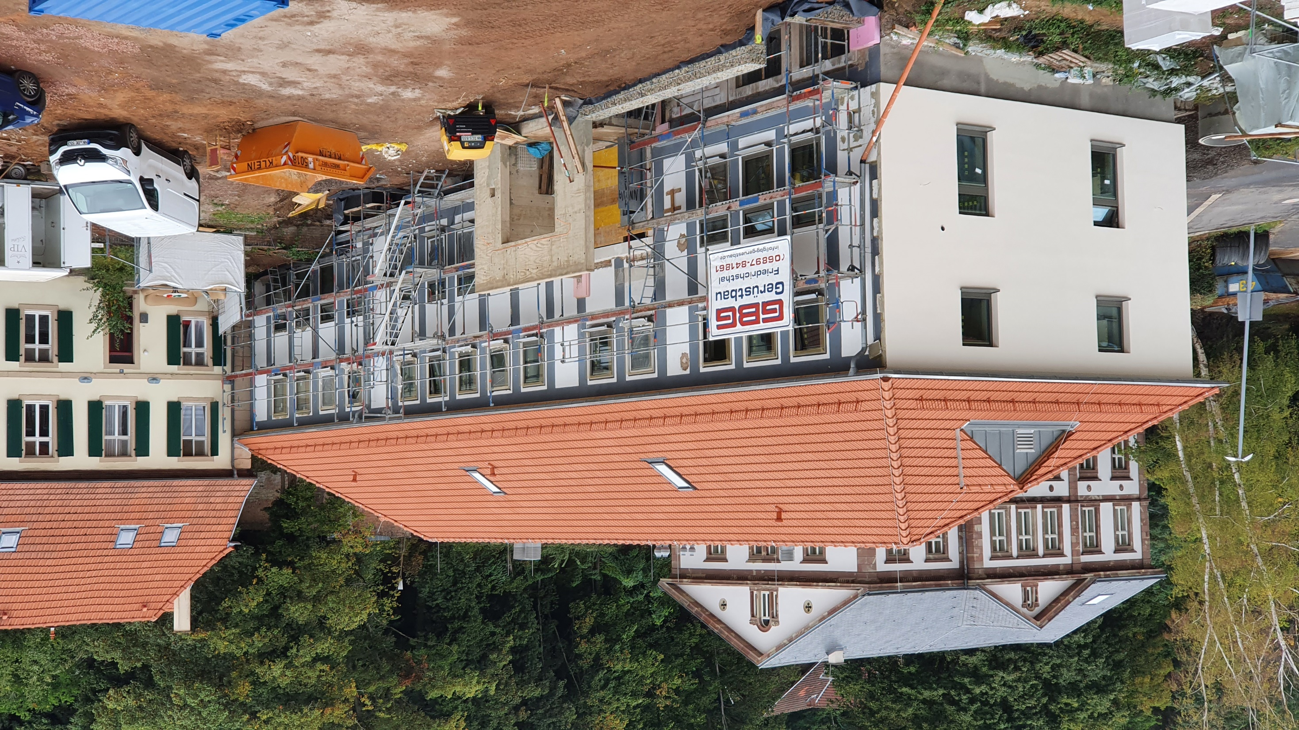
SFTZ, Stand Ende August 2020
29.08.2020

Slide 13
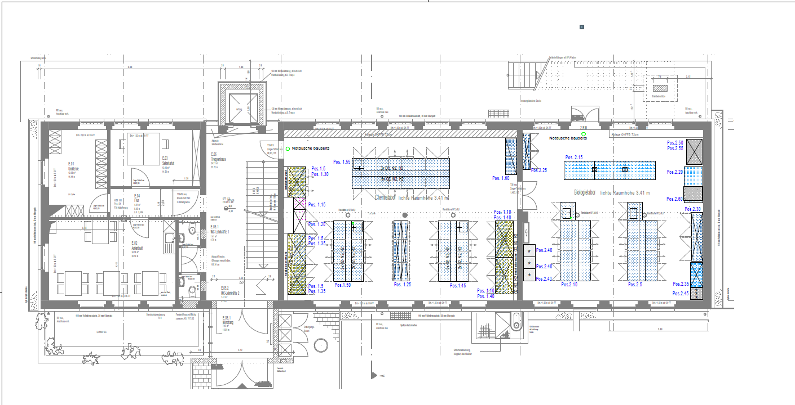
SFTZ, ground floor
Common Rooms Chemistry Lab Biology Lab
Physical Geography

Slide 14
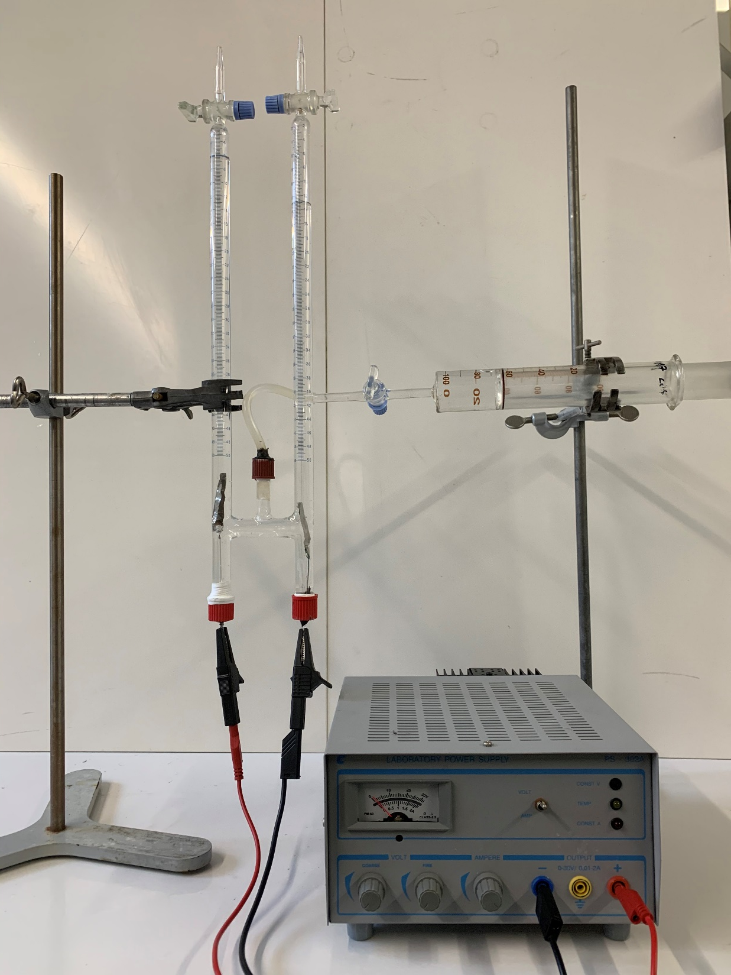
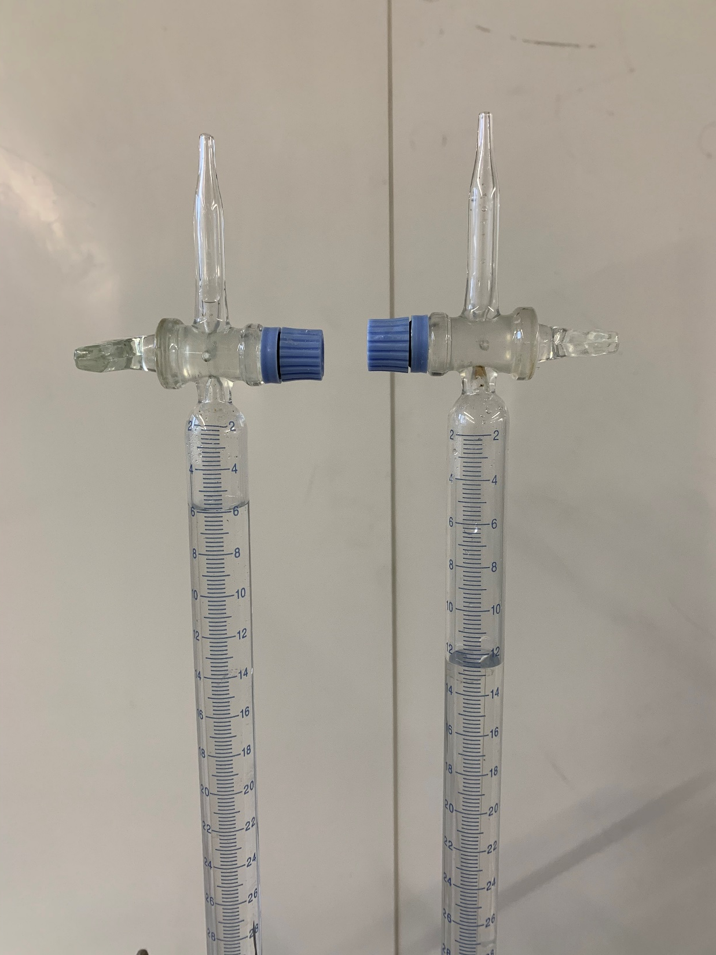
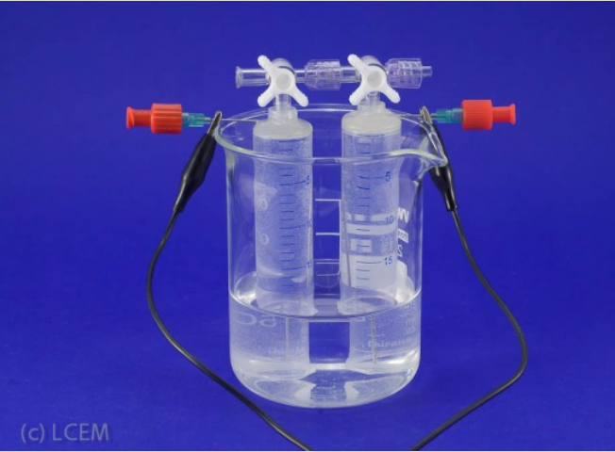
Water electrolysis

Slide 15
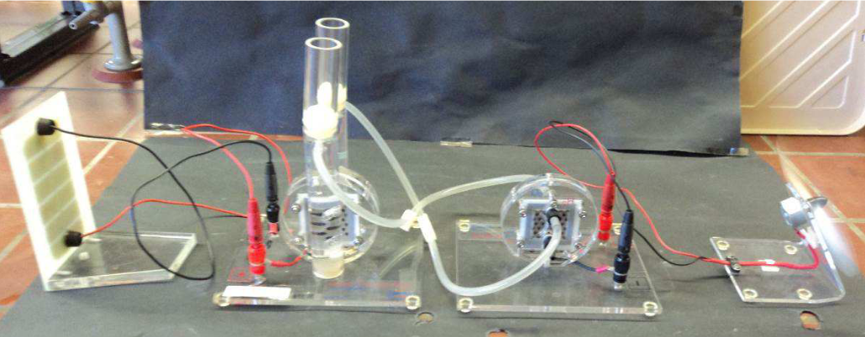
PV – electrolyser – fuel cell - consumer

Slide 16
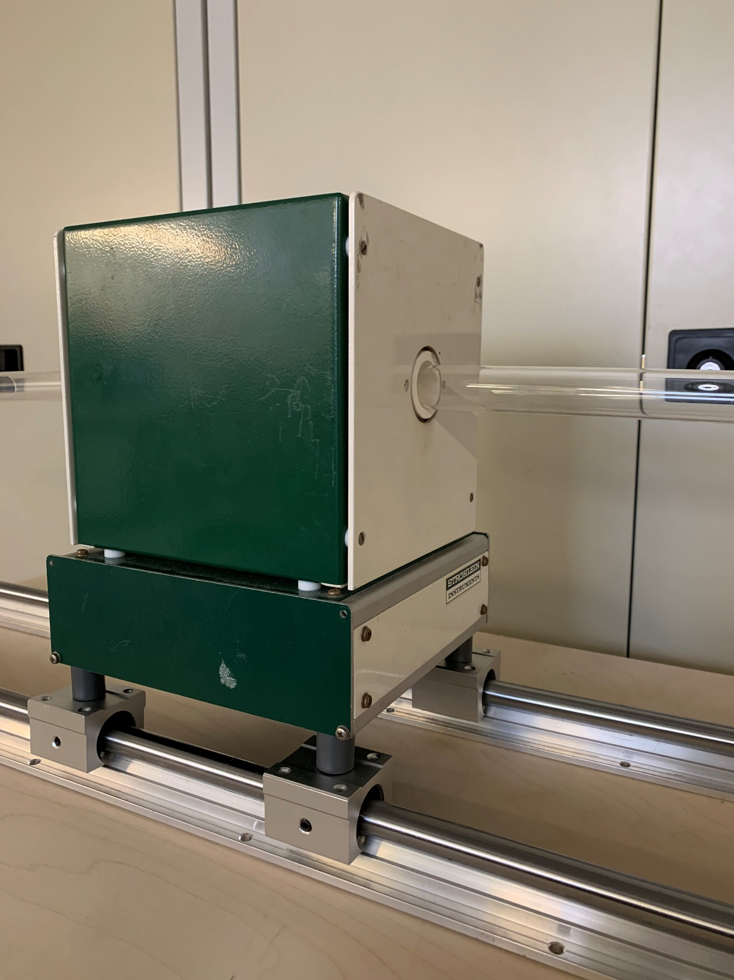
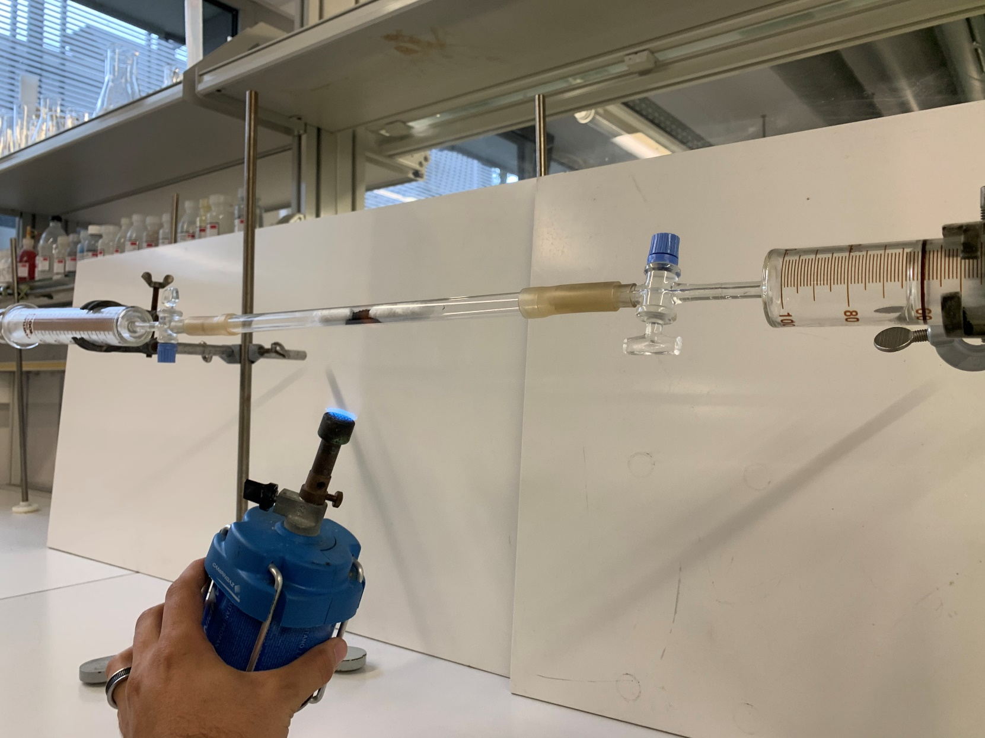
Green steel

Slide 17
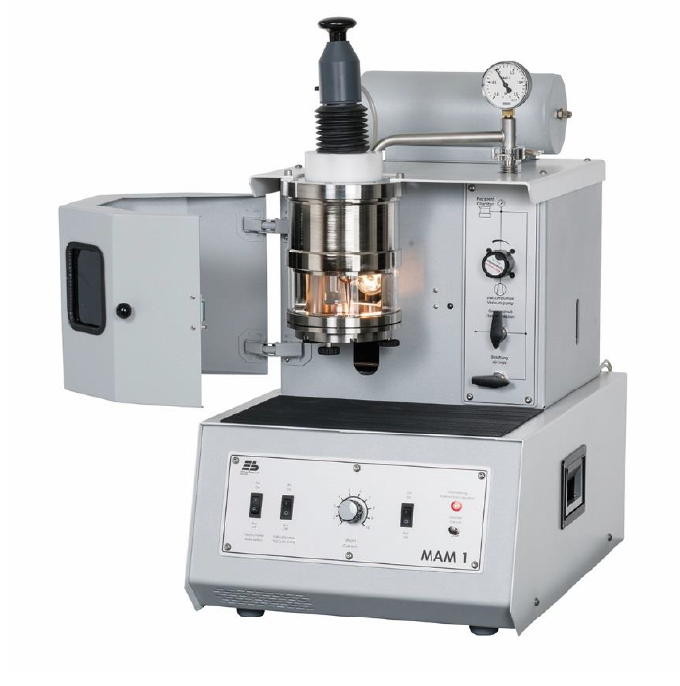
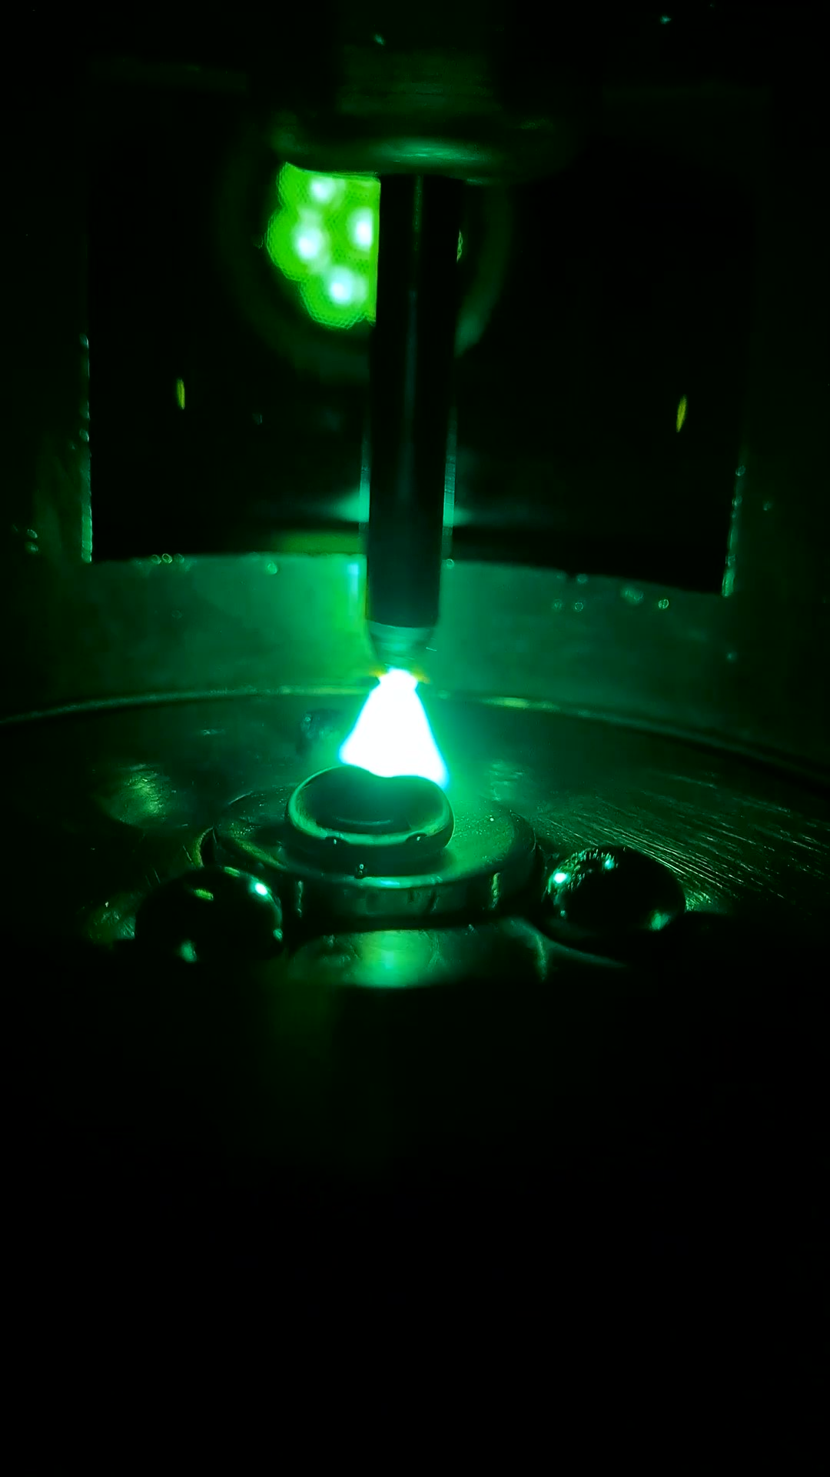

Slide 18
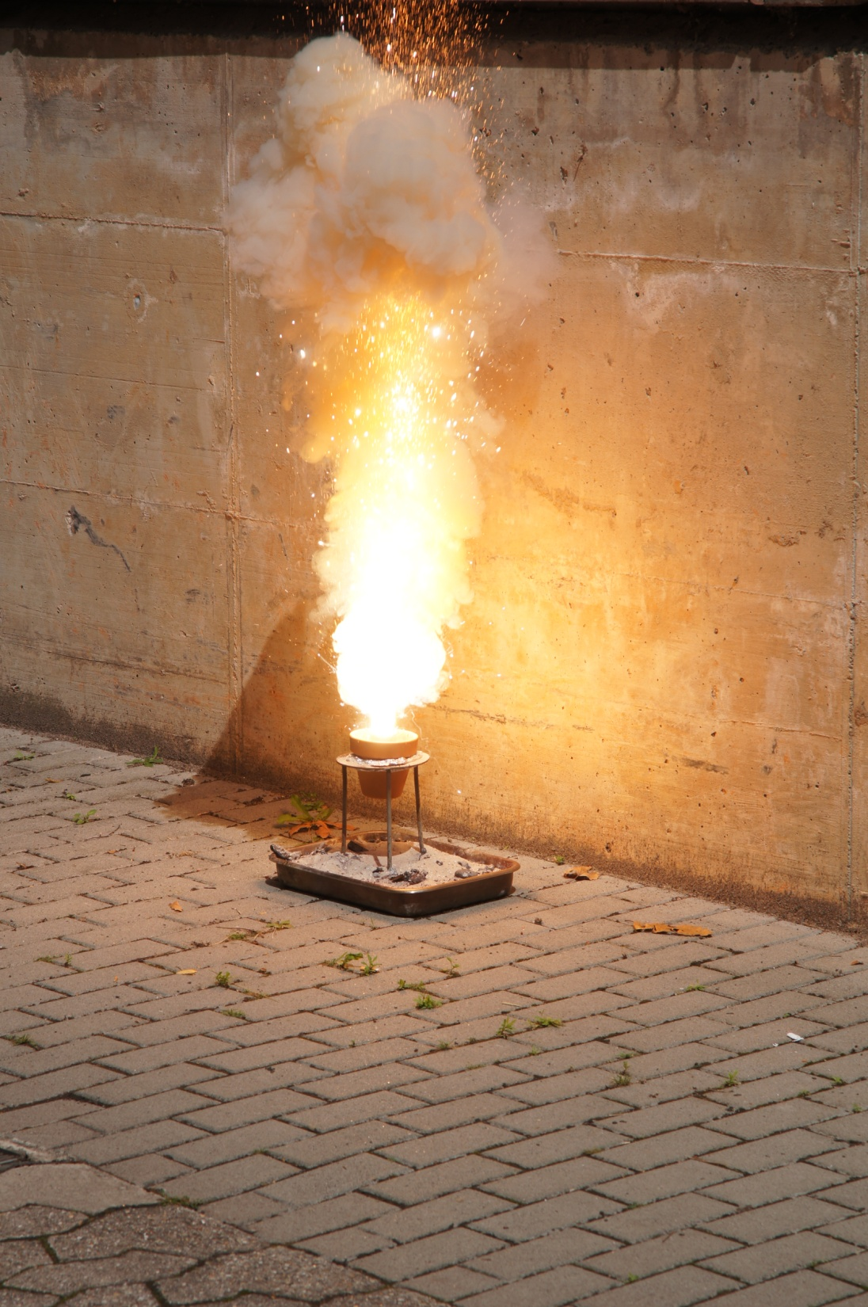
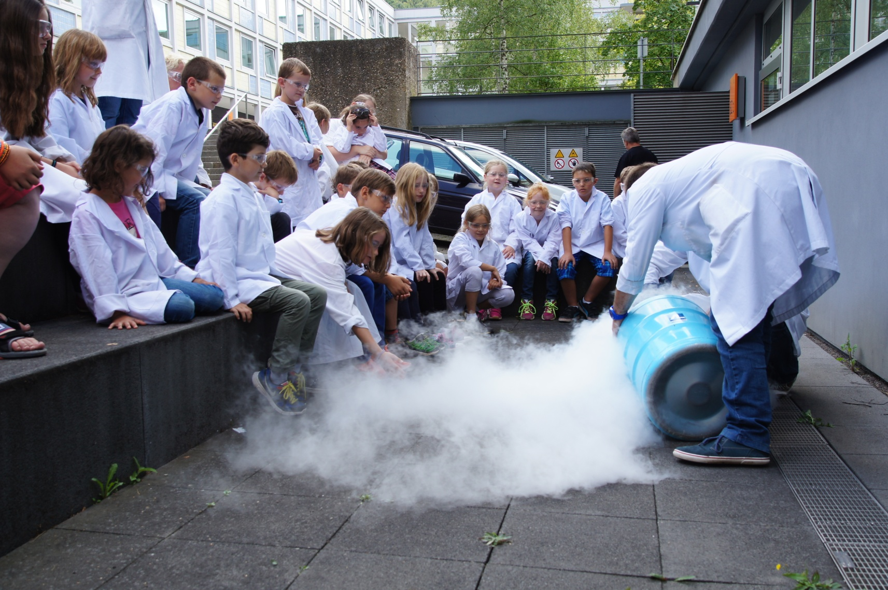
Es gibt nichts Gutes, außer man tut es.
There is nothing good, unless you do it.

