Slide 1
HAZEL Webinar 2:
Hydrogen Sustainability - H2 DXNET - Hydrogen injection into natural gas distribution networks
6th October 2020
Place image in this area.

Slide 2
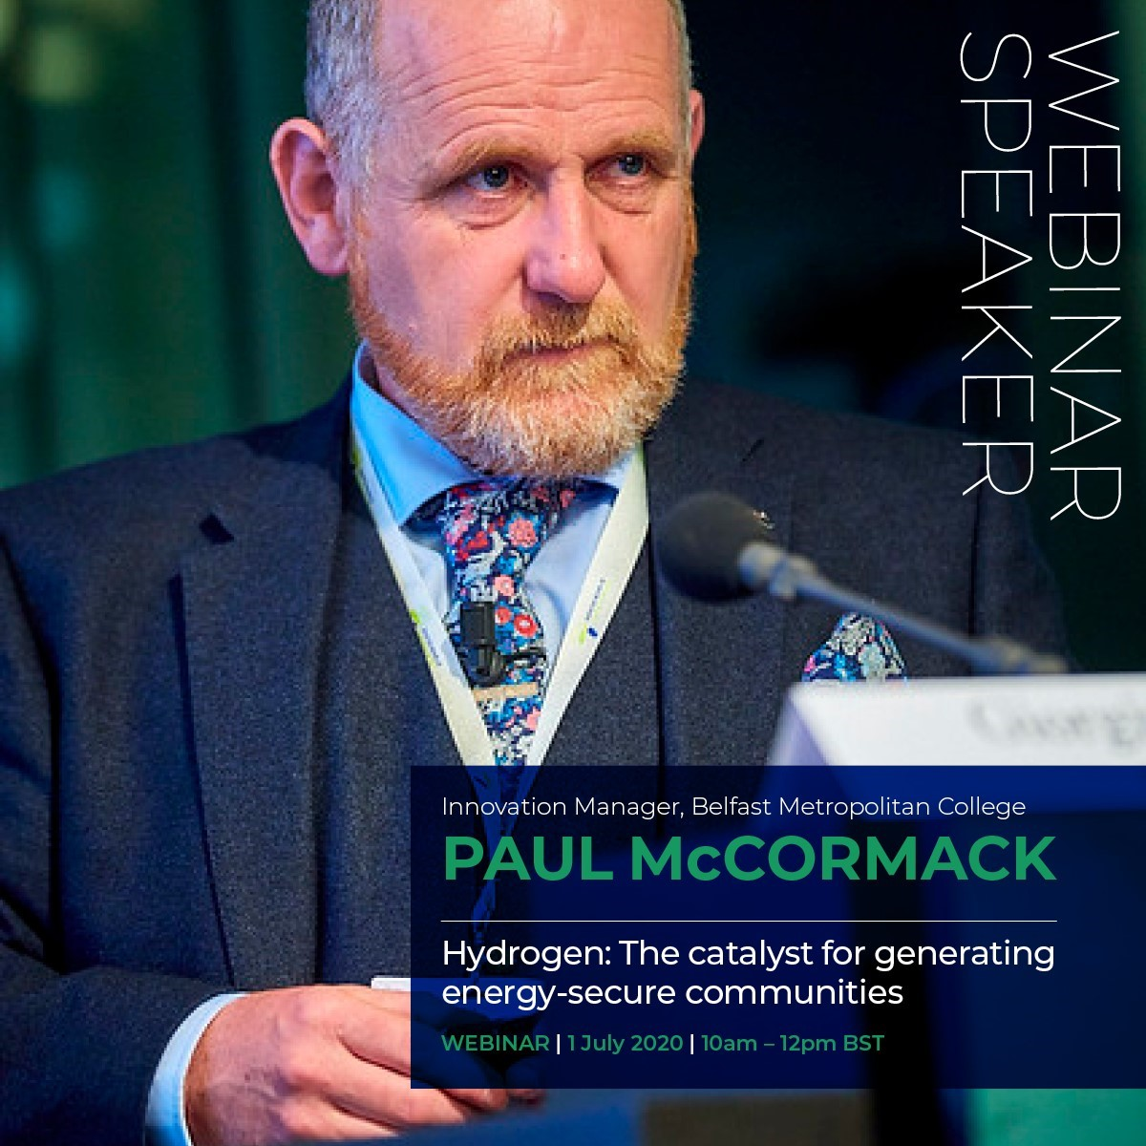
HAZEL Webinar 2: Hydrogen Sustainability - H2 DXNET - Hydrogen injection into natural gas distribution networks

Slide 3
AGENDA - 6th October 2020
10.00 BST: Welcome & Introduction, Paul McCormack, Innovation Manager, Belfast Metropolitan College
10.05 BST: "Decentralized Hydrogen Production from Green Methane - the Reformer Steam Iron Cycle (RESC)", Prof Viktor Hacker, Graz University of Technology, Austria
10.15 BST: "Gas Grid Injection - the Challenges", James Burchill, Head of Asset Operations, Gas Networks Ireland
10.25 BST: "Prospects and conditions for CO2-neutral steel production by 2050", Dr Helmut Lachmund, Manager Research & Development/Steelmaking, Dillinger Huttenwerke AG
10.40 BST: "Hydrogen and STEM Sustainability Education in Saarland's Schülerlabors", Prof. Rolf Hempelmann, UdS, Sustainable Electrochemistry Tech Trans Centre, Saarland University
10.50 BST: Q&A
HAZEL Webinar 2: Hydrogen Sustainability - H2 DXNET - Hydrogen injection into natural gas distribution networks

Slide 4
Introduction
What is HAZEL?
Who is involved in HAZEL?
Why are we delivering this series of seminars?
HAZEL Webinar 2: Hydrogen Sustainability - H2 DXNET - Hydrogen injection into natural gas distribution networks

Slide 5
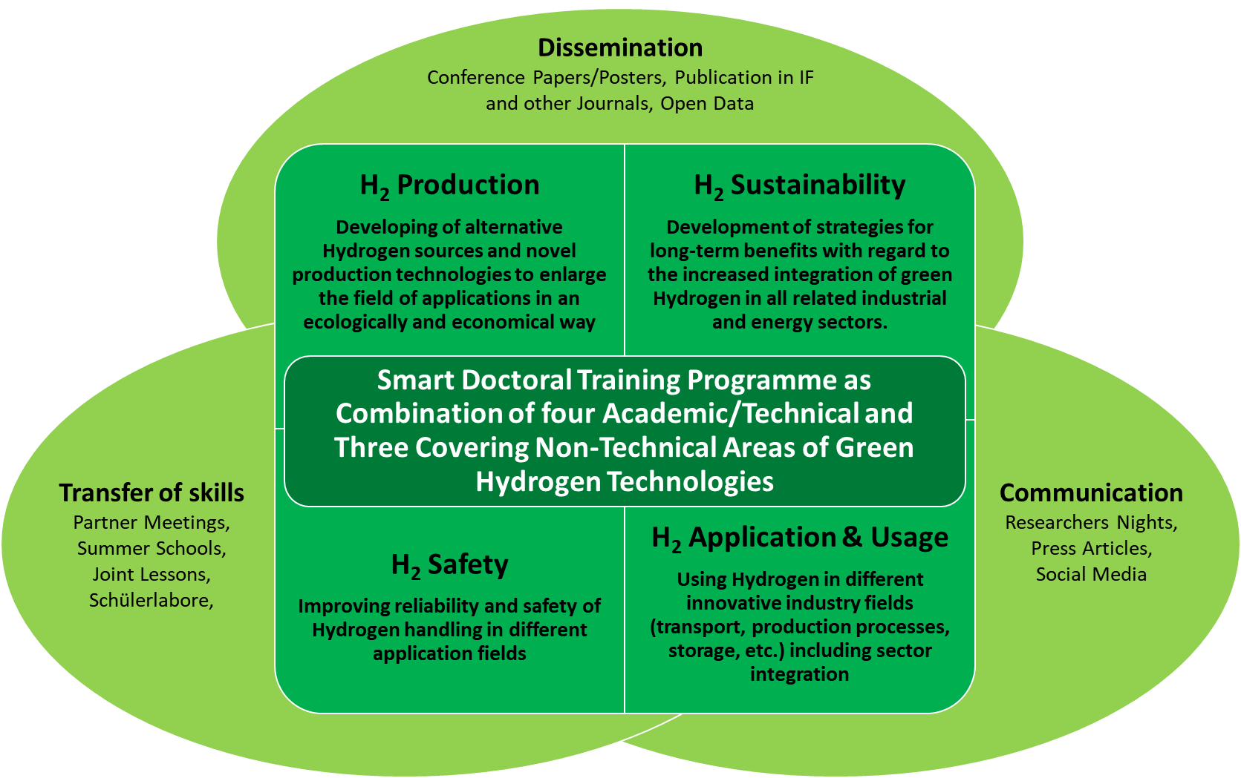
What is HAZEL?
Hydrogen enAbled Zero Emissions suppLy chains
HAZEL Webinar 2: Hydrogen Sustainability - H2 DXNET - Hydrogen injection into natural gas distribution networks

Slide 6
Why HAZEL?
As the EU embarks on the economic recovery journey from COVID-19 there is a clear opportunity to set the trajectory towards a truly green recovery. Clean, green hydrogen from renewables.
Hydrogenewables will play a pivotal role in realising the EU’s climate objectives.
Optimising the gas networks across Europe through H2-DxNET for energy transmission, distribution, storage and use will be the catalyst to sustainably reduce emissions in the long term, open all P2X options and drive economic growth.
HAZEL Webinar 2: Hydrogen Sustainability - H2 DXNET - Hydrogen injection into natural gas distribution networks

Slide 7
When HAZEL?
European Green Deal, which establishes a roadmap to transform the European economy based on the green transition.
The EC has identified this Green Deal as a catalyst for growth and the European Parliament and most governments are following the line set by it.
Now, with the EU Recovery Package, the Commission is showing its determination to allocate available resources to future sectors: clean energy, efficiency and electric mobility.
HAZEL Webinar 2: Hydrogen Sustainability - H2 DXNET - Hydrogen injection into natural gas distribution networks

Slide 8
Decentralized Hydrogen Production from Green Methane - the Reformer Steam Iron Cycle (RESC)
Prof Viktor Hacker, Graz University of Technology, Austria.
HAZEL Webinar 2: Hydrogen Sustainability - H2 DXNET - Hydrogen injection into natural gas distribution networks

Slide 9
"Gas Grid Injection - the Challenges“
James Burchill, Head of Asset Operations, Gas Networks Ireland
HAZEL Webinar 2: Hydrogen Sustainability - H2 DXNET - Hydrogen injection into natural gas distribution networks

Slide 10
Prospects and conditions for CO2-neutral steel production by 2050
Dr Helmut Lachmund, Manager Research & Development/Steelmaking, Dillinger Huttenwerke AG
HAZEL Webinar 2: Hydrogen Sustainability - H2 DXNET - Hydrogen injection into natural gas distribution networks

Slide 11
Hydrogen and STEM Sustainability Education in Saarland's Schülerlabors
Prof. Rolf Hempelmann, UdS, Sustainable Electrochemistry Tech Trans Centre, Saarland University
HAZEL Webinar 2: Hydrogen Sustainability - H2 DXNET - Hydrogen injection into natural gas distribution networks

Slide 12
Q&A
HAZEL Webinar 2: Hydrogen Sustainability - H2 DXNET - Hydrogen injection into natural gas distribution networks

Slide 13
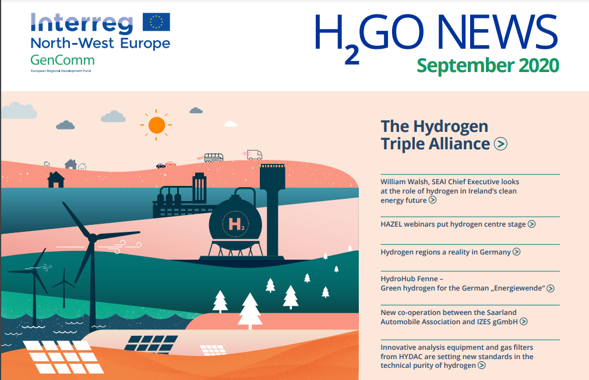
H2GO NEWS - GenComm Newsletter
https://www.nweurope.eu/media/11355/30384-gencomm-newsletter-september2020-v5.pdf
Page 1
HAZEL Webinar 2: Hydrogen Sustainability - H2 DXNET - Hydrogen injection into natural gas distribution networks

Slide 14
HAZEL - Hydrogen Enabled Zero Emission Supply Chains
Seminar 1 22nd September
Industrial Sector-Coupling using a Connected eH2-Cycle
Seminar 2 6th October
H2 Sustainability H2-DxNET - Hydrogen injection into natural gas distribution networks
Seminar 3 20th October
H2 Safety - Practical and theoretical analysis of H2 loss through polymeric materials & development of a H2 sensor for the measurement of hydrogen concentrations in air in the ppb range and a theoretical model to describe the 3 dimensional transport in hydrogen
Seminar 4 3rd November
H2 Application & usage - Hydrogen in a net zero energy system & H2 powered hybrid heat pumps
Seminar 5 17th November
Marketable hydrogen innovations - entrepreneurship of innovation of Energy Carriers through academia & industry alliances
HAZEL Webinar 2: Hydrogen Sustainability - H2 DXNET - Hydrogen injection into natural gas distribution networks

Slide 15
Social Distance Calling Card
GenComm Website - nweurope.eu/gencomm
LinkedIn - GenComm
Twitter - @GenComm_CH2F
Community Hydrogen Forum – CH2F - communityh2.eu
Hydrogen Ireland website - hydrogenireland.org
HAZEL Webinar 2: Hydrogen Sustainability - H2 DXNET - Hydrogen injection into natural gas distribution networks

