Slide 1
Hydrogen and hybrid heating in a net zero energy system Richard Halsey Director
November 2020

Slide 2
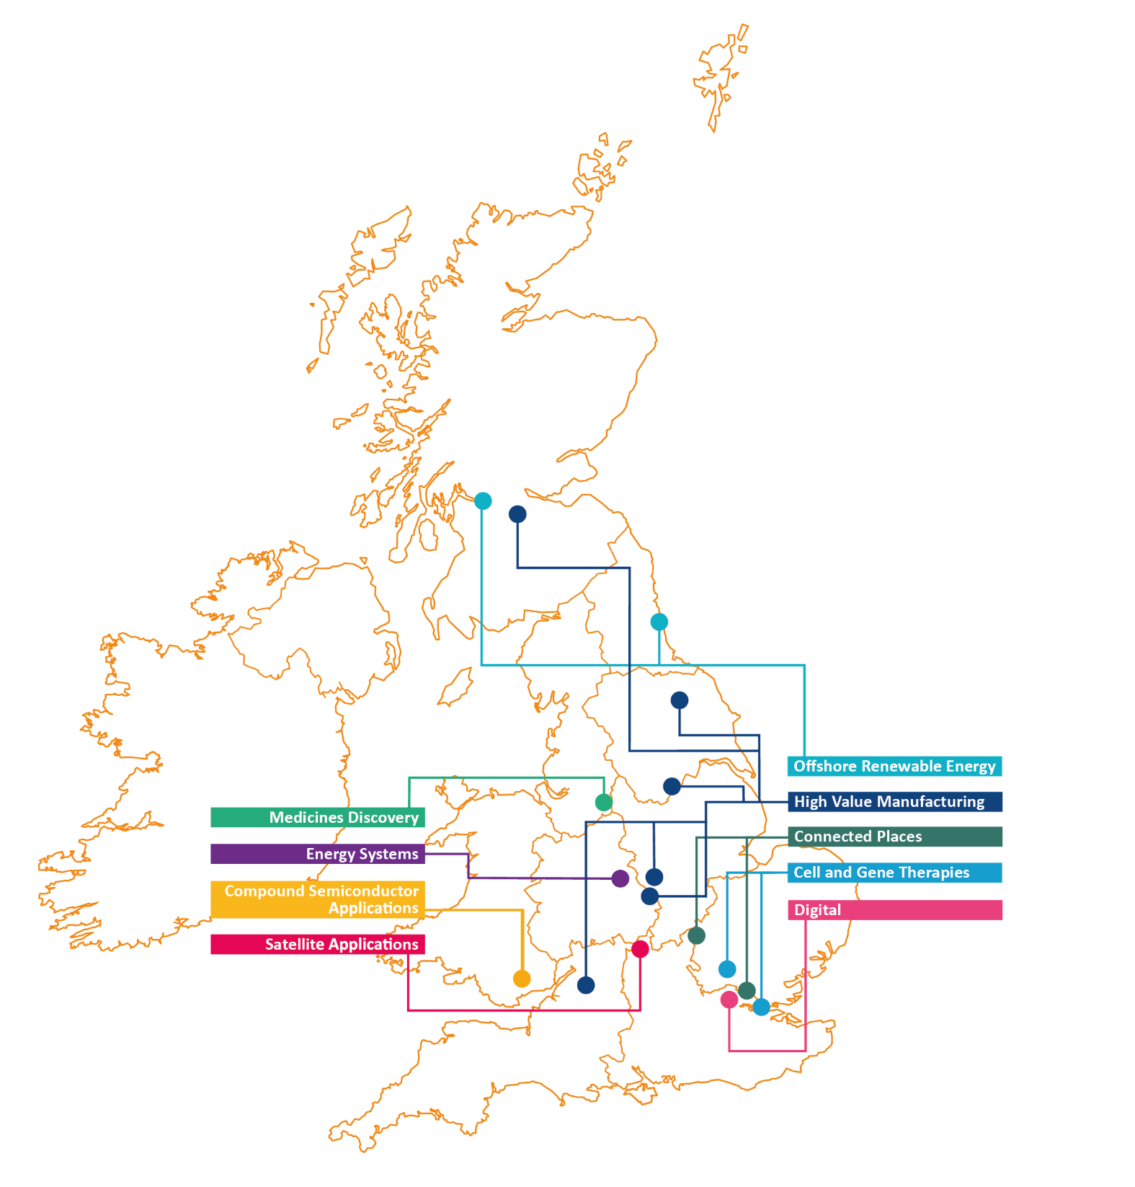
What is a Catapult?
Established and overseen
by Innovate UK
Technical capabilities, equipment, and other resources
Solve key problems and develop new products and services
Bridge the gap
between stakeholders
in the sector
Open up opportunities for innovators, in the UK and globally

Slide 3
About Energy Systems Catapult
Mission: Unleash innovation and open new markets to capture the clean growth opportunity
Innovation experts
Hubs in Birmingham and Derby
Supporting innovators
Research
Trials
Established, overseen and part-funded by Innovate UK. Independent from Government. Not for profit
Systems engineering
Digital
We take a whole system view
Bridge the gap between stakeholders in the sector
Modelling and simulation

Slide 4
About Me
Capabilities Director leading team of over 100 engineers, planners, data and social scientists
Over 15 years working in clean tech and energy innovation
Lead the Energy Technologies Institutes Smart System and Heat Programme and current BEIS Electrification of Heat Demonstration Project
Member of BEIS Hydrogen Advisory Council
Heads a number of innovation projects looking at the integration of hydrogen as part of integrated net zero smart local energy systems

Slide 5
What is a whole system approach?
Joining up the system from sources of energy to the consumer
+
+
+
+
Generation
Transmission
Distribution
Buildings
Consumer
Breaking down silos between different parts of the energy system
=
+
+
Electricity
Heat
Transport
Joining up physical requirements of the system, with policy, market and digital arrangements
+
+
+
Physical System
Digital System
Market System
Policy

Slide 6
Hydrogen in a net zero energy system
Could mean:
Unabated Fossil Fuel consumption down from ~1500TWh to <300TWh
Electricity
600-800TWh
Hydrogen
200-300TWh
District Heat
Up to 150TWh
Notes:
TODAY FF ¾ FINAL ENERGY CONS
NZ DROP TO ¼ …
¼ OF SMALLER STACK…EFFICIENCY
QUANTITIES…

Slide 7
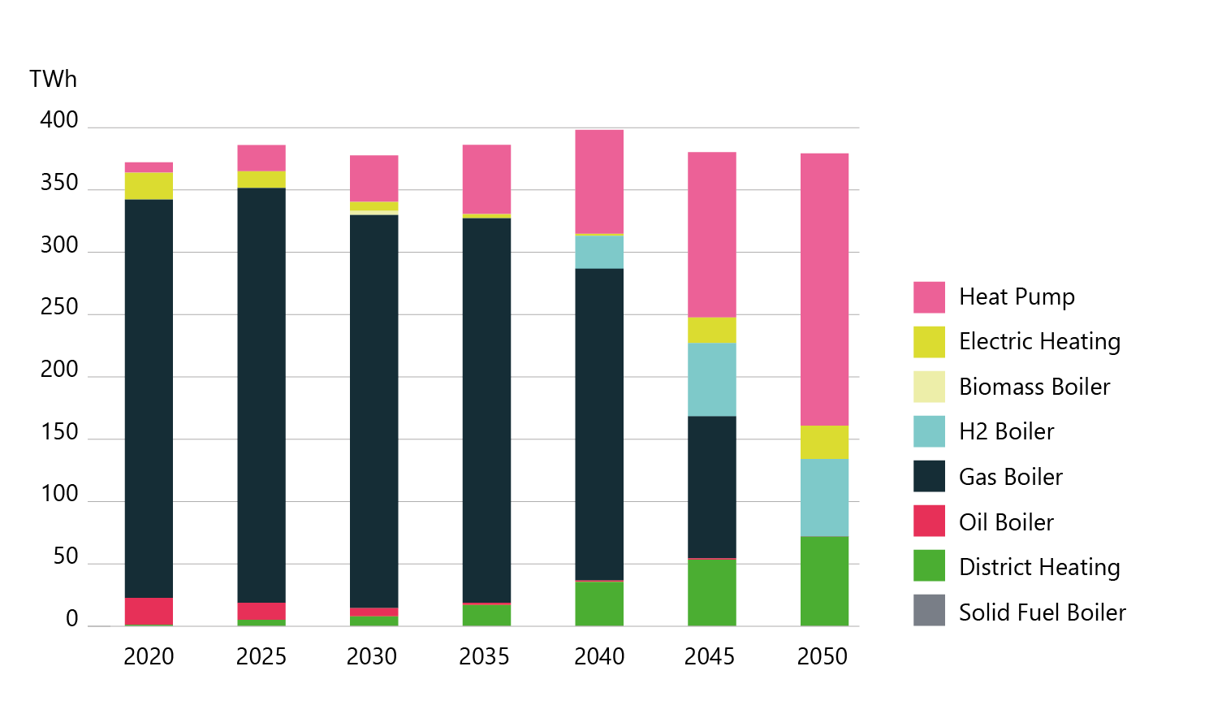
Buildings and heat – a critical challenge for net zero
2050
2050
Space Heat Output
Capacity
Innovation priorities:
GW
Whole house retrofit packages innovation to reduce cost, improve performance.
Smart multi-zone controls can reduce energy use while maintaining levels of comfort.
Hybrid heat pump and boiler demonstration of integrated solutions including H2 hybrids.
Heat storage with potential to substitute for gas boilers as back up for heat pumps.
100% hydrogen networks early demonstration essential to maintain this as an option.
7

Slide 8
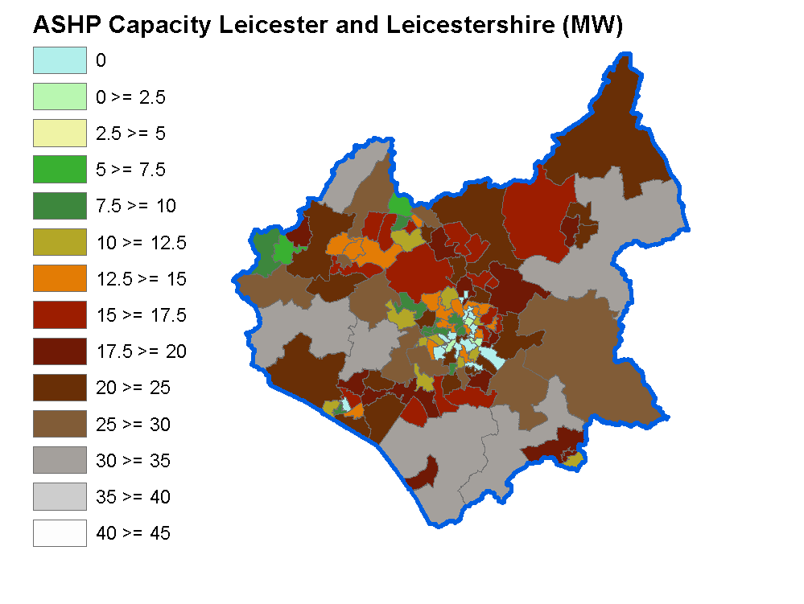
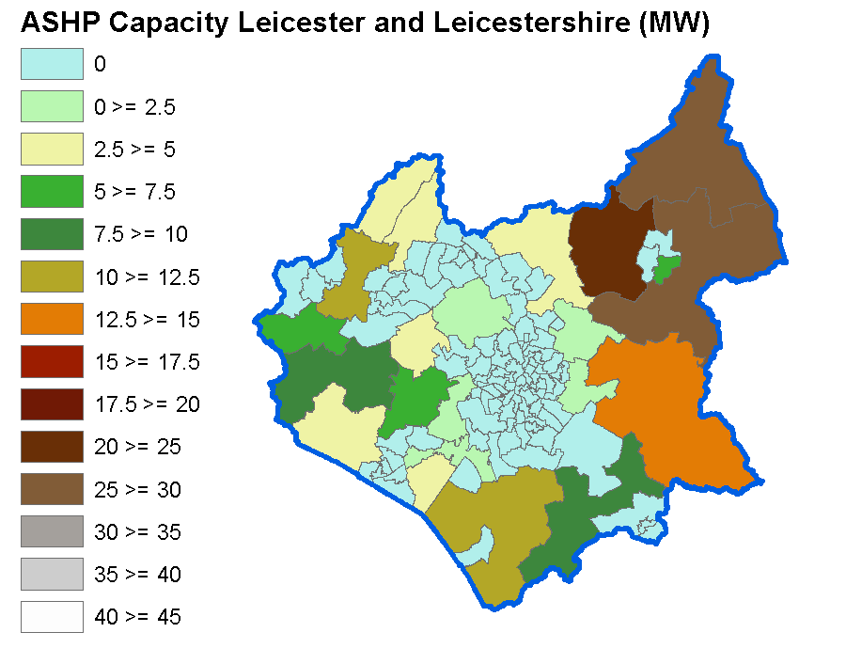
We need to understand what this might mean for local infrastructure transition
Installed Air Source Heat Pump Capacity (MW)
High Electrification
Hydrogen Baseload

Slide 9
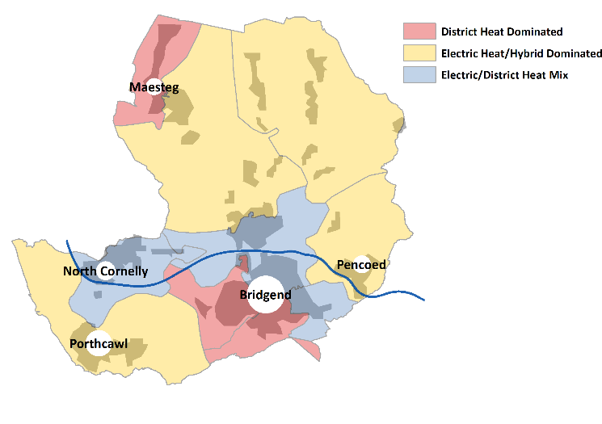
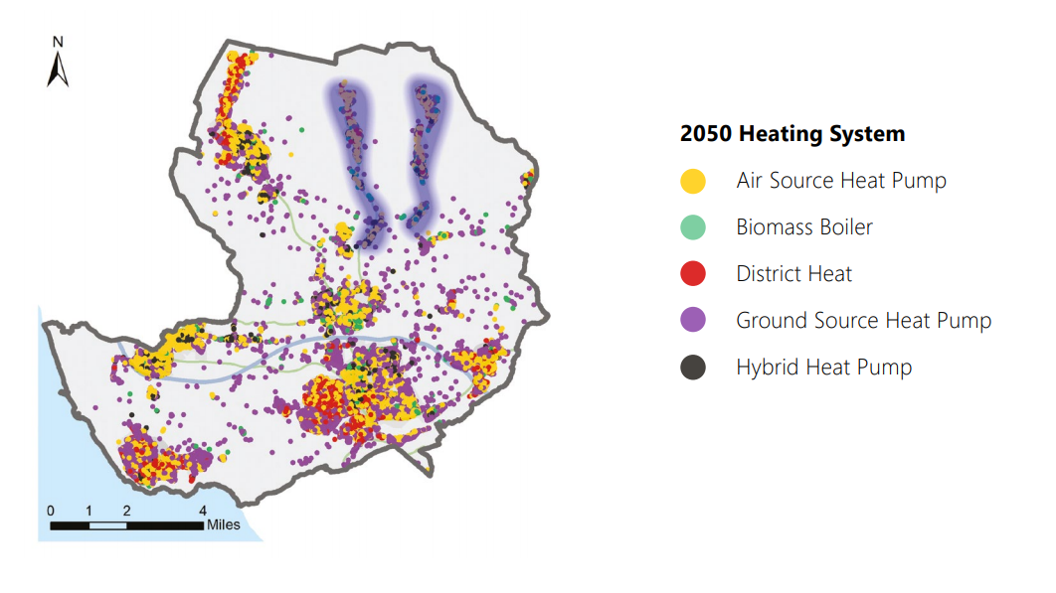
Targeting infrastructure and hybrid heating solutions as part of a Local Area Energy Plan

Slide 10
Understanding how hybrid heating solutions might work for households using a Living Lab of connected homes
Winter 17/18
Gas boiler only, investigation into heat as a service
Winter 18/19
Hybrid heating systems, can people get comfortable?
Winter 19/20
Heat Pump only, can people get comfortable and what is the cost impact?
Notes:
Hybrid heating and advanced control as an enabler for low carbon heat and new energy services combining electricity and hydrogen

Slide 11
@RichardHalsey

