Slide 1



HAZEL Webinar 4:
Hydrogen application and use
Hybrid Heat Pumps
Prof. NJ Hewitt
Ulster University
3rd November 2020
Place image in this area.

Slide 2
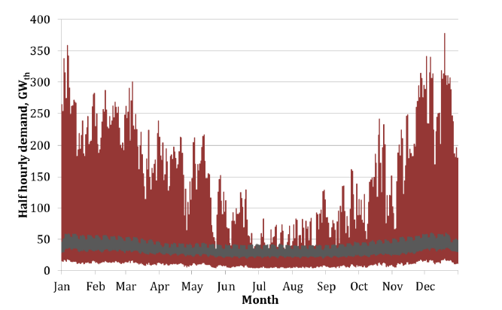
Electrification of Household Heating
HAZEL Webinar 4: Hydrogen application and use

Slide 3
Electrification of Household Heating
However, actual monitoring of electricity and heat use (the latter by gas) and conversion of the gas heat to electric heat with a heat pump and its seasonally adjusted coefficient of performance sees a much lower peak i.e. 140 GW as opposed to 375 GW.
HAZEL Webinar 4: Hydrogen application and use

Slide 4
Why Heat Pumps?
The Manchester Field Trial
HAZEL Webinar 4: Hydrogen application and use

Slide 5
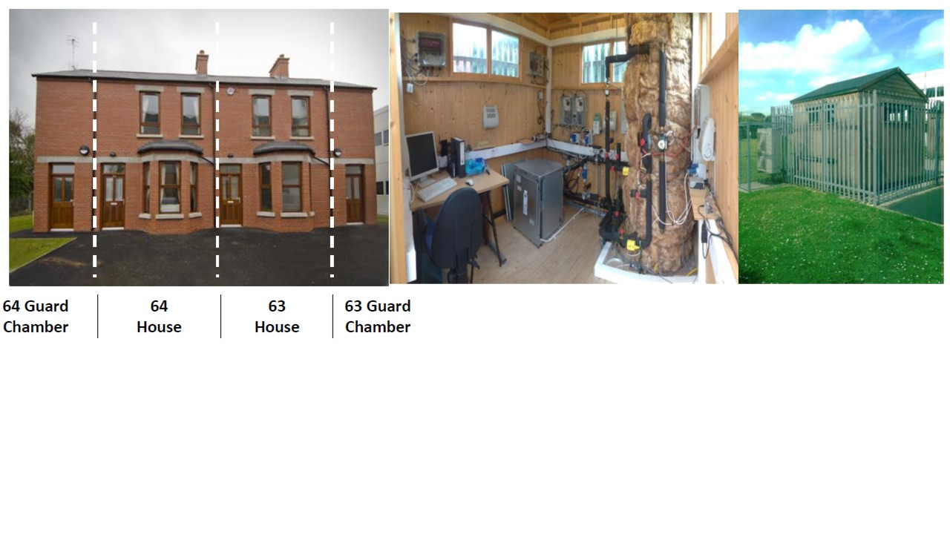
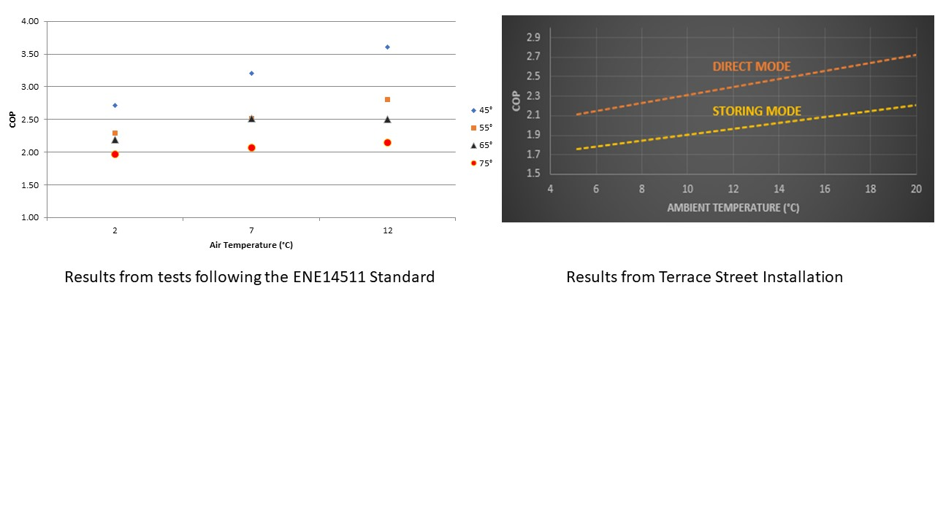
Terrace Street At Ulster
HAZEL Webinar 4: Hydrogen application and use

Slide 6
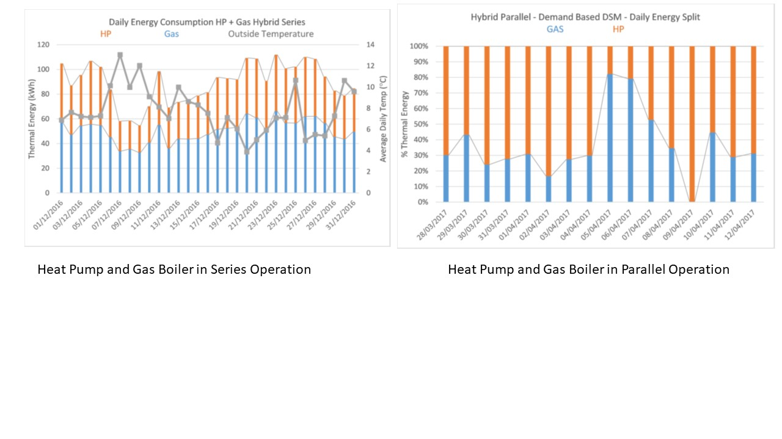
Hybrid Operations at Ulster
Series operation reduced gas consumption to 42% of that associated with previous ambient temperatures and increased the COP of the heat pump typically by 15% while in parallel operation, peak demands where avoided in terms of electricity demand.
HAZEL Webinar 4: Hydrogen application and use

Slide 7
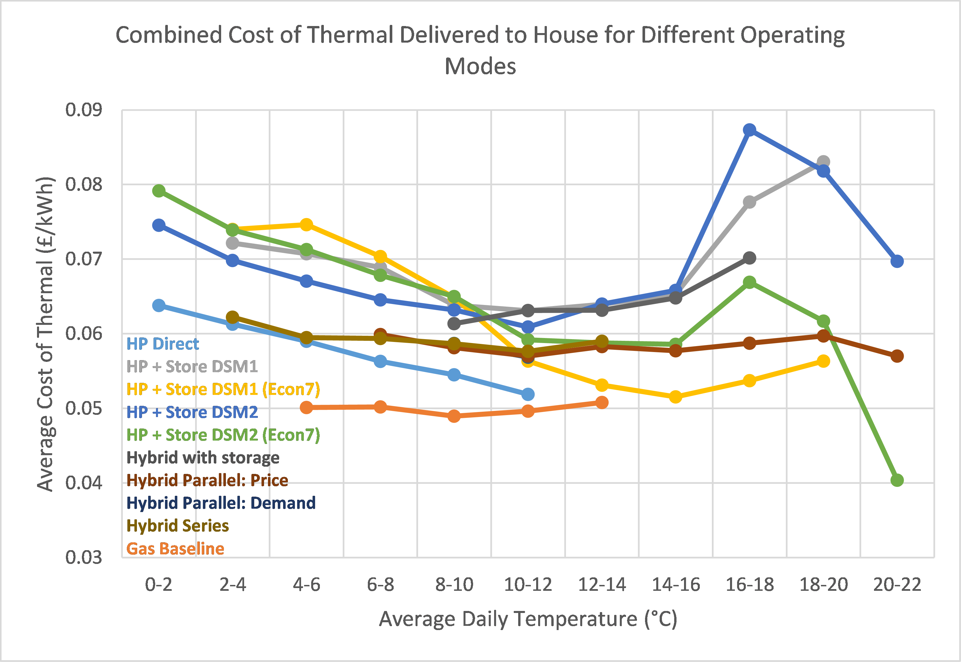
Running Costs
DSM2 cheaper than DSM1 (thermal store efficiency increased but demand shift less useful).
All more expensive than baseline HP.
Hybrid cheaper than DSM1 and DSM2 even though efficiency is worse because using gas fuel.
Hybrid demand and hybrid price the same practically.
Hybrid with storage performs poorly.
HP base approaches gas base at 10-12°C.
Hybrid series more expensive than parallel and more expensive than HP baseline - due to reduced gas COP in series (due to no optimisation).
DSM1 Econ7 prices more expensive than standard below 10°C - due to higher heat demand at higher daytime rates. Same for DSM2.
No Econ7 for hybrid because we have no storage.
HAZEL Webinar 4: Hydrogen application and use

Slide 8
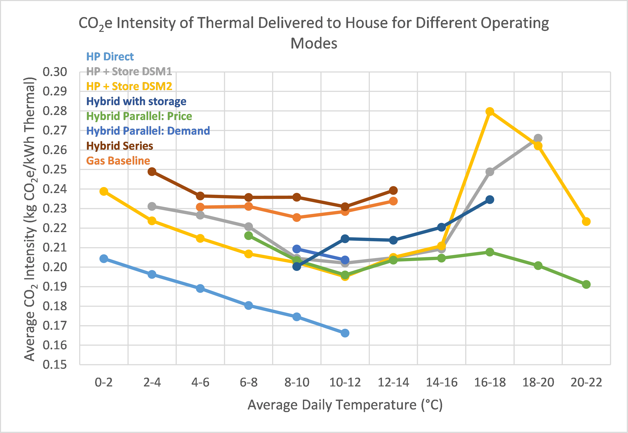
CO₂ Emissions
HP direct baseline lowest CO2.
Hybrid series (gas in series with HP) highest CO2.
DSM2 less CO2 intensive compared to DSM1, but slightly worse above 14°C.
Hybrid parallel has impact on reducing CO2e intensity of gas baseline.
Hybrid series has impact on increasing CO2e intensity of gas baseline. Running in series reduced the gas boiler efficiency as the system control was not optimised to run like this (gas boiler cycles).
Similar CO2 intensity when comparing hybrid parallel with HP+Storage – losses bring the COP of the store down to value comparable with gas boiler COP.
HAZEL Webinar 4: Hydrogen application and use

Slide 9
And To Conclude
Gas “boiler” can be replaced by Hydrogen
Limitations for Hydrogen on the gas network need to be resolved
We can use some of the valuable Hydrogen resource to manage the electricity network through hydrogen as a storage vector and the gas distribution network as a form of storage
Hydrogen can be “eased” into a space heating role having first delivered on
  Power generation for low renewable energy generation times
  Commercial transport applications
  High temperature heat processes
HAZEL Webinar 4: Hydrogen application and use

