Slide 1
Low-Temperature Fuel Cell
Dr. Reinhard TATSCHL
Research and Technology Manager
AVL List GmbH

Slide 3
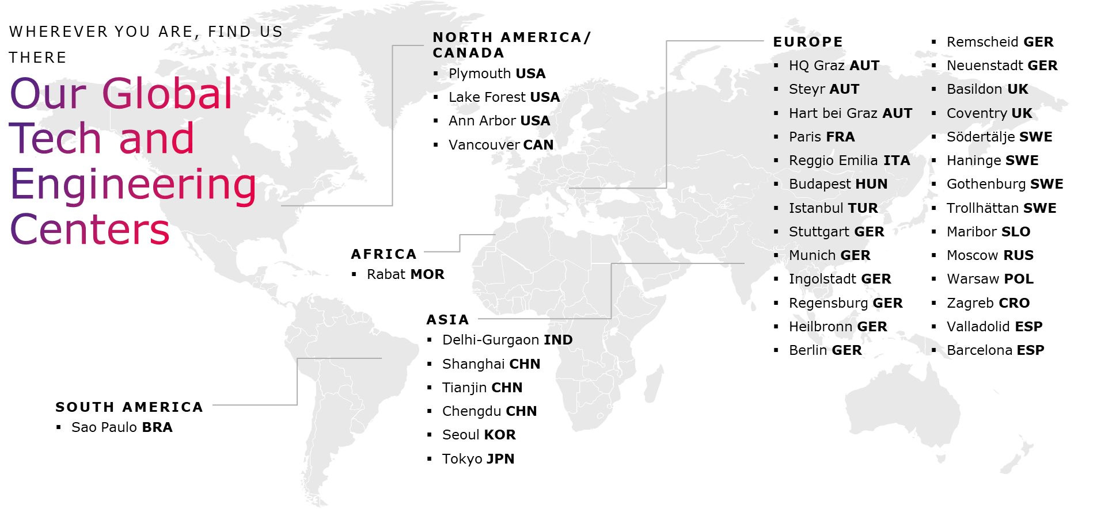
AVL – A Global Partner

Slide 4
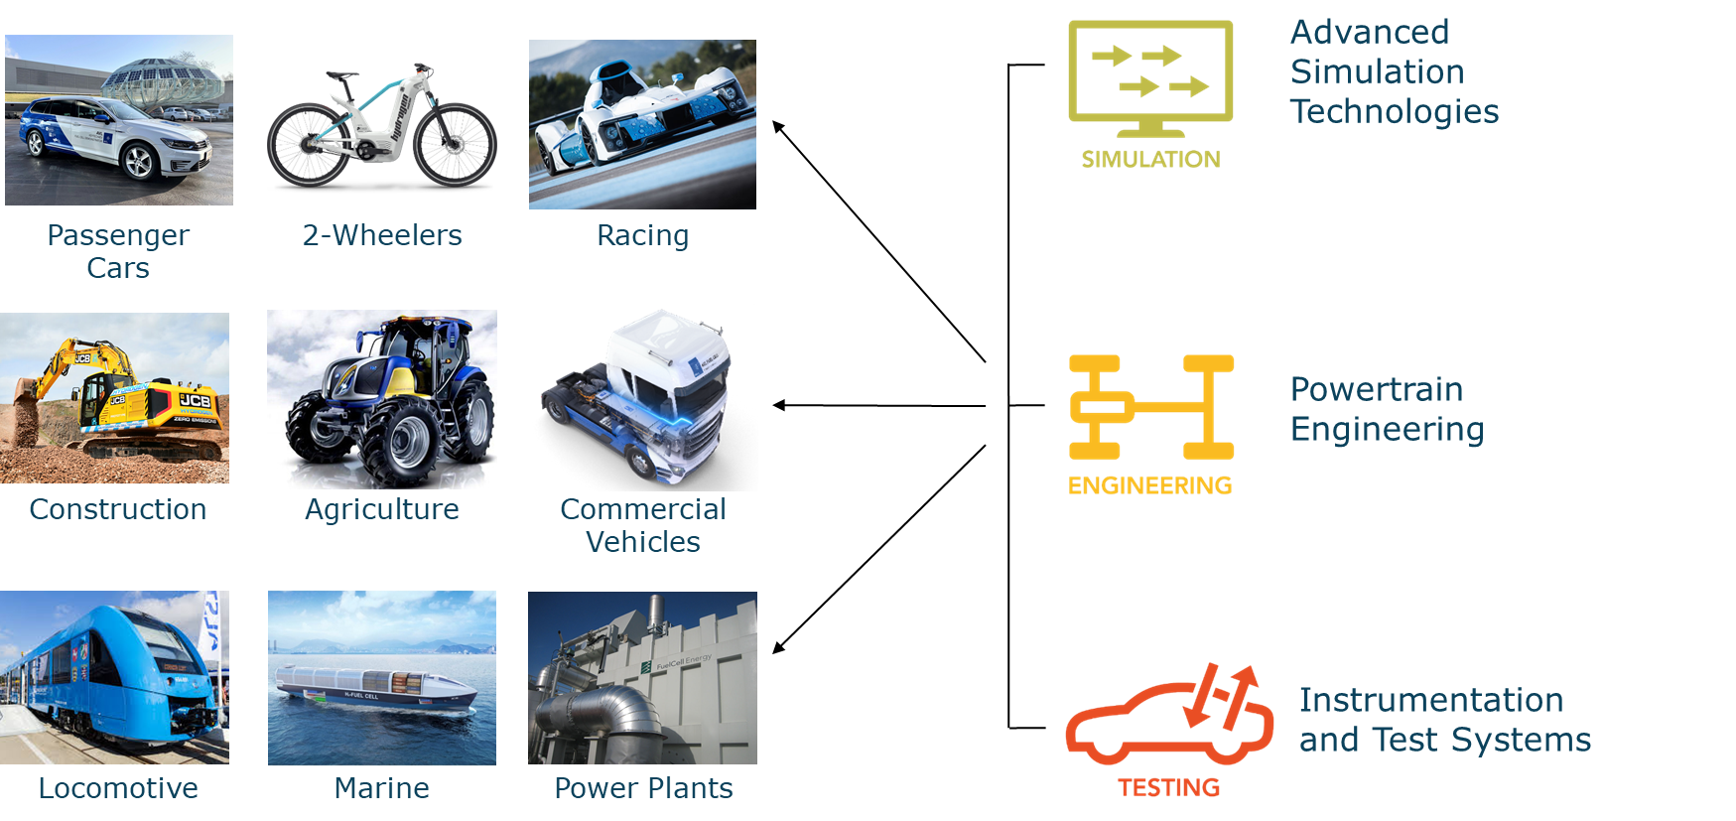
Solutions for all Customer Segments

Slide 5
Fuel Cell Activities in the AVL Business Units

Slide 6
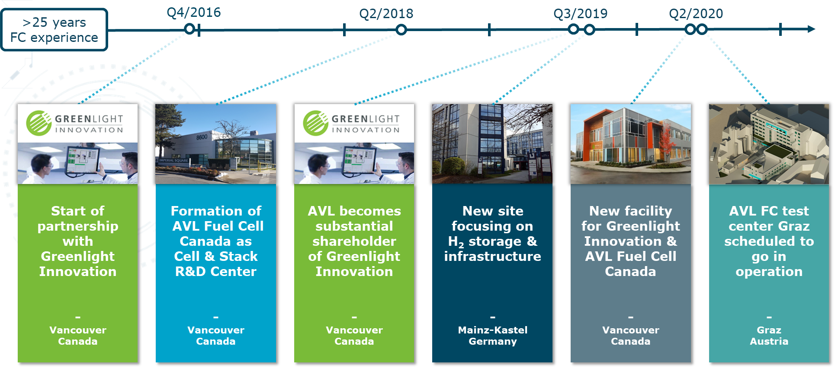
Recent Key AVL Investments into Fuel Cells

Slide 7
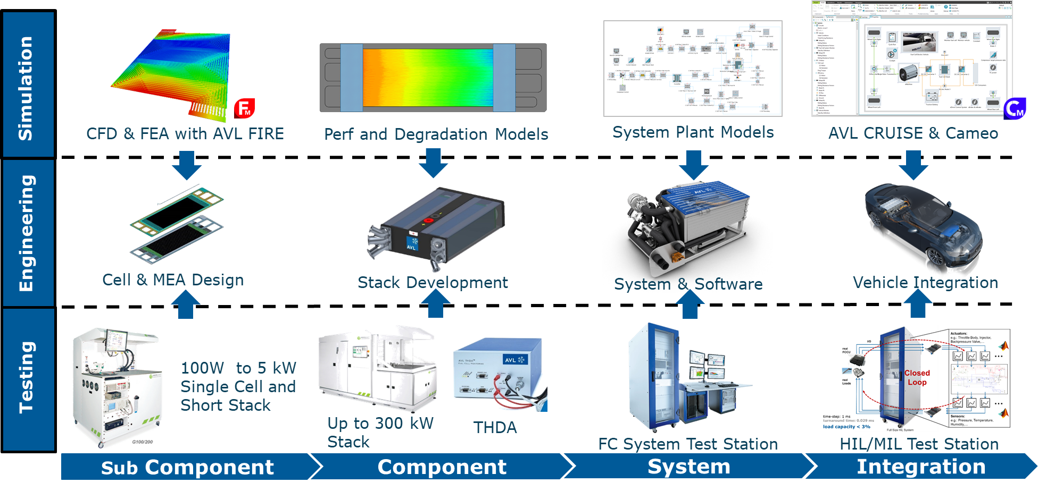
AVL Fuel Cell Products and Services Overview

Slide 8
Virtual Cell Development
Notes:
Major Tasks within Sub-System Layout:
Driveline Torsional Vibrations
Torque and Amplitudes due to torsional vibrations within Driveline
Load History and Work Load
Electrical Circuit
Analysis of current and voltage fluctuations within electrical devices and networks
Cooling Circuit
Layout of cooling circuit considering pipes, valves, pumps etc.
Control Functions
Detailed definition of control functions

Slide 9
Virtual Stack Development
Notes:
Major Tasks within Sub-System Layout:
Driveline Torsional Vibrations
Torque and Amplitudes due to torsional vibrations within Driveline
Load History and Work Load
Electrical Circuit
Analysis of current and voltage fluctuations within electrical devices and networks
Cooling Circuit
Layout of cooling circuit considering pipes, valves, pumps etc.
Control Functions
Detailed definition of control functions

Slide 10
Virtual System Development
Notes:
Major Tasks within Sub-System Layout:
Driveline Torsional Vibrations
Torque and Amplitudes due to torsional vibrations within Driveline
Load History and Work Load
Electrical Circuit
Analysis of current and voltage fluctuations within electrical devices and networks
Cooling Circuit
Layout of cooling circuit considering pipes, valves, pumps etc.
Control Functions
Detailed definition of control functions

Slide 11
System Development & Integration

