Slide 1



HAZEL Webinar 4:
"Hydrogen application and use"
3rd November 2020
Place image in this area.

Slide 2
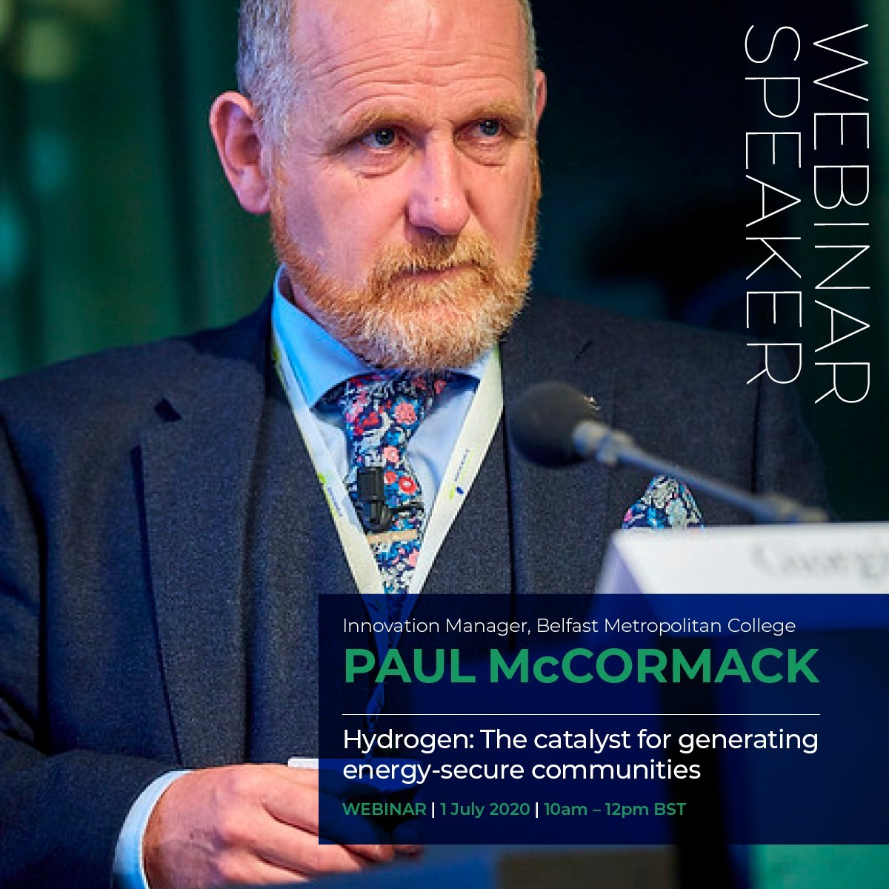
HAZEL Webinar 4: "Hydrogen application and use"

Slide 3
AGENDA – 3rd November 2020
AGENDA
10:00 GMT: "GenComm & HAZEL Introduction", Paul McCormack, Belfast Metropolitan College
10:10 GMT: "Regenerative low-temperature fuel cell", Dipl. - Ing. Dr. Reinhard Tatschl, AVL List GmbH
10:20 GMT: "H2 Powered Hybrid Heat Pumps", Prof. Neil Hewitt, Ulster University
​​​​​​​
10:30 GMT: " The role of hydrogen in a net zero energy system and potential for hybrid heating solutions in existing homes ", Richard Halsey, Energy Systems Catapult
​​​​​​​
10:40 GMT: Key Note Speaker - "Hydrogen in a net zero energy system", Mark Welsh, Energia
​​​​​​​​​​​​​​
10:50 GMT: Q&A
HAZEL Webinar 4: "Hydrogen application and use"

Slide 4
Hydrogenewables
The GenComm and HAZEL projects are pathfinders on this net zero journey, assisting Europe to navigate its journey to sustainability using Green Hydrogen as the true north on the Net Zero Strategy Compass.
In this our 4th HAZEL webinar our speakers will highlight the potential of Hydrogenewables - Clean, green hydrogen from renewables and how these applications will play a pivotal role in realising the EU’s climate objectives.
Clean, green hydrogen from renewables – Hydrogenewables will play a pivotal role in realising the EU’s climate objectives
HAZEL Webinar 4: "Hydrogen application and use"

Slide 5


Green H2
Green Hydrogen is a key energy vector that can assist Europe reach climate change targets as it enables massive decarbonization of industry heat, power generation and transport sectors.
Global demand for hydrogen is forecast to reach 50 million tons by 2025 and there is a potential that 50-60% of this will be GreenH2.
HAZEL Webinar 4: "Hydrogen application and use"

Slide 6

Green H2 “tipping point”
A year ago there were green hydrogen projects with a total capacity of 3.2 gigawatts under development.
By August 2020, that had more than quadrupled to more than 15 gigawatts of capacity.
by 2040 the cost of green hydrogen is forecast to have fallen by up to 64%.
But the rapid decline in costs means that in some places it could start to be competitive as soon as 2025. In Germany, for example, green hydrogen is expected to compete with hydrogen from fossil fuels in most scenarios by 2035.

Slide 7
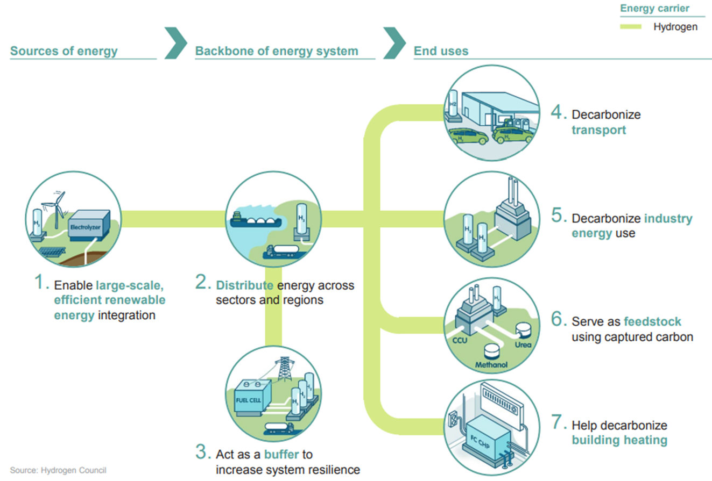
validate new opportunities P2X
As the opportunities for greater use of hydrogen in the energy equation evolve we now are now pushing the boundaries where we can utilise
SMARTH2 to provide low carbon solutions.
  Power to transport (P2T),
  Power to Industry (P2I),
  Power to Mobility (P2M),
  Power to Heat (P2H)
  Power to Gas grid injection (P2G).
  optimise SMARTH2 commercially (P2€)
  developing additional valorisation pathways (P2V)
  new commercial and technical (P2?)
we are witnessing the real evolution of SMARTH2 as a sustainable energy future in a Green Europe

Slide 8
Audience Poll
How can Europe prosper from the Hydrogen evolution?
Low carbon solutions for transport
Greener energy options
Tackling climate change
Alternative energy options

Slide 9
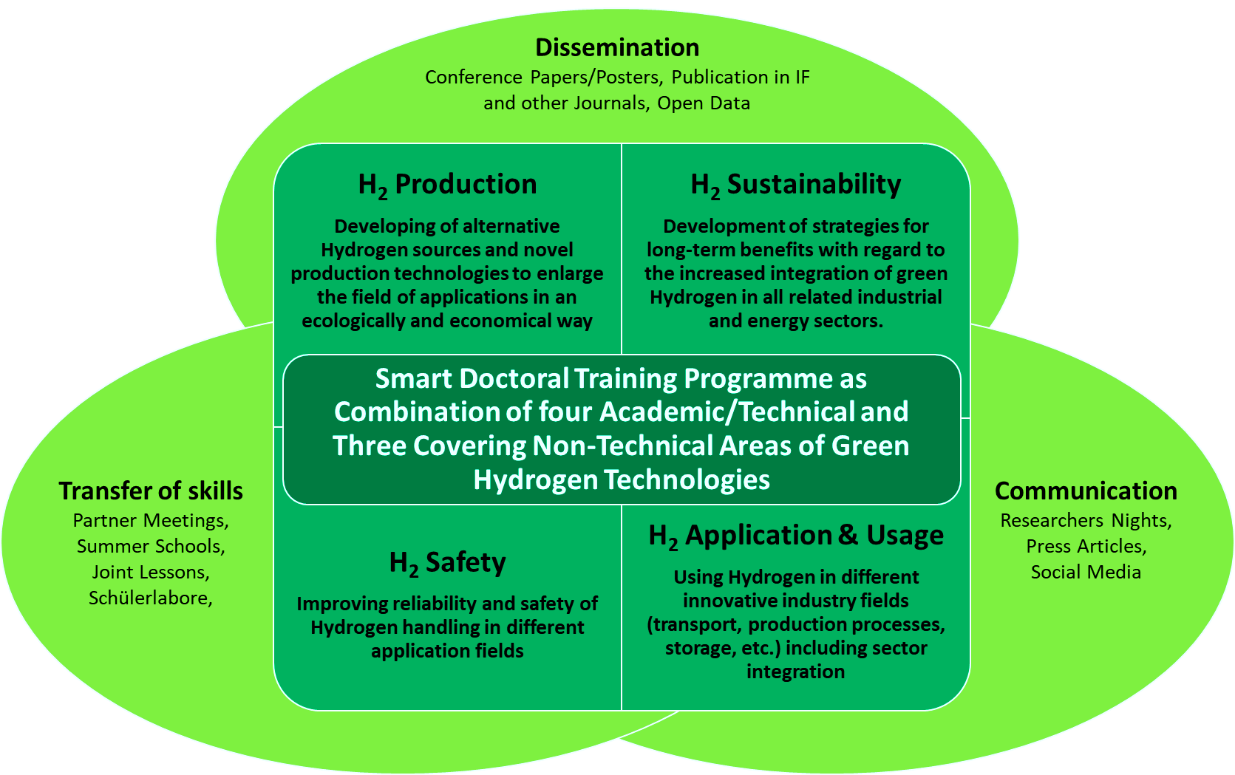
What is HAZEL?
Hydrogen enAbled Zero Emissions suppLy

Slide 10
Why HAZEL?
As the EU embarks on the economic recovery journeyfrom COVID-19 there is a clear opportunity to set the trajectory towards a truly green recovery. Clean, green hydrogen from renewables
Hydrogenewables will play a pivotal role in realising the EU’s climate objectives.
Optimising the gas networks across Europe through H2-DxNET for energy transmission, distribution, storage and use will be the catalyst to sustainably reduce emissions in the long term, open all P2X options and drive economic growth.

Slide 11
When HAZEL?
European Green Deal, which establishes a roadmap to transform the European economy based on the green transition.
The EC has identified this Green Deal as a catalyst for growth and the European Parliament and most governments are following the line set by it.
Now, with the EU Recovery Package, the Commission is showing its determination to allocate available resources to future sectors: clean energy, efficiency and electric mobility

Slide 12
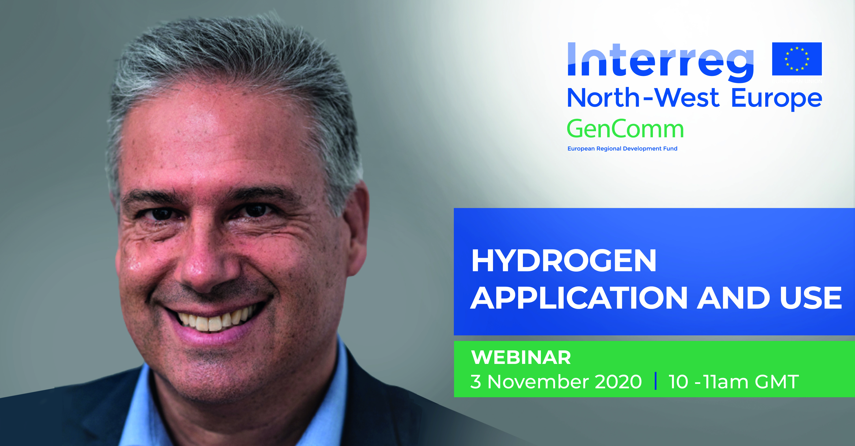
"Regenerative low-temperature fuel cell", Dipl. - Ing. Dr. Reinhard Tatschl, AVL List GmbH

Slide 13
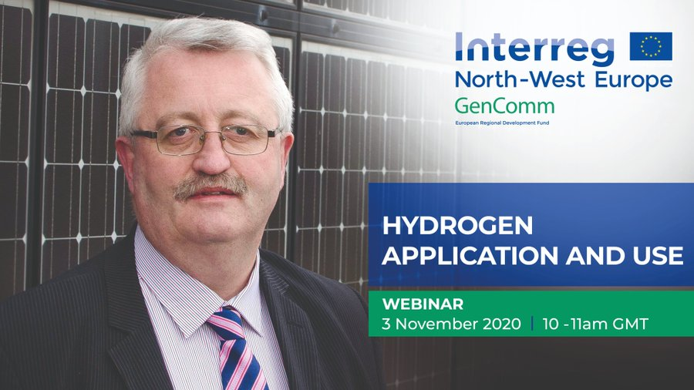
"H2 Powered Hybrid Heat Pumps", Prof. Neil Hewitt, Ulster University

Slide 14
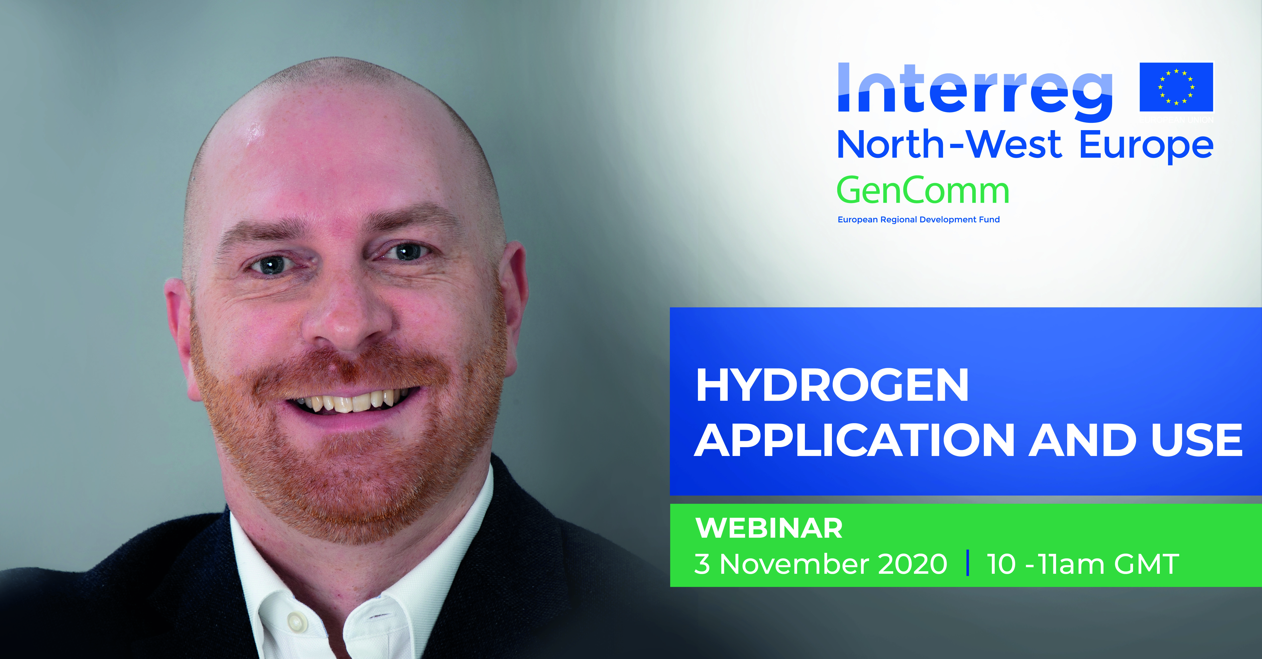
" The role of hydrogen in a net zero energy system and potential for hybrid heating solutions in existing homes ", Richard Halsey, Energy Systems Catapult

Slide 15
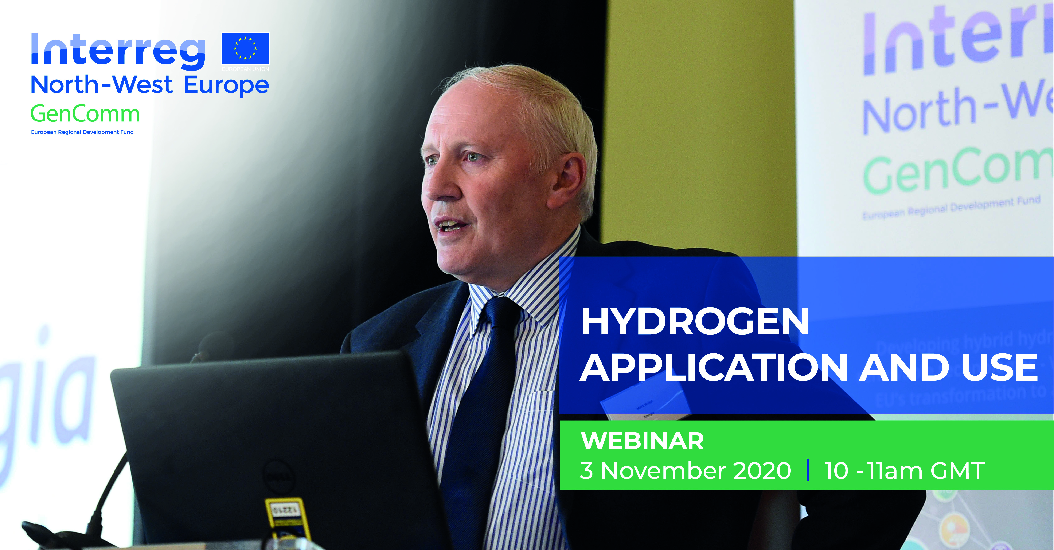
"Hydrogen in a net zero energy system", Mark Welsh, Energia

Slide 16
Q&A
Page 1

Slide 17
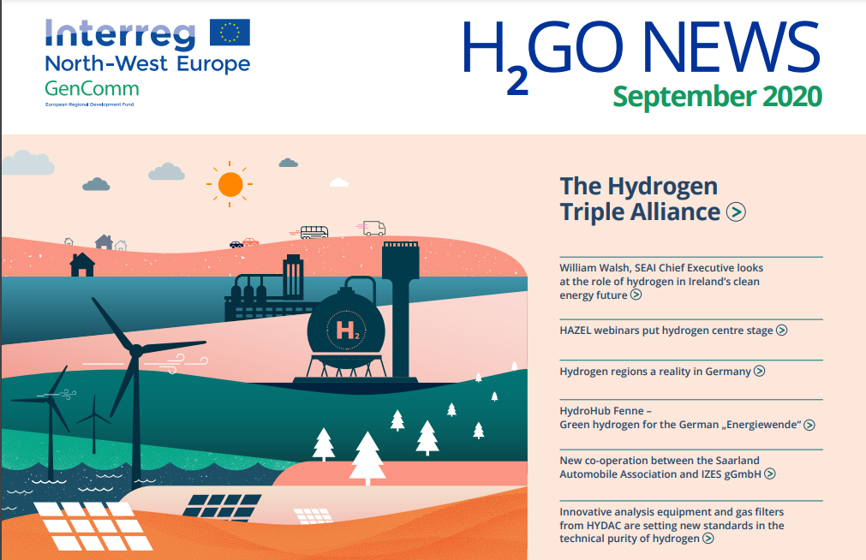
H2GO NEWS – GenComm Newsletter
https://www.nweurope.eu/media/11355/30384-gencomm-newsletter-september2020-v5.pdf
Page 1

Slide 18
HAZEL – Hydrogen Enabled Zero Emission Supply Chains
Seminar 1 22nd September
  Industrial Sector-Coupling using a Connected eH2-Cycle
Seminar 2 6th October
  H2 Sustainability H2-DxNET – Hydrogen injection into natural gas distribution networks
Seminar 3 20th October
  H2 Safety –Practical and theoretical analysis of H2 loss through polymeric materials & development of a H2 sensor for the measurement of hydrogen concentrations in air in the ppb range and a theoretical model to describe the 3 dimensional transport in hydrogen
Seminar 4 3rd November
  H2 Application & usage - Hydrogen in a net zero energy system & H2 powered hybrid heat pumps .
Seminar 5 17th November
  Marketable hydrogen innovations - entrepreneurship of innovation of Energy Carriers through academia & industry alliances,

Slide 19

Social Distance Calling Card

