Slide 1

RED WoLF Student Engagement
Meg Baker – Senior Project Manager (Education)

Slide 2
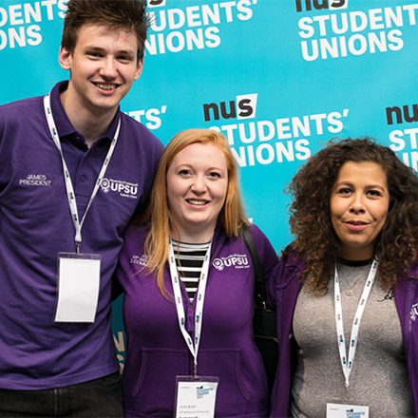




INTRODUCTION TO SOS-UK
We are working to…
Move sustainability from being a niche subject that relatively few study to something all students learn about - all students should be “sustainability students”.
Create cohort after cohort of positive, solutions-driven students who go on to make the world a more sustainable place.
Shift society from an obsession with short-term profit to long-term benefit.
By…
Getting more students leading on, and learning about, sustainability.
Embedding sustainability in formal education, from early years to adult learning.
Making sustainability more inclusive, for everyone.
Connect with us:
Notes:
SOS-UK was launched in October last year, in response to the climate emergency and ecological crisis. We were founded by student officers and staff at NUS, to go further and faster with NUS’ transformational sustainability work. We’re part of that NUS family that has been at the forefront of social change since 1923 representing 7 million students in tertiary education across the UK.
We joined RED WoLF as a project partner when we were still part of NUS and continue as SOS-UK. We have fantastic reach to students across the education sector and a strong network of tertiary education institutions with whom we already work in the UK and Europe, making us well placed to lead on student engagement for the project.
Our work aims to engage, inspire and empower students to lead on sustainability. This is a long-term investment in education today for a better future tomorrow.

Slide 3



We know students want more…
91% say they agree their place of study should actively incorporate and promote sustainable development
83% would like to see sustainable development actively incorporated and promoted through all courses
65% say sustainable development is something they would like to learn more about
Source: NUS Sustainability Skills Survey 2019-20 | Base: Over 6000 respondents in higher education across the UK
Notes:
When we talk about learning about climate change and embedding it in the curriculum, it’s crucial that students can understand it in the context of the whole system, which is why we focus on education for sustainable development as a way of achieving this.
We know students want to learn about sustainability and we know they feel ill equipped to address the challenges of our current time.
10 years of research evidencing significant student demand for sustainability
Research conducted by NUS across the UK, in FE and HE
Statistically significant and across all disciplines (e.g. not just keen beans!)

Slide 4
Responding to growing concern…
“How concerned, if at all, are you about climate change?”
[Responses shown for very or fairly concerned]
Higher & further education students
Source: NUS Student Opinion Climate Change | Base: See brackets - respondents in higher and further education across the UK
Notes:
We have also been tracking student concern about climate change since 2014. In March 2019, we saw this concern rise all the way to 91% of UK students reflecting a trend very similar to that of the UK public but c 10% higher over time (data from Government Department for Business, Energy and Industrial Strategy).
There is little doubt this is directly connected with the release of the 2018 IPCC special report on the impacts of Global Warming of 1.5 degrees C above pre-industrial levels.

Slide 5

Addressing the sustainability skills gap
75% of employers believe that a broad based sustainability skills gap exists (out of 900 global businesses).
Only 13% of companies are fully confident that they have the skills to successfully compete in the sustainable economy.
Support growth of ‘green collar jobs’
IEMA: https://www.iema.net/policy/sustainability-skills-in-infrastructure.pdf 2017
Notes:
Student demand is mirrored by the skills and knowledge gaps being identified by employers globally too – RED WoLF aims to contribute towards positively addressing these skills gaps highlighted by a 2017 IEMA (institute of environmental management and assessment) employers survey.
In the UK. it is estimated that up to 2 million ‘green collar jobs’ will emerge by 2030 as part of the country’s target to achieve net zero emissions by 2050, engaging students with projects such as RED WoLF should support our nation’s competencies to do that.

Slide 6
RED WoLF: Engaging and empowering students
Notes:
By engaging students with RED WoLF, we aim to create opportunities for students to turn their concern about climate change into hope and optimism through the development of skills, understanding and competencies for addressing our currently high carbon ways of living.

Slide 7

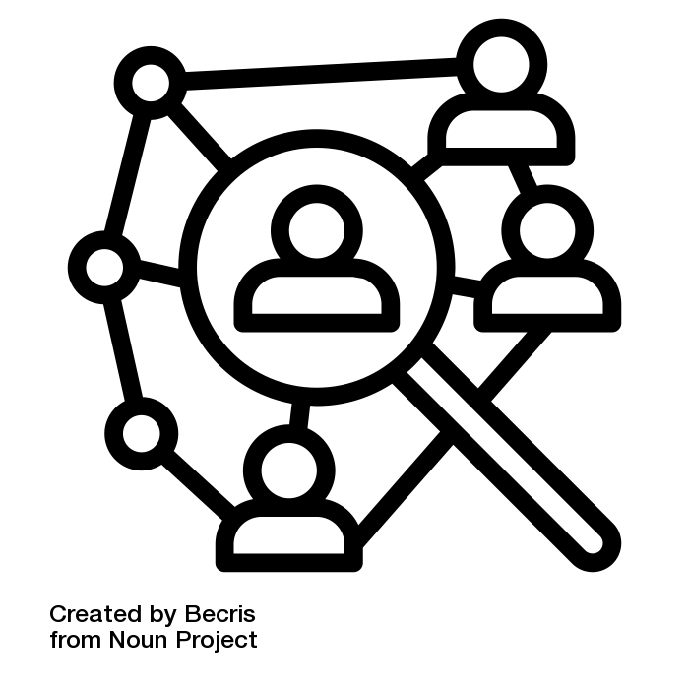
RED WoLF Student Engagement School (April 2021)
Online learning and engagement school for students from a wide range of disciplines to engage with RED WoLF.
Responding to challenges related to social science and ‘hard science’ to support the project development.
Notes:
Details TBC, but students will be supported and tutored by experts in the specialisms associated with the 2 strands of this students engagement school. It will be open to students from across the globe.
Initial block week of teaching and support, then students to work on set challenges that contribute towards RED WoLF progress and development, to then present back findings, solutions and recommendations (likely to cover 4-6 weeks. Please let us know if you are interested.
Social science: (up to 20 students)
Resident engagement evaluation
Behaviour change
Hard Science: (c20 students)
Algorithm problem solving - max 15 students, ideally 10
ICT - Similar for ICT (probably)

Slide 8
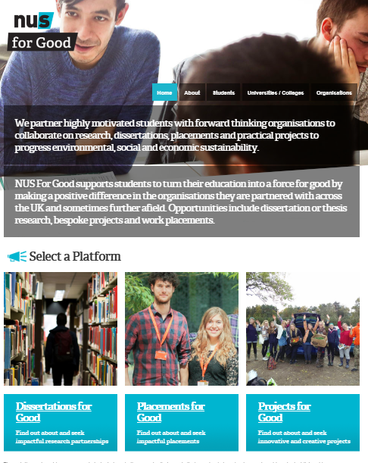
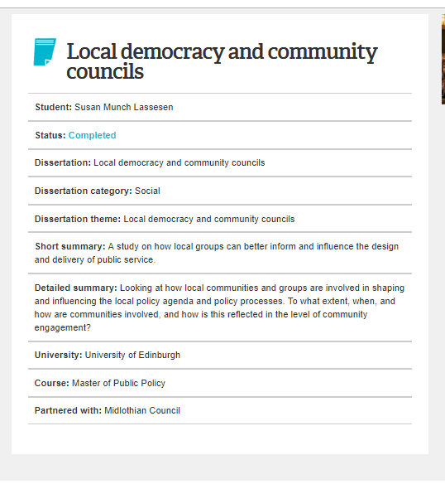
For Good partnerships: Projects, placements and research (on-going)
Living Lab Opportunities with RED WoLF
“Dissertations for Good has given real meaning to my University studies.” – Student 2019
https://forgood.nus.org.uk
Notes:
As the pilots develop and project partners identify more entry points, we will also be promoting opportunities for students to engage with RED WoLF through the For Good platform – any student can register with/ search on the site and express an interest in partnering on project opportunities promoted there.

Slide 9
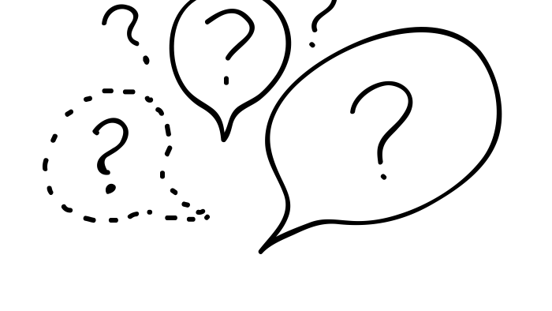
Any further suggestions, questions or ideas?
Notes:
Use this as an opportunity to ask participants how and where they think students could or should be engaging with RED WoLF?

Slide 10
Thank you
e. meg.baker@sos-uk.org
w. https://sustainability.nus.org.uk
@sosukcharity

