Slide 1

RED WoLF
ALGORITHM
Dr Alexander Shukhobodskiy and Dr Aleksandr Zaitcev - Leeds Beckett University, School of Built Environment, Engineering & Computing

Slide 2
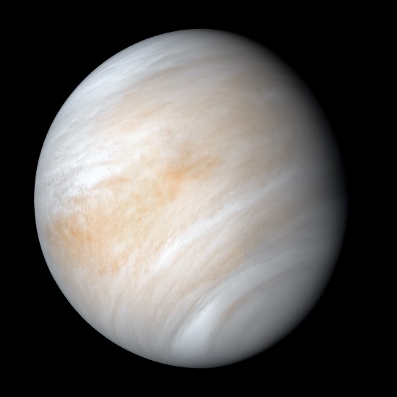

(not this)
Introduction - motivation
Lowering the CO2 emissions
Lowering the construction cost and bills
Removing wet heating system
Saving the PLANET!
(this)

Slide 3
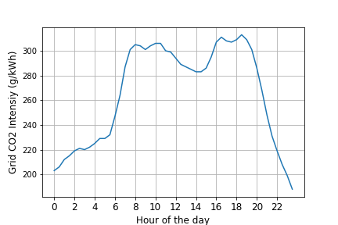
Basic idea
What is CO2 intensity?
How do we reduce it?
Using the CO2 threshold
“CO2 Threshold? What are these people talking about?”

Slide 4
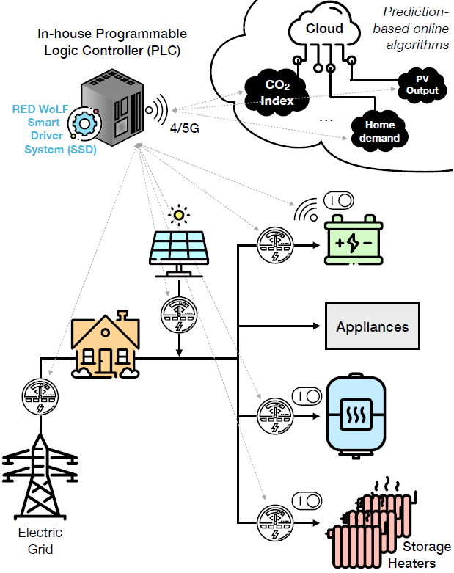
Design of the system
The extra components:
PV panel
Battery
Storage heaters
Water cylinder
Predictive server
Controller (eg. PLC)

Slide 5
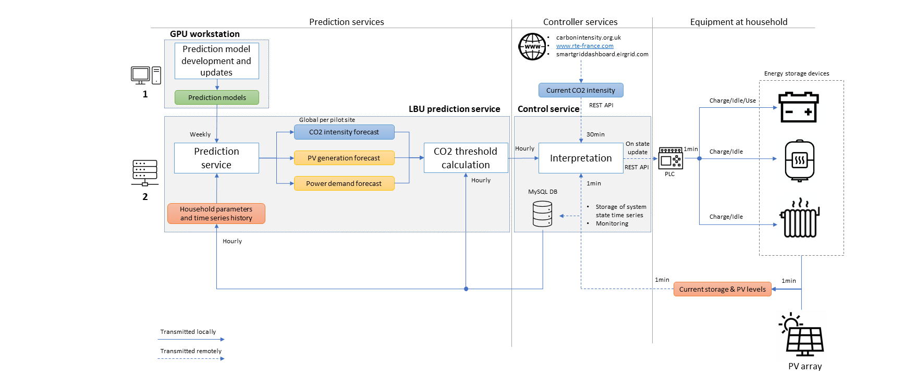

Slide 6

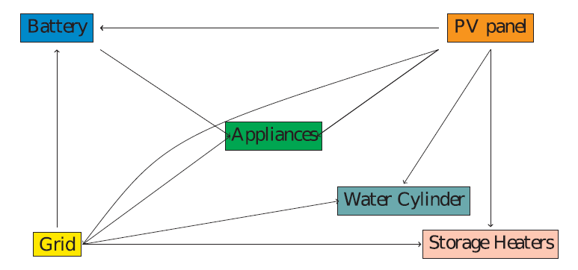
Introducing the grid
Where does the power come from?

Slide 7
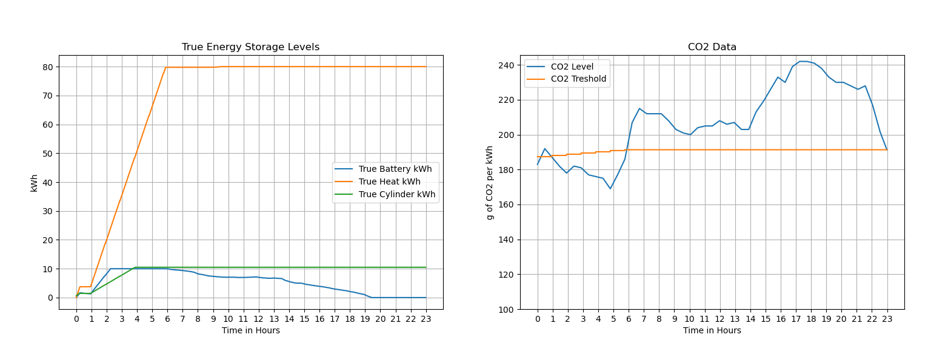
The original one day scenario

Slide 8
CO2 threshold - how to calculate it?
Estimate the power demand and generation
Estimate the requirements of energy storages
Calculate the minimum amount of time to supply the house from the grid
Find the threshold by sorting the CO2 levels with the aid of the time estimate

Slide 9
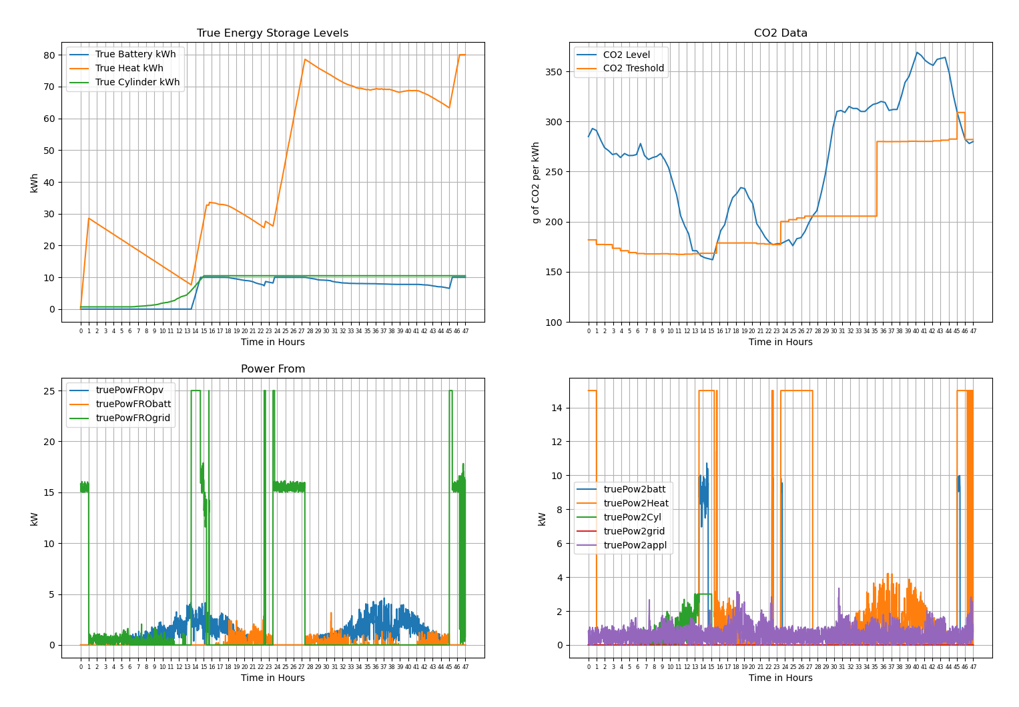
Two days scenario

Slide 10
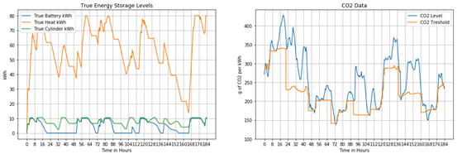
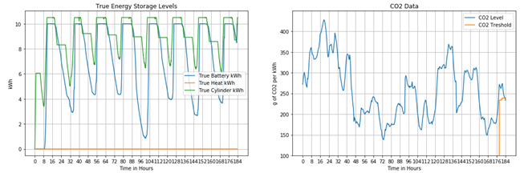
Eight days scenario and CO2 saving
PV (kW) | 0 | 2 | 4 | 8
REDWoLF (kg) | 140 | 132 | 121 | 110
REDWoLF | 151 | 151 | 151 | 151
Rel.CO2 | 7.6% | 12.5% | 20.3% | 27.4%
Winter case
Winter savings are up to 30% and during Summer almost 100% !
PV (kW) | 0 | 2 | 4 | 8
REDWoLF (kg) | 44 | 27 | 4 | 3
REDWoLF | 50 | 50 | 50 | 50
Rel.CO2 | 11.7% | 44.9% | 93% | 93.4%
Summer case

Slide 11
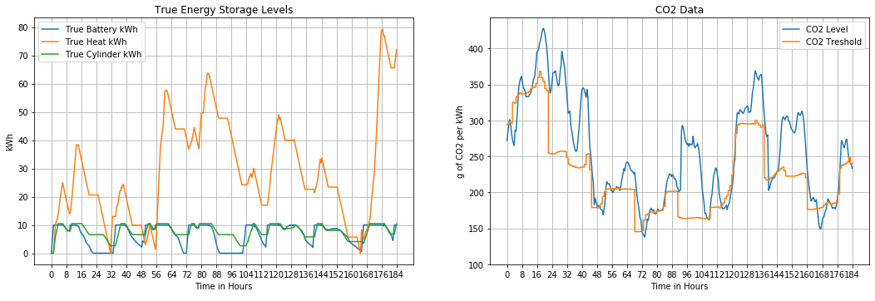
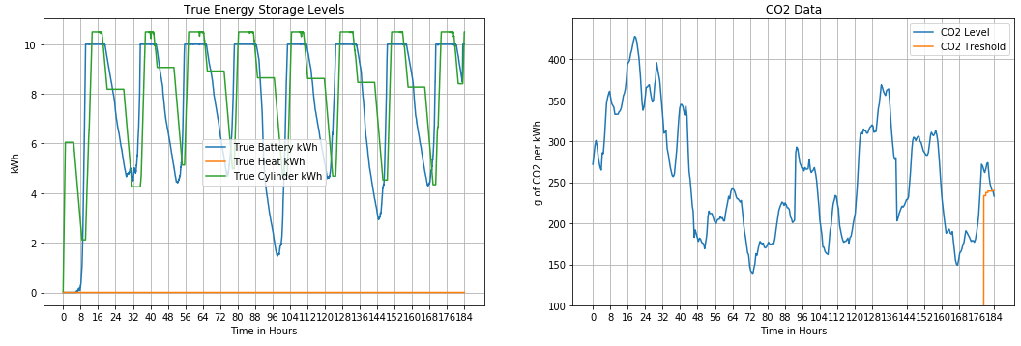
Modified system for Belgium (different house profile)
PV (kW) | 0 | 2 | 4 | 8
REDWoLF (kg) | 136 | 131 | 120 | 103
REDWoLF | 151 | 151 | 151 | 151
Rel.CO2 | 10.5% | 13.9% | 21.2% | 32.3%
Winter case
Savings can be even higher than in London!
PV (kW) | 0 | 2 | 4 | 8
REDWoLF (kg) | 43 | 26 | 3 | 3
REDWoLF | 50 | 50 | 50 | 50
Rel.CO2 | 13.2% | 47.3% | 93% | 93%
Summer case

Slide 12
Conclusion and discussion
RED WoLF target minimises CO2 emissions by only using the grid when CO2 emission level is low
The annual savings of CO2 58 %
The annual savings of Price 62 %

Slide 13
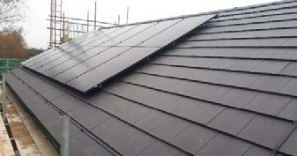
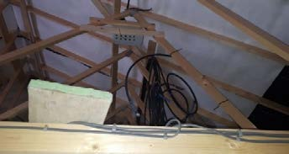
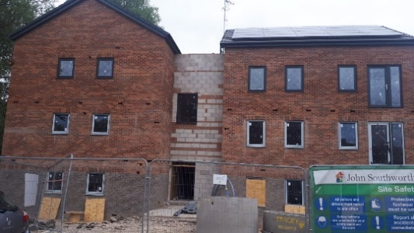
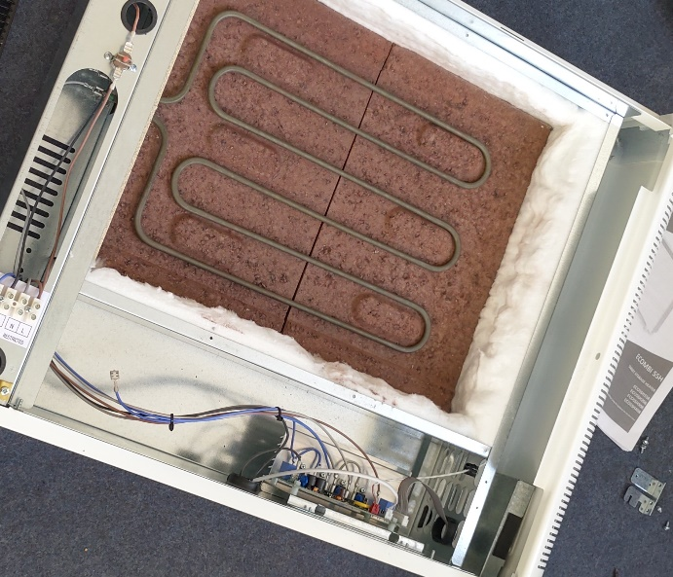
Oldham installation site June 2020

Slide 14
Thank you
for your attention!

