Slide 1
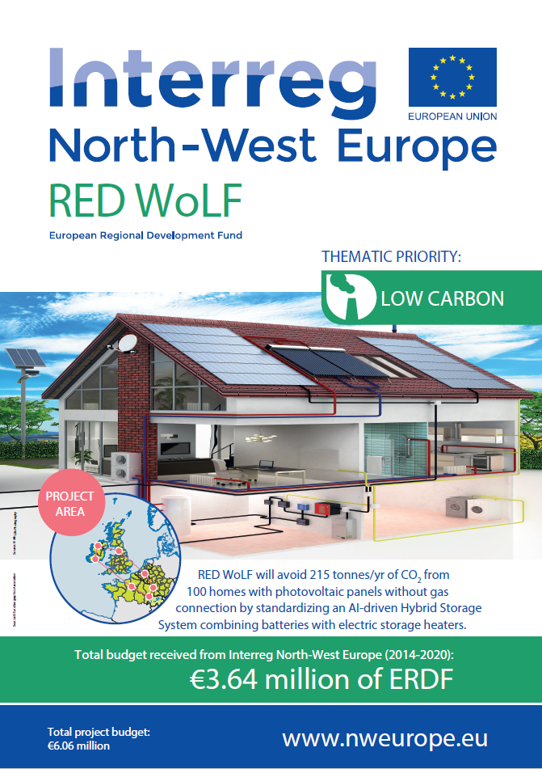
https://www.nweurope.eu/projects/project-search/red-wolf-rethink-electricity-distribution-without-load-following/

Slide 2
RED WoLF Partners
UK:
Leeds Beckett University
Wakefield District Housing
Oldham Metropolitan Borough Council
First Choice Homes
Students Organising for Sustainability (SOS-UK)
Belgium:
Volta
France:
Universitie of Lorraine
EDF
Campus De L’Espace
Neolia
Ireland:
IT Sligo
Cork City Council
Carberry Housing
Association

Slide 3
Inaugural Stakeholder Event for RED WoLF
Rethink
Electricity
Distribution
Without
Load
Following

Slide 4
RED WoLF
The project will develop a hybrid storage system which will be installed within 90 homes (both new build and retrofit) across the partner regions (UK, France and Ireland) which draws down electricity when greener.
Our Artificial Intelligence-driven system combines Grid electricity with PV panels, batteries and thermal storage.

