Slide 1
IT Sligo – RED WoLF
27 October 2020

Slide 2
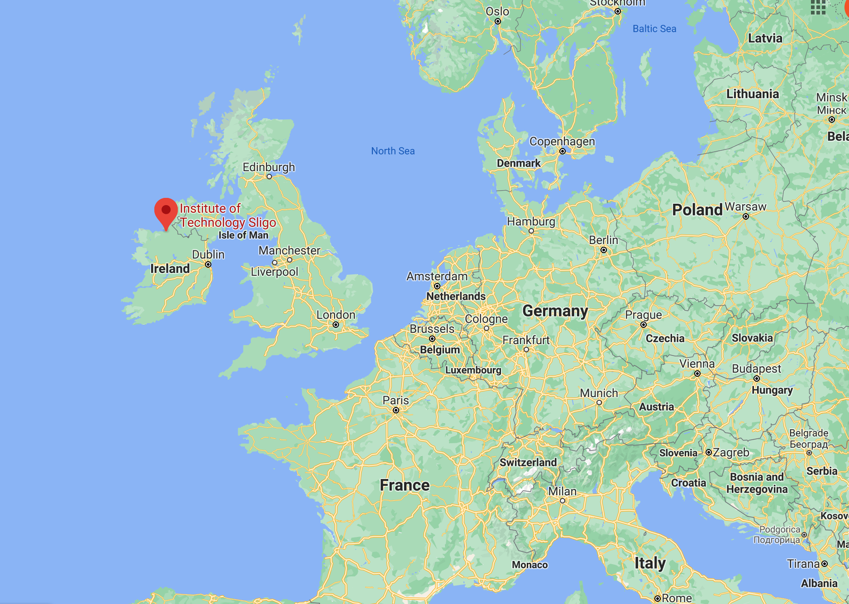
Institute of Technology - Sligo
Mission Statement:
Advancing economic, social and environmental sustainability through education, innovation, and engagement, producing graduates who are innovative, confident and capable of leading the development of the region and beyond.
Further expertise in sustainable energy systems
Improve the environmental sustainability of the region
Enable staff to conduct research and gain recognition in key research areas
Support our objective to become a Technological University
Build national and international research alliances in key areas

Slide 3
IT Sligo Contract Research Unit (CRU)
The CRU as part of the IT Sligo Research Department provides dedicated outreach Research, Development & Innovation support to regional enterprises, communities, individuals and public sector.

Slide 4
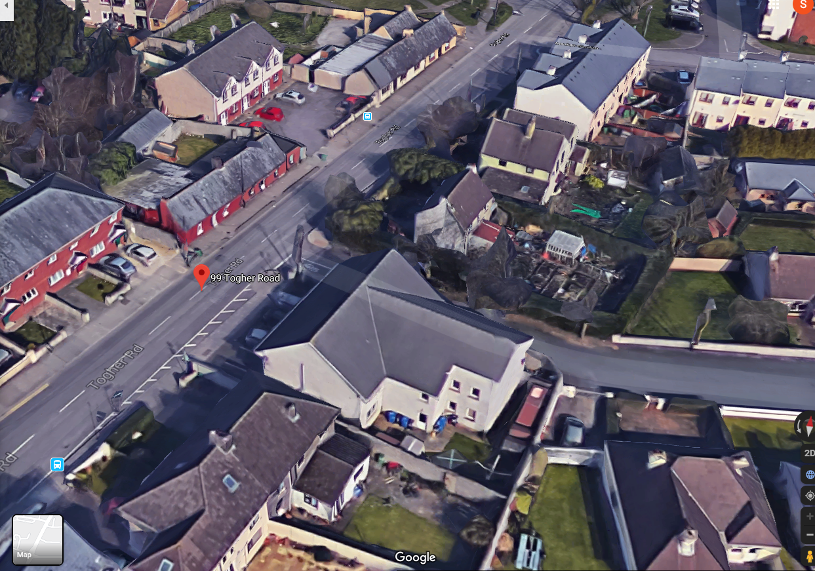
Development of the Pilots
6 no. Apartments located at Grenville, Togher Road, Cork
12 no. Apartments located at Dominick Street, Cork

Slide 5
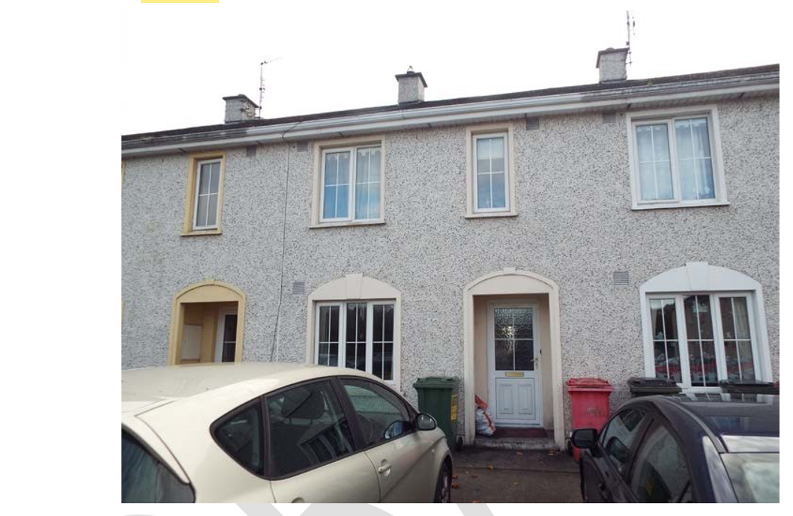
Development of the Pilots

Slide 6
RED WoLF system main components
Solar PV modules (incl module mounting system)
DC and AC wiring and isolators (including electrical protection)
Battery Energy Storage System (BESS)
Hybrid PV Inverter & Battery Inverter/charge controller
Storage Heaters with local and web-based control interface
Energy management system including:
Electricity flows monitoring & data logging system
Diverter to resistive loads, i.e. Domestic Hot Water cylinder with Immersion Heater
Room Temperature Sensors
Data logging and communications between components and with independent 3G/4G network to facilitate Clients control requirements and off-site monitoring via the IT Sligo Red Wolf project server
Client User Requirement Specification
Notes:
Finalise design for CCC & CHA homes and then Procure, supply, install, monitor

Slide 7
RED WoLF system main components
Component | Unit | Size
Solar PV array nominal capacity | kW peak (DC) | 4.2
Battery nominal storage capacity | kWh | 5
DHW immersion heater (in situ) | kW | 3
Storage Heaters | kW | (0.5 to 2.5)
Fan heater | kW | (1 to 2)
Specify Inverter size | kW | 4.2
Notes:
Finalise design for CCC & CHA homes and then Procure, supply, install, monitor

Slide 8
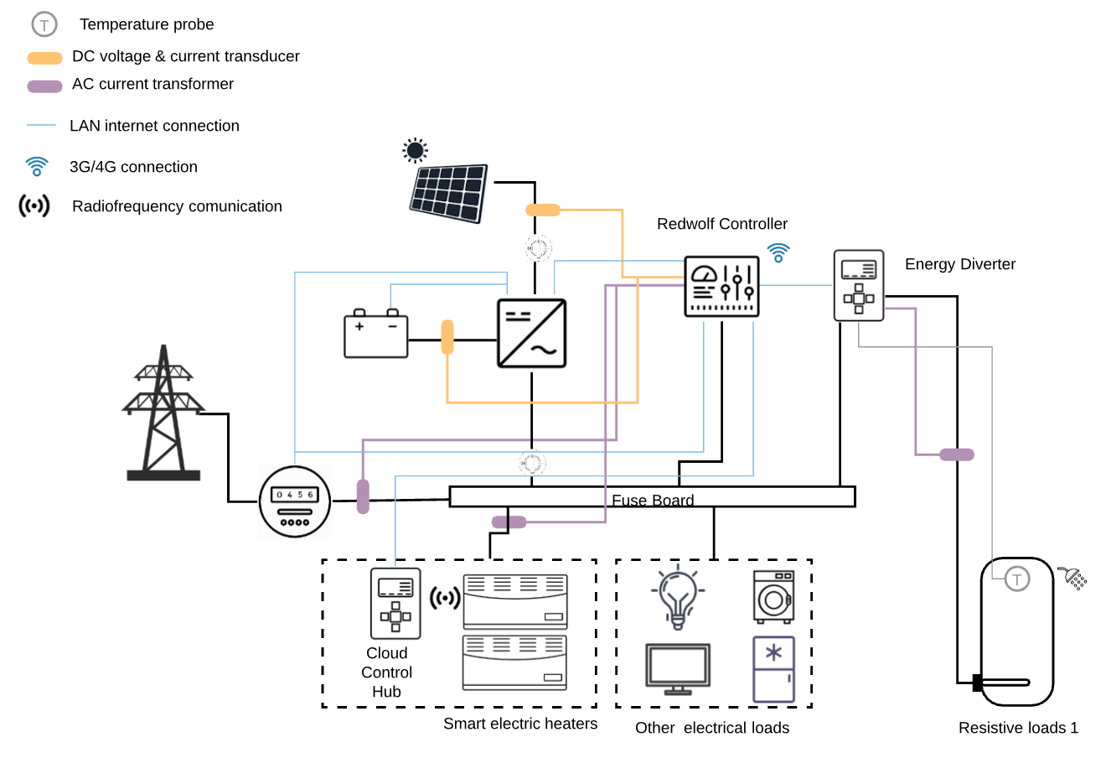
RED WoLF – system configuration
Notes:
Finalise design for CCC & CHA homes and then Procure, supply, install, monitor

