Slide 1
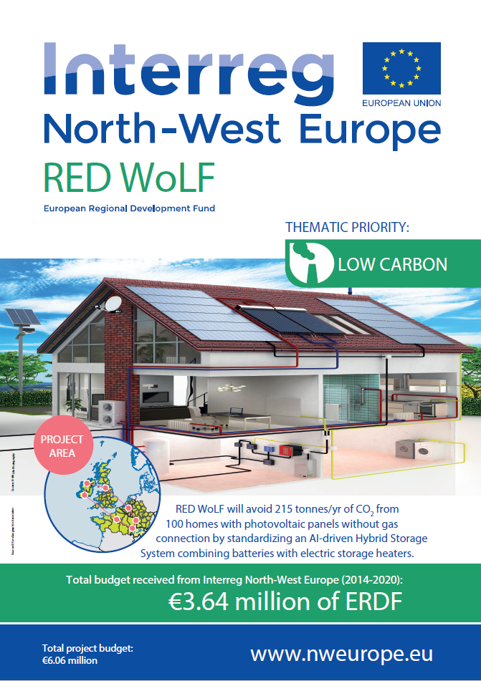
Andy Hunt
Programme Manager
Community Wealth Building
Oldham Council
Interreg NWE V B RED WoLF

Slide 2
Market Capitalisation of RED WoLF system
27th October 2020

Slide 3
Market capitalisation of RED WoLF heating system
Market Capitalisation means taking the RED WoLF system from the Pilot Phase to the Commercialisation Phase to achieve the project’s target of at least 15,000 systems installed across the partnership regions by 2032
Every successful commercialised product has the following Market Capitalisation elements:-
Manufacturers
Suppliers
Customer identification
Promotion and marketing
Endorsements
Case studies
Accreditations
The Project Partners are looking to engage with stakeholders like yourselves to put together a plan to successfully commercialise the RED WoLF system.

Slide 4
Key stakeholder types
Primary stakeholders (Pilot area local market influencers)
a. Distribution Network Operators / Distribution System Operators b. Local authorities / municipalities c. Developers including housing associations d. National energy authorities including central government departments
Secondary stakeholders (providers and customers) e. Home occupiers (primary customers) f. Manufacturers and supply chain g. Installers Tertiary stakeholders (wider market influencers) h. Energy suppliers i. Aggregators j. Local Energy Market platforms

Slide 5
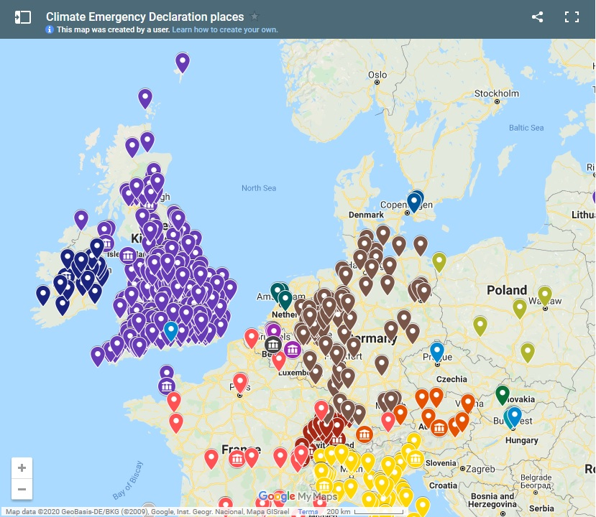
“Climate Emergency” Local Authorities / Municipalities
Local Authorities / Municipalities which have declared a “Climate Emergency”:-
https://www.climateemergency.uk/blog/map-of-local-council-declarations/
Q: what does this tell us?
A: there is a potentially huge market for RED WoLF across Europe

Slide 6
Question:-
How can your organisation contribute to the RED WoLF Market Capitalisation process?
Please post in the chat section of Teams or let us know if you would like to meet up ‘offline’ after the webinar.

Slide 7
Thank you!

