Slide 1
Hydrogen Exploring Opportunities in the Northern Ireland Energy Transition
Dr Rory Monaghan
Ryan Institute Energy Research Centre, School of Engineering, NUI Galway
MaREI, the SFI Centre for Energy, Climate and Marine Research
11 November 2020

Slide 2
Background
NI Department for the Economy commissioned NUI Galway, with partners Dublin City University and HyEnergy Consulting, to prepare a report on the opportunities for Northern Ireland in hydrogen.
This webinar seeks input from key stakeholders for the final report.
Your further input is very welcome. Please email rory.monaghan@nuigalway.ie with the subject line “Northern Ireland Hydrogen”.

Slide 3
Overview
Key Technologies & Applications for NI
Enabling Policies in UK, ROI & EU
2030 Hydrogen Scenarios
Outlook

Slide 4
Key Technologies & Applications
Water
Electricity
Natural gas
Water
Production
Oxygen
Electrolyser
Steam Methane Reformer
CO₂
Carbon capture
Production
Electrolysers
Steam Methane Reforming (with & without CCUS)
Storage & Transportation
Pressurised gas
Cryogenic liquid
Hydrogen-containing liquids
End use
Existing gas-burning appliances (boilers, engines, gas turbines)
Industrial feedstock
Fuel cells
Hydrogen
Hydrogen

Slide 5
Key Technologies & Applications
Water
Electricity
Natural gas
Water
Production
Oxygen
Electrolyser
Steam Methane Reformer
CO₂
Carbon capture
Production
Electrolysers
Steam Methane Reforming (with & without CCUS)
Storage & Distribution
Pressurised gas
Cryogenic liquid
Hydrogen-containing liquids
End use
Existing gas-burning appliances (boilers, engines, gas turbines)
Industrial feedstock
Fuel cells
Hydrogen
Hydrogen
Storage & Distribution
Compressor
Liquefaction
Chemical transformation
High-press cyl
Nat. gas grid
Salt cav-erns
Cryo liq. tanks
Liquid tanks

Slide 6
Key Technologies & Applications
Water
Electricity
Natural gas
Water
Production
Oxygen
Electrolyser
Steam Methane Reformer
CO₂
Carbon capture
Production
Electrolysers
Steam Methane Reforming (with & without CCUS)
Storage & Distribution
Pressurised gas
Cryogenic liquid
Hydrogen-containing liquids
End use applications
Existing gas-burning appliances (boilers, engines, gas turbines)
Industrial feedstock
Fuel cells
Hydrogen
Hydrogen
Storage & Distribution
Compressor
Liquefaction
Chemical transformation
High-press cyl
Nat. gas grid
Salt cav-erns
Cryo liq. tanks
Liquid tanks
End Use Applications
Transport
Heating
Power
Trans & Storage
Ind. Feed.
Blended ICEs, fuel cells
Boilers, fuel cells (for CHP)
Blended GTs, fuel cells
Long-term, high-capacity
Chem, steel, others

Slide 7
Key Technologies & Applications
Water
Electricity
Natural gas
Water
Production
Oxygen
Electrolyser
Steam Methane Reformer
CO₂
Carbon capture
Production
Electrolysers
Steam Methane Reforming (with & without CCUS)
Storage & Distribution
Pressurised gas
Cryogenic liquid
Hydrogen-containing liquids
End use applications
Existing gas-burning appliances (boilers, engines, gas turbines)
Industrial feedstock
Fuel cells
Hydrogen
Hydrogen
Storage & Distribution
Compressor
Liquefaction
Chemical transformation
High-press cyl
Nat. gas grid
Salt cav-erns
Cryo liq. tanks
Liquid tanks
End Use Applications
Transport
Heating
Power
Trans & Storage
Ind. Feed.
Blended ICEs, fuel cells
Boilers, fuel cells (for CHP)
Blended GTs, fuel cells
Long-term, high-capacity
Chem, steel, others

Slide 8
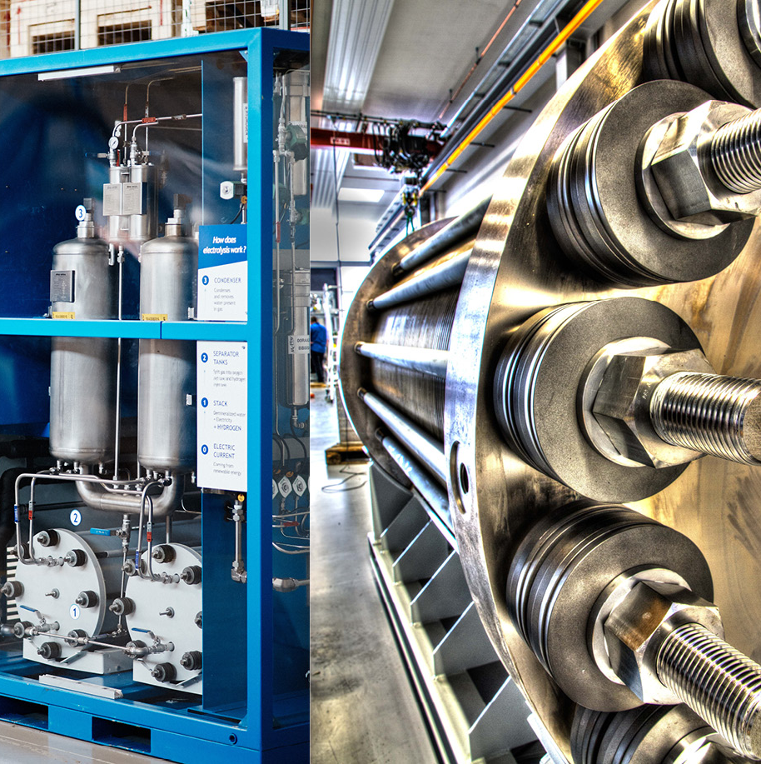
Electrolysers
System that splits water to hydrogen and oxygen
Input water needs to be pure but can be sourced via mains, bore holes or desalination processes
Produced hydrogen can be compressed, stored and shipped to power a variety of applications
If electricity is renewable, HYDROGEN IS GREEN
Scale up
Electrolysis has been widely accepted through Europe as a leading method to fight CO₂ emissions
Gigawatts (GWs) of electrolysers are being planned around the globe
UK also has large systems planned i.e. 1.8 GW for the Zero Teesside initiative

Slide 9
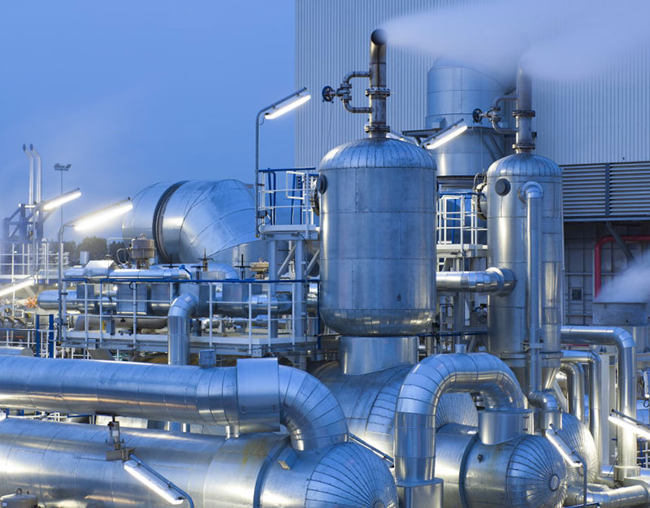
Steam Methane Reforming (SMR)
SMR technology splits natural gas (NG) into mixture of hydrogen, CO and CO₂
Industries use SMR technology to deliver large quantities of H₂ and CO with remaining CO₂ being released to atmosphere
The process is mature with systems capable of producing up to 100s of metric tonnes per day of H₂/CO
Currently over half the worlds hydrogen is derived from NG feedstocks

Slide 10
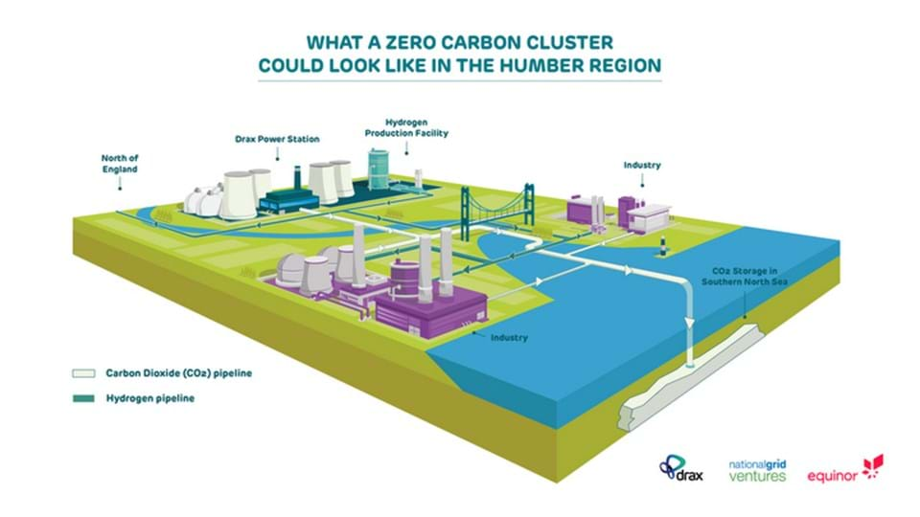
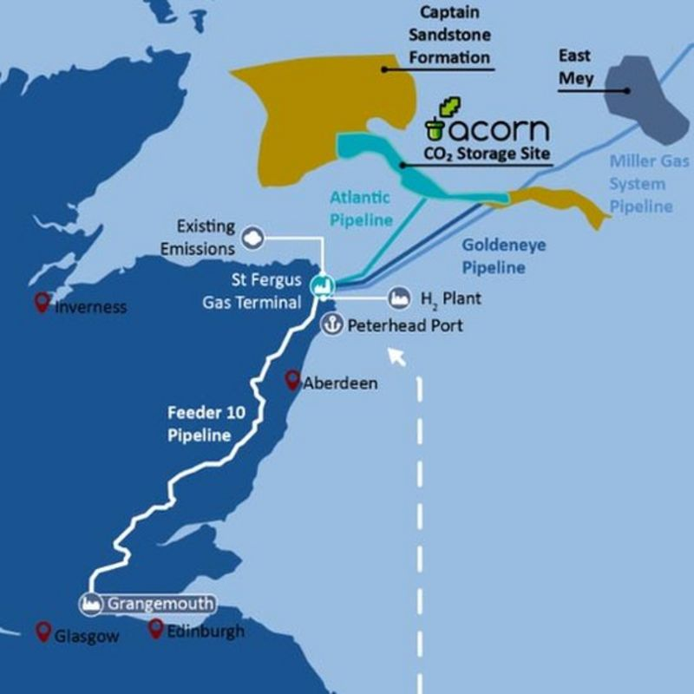
SMR and Carbon Capture Utilisation and Storage (CCUS)
Capturing the CO₂ produced by SMR can decarbonise the process
Captured CO₂ can be stored in underground geological features or used
If CO₂ is captured/used, HYDROGEN IS BLUE
Many large scale CCUS projects are being developed, and the UK is seeking to become world leading in CCUS technology.
The Acorn Project will capture about 200,000 tonnes of CO₂ from the St Fergus Gas Terminal

Slide 11
Salt Caverns for Gas Storage
Used to store gases including hydrogen since the 1950s
Sites have traditionally been developed after salt extraction by the chlorine industry
Over 30 caverns in use in the UK today
mainly used for NG
1 in use for hydrogen
internal wall properties prevent leakage and contamination of the hydrogen
Lowest cost direct storage mechanism for large hydrogen volumes
Possibility to use Larne salt caverns for hydrogen storage

Slide 12
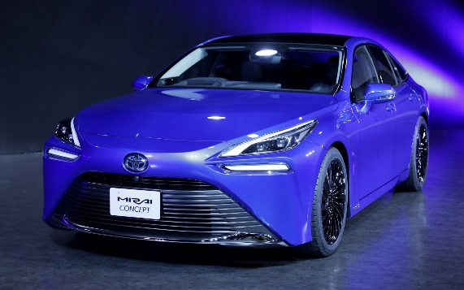
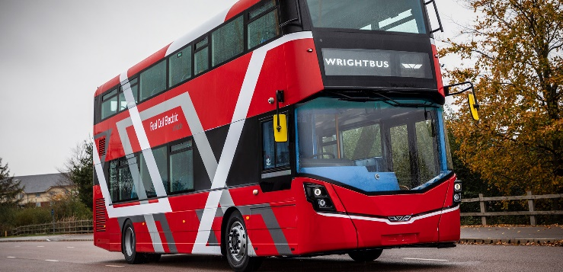
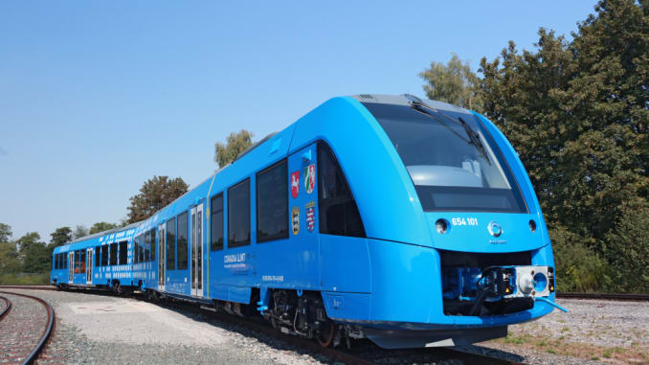
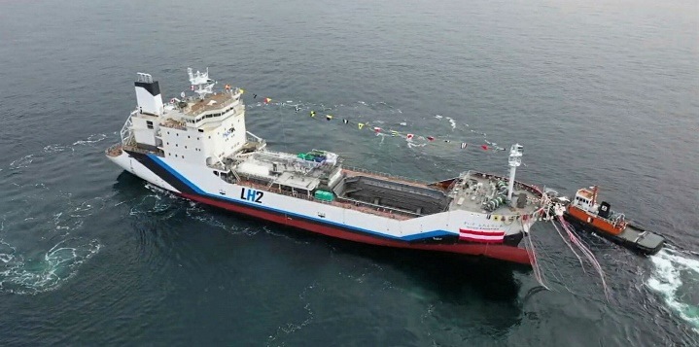
Renewable Hydrogen in Mobility & Transport
Application | Status/Examples | Advantages | Disadvantages
Cars & vans | 11,000+ vehicles in California, Japan, Europe | Short refuelling time High energy density (v Li-ion) Long range (v Li-ion) Zero tailpipe emissions Low material footprint | Low network efficiency H₂: Chicken and egg P2L: High cost NH₃: Hazardous
Trucks & buses | Early commercial technologies 25,000 forklifts, 900 buses & trucks, including Aberdeen, Belfast & Dublin
Rail | Trains in Germany, UK, Austria & Netherlands | Low cost zero emissions for low utilisation lines | Many lines already electrified
Maritime | Small demonstration projects | H₂ & NH₃: Zero exhaust emissions Very few other options | Low energy density (v liquids)
Aviation | Small demonstration projects | P2L: High energy density Long range High value use for biomass | P2L: High cost H2: Fuel tank & airframe redesign

Slide 13
EU Position on Hydrogen
European Commission “A Hydrogen Strategy for a Climate-Neutral Europe”, 2020. https://ec.europa.eu/energy/sites/ener/files/hydrogen_strategy.pdf

Slide 14
Policy – UK and EU
2020 has seen release of Hydrogen policies and roadmaps in France, Germany, Netherlands & Portugal
UK and Ireland (due 2021) are lagging behind which has a knock-on effect on Northern Ireland
How will Northern Ireland’s policy be shaped by the regions surrounding them?
UK government primary targets:
Reduction in carbon emissions
Hydrogen Mobility
Utilising and promoting the use of British solutions
Job creation and skills development
Green hydrogen with substantial blue hydrogen use
EU and other regions primary targets:
Reduction in carbon emissions
Hydrogen Mobility
Energy Diversity and Security
Foster regional economic growth
Green hydrogen almost exclusively, with other technologies to help transition
Market Development
Rapid Market Delivery/Uptake
Market Rationalisation
2020
2030
2040
2050

Slide 15
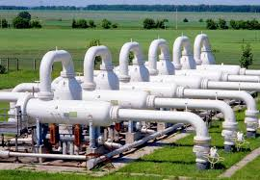
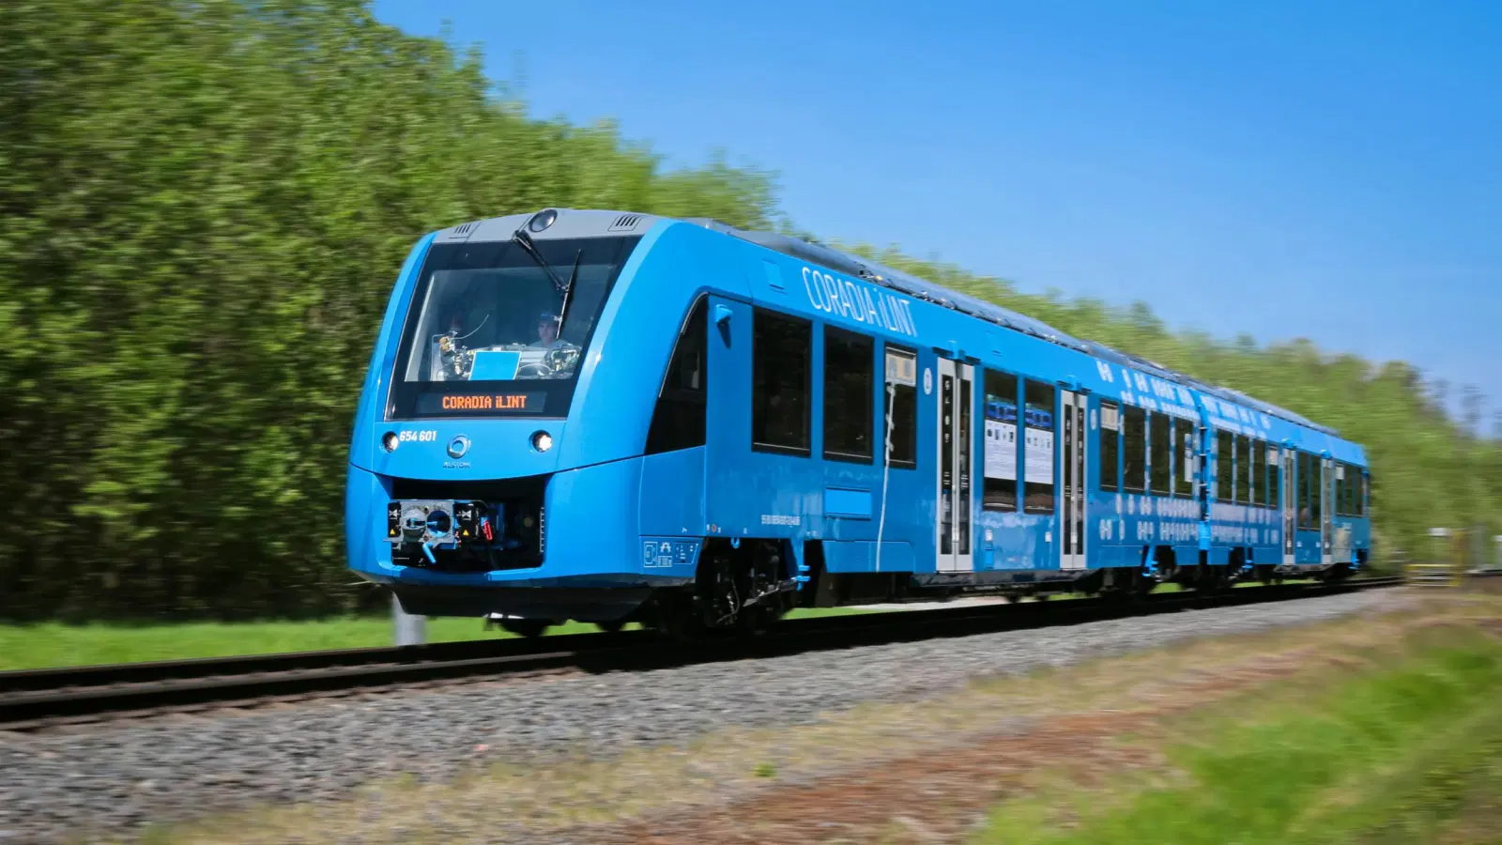
All-Island Potential
Both Ireland and Northern Ireland have enormous untapped renewable energy resources
Modern, increasingly interconnected electricity grid can accommodate high RES-E & SNSP
The modern, shared interconnected gas grid can be primed for hydrogen injection at a relatively low cost
Reduce reliance on imported fuels and help bring household expenditure on energy down (NI has highest UK regional cost)
Shared codes and standards
Shared storage systems
Shared mobility infrastructure projects?
Hydrogen refuelling stations both sides of the border
Enables island-wide transportation corridors
Renewal of rail rolling stock with H₂ trains
EUCO scenarios suggests Ireland will be utilising only 2% of renewable energy generation potential in 2030!
Notes:
UK has committed to spending another £2.5 billion
through the clean growth grand challenge to support
low carbon innovation through to 2021.
UK already has offered feed-in tariffs for biomethane
under the non-domestic renewable heat incentive
scheme – hydrogen could be next.

Slide 16
2030 Hydrogen Scenarios
Scenario 1: distributed H₂ electrolysis, transport to nearest bus network or grid injection point

Slide 17
2030 Hydrogen Scenarios
Scenario 1: distributed H₂ electrolysis, transport to nearest bus network or grid injection point
Scenario 2: Regional H₂ electrolysis in Northwest, followed by:
2a: Transport to Derry/Londonderry to fuel 90 buses & 150 trucks
2b: Injection to natural gas grid to meet 10% of regional demand

Slide 18
2030 Hydrogen Scenarios
Scenario 1: distributed H₂ electrolysis, transport to nearest bus network or grid injection point
Scenario 2: Regional H₂ electrolysis in Northwest, followed by:
2a: Transport to Derry/Londonderry to fuel 90 buses & 150 trucks
2b: Injection to natural gas grid to meet 10% of regional demand
Scenario 3: Centralised H₂ production near Belfast, followed by:
3a: Transport to Belfast to fuel 210 buses & 350 trucks
3b: Injection to natural gas grid to meet 10% of Greater Belfast demand

Slide 19
Estimating Hydrogen Demand
Transport Sector
Projections based on fleet turnovers, diesel bans, EU & HMI figures
Projected number of FCEV urban buses in NI
70:30 split between Belfast & Derry
50,000 km per year
Projected number of FCEV 40-tonne trucks in NI
70:30 split between Belfast & Derry areas
100,000 km per year

Slide 20
Estimating Hydrogen Demand
Transport Sector
Natural Gas Use
Projections based on fleet turnovers, diesel bans, EU & HMI figures
10% of 2019 gas consumption in Derry-Strabane and Causeway Coast & Glens (Scenario 2)
10% of 2019 gas consumption in Greater Belfast (Scenario 3)
Projected number of FCEV urban buses in NI
70:30 split between Belfast & Derry
50,000 km per year
Projected number of FCEV 40-tonne trucks in NI
70:30 split between Belfast & Derry areas
100,000 km per year

Slide 21
Production location?
Annual hydrogen demand?
Production capacity?
Demand location?
Supply
Demand
Industry
Centralised/ decentralised?
Applications and end-users?
Transport
Developing a Hydrogen Value Chain
For each scenario, we calculate capital & operating costs for hydrogen production, storage & transportation in the value chain.
Cost projections to 2030, transportation distances & economies of scale are included.
This gives a levelised cost per kg of delivered hydrogen for each scenario
Gas grid
Capacity?
Location?
Renewable sources?

Slide 22
2030 Hydrogen Scenarios - Results
Scenario | Value Chain Type | Location | Electricity Source | Demand Type | Optimum Electrolyser Capacity | Production Cost per kg H₂ | Transport Cost per kg H₂ | CO₂ Savings
1 | Distributed | Throughout NI | Wind Farms | Various | 350 kW – 3.5 MW | £2.30 - £12 | £0.45 - £2.25 | n/a
2a | Regional | Derry | Grid | 90 buses, 150 trucks | 10 MW | £2.70 - £4.50 | £0.40 | 4,400 t_{CO2}
2b | Regional | Northwest | Grid | 10% NW NG Demand | 14 MW | £2.60 - £4.40 | £0.00 | 2,800 t_{CO2}
3a | Centralised | Belfast | Grid | 210 buses, 350 trucks | 23 MW | £2.50 - £4.40 | £0.10 | 10,300 t_{CO2}
3b | Centralised | Greater Belfast | Grid | 10% Greater Belfast NG Demand | 94 MW | £2.40 - £4.20 | £0.00 | 18,500 t_{CO2}

Slide 23
2030 Hydrogen Scenarios - Context
Transport scenarios
Scale & location are crucial to reduce production and transportation costs
Minimum delivered cost = £2.60/kg for Belfast
Equivalent to 72p per litre of diesel
Bans on diesel-only buses in place in UK & ROI
RTFO could subsidise hydrogen production ~£5/kg if
Electrolyser is connected directly to RES-E
RES-E is purpose-built for hydrogen production
World’s first double-decker hydrogen fuel cell bus is designed and built in Northern Ireland
Hyundai Xcient hydrogen fuel cell 40-tonne truck has entered the European market (Switzerland)

Slide 24
2030 Hydrogen Scenarios - Context
Gas grid scenarios
Scale & location are crucial to reduce production and transportation costs
Minimum delivered cost = £2.40/kg for Belfast
Equivalent to 7.2p/kWh
Median NI domestic gas customer paid 4.8 p/kWh in H1 2019
Modern and growing gas grid in NI and ROI presents opportunities
Grid injection underway in GB (HyDeploy) and ROI (GNI blending site in Brownsbarn, Dublin)
Options for further in the future
Blending at gas-fired power plants
Storage in Larne salt cavern

Slide 25
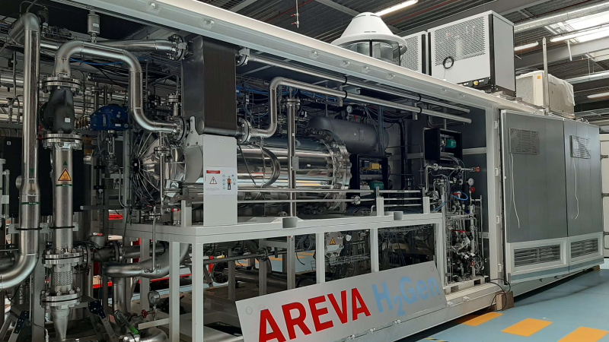
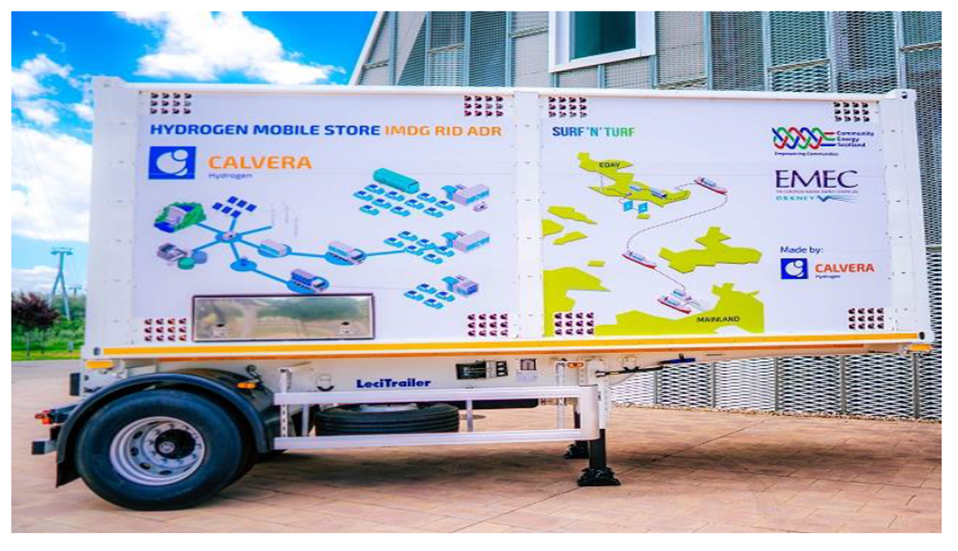
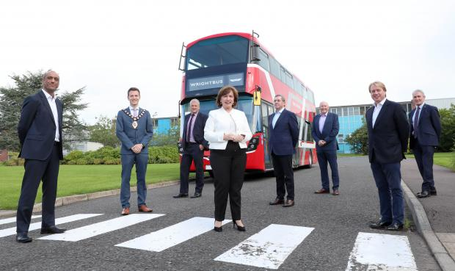
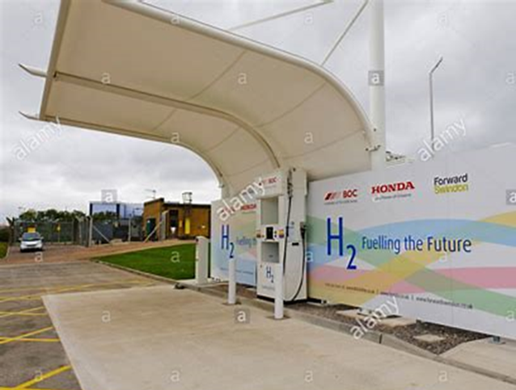
GenComm Ireland’s First Green Hydrogen Supply Chain
2x 250-bar tube trailers
27-MW Long Mountain Wind Farm, Co Antrim
500-kW Areva electrolyser
3x Bamford Fuel Cell double-decker buses
Bus fuelling depot, Belfast

Slide 26
Outlook
Offset fossil fuel usage with H2
Utilise large renewables potential
Emission Reductions
RES Expansion
New H₂ applications to replace carbon-emitting processes
Large green H₂ Potential
Reduce reliance on imported carbon fuels
What does this mean for Northern Ireland?
Prove viability of UK technology
Energy Diversity
H₂ Tech testing ground
Focus on hydrogen for heat and goods across Ireland
Ireland-wide gas grid injection
Skilled Job Creation – Manufacturing and O&M
Historic manufacturing and fabrication
Economic Benefits
Northern Irish Expertise
Potential Hydrogen Export to UK/ROI/EU
Operational skills, expertise and added value
Drivers
Opportunities

Slide 27
Acknowledgements
Cian Moran & Arya Gunawan at NUI Galway
Jochelle Laguipo & Dr James Carton at Dublin City University
Josh Williamson, Tim Williamson, Diana Raine & Ian Williamson at HyEnergy Consulting
Paul McCormack at Belfast Metropolitan College
Meabh Cormacain & Eddie Kerr at the Department for the Economy
Your further input is very welcome. Please email rory.monaghan@nuigalway.ie with the subject line “Northern Ireland Hydrogen”.

