Slide 1
Hydrogen and HEAVENN Power to the molecules
Patrick Cnubben
New Energy Coalition

Slide 2
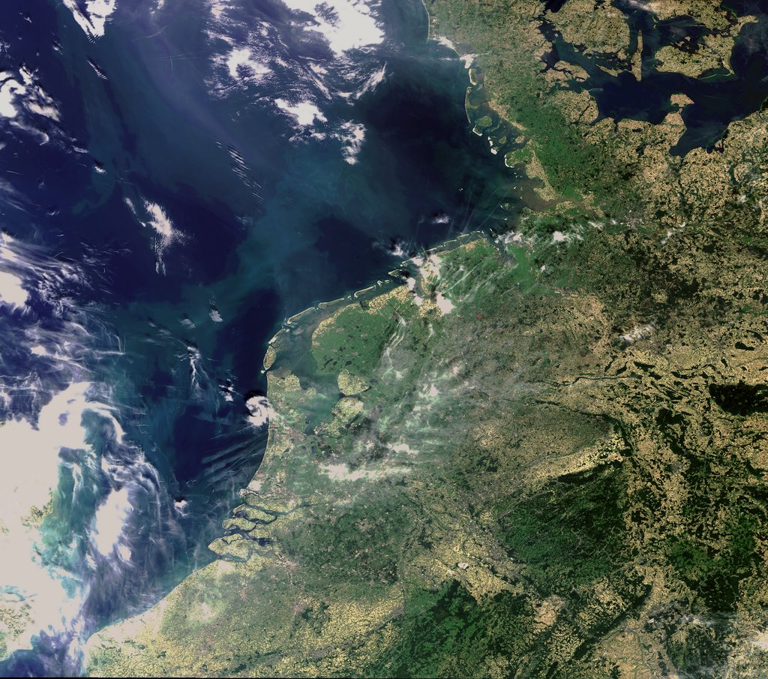
Where are we located?

Slide 3
HEAVENN
The consortium
Stichting Energy Valley, part of New Energy Coalition
29 entities from 7 EU countries (NL, D, DK, B, UK, ES and E)
Parties from business: large, mid-sized and SME, associations, knowledge institutions, expert advisories, regional development institutions
Broad national and international support
Over 60 parties from over 12 countries have given their support to the project via the means of a Letter of Support
The project also can rely on broad political support covering the whole political spectrum – nationally and EU level

Slide 4
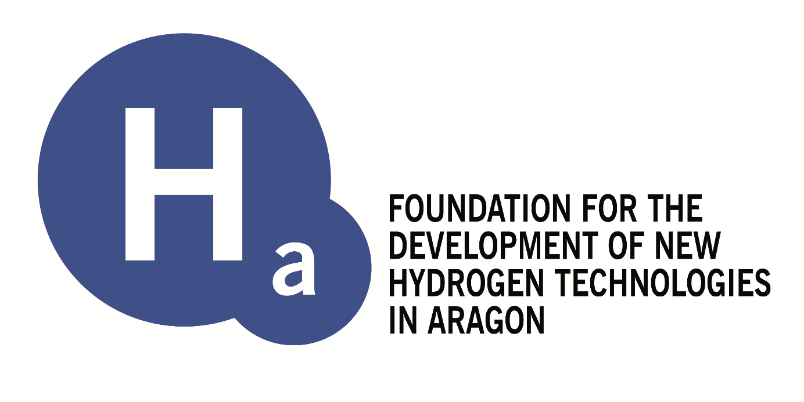
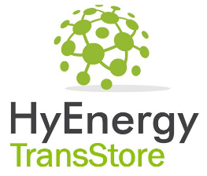
HEAVENN

Slide 5
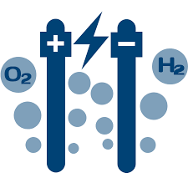
HEAVENN
NorNed/CoBra
Tennet/TSO
North Sea
Renewable fuel
Production
Cluster I
Engie/cs
Nouryon
Bytesnet: Back-up power
Cluster II
GSP
Gasunie
Heat: Gem Hoogeveen, Groningen
HyStock/
Gasunie
Pitpoint
Cluster IV
Green Planet
Cluster III
UVO Vervoer
90
GZI - NAM
Gem. Groningen
Gem. Emmen
EBN
Enexis/
Rendo/
Alliander/
Stedin/
DSO’s
Lenten/NPRC
QBuzz
Gasunie
SNN, SEV, Enercy, H2Tec, HTS, Hinicio,
Aragon Foundation, EMEC, EWE, Hydrogen Valley
Ireland HA , ERIG
Emmtec

Slide 6
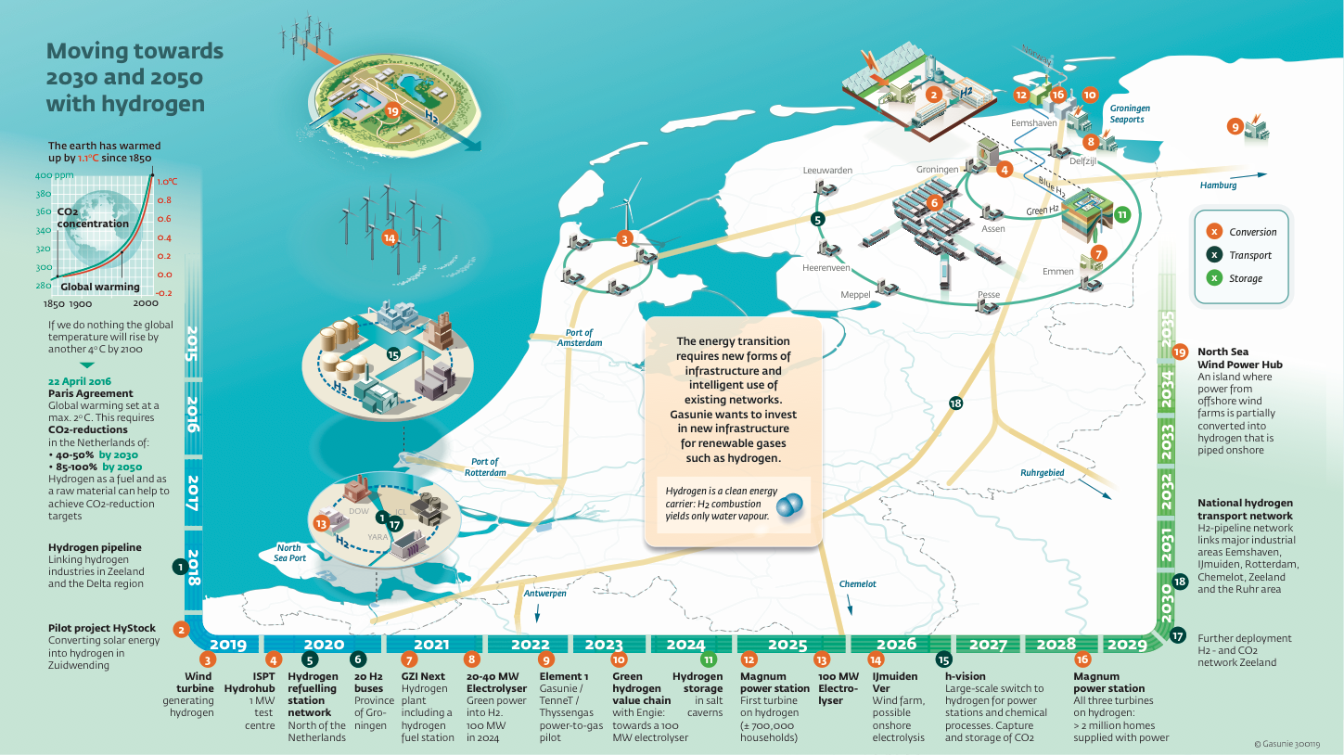
More than Heavenn Roll out to mass application

Slide 7
Join us in Heavenn!
Patrick Cnubben
p.cnubben@newenergycoalition.org

