Slide 1
Hydrogen Europe: Who we are
Our Vision
Hydrogen enabling a zero emission society
Our Mission: NO EMISSION
We bring together diverse industry players, large companies and SMEs, who support the delivery of hydrogen and fuel cells technologies. We do this to enable the adoption of an abundant and reliable energy which efficiently fuels Europe’s low carbon economy.

Slide 2
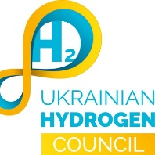

Slide 3
What we want
Enable clean hydrogen to:
replace all unabated fossil hydrogen consumption,
replace fossil fuels and feedstocks in other sectors where hydrogen can play a role.
By 2024 Clean Hydrogen Production should be 13x times that of today and by 2030, it should be 130 times larger.
10 x increase
13x increase
Source: Hydrogen Europe

Slide 4
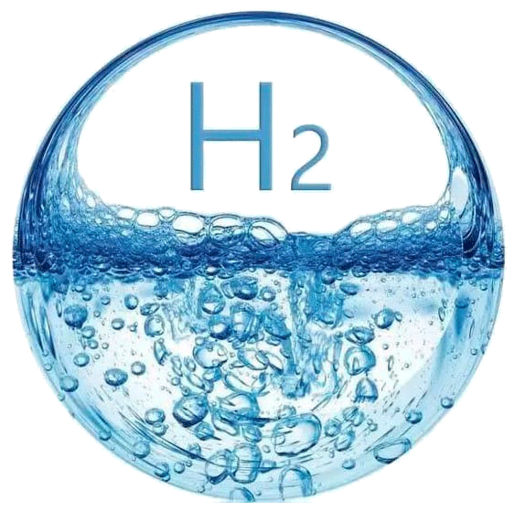
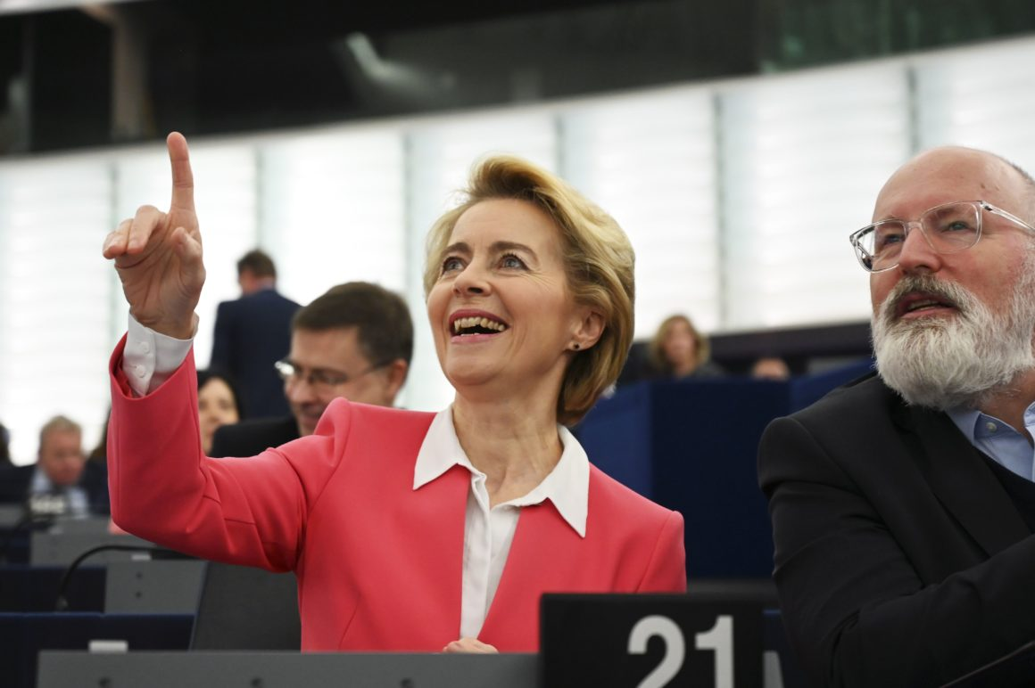
At EU level
“Next Generation EU should invest in Hydrogen.”
Ursula von der Leyen @State of Union speech, September 2020
“H2 rocks, and I am committed to making it a success!”
Frans Timmermans- Executive Vice-President for the European Green Deal

Slide 5
What does the EU want?
Green Deal
ENERGY SYSTEM INTEGRATION
EU CLEAN HYDROGEN ALLIANCE
EU HYDROGEN STRATEGY
2x40 GW

Slide 6
What is industry planning right now
Cumulative planned PtH projects by year 2020 - 2040 (MW and # of projects)
Comments
20,011 MW by 2040 (additional 1,278 MW with Date N/A)
Annual 2020 – 2030 capacity growth rate at 63%
2,131 MW by 2024 compared to 6 GW EU target, 36%
9,101 MW by 2030 compared to 40 GW EU target, 23%
The currently announced projects amount to at least ~€ 10.6 billion worth of investments in electrolyzer technology
Sizeable new PtH facilities are being announced regularly
The effect of new policies and incentives stemming from strategies
Source: Hydrogen Europe

Slide 7
Six countries have planned additions above 1 GW by 2030
Map of PtH additions by country 2020 – 2040 (MW)
PtH projects in ten countries 2020 – 2030 (MW and # of projects)
Source: Hydrogen Europe

Slide 8
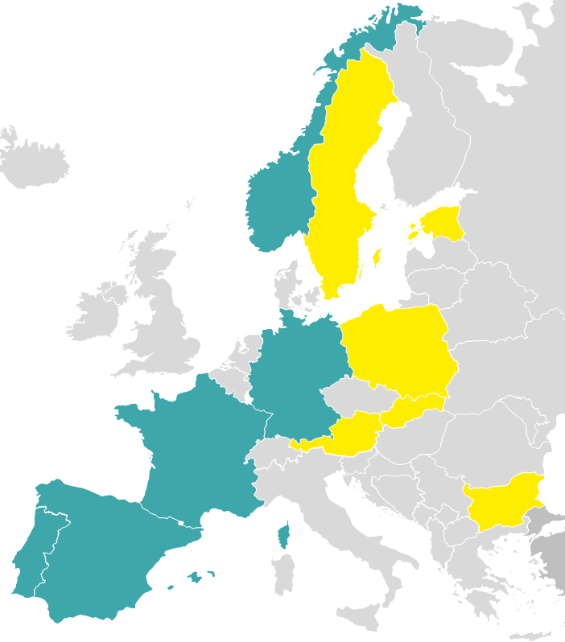
National Ambitions
H2 strategy adoption
Most ambitious countries by H2 policies¹
Five countries have officially adopted an H2 strategy
These include Germany, France, Spain, Portugal, and Norway
Six countries are currently working on their national H2 strategies
Adopted H2 strategy
Planned H2 strategy
Notes: 1. Illustrative as exact number of policies continues to change
Source: Hydrogen Europe, Fuel Cells and Hydrogen Observatory

Slide 9
National hydrogen strategies
How far are we from the 2030 EU target for electrolyser capacity (GW)?
Source: Hydrogen Europe

Slide 10
Billions to be invested in the EU
EU governments propose hydrogen strategies with dedicated 2030 investment plans:
Germany | €7bn (+ €2bn external partnerships)
Spain | €8.9bn
France | €7.2bn
Portugal | €1bn
Italy | €4bn
Austria | €2bn

Slide 11
Unfortunately,
National policies supporting H2 production and use lacking…
CAPEX subsidies for renewable/low-carbon H2 plants used in industry
Electricity price component reduction for H2 production in industry
Only six countries in Europe currently provide some form of CAPEX subsidies for H2 production destined for industry
These include Norway, Germany, Belgium, Netherlands, Austria, and Bulgaria
Only five countries in Europe currently provide reduced electricity price for H2 production destined for industry
These include Norway, Sweden Germany, France, and Bulgaria
Source: Fuel Cells and Hydrogen Observatory

Slide 12
Back to the EU level
01
02
03
04
Energy union
Clean energy package
EU Green deal
EU Recovery plan
Five fundamental pillars for the EU’s energy system:
energy security,
internal energy market,
energy efficiency,
decarbonisation, and
research & innovation
“The EU’s new growth strategy”
Carbon neutrality by 2050
Upgraded targets
Revised legislations
Implementation of the Energy Union strategy
Governance Regulation (EU) 2018/1999
Renewable Energy Directive (2018/2001/EU)
And 6 additional legislations
Additional funding opportunities via new schemes or the upgrade of existing ones.

Slide 13
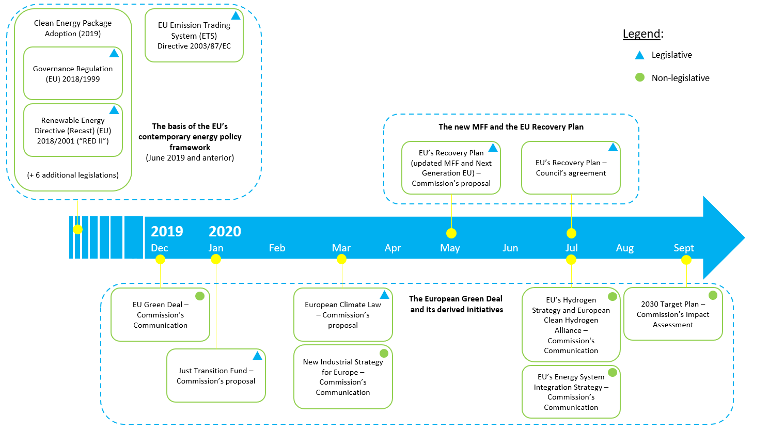
The EU’s contemporary energy policy framework
Source: Hydrogen Europe

Slide 14
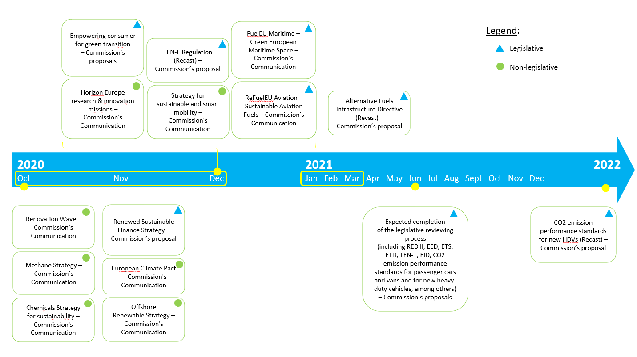
Expectation for future policy development
Source: Hydrogen Europe

Slide 15
Expectation for future policy development
Source: Hydrogen Europe

