Slide 1
Northern Ireland Energy Policy Perspective
Hydrogen: Exploring Opportunities in the Northern Ireland Energy Transition
11 November 2020

Slide 2
Introduction
New Energy Strategy for Northern Ireland under development
Building an evidence base
Cross-government issues and cross-government working
Focusing on decarbonisation and consumers

Slide 3
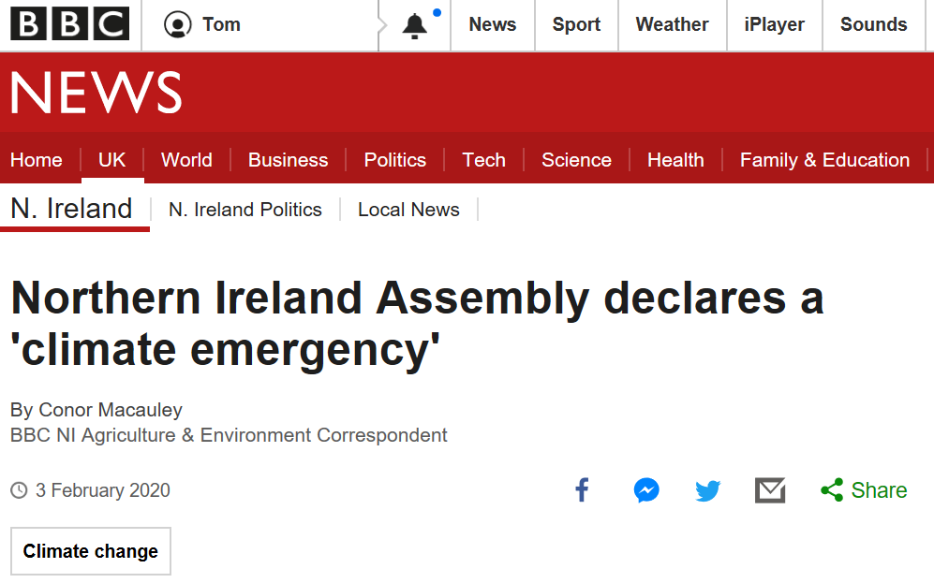
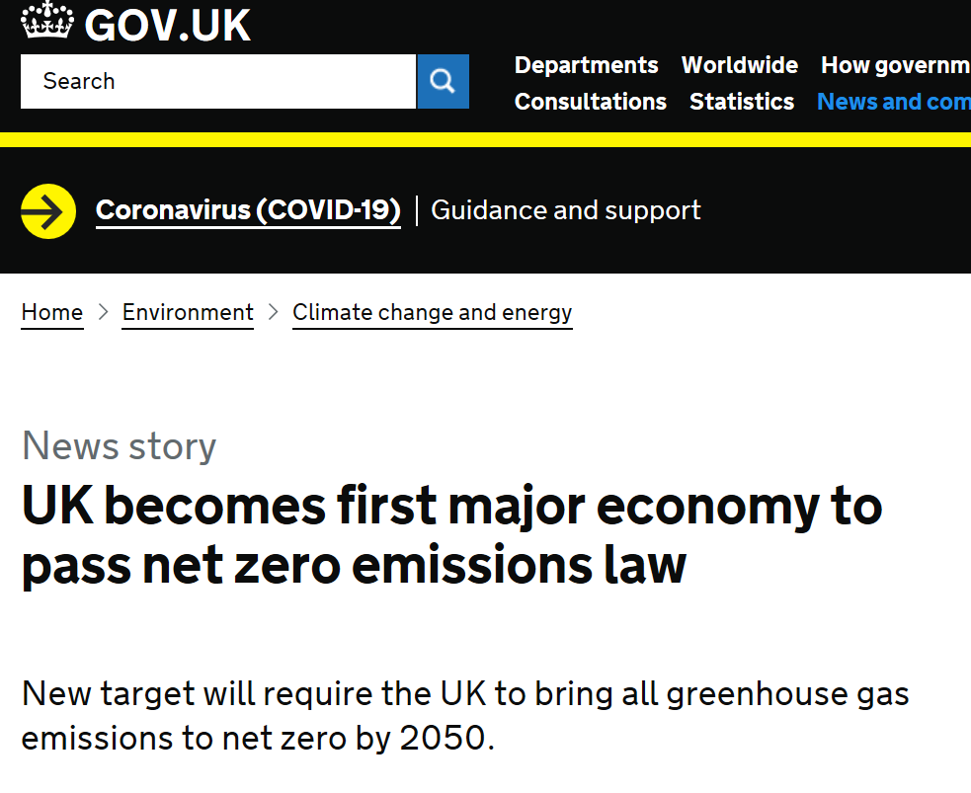
Context
Notes:
Strategic Energy Framework 2010-2020
Paris Climate Change Accord to limit global warming to 2°C (1.5°C)
UK legislation (2019) committing to net zero carbon emissions by 2050
New Decade New Approach commits to targets/legislation for reducing carbon emissions in line with the Paris Accord

Slide 4
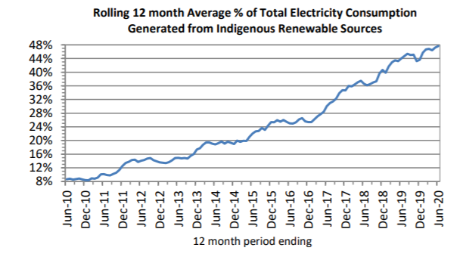
Our renewable electricity success
40.0%
47.7%
16.0%

Slide 5
Timeline
Call for Evidence
Dec 19 – Apr 20
Options Consultation
Apr 20 – Mar 21
Final Energy Strategy
Mar 21 – Nov 21
Formal call for evidence
Closed 20 March but extended due to Covid
Workshops
Presentations
Stakeholder engagement
Creation of five thematic working groups
Review evidence received
Additional research
Energy modelling
Develop policy options
Stakeholder engagement
Review consultation responses
Gather final evidence
Make policy decisions
Executive approvals
Publish strategy
Stakeholder engagement

Slide 6
Evidence and policy-making
161
June 20
Evidence-gathering a continuous process
CfE responses received
summary report and responses published
Policy development facilitated and framed elsewhere

Slide 7
Thematic working groups
Five working groups established:
Consumers | Energy Efficiency | Heat | Power | Transport
Considering evidence, commission new research and provide evidence-based options for consultation
Membership from a mix of government (both central and local), industry and other representatives where appropriate
More than 70 members from 27 different organisations

Slide 8
Heat themes
The future of oil and solid fuels
The Future of the Gas Network
Decarbonising Gas
Renewable Heat Technologies

Slide 9
Power themes
Transforming the Power Sector
New Renewable Electricity Target
Routes to Market for Renewables
Diversifying the technology mix
Public support for renewables

Slide 10
Transport themes
Modal shift
Electrification of Transport
Alternative fuels
Future of mobility

Slide 11
Energy Efficiency themes
Establishing a new Energy Efficiency Target
Enhancing the Regulatory Framework and Standards for Energy Efficiency in Buildings
Encouraging investment in Energy Efficiency in existing buildings
Building capacity and capability in the sector

Slide 12
Consumer themes (1)
Co-production and co-design principles
New Decade New Approach: “the principles and practice of citizen and community engagement and co-design will be a key part of the development and delivery of the Programme for Government and its supporting strategies.”
Consumer reference groups
Call for Evidence focus on benefiting energy consumers
Five consumer groups have been identified (2 domestic/3 non-domestic)
Virtual reference groups will be established to develop a shared agenda and bring consumer knowledge and experience to the table

Slide 13
Consumer themes (2)
Citizen energy communities
Gathering evidence to develop policy options that help provide a regulatory framework that enables these citizen energy communities.
NI Energy Authority (one stop shop)
The responses to the Call for Evidence showed overwhelming support for a NI one stop shop that helps deliver adequate energy advice and information
Enabling and Protecting consumers
Policy options for a new or expanded energy legal and regulatory framework that help enable and protect consumers during the transition to zero carbon.

Slide 14
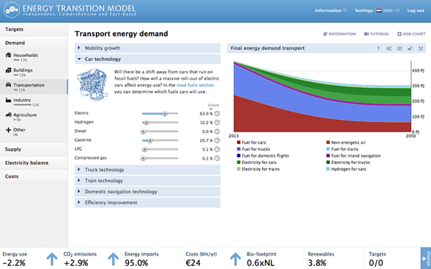
Energy transition model
Replicates energy system
Looks at:
What energy we use
What we use it for
How efficiently we use it
Carbon emissions
Run scenarios on potential energy pathways
Published for all to use

Slide 15
Everything else
New technologies and innovation, as well as the role of data
Energy and the Economy – Clean Growth
Business and Industrial Energy
Governance of energy and climate, role of local Councils, legislative and regulatory changes required

Slide 16
Working across government
Government stakeholders group includes:
DAERA | DfI | DfC | DoF | TEO | DE | DoJ | Solace | NIAUR | Invest NI
Working group members include:
DAERA | DfI | DfC | DoF | Fermanagh & Omagh Council | Mid & East Antrim Council | Belfast City Council | Derry & Strabane Council | NIAUR | CCNI and more
Wider connections include:
BEIS | Scottish Government | DCCAE

Slide 17
Thank you Any questions? energystrategy@economy-ni.gov.uk
k

