Slide 1
"Innovation foundations“
Dijana Likar, Head of Energy Department, IECE, North Macedonia

Slide 2
Innovation
Foundations & Models
IECE, North Macedonia
HAZEL Webinar 5: Marketable hydrogen innovations - Innovation & entrepreneurship of innovation of Energy Carriers through academia & industry alliances

Slide 3
IECE in brief
Institute for Research in Environment, Civil Engineering and Energy, Skopje, North Macedonia, is based on three pillars:
Research and Innovation,
Education,
Consultancy,
In cross- sectoral technological fields, with a specific focus on integrated and efficient
management of resources.
One of the specifics of IECE’s is experience in establishing and supporting collaborative partnerships between academia and industry (CO – IN Model), through common R&I programs:
ALL4R&D Platform – Promoting academia – industry alliances for R&D, through collaborative and open innovation platform (http://platform.all4rd.net/),
Research project (with several PhD and MSc thesis included): Return on investment in human capital in industrial companies,
Sustainable Leadership and Entrepreneurship Training program, etc.
The developed and implemented programs have resulted in collaborative partnerships leading to marketable services and products in industrial companies, as well as improved market, financial and innovation performance of companies wherein the model has been deployed.
HAZEL Webinar 5: Marketable hydrogen innovations - Innovation & entrepreneurship of innovation of Energy Carriers through academia & industry alliances

Slide 4
IECE in brief
The IECE’s research project and demonstration study: Innovative model for development of learning organizations through knowledge management and intellectual capital, submitted to the 2020 International Knowledge Management /Intellectual Capital Excellence Awards, has been selected as one of the ten finalists to go through to the final round of judging (evaluation decision is expected on 4th December 2020).
Research and innovation in energy sector, more specifically: the Energy efficiency – Renewable sources – Clean energy nexus, are within IECE’s fields of occupation. Nexus approaches are proven to have positive impact on efficient resource management.
Being one of the pillars for the Energy Roadmap 2050, the hydrogen is included in IECE’s research program, in particular:
Generation sources and models: water –energy –materials nexus, at the production side,
Coupling with RES, for their optimal integration in the power grid: complex multi criteria approaches, algorithms and software, for multi-sources energy systems simulation, evaluation and decision making.
HAZEL Webinar 5: Marketable hydrogen innovations - Innovation & entrepreneurship of innovation of Energy Carriers through academia & industry alliances

Slide 5
Research and Innovation in Hydrogen Technologies within the European decarburization agenda
The Hydrogen strategy for a climate-neutral Europe includes promoting and supporting new ways of research and innovation in hydrogen technologies.
To ensure a full hydrogen supply chain to serve the European economy, further research and innovation efforts are required:
First, on the generation side, this will include upscaling of existing, and development of new, more efficient and cost-effective sources, methods and materials for hydrogen production,
Second, infrastructure needs further development to distribute, store and dispense hydrogen at large volumes and possibly over longer distances,
Third, large scale end-use applications need to be further developed, notably in industry and in transport,
Finally, further research is needed to support policy making on a number of cross-cutting areas, in particular to enable improved and harmonized (safety) standards.
HAZEL Webinar 5: Marketable hydrogen innovations - Innovation & entrepreneurship of innovation of Energy Carriers through academia & industry alliances

Slide 6
New hydrogen exploratory fields
The World Energy Outlook, Special Report on Green Recovery, from July 2020, recognizes hydrogen technologies as one of the six strategic opportunities in technology innovation needed for green recovery of the world economy.
At the production side that includes:
Improving water life cycle in hydrogen generation – waste water to hydrogen: closing loops of water, energy and materials, cross sectoring circular economy and clean energy,
Cost effective and environmental friendly methods and materials applied for green hydrogen generation,
Systemic inclusion of hydrogen in energy networks – coupling hydrogen with renewable energy sources, by optimal integration thereof into the power grid; multi- criteria optimization models (accounting: reliability, availability, costs and environmental aspects).
HAZEL Webinar 5: Marketable hydrogen innovations - Innovation & entrepreneurship of innovation of Energy Carriers through academia & industry alliances

Slide 7
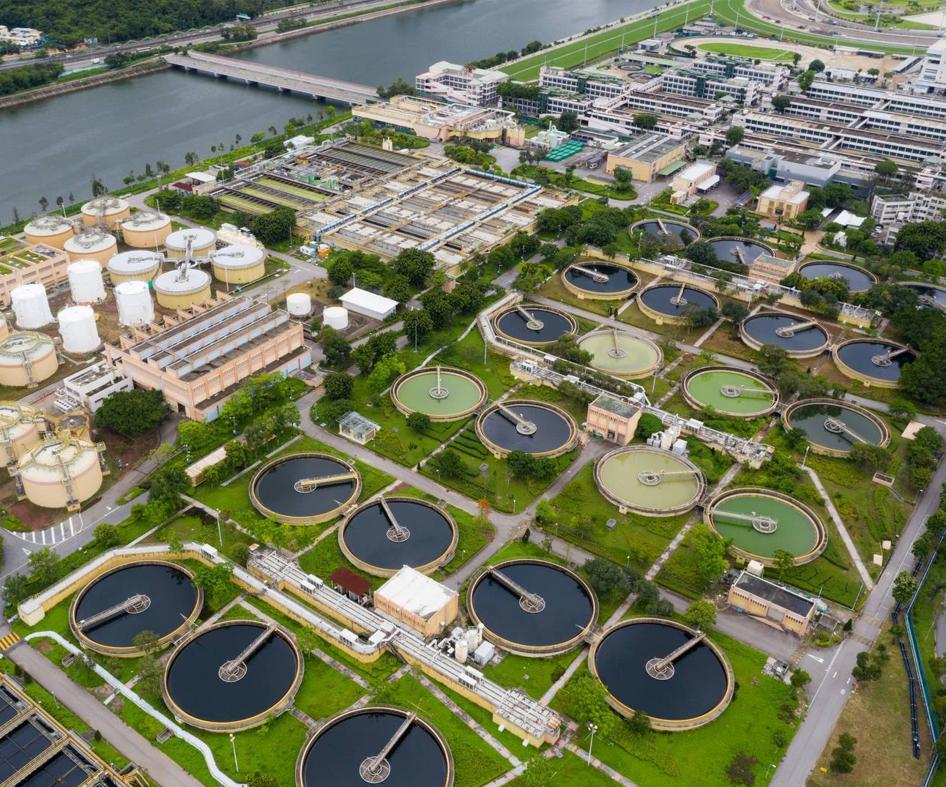
New hydrogen exploratory fields– at the production side
Waste water to hydrogen – the fuel of the future?
Cleaning up transport with dirty water:
Potentially, wastewater makes a readily available, attractive and low-cost stream of material from which hydrogen can be produced.
Numerous different approaches are being explored and developed that can reduce the environmental impact of water treatment while increasing the production of hydrogen.
Perhaps more significantly, wastewater may ultimately prove to be the clean fuel of the future.
Source: https://www.aquatechtrade.com/news/wastewater/wastewater-to-hydrogen-fuel-of-the-future/?utm_term=&utm_content=AQD2020_NB_41&utm_medium=email&utm_campaign=Nieuwsbrieven_2020&utm_source=RE_emailmarketing&tid=TIDP2358832XFE6F89E40A974A5C99D60B342F886D6AYI2&noactioncode=1
HAZEL Webinar 5: Marketable hydrogen innovations - Innovation & entrepreneurship of innovation of Energy Carriers through academia & industry alliances

Slide 8
New hydrogen exploratory fields– at the production side
Water treatment companies are also exploring other approaches to generating hydrogen.
Scottish Water in the UK, announced earlier this year that it was exploring use of electrolysis to produce hydrogen and oxygen from its wastewater stream.
The preliminary results confirmed feasibility of the method applied.
The research was carried out by a MSc student and company’s personnel.
The common academia – industry research resulted in market oriented product.
A WIN –WIN strategy:
Since oxygen is used for ozonization (disinfection) of the water in tertiary phase of the treatment processes and it requires a lot of energy to create ozone, then the oxygen produced during H2 generation can be used to reduce plant’s energy consumption and carbon emissions.
HAZEL Webinar 5: Marketable hydrogen innovations - Innovation & entrepreneurship of innovation of Energy Carriers through academia & industry alliances

Slide 9
Contribution of HAZEL project
to hydrogen – supported climate neutrality
HAZEL is a Smart Doctoral Training program designed to ensure that learners, researchers and industry are really ready to face the low carbon and climate resilient energy challenge by implementation of Green Hydrogen Technologies.
HAZEL mission:
To convert knowledge and ideas in the field of hydrogen into products and services for economic and social benefit.
To establish synergies and exploit complementary competences of the participating industrial and academic organizations enabling the sharing of knowledge through common research activities.
To raise capacity of various industry sectors to apply research results and innovations in order to achieve low carbon yet profitable economy.
HAZEL Webinar 5: Marketable hydrogen innovations - Innovation & entrepreneurship of innovation of Energy Carriers through academia & industry alliances

Slide 10
Research & Innovation Foundations and Models
Creating Knowledge Alliances – One of the most promising models of R&I:
Knowledge Alliances aim at strengthening Europe's innovation capacity and at fostering innovation in higher education and business, by linking them and boosting their capacities.
They intend to:
develop new, innovative and multidisciplinary approaches to teaching and learning;
stimulate entrepreneurship and entrepreneurial skills of higher education teaching staff, senior and younger researchers and company staff;
facilitate the exchange, flow and co-creation of knowledge.
Knowledge Alliances’ objectives:
Boosting innovation in higher education, business and in the broader socio-economic environment by providing links between them – a modified triple helix model (academia – industry – society) for generation and deployment of technological innovations, through an open collaborative platform.
HAZEL Webinar 5: Marketable hydrogen innovations - Innovation & entrepreneurship of innovation of Energy Carriers through academia & industry alliances

Slide 11
HAZEL as a new collaborative research model
New paradigm:
COLABORATION THROUGH PARTNERSHIP IN RESEARCH
The industry is now partner for academia, providing inspiration, feedback and resources, promoting scientific/basic into applied research that result in marketable innovations and products.
In the same time, this approach foster industry to go faster and follow the science.
One of the possibilities of collaborative partnerships: Industry–academia collaborative R&D programs / Collaborative Research Based on Industrial Demand.
Strategic Research and Innovation Partnerships (Strategy for Smart Specialization of Slovenia) act as enablers of technology transfer and boosters of industry innovation capacity.
HAZEL Webinar 5: Marketable hydrogen innovations - Innovation & entrepreneurship of innovation of Energy Carriers through academia & industry alliances

Slide 12
HAZEL innovative approach
Will bring benefit:
1) For ESRs:
ESRs will be trained as scientists, entrepreneurs and managers, with high social responsibility and inspired by real life problems.
This will ensure that each ESR will have the optimal combination of skills and experience to access academic, private industry, and technology transfer jobs.
2) For industry:
raising industry R&I potential,
establishment of industry R&D centres,
marketable industry products based on innovations,
wider demonstrations of economic and social benefits of research,
therefore wider acceptance of the research in industry and society,
new models of financing of research.
HAZEL Webinar 5: Marketable hydrogen innovations - Innovation & entrepreneurship of innovation of Energy Carriers through academia & industry alliances

Slide 13
Conclusions
There is still a lot to be done to increase and improve hydrogen application in already recognized as well as in new sectors.
A systemic approach is needed, integrating the whole energy supply and consumption chain.
Research and innovation play a crucial role in hydrogen strategy, but new approaches are needed to improve their effectiveness and market deployment of results.
Partnership and collaboration between academia and industry through common R&I projects bring benefit for both sides and result in market oriented innovations.
HAZEL Webinar 5: Marketable hydrogen innovations - Innovation & entrepreneurship of innovation of Energy Carriers through academia & industry alliances

Slide 14
Thank you for your attention
HAZEL Webinar 5: Marketable hydrogen innovations - Innovation & entrepreneurship of innovation of Energy Carriers through academia & industry alliances

