Slide 1

Introduction to the eHUBS project
Arjen Rodenburg – eHUBS Project Manager
15 December 2020
Notes:
Lead partner = city of Amsterdam

Slide 2
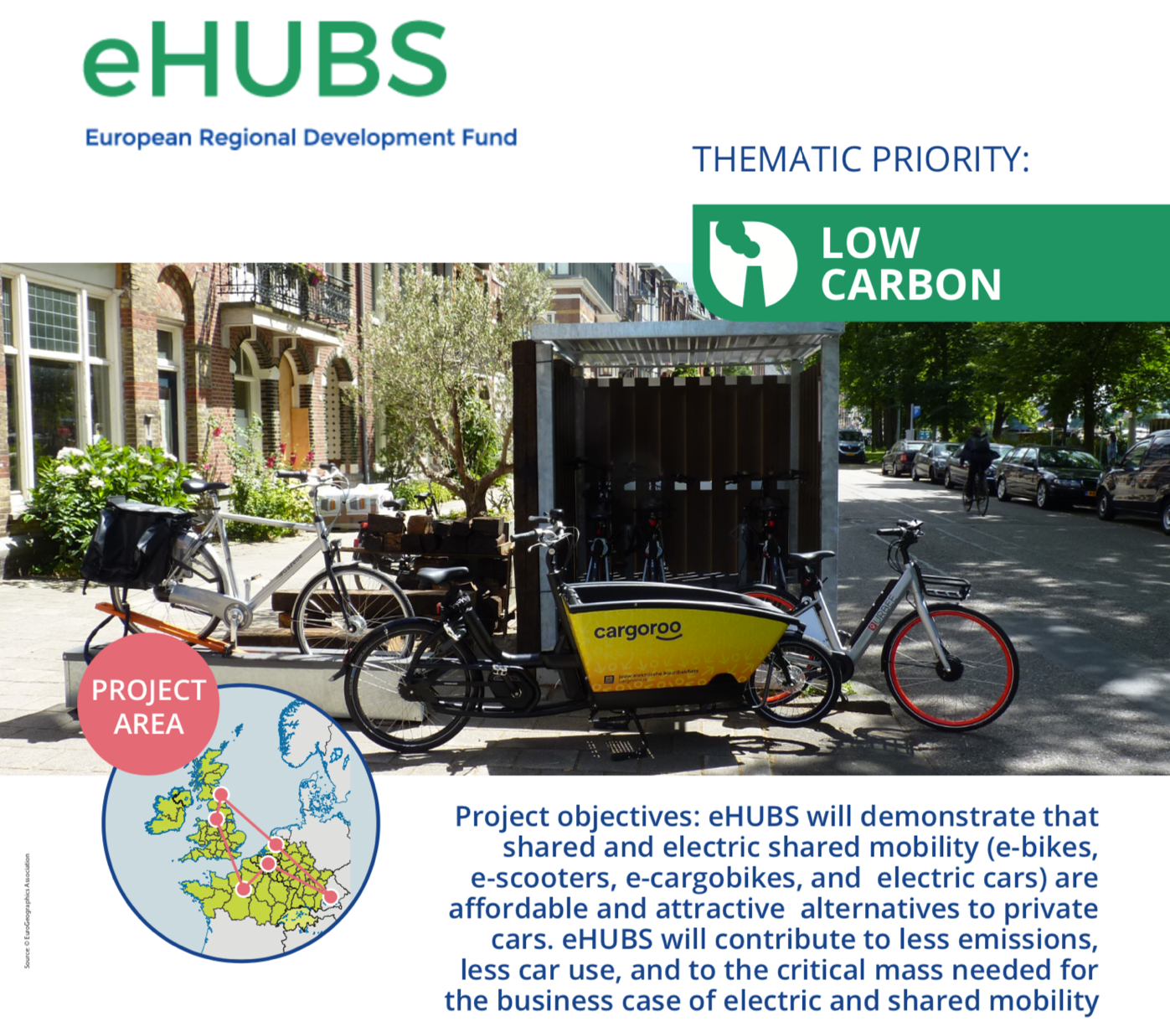
Notes:
With this project, we aim to demonstrate that shared electric mobility organised as mobility hubs is a good alternative for a private car and to pave the way for a critical mass.

Slide 3
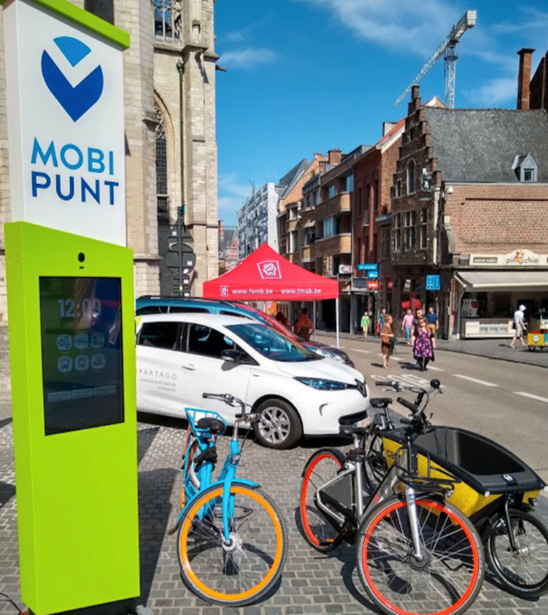
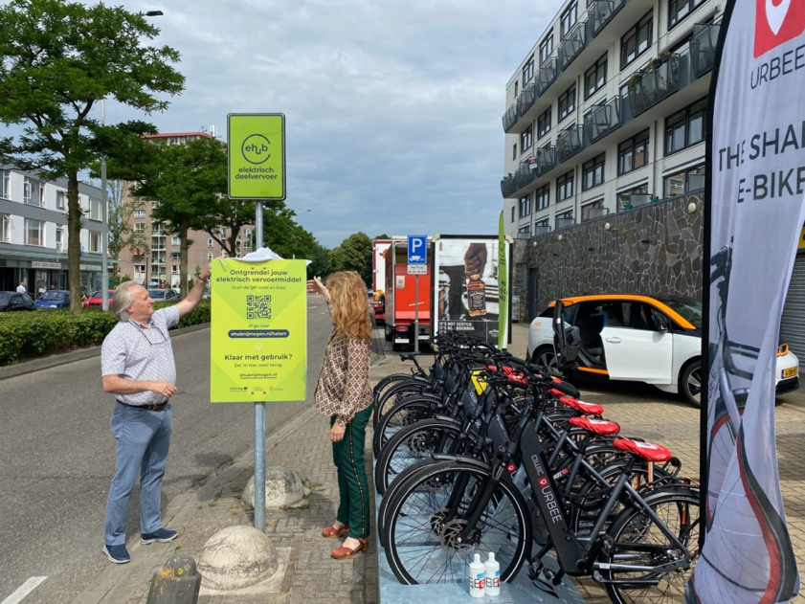
What are eHUBS?
Physical clusters of shared and electric mobility modes
Tailored to local conditions & needs: neighbourhoods, city centres
Can be linked together in a network, as well as connected to the existing PT-network
Bring together e-bikes, e-cargo bikes, e-scooters and/or e-cars and charging infrastructure
Can vary in size, type of location, and type of offer
Integration with transport system through MaaS
Notes:
The eHUBS are clusters of shared electric mobility. They mostly use public-space, so cities need to be involved.
The eHUBS focus to provide a good mix of vehicles with appropriate amounts to target groups in certain areas. So tailored to local conditions and needs. They are offered in small neighbourhoods, but also in city centers, at the egde of a city or as part of a transfer location.
They can also be linked in a network or connected to the PT-network as a first and last mile solution.
To make sure the eHUBS will be used, communication is important to the potential user, but also the integration with Mobility as a Service. Therefore, the project contributed to the development of an API that can be used by MaaS operators.

Slide 4
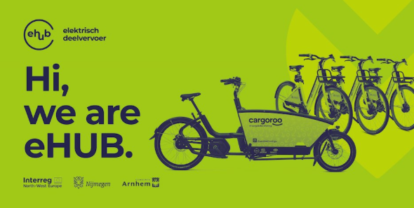
eHUBS outputs
92 eHUBS in 7 pilot cities:
  Amsterdam
  Leuven, launch end of September
  Nijmegen / Arnhem, first eHUBS are operational
  Manchester
  Dreux
  Kempten
2,400 Shared e-bikes, e-cargobikes (and other LEV’s) + 670 shared EV’s
Toolkit for other cities to implement eHUBS
Evidence that eHUBS contribute to less cars and related reduced emissions
Notes:
We plan to make available 2400 shared LEV’s (e-bikes, e-cargobike, e-scooters) and 670 shared EV's. These are divided over more than 90 eHUBS in 7 cities.
Furthermore, we will make available a toolkit for other cities to implement similar solutions. Aim is to support 20 so-called replication cities, but we might manage to do more than that.
The result of a large scale uptake of shared mobility will be a modal shift and reduced CO2 emissions.

Slide 5















Partnership
7 pilot cities, 2 e-mobility providers,
3 universities, 4 network organisations
Additional shared mobility providers will be selected by the involved cities, mostly through tenders
Notes:
Participating cities: mix of larger, medium sized and smaller cities with different target groups
Two e-mobility providers: Cargoroo for the e-cargobikes and Urbee for the e-bikes. Other providers will be contracted by the cities involved where this is needed.
The network organisations: they are especially involved in dissemination and involving replication cities
The universities involved are TU Delft and Newcastle University for measuring effects and transport modelling, University of Antwerp for the business models, and as a subpartner of Amsterdam: the Amsterdam University of Applied Sciences for behavioural change.

Slide 6
Intermediary results
State of the art report on shared e-mobility
Heat maps based on data analysis
Technical and functional requirements
Joint methodology to select locations
Strategic and operational plans per city
Ten recommendations to stimulate the uptake of shared electric mobility hubs.
Prototype of a Service Level Agreement
Report identifying 5 prototypes of business models for eHUBS
Contribution to standard API (TOMP)
First eHUBS operational (Nijmegen / Arnhem / Leuven)
Pending questionnaire in pilot cities with some first insights about the willingness to use the eHUBS
Notes:
State of the art report: we among others discovered that the user profile for eHUBS will be male, young and middle-aged (25-40), and they are a frequent PT and bike users​.
Heat maps: based on among others presence of these user profiles. The higher the presence, the better these areas score (deep green)
Technical requirements: list among others several types of eHUBS (1, 2 and 3). 1 is the biggest and will be an interregional level with high numbers of vehicles but also additional services, 2 = regional / city level or on city egde, 3 = is small, local. But also the look and feel and a non exhaustive list of preferred and additional services at these hubs (ticketing, lockers, etc.)
Methodology: top down or bottom-up or mix, determination what kind of type, number of vehicles, etc.
10 recommendations: among others inform people before the service is available, hassle free / instructions certainly with charging the vehicle
SLA: contains sort of a choice model based on level of regulation. Lowest = only traffic regulations. Highest is concession. SLA also has a list of things that need to be part of the SLA such as minimum or maximum amount of vehicles, role of the city, maintenance and to make sure the shared mobility provider uses the standard API.
Business models: first and last mile, cluster network, POI network, hybrid or closed network
TOMP API = Transport Operator to Mobility Provider API
And of course we have some eHUBS already operational in Nijmegen and Arnhem, end the ones in Leuven will start end of September. The rest will follow the oncoming half year.
Finally, a questionnaire is completed at the moment to gather insights about the willingness to use the hubs

Slide 7
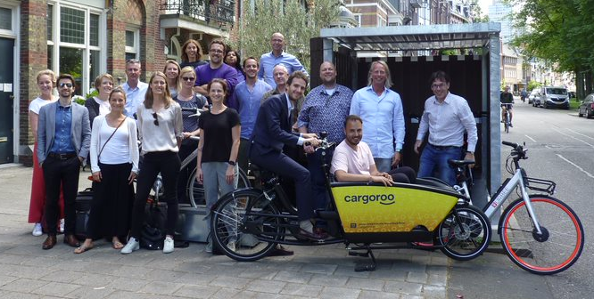
More information
Website: https://www.nweurope.eu/projects/project-search/ehubs-smart-shared-green-mobility-hubs/
Linkedin: https://www.linkedin.com/company/ehubs-nwe/
Twitter: https://twitter.com/eHUBS_NWE
Newsletter: sign up!

