Slide 1
DISCLAIMER
Any use or further distribution of this document is only permitted with written permission of the NEMO coordinator.
EUROPEAN UNION
The NEMO project has received funding from the European Union’s Horizon2020 research and innovation programme under grant agreement No 776846
NEMO website: https://h2020-nemo.eu/
Mika.Paajanen@vtt.fi +358407370910
Lieven.machiels@kuleuven.be +32494918649

Slide 2
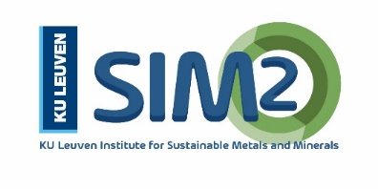
Rawfill Final Conference – 10/12/2020
Mining waste recycling: towards a combined metal recovery and sanitation approach
Lieven Machiels
KU Leuven Institute of Metals and Minerals – SIM² https://kuleuven.sim2.be/
KU Leuven SOLVOMET Industrial Service Centre
https://solvomet.eu/
https://www.linkedin.com/in/lieven-machiels/

Slide 3
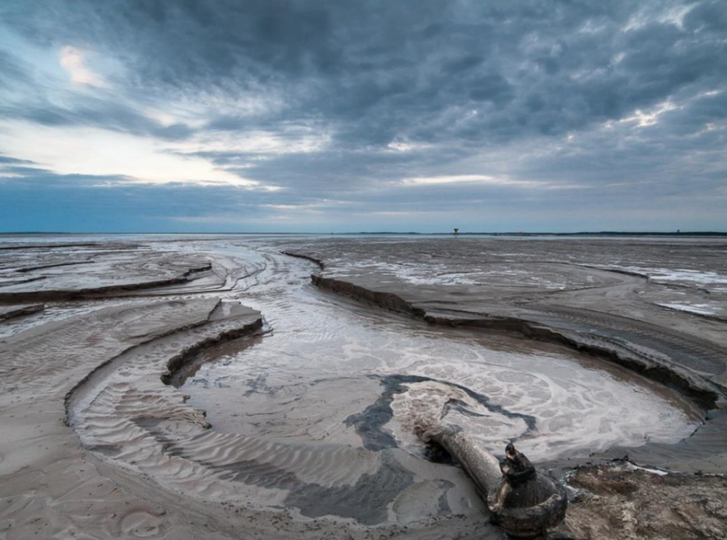
Sulphidic mining waste?
Tailings, residues of the processing of sulphidic ores for production of Cu, Zn, Pb, Ni, Co, Au, others
In E.U., 600 Mtonne/yr produced and historic stockpile of 28,000 Mtonne
IMAGE - Żelazny Most – largest operational tailing pond in Europe (Poland). Source

Slide 4
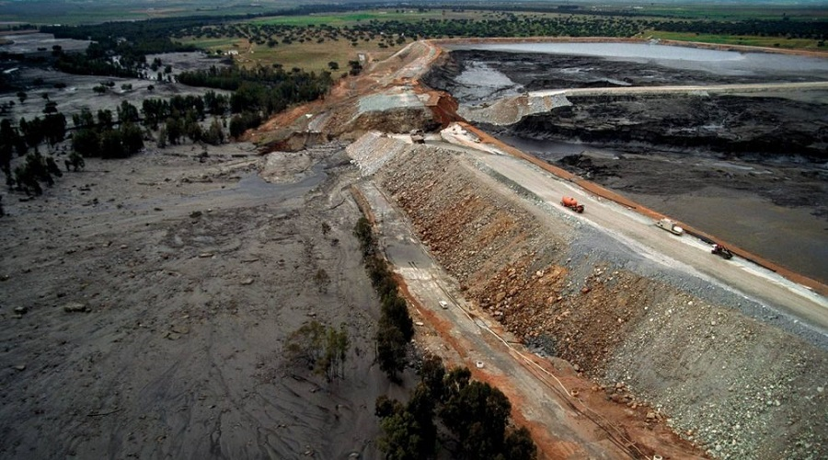
Problems..
When poorly managed, these “tailings” may cause environmental problems such as acid mine drainage and can pose risks, E.G. tailings dam breakage.
IMAGE - Los Frailes tailing dam accident, Spain Source

Slide 5
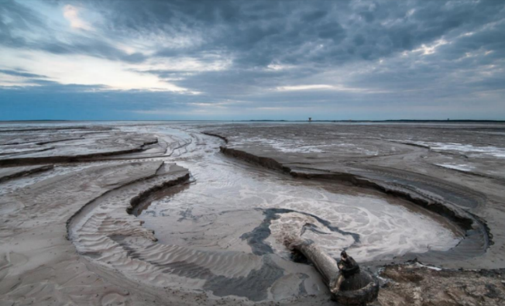
Opportunity?
Extractive-waste problem
In 2016, the European Commission launched a “call to arms” to transform the “extractive-waste problem” into a “resource-recovery opportunity”, as “tailings” still contain valuable & critical metals.
Resource-recovery opportunity

Slide 6
Near-zero-waste recycling of low-grade sulphidic mining waste for critical-metal, mineral and construction raw-material production in a circular economy
The NEMO project has received funding from the European Union's EU Framework Programme for Research and Innovation Horizon 2020 under Grant Agreement No 776846

Slide 7
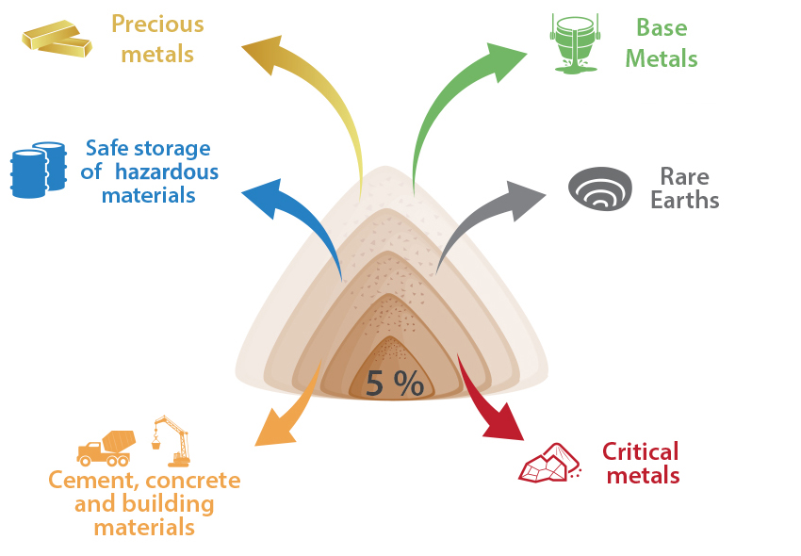
NEMO – towards integral ore valorisation
NEMO is in line with a general evolution in the mining sector:
Recovery of a few ppm/tonne (E.G. gold mining)
Recovery of associated metals (Pb-Zn)
NEMO: integral valorisation of the ore

Slide 8
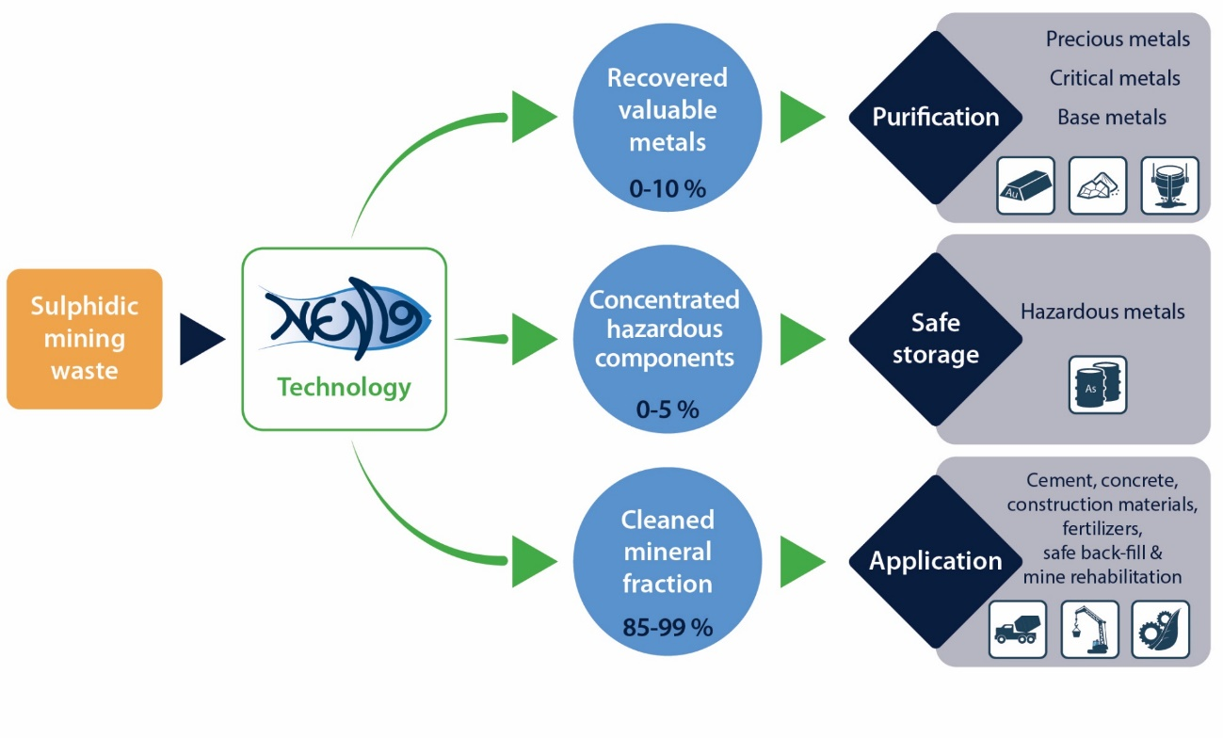
NEMO – Combining resource efficiency with environmental impact reduction

Slide 9
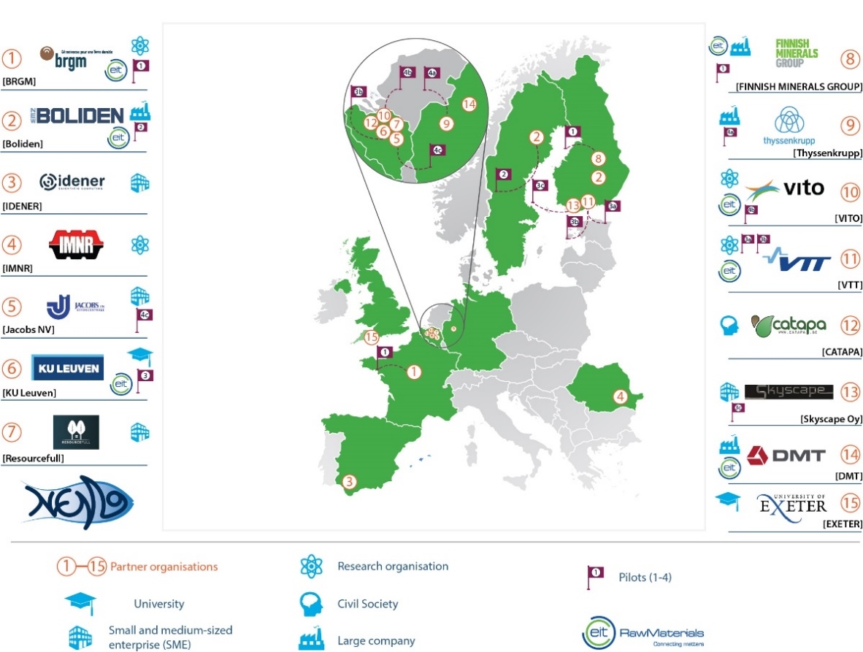
NEMO – Upscaling of innovative pilot installations for sulphidic waste processing
Pilots in:
Bioleaching (in tanks, ponds, heaps)
Metal recovery from leach solutions & metal purification through sulphide and hydroxide precipitation and solvent extraction
Mineral fraction valorisation in cement and construction materials

Slide 10
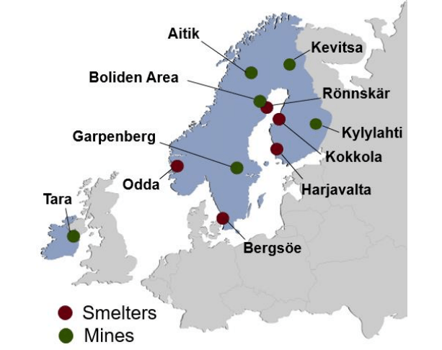
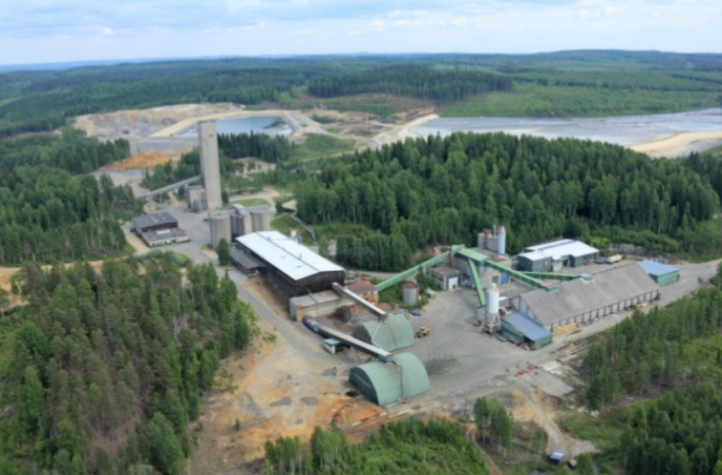
NEMO Case study 1– Luikonlahti Cu-Zn-Ni-Co-Au processing plant, Finland
Luikonlahti, processing plant of Luikonlahti mine, Boliden
Source: https://www.boliden.com/

Slide 11
NEMO Case study 1– Luikonlahti Cu-Zn-Ni-Co-Au processing plant, Finland
Current flowsheet
Source: https://www.boliden.com/
NEMO feed material

Slide 12
NEMO Case study 1– Luikonlahti Cu-Zn-Ni-Co-Au processing plant, Finland
NEMO objectives:
Further process the Co-Ni concentrate produced at the final flotation stage of the Luikonlahti plant
Recovery and purification of Co, Ni, Cu, Zn
Production of Fe-rich residue as a sink for arsenic
Recycle CaSO₄ to produce CaO
The cleaned leaching residue is aimed to remain at the site

Slide 13
NEMO Case study 2 – Sotkamo Ni-Co-Zn-Cu mine, Finland
Source: Terrafame.com

Slide 14
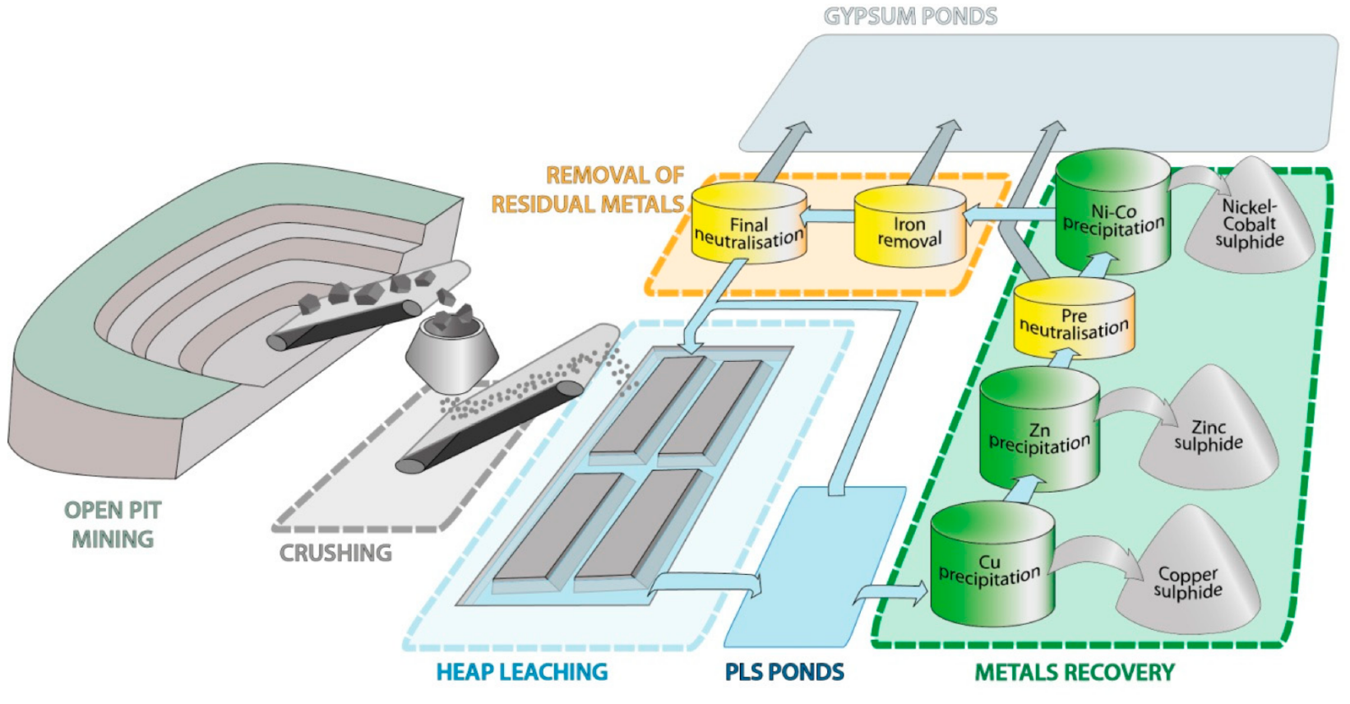
NEMO Case study 2 – Sotkamo Ni-Co-Zn-Cu mine, Finland
Current flowsheet
Source: Geosciences 2018, 8, 66; doi:10.3390/geosciences8020066

Slide 15
NEMO Case study 2 – Sotkamo Ni-Co-Zn-Cu mine, Finland
Current products: (Co,Ni)S, ZnS, by-product CuS
NEMO objectives:
Improve leaching from secondary heaps & improve recovery of Co, Ni, Zn & Cu from pregnant leach solution
Additional metal recovery from pregnant leach solution (metals currently ending up in waste precipitates): Mn, REE, Sc
Cleaned mineral fraction: heaps remain in place after leaching = final storage of mineral fraction

Slide 16
Want to follow-up on NEMO results? https://h2020-nemo.eu/

Slide 17
Rawfill Final Conference – 10/12/2020
Mining waste recycling: towards a combined metal recovery and sanitation approach
Lieven Machiels
KU Leuven Institute of Metals and Minerals – SIM² https://kuleuven.sim2.be/
KU Leuven SOLVOMET Industrial Service Centre
https://solvomet.eu/
https://www.linkedin.com/in/lieven-machiels/

