Slide 1
Zero emission road transport
Irene García Fernández
SEAFUEL
18th February 2021
Notes:
1

Slide 2
Hydrogen
Hydrogen as energy source
Types of Hydrogen
Green Hydrogen
Buffer for renewable energy
Source: www.ariema.com

Slide 3
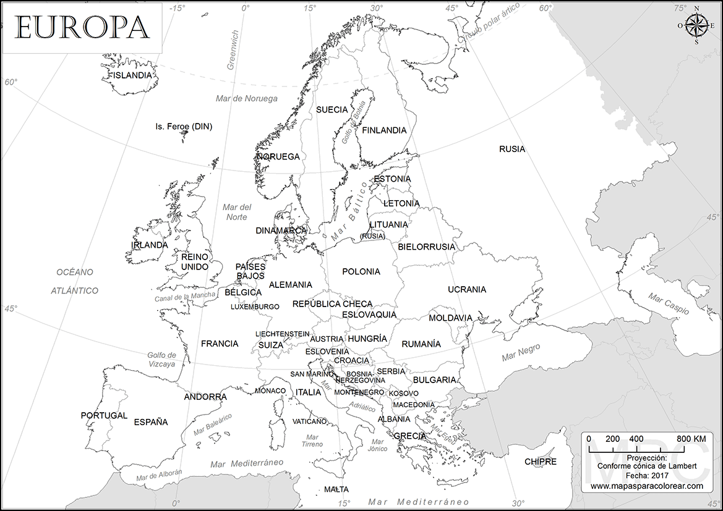
Coastal Areas – Common Issues
Isolated Territories
Large energy dependence
Expensive fuel/energy imports
Aim at small/medium scale installations
Weak grids

Slide 4
Benefits of Green H2 Technologies
Source: Hydrogeneurope.eu
Distributed generation → advantage in isolated communities
Green Tourism → FCEVs fleet in car rental companies
Increased RE share → H₂ production as energy vector
Reduction of imports pressure

Slide 5
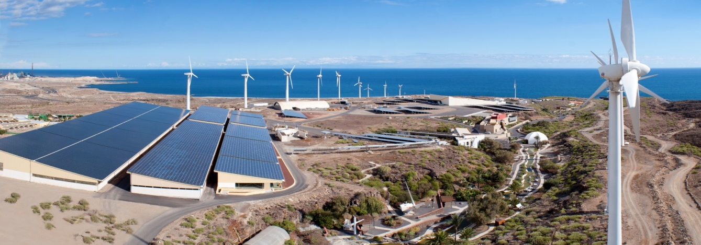
Communities Empowerment
Life quality improvement
Energy generation implies reducing external dependency
From importing energy to exporting possibilities
Enable communities to meet targets set by European Commission

Slide 6
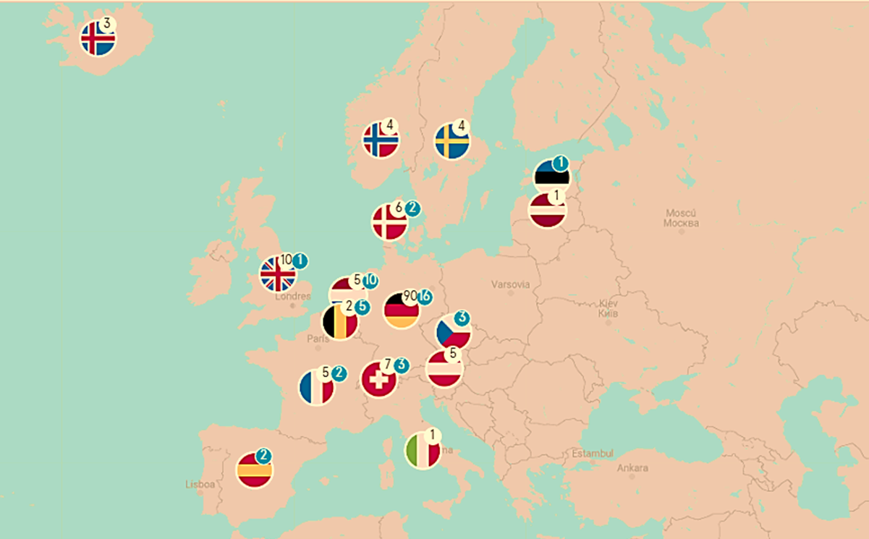
HRS in Europe
In operation
In progress
Source:
H2.LIVE: Hydrogen Stations in Germany & Europe
Notes:
H2.LIVE: Hydrogen Stations in Germany & Europe
As for 2019, hydrogen refuelling infrastructure expanded globally, with significant new deployments in Germany, Japan, Korea, California and China.
The total European stations in operation or under construction stood at 155 with significantly more in the planning stage at year end. Germany led the way with 89 stations operating or under construction, including 28 new stations becoming operational in 2019.
The early part of 2020 is expected to show a sharp ramp up in deployments in France, Netherlands and Germany, with Germany hitting its 2020 target of 100 HRS. Continued momentum is needed, alongside suitable levels of vehicle deployments, if individual country targets are to be reached for example, Germany’s target of 400 HRS by 2025.

Slide 7
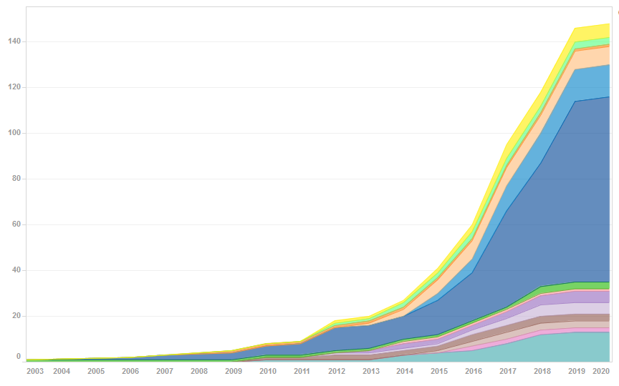
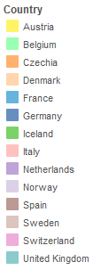
HRS in Europe
Cumulative data on installed HRS in Europe
Source: FCHObservatory
Notes:
Cumulative data on installed HRS | FCHObservatory
The graph displays the country by country deployment of HRS in Europe by year.

Slide 8
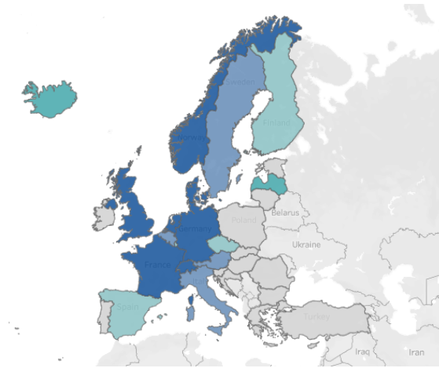
FCEVs in Europe
New FCEVs registrations by country in 2020
205
293
218
628
493
Source: FCHObservatory
Notes:
The map displays the number of registered FCEVs per country in 2020.
The total number of registrations in Germany in 2020 was 628, followed by France with 493.

Slide 9
Forecast – Hydrogen technology
Source: Hydrogen Roadmap Europe
Notes:
Hydrogen-powered vehicles are now available or will become so within the next few years in the large car, bus, train, and forklift segments. The C/D car segment, e.g., is already expanding with the first models in series production. Road vehicles with higher range and load requirements – fuel cell taxis, coaches, vans, and larger cars – should reach mass market acceptability, which we define as annual sales exceeding 1% within the segment, by 2025. City buses could reach this target early (about 2020) in the EU. Small cars show a much later market acceptability for FCEVs because they are more likely to use batteries initially to reach decarbonization goals, at least as long as deployment can rely on existing infrastructure (power grids, domestic sockets). Fuel cell trucks could achieve more than 1% of annual sales in 2030. Although hydrogen is highly advantageous for heavy-duty transport, as explained above, lighter vehicles could initially lead in development because their technology is more mature as of today. Several pilot and development projects for fuel cell trucks are currently underway. However, as the truck business is highly sensitive to the total costs of ownership, costs must significantly improve before ramp-up occurs. Fuel cell trucks could thus reach mass market acceptability later, but account for 35% of overall truck sales or more than 40% of heavy-duty trucks in 2050.
Responsible for approximately 30% of total hydrogen demand in 2050 (675 TWh), the transportation sector could have the highest need for hydrogen in the ambitious scenario. By 2050, hydrogen could power a European fleet of approximately 45 million passenger cars, 6.5 million LCVs, 250,000 buses and 1.7 million trucks. That means FCEVs could make up 20 to 25% of these segments’ fleets. For larger vehicles with long-range requirements, adoption rates could be higher since hydrogen has clear range advantages. Adoption rates could reach 30% for large cars and vans and 55% for taxis, while small FCEVs make up only 15% of the 2050 small cars fleet.
Info sobre los escenarios: Hydrogen Roadmap Europe, page 45-46

Slide 10
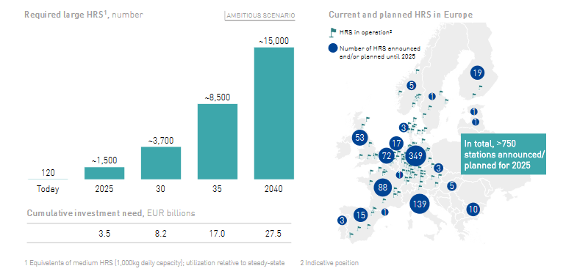
Forecast – Future HRS (Europe)
Source: Hydrogen Roadmap Europe
Notes:
The infrastructure to fuel this fleet needs to ramp up in line with the number of vehicles on the road. With about 3,700 large refueling stations in 2030, FCEVs could provide “full mobility” across Europe. This is equivalent to an investment of roughly EUR 8 billion. Today, roughly 120 HRS are in operation, and there are intentions and plans to build more than 750 by 2025, but the deployment would still require a significant step-up of activities to ensure this initial infrastructure is put in place

Slide 11
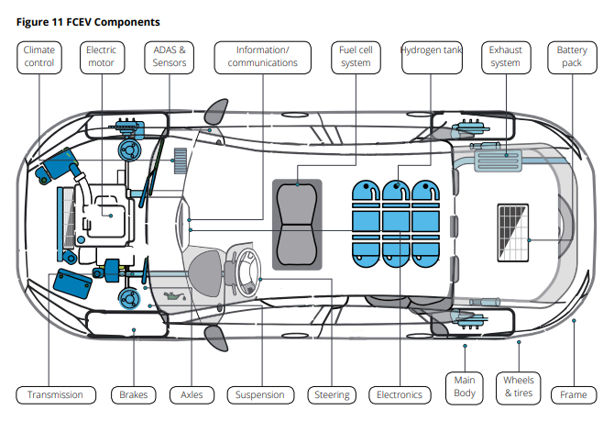
Fuel cell electric vehicle technology
FCEV Components
Notes:
Similar to the majority of modern day vehicles, fuel cell vehicles are comprised of four basic component categories: propulsion system, chassis, automotive electronics and body.
-The propulsion system provides electricity to power the car through a fuel system and electric motor. This power is derived from hydrogen, which is stored in pressurized tanks in the vehicle. A fuel cell stack converts this energy to electricity, which is supplemented by a battery to drive the electric motor.
-The vehicle chassis includes transmission, steering, brake and running systems.
-Automotive electronics are compromised of electronic control system such as chassis control system, safety system and vehicle electronics products such as infotainment/communications, Advanced Driver Assist System (“ADAS”) & sensors.
-Finally, body contains main body, seats and interior

Slide 12
Fuel cell vehicle applications
Hydrogen bin truck
Notes:
Fuel cells for transportation include a wide range of use cases such as passenger vehicles…...
We will focus on passenger and commercial vehicle applications of fuel cell technology, which is perhaps one of the areas showing highest signs of promise for widespread adoption.

Slide 13
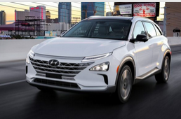
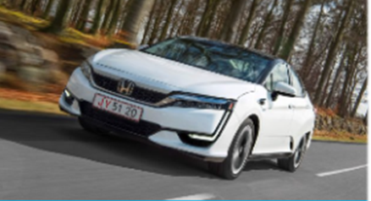
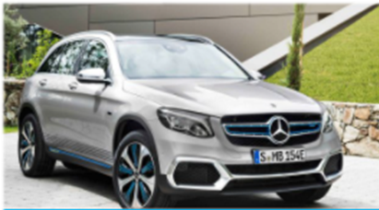
FCEV Passenger cars
Hyundai ix35
Hyundai NEXO
Toyota MIRAI
Honda Clarity Fuel Cell
Mercedes-Benz GLC F-CELL
Notes:
They are all FCEV (Fuel Cell Electric Vehicles) but Mercedes-Benz, which is a FCPHEV (Fuel Cell Plug-in Hybrid Electric Vehicle)
H2.LIVE: Hydrogen Stations in Germany & Europe
Average range: 600 kms

Slide 14
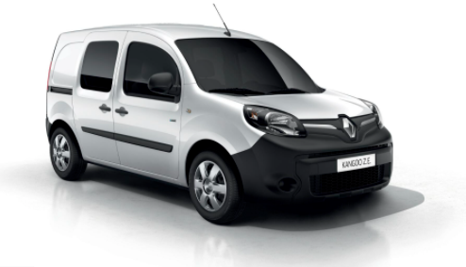
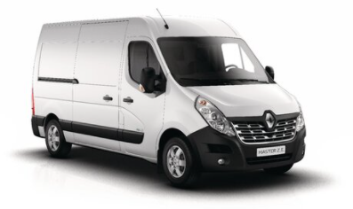
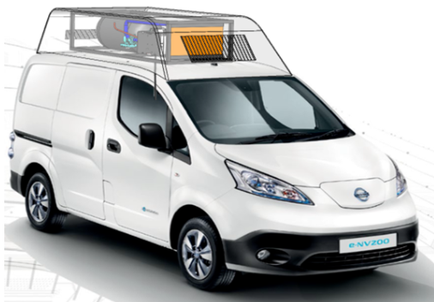
FCEV Range Extended Vans
Renault Kangoo Z.E. Hydrogen
Renault Master Z.E. Hydrogen
Nissan e-NV200
Notes:
Symbio – Zero emission mobility solutions
En pruebas desde 2014, la tecnología de hidrógeno del Grupo Renault se ha desarrollado en colaboración con Symbio, filial del Grupo Michelin. Los vehículos están equipados con una pila de combustible extensor de alcance con 10 kW de energía eléctrica y térmica, lo que permite al renault Master Z.E. Hydrogen y Renault Kangoo Z.E. Hydrogen alcance a más de 350 km. Otra ventaja del hidrógeno es un tiempo de recarga de sólo 5 a 10 minutos. El hidrógeno se utiliza para responder a usos intensivos, no cubiertos por el vehículo eléctrico, especialmente para largas distancias a áreas suburbanas.

Slide 15
Switching to H₂
Conversion of standard diesel vehicles to
hydrogen/diesel dual-fuel (H2ICED®)
Range extension of electric vehicles
(FC Rx power module)
Emission reductions
 | Diesel Only | ECO Mode
CO₂ | 250 g/km | 75 g/km
From Light to Heavy Commercial Vehicles

Slide 16
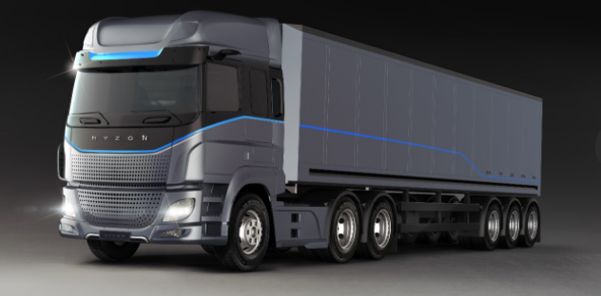
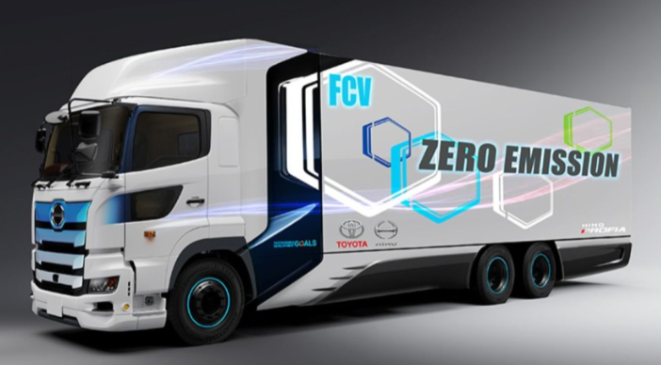
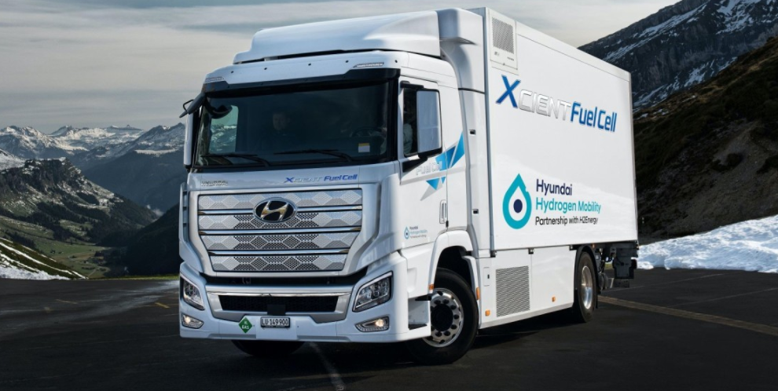
FCEV Trucks
Hyzon Hydrogen Heavy Truck
Toyota Hino Profia FC
Hyundai Xcent Fuel Cell

Slide 17
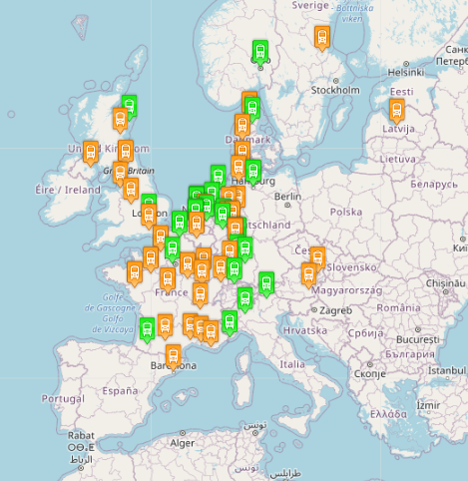
FCEV Buses
Source:
Fuel Cell Electric Buses

Slide 18
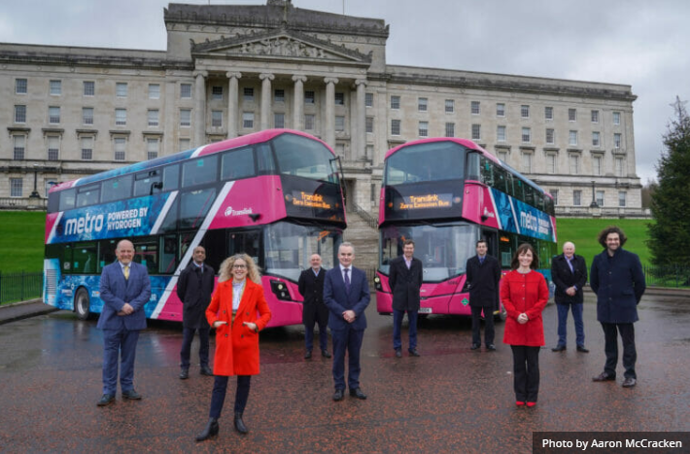
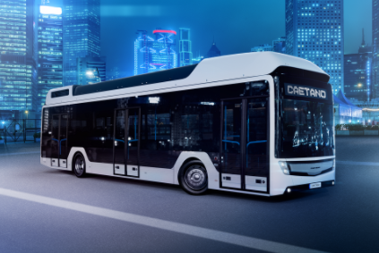
FCEV Buses
GenComm Project
3 double-decked hydrogen buses for urban service in Northern Ireland
Caetano Bus
H2. City Gold: latest development (2019) Long range bus, up to 400 km

Slide 19
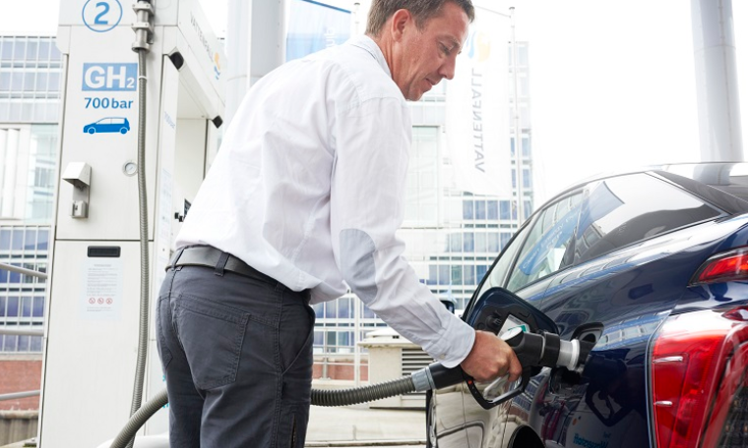
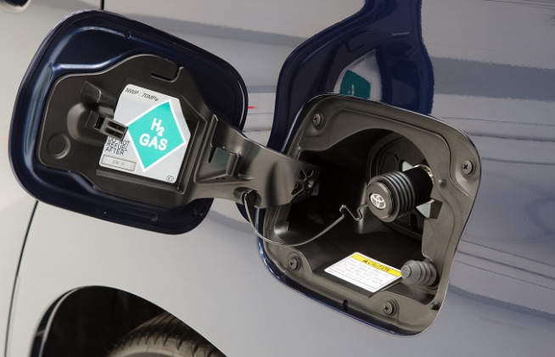
Refuelling with Hydrogen

Slide 20
Benefits of H₂ applied to road transport
Environmental Benefits
No toxic tailpipe emissions
Operational Benefits
Compliance with regulations
Noise reduction
GHG emission reductions
Lack of vibration
Long range
Short refuelling time
Smooth driving experience
On low-carbon mobility
On air quality
Reduction of vulnerability to fossil fuel imports
Storage solution to volatile local renewable energy that can be used as a fuel
Production of new local jobs and improvement of economic competitiveness

Slide 21
Case Study - Tenerife
Land area: 2,034 km²
Population: 928,000 inhabitants (2020)
Tourists: 5.6 millions (2019)
RAC: almost 30,000 vehicles (2018)
TENERIFE Highways | Number | Total distance (km)
TOTAL | 129 | 1,196.16
Motorways and dual carriageways | 5 | 176.82
First level autonomic highways | 18 | 465.87
Third level autonomic highways | 106 | 553.47
Vehicle type | Number
Sedan | 2
Minivan | 9
Van | 5
Jeep | 1
Light truck | 6
Medium & Heavy truck | 5
Forklift | 4
Crane | 1
TOTAL Vehicles | 33
ITER Vehicle Fleet
HRS at ITER facilities
Notes:
Utilising hydrogen to increase coastal sustainability

Slide 22
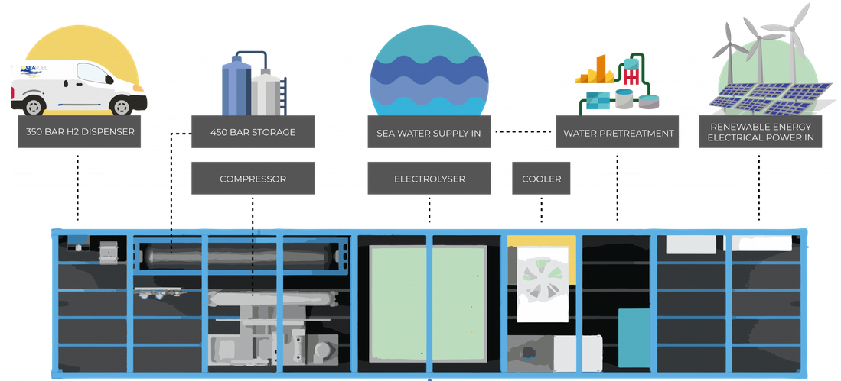
Case Study - Tenerife
HRS at ITER facilities in Tenerife (Canary Islands)
Water consumption
150 litres/day (maximun)

Slide 23
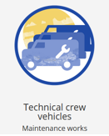
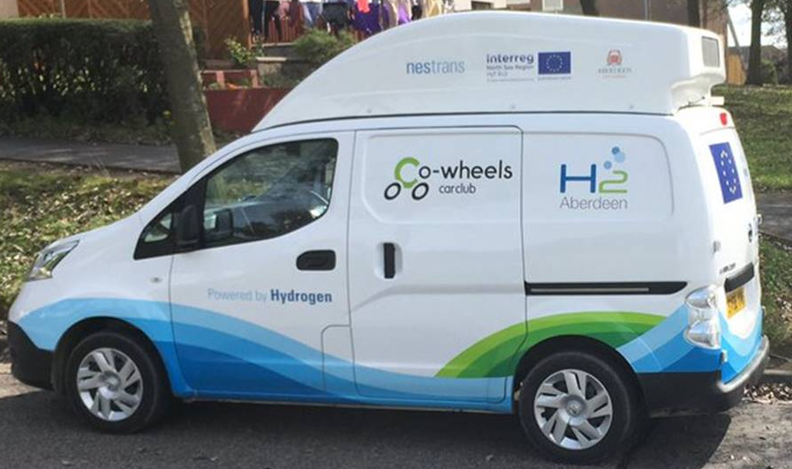
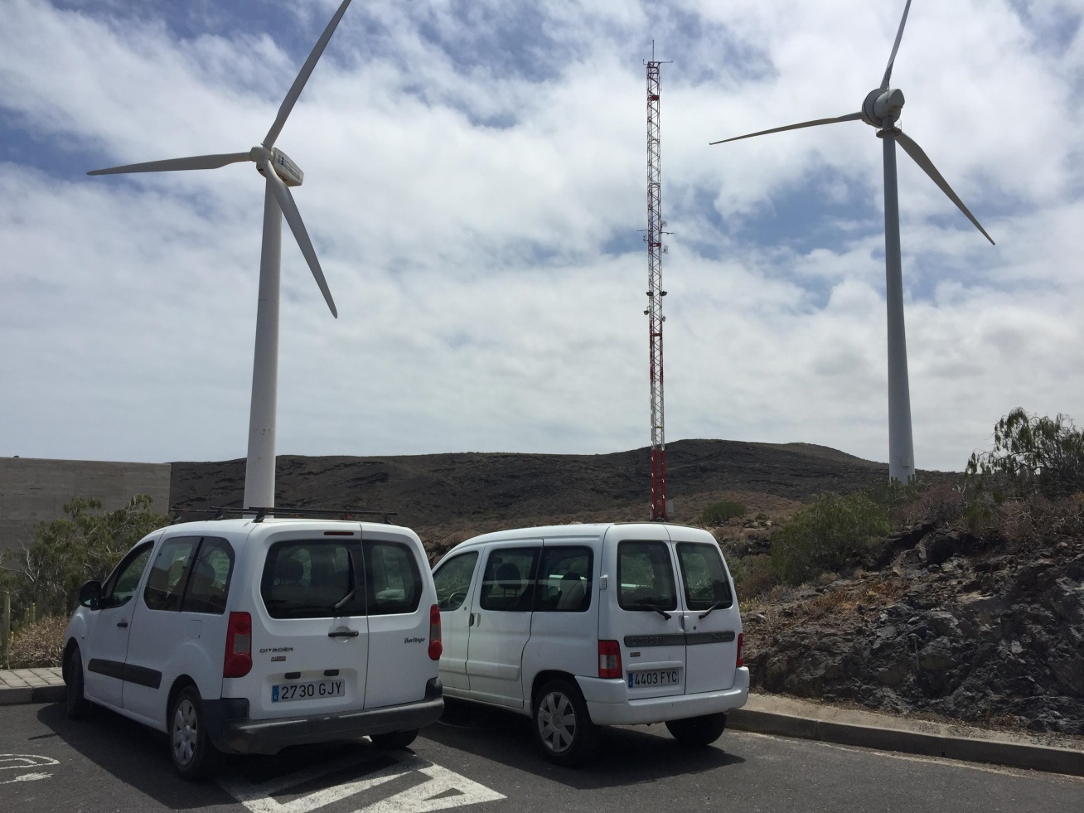
Case Study - Tenerife
Conversion of 3 diesel-fuelled vans for partial replacement of ITER’s fleet by Logan Energy

Slide 24
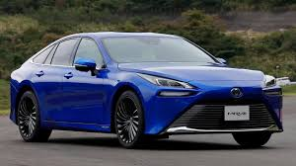
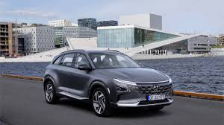
Case Study - Tenerife
Trial of Hyundai Nexo and Toyota Mirai for testing driving experience and survey on tourist acceptance
Toyota Mirai
Hyundai Nexo

Slide 25
THANKS
For Your
Attention
Notes:
25

