Slide 1









Hydrogen Aviation
Ian Williamson
HyEnergy Consultancy
18th February 2021
Notes:
1

Slide 2






HyEnergy
A specialist hydrogen energy company
  Unite the hydrogen and energy communities
  Create interconnected sustainability projects
  Ensure systems and technologies gain commercial acceptance by delivering low cost, clean, onsite energy solutions
  We work with a variety of stakeholders
    industry, regional public sector organisations and national governments
Our projects include:
€130m+
of funding and investments secured
30
Key Customers
50
Years of H2 Sector Experience
Notes:
2

Slide 3
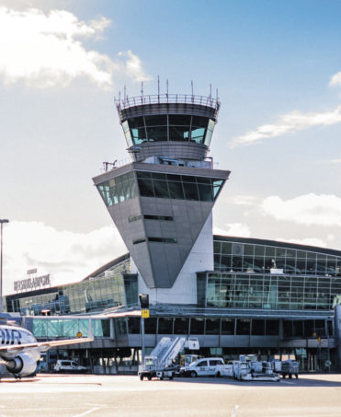
Why Is Making Aviation Clean Important?
To reach EU targets all modes of transport must decarbonise
Aviation contributes growing
  3% of the global CO₂ emissions, and 12% of all transport
No concrete, scalable solutions exist today to decarbonization
New sustainable fuels are being developed…
Notes:
3

Slide 4
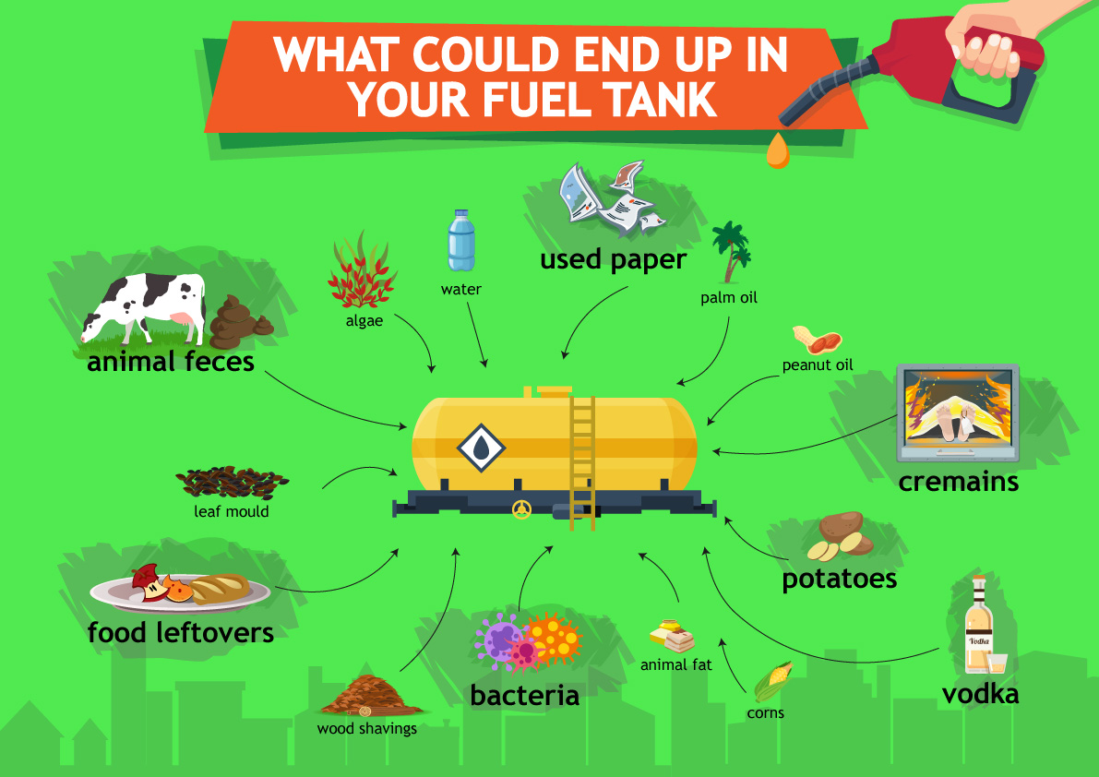
What Alternatives Exist?
Sustainable Aviation Fuels (SAFs)
Synthetic fuels (Synfuels)
Hydrogen produced from water has CO₂ added to it, usually recycled from industrial processes
Combining the CO₂ and H₂ can result in synfuels such as gasoline, diesel or kerosene
Biofuels
Can be produced from plant sources such as crops, algae, tallows and waste oils
Resulting in a net neutral/loss of CO₂
All still pollute at point of use
…so how about hydrogen?
Notes:
4

Slide 5
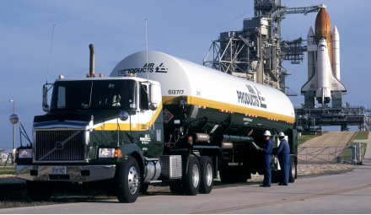
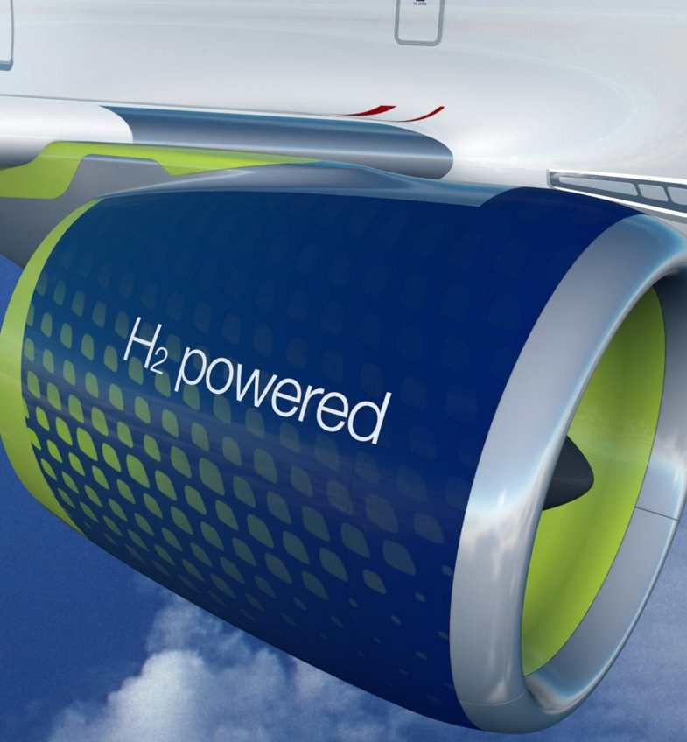
Is Hydrogen an Option?
Alternative energy sources such as Hydrogen propulsion have been around for a long time….and have incredible future potential
As with many fuel cell applications, zero emissions at point of use is key
What are the barriers?
Commercial hydrogen aircraft need to be developed
Large scale infrastructure changes are required to enable hydrogen’s use
As we see in many areas, hydrogen will not be the only solution to sustainable mobility - SAF decarbonisation routes are required to achieve 2050 goals
BUT we have first proof of concepts today and companies like Airbus saying hydrogen aviation WILL be developed…
Notes:
5

Slide 6
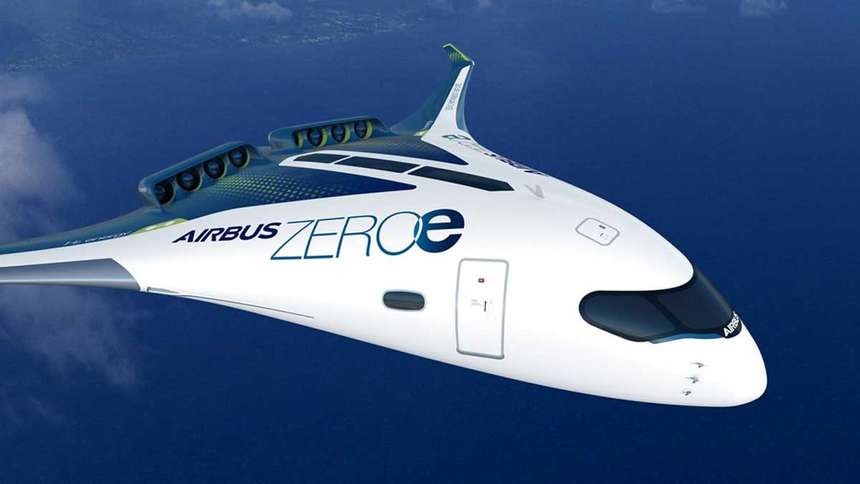
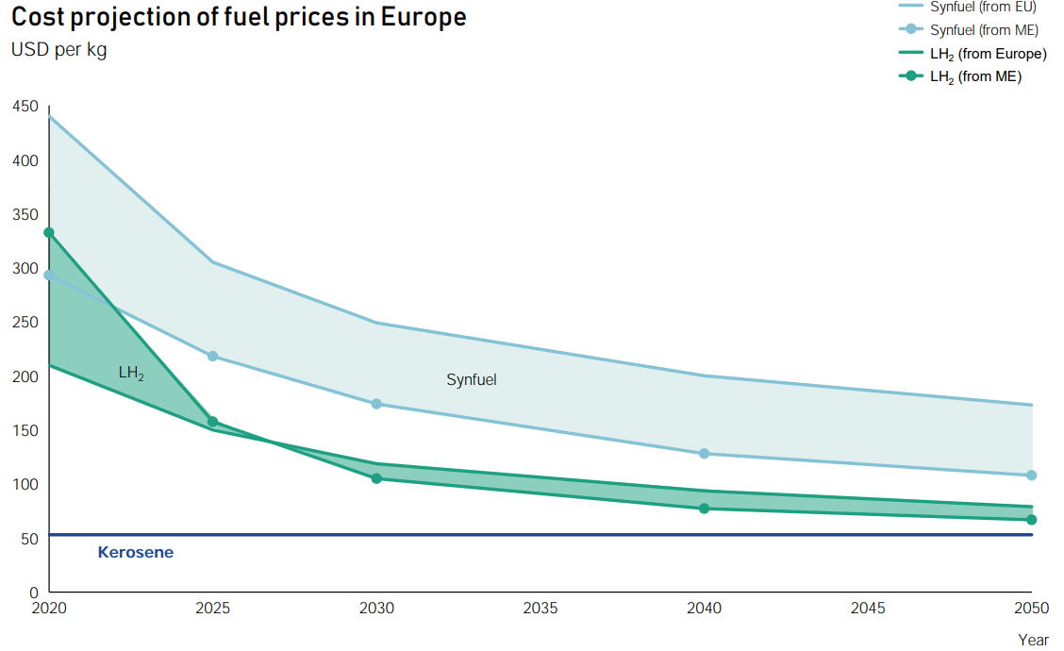
Is Hydrogen an Option?
So, will hydrogen be cost effective…?
All sustainable alternatives are projected to be more expensive…
Hydrogen costs could approach those of fossil fuels when mature…
Notes:
6

Slide 7
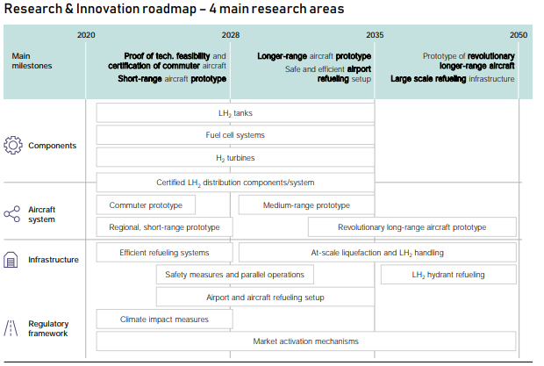
Where Do We Start?
Components such as light weight liquid hydrogen tanks, hydrogen turbines and FC systems are being researched and adapted Different sized aircraft are being developed
  Small regional planes with transition first
  Commuter prototypes are on the horizon
  Long range aircraft further off / might follow a different sustainability pathway (SAFs)
Infrastructure funding and policy will need to adapt ASAP to entice action
Notes:
7

Slide 8
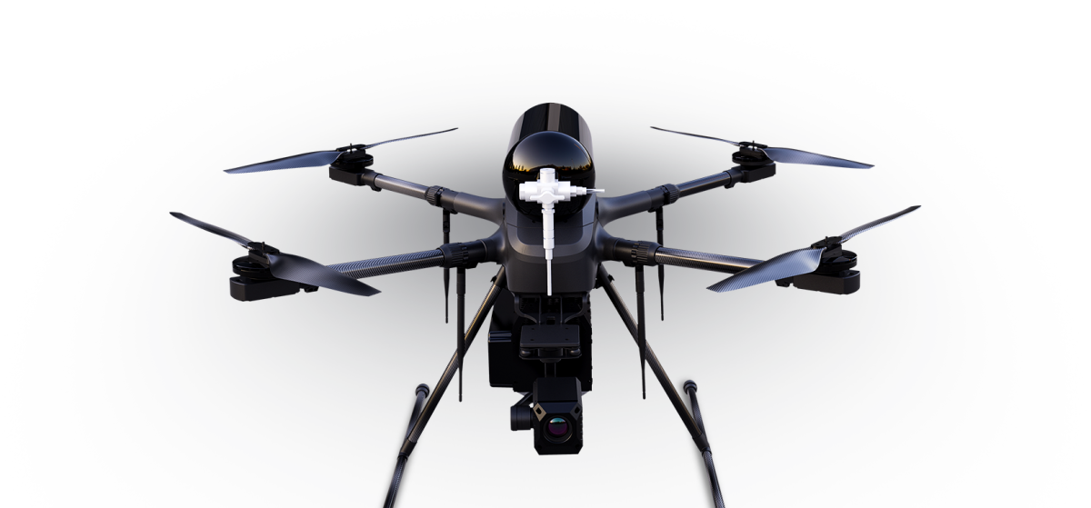
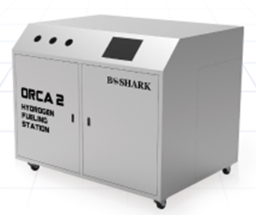
First applications: Hydrogen UAVs
Technology Status
Drones setting the hydrogen pace…
The UAV industry has already developed many hydrogen drones that are in use today
Lightweight FC developments allow longer flight times delivering multiple day flight times for LHY powered systems
Many applications – agriculture, military, remote deliverys
Refuelling:
Mobile refuelling units developed if multiple charges needed
Drop and swap of used to full hydrogen tanks from companies such as Doosan if the hydrogen usage is known
Notes:
8

Slide 9
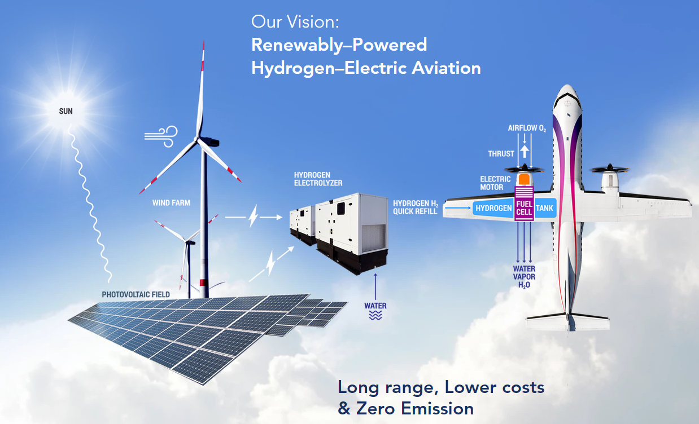

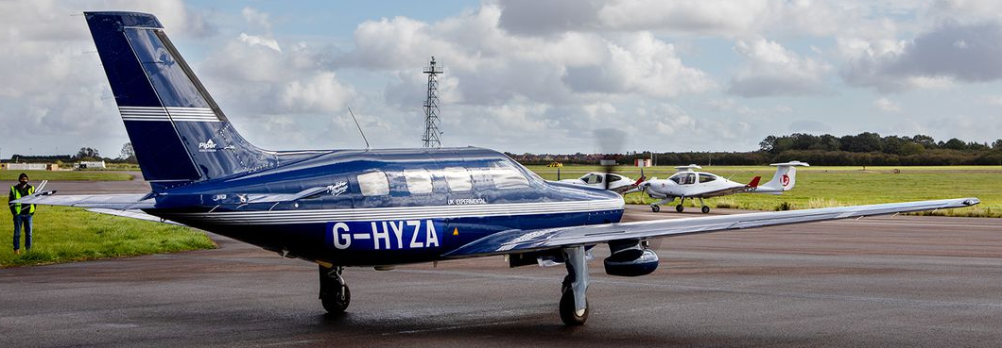

ZeroAvia
Use of solar and wind power to produce green hydrogen to power its fuel cell driven aircraft
HyFlyer demo to deliver a 300mile zero emission flight
10-20 seat fixed wing demonstrator aircraft
Notes:
9

Slide 10
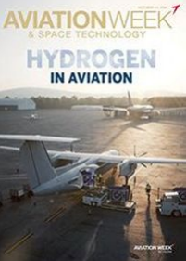
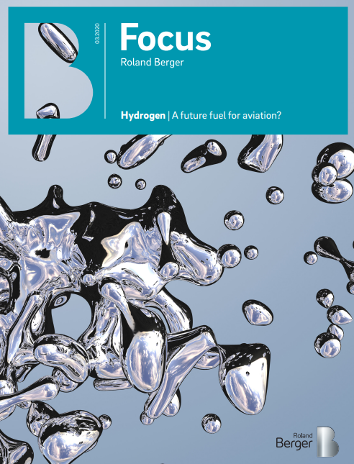
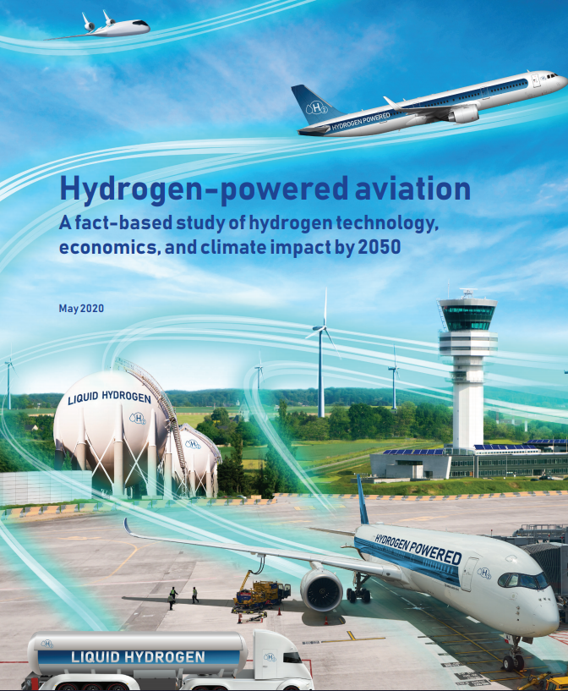
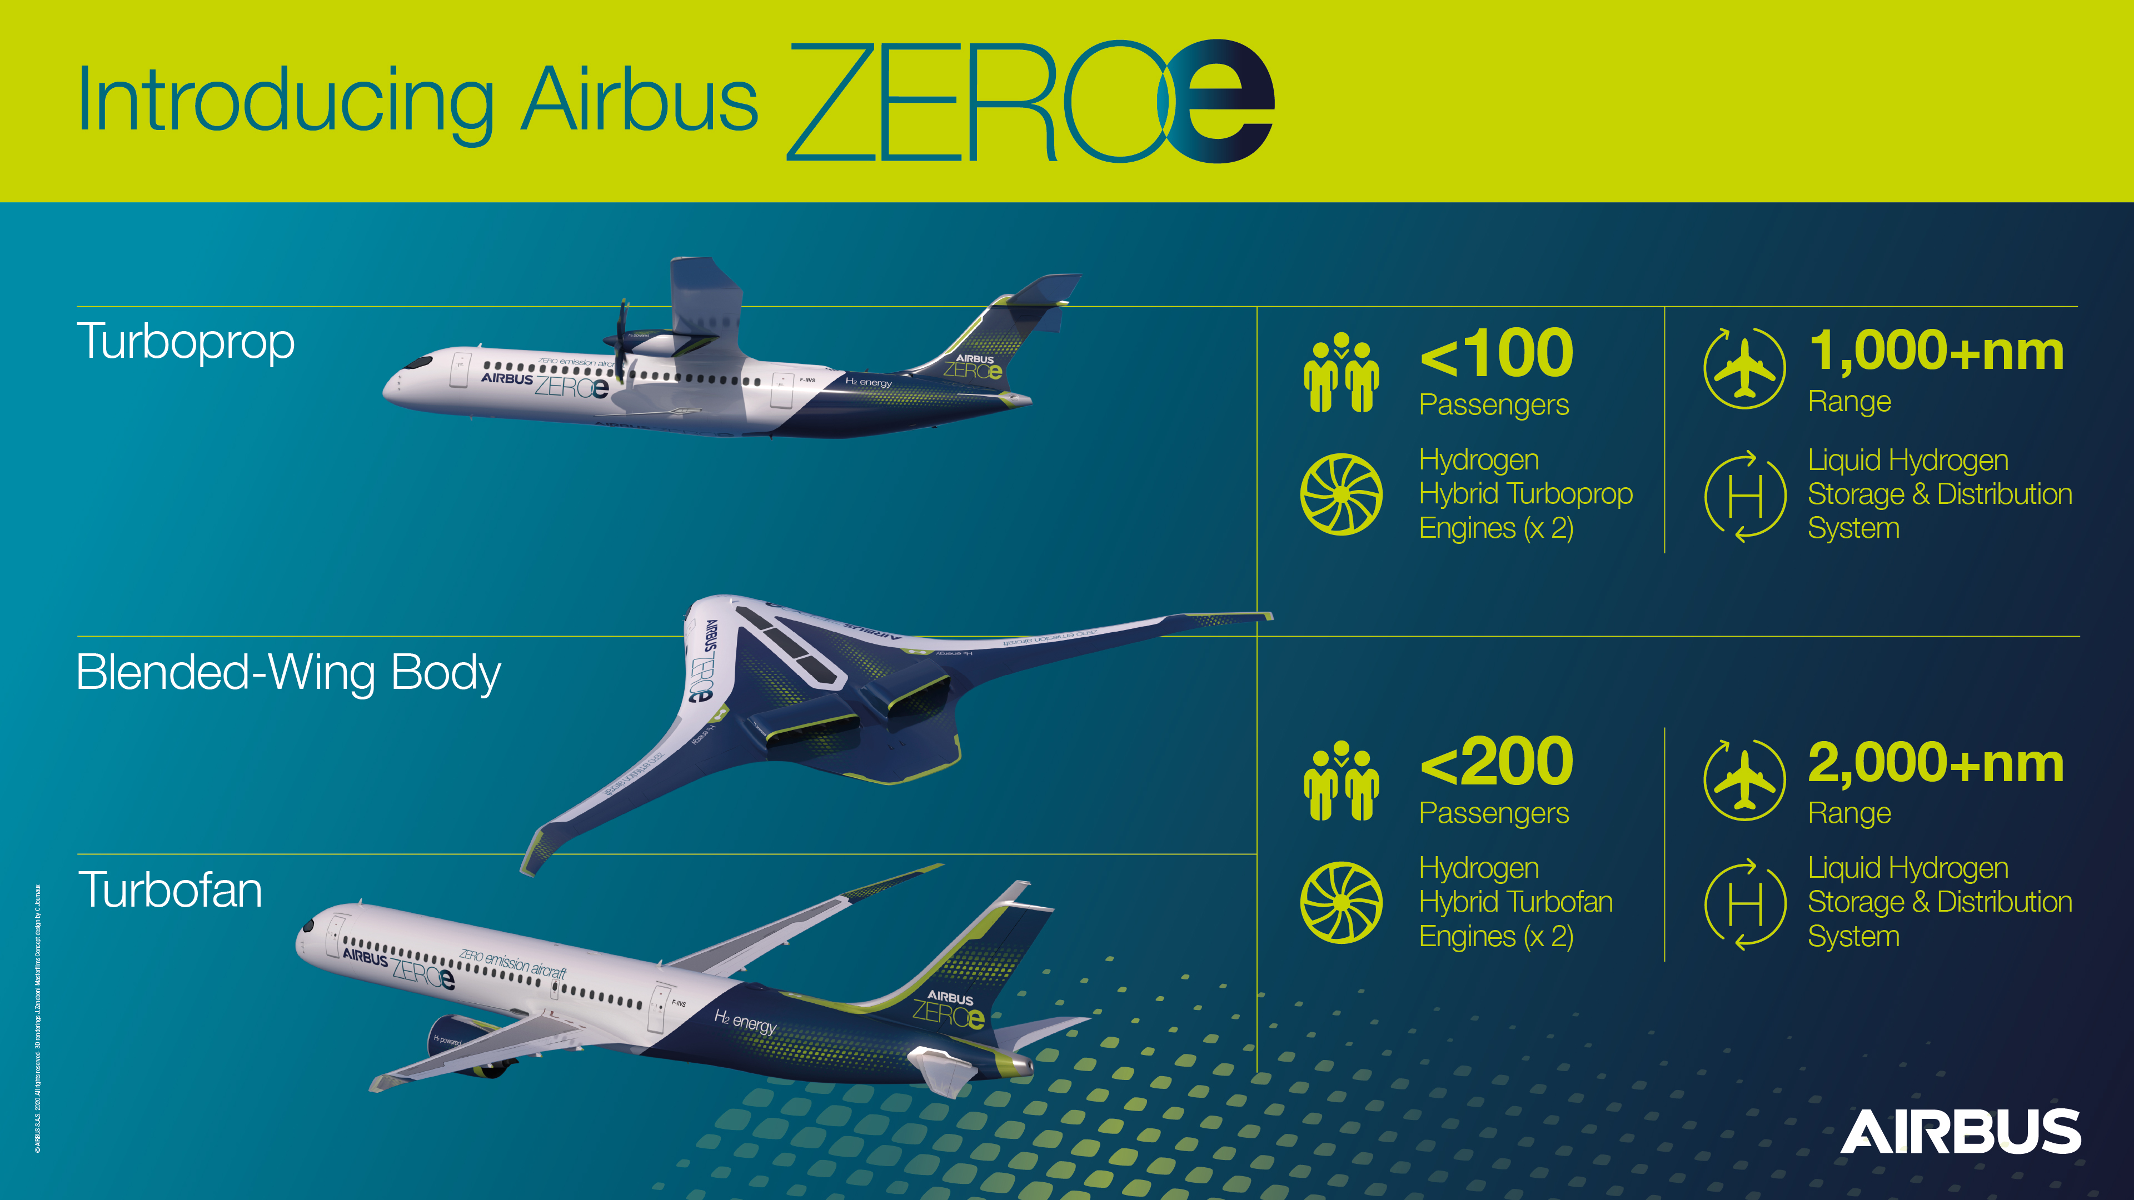
Hydrogen Powered Aviation
Momentum building….
Three aspects are required for success:
  A sector roadmap to guide the transition
  Step-up research & innovation activity and funding
  A long-term, regional and global policy framework
Notes:
10

Slide 11

Enable H2
Demonstrate the switching to hydrogen is feasible
R&D into advanced airframes and propulsion systems
Quantify the life cycle emission and cost benefits of LH₂
Deliver a comprehensive safety audit for LH2 hazards
Alleviate perceived public/industry concerns with LH2
Provide comprehensive roadmaps for the introduction of LH2
Notes:
11

Slide 12
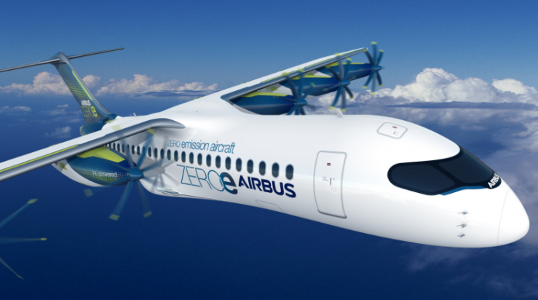
Vision: aircraft
We know cabin power needs can be run on hydrogen as a starting point
Smaller regional aircraft will be the first to fly on gaseous hydrogen
Expansion to short and medium range aircraft after liquid hydrogen refuelling and concepts are fully proven
Acceleration as EU and governments push tightening emissions legislation
Notes:
12

Slide 13
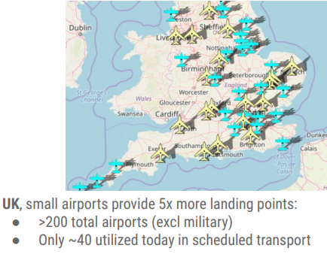
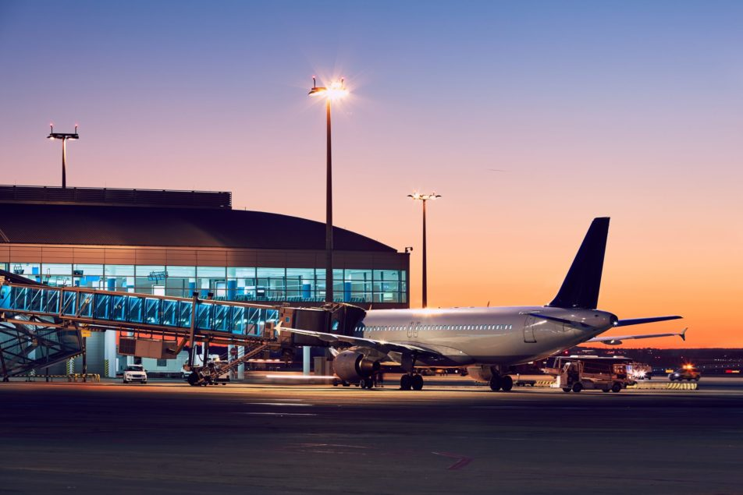
Vision: Airports
  Regional and smaller airports will lead the way; opening distributed air travel once again
  Large airports are likely to need their own infrastructure and be interconnected via hydrogen pipelines
  Large infrastructure and storage systems to be developed, refuelling infrastructure designed and installed
  Airside supply, initially via trucks
  Act as supply hydrogen supply hubs for local region
Notes:
13

Slide 14

Vision: funding
Through the Horizon 2020 ‘Green Deal’ the EU has made millions available
Targets decarbonisation of high use transport hubs, such as air and seaports
The projects should be large scale, real-life high TRL demonstrations of green airports
French hydrogen plan has hydrogen aviation as a strategic area
UK funding for a 100 seat zero emission jet by 2030
More coming every day…
Notes:
14

Slide 15

What is going to happen next?
Hydrogen aviation is coming to an airport near you…
Regional and community airports can be at the forefront of this fuel transition
First movers are already positioning
Funding is being made available
…final call for the first hydrogen aviators…
Notes:
15

Slide 16
Thank you for listening…
Ian.Williamson@hy-energy.co.uk
Notes:
16

