Slide 1
The Community Hydrogen Forum and Decision Support Tool
Dr Rory Monaghan, NUI Galway
18th February 2021
Hydrogen Triple Alliance Webinar

Slide 2
Overview
The Renewable Hydrogen Opportunity for Communities
The Community Hydrogen Forum
The CH2F Decision Support Tool
The Next Steps

Slide 3
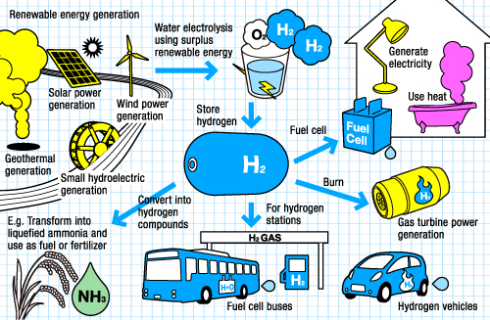
The Renewable Hydrogen Opportunity for Communities
Energy security
Reliable emissions free transport, heat and power
Long-term energy storage
Reduced fossil fuel use
Local investment
New clean industries
Hi-tech employment
Community development
http://www.thinktheearth.net/thinkdaily/report/2010/08/rpt-53.html#page-2
How can communities recognise and take the H₂ opportunity?

Slide 4
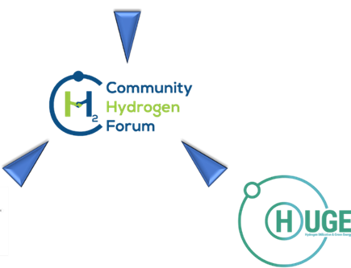
The Community Hydrogen Forum
Hydrogen insights
Hydrogen links
Hydrogen case studies
Hydrogen forum
Decision support tool
Hydrogen networking

Slide 5
The Community Hydrogen Forum Overview
Platform designed to help everyone understand the opportunities renewable hydrogen technologies offer in Europe.
Intended to be a forum for national, regional, and local governments, energy agencies, community development groups, energy cooperatives, educational institutions, renewable energy developers, transport sectors, and grid operators.
Any stakeholder from Northwest Europe, the Atlantic Area or the Northern Peripheries and Arctic is encouraged to participate as a member.
http://communityh2.eu/

Slide 6
The Community Hydrogen Forum Objectives
To raise awareness of the potential of hydrogen in sustainable community development, decarbonisation, and energy security.
To offer a forum to share information, experience and best practice of how communities and projects are deploying hydrogen across Europe.
To provide an up-to-date, informed resource for hydrogen information and case studies.
To provide access to a unique Decision Support Tool (DST) to assist in evaluating how hydrogen technologies can be deployed in individual scenarios.
To play a role in developing long term strategies for the advancement in adoption of hydrogen technologies.
http://communityh2.eu/

Slide 7
The Community Hydrogen Forum A tour of the website
http://communityh2.eu/

Slide 8
Decision Support Tool
Where can I learn about hydrogen opportunities?

Slide 9
Decision Support Tool
Decision Support Tool
Curtailed renewable energy sources
Hydrogen could make sense for my community, organisation or company.
But how do I make it happen?
How do I find a hydrogen source or market?
Energy demands
Where can I learn about hydrogen opportunities?
Industry
Wind Energy
Mobility
Solar Energy
AD Plant
Stationary Energy

Slide 10
Decision Support Tool
Decision Support Tool
Curtailed renewable energy sources
Hydrogen could make sense for my community, organisation or company.
But how do I make it happen?
How do I find a hydrogen source or market?
Energy demands
Where can I learn about hydrogen opportunities?
How do I take the next steps?
How do I connect with others across Europe?
Industry
Wind Energy
Mobility
Solar Energy
AD Plant
Stationary Energy

Slide 11
The Decision Support Tool What is it?
Supports stakeholders to evaluate the potential of hydrogen in:
sustainable community development
Decarbonisation
energy security
Achieves this by demonstrating the role of hydrogen produced at onshore wind farms with battery storage and PV arrays in decarbonising public bus fleets in large cities across the region
Visualised in an online interactive map of Europe

Slide 12
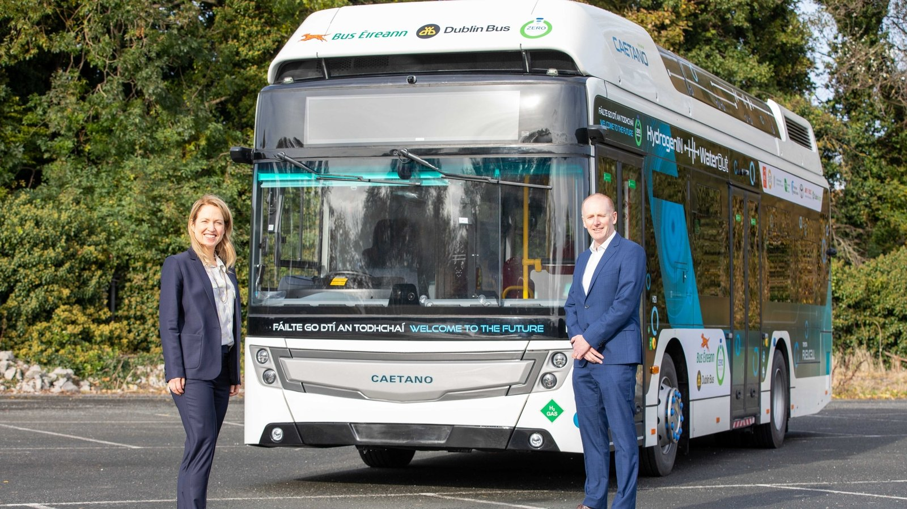
The Decision Support Tool Why city buses?
Hydrogen fuel cell city buses are now on sale commercially
They provide a large, predictable, centralised hydrogen demand
Fuel cell buses or fleets operate in Aberdeen, Belfast, Dublin, London, Seoul, Tokyo, and many other cities
CaetanoBus & WrightBus offer single-and double-decker FCEV buses
Dublin Caetano FCEV bus trial, Nov 2020
https://www.rte.ie/news/business/2020/1111/1177483-cie-group-partners-in-hydrogen-fuel-cell-bus-trial/
Belfast WrightBus FCEV bus deployment, Dec 2020
https://www.belfasttelegraph.co.uk/news/northern-ireland/translinks-hydrogen-powered-buses-enter-service-in-northern-ireland-39872290.html

Slide 13
The Hydrogen Tools of the Community Hydrogen Forum
Hydrogen Tools
Decision Support Tool (DST)
(National/City)
Biomass-derived Hydrogen
(National)
Wind Hydrogen Bus
(City)
Simplified Decision Support Tool (SDST)
(National)
Solar-Wind Hydrogen Bus
(City)

Slide 14
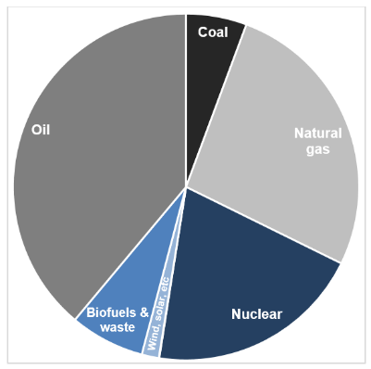
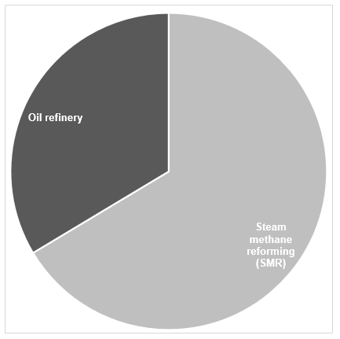
The Simplified Decision Support Tool (SDST) Energy & hydrogen outlook for Belgium
What Are the Primary Energy Sources in My Country?
This figure shows the percentage share of total primary energy supply (TPES) by energy source. It can be seen that 71% of the Belgian energy demand are supplied by fossil fuels (coal, natural gas and oil). Renewable energy contributes to nearly 9% of the total energy supply. Renewable includes wind, solar, hydro, biofuels & waste.
How Is Hydrogen Produced in My Country?
The pie diagram illustrates the percentage share of total hydrogen capacity by process production. The figure shows the hydrogen has been produced and consumed in Belgium. In fact, most of hydrogen is generated from fossil fuels via steam methane reforming (SMR). The rest of hydrogen is extracted in oil refinery. In the near future, renewables can also be potential energy sources for hydrogen production.
Reference
International Energy Agency (IEA). Total primary energy supply in Europe. 2017. https://www.iea.org/regions/europe
Hydrogen Tools. Merchant Hydrogen Plant Capacities in Europe. Hydrogen Analysis Resource Center. 2015. https://h2tools.org/hyarc/hydrogen-data/merchant-hydrogen-plant-capacities-europe

Slide 15
The Decision Support Tool - Biomass-derived H₂ How to Produce Hydrogen from Biomass?
Biomass Resources
Agricultural Residues
Organic Waste
Animal Manures
Sewage Sludge
Vegetable
Oil
Biological
Thermochemical
Chemical
Anaerobic
Alcoholic
Gasification
Pyrolysis
Transesterification
Biogas
Ethanol
Synthetic gas
Bio-oil
Biodiesel
Steam reforming, partial oxidation, and autothermal reforming
CO₂ & H₂
Pressure Swing Adsorption (PSA)
Hydrogen
Reference
Dou, B. Hydrogen production from the thermochemical conversion of biomass: issues and challenges. Sustainable Energy & Fuels. Issue 2, 2019.
Milne, T.A. Hydrogen from Biomass. State of the Art and Research Challenges. National Renewable Energy Laboratory. Golden, USA. 2010.
IEA. The Future of Hydrogen. Seizing today’s opportunities. International Energy Agency (IEA).Paris, France. 2019.

Slide 16
The Decision Support Tool - Wind/Solar-based H₂ How it works
Annual energy demands for big city bus fleets
Hydrogen energy equivalent
Total hydrogen demand
Big city locations
Hydrogen supply chain
Wind farm locations
37 cities across North West Europe
4,252 wind farms across North West Europe
Total hydrogen supply
Optimal electrolyser size at every wind farm
Available curtailed wind
“Topped up” with grid electricity
Additional solar power & battery

Slide 17
The Decision Support Tool – Wind-based H₂ How it works
wind curtailment (%)
wind cap. factor (%)
wind farm cap. (MW)
Input
wind curtailment (MWh)
hydrogen production (kg/y)
opt. electrolyser size (MW)
Technical model
required water (kg/y)
required grid elect. (MWh)
CAPEX ($€$)
OPEX ($€$)
travel cost ($€$)
distance (km)
Economic model
production ($€$/kg)
transport ($€$/kg)
full operating cost relative to diesel

Slide 18
The Decision Support Tool – Solar-Wind-based H₂ How it works
wind curtailment (%)
wind cap. factor (%)
wind farm cap. (MW)
solar cap. factor (%)
Input
wind curtailment (MWh)
hydrogen production (kg/y)
opt. electrolyser size (MW)
battery size. (MWh)
PV size. (MW)
Technical model
required water (kg/y)
required grid elect. (MWh)
batt. elect. (MWh)
PV elect. (MWh)
CAPEX ($€$)
OPEX ($€$)
travel cost ($€$)
distance (km)
Economic model
production ($€$/kg)
transport ($€$/kg)
full operating cost relative to diesel

Slide 19
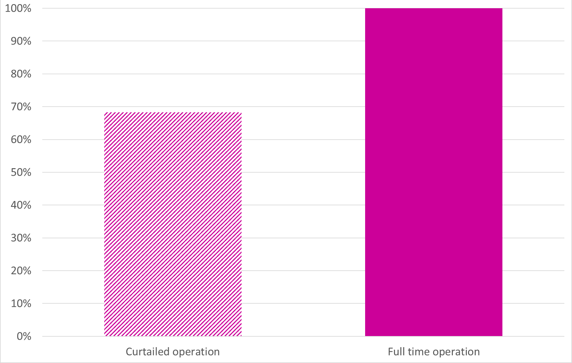
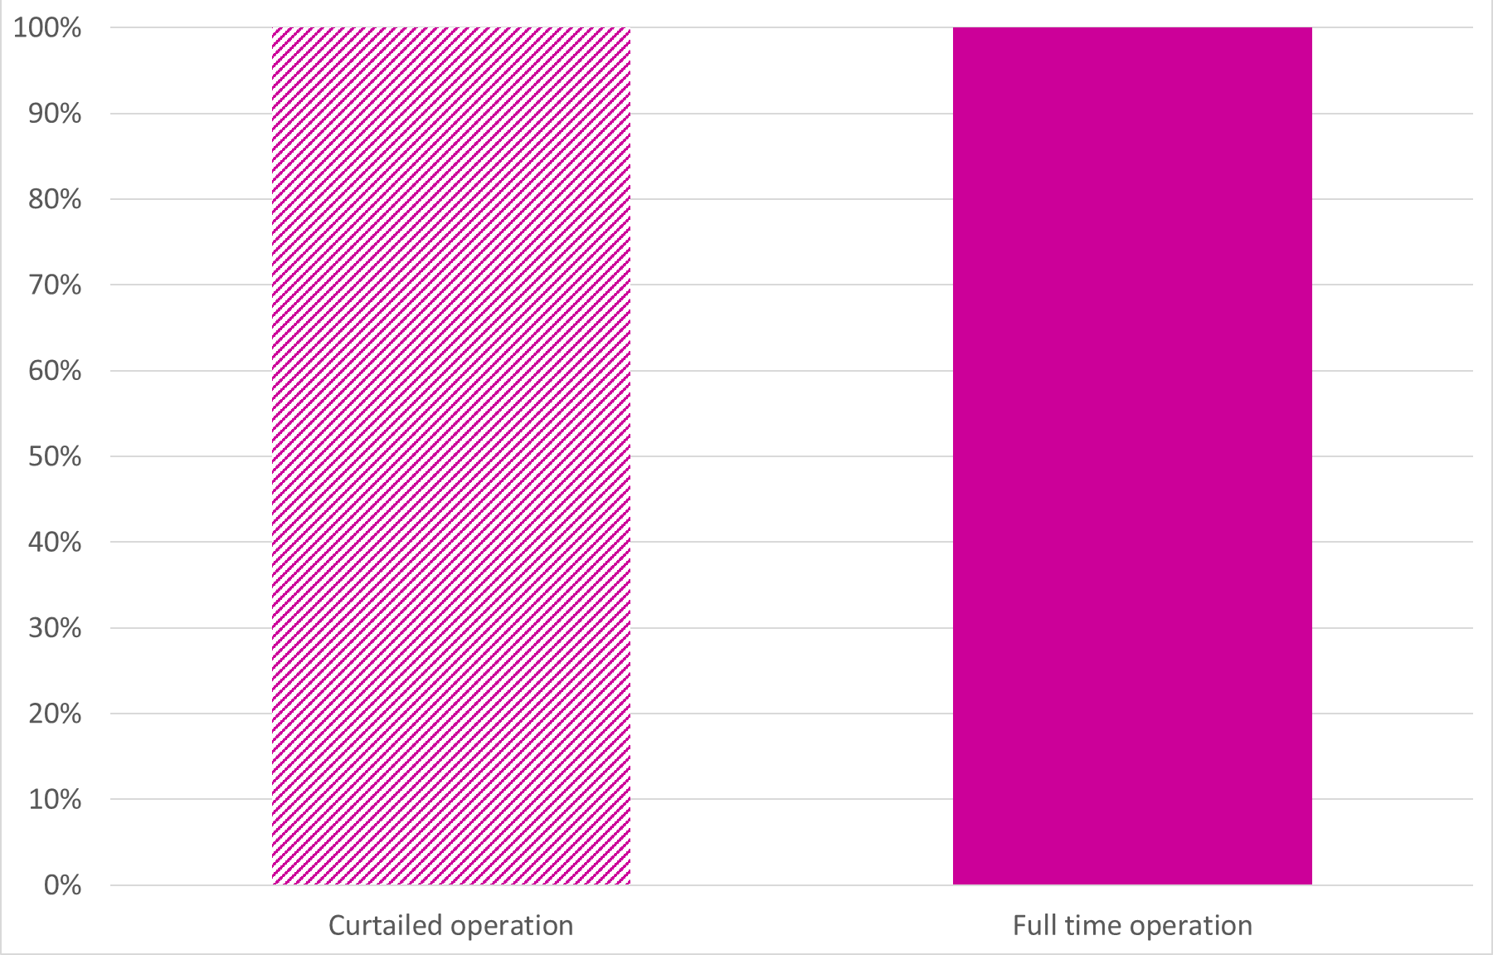
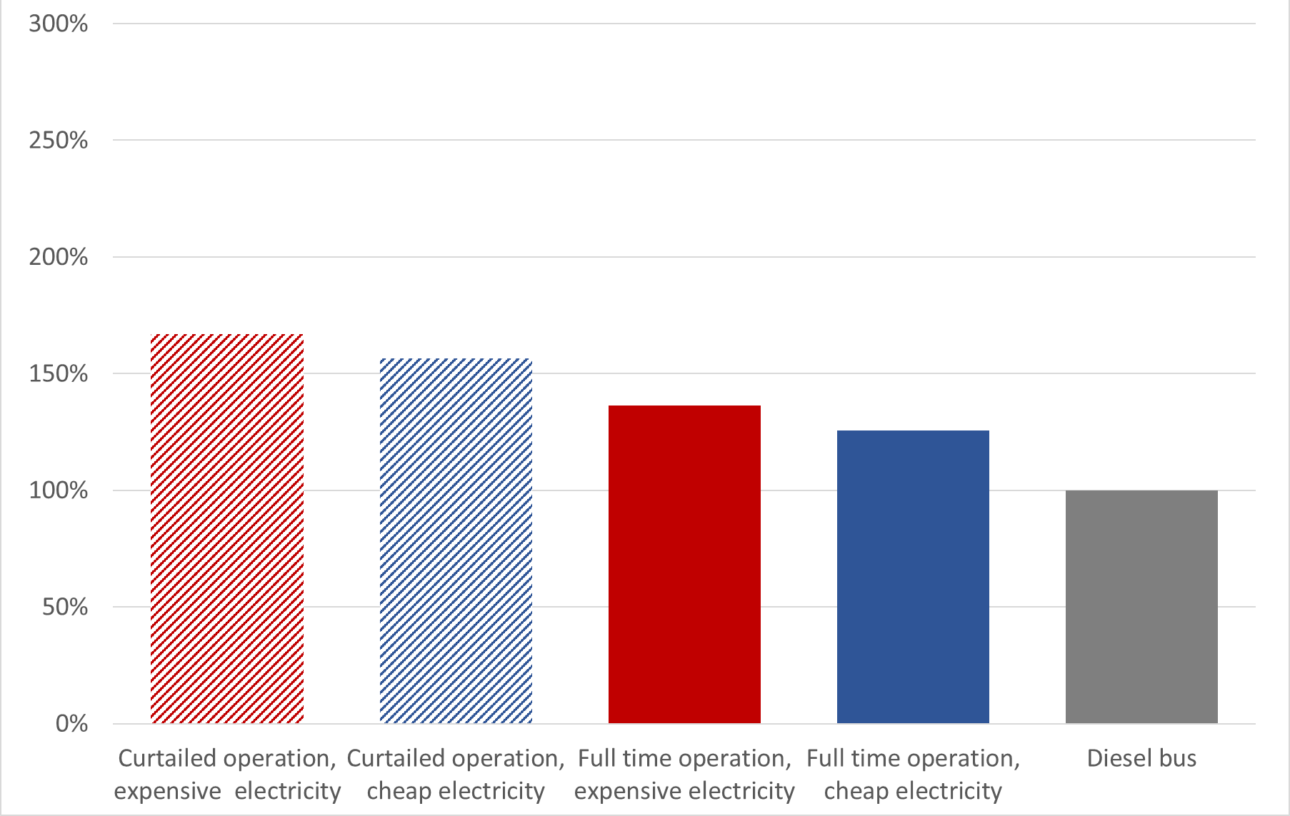
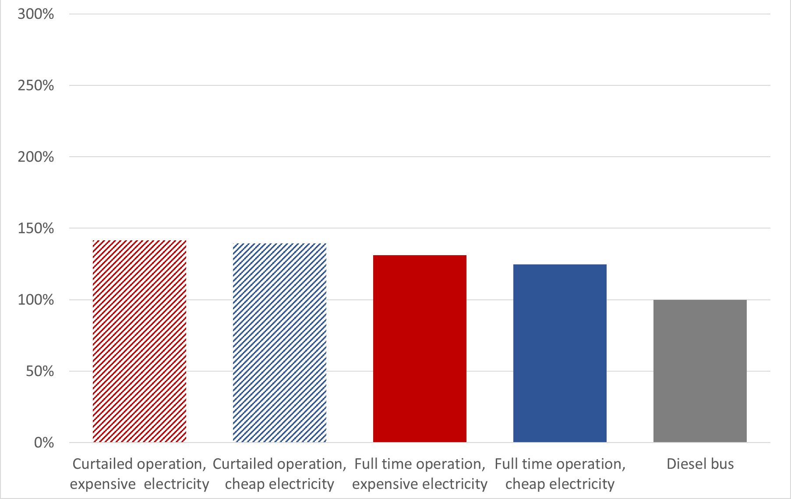
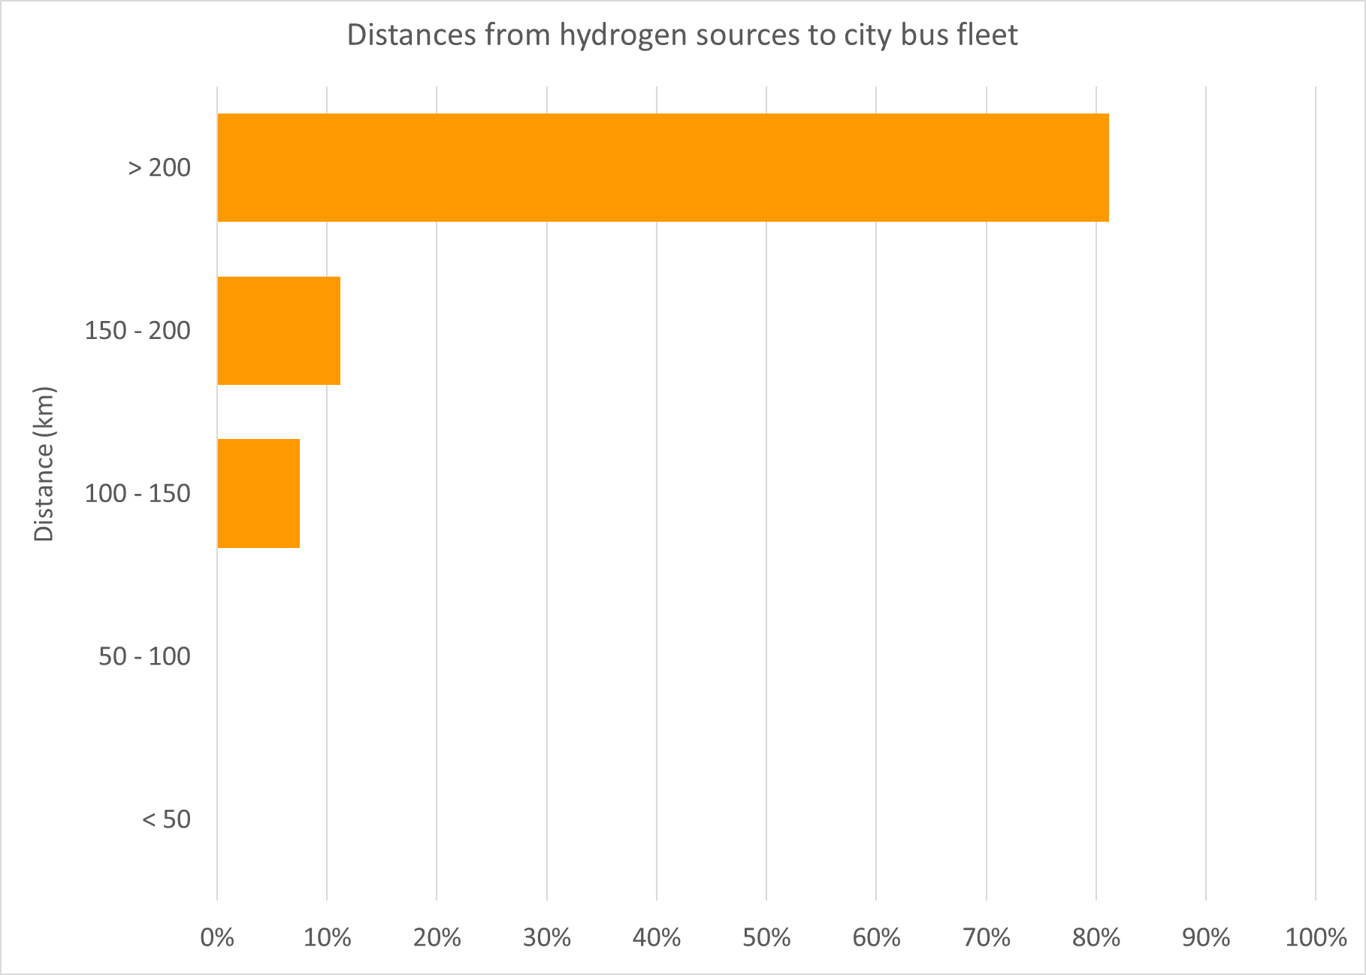
The Decision Support Tool Results for Dublin
Wind-only results
Wind+PV+battery results
The percentage of city bus fuel displaceable by renewable H2 for different electrolyser operation modes
The percentage of operational costs for hydrogen buses for different electricity prices and electrolyser operation modes, relative to diesel
Distances from hydrogen sources to city bus fleet

Slide 20
The Hydrogen Tools of the Community Hydrogen Forum
The hydrogen opportunity is here.
Will your community explore it?
http://communityh2.eu/dst-simple/
http://communityh2.eu/dst/

Slide 21
The Next Steps For potential hydrogen stakeholders
Go to http://communityh2.eu/ and register to join the Community Hydrogen Forum
Learn about the exciting community hydrogen projects underway across Europe
Explore your region’s renewable hydrogen potential using the DST
Contact the Community Hydrogen Forum at info@communityh2.eu to start taking the next steps to realise your community’s renewable hydrogen opportunity

Slide 22
Backup slides

Slide 23
Tour backup slides About us
http://communityh2.eu/about-us/

Slide 24
Tour backup slides Hydrogen insights
http://communityh2.eu/h2-insights/

Slide 25
Tour backup slides Links
http://communityh2.eu/

Slide 26
Tour backup slides Links – National hydrogen associations
http://communityh2.eu/links/

Slide 27
Tour backup slides Links – Some key EU projects
http://communityh2.eu/links/

Slide 28
Tour backup slides Hydrogen discussion forum
http://communityh2.eu/community/

Slide 29
Tour backup slides Decision Support Tool
http://communityh2.eu/dst/

Slide 30
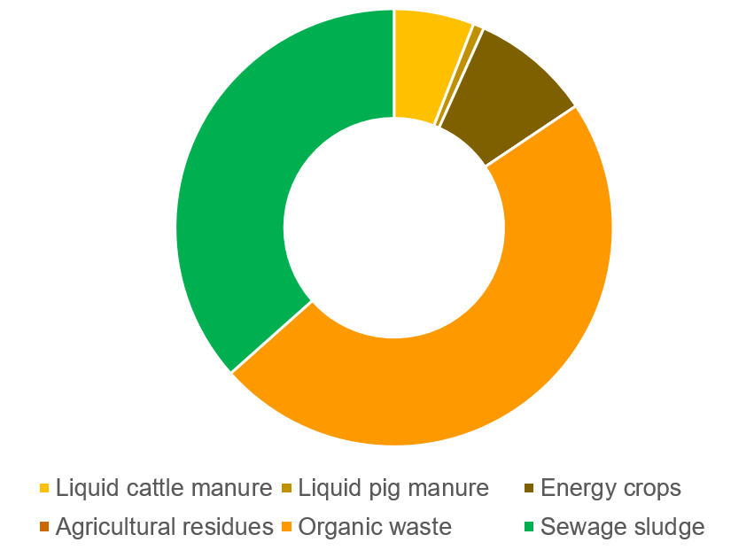
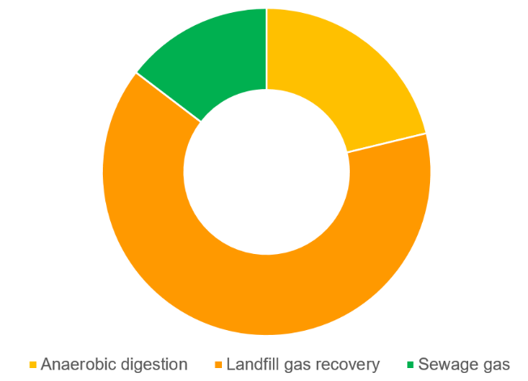
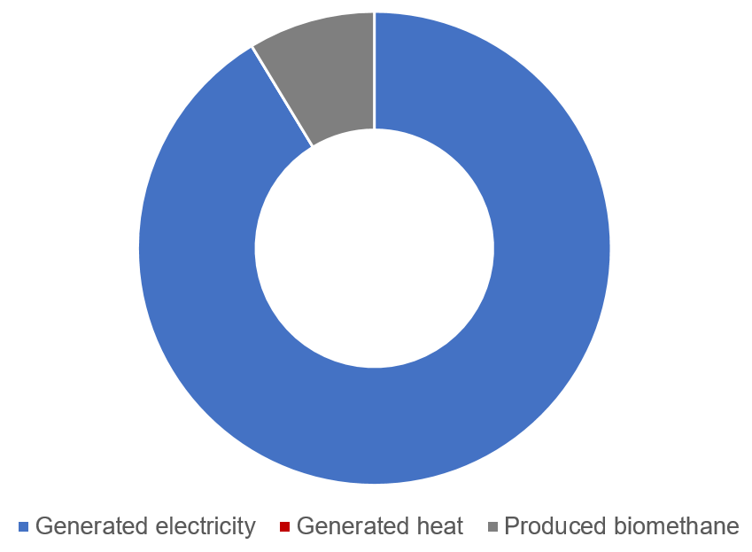
The Decision Support Tool - Biomass-derived H₂ Results for the United Kingdom (UK)
The percentage share of feedstock to produce biogas
This graph illustrates the portion of feedstocks to produce the entire biogas in the UK. As can be seen in the figure, nearly half of the entire biogas in the UK is produced from organic waste. Followed by sewage sludge and energy crops. Manures from pig and cattle have a small portion.
The percentage share of processes to produce biogas
The figure shows three anaerobic processes to produce biogas in the UK. It can be seen that more than 50% of the entire biogas in the UK is produced by land fill recovery. Anaerobic digestion and sewage gas are the second and third large contributors, respectively.
The percentage share of generated energy from biogas
This figure indicates how biogas is utilised in the UK. Most of biogas is used to generate power. A little portion of biogas is upgraded to biomethane.
Reference
European Commission, “Optimal Use of Biogas from Waste Streams” An Assignment of the Potential of Biogas from Digestion in the EU beyond 2020.
Scarlat, N. “Biogas: Developments and perspectives in Europe”. Renewable Energy. 2018.
European Commission, “Impact of the use of the biomethane and hydrogen potential on trans-European infrastructure”. 2020.
Banja, M. “Biomass for energy in the EU – The support framework”. Energy Policy. 2019.

Slide 31
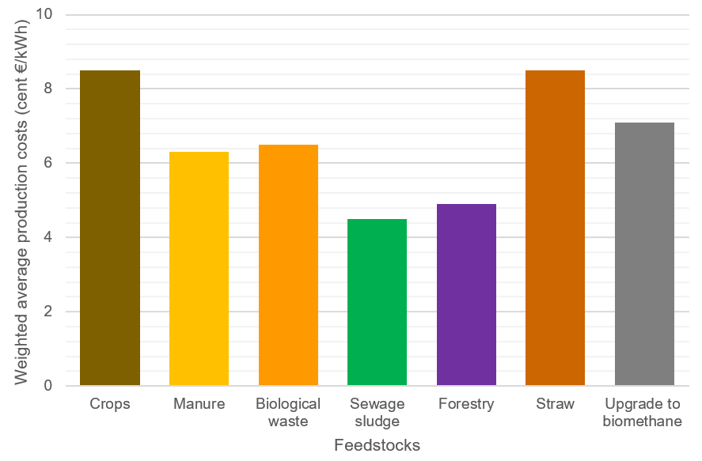
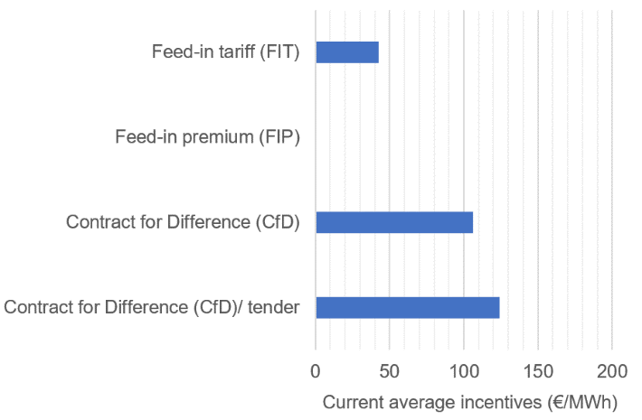
The Decision Support Tool - Biomass-derived H₂ Results for the United Kingdom (UK)
The weighted average production costs of biogas from various type of feedstock
The bar graph shows the average production cost of biogas from various type of feedstocks. Biogas produced from sewage sludge (coloured in green) has the lowest production cost compared to other feedstocks. The upgrading cost to biomethane is indicated at the last bar (coloured in grey).
The percentage share of processes to produce biogas
This figure informs the energy communities with regard to the available support scheme. In the UK, biogas production is supported by various schemes such as feed-in tariff, contract for difference and tender. The incentives vary from 40 to 120 €/MWh.
Reference
European Commission, “Optimal Use of Biogas from Waste Streams” An Assignment of the Potential of Biogas from Digestion in the EU beyond 2020.
Scarlat, N. “Biogas: Developments and perspectives in Europe”. Renewable Energy. 2018.
European Commission, “Impact of the use of the biomethane and hydrogen potential on trans-European infrastructure”. 2020.
Banja, M. “Biomass for energy in the EU – The support framework”. Energy Policy. 2019.

Slide 32
Tour backup slides DST Simple

