Slide 1
How Can Renewables Sustain Resilient Communities? Utilising hydrogen to increase coastal sustainability
18th February 2021
Notes:
1

Slide 2
AGENDA
10:00 - 10:15: The Hydrogen Triple Alliance - Introductory video. Welcome & Introductions, Paul McCormack, GenComm 10:15 - 10:35: Zero emission road transport, Irene García Fernández, SEAFUEL 10:35 - 10:55: Sustainable Maritime Transports, Avril Ní Shearcaigh, HUGE ​ 10:55 - 11:15: The opportunity for low carbon air transport, Ian Williamson, GenComm, SEAFUEL 11:15 - 11:35: The Community Hydrogen Forum CH2F, Dr. Rory Monaghan, GenComm 11:35 - 11:45: Interreg Directors - collaborating to meet Europe’s energy challenges 11:45 - 12:00: Q&A
Notes:
2

Slide 3
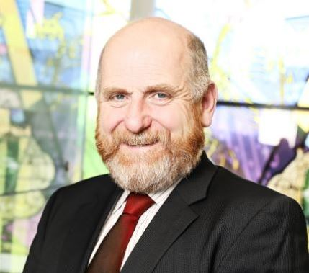
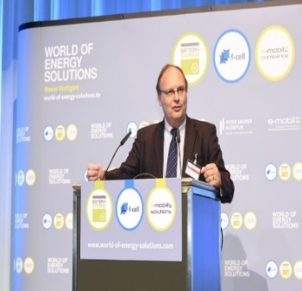
Webinar Presenters
Irene García Fernández,
SEAFUEL
Avril Ní Shearcaigh,
HUGE
Dr. Rory Monaghan,
GenComm
Ian Williamson,
GenComm, SEAFUEL
Paul McCormack, GenComm
Webinar Host & Presenter

Slide 4
Hydrogen Opportunity
The European Commission is committed to “tackling climate and environmental-related challenges that is this generation’s defining task”.
The EU has defined a set of strong measures aiming at achieving zero net greenhouse gases emissions by 2050 and decoupling economic growth from resource use. This decoupling creates sector-coupling activities in energy, transport and industry with Hydrogen as the energy vector.
Notes:
4

Slide 5
Green H2 why now?
The term ‘hydrogen economy’ was first used way back in the1970’s.
Despite several attempts it has never reached the energy starting gate.
There have been a number of ‘false starts’ in the energy race.
We are in the middle of a perfect storm that creates the correct conditions for a future role for green hydrogen.
The level of EU governmental commitment, the greater availability of cheap, renewable power, the climate crisis and energy security need are key differentiators.
Notes:
5

Slide 6
Community Engagement
The use of hydrogen as an energy fuel presents a plethora of technical, safety and regulatory challenges.
The attraction, particularly given current EU environmental tensions and commercial opportunity, is that it offers zero-emission operations - making it a mighty contender in the quest for shipping industry decarbonisation.
In the most optimistic outlooks, hydrogen could soon power trucks, planes and ships. It could heat homes, balance electricity grids and help heavy industry to make everything from steel to cement.
Notes:
6

Slide 7
The on Ramp for the Green H2 Highway
As Europe embraces the Green Hydrogen revolution many are confused and wonder how they can participate in the drive to a zero carbon destination.
The core rationale for green hydrogen is that it is as a clean energy alternative and is capable of tackling our huge C02 emission targets transportable energy storage system.
In order to make a just transition to a new green energy solution we must endeavour to leave no stranded assets. This includes communities, people and regions.
As we map out the hydrogen highway we must ensure there is an on-ramp for all to join.
The CH2F is this on-ramp, it is a forum for all to engage, be informed and inform and importantly allow people to appraise the opportunities for themselves.
​
Notes:
7

Slide 8
Green H2 where?
‘The challenge for us all is not a simple yes or no to hydrogen. It is where is the best place for us to use it and that will differ between communities, regions, and countries’.
Hydrogen has it’s place it is part of a hybrid energy solution and that place is different for us all.
Notes:
8

Slide 9
Audience Poll
What is the biggest hurdle in the hydrogen opportunity that communities need to overcome?
1. Lack of information
2. Lack of access
3. Lack of trust
4. Other (please specify)
To answer the question, please use the chat function.

Slide 10
Interreg Directors - Collaborating to Meet Europe’s Energy Challenges - Video
Notes:
10

Slide 11
Q & A
Notes:
11

Slide 12
Our upcoming webinars
Spring Series: March - May 2021
SMARTH2 - Hydrogen Optimisation - 10th March 2021
Green H2 Supply - 15th April 2021
Infrastructure & Storage - 29th April 2021
Demand and Use - 18th May 2021
Stakeholder Engagement - 27th May 2021

Slide 13
Social Distance Calling Card
SEAFUEL Project Website - seafuel.eu/the-project/
GenComm Project Website - nweurope.eu/gencomm
HUGE Project Website - huge-project.eu/
Community Hydrogen Forum – CH2F - communityh2.eu

