Slide 1

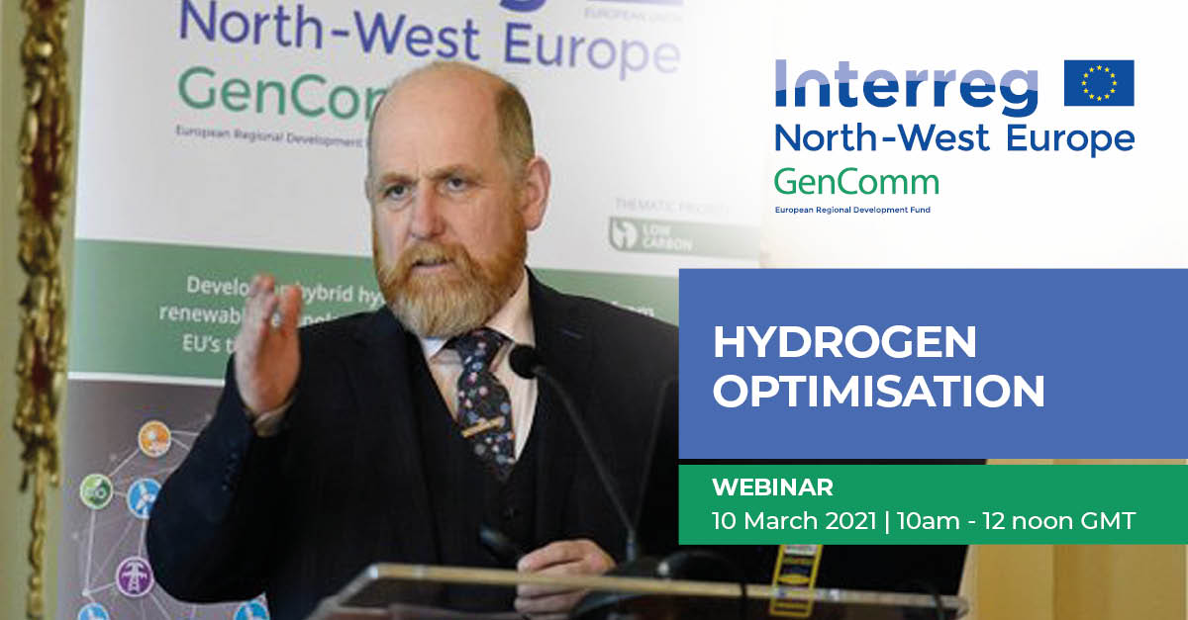
Welcome
Paul McCormack, Belfast Metropolitan College & GenComm
GenComm Spring Series of H₂ Webinars - Webinar 1: Hydrogen Optimisation

Slide 2
Audience Poll
Which area/sector is of particular importance for the commercialisation of Hydrogen technologies?
Industry
Mobility
Electricity
Heating
User Acceptance
To answer the question, please use the chat function.
GenComm Spring Series of H₂ Webinars - Webinar 1: Hydrogen Optimisation

Slide 3
Hydrogen
Long heralded as an alternative to fossil fuels, can Hydrogen really help solve the world’s dirtiest energy problems?
GenComm Spring Series of H₂ Webinars - Webinar 1: Hydrogen Optimisation

Slide 4
Green H2 Challenges
Green hydrogen (Green H2) — produced with renewable energy — is the energy sector’s great hope, but currently only accounts for about 1 per cent of global supplies.
Can it achieve efficiently and at a commercially viable price?
GenComm Spring Series of H₂ Webinars - Webinar 1: Hydrogen Optimisation

Slide 5
H2 Momentum
Since the 2015 Paris climate agreement, “low carbon hydrogen”, produced either without fossil fuels or by storing and capturing the emissions generated, is firmly on the agenda.
Governments adopting net zero targets are seeking ways to slash emissions from highly polluting sectors including heating, heavy industries like steel and transport.
There is significant momentum across the entire hydrogen value chain and it is accelerating cost reductions for hydrogen production, transmission, distribution, retail, and end applications.
GenComm Spring Series of H₂ Webinars - Webinar 1: Hydrogen Optimisation

Slide 6
H2 Rainbow
Green hydrogen Made by using clean electricity from renewable energy technologies to electrolyse water (H2O).
Blue hydrogen Produced using natural gas but with carbon emissions being captured and stored, or reused.
Grey hydrogen This is the most common form of hydrogen production. It comes from natural gas via steam methane reformation but without emissions capture.
Brown hydrogen The cheapest way to make hydrogen but also the most environmentally damaging due to the use of thermal coal in the production process.
Turquoise hydrogen Uses a process called methane pyrolysis to produce hydrogen and solid carbon.
Purple Hydrogen nuclear energy is used to produce hydrogen, It offers the advantage of lower CO2 emissions compared to electrolysis by natural gas.
GenComm Spring Series of H₂ Webinars - Webinar 1: Hydrogen Optimisation

Slide 7
SMART H2
The world is racing to scale up Green Hydrogen.
However as we scale up the use of GREEN H2 it must be done smartly and give us SMARTH2.
PRODUCTION
H2
CONVERSION
H2
DISTRIBUTION
H2
USE
TRANSMISSION
H2
GenComm Spring Series of H₂ Webinars - Webinar 1: Hydrogen Optimisation

Slide 8

Long heralded as an alternative to fossil fuels, can the gas really help solve the world’s dirtiest energy problems?
GenComm Spring Series of H₂ Webinars - Webinar 1: Hydrogen Optimisation

Slide 9
Legislation
The UK government’s legislation for net zero emissions by 2050 has changed the global energy landscape
The 2019 UK’s decision to become the first major economy to enshrine such a target in law has set a precedent.
GenComm Spring Series of H₂ Webinars - Webinar 1: Hydrogen Optimisation

Slide 10
SMART H2
Scaling up in green hydrogen has twin benefits:
it would replace the hydrogen produced from fossil fuels that it already uses at its refineries.
it would create new markets at a time when the long-term future of its core oil business is less certain.
GenComm Spring Series of H₂ Webinars - Webinar 1: Hydrogen Optimisation

Slide 11
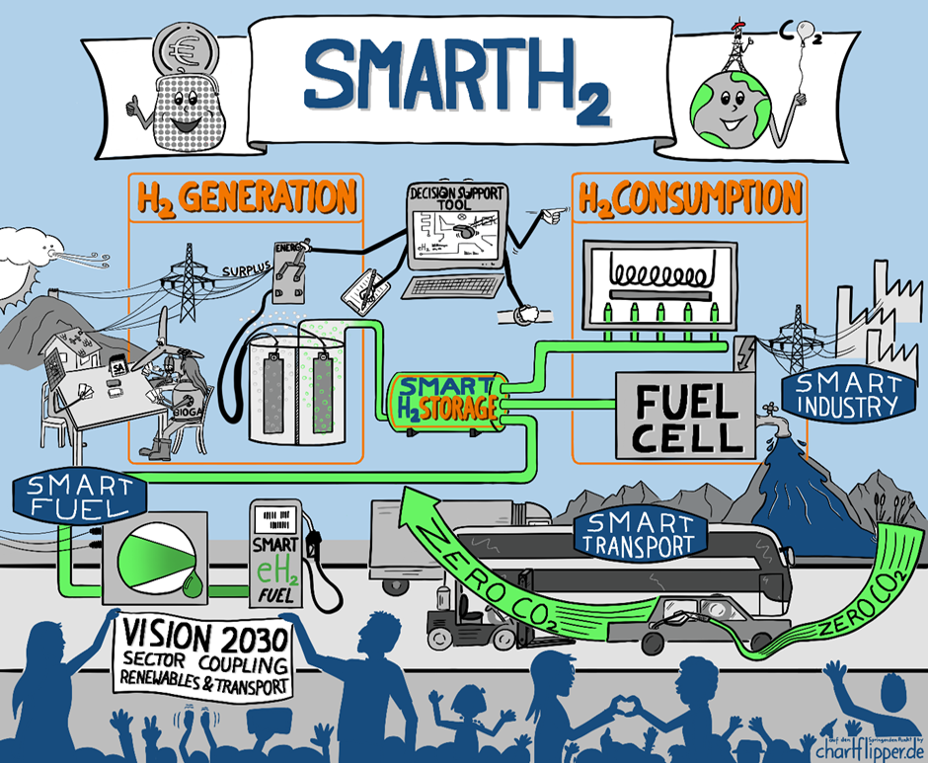
GenComm Spring Series of H₂ Webinars - Webinar 1: Hydrogen Optimisation

Slide 12

Hydrogen Optimisation Support Tool (HOST)
‘Hydrogen is the catalyst driving Europe’s energy transition. Optimising this journey through valorization of the hydrogen supply chain, production, storage and use is key to creating a successful hydrogen Europe.’
Extensive development and demonstration
skills & experience in innovation driven Hydrogenewable projects optimising
GreenH2 to become SMARTH2
GenComm Spring Series of H₂ Webinars - Webinar 1: Hydrogen Optimisation

Slide 13

Creating the Hydrogen Optimisation Support Tool (HOST)
Optimising hydrogen production, storage and use.
Actualising the CH2F to valorise and maximise the green energy outputs.
Evaluation parameters of performance and benefits realisation.
Validating P2X H2 technologies to be deployed in emerging scenarios.
Developing long term strategies for the advancement in adoption of hydrogen technologies.
Mapping Energy Navigation Routes for the transition of the EU energy system to the green destination
GenComm Spring Series of H₂ Webinars - Webinar 1: Hydrogen Optimisation

Slide 14

Leading an international partnership in the upcoming Horizon Europe call to ‘Book End’ a project - providing critical front & back end support:
Front End
Exploring Stakeholders’ perceptions
Identifying key factors for public/ user acceptance
Establishing public participation strategies
Moderation of decision-making processes
Back End
Optimising Value P2€
Delivering Long Term Effects
Supporting data informed decision
Creating optimal supply chain opportunities
GenComm Spring Series of H₂ Webinars - Webinar 1: Hydrogen Optimisation

Slide 15
Driving SMART H2 we aim to partner with and ‘Book End’ a project by providing critical front & back end support:
Front End
Exploring Stakeholders’ perceptions
Identifying key factors for public/ user acceptance
Establishing public participation strategies
Moderation of decision-making processes
Back End
Optimising Value P2€
Delivering Long Term Effects
Supporting data informed decision
Creating optimal supply chain opportunities
GenComm Spring Series of H₂ Webinars - Webinar 1: Hydrogen Optimisation

Slide 16
GenComm Spring ‘21 SMART H2 Webinars
SMARTH2 - Hydrogen optimisation - 10th March 2021
Green H2 Supply - 15th April 2021
Hydrogen - Infrastructure & storage - 29th April 2021
Hydrogen - Demand and Use - 18th May 2021
Hydrogen - Stakeholder engagement - 27th May 2021
GenComm Spring Series of H₂ Webinars - Webinar 1: Hydrogen Optimisation

Slide 17
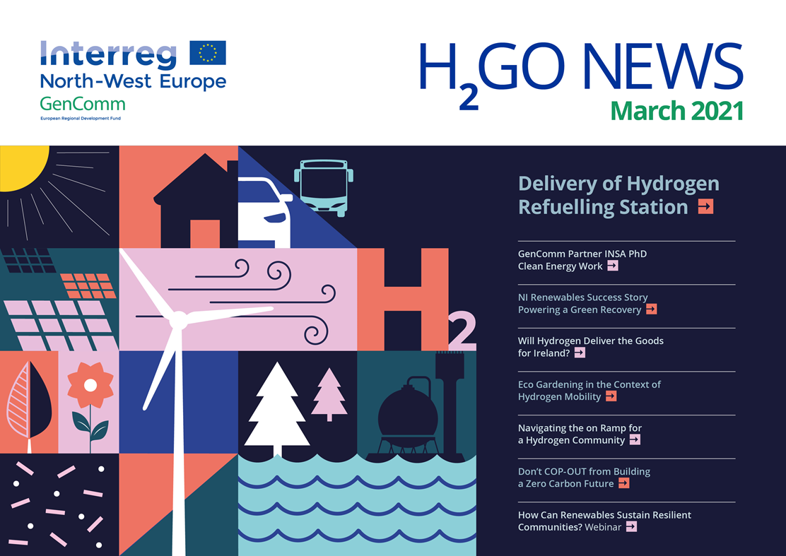
GenComm Spring Series of H₂ Webinars - Webinar 1: Hydrogen Optimisation

Slide 18
Social Distance Calling Card
GenComm Website - nweurope.eu/gencomm
LinkedIn - GenComm
Twitter - @GenComm_CH2F
Community Hydrogen Forum – CH2F - communityh2.eu
Hydrogen Ireland website - hydrogenireland.org
GenComm Spring Series of H₂ Webinars - Webinar 1: Hydrogen Optimisation

