Slide 1



GenComm Spring Series of H₂ Webinars
SMARTH2
Webinar 1:
Hydrogen Optimisation
10th March 2021
Place image in this area.

Slide 2





Smart Hydrogen
Common regional approach for the transformation of the energy system and the automotive industry
GenComm Webinar: Hydrogen Optimization
Hermann Guss, saaris e. V., 10th March 2021
GenComm Spring Series of H₂ Webinars - Webinar 1: Hydrogen Optimisation

Slide 3
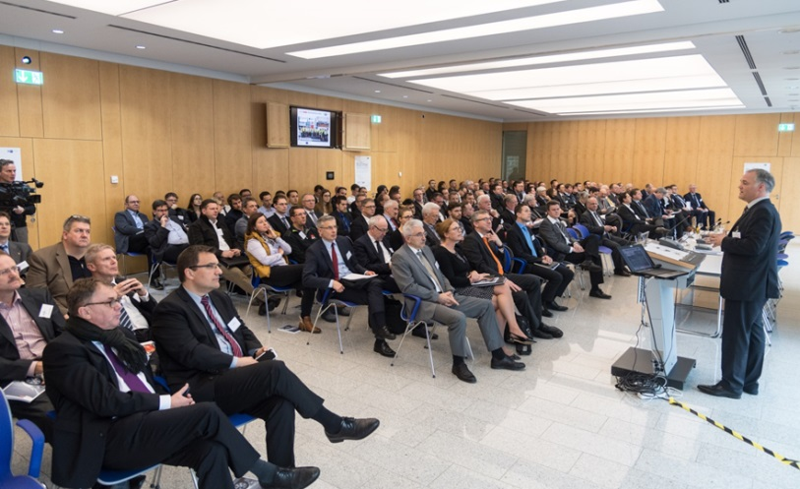
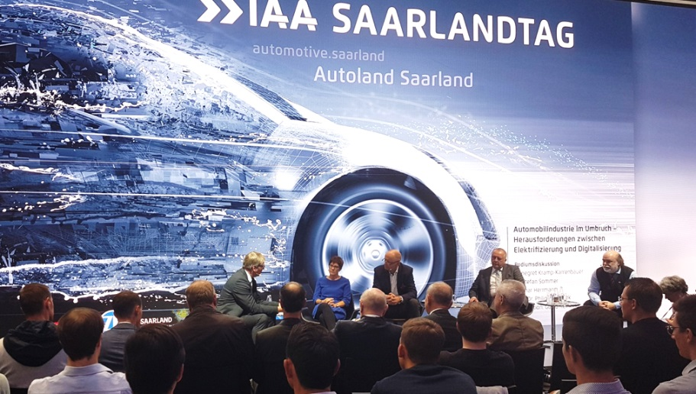
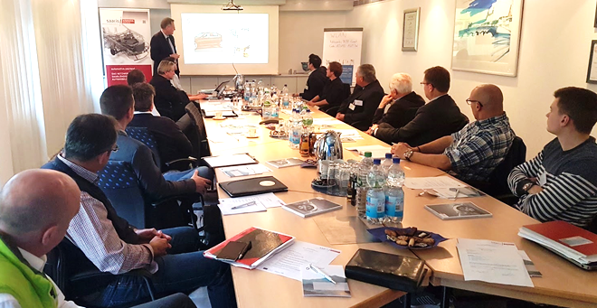
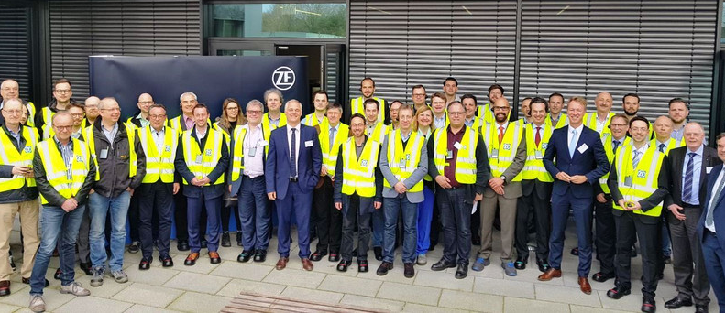
saaris – automotive.saarland
Knowledgetransfer
Site marketing
Expert training
Networking
GenComm Spring Series of H₂ Webinars - Webinar 1: Hydrogen Optimisation

Slide 4
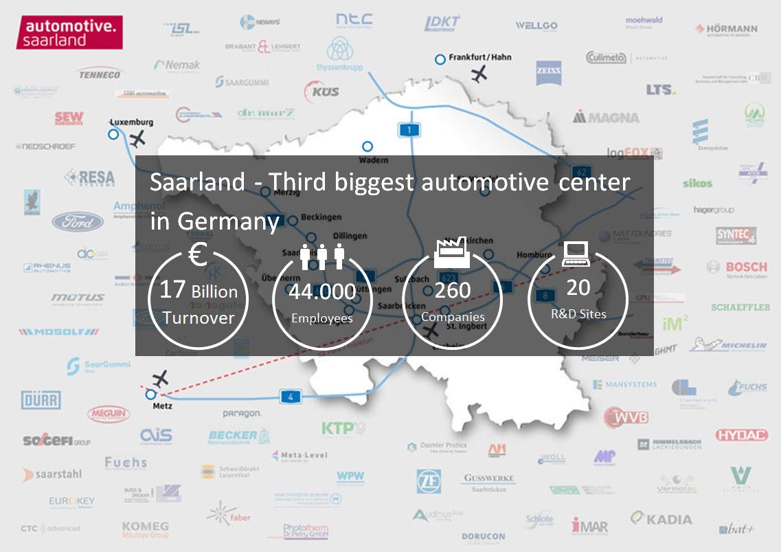
GenComm Spring Series of H₂ Webinars - Webinar 1: Hydrogen Optimisation

Slide 5
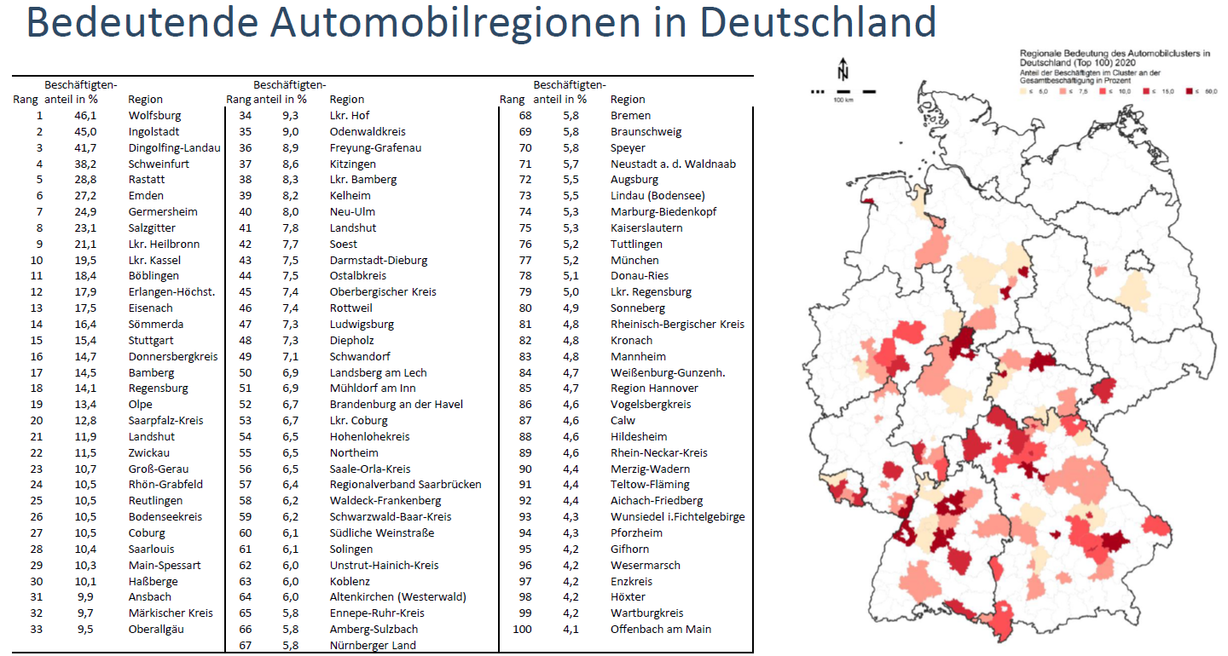
Economic importance of the automotive clusters
Source: IWKoeln, 26.11.2020
GenComm Spring Series of H₂ Webinars - Webinar 1: Hydrogen Optimisation

Slide 6
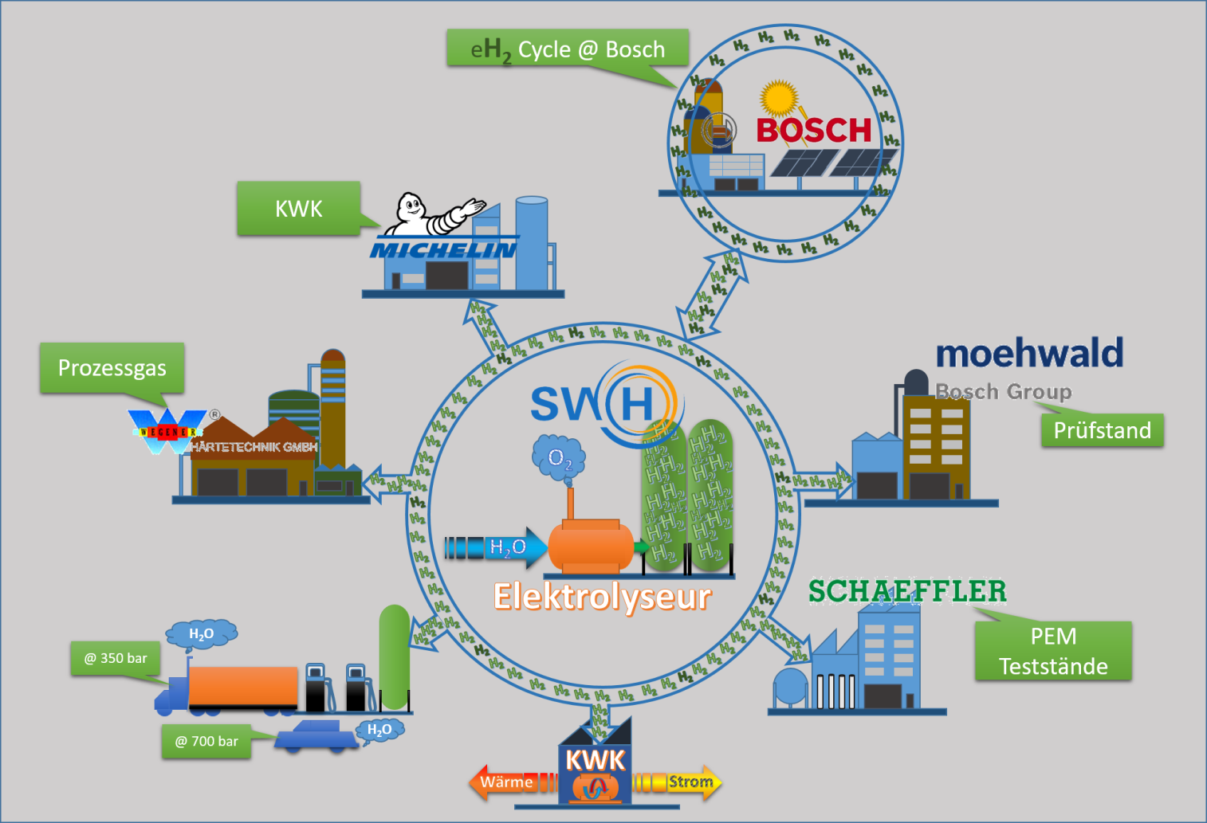
Hydrogen activities in the city of Homburg
Source: B. Groß, 10.02.2021
GenComm Spring Series of H₂ Webinars - Webinar 1: Hydrogen Optimisation

Slide 7
Common intrest leads to common project
Cross-company and
cross-sector
„Hydrogen-Management“
Heat
Electricity
Transport
Energymanagement
on company level
Company A
Company B
Company C
Energy- und hydrogendemand
and –production
GenComm Spring Series of H₂ Webinars - Webinar 1: Hydrogen Optimisation

Slide 8
Momentum of a common approach
History of the activities in Homburg:
Individual transformation of automotive production plants (Bosch, Schaeffler) led to new hydrogen demand.
City of Homburg plans hydrogen infrastructure to support.
  Hydrogen demand was queried.
  Transport sector and public transport was included. H2-Refuelling-Station will be build.
Thanks to the GenComm-Project the necessary know-how is in the region.
This caused a momentum which will be followed by further projects.
GenComm Spring Series of H₂ Webinars - Webinar 1: Hydrogen Optimisation

Slide 9
Conclusion
New hydrogen demand leads to new cooperative ventures.
Smart hydrogen has two meanings:
  The optimised an efficient use of green hydrogen.
  The cooperation between companies, administrations, public transport and researchers for a green future.
GenComm Spring Series of H₂ Webinars - Webinar 1: Hydrogen Optimisation

Slide 10
Thank you for your kind attention.
GenComm Spring Series of H₂ Webinars - Webinar 1: Hydrogen Optimisation

