Slide 1



GenComm Spring Series of H₂ Webinars
SMARTH2
Webinar 1:
Hydrogen Optimisation
10th March 2021
Place image in this area.

Slide 2

Public acceptance and participation concerning Hydrogen applications
GenComm Spring Series of H₂ Webinars - Webinar 1: Hydrogen Optimisation

Slide 3
Hydrogen as part of a socio-technical system
Broad Public
Macro-level
Politics
Media
Scientific community
Meso-level
Economy / Industry
NGOs/ civil organisations
Intermediaries / multiplicators
Micro-level
Municipalities /
End-users
GenComm Spring Series of H₂ Webinars - Webinar 1: Hydrogen Optimisation

Slide 4
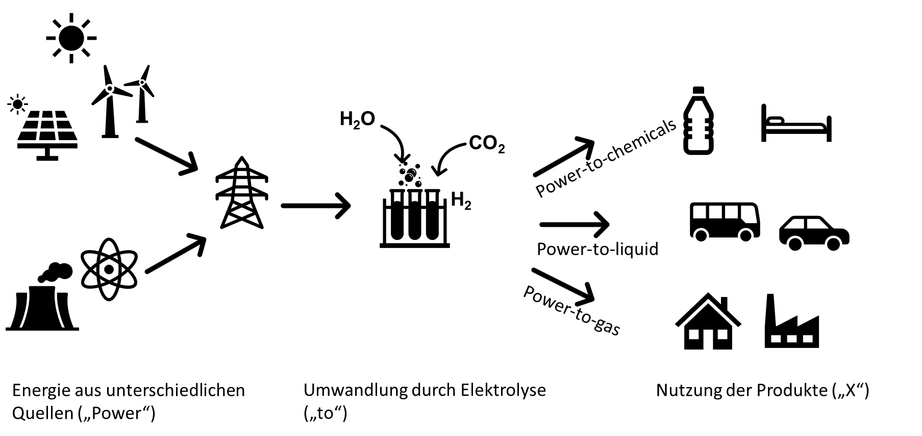


Hydrogen as part of a socio-technical system
Energy production
Electrolysis
Utilisation of products
Technology Acceptance
Consumer Acceptance
GenComm Spring Series of H₂ Webinars - Webinar 1: Hydrogen Optimisation

Slide 5


4 factors of public acceptance*
Orientation and insight: If people understand the necessity of a political decision and support the goals and means envisaged by this decision, they are more likely to accept it. Therefore, transparent information is needed about what they will face. Crucial elements are transparency about pros and cons and potential alternatives.
Positive risk-benefit balance: Acceptance is more likely the more the planned consequences of the decision benefit oneself or related groups. This includes the perception of low or at least acceptable risks. In this context, the risk assessments of experts and those of laypersons are often not congruent.
pixabay
pixabay
*Hildebrand, J. & Renn, O. (2019). Akzeptanz in der Energiewende. In: Jörg Radtke, Weert Canzler, Berlin (Hrsg.). Energiewende.
Eine sozialwissenschaftliche Einführung. Wiesbaden: Springer VS. S.261-282.
GenComm Spring Series of H₂ Webinars - Webinar 1: Hydrogen Optimisation

Slide 6
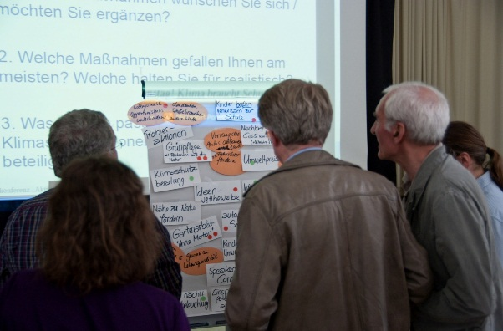
4 factors of public acceptance*
Self-efficacy: Energy transition means the change of infrastructures and daily life environments. It is important to experience one’s own impact and influence within this transformation process.
Identity: The more people can identify emotionally with a measure, the greater their willingness to accept it. This means that infrastructure measures must also be recognized emotionally as elements of one's own living environment. This is more likely to happen the more local stakeholders are involved.
*Hildebrand, J. & Renn, O. (2019). Akzeptanz in der Energiewende. In: Jörg Radtke, Weert Canzler, Berlin (Hrsg.). Energiewende.
Eine sozialwissenschaftliche Einführung. Wiesbaden: Springer VS. S.261-282.
GenComm Spring Series of H₂ Webinars - Webinar 1: Hydrogen Optimisation

Slide 7
Public acceptance and just transition
Just transition addresses distributional, procedural and interpersonal justice dimensions
Procedural justice: Transparency and participative involvement
Distributional justice: fair distribution of risks, disadvantages and costs as well as advantages and benefits
interpersonal justice: Trust and distrust in institutions /companies/ authorities-> important role of science
Not one size fits all: communication based on the requirements of the public, information easily accessible, understandable and well-adjusted to the specific needs of the target audience
Knowledge vs. beliefs: currently high level of uncertainty (quantities, time, alternatives)
GenComm Spring Series of H₂ Webinars - Webinar 1: Hydrogen Optimisation

Slide 8
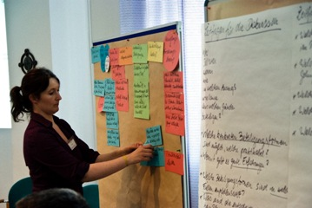
Participation in hydrogen
Transition requires an active role on all levels of society and changes in different sectors (energy infrastructure, mobility, industry, etc.)
Municipalities and regions are the level where the changes become visible -> Capacity building and empowerment, competence, personal and financial resources are needed
-> transfer of knowledge, good practices and success stories from renewable energy sector like 100% RES regions, sustainable communities, energy cooperatives -> Tools that help in planning and decision-making etc.
GenComm Spring Series of H₂ Webinars - Webinar 1: Hydrogen Optimisation

Slide 9
Outlook: Hydrogen in the public discourse
Challenges and uncertainties to solve for public discourse
Public acceptance of hydrogen is not (only) connected to risk perception
Ecological impact is the main added value: Demand for green hydrogen
Allocation to relevant sectors (mobility vs. industry)
Availabilities and quantities (connected to timeline)
Public dialogue as well as public participation measures on different levels (planning, financial) should be pro-actively undertaken
Understand energy transition as a task for society as a whole
GenComm Spring Series of H₂ Webinars - Webinar 1: Hydrogen Optimisation

Slide 10
Thank you for your attention!
IZES gGmbH
Jan Hildebrand
Department Environmental Psychology
E-Mail: hildebrand@izes.de
GenComm Spring Series of H₂ Webinars - Webinar 1: Hydrogen Optimisation

