Slide 1



GenComm Spring Series of H₂ Webinars
SMARTH2
Webinar 1:
Hydrogen Optimisation
10th March 2021
Place image in this area.

Slide 2

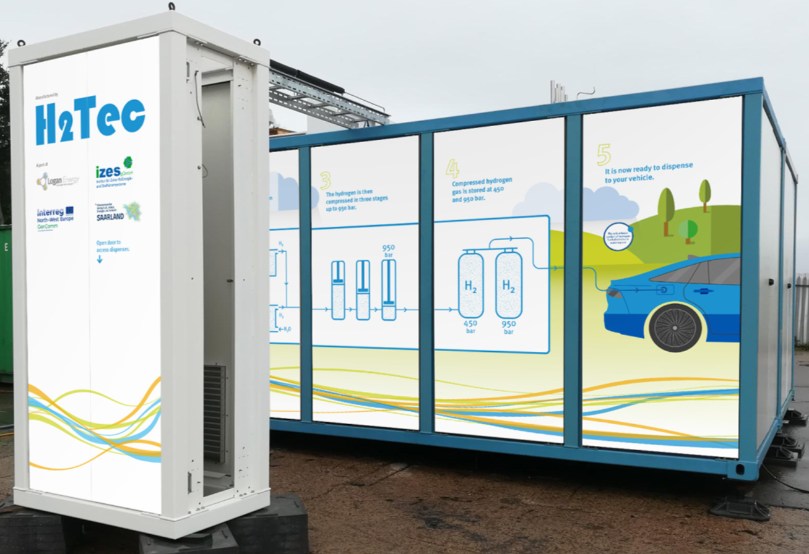
The IZES pilot plant of the GenComm project: "Solar Powered HRS"
Picture source: Logan Energy
GenComm Spring Series of H₂ Webinars - Webinar 1: Hydrogen Optimisation

Slide 3
Transferring the GenComm Results to a Single-Industrial Project
Transfer to the entire BOSCH Group and other Industrial Companies
Integration of all Hydrogen Related Industrial Sectors
Impact: Worldwide; > 400,000 employees at BOSCH + X from other companies
Concept Studies for 3 more BOSCH Production Sides
Integration of other Industrial Sectors
Impact: Throughout Germany; > 10,000 employees
Industrial Project with BOSCH (Start: May 2021)
Sector Coupling of Hydrogen Usage on an Industrial Production Side
Impact: Saarland; > 4,000 employees
GenComm Spring Series of H₂ Webinars - Webinar 1: Hydrogen Optimisation

Slide 4
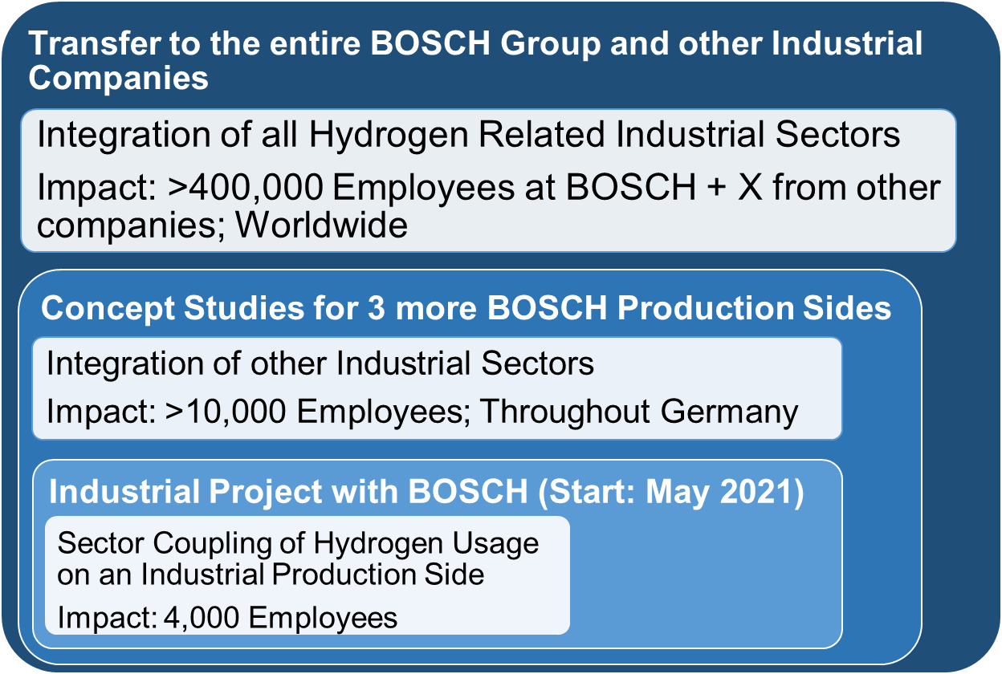

Multi-Industrial Project and Involvement of Local and Regional Community Stakeholders
Parallel Multi-Industrial and Multi-Sector Projects
Building block for the transition of the Saarland automotive industry towards emission free production sides and innovative products.
Impact: Project leads to cross-company and cross-sector Hydrogen on Demand Production and Management.
Application submitted in the current NWE capitalisation call for an additional GenComm WP, Decision: 24th March 2021.
Impact: Territorial enlargement (LU), new partner organisation (Uni Luxembourg) & integration of new stakeholders (public transport operators, local policy).
Multi-Industrial Project with Central green H₂ Production and involvement local and regional stakeholders (City and utility of Homburg, Saarpfalz County, saaris and many more.
Five Industrial Companies H₂ Micro Grid, Central green H₂ production
HRS for private users and public transport operators, county wide case studies
GenComm Spring Series of H₂ Webinars - Webinar 1: Hydrogen Optimisation

Slide 5
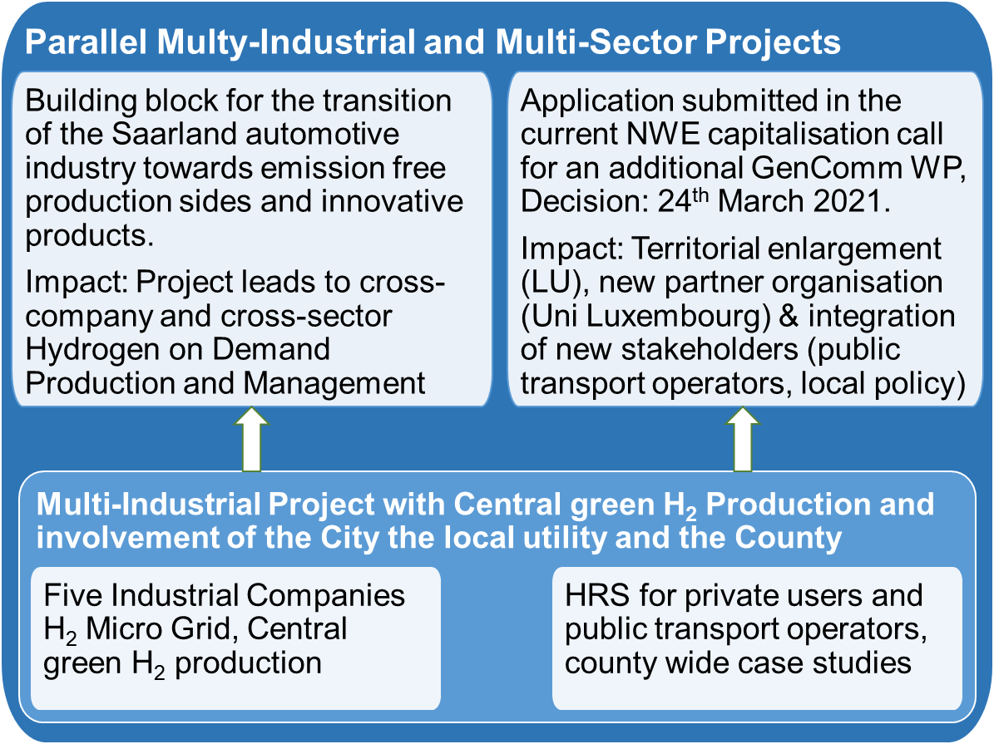
Public acceptance and user participation
Public acceptance and user participation in the context of the transition to a more sustainable energy system based on renewable sources
In the framework of the transition from an energy system based on fossil sources to a climate and environmentally friendly renewable system, the focus is mostly on technical aspects. Accompanying the transition from a social scientific perspective provides the basis for a successful and accelerated implementation.
GenComm Spring Series of H₂ Webinars - Webinar 1: Hydrogen Optimisation

Slide 6
GenComm Spring Series of H₂ Webinars; No. 1
“Hydrogen Optimisation”
On behalf of all GenComm partners, I wish you a good and interesting webinar.
Thank you for listening!
GenComm Spring Series of H₂ Webinars - Webinar 1: Hydrogen Optimisation

