Slide 1
GenComm Spring Series of H₂ Webinars
SMARTH2
Webinar 2:
Green H₂ Supply
15th April 2021
Place image in this area.

Slide 2
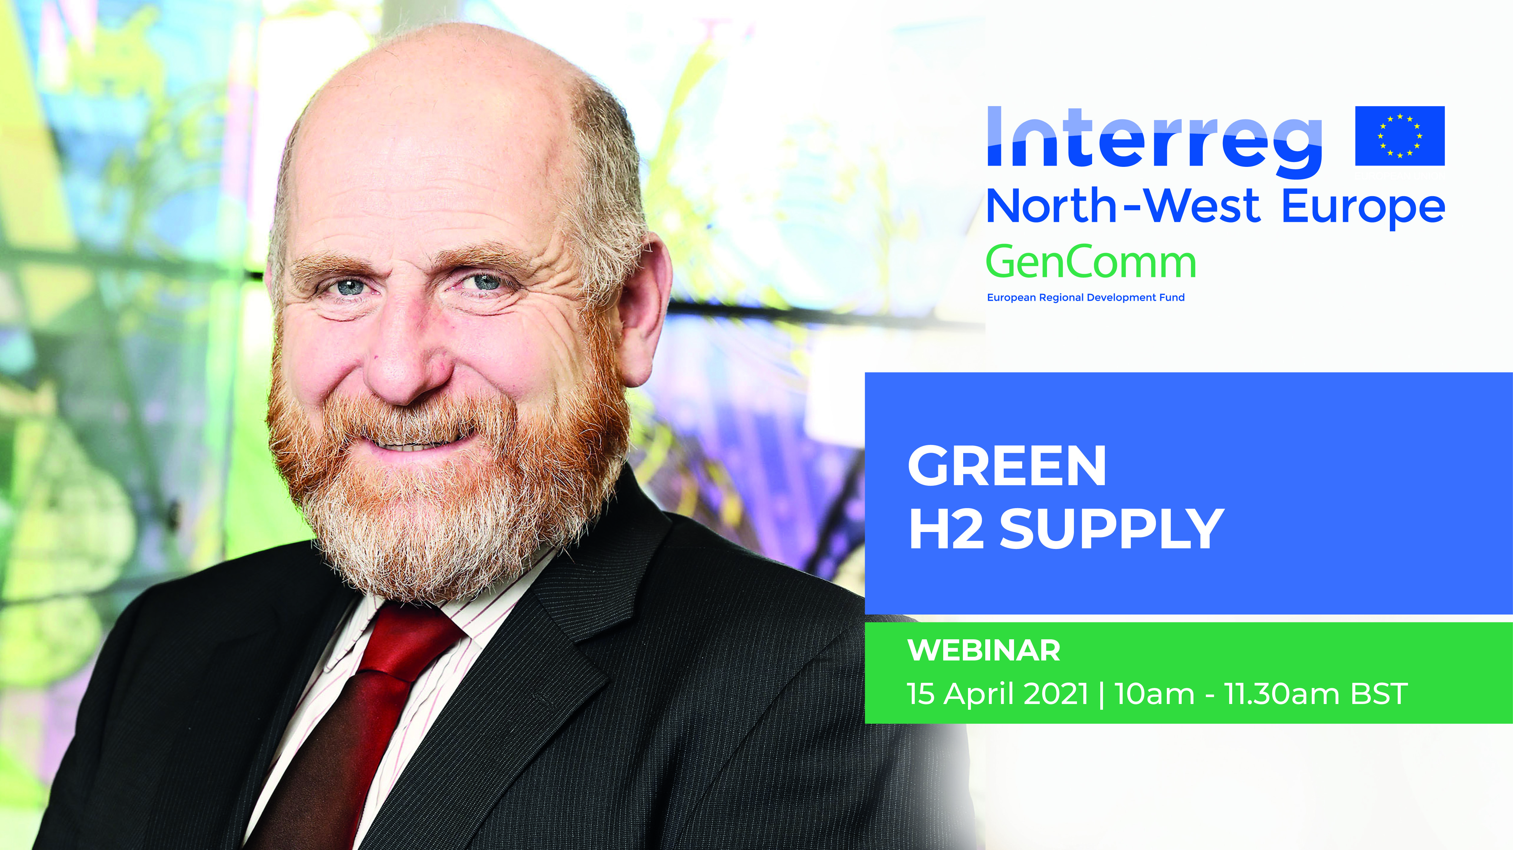
Introduction SMART H2
Paul McCormack
GenComm Project Co Ordinator
GenComm Spring Series of H₂ Webinars - Webinar 2: Green H₂ Supply

Slide 3
GenComm Spring ‘21 Series
To create webinar content that inspires, educates, and acquires you, our audience.
Build content intelligence.
Provide an information portal that is 2-way.
Inform, educate and inspire.
Putting you at the heart of the energy transition - achieving a just transition.
“It is essential that people affected by the transition are given a voice and are included in the dialogue. Transitions are affecting the livelihoods of workers and their families, they have concerns and maybe even fears, which should be addressed in an open dialogue.”
Dan Jorgensen, Denmark’s Minister of Climate, Energy and Utilities
GenComm Spring Series of H₂ Webinars - Webinar 2: Green H₂ Supply

Slide 4
the greatest economic opportunity
John Kerry, US Presidential Special Envoy for Climate:
“This is the greatest economic opportunity we’ve ever had. We are looking at the biggest job market ever known. Every task we have – building out the grid, solar power, wind power, building out hydrogen, batteries, switching to electric vehicles – will all create jobs.”
IEA-COP26 Net Zero Summit April 2021
GenComm Spring Series of H₂ Webinars - Webinar 2: Green H₂ Supply

Slide 5
Green H2
Recognised globally as a key element in global decarbonisation.
The catalyst accelerating the energy transition.
The gatekeeper opening up the full potential for offshore renewables.
GenComm Spring Series of H₂ Webinars - Webinar 2: Green H₂ Supply

Slide 6
H2 Catalyst
Hydrogen is the catalyst driving Europe’s energy transition. Optimising this journey delivering SMARTH2 through valorisation of the hydrogen supply chain, production, storage and use is key to creating a successful hydrogen Europe.
GenComm Spring Series of H₂ Webinars - Webinar 2: Green H₂ Supply

Slide 7
Webinar #2 Green H2 Supply
Today’s webinar covers the innovation pathway of production and use of this zero-carbon fuel as part of our energy transition journey. True energy innovation is about developing and delivering sustainable solutions that meet community and environmental need. As part of the GenComm work in generating energy secure communities, we are optimising solutions with SMARTH2 to meet the twin goals:
Energy security
Sustainability.
GenComm Spring Series of H₂ Webinars - Webinar 2: Green H₂ Supply

Slide 8
SMART H2
The world is racing to scale up Green Hydrogen.
However, as we scale up the use of GREEN H2 it must be done smartly and give us SMARTH2.
PRODUCTION
H2
CONVERSION
H2
DISTRIBUTION
H2
USE
TRANSMISSION
H2
GenComm Spring Series of H₂ Webinars - Webinar 2: Green H₂ Supply

Slide 9
Agenda
10:00 - 10:10: Introduction, SMART H2, Paul McCormack, Belfast Metropolitan College & GenComm
10:10 - 10:30: Green H2 Supply, Mark Welsh, Energia & GenComm
10:30 - 10:50: H2 Mobility, Dr Robert Best,
Wrightbus
10:50 - 11:10: Hydrogen Powering Data Centres, Simon McCormick, Echelon Data Centres
​​11:10 - 11:30: Q&A
GenComm Spring Series of H₂ Webinars - Webinar 2: Green H₂ Supply

Slide 10
Fossil gas 'has no viable future'
EU Minister EU climate chief Frans Timmermans said on Thursday (25th March).
Europe has set a clear goal for full decarbonisation by 2050, with renewables-based electricity set to become the dominant energy carrier, and that means fossil gas will have “only a marginal role” in the long run.
GenComm Spring Series of H₂ Webinars - Webinar 2: Green H₂ Supply

Slide 11
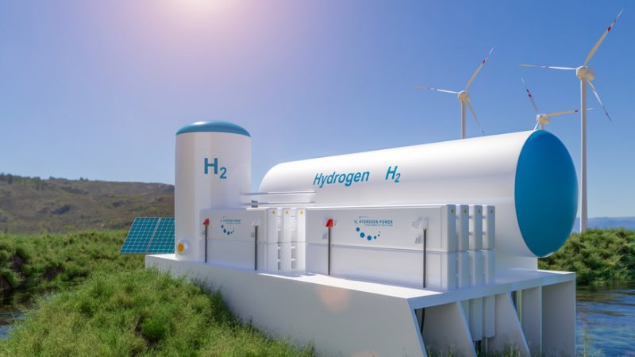
EU H2 Highway
European energy ministers have highlighted the need to create a stable regulatory framework for hydrogen in the European Union, capable of attracting private investors into a competitive and predictable market.
GenComm Spring Series of H₂ Webinars - Webinar 2: Green H₂ Supply

Slide 12
GenComm Spring ‘21 SMART H2 Webinars
SMARTH2 – 10th March
Green H2 Supply – 15th April
Infrastructure & storage – 29th April
Demand and Use – 18th May
Stakeholder engagement – 27th May
GenComm Spring Series of H₂ Webinars - Webinar 2: Green H₂ Supply

Slide 13
Audience Poll
Where do you think Green Hydrogen will have greatest impact as a source of energy?
In helping decarbonise our energy system.
Helping balance the grid when introducing more renewables options.
Achieving sector coupling opportunities.
Helping Industry to reduce carbon emissions.
Providing energy security for communities.
Other - please suggest.
To answer the question, please use the chat function.
GenComm Spring Series of H₂ Webinars - Webinar 2: Green H₂ Supply

Slide 14
The decade of delivery
Globally governments are not moving from positions where they debated climate change to now physically delivering on their promises of net zero.
Working in cohesion will accelerate progress, create jobs, generate prosperity, and deliver climate action not dialogue.
GenComm Spring Series of H₂ Webinars - Webinar 2: Green H₂ Supply

Slide 15
Horizon Europe
Is currently awaiting formal approval by the European Parliament and the Council of the EU.
In parallel to the approval process, the plans for the first Calls of Proposals are being developed.
Energy is now part of a Cluster with Climate and Mobility in Pillar 2, Global Challenges and European Industrial Competitiveness.
It is envisaged that this Cluster will have a budget of over €15 billion over the course of the programme.
The draft Work Programme for 2021 and 2022 has been published but is subject to change until the Calls for Proposals are published.
GenComm Spring Series of H₂ Webinars - Webinar 2: Green H₂ Supply

Slide 16
GenComm Spring Series of H₂ Webinars - Webinar 2: Green H₂ Supply

Slide 17
Social Distance Calling Card
GenComm Website - nweurope.eu/gencomm
LinkedIn - GenComm
Twitter - @GenComm_CH2F
Community Hydrogen Forum – CH2F - communityh2.eu
Hydrogen Ireland website - hydrogenireland.org
GenComm Spring Series of H₂ Webinars - Webinar 2: Green H₂ Supply

