Slide 1
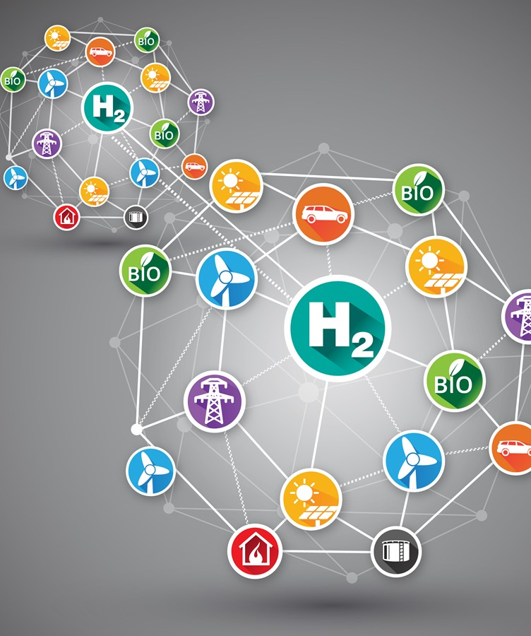


GenComm Spring Series of H₂ Webinars
Webinar 2:
Green H₂ Supply
Mark Welsh
Energia
15th April 2021
Place image in this area.

Slide 2
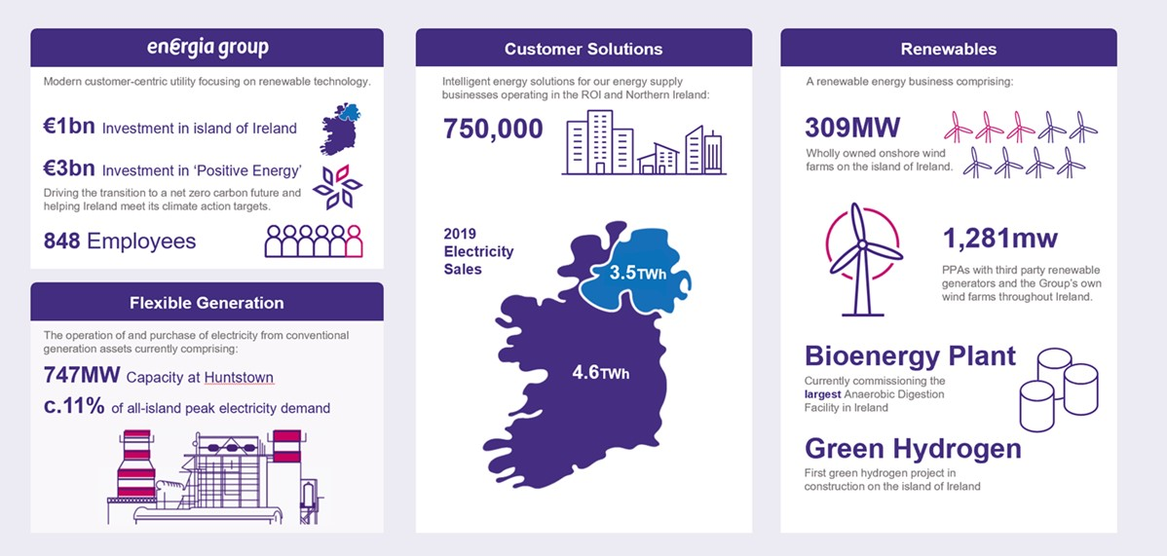
Energia Group Overview
GenComm Spring Series of H₂ Webinars - Webinar 2: Green H₂ Supply

Slide 3
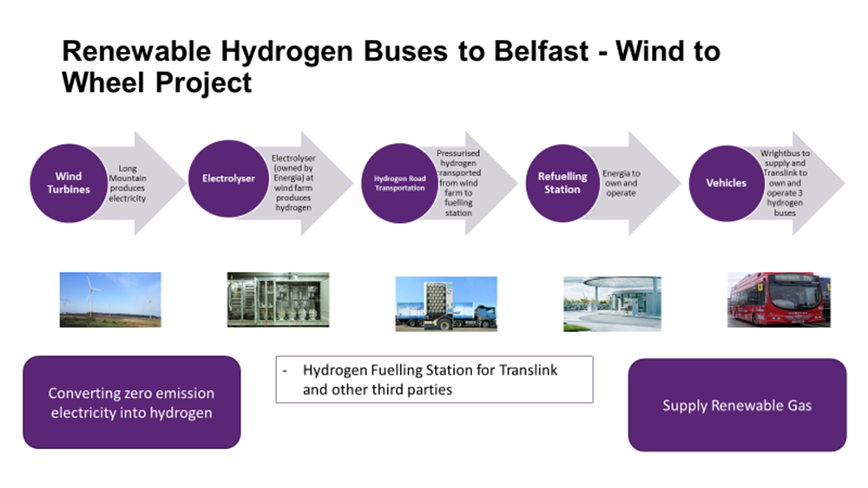
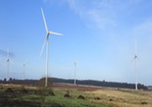
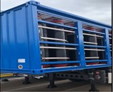
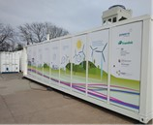
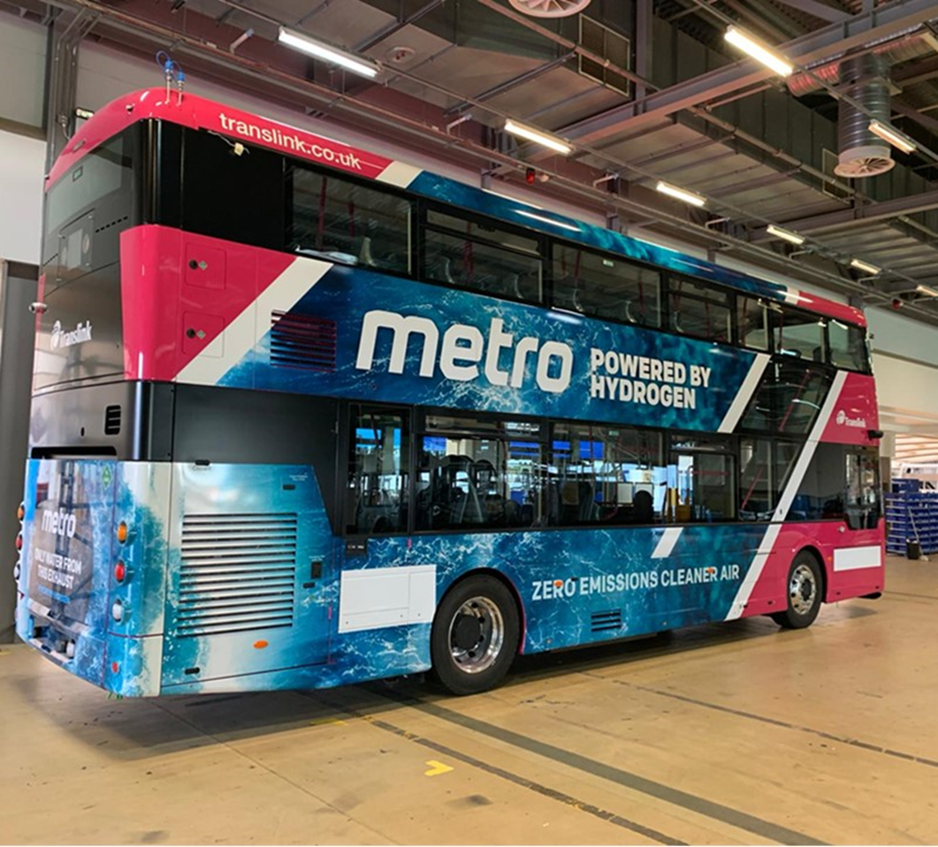
Zero Emission Hydrogen Transport Project
GenComm Spring Series of H₂ Webinars - Webinar 2: Green H₂ Supply

Slide 4
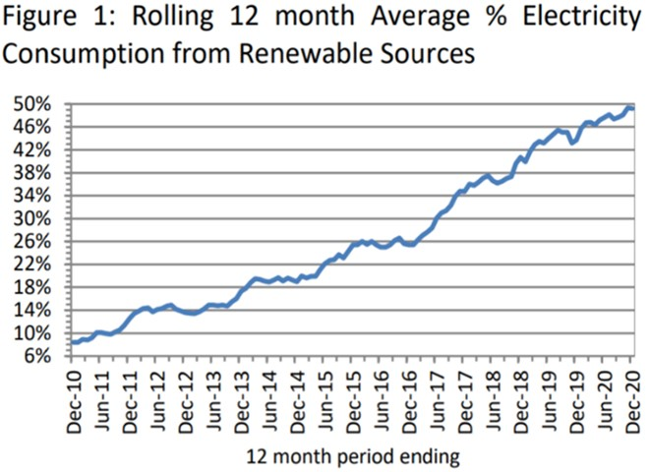
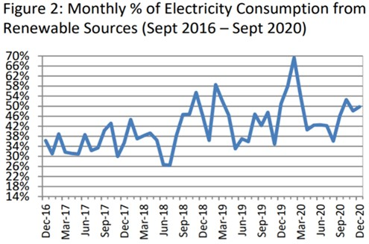
RENEWABLE GENERATION IN NORTHERN IRELAND: YEAR ENDING SEPTEMBER 2020
Key Points
In 2010 – 8.4% generated from Renewables
2020 – 49.2% generated from Renewables (target was 40%)
The monthly proportion of renewable generation in 2020 exceeded 40% in eleven of the twelve months and exceeded 50% in four of the twelve months, with a record high of 69.3% in February 2020
GenComm Spring Series of H₂ Webinars - Webinar 2: Green H₂ Supply

Slide 5
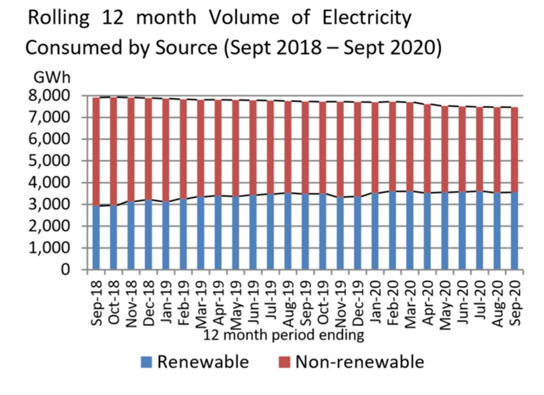
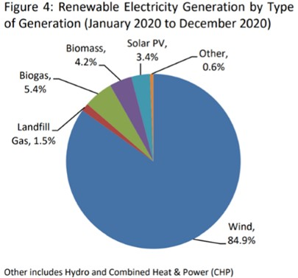
Renewable v Non Renewable in NI
Wind energy made up 84.9% in 2020 of the renewable electricity and 84.5% in 2019. The proportion of renewable electricity generated from sources other than wind was 14.4% in 2018 and 16.1% in 2020
GenComm Spring Series of H₂ Webinars - Webinar 2: Green H₂ Supply

Slide 6

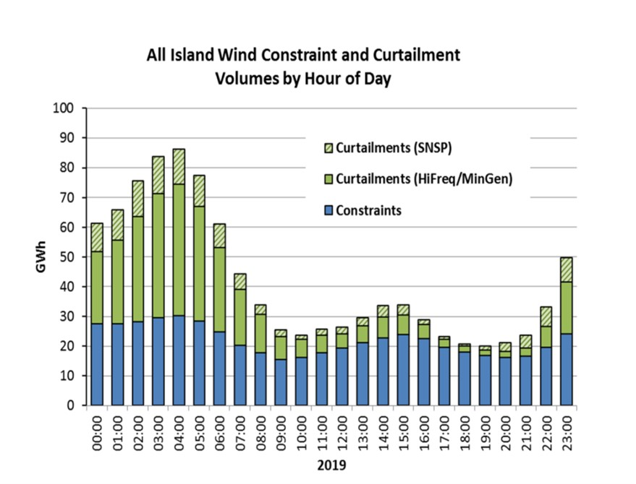
Curtailment & Constraints
Curtailment & Constraints refers to the dispatch-down (switching off) of wind / solar for system-wide reasons
The impact can be seen in the graph, which shows the total annual all-island dispatch-down of energy by hour of day.
GenComm Spring Series of H₂ Webinars - Webinar 2: Green H₂ Supply

Slide 7
Question – Can hydrogen generation and supply meet mobility needs and energy demands
GenComm Spring Series of H₂ Webinars - Webinar 2: Green H₂ Supply

Slide 8
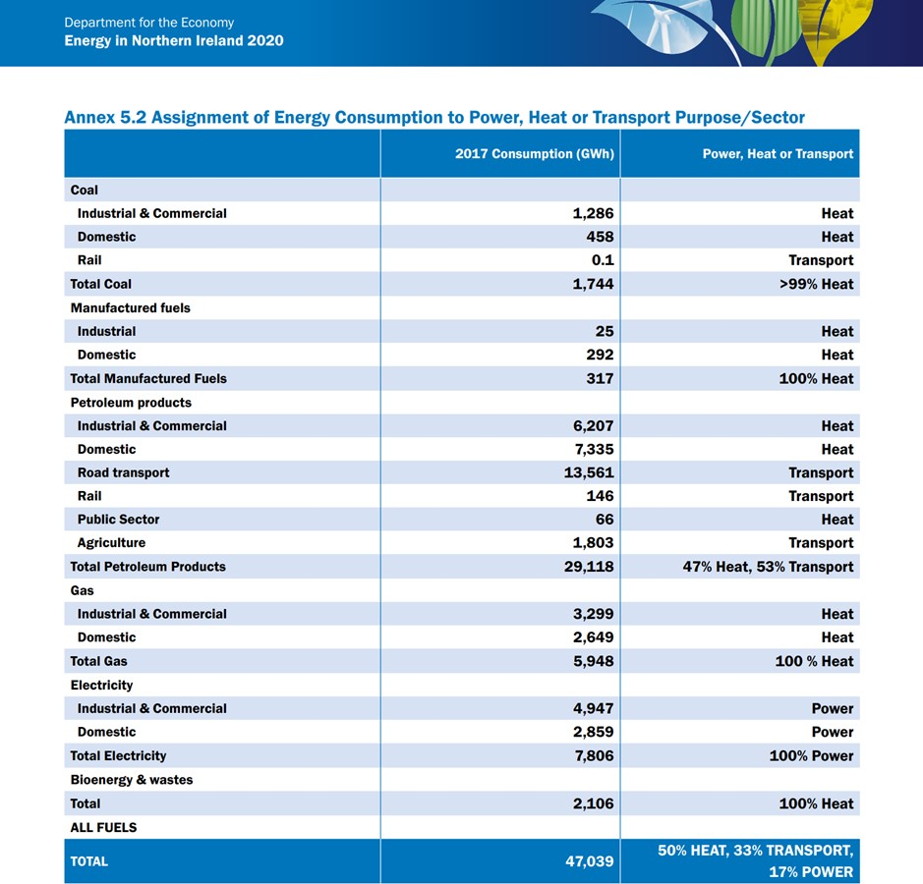

Can we deliver the energy required to meet 100% Renewable Energy by 2050

Slide 9
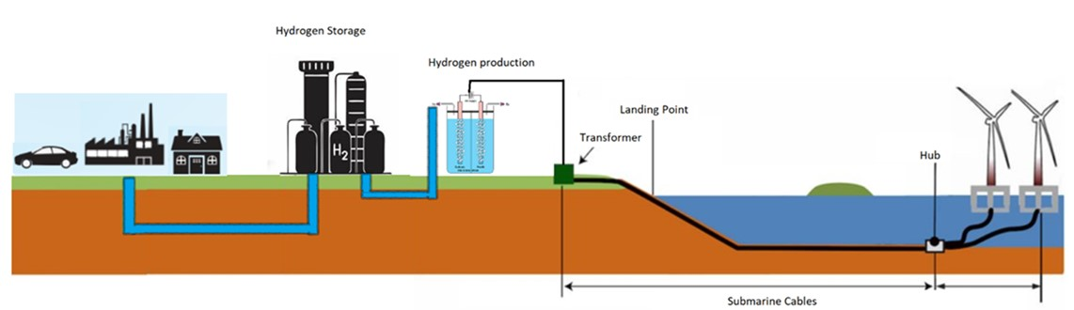
Off Shore
The potential for zero carbon Heat is enormous as renewable Hydrogen can help deliver the decarbonisation of the existing Natural Gas Network.
Using curtailment from On-shore and power from Offshore Wind there is potential to generate 100% green hydrogen which can be injected into the gas grid for use of heating in homes, offices and industry
Off shore wind development will significantly increase the renewable energy produced and will be a major step forward in achieving our 2050 net zero targets.
For this infrastructure to be realised it will require significant cooperation between all the major players including; Regulators, Government, Utility Network Operators, Energy Suppliers, Wind Developers and Marine Industry
GenComm Spring Series of H₂ Webinars - Webinar 2: Green H₂ Supply

Slide 10
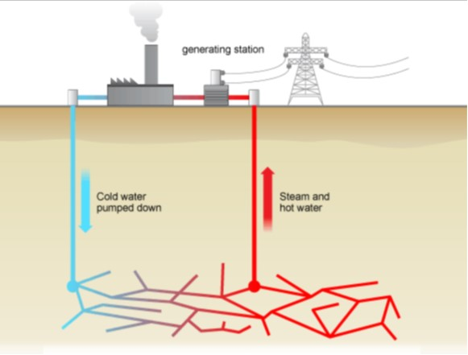
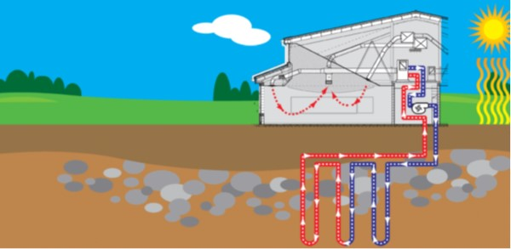
Heat - Geothermal Energy
Shallow
For individual commercial and domestic premises
Heat Pumps have potential of 24/7 renewable heat
NI has excellent geothermal resources (best in UK or Ireland).
Deep
With depths of between 2 and 3 km potential for electricity generation, industrial heat and hydrogen production
GenComm Spring Series of H₂ Webinars - Webinar 2: Green H₂ Supply

Slide 11
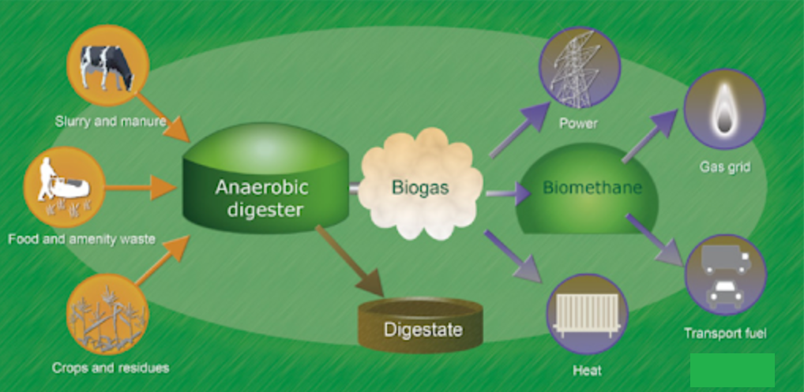
Anaerobic Digestion
Classic environmental life cycle
Delivering CO2 savings in Power, Transport and Heating Industries
  Extract Co2 react with Hydrogen to produce methane
Digestate processing
  Crop fertiliser reducing requirement for fossil fertilisers
    Hydrogen reacting with Nitrogen = Ammonia
GenComm Spring Series of H₂ Webinars - Webinar 2: Green H₂ Supply

Slide 12
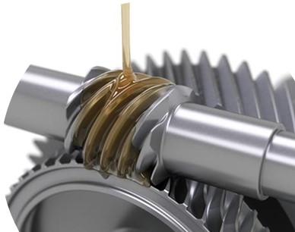
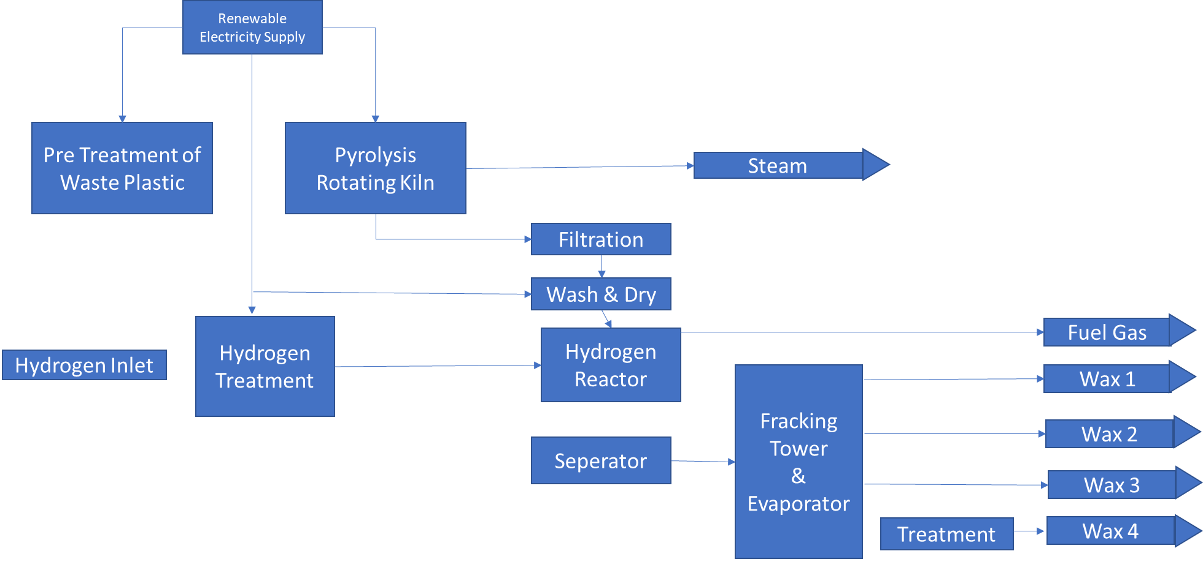
Hydrogen and Recycling of Waste Plastic
Plastic waste is a Global Environmental Challenge
The reuse of plastic for fuel contributes to global warming.
Potential to reduce plastic waste and reuse with minimal environmental impacts.
Hydrogen reacting waste plastic will alter its chemistry resulting in the production of fuels and high value waxes.
These products can be used in a variety of industries such as
  Coatings
  Lubricants
  Candles
  Specialty waxes
GenComm Spring Series of H₂ Webinars - Webinar 2: Green H₂ Supply

Slide 13
Concluding thoughts
Hydrogen is revolutionising our energy matrix and will be key to helping us to continue our journey to net zero C02
It is a major challenge, it wont be easy but we have the talent and innovators who can deliver
We are in the early stages but hydrogen generation utilising curtailment and renewable assets we can meet transport requirements
It is essential we keep innovating and developing renewable generating opportunities including; off shore, wave, tidal, geothermal and AD solutions
Our universities and industry have to be focused in delivering robust and sustainable solutions
With Hydrogen as the energy vector (that is producing and storing energy during times of curtailment and over generation) will ensure our energy network is optimised to meet our current and energy demands
GenComm has shown energy innovation in action pointing the way to a clean and sustainable energy future
GenComm Spring Series of H₂ Webinars - Webinar 2: Green H₂ Supply

