Slide 1
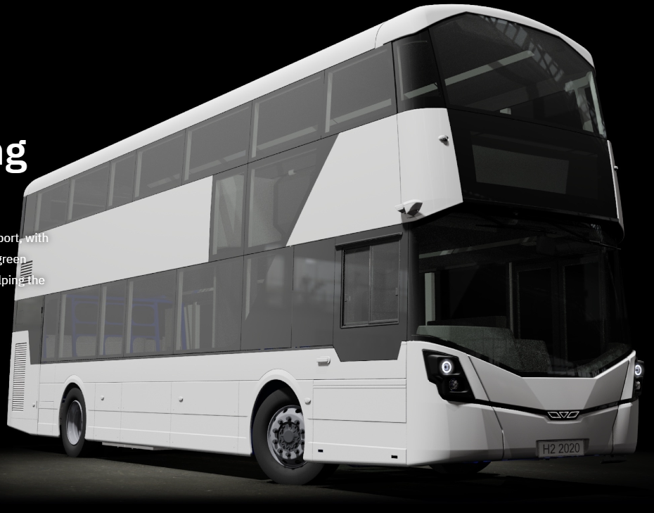
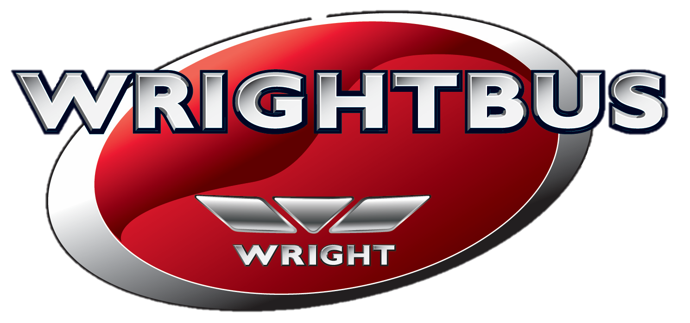
1
H₂ Mobility: Wrightbus Hydrogen Fuel-Cell Buses
Dr Robert Best Director of Engineering
Bamford Bus Company T/A Wrightbus
15/04/2021
1
Company Registration no: 12214576 VAT Registration no: GB 333 9869 60
Company Registration no: 12214576 | VAT no: GB 333 9869 60

Slide 2
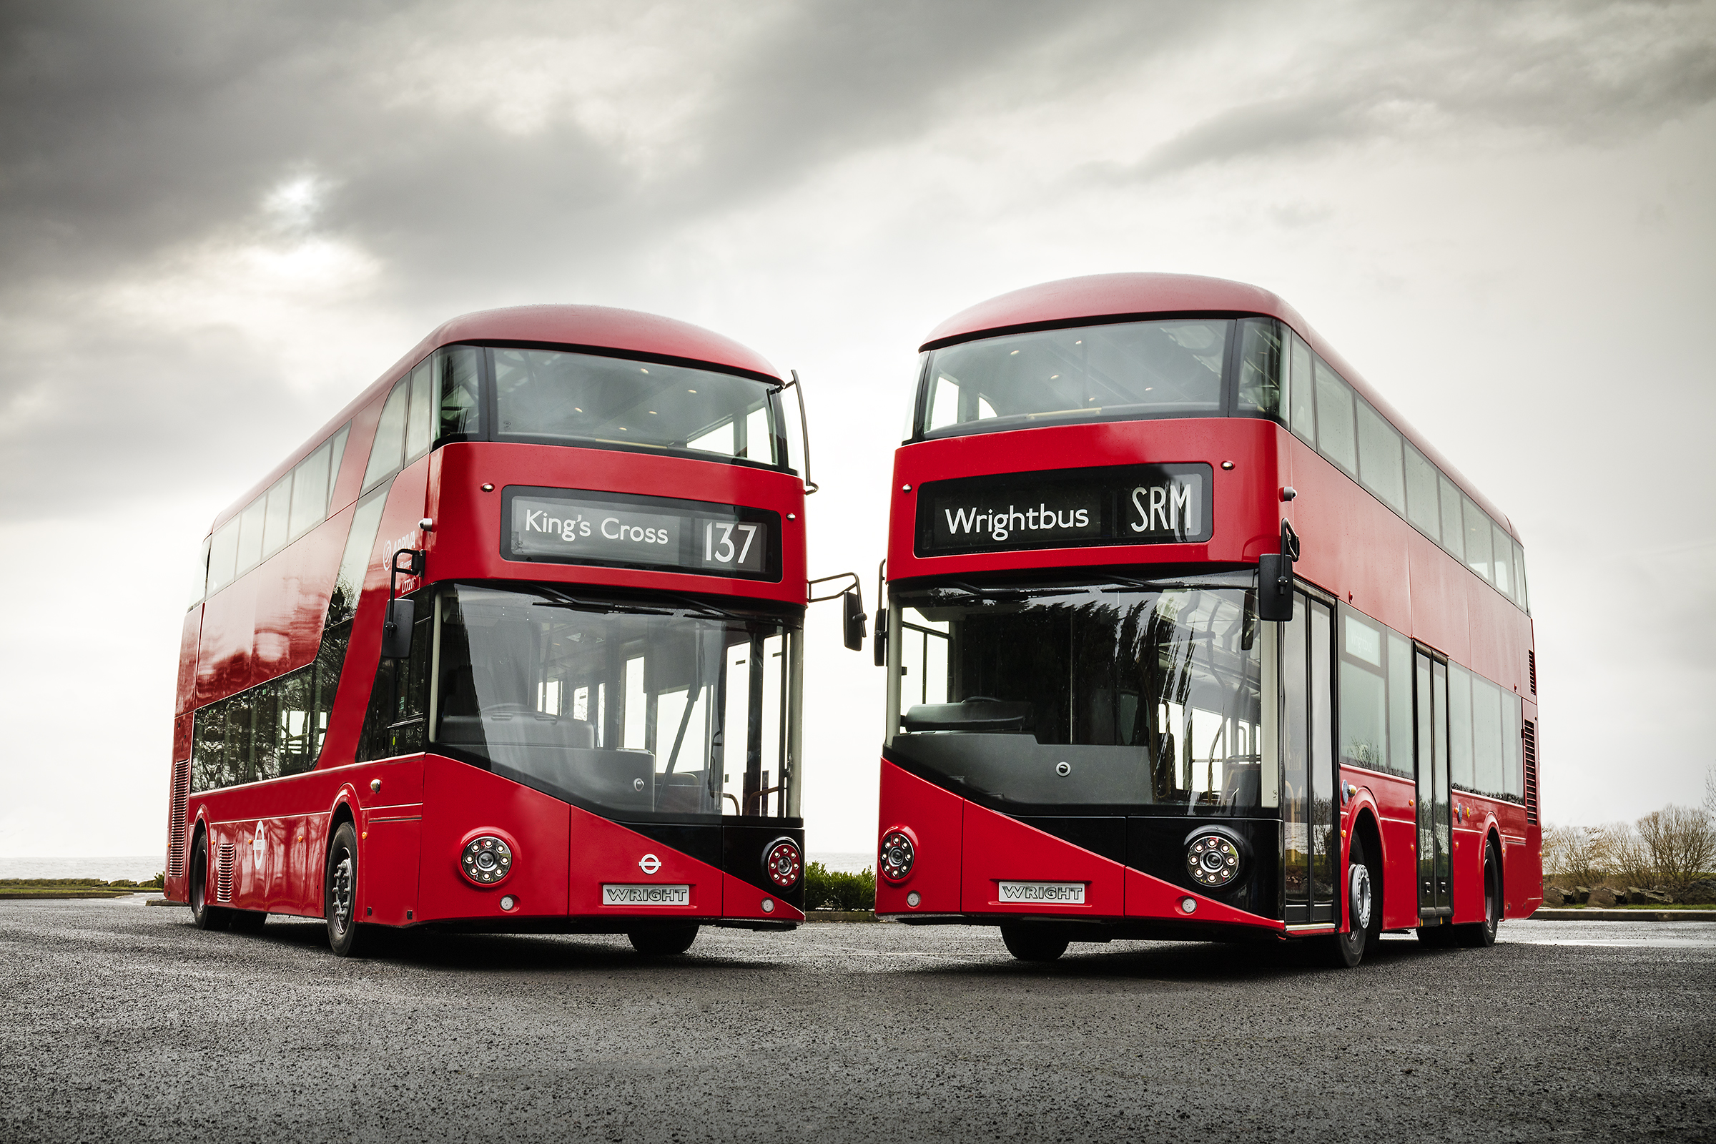
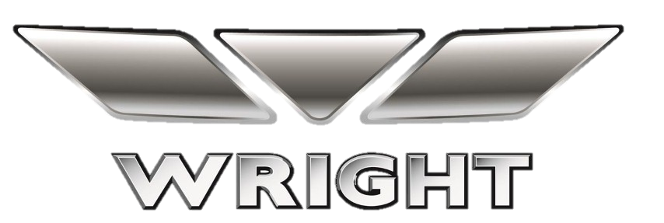
Organisation Background
2
2
Founded in 1946 in Ballymena, Northern Ireland.
Global, multi-award winning brand with sales in UK, Europe, Asia, South & North America.
UK's leading independent supplier of low-floor accessible buses and pioneer of lightweight aluminium bodywork.
>70 years’ experience in vehicle body-building.
>20 years' experience producing low and zero-tailpipe-emissions vehicles: hybrid, EV and hydrogen fuel-cell.
Manufacturer of the iconic London Routemaster (pictured right).
2019 saw new ownership via Jo Bamford and JCB.
Joint research centre with Queen’s University, Belfast.
Currently employs 650 skilled workers (August, 2020).
Company Registration no: 12214576 VAT Registration no: GB 333 9869 60
Company Registration no: 12214576 | VAT no: GB 333 9869 60

Slide 3
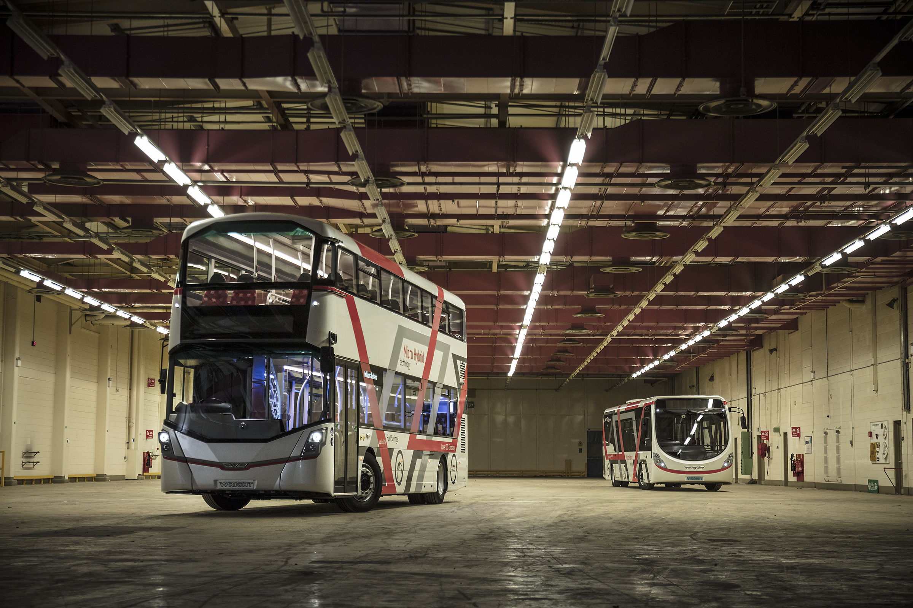
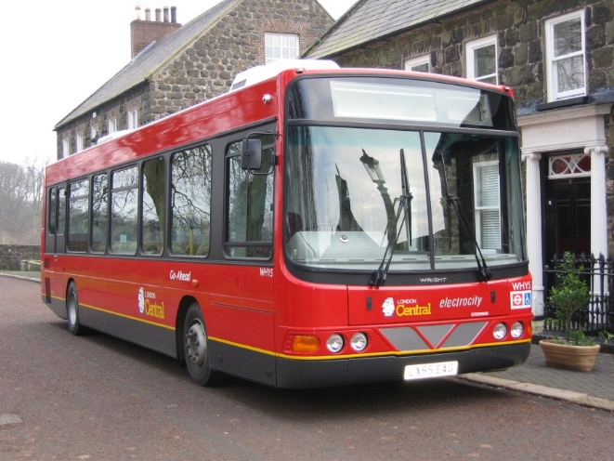
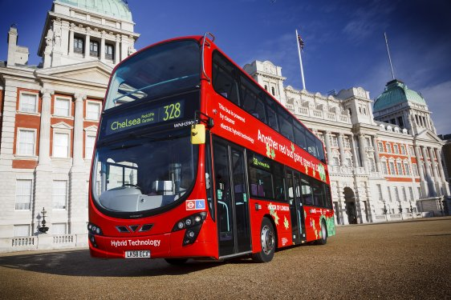
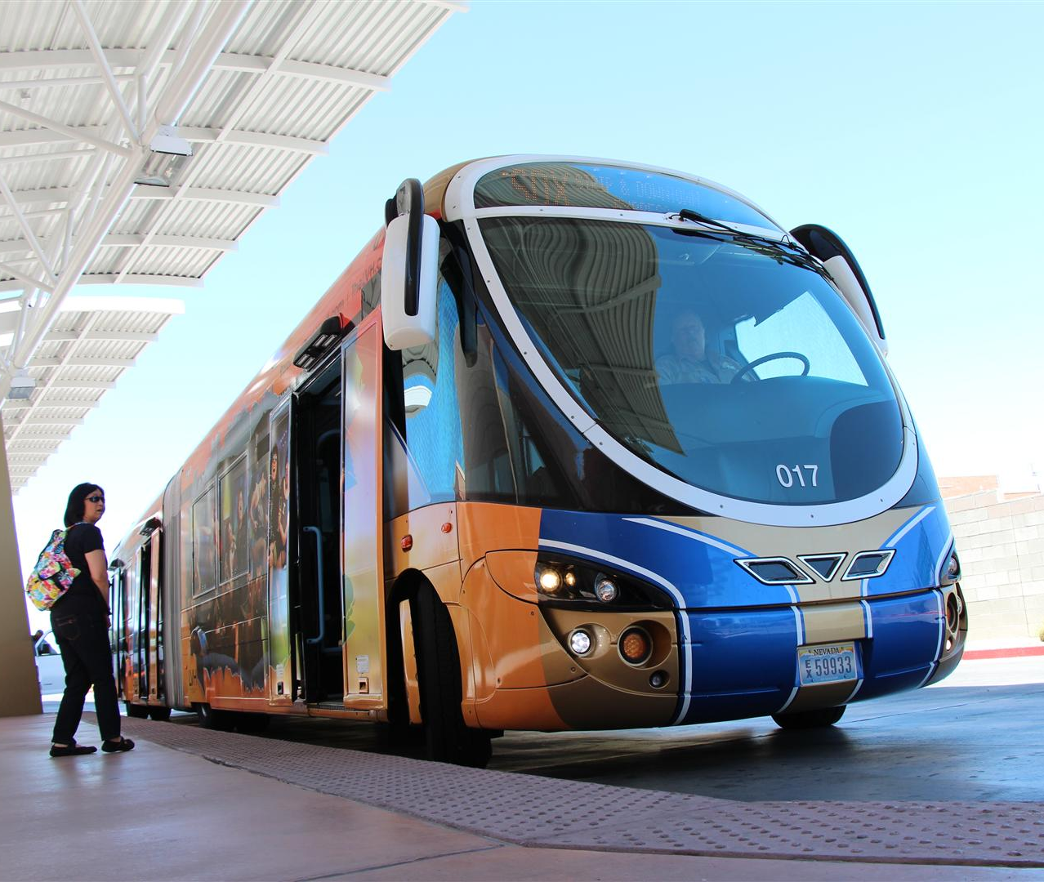
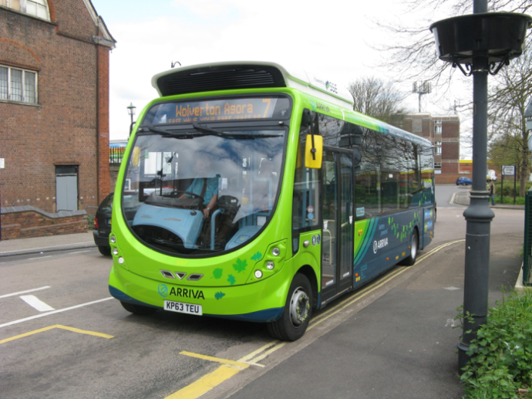
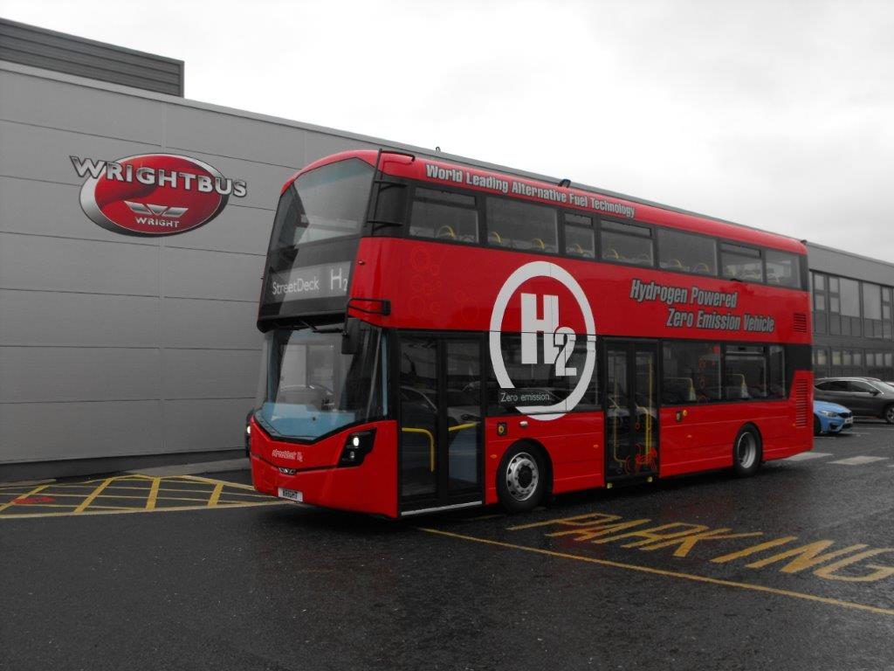
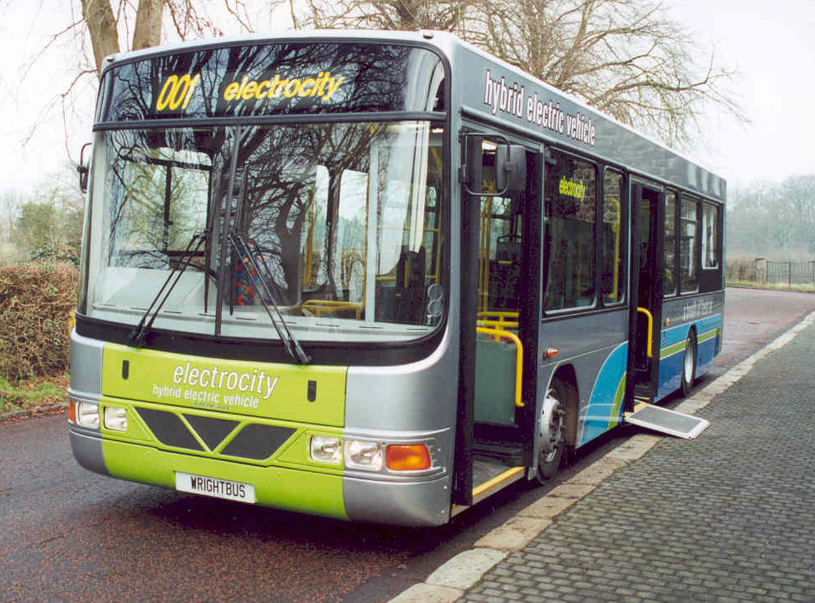
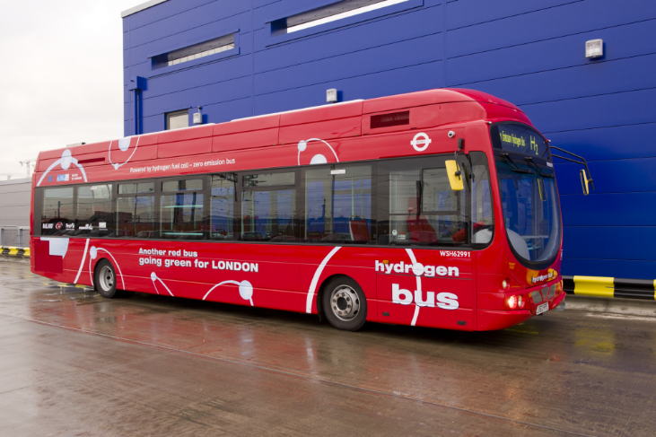
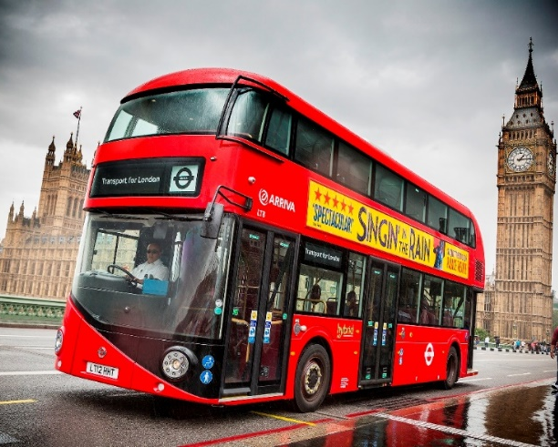
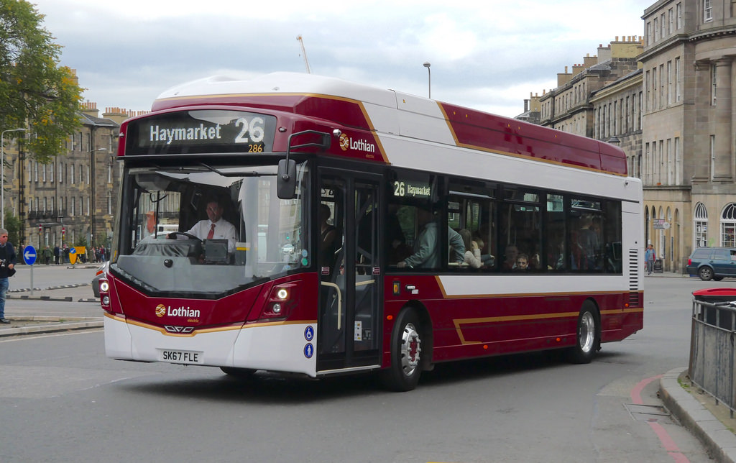
3
Clean Energy Product History
3
Las Vegas Streetcar Parallel-hybrid-electric
First EV
Hybrid double-deck
IPT-charge EV
FCEV double-deck
1999
2006
2008
2014
2019
2002
2008
2012
2016
Hybrid single-deck
Hydrogen single-deck
New Routemaster
Overnight-charge EV
Company Registration no: 12214576 VAT Registration no: GB 333 9869 60
Company Registration no: 12214576 | VAT no: GB 333 9869 60

Slide 4
4
Fuel-Cell Electric Vehicle
4
Wrightbus fuel-cell electric vehicle provides a zero-emission hybrid drive platform which encompasses a hydrogen fuel cell with:
H₂ Storage tanks
Battery pack
Electric drive line
To power both single and double deck buses.
The combination of the FCEV technology makes continuous operation of a zero-emission bus possible, offering a reliable system that will operate continually on a day-to-day basis comparable with diesel vehicles.
A hydrogen fuel-cell combines hydrogen and oxygen through a proton exchange membrane to produce electricity with only water as a by-product.
Company Registration no: 12214576 VAT Registration no: GB 333 9869 60
Company Registration no: 12214576 | VAT no: GB 333 9869 60

Slide 5
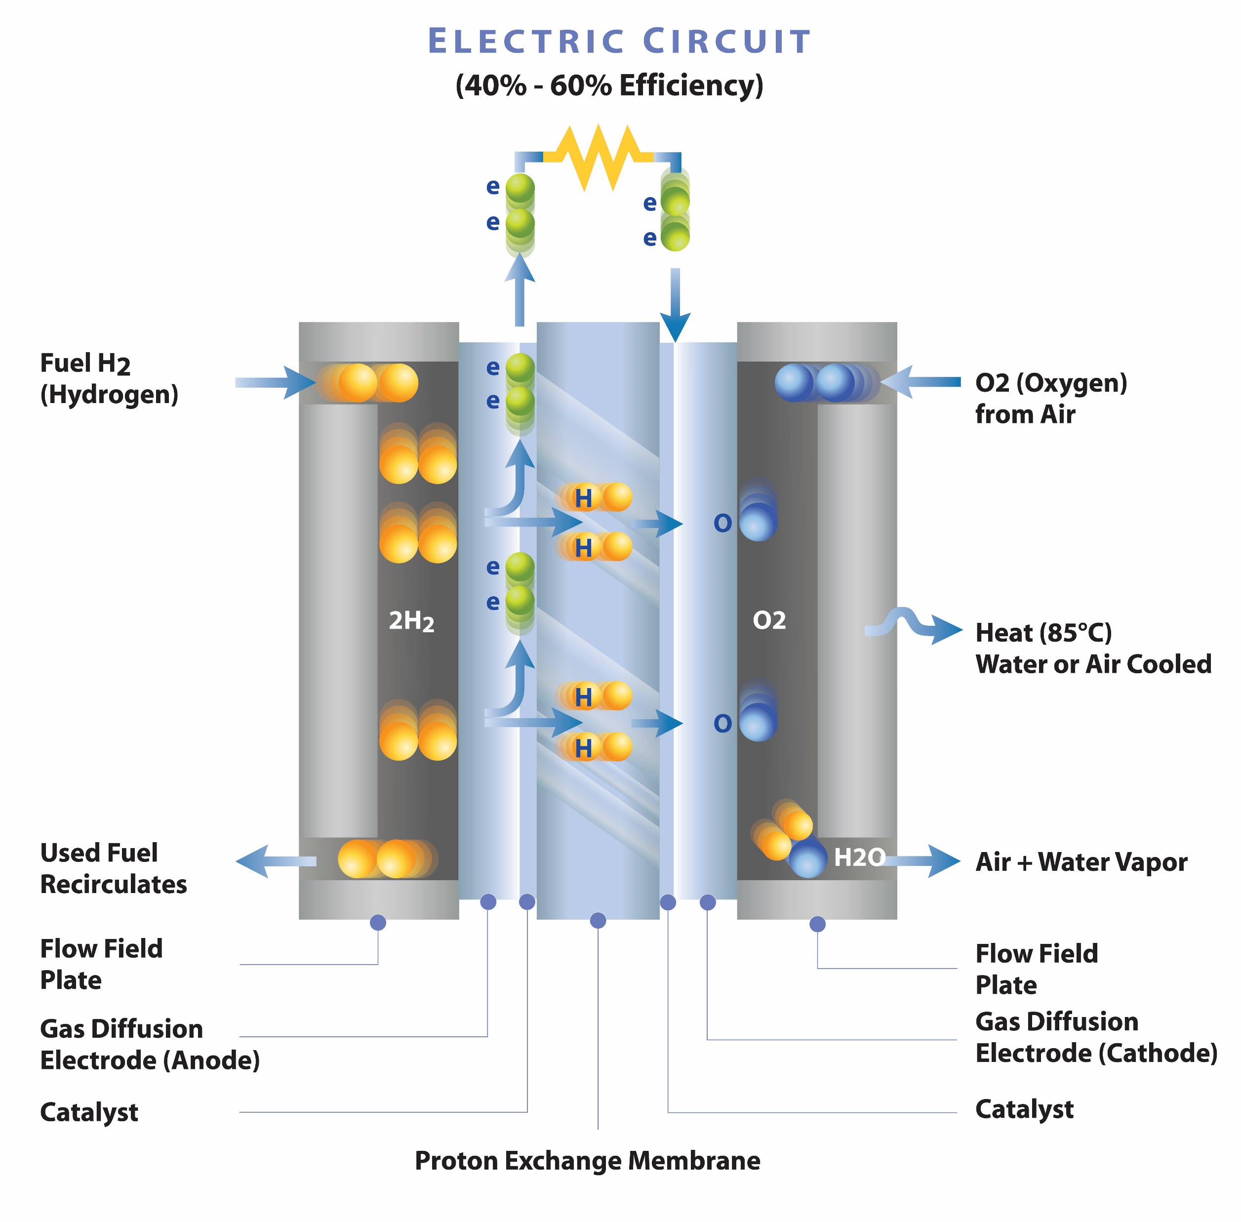
5
What is a fuel-cell?
A fuel cell combines hydrogen fuel and oxygen from the air to produce electrical energy efficiently, quietly and reliably. The only by-products are water and heat.
Fuel cells produce electricity without combustion, which means that, unlike internal combustion engines, they generate little (if any) noise, vibration, air pollution, or greenhouse gasses and operate at high efficiency over a wide range of loads.
Unlike batteries, fuel cells do not have a need for replacement or lengthy recharging when its fuel is spent. Additionally, since fuel-cells store their fuel in external storage tanks, the maximum operating range of a fuel cell-powered device is limited only by the amount of fuel that can be carried.
Watch this animation to see how a fuel cell works.
Company Registration no: 12214576 VAT Registration no: GB 333 9869 60

Slide 6
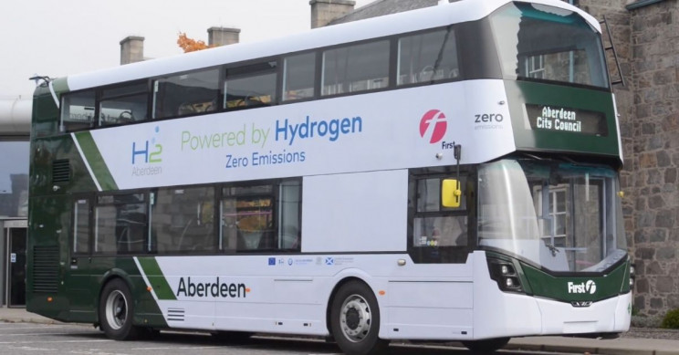
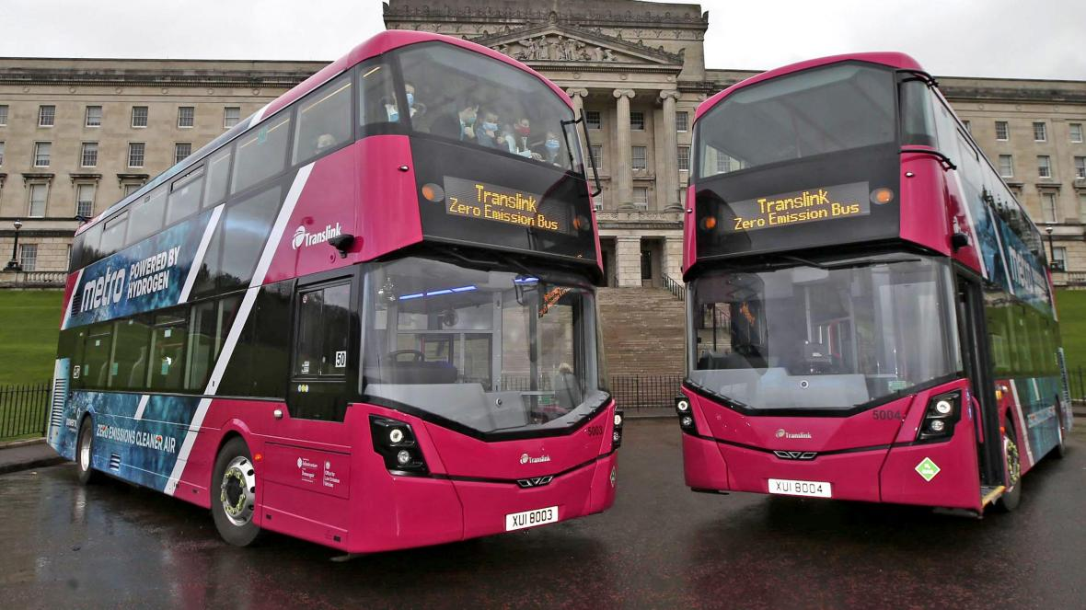
Orders for 120+ FCEV buses:
6
6
Manufacturer of the Worlds First Double-Deck FCEB
Company Registration no: 12214576 VAT Registration no: GB 333 9869 60
Company Registration no: 12214576 | VAT no: GB 333 9869 60

Slide 7
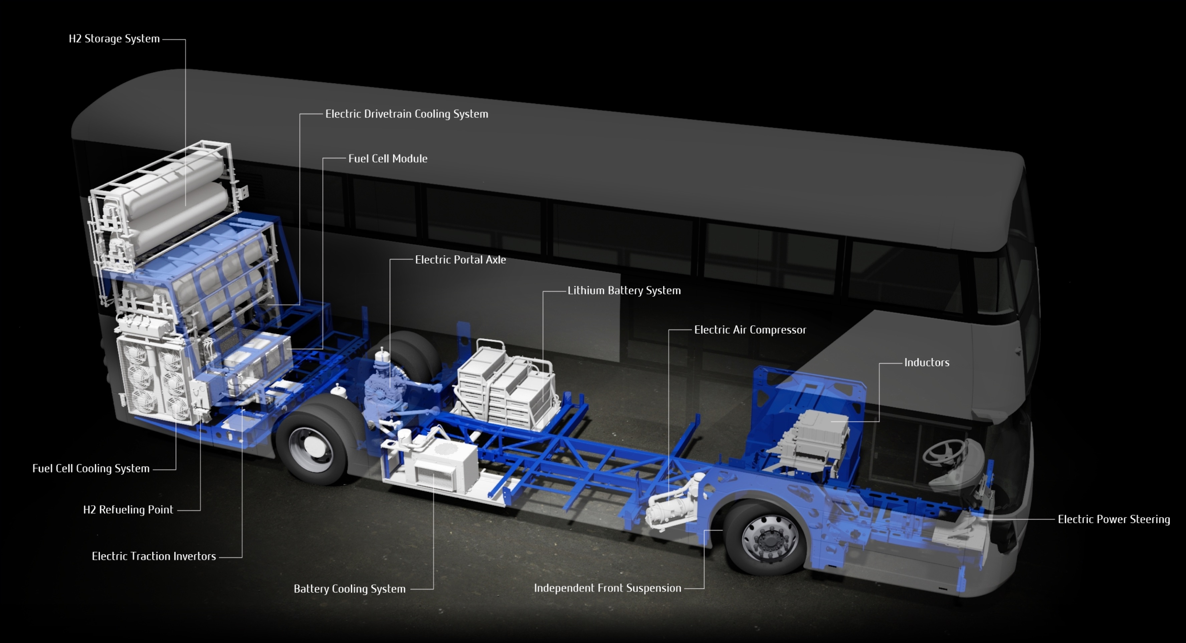
7
Fuel Cell Electric Vehicle First generation FCEV Streetdeck
7
Company Registration no: 12214576 VAT Registration no: GB 333 9869 60
Company Registration no: 12214576 | VAT no: GB 333 9869 60

Slide 8
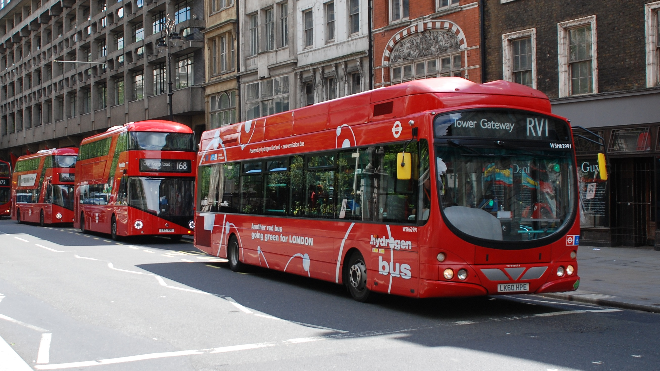
8
Fuel-cell Electric Bus Experience
8
Single-deck FCEB operated in London from 2011
Over 2,000,000km travelled
Fuel cell module lasting over 35,000 hours
Company Registration no: 12214576 VAT Registration no: GB 333 9869 60
Company Registration no: 12214576 | VAT no: GB 333 9869 60

Slide 9
9
Customer Advisory Tools
9
Our Advanced Engineering team, in collaboration with QUB have developed several customer advisory tools to support the decision-making process for vehicle operators:
F_{acc}
F_{aero}
Technology Recommendation (FCEV or EV?)
Range/remaining capacity
Complete the daily maximum distance?
Complete in winter/summer conditions?
How much capacity is left?
Number of refuelling/recharging events?
F_{rr}
mg
1. Identify Routes for Analysis
2. Generate Duty Cycles
3. Vehicle Simulations
Customer timetable data?
Weekday/Sat/Sun mileage?
Routes for tender.
Bamford Technology Centre - Queen’s University, Belfast
Velocity/elevation profile of the bus: stops, traffic, acceleration/braking, etc.
Vehicle power demands
Energy/ fuel-consumption
Company Registration no: 12214576 VAT Registration no: GB 333 9869 60
Company Registration no: 12214576 | VAT no: GB 333 9869 60

Slide 10
10
Technology Recommendation
10
Example analysis – recent simulation results of bus routes in a UK city with challenging winter conditions/inner-urban and outer-urban environments:
Suitable for the inner-urban style routes with lower daily mileage (approx. 35% of routes).
Suitable for BOTH the inner-urban and outer-urban style routes with high daily mileage (approx. 65% of routes).
Company Registration no: 12214576 VAT Registration no: GB 333 9869 60
Company Registration no: 12214576 | VAT no: GB 333 9869 60

Slide 11
11
11
H₂ Mobility: Wrightbus Hydrogen Fuel-Cell Buses
Thanks for Listening!
Dr Robert Best Director of Engineering
Bamford Bus Company T/A Wrightbus
15/04/2021
Company Registration no: 12214576 VAT Registration no: GB 333 9869 60
Company Registration no: 12214576 | VAT no: GB 333 9869 60

