Slide 1
GenComm Spring Series of H₂ Webinars
SMARTH2
Webinar 3:
Hydrogen opportunities emanating from Energy Transition
29th April 2021
Place image in this area.

Slide 2
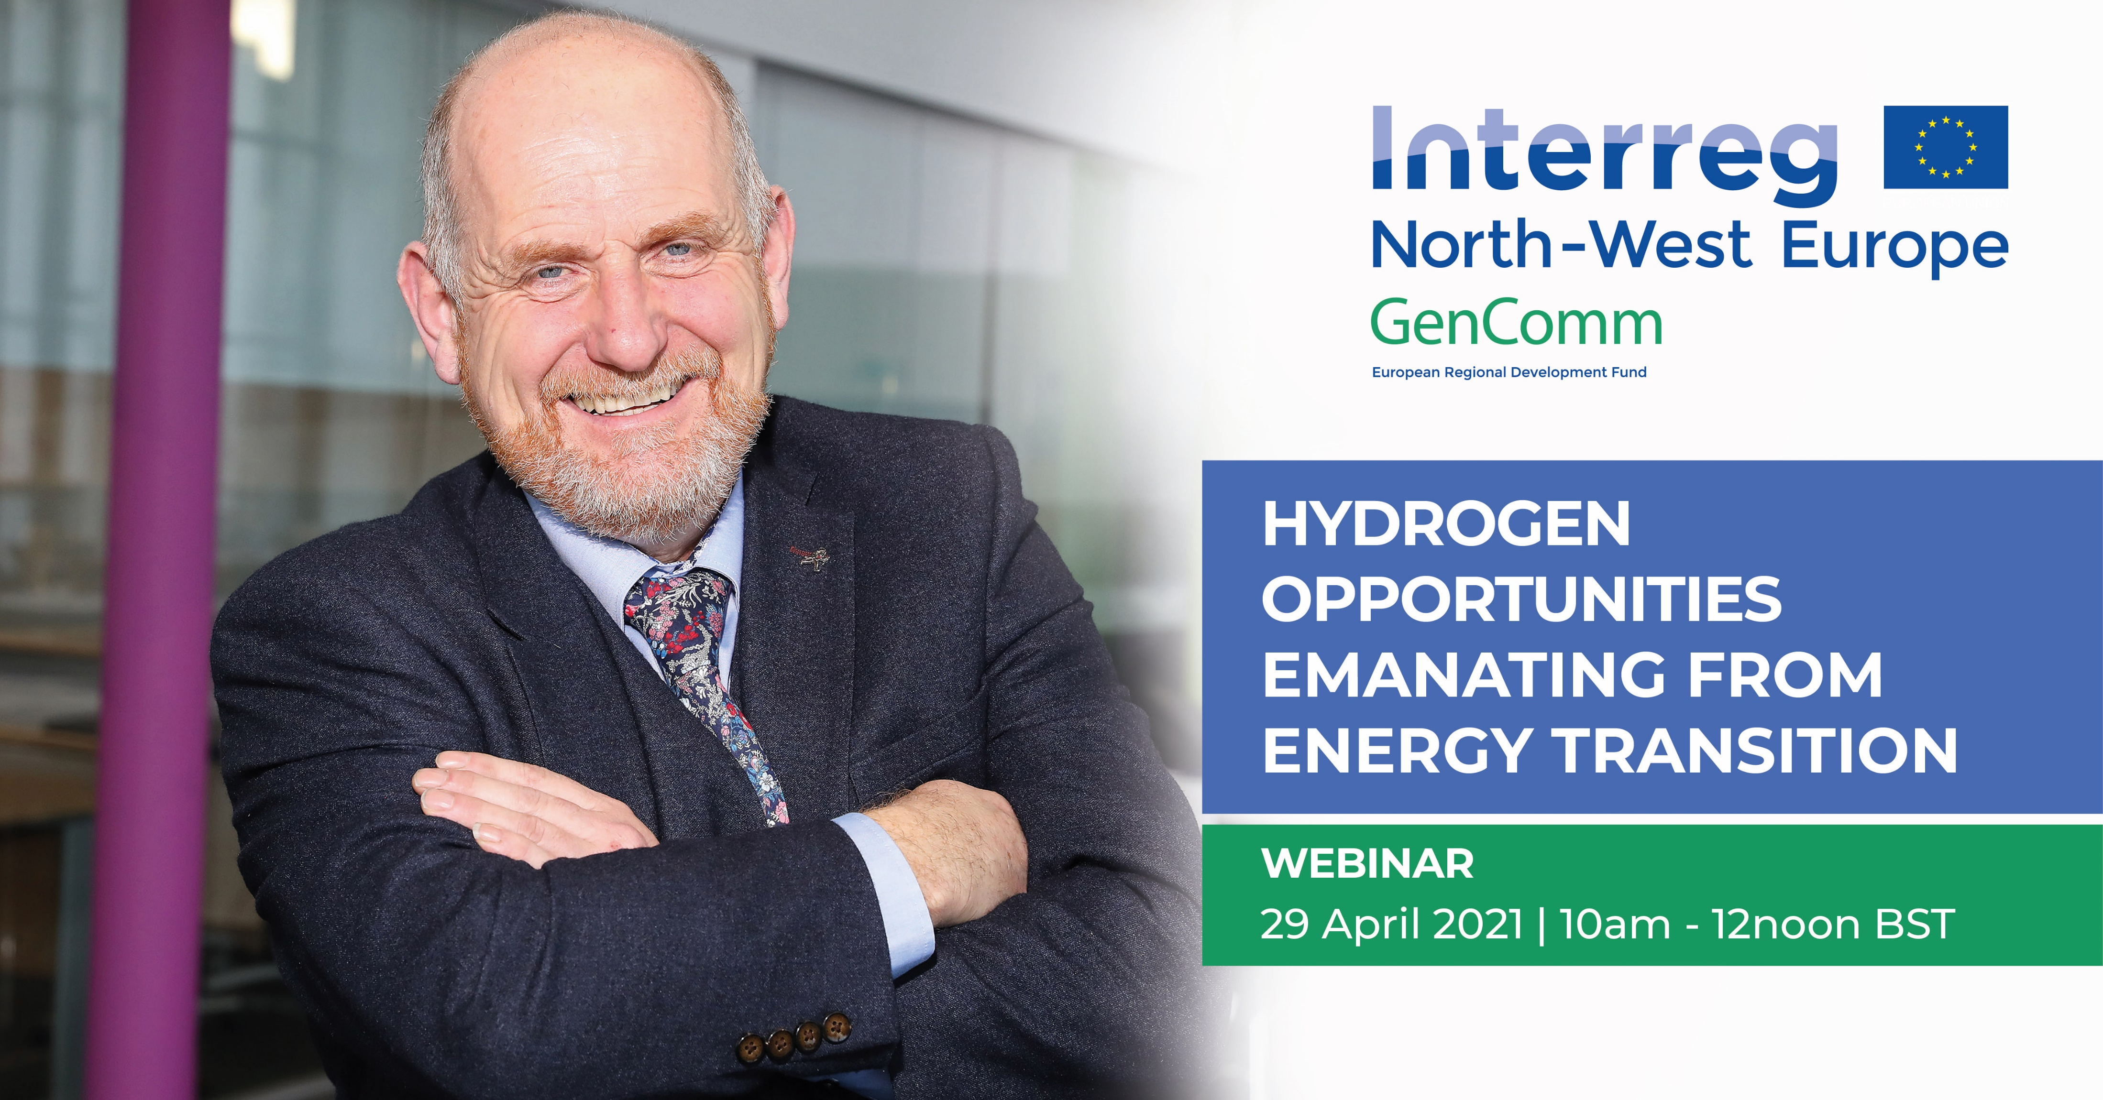
Welcome & Introduction
Paul McCormack, Belfast Met & GenComm
GenComm Spring Series of H₂ Webinars - Webinar 3: Hydrogen opportunities emanating from Energy Transition

Slide 3
Agenda 10:00 - 10:10: Welcome & Introduction, Paul McCormack, Belfast Met & GenComm 10:10 - 10:30: Intro, Thomas Byrne, DfE 10:30 - 10:50: Large Scale Energy Storage, Dr. James Carton, DCU & Hydrogen Ireland ​​​ 10:50 - 11:10: Sustainable Hydrogen Supply/Demand - Scaling Up, Diana Raine, HyEnergy & GenComm 11:10 - 11:30: Exploring opportunities in the Northern Ireland Energy Transition, Dr. Rory Monaghan, NUI Galway & GenComm
GenComm Spring Series of H₂ Webinars - Webinar 3: Hydrogen opportunities emanating from Energy Transition

Slide 4
Hydrogen - a fundamental pillar of energy policy of the EU
It is a key component of the EU Strategy for Energy System Integration and has been included in the TEN-E framework. To unlock hydrogen’s benefits the EU hydrogen strategy targets 6 GW of electrolyser by 2024 and 40 GW by 2040, with heavy-duty transport identified as a key sector.
Globally, hydrogen trucks, buses and cars are now being deployed at large scale: 1,600 hydrogen trucks are being deployed in Switzerland by 2025 and manufacturers target 100,000 hydrogen trucks in Europe by 2030. WrightBus is deploying 600 fuel cell buses across Europe by 2023, targeting the supply of 3,000 fuel cell buses to the UK by 2024 and are investing £22m (alongside £11.2m funding) to further develop and manufacture low-cost hydrogen fuel cell buses.
GenComm Spring Series of H₂ Webinars - Webinar 3: Hydrogen opportunities emanating from Energy Transition

Slide 5
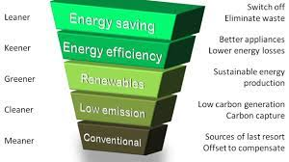
The Hierarchy of Energy Efficiency
The EU energy integration strategy recognises the hierarchy of energy efficiency, electrification and then the use of renewable molecules, e.g., green hydrogen. Member states are recognising this and providing support programmes for hydrogen and hydrogen mobility.
GenComm Spring Series of H₂ Webinars - Webinar 3: Hydrogen opportunities emanating from Energy Transition

Slide 6
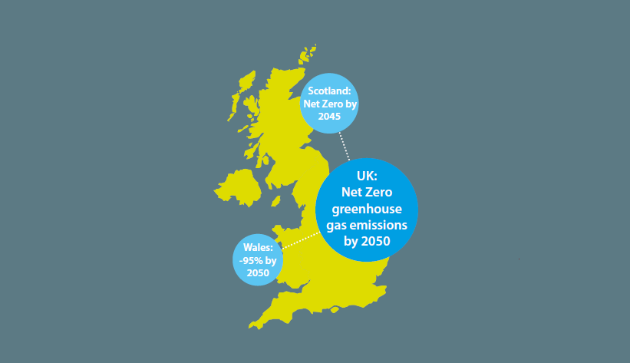
Net-zero emission Northern Ireland
What will be Hydrogen’s role in the final energy mix of a future net-zero emission Northern Ireland?”
Achieving net-zero emissions is an immense challenge and it is the EU that this goal cannot be achieved without green hydrogen.
Introducing hydrogen - a new energy vector - is a challenge.
GenComm Spring Series of H₂ Webinars - Webinar 3: Hydrogen opportunities emanating from Energy Transition

Slide 7
H2 Investments
France has announced €7 bn of funding for hydrogen (with 27% for earmarked for transport) and targets 100 refuelling stations by 2023.
Portugal has announced €7-9 bn of investment in hydrogen technologies to 2030.
The UK is providing a subsidy per kilogram sold through the RTFO7, which provides up to £7.25/kg H2 alongside capital support schemes.
The PM of Australia, Scott Morrison, “We are investing around $20 billion to achieve ambitious goals that will bring the cost of clean hydrogen, green steel, energy storage and carbon capture to commercial parity. We expect this to leverage more than $80 billion in investment in the decade ahead. In Australia our ambition is to produce the cheapest clean hydrogen in the world, at $2 per kilogram Australian. Mr President, in the United States you have the Silicon Valley. Here in Australia we are creating our own ‘Hydrogen Valleys’. Where we will transform our transport industries, our mining and resource sectors, our manufacturing, our fuel and energy production”.
GenComm Spring Series of H₂ Webinars - Webinar 3: Hydrogen opportunities emanating from Energy Transition

Slide 8
Hydrogen is a major opportunity
for Northern Ireland
The development of a hydrogen ecosystem offers significant opportunities:
Hydrogen offers a practically zero emission (particulates and CO2) fuel for the transport sector.
Hydrogen is well suited for heavy-duty and high-use applications where battery electrification faces significant challenges.
Jobs are created and imported fossil fuels are replaced with locally produced hydrogen.
Hydrogen offers the major opportunity to export our renewable resources.
Hydrogen is a form of long-term renewable energy storage.
Hydrogen can facilitate the integration of additional renewable energy into our energy system. In turn, this increases security of supply and eases system-wide pressures on the electricity network (less renewables and network infrastructure required).
GenComm Spring Series of H₂ Webinars - Webinar 3: Hydrogen opportunities emanating from Energy Transition

Slide 9
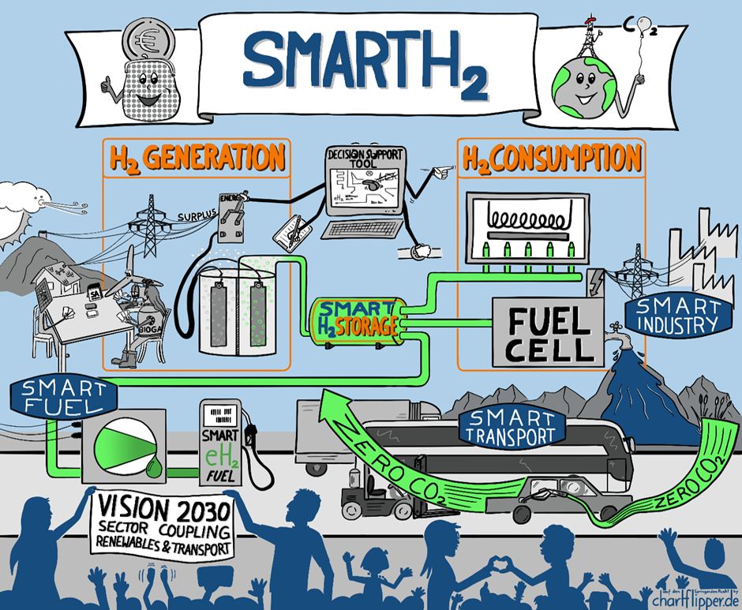
Northern Ireland Opportunity
Hydrogen yes but with our own slant.
Developed and dedicated to meet our energy needs, opportunities and commercial growth.
GenComm Spring Series of H₂ Webinars - Webinar 3: Hydrogen opportunities emanating from Energy Transition

Slide 10
Hydrogen Optimisation Support Tool
Optimising hydrogen production, storage and use.
Actualising the CH2F to valorise and maximise the green energy outputs.
Evaluation parameters of performance and benefits realisation.
Validating P2X H2 technologies to be deployed in emerging scenarios.
Developing long term strategies for the advancement in adoption of hydrogen technologies.
Mapping Energy Navigation Routes for the transition of the EU energy system to the green destination.
GenComm Spring Series of H₂ Webinars - Webinar 3: Hydrogen opportunities emanating from Energy Transition

Slide 11
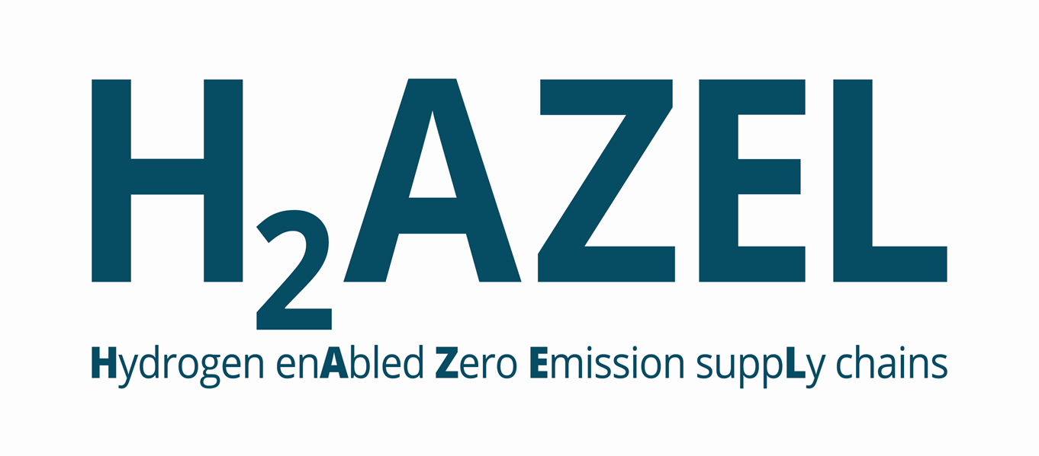
GenComm Spring Series of H₂ Webinars - Webinar 3: Hydrogen opportunities emanating from Energy Transition

Slide 12
H2 CAT
CAT
the pathway for increased NI competitiveness
- the catalyst for hydrogen innovation, entrepreneurship and deployment.
GenComm Spring Series of H₂ Webinars - Webinar 3: Hydrogen opportunities emanating from Energy Transition

Slide 13
Innovation for Sustainability
We are at a perfect point in time to embrace business models that tackle our global challenges like over exploitation and pollution by extending our resources for continual use.
Develop an energy circular economy.
Applying circular thinking to the energy industry will not only empower us to become more innovative, it will also offer cost-effective and efficient solutions for making the energy transition a reality.
GenComm Spring Series of H₂ Webinars - Webinar 3: Hydrogen opportunities emanating from Energy Transition

Slide 14
Audience Poll
As we travel along our energy transition journey where do you think the greatest opportunity lies in the short term?
Decarbonising our energy system.
Opening our energy system for more renewables integration.
Provision of greater energy security opportunity.
Commercial opportunities from innovation within the new energy value chain.
Other.
To answer the question, please use the chat function.
GenComm Spring Series of H₂ Webinars - Webinar 3: Hydrogen opportunities emanating from Energy Transition

Slide 15
Social Distance Calling Card
GenComm Website - nweurope.eu/gencomm
LinkedIn - GenComm
Twitter - @GenComm_CH2F
Community Hydrogen Forum – CH2F - communityh2.eu
Hydrogen Ireland website - hydrogenireland.org
GenComm Spring Series of H₂ Webinars - Webinar 3: Hydrogen opportunities emanating from Energy Transition

