Slide 1
Energy Strategy for Northern Ireland
Thomas Byrne
Department for the Economy

Slide 2
Options Consultation
Published on 31 March and open until 30 June.
Seek views and evidence on:
Strategic framework
Illustrative scenarios
Potential policy options
Total of 79 questions – only answer those most relevant.

Slide 3
Our Vision
“Net Zero Carbon and Affordable Energy”

Slide 4
Our Opportunity
Market leader in renewable electricity: almost 50% of electricity consumption from renewables.
Unique strengths: size; world-leading wind resources; rural agriculture base; modern gas network; publicly-owned assets.
Economy built on net zero carbon: £1.1bn turnover and 5,300 jobs; economic recovery plan; advanced manufacturing base.
Consumers at the centre: energy seen not just as a cost but as a direct opportunity to participate in addressing climate change.

Slide 5
Our Principles

Slide 6
Key proposals include:
Establishing a new “one stop shop” for consumers.
Measures to ‘enable and protect’ consumers.
Ensuring affordability and fairness for consumers.

Slide 7
Key proposals include:
Maximising the economic impact of energy efficiency, renewable energy and the circular economy policies.
Growing the hydrogen economy through production, demand and supply chain opportunities.
A pilot green innovation challenge fund.
Establishing an energy skills forum.

Slide 8
Key proposals include:
Introducing an energy savings target, minimum energy efficiency standards for buildings and uplifted building regulations.
Comprehensive additional energy efficiency support for domestic and non-domestic consumers.
Building consumer trust and confidence in energy efficiency work carried out by the industry.
Supporting consumers to change how they use energy and travel.

Slide 9
Key proposals include:
A 70% renewable electricity target by 2030 with flexibility to increase this.
Extending ‘Contracts for Difference’ support and a targeted action plan for offshore & marine renewables.
A phased approach to removing fossil fuel heating sources.
Adopting on and off-gas grid approaches keeping a range of solutions open.
Pilot support for low carbon technologies and trials of heat pumps, decarbonised gas and biofuels.
EV infrastructure plan and demonstrator projects to trial alternative vehicle fuels.

Slide 10
Key proposals include:
More flexibility in our electricity infrastructure supported by markets that deliver for consumers.
Cost benefit analysis of smart meters to gather and use energy data as part of a smart system.
Enabling consumers and communities to generate, use, sell and share energy with access to market revenue streams.
Trials of geothermal, waste and biomass heat networks.

Slide 11
Policy Options Timeline
March 2021
Options Consultation
Apr-Jun 21
Consultation Period
July 21 onwards
Responses Inform Policy Development
Winter 21
New Energy Strategy
2022 onwards
Regular Reporting and Updating

Slide 12
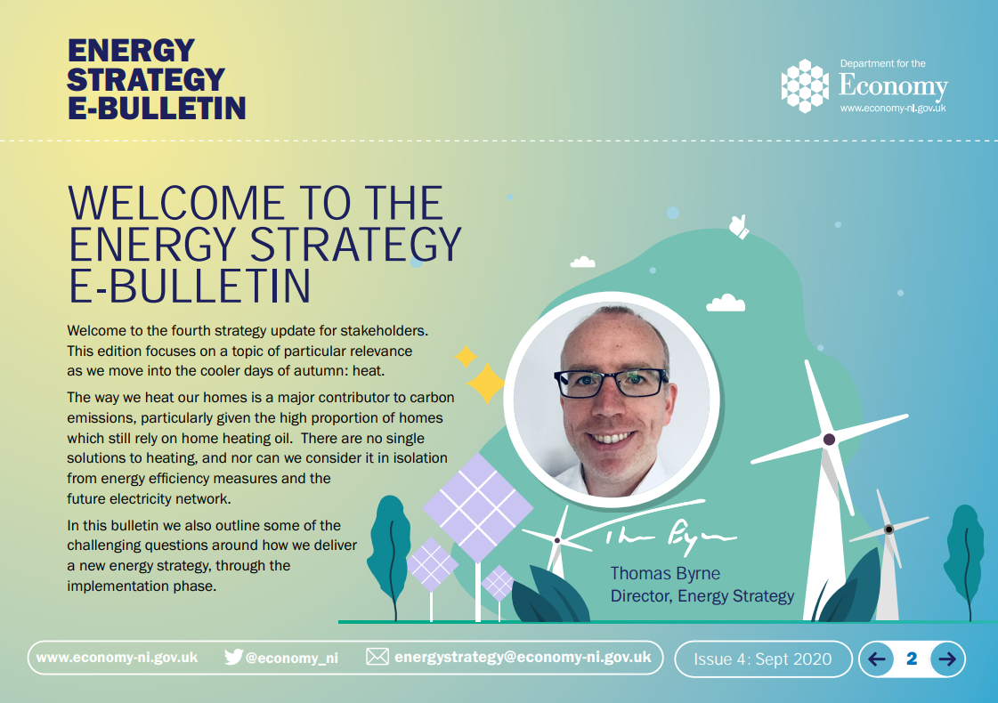
Keeping in touch
Join our stakeholder mailing list:
energystrategy@economy-ni.gov.uk

