Slide 1
Dr James Carton
Assistant Professor in Energy Sustainability & Hydrogen
Insight Centre / Dublin City University
MaREI Centre / UCC
World Energy Council - Hydrogen Advisor
United Nations ECE - Hydrogen Expert
Hydrogen Ireland Association – Co-founder
Hydrogen Mobility Ireland – Academic Advisor
James.carton@dcu.ie
@eaasolutions

Slide 2
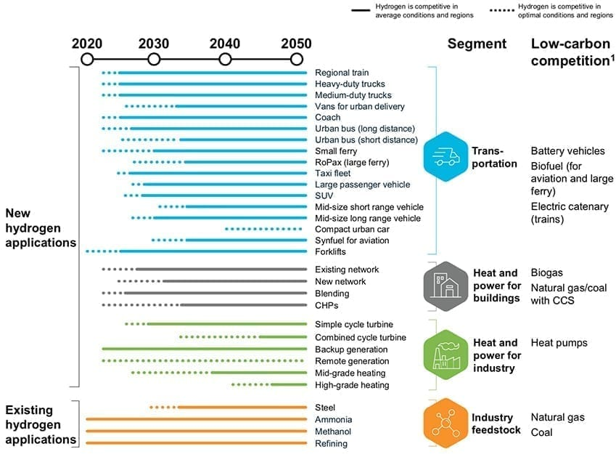
In which sectors & what applications should green hydrogen be deployed in the energy system? In what order / timeframe would likely progress?
Hydrogen Applications: Large Scale Energy Storage
Hydrogen Council

Slide 3
Hydrogen Applications: From the ground up…
Hydrogen Demand Hierarchy & Expected deployment (Ireland):
Industry – Ammonia, Steel, SemiCon, HVO, Oil, etc - 2021
Heavy Transport - 2025
Heavy Heat Loads – 2025
Gas Grid - heating / electricity CCGT/OC – 2025
Direct Electricity CHP CCGT/OC - 2030
Direct Electricity Grid Fuel Cell - >2035
* . Oxygen from Electrolysis for Waste Water/Industry - 2021

Slide 4
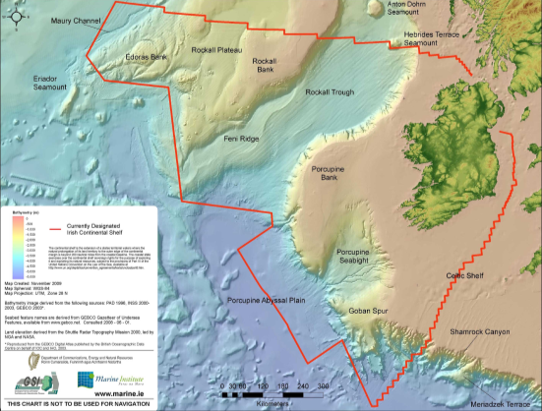
Irish Potential for Renewable Energy & Hydrogen
H₂
IRELAND:
Irish Offshore Territory: c.880,000km²
Offshore Wind capacity >50 GW
East & South offshore 4 GW by 2030
Capacity factors >45%
Hydrogen Produced for 2-3€/kg 2025*
Decarbonise by 2050
*SFI Funded “H2West” Project
H₂

Slide 5
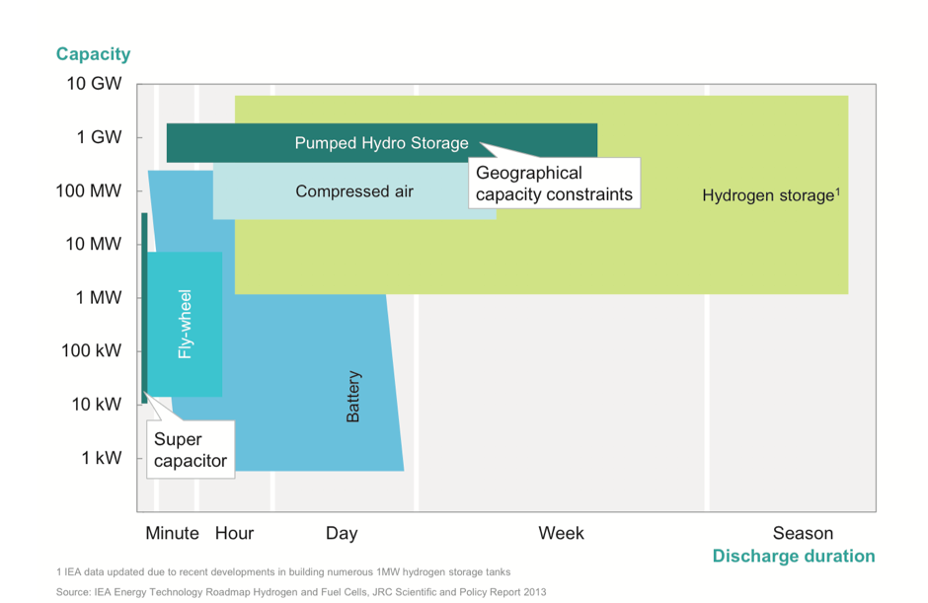
The Scale of Energy Storage
https://hydrogeneurope.eu/hydrogen-storage

Slide 6
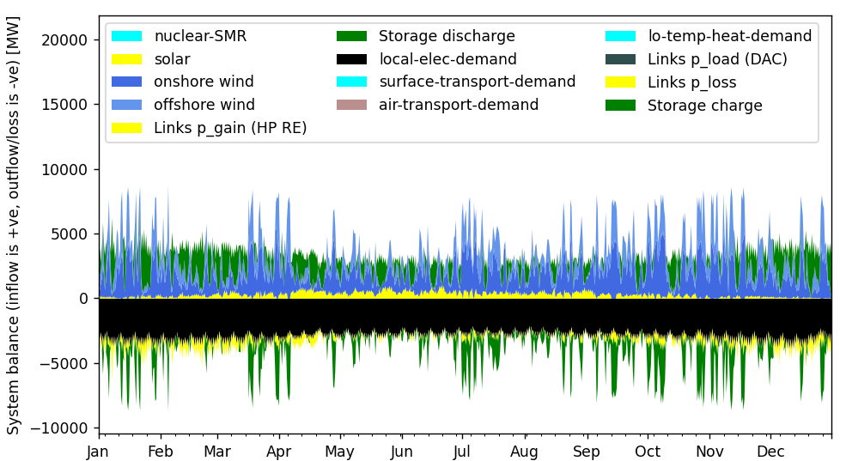
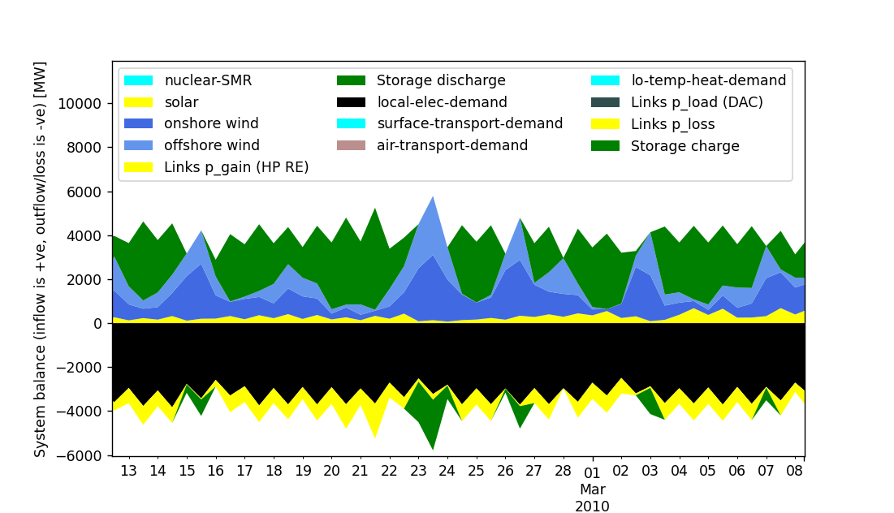
Zero Carbon Energy Scenario – “SWIS-100-IE”
Just Electricity Demand!
Model Run*:
Example Year: 2030
Weather Year: 2010
Energy Source: Wind (onshore & offshore) & Solar
Demand: Electricity
Balance: Interconnector, Battery & Hydrogen Gas Turbine
*SEAI Funded Project - Role of Heterogenous Energy Storage in Paris-Aligned Scenarios for the Irish Energy System
SEAI Curtailment Mitigation Project - https://www.seai.ie/documents/research-projects/RDD-000326.pdf

Slide 7
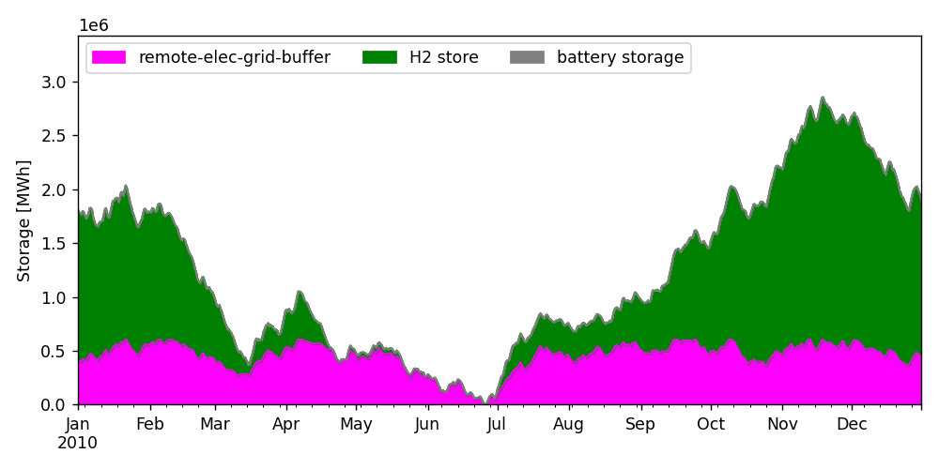
Irish Energy Storage (Hydrogen & Interconnector)
Just Electricity Demand!

Slide 8
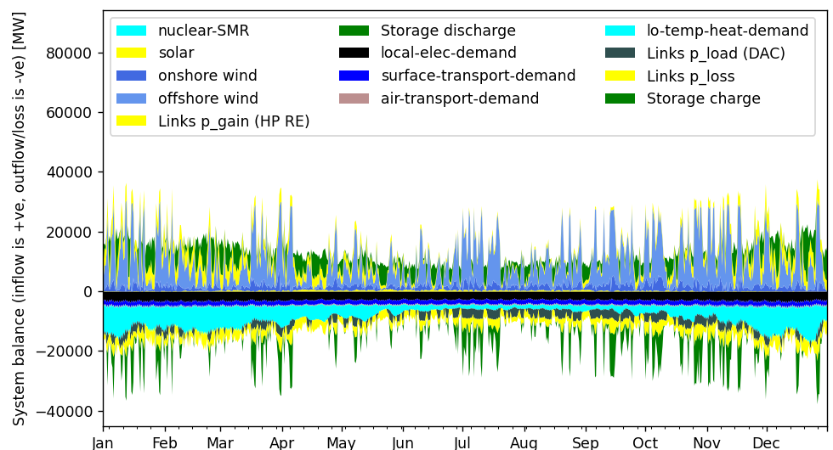
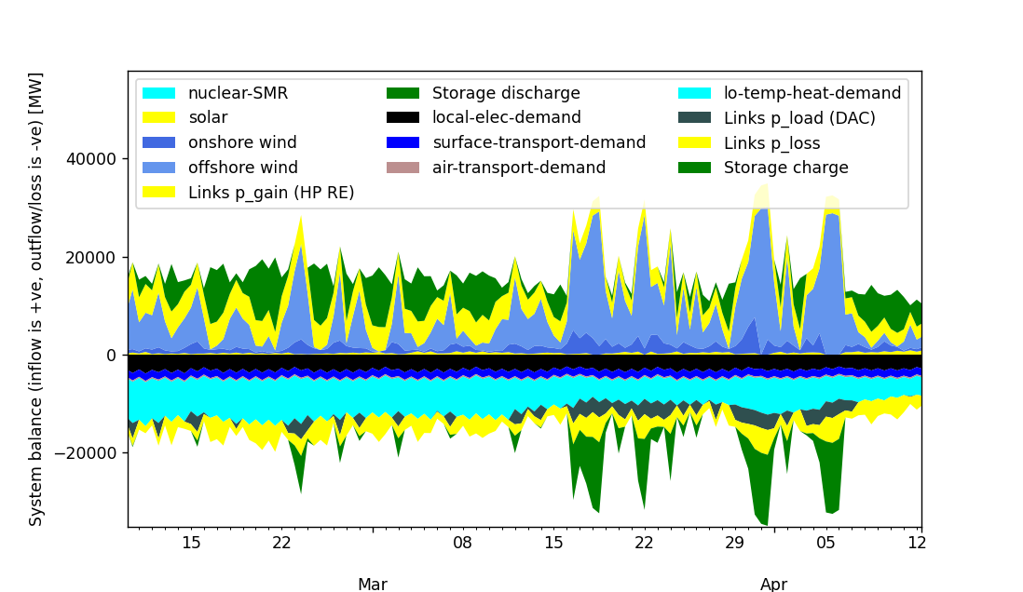
Negative Carbon Energy Scenario – “SWIS-100-IE”
Electricity, Transport, Heat, DAC & Aviation
Model Run*:
Example Year: 2030
Weather Year: 2010
Energy Source: Wind (onshore & offshore) & Solar
Demand: Electricity, Transport, Heat, DAC & Aviation
Balance: Interconnector, Battery & Hydrogen Gas Turbine
*SEAI Funded Project - Role of Heterogenous Energy Storage in Paris-Aligned Scenarios for the Irish Energy System

Slide 9
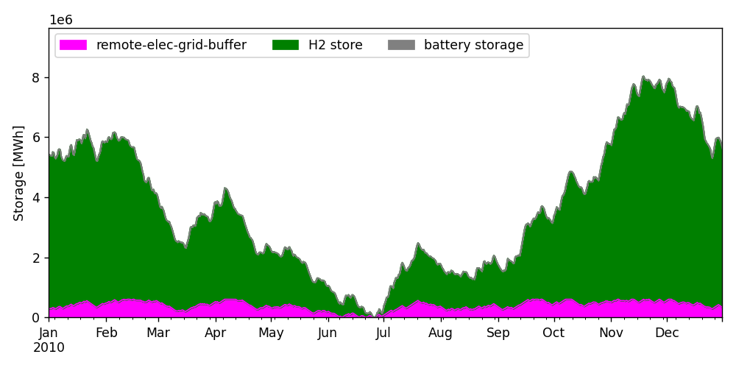
Irish Energy Storage (Hydrogen & Interconnector)

Slide 10
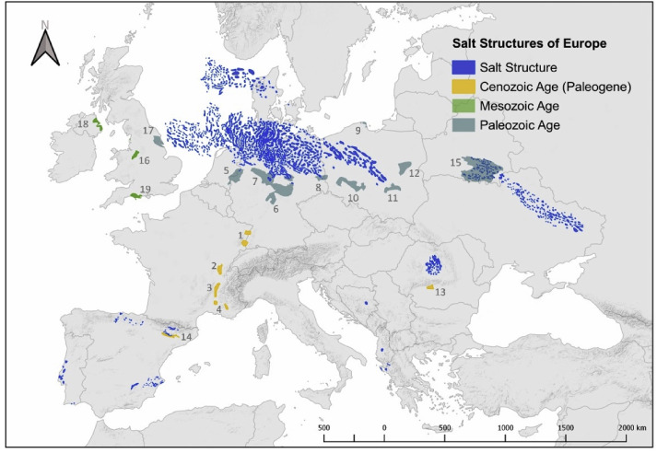
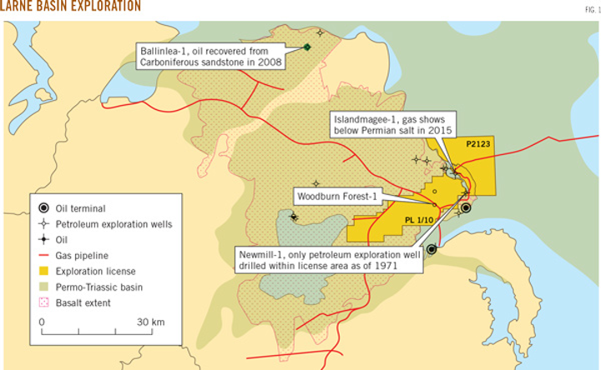
Suitable European salt deposits for Hydrogen Storage
Technical potential of salt caverns for hydrogen storage in Europe
https://www.ogj.com/exploration-development/discoveries/article/17209796/larne-basin-exploration-weighs-carboniferous-potential

Slide 11
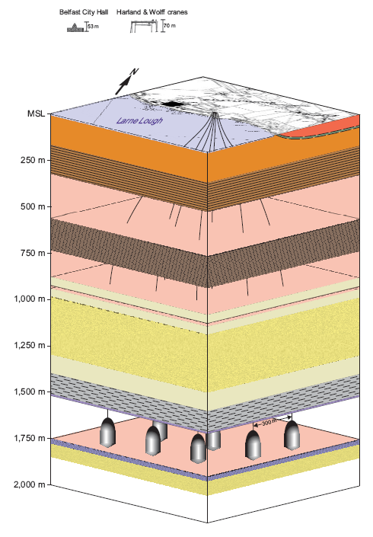
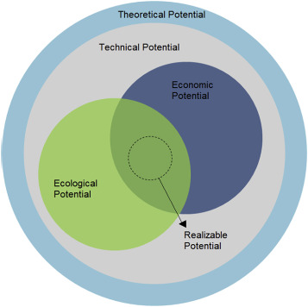
Suitable Hydrogen Storage Potential on the Island
>180 TWh
>100 TWh
>10 TWh
Example: IslandMagee Gas Storage Facility
Northern Ireland
c.2TWh hydrogen storage capability
Salt Storage Potential “Larne”
https://www.islandmageeenergy.com/project-overview/#how-gas-works
Technical potential of salt caverns for hydrogen storage in Europe

Slide 12
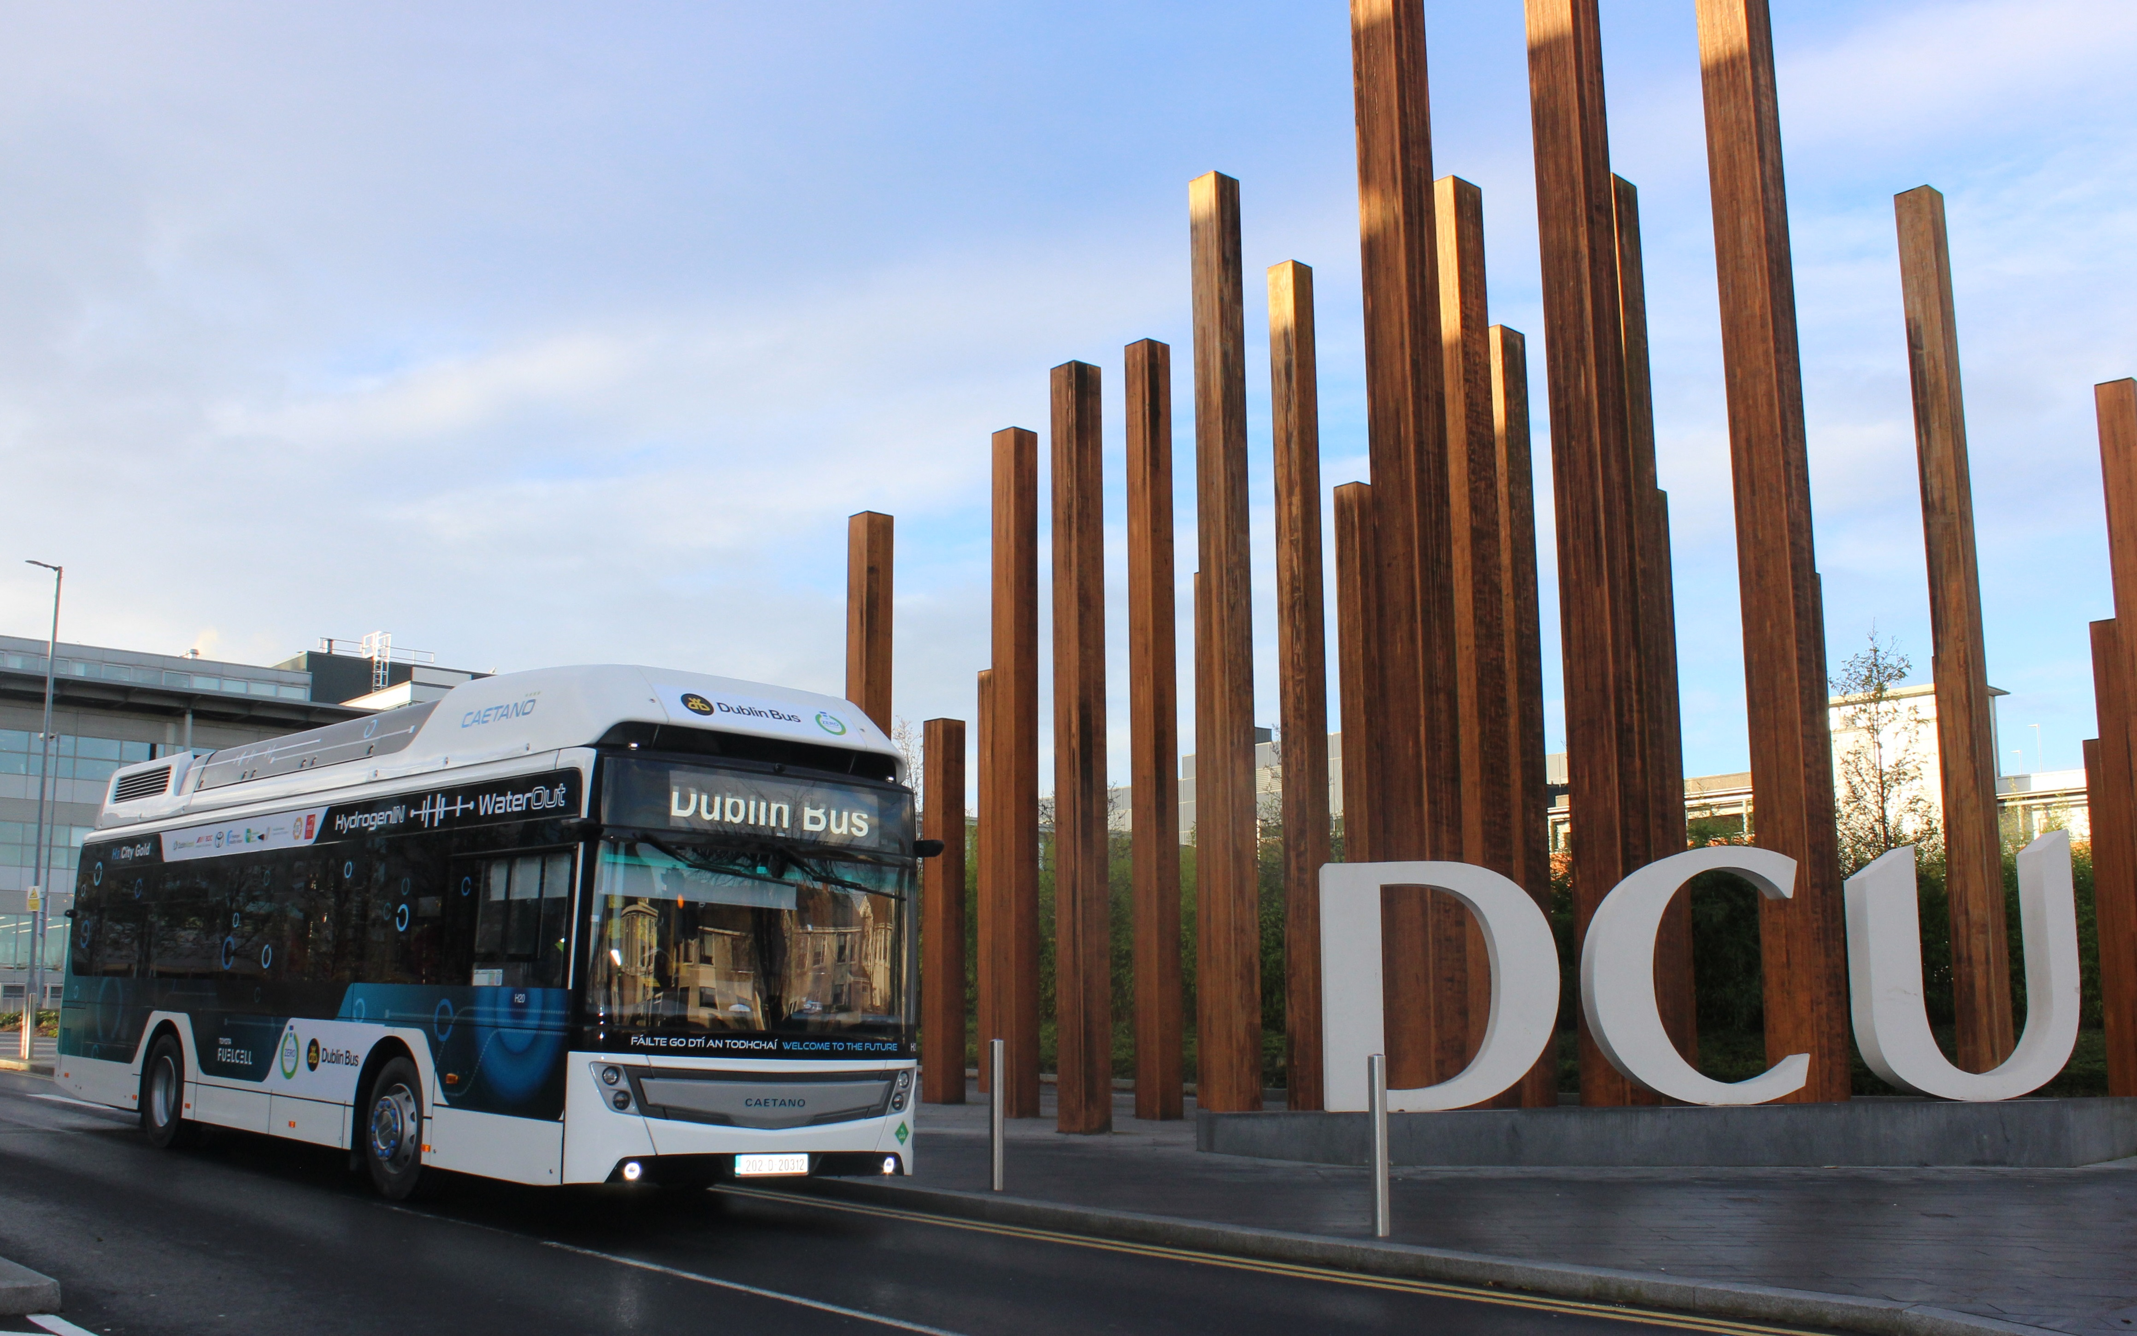
Thank You.
Questions Welcome.
The 1st Hydrogen Bus in Ireland 2020
James.carton@dcu.ie

