Slide 1
Sustainable Hydrogen Supply/ Demand Scaling Up
Diana rainE
29th April 2021

Slide 2
HyEnergy
A specialist hydrogen energy company
Unite the hydrogen and energy communities
Create interconnected sustainability projects
Ensure systems and technologies gain commercial acceptance by delivering low cost, clean, onsite energy solutions
We work with a variety of stakeholders
industry, regional public sector organisations and national governments
Our projects include:
€130m+
of funding and investments secured
30
Key Customers
50
Years of H2 Sector Experience
Notes:
2

Slide 3
Contents
EU targets
Sector and regional coupling
Preparing for hydrogen
Application Technology is Ready
Demand Growth
Supply Options
Electrolyser Growth and Scaling
Summary

Slide 4
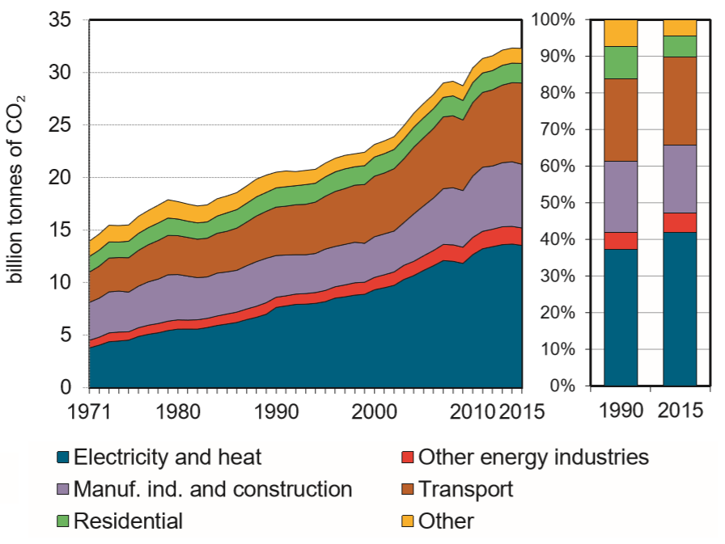
The path to Net Zero
Global energy-related GhG emissions 1975-2015
The Paris Agreement provided initial impetus and a framework for GhG emission reduction initiatives
By 2021, 195 Parties out of 197 have signed the agreement, and 189 have ratified it. 45 countries have submitted new NDC targets, and 113 have not updated their targets
Net Zero across all sectors is required by 2050 to give some chance of keeping global warming below 1.5 degrees Celsius
Source: iea

Slide 5
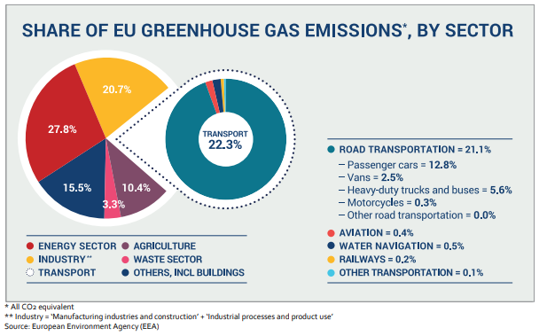
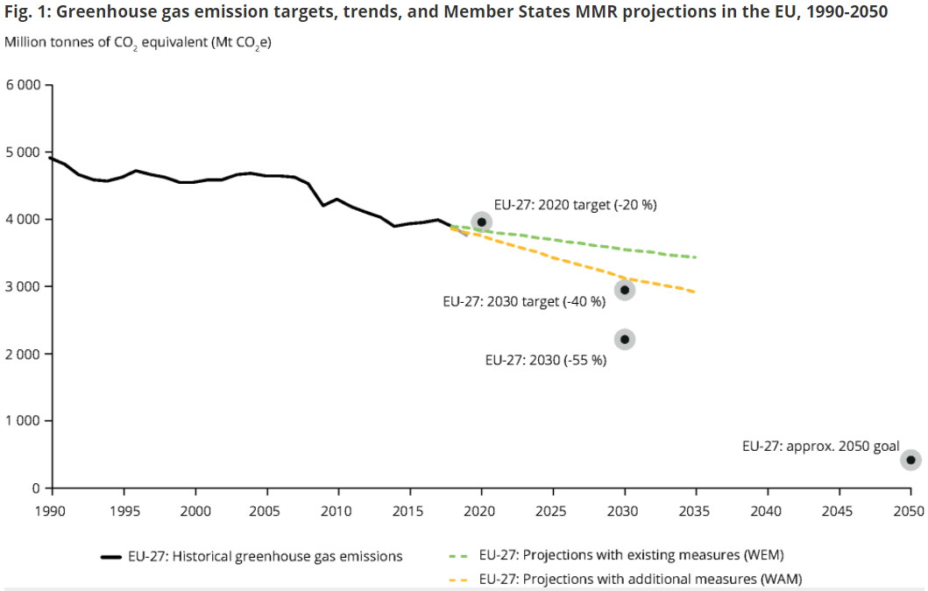
Progress is being made but not fast enough
Industry/energy, heating and fuel combustion and transport are the largest carbon polluting sectors
EU achieved its 2020 goal of reducing CO₂ emissions by 20% vs 1990 levels (24% achieved)
By 2030, projections based on current and planned measures of the EU-27 show an emission reduction of 36%
Further effort will certainly be necessary to achieve climate neutrality by 2050, in-line with Paris Agreement
On 20/04 UK announced target of 78% emissions reduction by 2035 cw 1990 levels, building on the UK’s NDC of at least 68% reduction in 2030

Slide 6
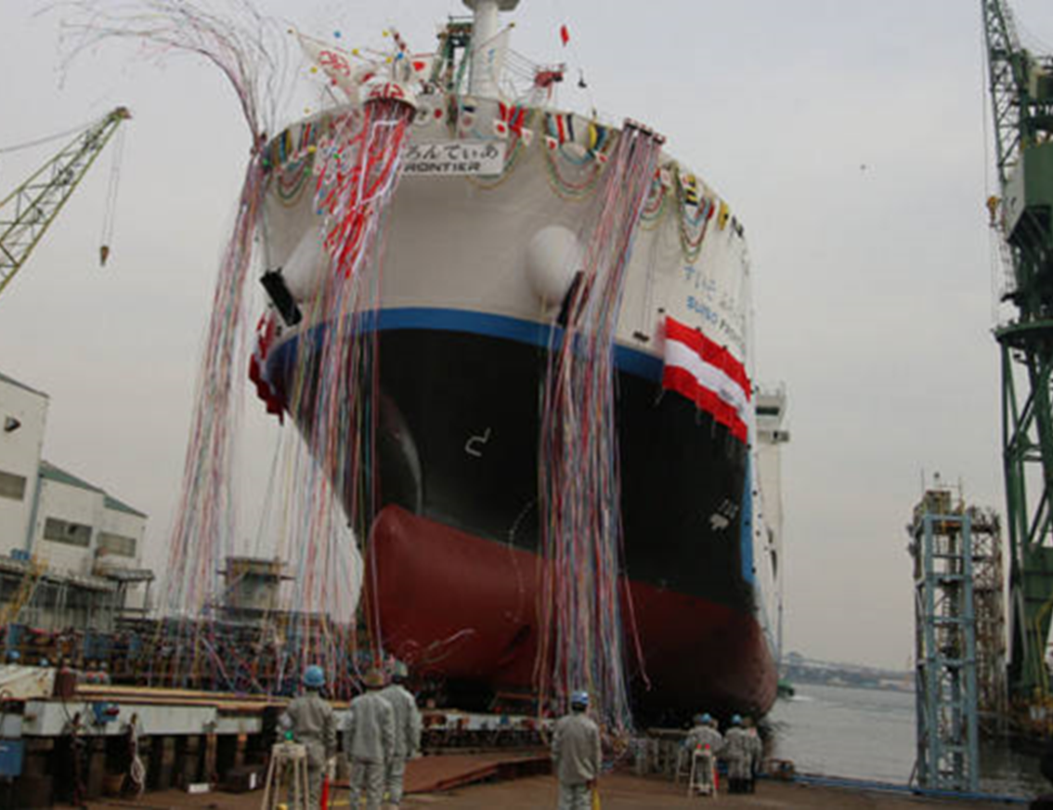
Energy sector and regional coupling is key…
2025 Headline:
Imports of renewable energy begin in Europe in the form of ammonia and methanol
2020 Headline:
Green hydrogen production costs are down 40% since 2015 and are expected to fall by a further 40% by 2025
Notes:
Fuel cells and hydrogen technologies have the potential to decarbonize hard to abate sectors like heavy duty road transport, maritime transport, and commercial and domestic heat.
The decarbonisation of all sectors will require a transformation of energy systems, providing opportunities for local companies to generate employment and value in the process
The various sectors involved in the energy transformation consist of complex sets of value chains which could either replace existing energy activities or create new avenues for value and job creation
FCH technologies could play a role in many sectors, stimulating economic growth and encouraging job creation

Slide 7
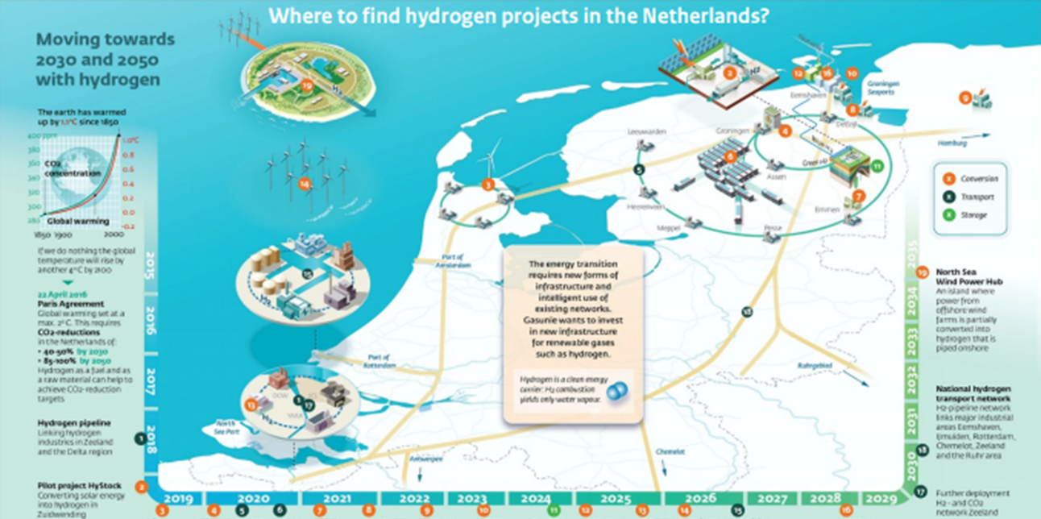
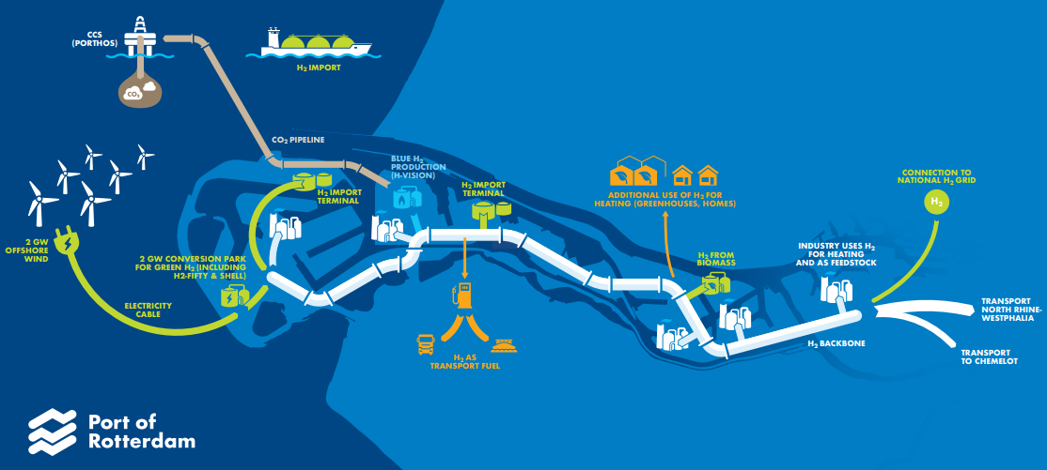
The world is preparing for hydrogen…
2020 Headline:
$44 billion will be invested in green and blue hydrogen projects in just five key European countries: France, Germany, Italy, Portugal, and Spain
Notes:
The EU Hydrogen strategy encourages the uptake of electrolysers, clean hydrogen generation, and the inclusion of hydrogen in energy infrastructure policies and legislation
Most NECPs defined in the Governance Regulation include hydrogen, some also fuel cells, to meet national targets
The Renewable Energy Directive will increase the penetration of renewables, creating opportunities for Power-to-X (PtX) and storage solutions, including stationary hydrogen and fuel cell solutions. It may also increase the demand for fuel cell vehicles, and provides incentive for fuel suppliers to produce clean fuels, including renewable natural gas
The Energy Efficiency directive could drive demand for stationary applications of fuel cell and hydrogen technologies, including natural gas fuel cells
The ETS and ESR will encourage the uptake of clean technologies, including hydrogen and natural gas fuel cells in sectors like steelmaking, chemicals, land and air transport, and potentially maritime transport
The EU Industrial strategy will encourage the development of European value chains for clean technologies, including hydrogen and natural gas fuel cells
The Energy System Integration Strategy highlights FC technologies as a way to decarbonize hard to abate sectors, like heavy-duty road transport, aviation, maritime transport, and energy-intensive industries. It also points to FC technologies’ role as PtX and storage solutions
The Green Deal Call includes areas that are relevant to FC technologies, with for example the second area with a focus on hydrogen production via electrolysis, or decarbonisation of industry (call area 3), the improvement of buildings’ energy efficiency (call area 4), and the greening of ports and airports (call area 5)

Slide 8
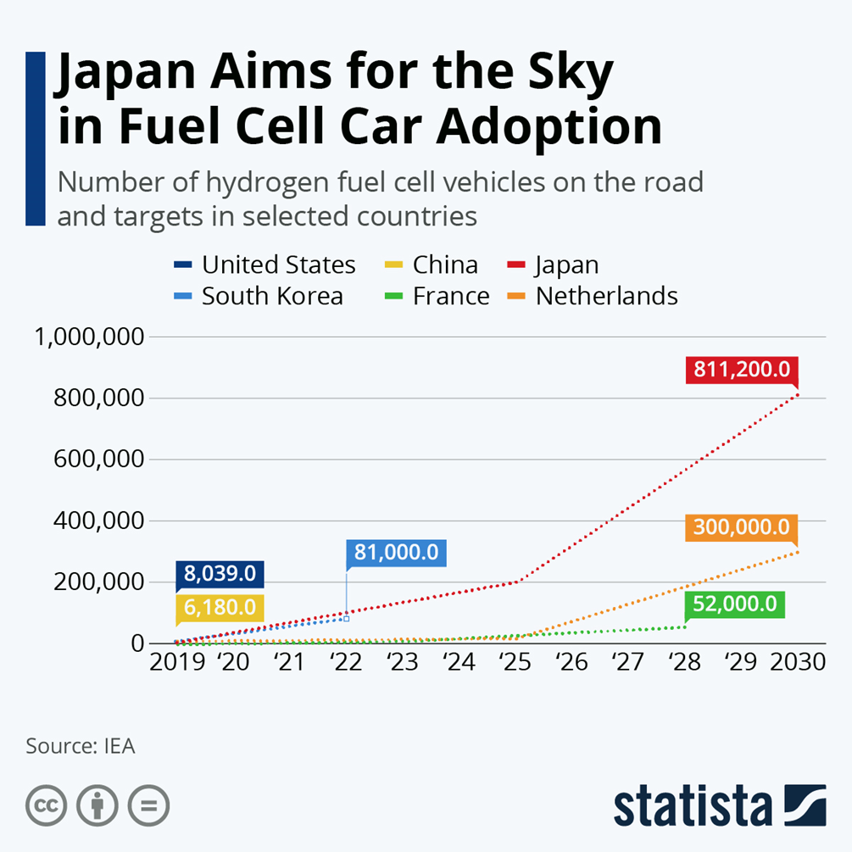
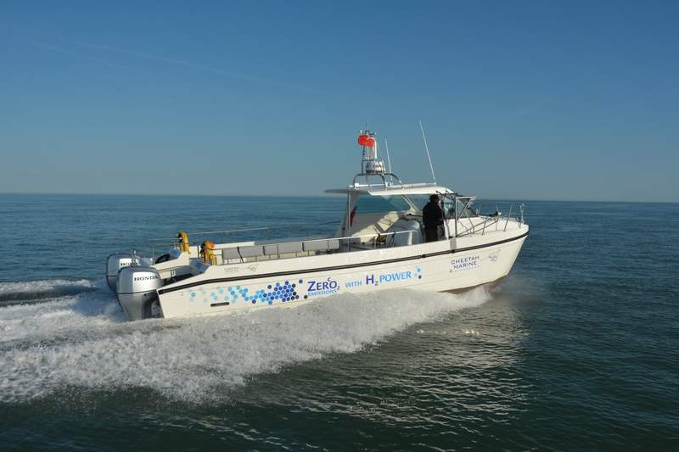
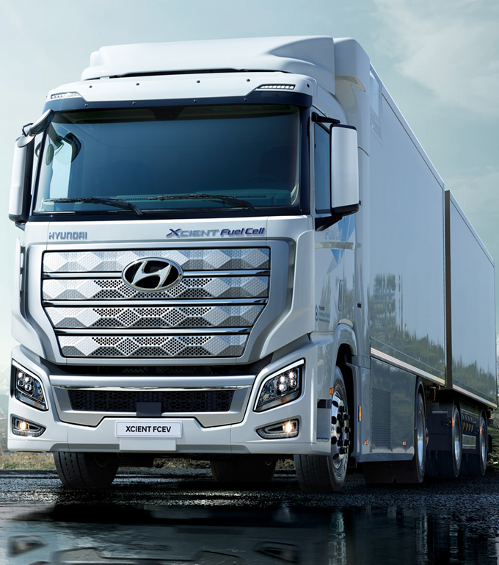
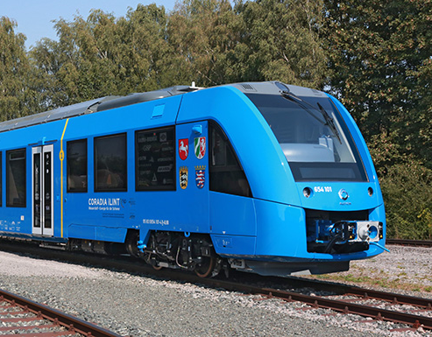
Tried, tested and available technology…creating market demand…
The integration of renewables with hydrogen has been used in many projects
2030- 2035 projected H2 fleet will include:
250,000 Passenger Vehicles/Vans
150,000 Buses
100,000 Trucks
1000 Trains
Hydrogen technology is proven and ready to be deployed, including:
Full integration with renewable energies
Electrolysers
Compressors
Lightweight storage
Refuelling stations
NG/H2 mixing systems
Hydrogen ready boilers
GenComm Spring Series of H₂ Webinars - Webinar 3: Hydrogen opportunities emanating from Energy Transition

Slide 9
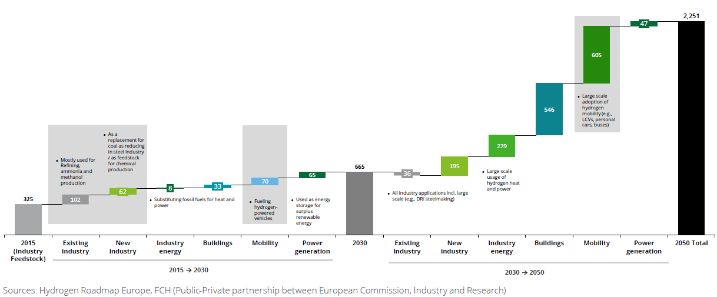
Hydrogen Demand Evolution
Industry and mobility are expected to be key contributors of incremental hydrogen demand by 2030
Potential Europe hydrogen demand evolution to 2030 by final use [TWheq]

Slide 10
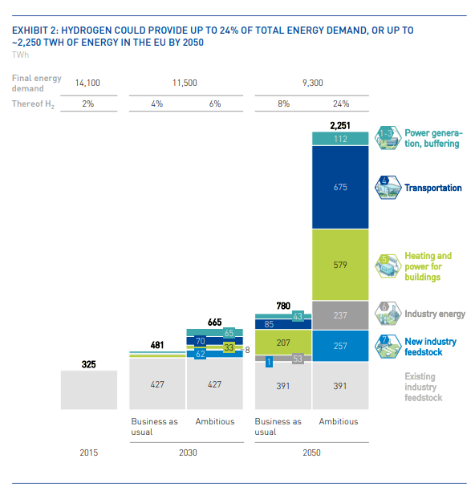
Key Future H2 Production Pathways
H2O
O2
Renewable Energy Source
Electrolyser
Green H2
EU favoured route
H2O
Natural Gas
Steam Methane Reformation Plant
Grey H2
Fossil benchmark route
Sequestering of CO₂ produced during the process
Blue H2
UK favoured route

Slide 11
Hydrogen demand forecast, IEA
1 920
1 600
1 280
960
640
320
0
0
14Mt hydrogen will be produced by electricity in 2030, requiring 89GW of electrolysers capacity
European Union has an objective of 40 GW in 2030, accounting for 45% of IEA’s forecast
GW
Source: International Energy Agency
Notes: Ammonia production refers to the fuel production for the shipping sector.
Hydrogen use for industrial ammonia production is included within the industry use
Notes:
Caractère central de l’hydrogène dans la décarbonation de nombreux secteurs d’activité (transports, industrie, etc)

Slide 12
Evolution of Electrolyser capacity
Cumulative capacity of Electrolysers 2010-2020
Source: International Energy Agency
Notes: 2020 values represent estimates based on successful completion of all projects publicly stating a 2020 commissioning data as of the start of 2020.
Source: Wood Mackenzie
Notes:
Caractère central de l’hydrogène dans la décarbonation de nombreux secteurs d’activité (transports, industrie, etc)

Slide 13
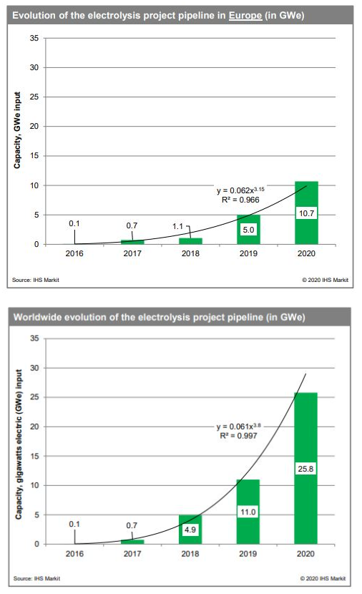
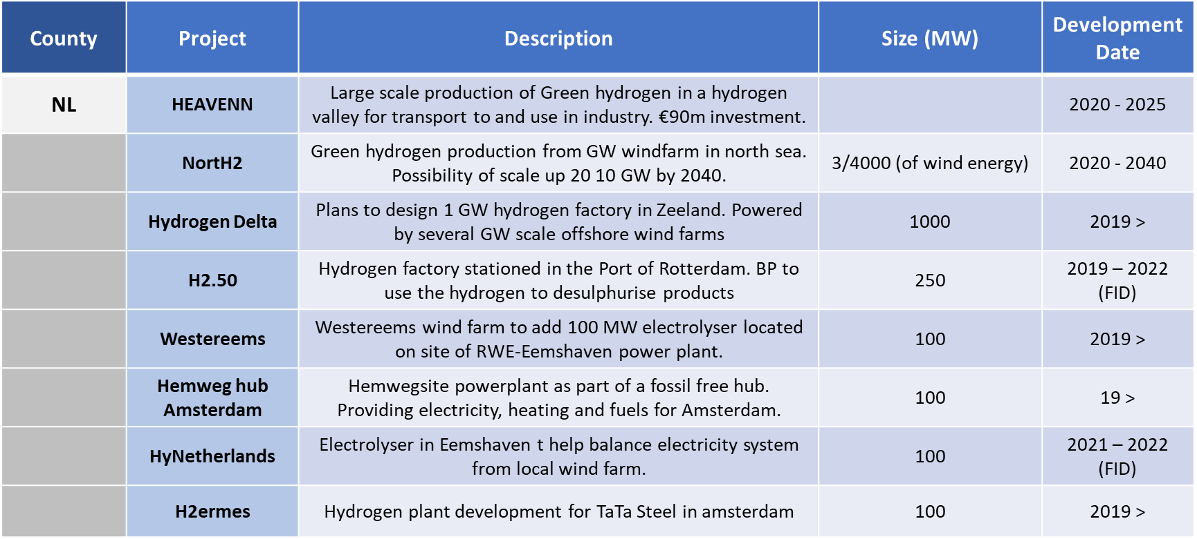
Electrolysis Scale-Up
Electrolysis technology has been rapidly maturing over the past decade.
No longer talking in the scale of KWs, but MWs and GWs.
Here are some of the Dutch projects as an example:

Slide 14
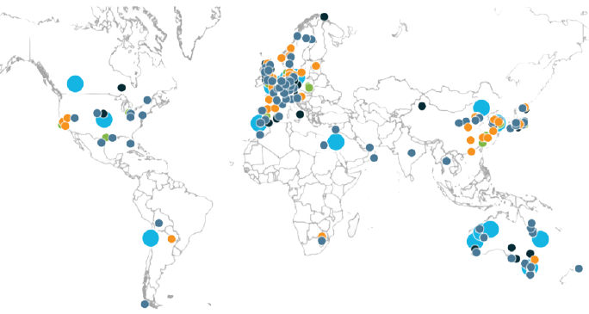
228 Electrolysis Projects have been Announced
126
Giga-scale production:
renewable H2 projects >1GW and low-carbon H2 projects
> 200kt p.a.
Transport: trains, ships, trucks, cars and other hydrogen mobility Applications
Infrastructure projects:
H2 distribution,
transportation,
conversion, and storage
Large-scale industrial
usage: refinery, ammonia, power, methanol, steel
and industry feedstock
Integrated H2 economy:
cross-industry and projects with different
types of end-uses
46
24
If projects come to fruition, total investment will exceed USD 300 billion through 2030
Source: Hydrogen Council, McKinsey & Company
Notes:
Caractère central de l’hydrogène dans la décarbonation de nombreux secteurs d’activité (transports, industrie, etc)

Slide 15
Expected Future Business Model for Electrolyser Scale Up
Currently most systems – up to 10MW – are containerised
Stacks and BoP are provided by the electrolyser companies
Most of these companies historically did not have the financial might to scale their systems rapidly and have adopted the technology proof approach as reduced sizes
Stacks have now grown in power to be suitable for deployment and duplication in the future larger systems i.e. >20MW
This has increased interest in electrolyser companies from other market players and they are now subject to take over approaches and/or trying to form alliances with others to gain traction in the market
EPC companies are now developing designs for these larger plants with electrolyser companies just supplying stacks and EPCs delivering the BoP and the overall system guarantee (wrap)
Some players have financial capability and a proven system capability which allows the to choose how to approach the market.

Slide 16
Summary
We are only just at the start of seeing the results of environmental legislation being put into place
Policy will tighten increasingly quickly, support schemes are there for early adopters
Hydrogen will be one of a host of technologies that will work together to reduce emissions
it will not be the only one
Industry has begun to look at decarbonisation
Hydrogen mobility demand is growing fast
Electrolyser projects are growing both in number and scale
The global green hydrogen market is expected to reach $2.28 billion by 2027, up from $786.9 million in 2019.

Slide 17
Thank you
DIANA RAINE@hy-energy.co.uk
+44 7801 318856

