Slide 1
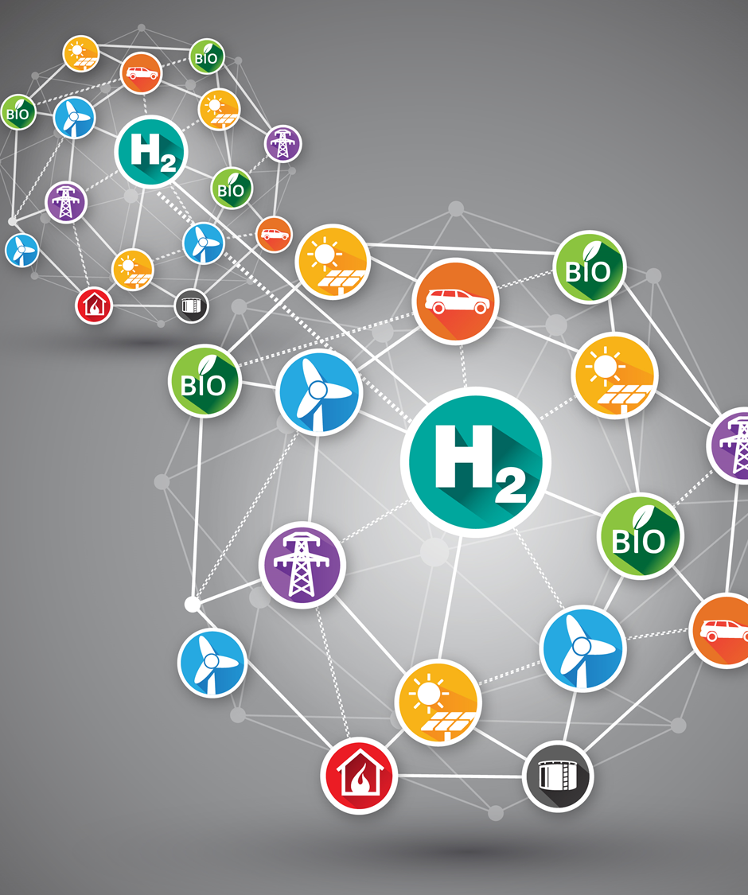
GenComm Spring ‘21 Series of H₂ Webinars SMARTH2 Webinar 5: H₂ Stakeholder Engagement 27th May 2021

Slide 2
GenComm Spring ‘21 Series of H₂ Webinars - Webinar 5: H₂ Stakeholder Engagement

Slide 3
WELCOME
Hydrogen is the catalyst driving Europe’s energy transition. Optimising this journey delivering SMARTH2 through valorization of the hydrogen supply chain, production, storage and use is key to creating a successful hydrogen Europe. The GenComm Spring Series of H2 webinars is focused on SMARTH2. Looking at how we can optimise GreenH2 to deliver increased benefits across the hydrogen value chain, accelerating cost reductions for hydrogen production, transmission, distribution, retail, and end applications.
GenComm Spring ‘21 Series of H₂ Webinars - Webinar 5: H₂ Stakeholder Engagement

Slide 4
Agenda
​​​​​​​ 10:00 - 10:10: Welcome & Introduction, Paul McCormack, Belfast Met & GenComm 10:10 - 10:30: Enhancing stakeholder engagement, Jan Hildebrand, IZES 10:30 - 10:50: Empowering H2 integration, Anne Toner, Hydrogen Ireland (H2Irl) 10:50 - 11:10: H2 in European Energy systems 2025+, Bart Biebuyck, The Fuel Cells and
Hydrogen Joint Undertaking (FCH JU) 11:10 - 11:20: Q&A
GenComm Spring ‘21 Series of H₂ Webinars - Webinar 5: H₂ Stakeholder Engagement

Slide 5
Spring ’21 SMART H2 series
Infrastructure & Storage
Demand and Use
Stakeholder Engagement
Hydrogen Optimisation
Green H2 Supply
The previous webinars all looked at different stages of the Hydrogen value chain.
Today’s webinar is focussed on the most important part, that of Stakeholder Engagement.
GenComm Spring ‘21 Series of H₂ Webinars - Webinar 5: H₂ Stakeholder Engagement

Slide 6
Net Zero by 2050
The energy sector is one of the leading sectors that must respond to the global climate challenge. On the 18th May the International Energy Agency announced their net zero by 2050 roadmap. The recently announced IEA roadmap is a viable pathway to building a global energy sector with net-zero greenhouse gas emissions in 2050.
However it is a narrow route that needs widened by technology adaption and more importantly it needs populated. Stakeholder engagement is the key to the roadmap being successful, it requires immediate action from stakeholders across all countries to deliver a SMART H2 Highway - a transformation of our energy spectrum where all can participate and secure a just transition to net zero.
https://www.iea.org/reports/net-zero-by-2050
GenComm Spring ‘21 Series of H₂ Webinars - Webinar 5: H₂ Stakeholder Engagement

Slide 7
SKILLS
We must address the challenges workers face by ensuring that they have the appropriate skills and training to build back greener post COVID alongside long term plans for skills necessary to bet to a net zero economy.
GenComm Spring ‘21 Series of H₂ Webinars - Webinar 5: H₂ Stakeholder Engagement

Slide 8
An energy sector dominated by renewables
Instead of fossil fuels, the energy sector is based largely on renewable energy. Two-thirds of total energy supply in 2050 is from wind, solar, bioenergy, geothermal and hydro energy. Solar becomes the largest source, accounting for one-fifth of energy supplies. Solar PV capacity increases 20-fold between now and 2050, and wind power 11-fold.
GenComm Spring ‘21 Series of H₂ Webinars - Webinar 5: H₂ Stakeholder Engagement

Slide 9
The transition to net zero is for and about people
A transition of the scale and speed described by the net zero pathway cannot be achieved without sustained support and participation from citizens.
GenComm Spring ‘21 Series of H₂ Webinars - Webinar 5: H₂ Stakeholder Engagement

Slide 10
Clean energy jobs will grow strongly but must be spread widely
The transition to net zero brings substantial new opportunities for employment, with 14 million jobs created by 2030 in our pathway thanks to new activities and investment in clean energy.
Spending on more efficient appliances, electric and fuel cell vehicles, and building retrofits and energy-efficient construction would require a further 16 million workers.
GenComm Spring ‘21 Series of H₂ Webinars - Webinar 5: H₂ Stakeholder Engagement

Slide 11
Clean energy jobs will grow strongly but must be spread widely
The transition to net zero brings substantial new opportunities for employment, with 14 million jobs created by 2030 in our pathway thanks to new activities and investment in clean energy.
Spending on more efficient appliances, electric and fuel cell vehicles, and building retrofits and energy-efficient construction would require a further 16 million workers.
GenComm Spring ‘21 Series of H₂ Webinars - Webinar 5: H₂ Stakeholder Engagement

Slide 12
Net zero by 2050 requires huge leaps in clean energy innovation
Reaching net zero by 2050 requires further rapid deployment of available technologies as well as widespread use of technologies that are not on the market yet.
Most of the global reductions in CO₂ emissions through 2030 in our pathway come from technologies readily available today.
But in 2050, almost half the reductions come from technologies that are currently at the demonstration or prototype phase.
In heavy industry and long-distance transport, the share of emissions reductions from technologies that are still under development today is even higher.
GenComm Spring ‘21 Series of H₂ Webinars - Webinar 5: H₂ Stakeholder Engagement

Slide 13
Engagement
We must accelerate the clean energy transition, promote a circular economic approach, transition to sustainable supply chains and mainstream renewables.
Our transition to net zero will depend upon developing a skilled workforce necessary to deliver it, in a way that leaves no one behind.
To achieve this we must build on the skills and knowledge in transition sectors specifically the built environment. We must develop new labour markets for decent work and quality green jobs as well as investing in pioneering digitalisation as a key delivery model.
GenComm Spring ‘21 Series of H₂ Webinars - Webinar 5: H₂ Stakeholder Engagement

Slide 14
Net zero by 2050 requires huge leaps in clean energy innovation
Reaching net zero by 2050 requires further rapid deployment of available technologies as well as widespread use of technologies that are not on the market yet.
Most of the global reductions in CO₂ emissions through 2030 in our pathway come from technologies readily available today.
But in 2050, almost half the reductions come from technologies that are currently at the demonstration or prototype phase.
In heavy industry and long-distance transport, the share of emissions reductions from technologies that are still under development today is even higher.
GenComm Spring ‘21 Series of H₂ Webinars - Webinar 5: H₂ Stakeholder Engagement

Slide 15
Q & A
GenComm Spring ‘21 Series of H₂ Webinars - Webinar 5: H₂ Stakeholder Engagement

Slide 16
Social Distance Calling Card
GenComm Website - nweurope.eu/gencomm
LinkedIn - GenComm
Twitter - @GenComm_CH2F
Community Hydrogen Forum – CH2F - communityh2.eu
Hydrogen Ireland website - hydrogenireland.org
GenComm Spring ‘21 Series of H₂ Webinars - Webinar 5: H₂ Stakeholder Engagement

