Slide 1



GenComm Spring Series of H₂ Webinars
SMARTH2
Webinar 5:
Stakeholder Engagment
27th May 2021
Place image in this area.

Slide 2

Stakeholder engagement
GenComm Spring Series of H₂ Webinars - Webinar 5: H₂ Stakeholder Engagement

Slide 3
Meaning of participation and stakeholder engagement
Participation is an important influencing factor, but not a guarantee of acceptance
Good participation can increase procedural justice and make local potential visible and usable.
Central criteria are transparency and opportunities for participation (through the stages of information, consultation and cooperation).
Careful planning reduces the risk of poor participation which may lead to disappointment and conflict
GenComm Spring Series of H₂ Webinars - Webinar 5: H₂ Stakeholder Engagement

Slide 4
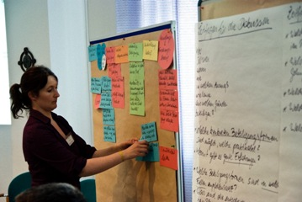
Participation in hydrogen
Transition requires an active role on all levels of society and changes in different sectors (energy infrastructure, mobility, industry, etc.)
Municipalities and regions are the level where the changes become visible -> Capacity building and empowerment, competence, personal and financial resources are needed
  -> transfer of knowledge, good practices and success stories from renewable energy sector like 100% RES regions, sustainable communities, energy cooperatives -> Tools that help in planning and decision-making etc.
GenComm Spring Series of H₂ Webinars - Webinar 5: H₂ Stakeholder Engagement

Slide 5
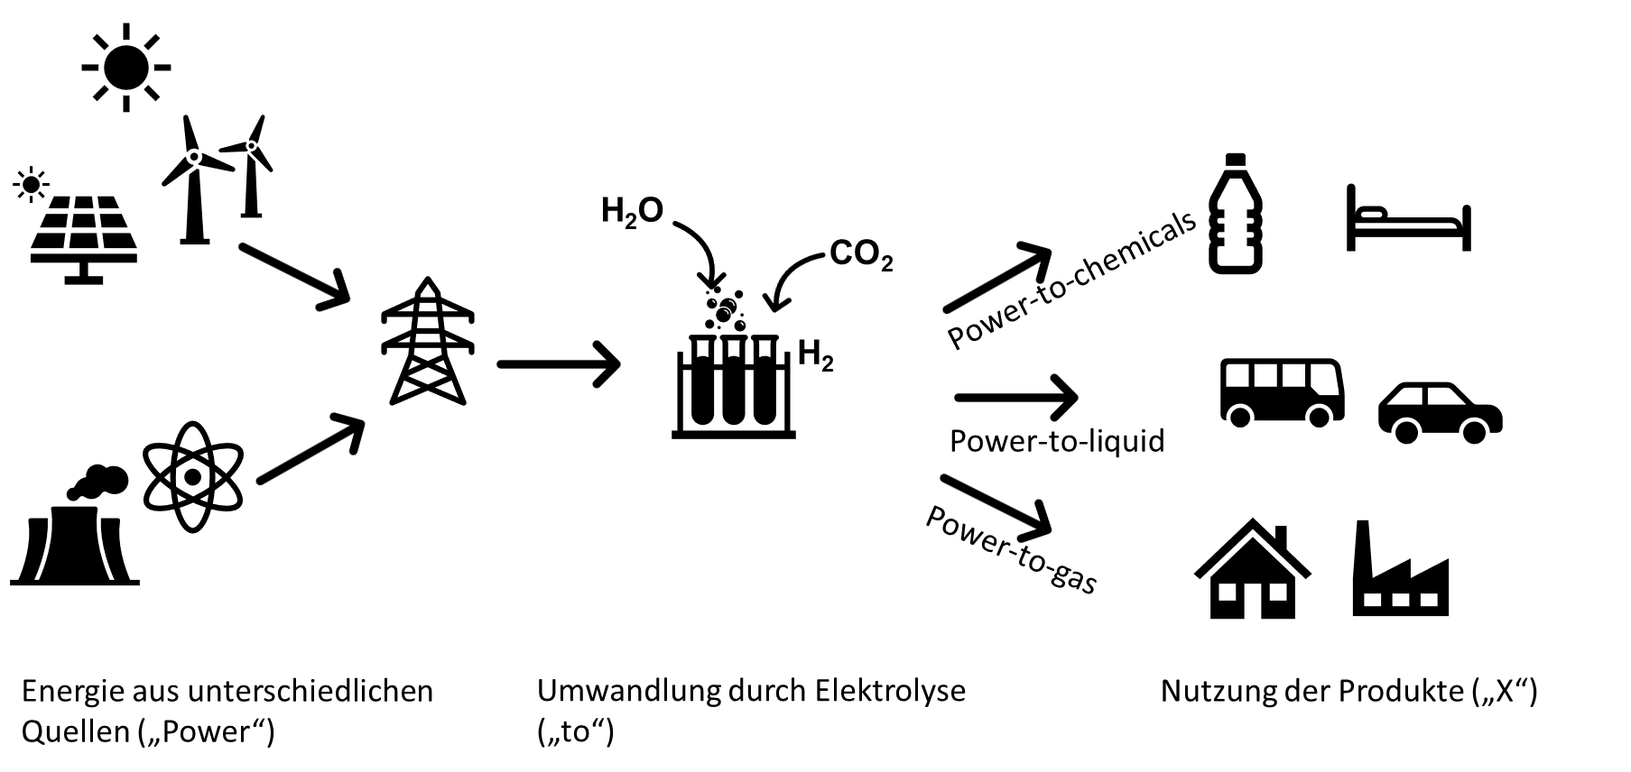


Hydrogen as part of a socio-technical system
Energy production
Electrolysis
Utilisation of products
Technology Acceptance
Consumer Acceptance
GenComm Spring Series of H₂ Webinars - Webinar 5: H₂ Stakeholder Engagement

Slide 6
Hydrogen as part of a socio-technical system
Poll Question I
In which areas do you see the main need for stakeholder engagement and activation towards a H2-transition?
Mobility
Chemistry
Industry (steel, glass)
all
GenComm Spring Series of H₂ Webinars - Webinar 5: H₂ Stakeholder Engagement

Slide 7
Engagement levels
Political participation on planning and decision making (permitting procedures)
Challenges: Often too late, local needs not part of the formal procedure, lack of transparency and knowledge on procedures
Financial participation (-> value creation): individual vs. collective, direct vs. indirect approaches, singular vs. continuously during project phases
Recent research indicates correlation between participation and acceptance, but the concrete relation has not be shown yet
GenComm Spring Series of H₂ Webinars - Webinar 5: H₂ Stakeholder Engagement

Slide 8
Engagement levels
Financial
Participation
Opportunities
Pyramid of Participation, inspired by 'Ladder of participation' from Arnstein, 1969 (Rau, Schweizer-Ries, & Hildebrand, 2012)
GenComm Spring Series of H₂ Webinars - Webinar 5: H₂ Stakeholder Engagement

Slide 9
Planning of engagement
What exactly is topic of the engagement process?
What is the goal of the planned participation? E.G
....is acceptance to be achieved (from whom exactly?)?
...should citizens be activated for the project and further climate protection actions?
...should financial participation be encouraged?
...should conflicts be reduced?
...should a procedure gain legitimacy or be secured in this respect?
-> How do possible individual steps help to achieve the goal? Which stakeholders need to be addressed?
  In the case of a population survey: what happens to the results? In the case of a yes/no vote, how strongly does one feel bound to the sentiment?
-> What resources are available for the participation process?
GenComm Spring Series of H₂ Webinars - Webinar 5: H₂ Stakeholder Engagement

Slide 10
Planning of engagement – system analysis
CONTEXTUAL ANALYSIS/ CONTEXTUAL FACTORS
  Community and Stakeholder analysis
  Socio-economical context
  Historical Context
  Vision -> renewable energy goals
  Political Context
  Knowledge on Hydrogen / energy topics
METHODS preparing public engagement
Stakeholder map
Media Analysis
Interviews / Surveys
GenComm Spring Series of H₂ Webinars - Webinar 5: H₂ Stakeholder Engagement

Slide 11
Public acceptance and just transition
Just transition addresses distributional, procedural and interpersonal justice dimensions
  Procedural justice: Transparency and participative involvement
  Distributional justice: fair distribution of risks, disadvantages and costs as well as advantages and benefits
  interpersonal justice: Trust and distrust in institutions /companies/ authorities-> important role of science
  Not one size fits all: communication and engagement strategies based on the requirements of the public, information easily accessible, understandable and well-adjusted to the specific needs of the target audience
  Knowledge vs. beliefs: currently high level of uncertainty (quantities, time, alternatives)
GenComm Spring Series of H₂ Webinars - Webinar 5: H₂ Stakeholder Engagement

Slide 12
Hydrogen as part of a socio-technical system
Poll Question II
Which stakeholder groups should be mainly addressed in H2 engagement activities?
Individuals / private persons
NGOs
Municipalities
Economic / industry stakeholders
Political level
Nationwide discourse
all
GenComm Spring Series of H₂ Webinars - Webinar 5: H₂ Stakeholder Engagement

Slide 13
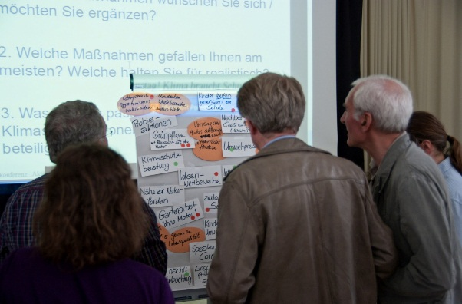
Conclusion
Current public perception: Hydrogen as a silver bullet for energy transition -> differentiated public discourse about potentials and limitations needed
Stakeholder engagement is one approach for making this transition socially acceptable, just and sustainable
The planning and reflection phase of engagement is as relevant as the choice of concrete engagement tools
Overall goal should be engagement not only on single projects but a structural empowerment for energy transition
GenComm Spring Series of H₂ Webinars - Webinar 5: H₂ Stakeholder Engagement

Slide 14
Thank you for your attention!
IZES gGmbH
Jan Hildebrand
Department Environmental Psychology
E-Mail: hildebrand@izes.de
GenComm Spring Series of H₂ Webinars - Webinar 5: H₂ Stakeholder Engagement

