Slide 1
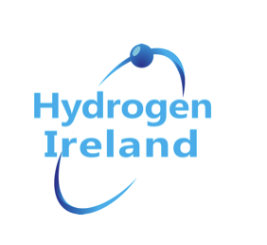
H2Irl - Driving the Hydrogen Revolution across the Island (NI/ROI)
HydrogenIreland (H2IRL) is a new national association that will act as a forum for the hydrogen community on the island of Ireland, both North and South.
H2IRL will bring together industry, universities, research institutes and policy-makers to create a voice and forum for the hydrogen community. It will provide a focal point for hydrogen expertise on the island, support commercialisation and position hydrogen technology as a sustainable energy medium for the future. Connecting this new community to existing energy solutions and sustainable energy resources will increase the penetration of renewables, and offer enhanced commercial opportunities.
Under the overarching umbrella of the European Hydrogen Association and Hydrogen Europe, H2IRL will raise the profile of hydrogen and drive policy change, helping to secure clean sustainable energy for the island of Ireland.
GenComm Spring ‘21 Series of H₂ Webinars - Webinar 5: H₂ Stakeholder Engagement

Slide 2
Our Members
GenComm Spring ‘21 Series of H₂ Webinars - Webinar 5: H₂ Stakeholder Engagement

Slide 3
Why Ireland?
Ireland has one of the highest technical potentials of intermittent renewable electricity production in the European Union, both in absolute values and also as a ratio compared to its forecasted electricity demand in 2030.
GenComm Spring ‘21 Series of H₂ Webinars - Webinar 5: H₂ Stakeholder Engagement

Slide 4
H2Irl Driving the Hydrogen Revolution across the Island
2018
Ireland is a world leader at incorporating large amounts of wind-generated electricity onto the network. 358 MW of additional wind-generation capacity was installed in 2018
2020
The total capacity from renewable sources in Ireland has been increasing steadily since 2008. By 2020, the capacity had increased to 4,685 megawatts.
GenComm Spring ‘21 Series of H₂ Webinars - Webinar 5: H₂ Stakeholder Engagement

Slide 5
H2Irl Fostering Innovation and greater adaption
Globally, 228 hydrogen projects have been announced to be developed between 2021 and 2030, of which 17 are giga-scale green hydrogen projects.
The majority of hydrogen activity will be located in Europe, at 126 hydrogen projects.
Many European countries have been invested in finding non-carbon intensive alternatives for industrial and transportation usage in line with the European Unions Green Deal and an effort to strengthen the local value chain.
GenComm Spring ‘21 Series of H₂ Webinars - Webinar 5: H₂ Stakeholder Engagement

Slide 6
H2Irl Fostering Innovation and greater adaption
Globally, 228 hydrogen projects have been announced to be developed between 2021 and 2030, of which 17 are giga-scale green hydrogen projects.
The majority of hydrogen activity will be located in Europe, at 126 hydrogen projects.
Many European countries have been invested in finding non-carbon intensive alternatives for industrial and transportation usage in line with the European Unions Green Deal and an effort to strengthen the local value chain.
GenComm Spring ‘21 Series of H₂ Webinars - Webinar 5: H₂ Stakeholder Engagement

Slide 7
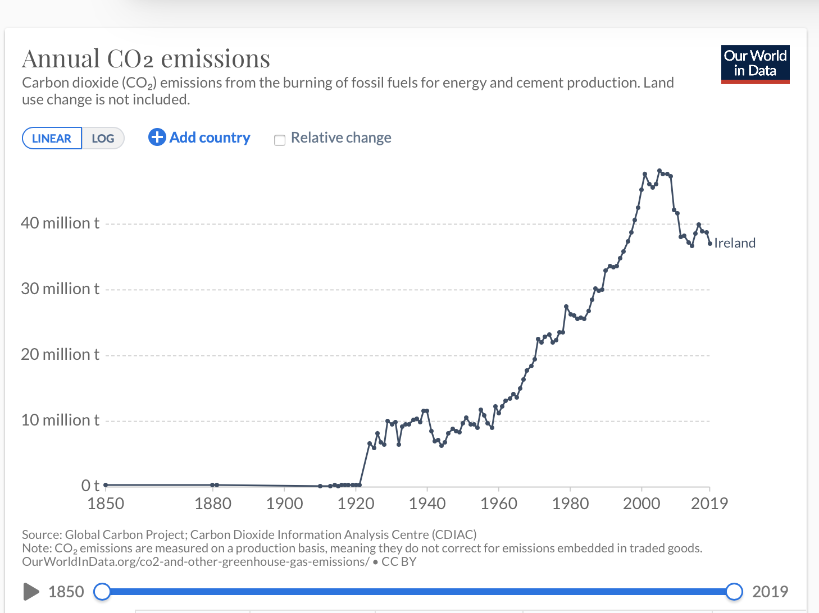
GenComm Spring ‘21 Series of H₂ Webinars - Webinar 5: H₂ Stakeholder Engagement

Slide 8
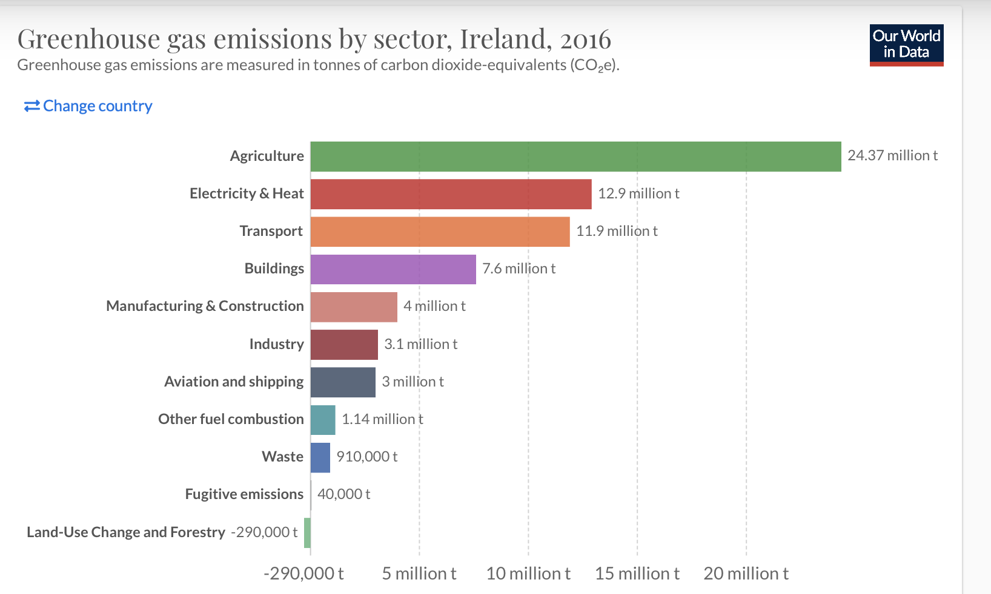
GenComm Spring ‘21 Series of H₂ Webinars - Webinar 5: H₂ Stakeholder Engagement

Slide 9
Governments will support hydrogen as they did with
renewables to drive down costs.
In its draft NECP, Ireland estimates an installed capacity in 2030 of 8.5 GW in wind energy and 1.5 GW in solar PV, generating almost 22 TWh of renewable electricity in 2030
UK Government has just announced £166.5m available for new Hydrogen Projects
Irish Government still set to release targets and budget
GenComm Spring ‘21 Series of H₂ Webinars - Webinar 5: H₂ Stakeholder Engagement

Slide 10
Hydrogen Economy
Green hydrogen could help cut emissions by a third. Thereby providing $11 Trillion worth of infrastructure investment opportunities over the next thirty years.
GenComm Spring ‘21 Series of H₂ Webinars - Webinar 5: H₂ Stakeholder Engagement

Slide 11
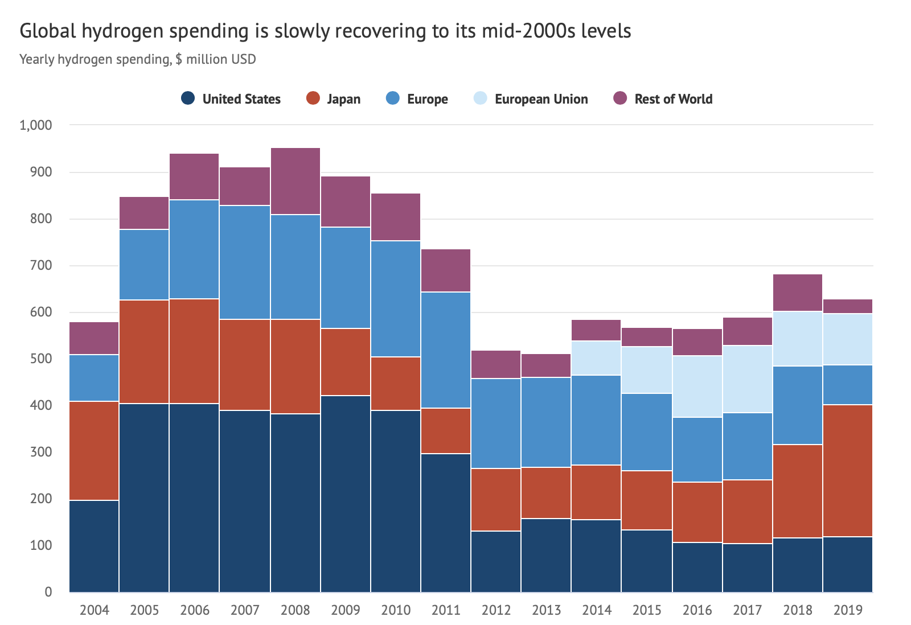
Green hydrogen could help cut emissions by a third. Thereby providing $11 Trillion worth of infrastructure investment opportunities over the next thirty years.
.
GenComm Spring ‘21 Series of H₂ Webinars - Webinar 5: H₂ Stakeholder Engagement

Slide 12
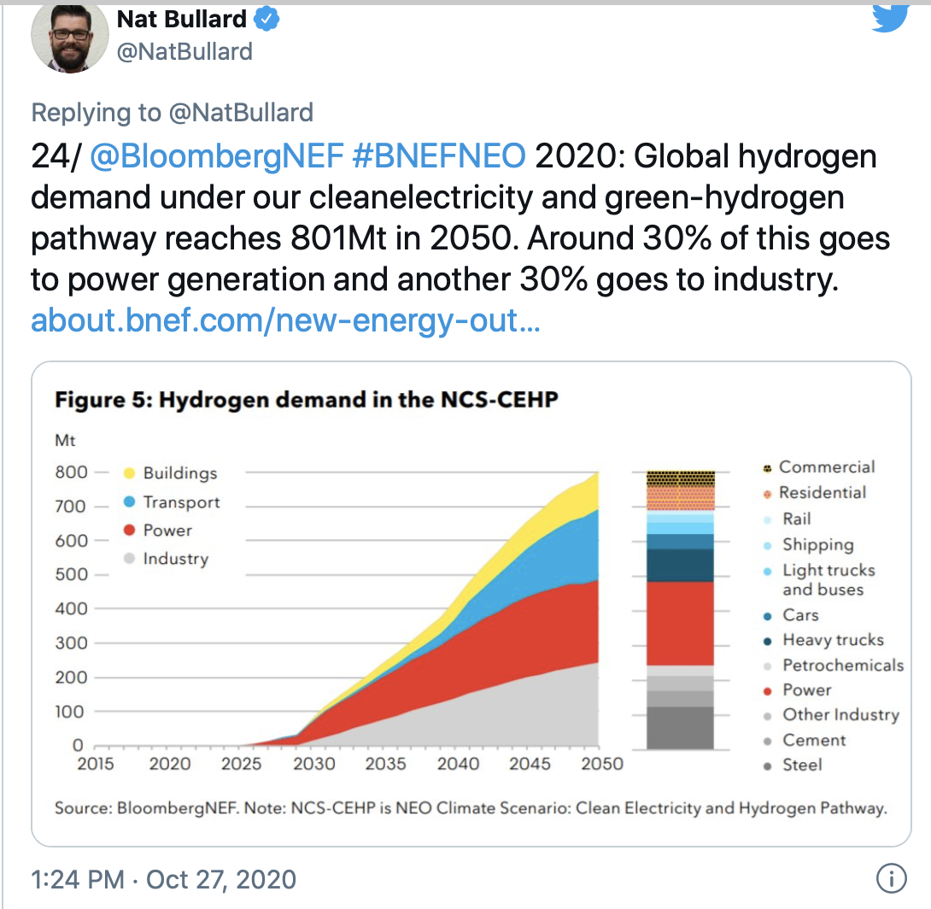
GenComm Spring ‘21 Series of H₂ Webinars - Webinar 5: H₂ Stakeholder Engagement

Slide 13
Infrastructure is Critical
553 hydrogen refuelling stations were in operation worldwide.
7 additional stations were added in the first few weeks of 2021 and concrete plans are already in place for 225 additional refuelling station locations.
Plans for 80 hydrogen fuel stations for Ireland by 2030
GenComm Spring ‘21 Series of H₂ Webinars - Webinar 5: H₂ Stakeholder Engagement

Slide 14
Latest Hydrogen Investment across NI/ROI
€120m Green Hydrogen Plant – Planned for Cork
Microsoft Claims a First in Hydrogen-Fueled Data Center Test
Mayo company’s floating renewable energy system demonstrates power of Green hydrogen
CIÉ Group partners in hydrogen fuel cell bus trial
Hydrogen as energy supply is tested by Gas Networks Ireland
Wrightbus to get £11.2m for hydrogen-fuel technology
Translink invest €66m into Hydrogen Powered Buses
GenComm Spring ‘21 Series of H₂ Webinars - Webinar 5: H₂ Stakeholder Engagement

Slide 15
Funding Ireland and Northern Ireland
UK Low Carbon Hydrogen Supply 2 Competition (£166.5m) opens June 2021
Horizon Europe: Cluster 5
GenComm Spring ‘21 Series of H₂ Webinars - Webinar 5: H₂ Stakeholder Engagement

