Slide 1
The Enabling Support Tool (EST)
& European Engagement
Tadgh Cummins
Marianna Rossi
Branca Delmonte
Ian Williamson
Place image in this area.
GenComm Project Partners’ Meeting
24th & 25th February 2022 - Dublin

Slide 2
The Enabling Support Tool
Tadgh Cummins
Place image in this area.
GenComm Project Partners’ Meeting
24th & 25th February 2022 - Dublin

Slide 3
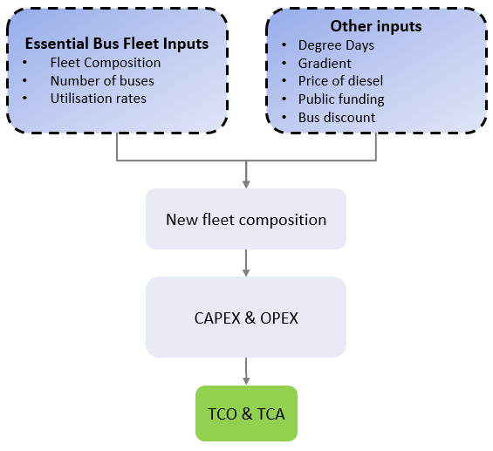
The Enabling Support Tool (EST) How will it work?
Inform user on H₂ potential for fleet decarbonisation
Enter inputs in easy-to-use online interface
View results – graphs of Total Cost of Ownership (TCO) & Total Carbon Abatement Cost (TCA) for different fleet compositions
Access to TCO & TCA Excel model for more in-depth analysis
GenComm Project Partners’ Meeting #19 - 24th & 25th February 2022

Slide 4
The Enabling Support Tool (EST) How will it work?
In order to optimise a mixed fleet of FCEBs and BEBs, the EST needs to collect information about factors affecting the range of a BEB
1
How many buses in the fleet?
2
HVAC energy consumption reduces the range of BEBs:
Input degree days of heating and cooling
3
Steep roads can reduce the range of BEBs:
Input gradient info for all steep routes
4
5
6
Divide buses based on Utilisation Rate
For each steep route:
Divide the rest of the fleet based on Utilisation Rate
Input average Utilisation Rate for each fleet division
UR > X
FCEB
UR < X
BEB
GenComm Project Partners’ Meeting #19 - 24th & 25th February 2022

Slide 5
EST Outputs & Insight
All FCEB Fleet
All BEB Fleet
Additional buses & chargers to meet range requirements
+
Mixed Fleet
How do these different fleet combinations compare? (CAPEX, OPEX, TCO & TCA of fleet)
Economy of scale
Roll-out now vs 2030 – increased availability of H2
Effect of carbon tax & electricity price
Fleet operators can use this insight to make better decisions
GenComm Project Partners’ Meeting #19 - 24th & 25th February 2022

Slide 6
Saarland
Marianna Rossi
Place image in this area.
GenComm Project Partners’ Meeting
24th & 25th February 2022 - Dublin

Slide 7
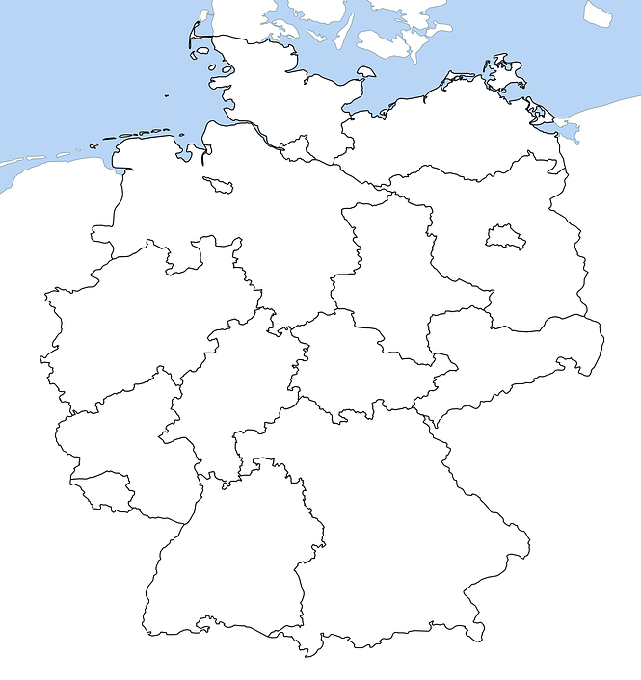
Contribution of the IZES to the EST
Primary Goal
Concept development for the use of hydrogen in local public transport focusing on the regions Merzig-Wadern and Saarpfalz.
Current Actions:
Conduction of Interviews
GenComm Project Partners’ Meeting #19 - 24th & 25th February 2022

Slide 8
INTERVIEW PARTNERS
INTERVIEW TYPE 1 | INTERVIEW TYPE 2
Relevant, local stakeholders Administration and politics Transportation and bus companies Project-related industries and companies Influential individuals | Participants of successful comparative projects Companies accompanying the project Stakeholder involved in the project
PARTNERS
GenComm Project Partners’ Meeting #19 - 24th & 25th February 2022

Slide 9
INTERVIEW PURPOSE
INTERVIEW TYPE 1 | INTERVIEW TYPE 2
Relevant, local stakeholders Administration and politics Transportation and bus companies Project-related industries and companies Influential individuals | Participants of successful comparative projects Companies accompanying the project Stakeholder involved in the project
Analysis of the current situation in counties of interest Project Evaluation Project Expectations Expected project-inhibiting factors Potential project-beneficial factors Analysis of EST user needs (Prospective) Information the EST should ideally provide Factors the EST should take into account | Supplementing local analysis with real experiences Lessons Learned Experienced project-inhibiting factors Ways to overcome project-inhibiting factors Experienced project-beneficial factors Analysis of EST user needs (Retrospective) Information the EST should ideally provide Factors the EST should take into account
PARTNERS
PURPOSE
GenComm Project Partners’ Meeting #19 - 24th & 25th February 2022

Slide 10
INTERVIEW RESULTS
INTERVIEW TYPE 1 | INTERVIEW TYPE 2
Relevant, local stakeholders Administration and politics Transportation and bus companies Project-related industries and companies Influential individuals | Participants of successful comparative projects Companies accompanying the project Stakeholder involved in the project
Analysis of the current situation in counties of interest Project Evaluation Project Expectations Expected project-inhibiting factors Potential project-beneficial factors Analysis of EST user needs (Prospective) Information the EST should ideally provide Factors the EST should take into account | Supplementing local analysis with real experiences Lessons Learned Experienced project-inhibiting factors Ways to overcome project-inhibiting factors Experienced project-beneficial factors Analysis of EST user needs (Retrospective) Information the EST should ideally provide Factors the EST should take into account
Recommendations for further action Regulate expectations Formulate common goals Remove barriers early on Activate potential Recommendations for EST | Recommendations on Best-Practice Remove barriers early on Activate potential Network between local and experienced Stakeholder Recommendations for EST
PARTNERS
PURPOSE
RESULTS
GenComm Project Partners’ Meeting #19 - 24th & 25th February 2022

Slide 11
Luxembourg
Branca Delmonte
Feb/22
Place image in this area.
GenComm Project Partners’ Meeting
24th & 25th February 2022 - Dublin

Slide 12
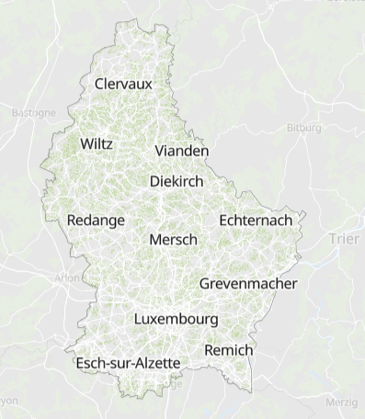
Luxembourg
Size 2.586 km²
82 km long
57 km wide
Population 602.005
Cross-border 192.766
GenComm Project Partners’ Meeting #19 - 24th & 25th February 2022

Slide 13
Luxembourg
Mobility >50% of energy demand
Highly dependent on fossil fuels
GenComm Project Partners’ Meeting #19 - 24th & 25th February 2022

Slide 14
Mobility
Free public transportation
Electrification
Hydrogen
GenComm Project Partners’ Meeting #19 - 24th & 25th February 2022

Slide 15
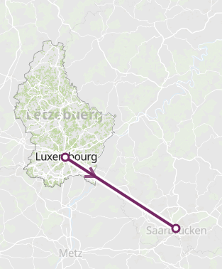
H2 Study
Identify suitable lines
TCO
Infrastructure
Supply chain
Technical support
Safety
GenComm Project Partners’ Meeting #19 - 24th & 25th February 2022

Slide 16
EST UI and Website Implementation
Ian Williamson
Place image in this area.
GenComm Project Partners’ Meeting
24th & 25th February 2022 - Dublin

Slide 17
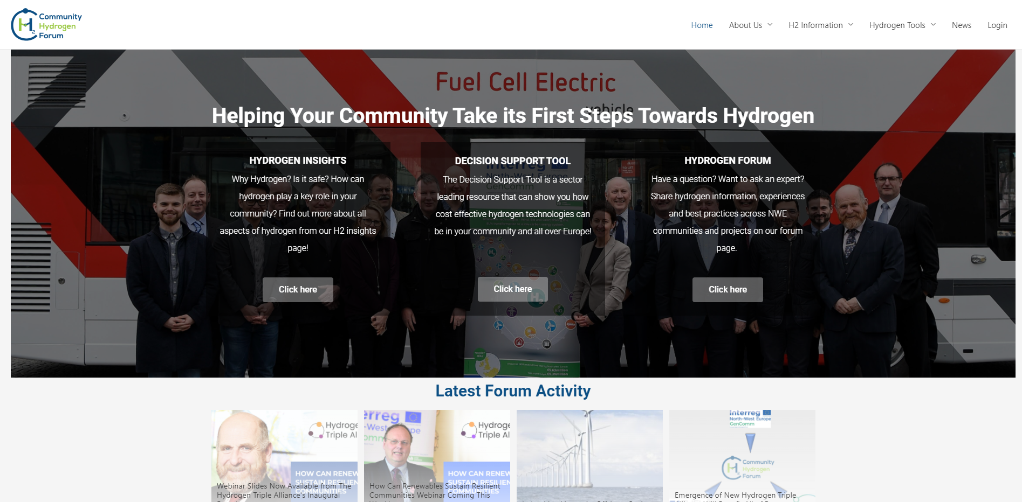
Deliverables
Set of input questions for the EST model
Develop functional EST from model:
Design user interface of EST
Connect Model to user interface for Functional EST
GenComm Project Partners’ Meeting #19 - 24th & 25th February 2022

Slide 18
Where are we?
Actions | Status
Finalise input questions for EST | ✔
Create initial draft format of EST Form | ✔
Create intro page of EST | ❌
Tailor NUIG EST Model for online use, using test inputs of model as drop down menus for inputs | ❌
Integrate online form with simplified model and create output page where results are shown | ❌
Actions beyond this will be reliant on the completion of the EST before commencing
GenComm Project Partners’ Meeting #19 - 24th & 25th February 2022

Slide 19
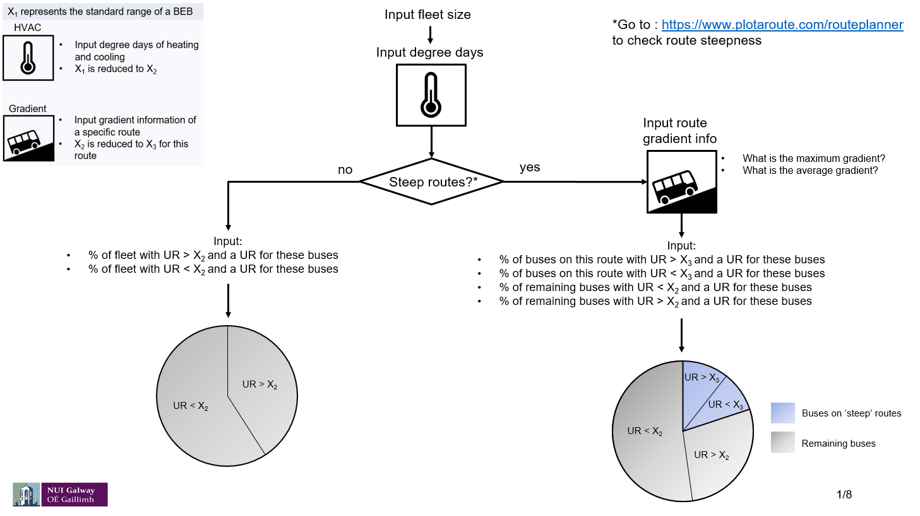
Develop input questions for the EST model
Questions set alongside NUIG modelling and Luxembourg/Saarland Interviews
EST Flow chart from NUIG set the framework for the questions
GenComm Project Partners’ Meeting #19 - 24th & 25th February 2022
Notes:
Questions shown in UI over next slides

Slide 20
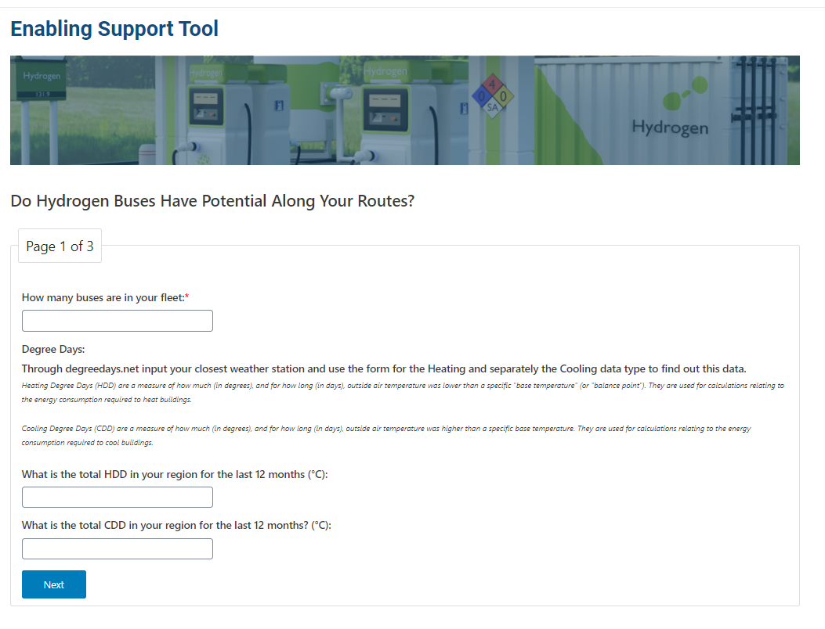
Design User Interface for EST
GenComm Project Partners’ Meeting #19 - 24th & 25th February 2022

Slide 21
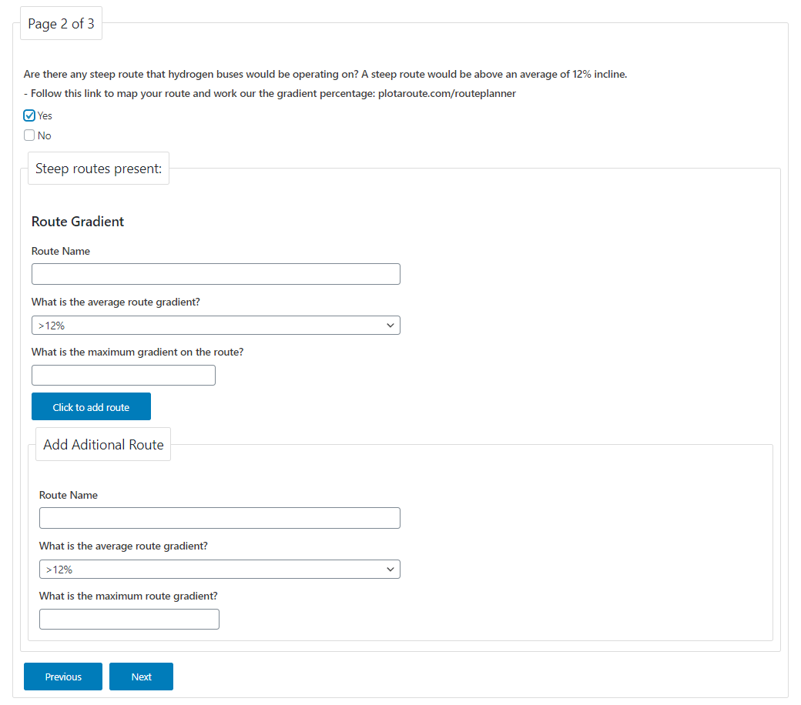
Design User Interface for EST
GenComm Project Partners’ Meeting #19 - 24th & 25th February 2022

Slide 22
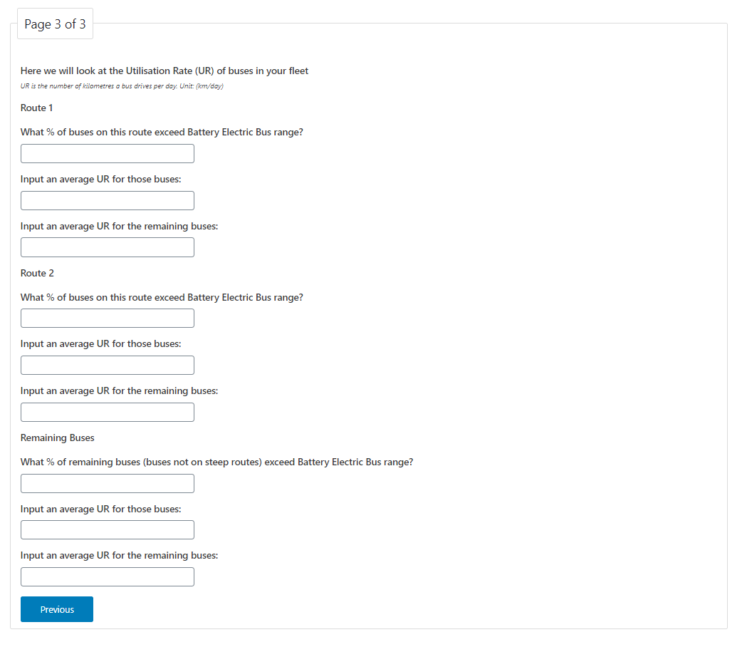
Design User Interface for EST
GenComm Project Partners’ Meeting #19 - 24th & 25th February 2022

Slide 23
To recap – Next Steps
Actions | Status
Finalise input questions for EST | ✔
Create initial draft format of EST Form | ✔
Create intro page of EST | ❌
Tailor NUIG EST Model for online use, using test inputs of model as drop down menus for inputs | ❌
Integrate online form with simplified model and create output page where results are shown | ❌
GenComm Project Partners’ Meeting #19 - 24th & 25th February 2022

Slide 24
Any Questions?
Tadgh Cummins – t.cummins@nuiggalway.ie
Marianna Rossi – rossi@izes.de
Branca Delmonte – branca.delmonte@uni.lu
Ian Williamson – ian.Williamson@hy-energy.co.uk
For questions regarding the UI Design/Function email
Tim.Williamson@hy-energy.co.uk
GenComm Project Partners’ Meeting 24th & 25th February 2022 - Dublin

