Slide 1
The Hydrogen Enabling Support Tool Improving Decision-making for hydrogen bus fleets
Rory Monaghan & Tadgh Cummins
NUI Galway

Slide 2
Overview
The Renewable Hydrogen Opportunity for Communities
The Community Hydrogen Forum
The CH2F Decision Support Tool
Progressing to the Enabling Support Tool
GenComm Project Partners’ Meeting #19 - 24th & 25th February 2022

Slide 3
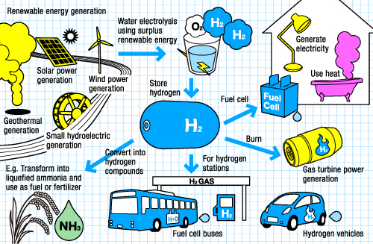
The Renewable Hydrogen Opportunity for Communities
Energy security
Reliable emissions free transport, heat and power
Long-term energy storage
Reduced fossil fuel use
Local investment
New clean industries
Hi-tech employment
Community development
http://www.thinktheearth.net/thinkdaily/report/2010/08/rpt-53.html#page-2
How can communities recognise and take the H₂ opportunity?

Slide 4
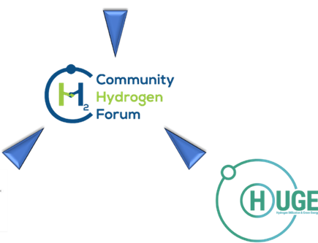
The Community Hydrogen Forum
Hydrogen insights
Hydrogen links
Hydrogen case studies
Hydrogen forum
Decision support tool
Hydrogen networking
GenComm Project Partners’ Meeting #19 - 24th & 25th February 2022

Slide 5
The Community Hydrogen Forum Overview
Platform designed to help everyone understand the opportunities renewable hydrogen technologies offer in Europe.
Intended to be a forum for national, regional, and local governments, energy agencies, community development groups, energy cooperatives, educational institutions, renewable energy developers, transport sectors, and grid operators.
Any stakeholder from Northwest Europe, the Atlantic Area or the Northern Peripheries and Arctic is encouraged to participate as a member.
http://communityh2.eu/

Slide 6
The Community Hydrogen Forum Objectives
To raise awareness of the potential of hydrogen in sustainable community development, decarbonisation, and energy security.
To offer a forum to share information, experience and best practice of how communities and projects are deploying hydrogen across Europe.
To provide an up-to-date, informed resource for hydrogen information and case studies.
To provide access to a unique Decision Support Tool (DST) to assist in evaluating how hydrogen technologies can be deployed in individual scenarios.
To play a role in developing long term strategies for the advancement in adoption of hydrogen technologies.
http://communityh2.eu/

Slide 7
The Community Hydrogen Forum You can tour the website with a free account
http://communityh2.eu/

Slide 8
Decision Support Tool
Where can I learn about hydrogen opportunities?
GenComm Project Partners’ Meeting #19 - 24th & 25th February 2022

Slide 9
Decision Support Tool
Decision Support Tool
Curtailed renewable energy sources
Hydrogen could make sense for my community, organisation or company.
But how do I make it happen?
How do I find a hydrogen source or market?
Energy demands
Where can I learn about hydrogen opportunities?
Industry
Wind Energy
Mobility
Solar Energy
AD Plant
Stationary Energy
GenComm Project Partners’ Meeting #19 - 24th & 25th February 2022

Slide 10
Decision Support Tool
Decision Support Tool
Curtailed renewable energy sources
Hydrogen could make sense for my community, organisation or company.
But how do I make it happen?
How do I find a hydrogen source or market?
Energy demands
Where can I learn about hydrogen opportunities?
How do I take the next steps?
How do I connect with others across Europe?
Industry
Wind Energy
Mobility
Solar Energy
AD Plant
Stationary Energy
GenComm Project Partners’ Meeting #19 - 24th & 25th February 2022

Slide 11
The Decision Support Tool What is it?
Supports stakeholders to evaluate the potential of hydrogen in:
sustainable community development
Decarbonisation
energy security
Achieves this by demonstrating the role of hydrogen produced at onshore wind farms (and also with battery storage and PV arrays) in decarbonising public bus fleets in large cities across the region
Visualised in an online interactive map of Europe
GenComm Project Partners’ Meeting #19 - 24th & 25th February 2022

Slide 12
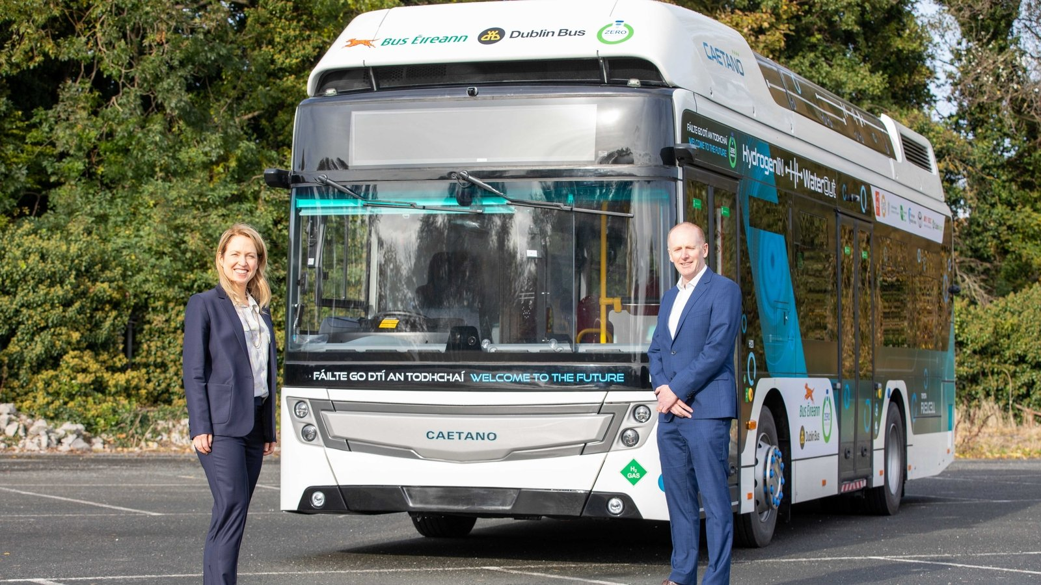
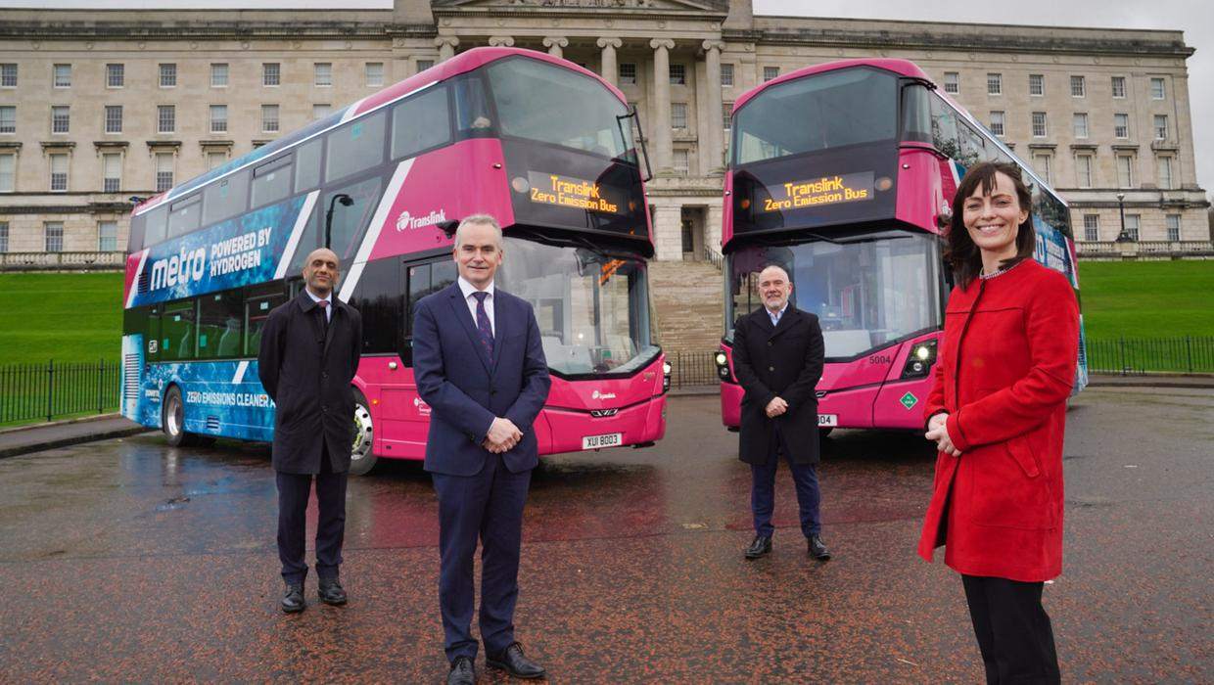
The Decision Support Tool Why city buses?
Hydrogen fuel cell city buses are now on sale commercially
They provide a large, predictable, centralised hydrogen demand
Fuel cell electric buses (FCEBs) or fleets operate in Aberdeen, Belfast, Dublin, London, Seoul, Tokyo, and many other cities
CaetanoBus & WrightBus offer single-and double-decker FCEBs
Dublin Caetano FCEV bus trial, Nov 2020
https://www.rte.ie/news/business/2020/1111/1177483-cie-group-partners-in-hydrogen-fuel-cell-bus-trial/
Belfast WrightBus FCEV bus deployment, Dec 2020
https://www.belfasttelegraph.co.uk/news/northern-ireland/translinks-hydrogen-powered-buses-enter-service-in-northern-ireland-39872290.html

Slide 13
Hydrogen Tools in the Community Hydrogen Forum
http://communityh2.eu/dst-simple/
http://communityh2.eu/dst/
GenComm Project Partners’ Meeting #19 - 24th & 25th February 2022

Slide 14
Hydrogen Tools in the Community Hydrogen Forum
Hydrogen Tools
Decision Support Tool (DST)
(National/City)
Biomass-derived Hydrogen
(National)
Wind Hydrogen Bus
(City)
Simplified Decision Support Tool (SDST)
(National)
Solar-Wind Hydrogen Bus
(City)
GenComm Project Partners’ Meeting #19 - 24th & 25th February 2022

Slide 15
The Decision Support Tool - Wind/Solar-based H₂ How it works
Annual energy demands for big city bus fleets
Hydrogen energy equivalent
Total hydrogen demand
Big city locations
Hydrogen supply chain
Wind farm locations
37 cities across North West Europe
4,252 wind farms across North West Europe
Total hydrogen supply
Optimal electrolyser size at every wind farm
Available & curtailed wind at wind farms
“Topped up” with grid electricity
Additional hypothetical solar power & battery at wind farm
GenComm Project Partners’ Meeting #19 - 24th & 25th February 2022

Slide 16
The Decision Support Tool – Wind-based H₂ How it works
wind curtailment (%)
wind cap. factor (%)
wind farm cap. (MW)
Input
wind curtailment (MWh)
hydrogen production (kg/y)
opt. electrolyser size (MW)
Technical model
required water (kg/y)
required grid elect. (MWh)
CAPEX ($€$)
OPEX ($€$)
travel cost ($€$)
distance (km)
Economic model
production ($€$/kg)
transport ($€$/kg)
FCEB fuel cost relative to diesel
GenComm Project Partners’ Meeting #19 - 24th & 25th February 2022

Slide 17
The Decision Support Tool – Solar-Wind-based H₂ How it works
wind curtailment (%)
wind cap. factor (%)
wind farm cap. (MW)
solar cap. factor (%)
Input
wind curtailment (MWh)
hydrogen production (kg/y)
opt. electrolyser size (MW)
battery size. (MWh)
PV size. (MW)
Technical model
required water (kg/y)
required grid elect. (MWh)
batt. elect. (MWh)
PV elect. (MWh)
CAPEX ($€$)
OPEX ($€$)
travel cost ($€$)
distance (km)
Economic model
production ($€$/kg)
transport ($€$/kg)
FCEB fuel cost relative to diesel
GenComm Project Partners’ Meeting #19 - 24th & 25th February 2022

Slide 18
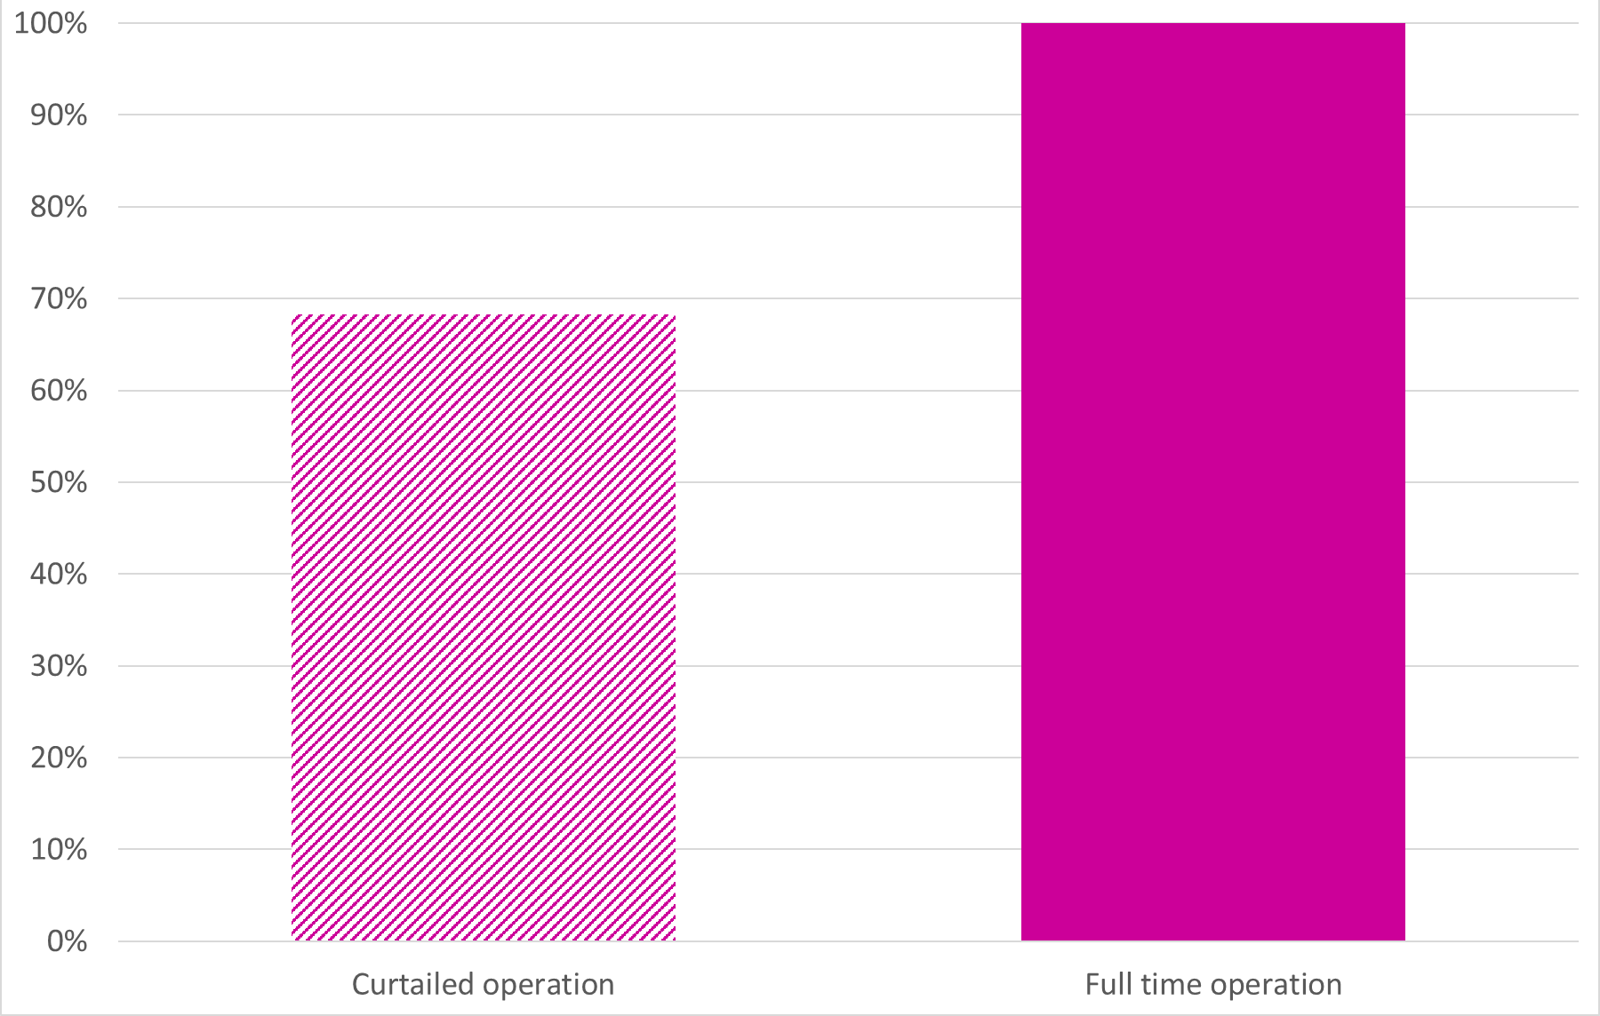
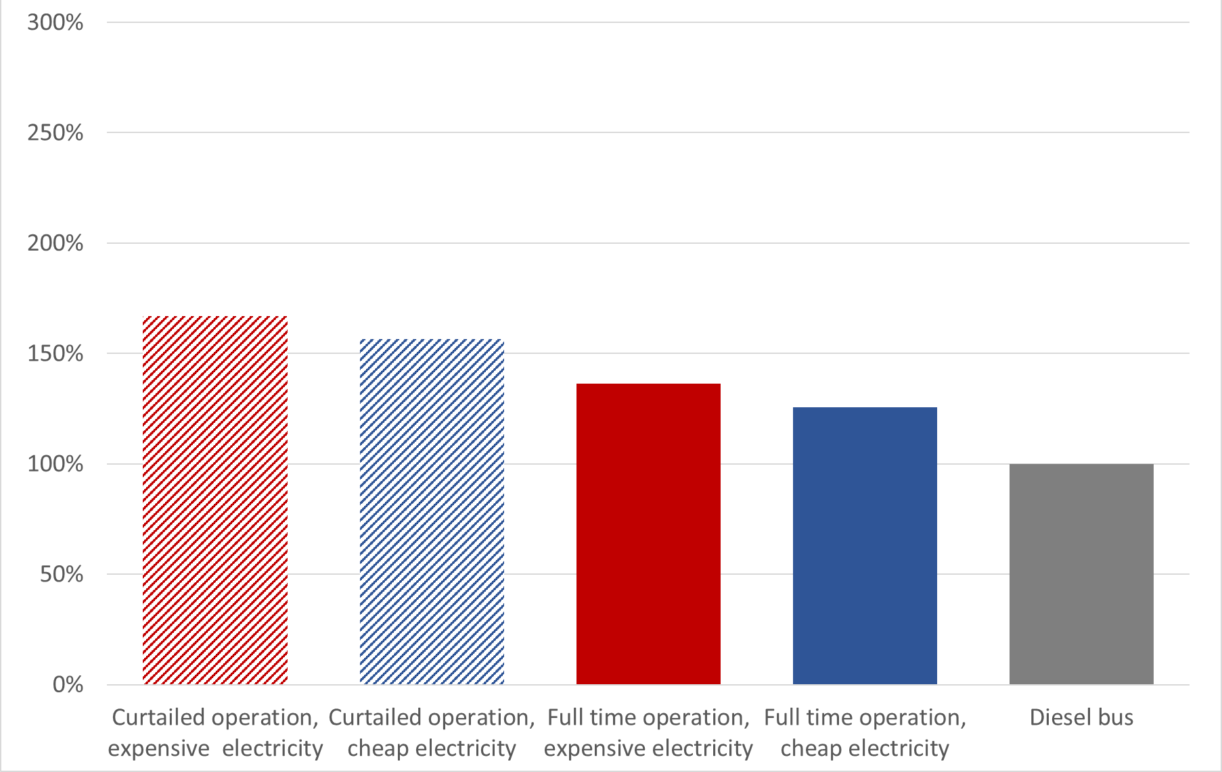
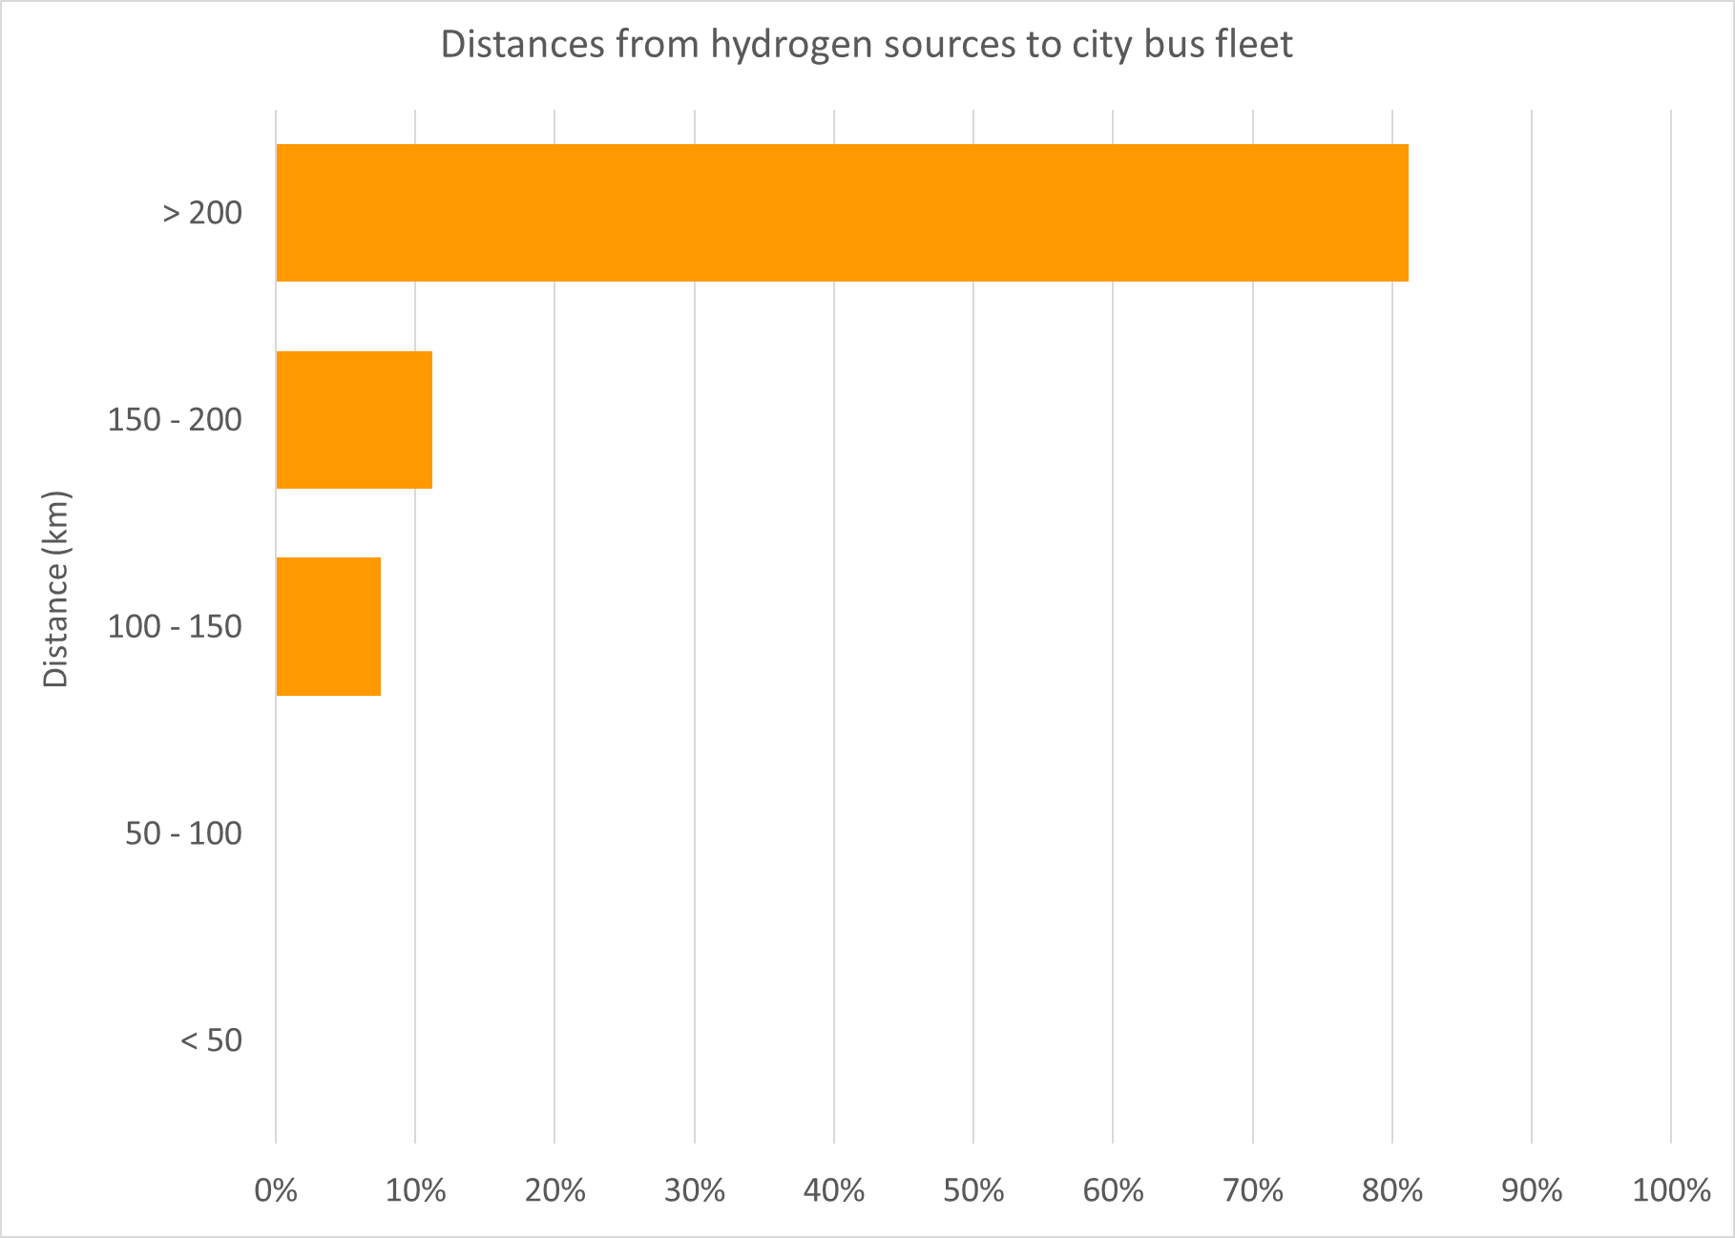
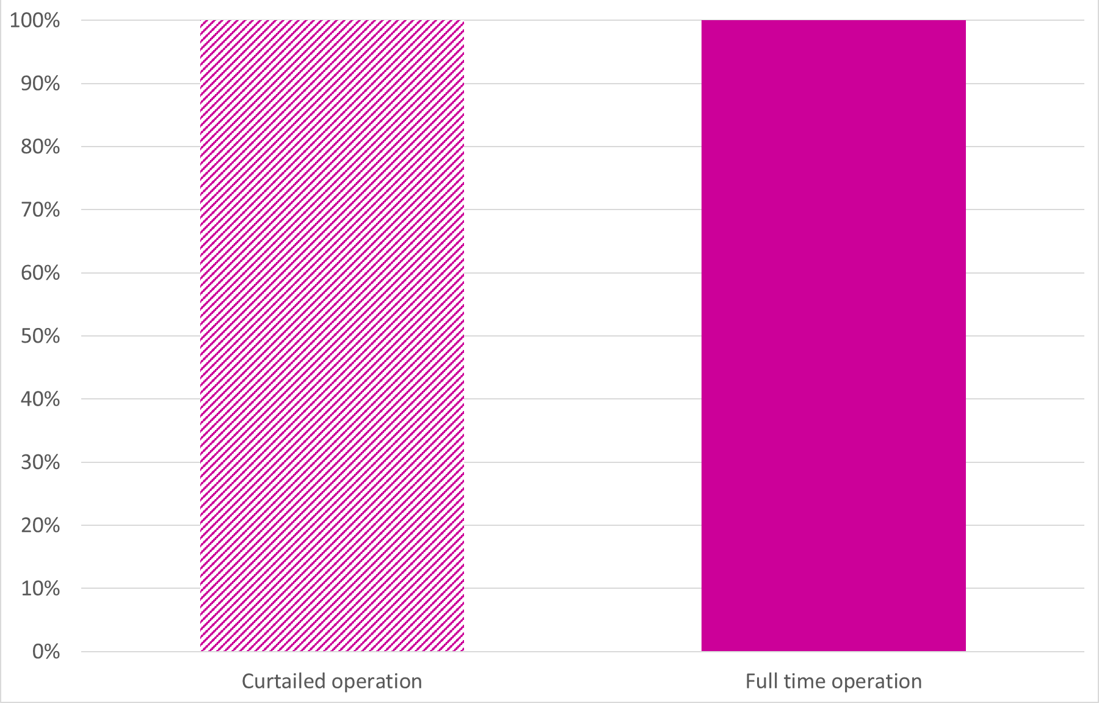
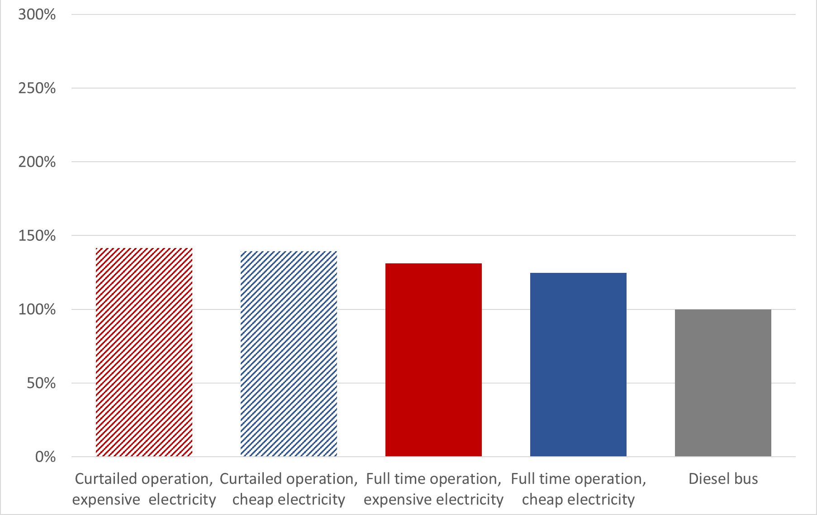
The Decision Support Tool Results for Dublin
Wind-H₂
Wind-H₂
Wind-H₂
The percentage of city bus fuel displaceable by renewable H2 for different electrolyser operation modes
The percentage of operational costs for FCEBs for different electricity prices and electrolyser operation modes, relative to diesel
Distances from hydrogen sources to city bus fleet
Wind+PV-H₂
Wind+PV-H₂
Wind+PV-H₂

Slide 19
Moving Beyond the DST
Fuel and operational costs are important but are only part of the picture
Many decarbonised fleets will have sizeable numbers of battery electric buses (BEBs)
Comparison of FCEBs with internal combustion engine buses (ICEBs) is becoming less relevant
Electrolysers located at wind farms comply with existing green hydrogen standards but can be expensive
We need to ENABLE better decision-making

Slide 20
Moving Beyond the DST
Opportunity for improvement | Action
Fuel and operational costs are important but are only part of the picture | Total Cost of Ownership modelling
Many decarbonised fleets will have sizeable numbers of BEBs | Integrating BEBs and FCEBs in mixed-fleet modelling
Comparison of FCEBs with ICEBs becoming less relevant | Comparison of FCEB fleets with BEB and hybrid electric bus (HEB) fleets
Electrolysers located at wind farms comply with existing green hydrogen standards but can be expensive | Investigating other means of green hydrogen production & supply
GenComm Project Partners’ Meeting #19 - 24th & 25th February 2022

Slide 21
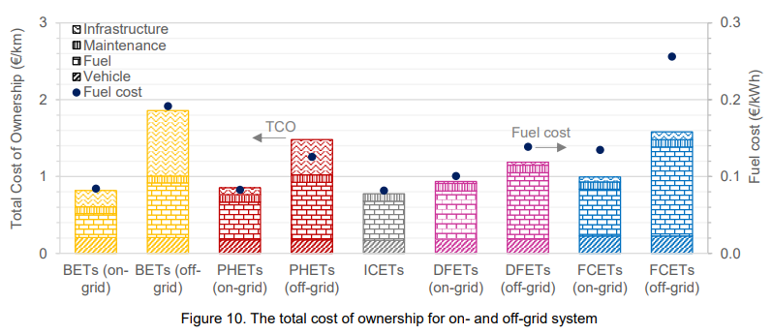
Moving Beyond Fuel-Only Costs
Total Cost of Ownership (TCO) and Total Carbon Abatement Cost (TCA) modelling
TCO: Sum of operating costs and investment costs of a fleet (€/km)
Cost of Infrastructure, maintenance, vehicles and fuel can be compared across fleet types
Well known and widely used among fleet operators
Useful for making business cases
TCA: Cost of abating 1kg of CO₂ emissions when moving to a green fleet (€/kg)
A graph of TCO & TCA for different truck fleets
GenComm Project Partners’ Meeting #19 - 24th & 25th February 2022

Slide 22
How Will FCEBs and BEBs Co-exist?
BEBs are generally cheaper than FCEBs,
BEBs suffer from range limitations
Additional BEBs and/or more expensive infrastructure required
FCEBs have comparable range to ICEBs: can deal with more energy intensive routes
Improvements in battery capacity will reach a plateau
BUT:
+
H₂
GenComm Project Partners’ Meeting #19 - 24th & 25th February 2022

Slide 23
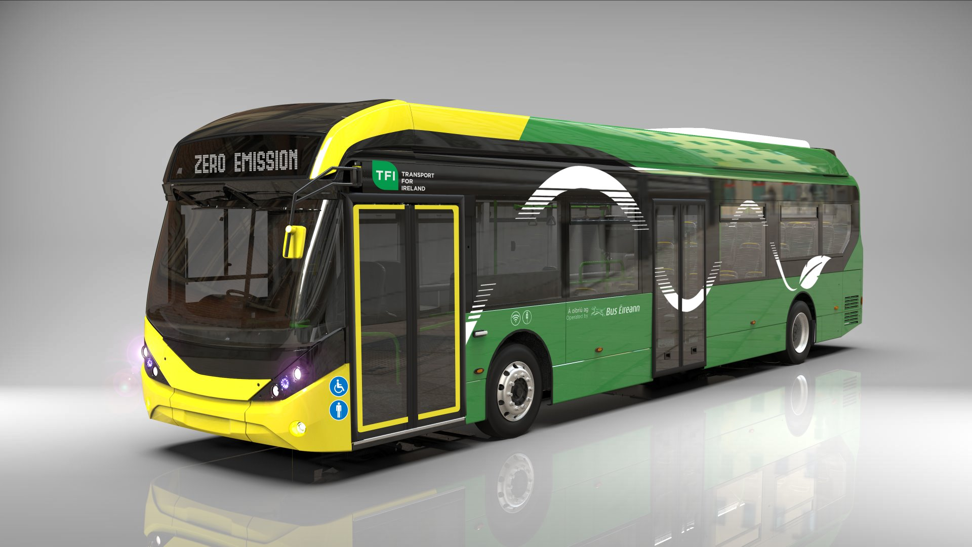
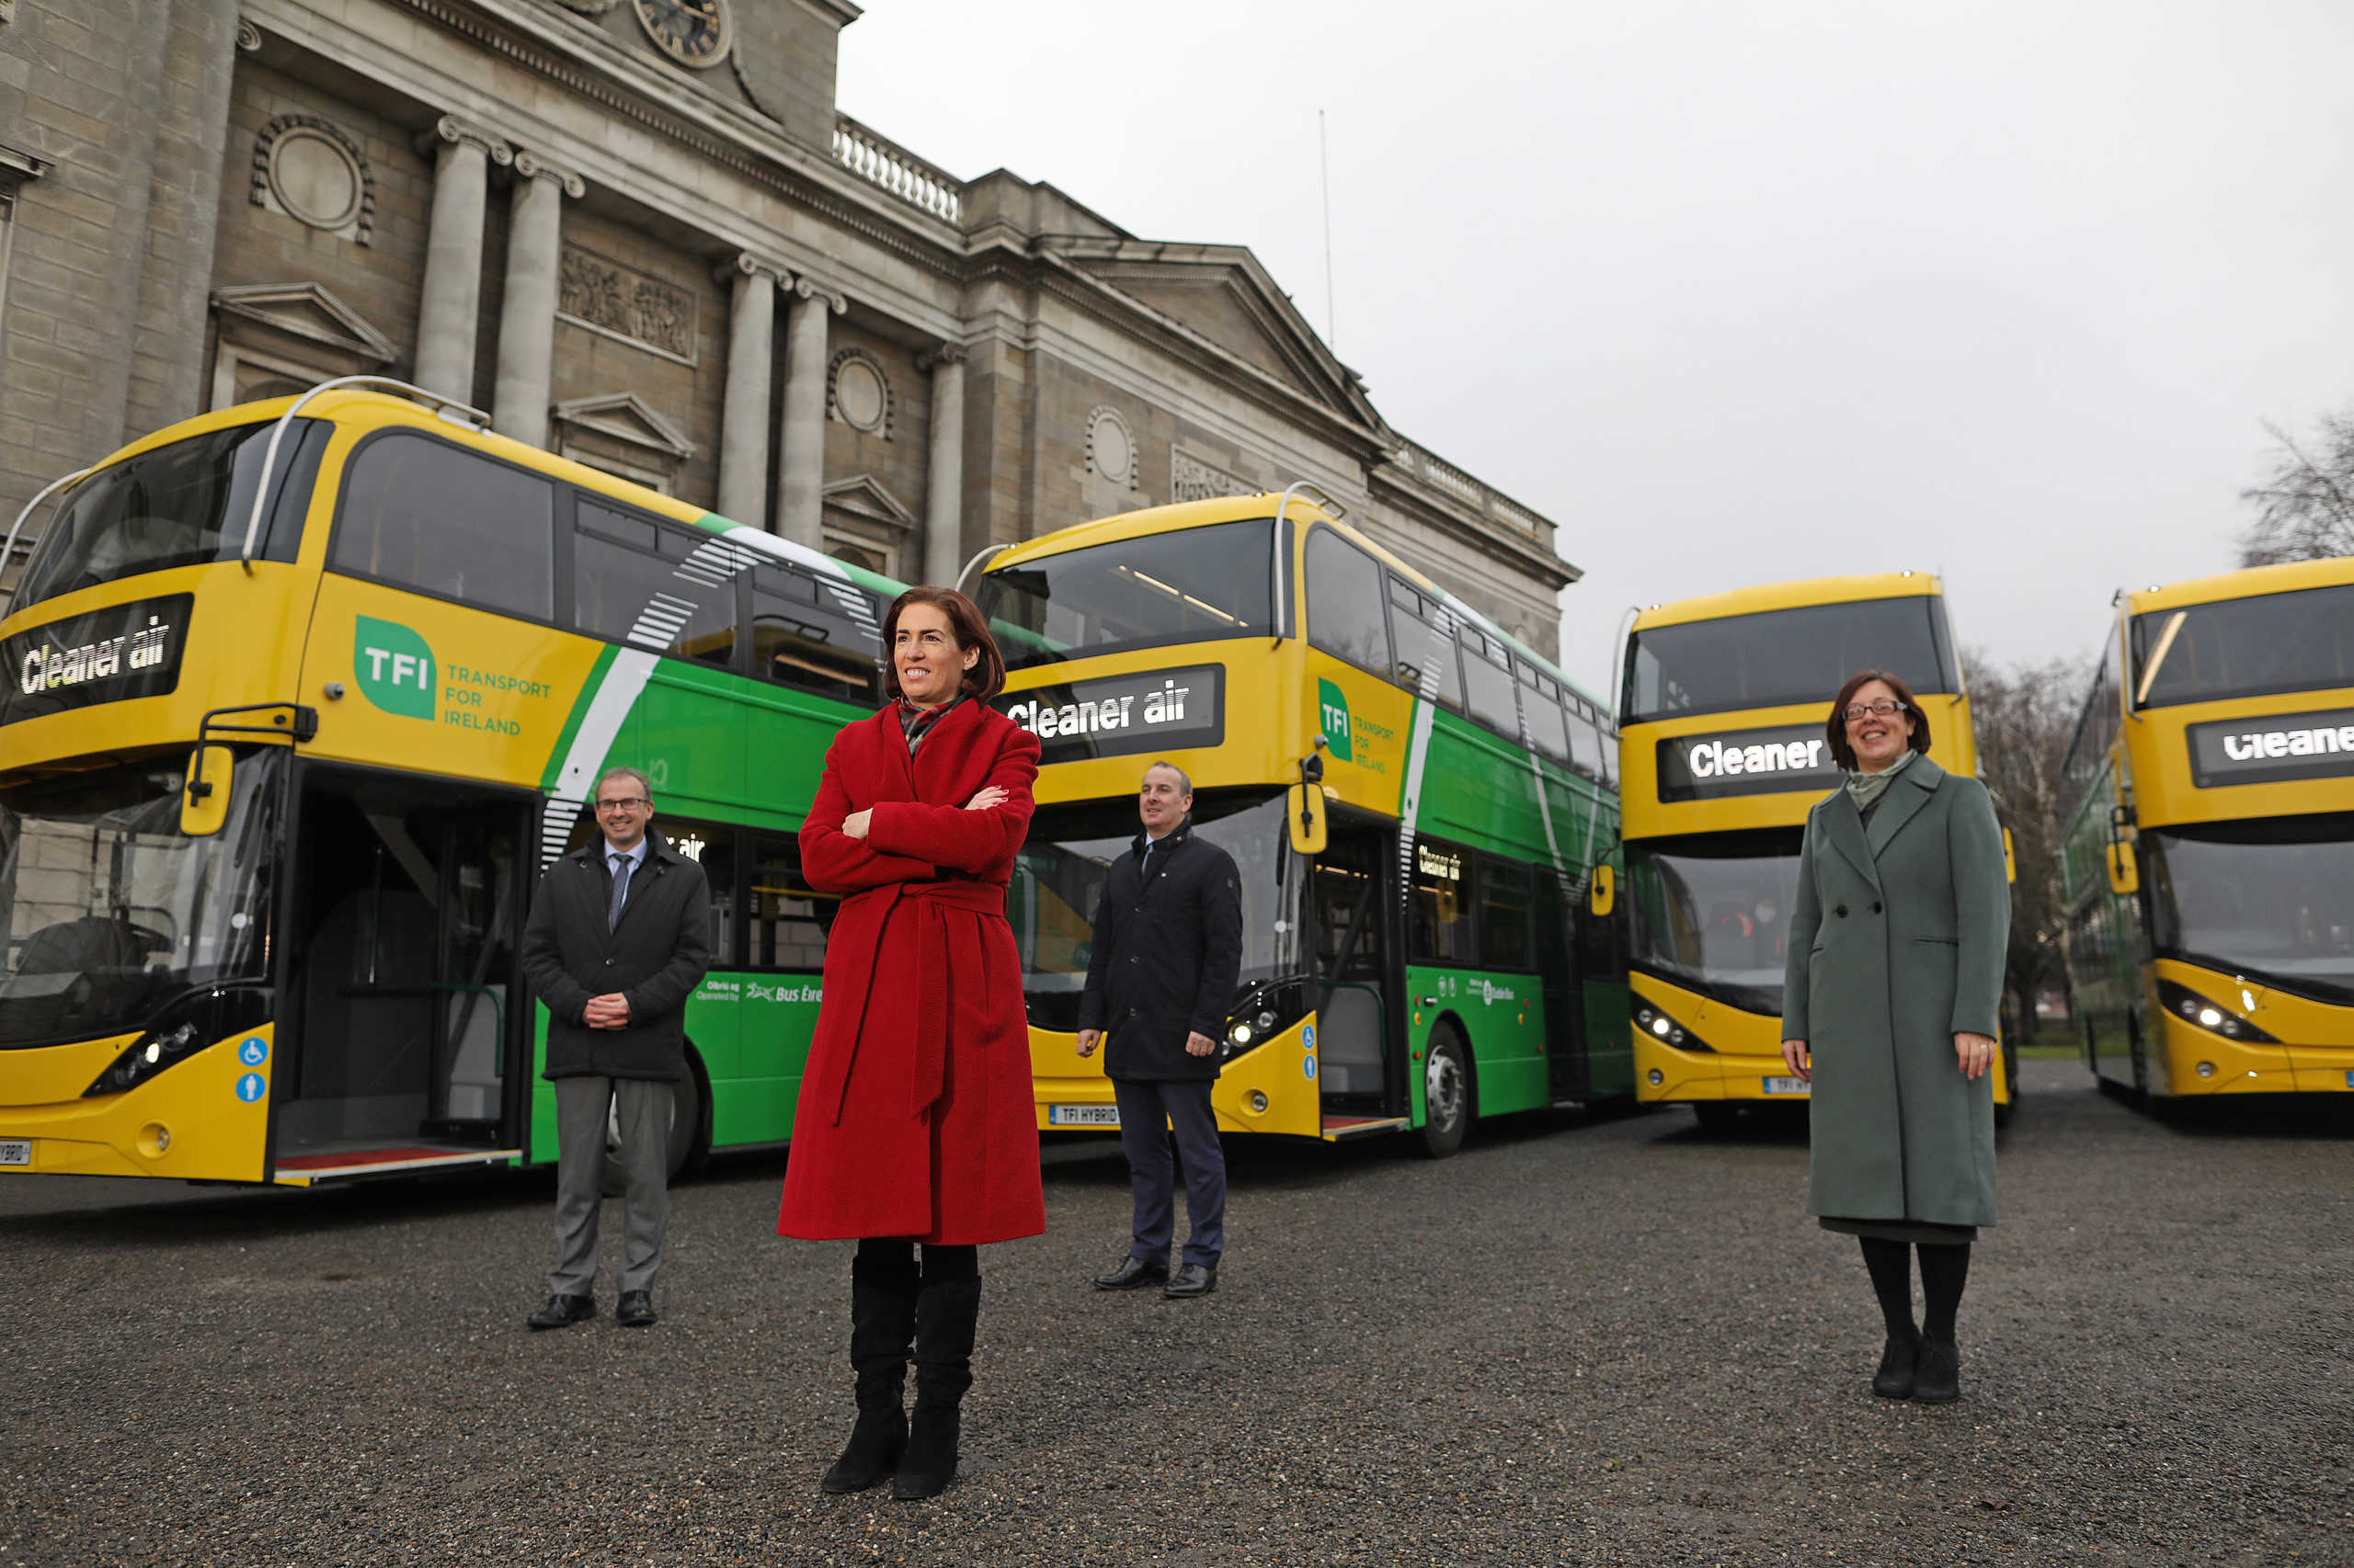
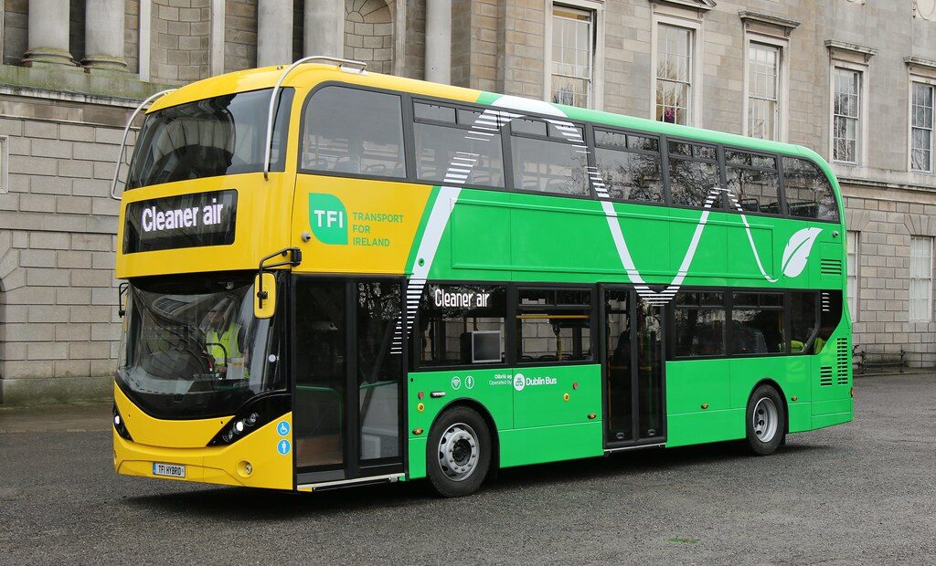
‘Baseline’ is Moving From Diesel to Electric
Only comparing FCEBs with ICEBs is not enough
More and more electric/hybrid buses are being deployed – a new baseline for comparison
Order placed for 45 single-deck BEBs for Dublin & Athlone
Double-deck HEBs in service in Galway & Dublin
3 FCEBs in operation in Dublin
GenComm Project Partners’ Meeting #19 - 24th & 25th February 2022

Slide 24
Thank You!

