Slide 1
GenComm Project
Partners’
Meeting #19
24th & 25th February 2022
DCU
Place image in this area.

Slide 2
Introduction
the 7 W’s of
GenComm

Slide 3
Why?
Renewable energy sources continue to increase their share of installed capacity worldwide. Their integration, in conjunction with increased energy efficiency and other low-carbon technologies, constitutes the best opportunity to achieve energy sustainability.
Renewable energy sources also constitute the best option to avert the risks that conventional non-renewable sources pose to health, geopolitics, the economy and the environment. In accordance with their commitment to the Paris Agreement of 2015,
Green H2 Energy Opportunity to develop a new model for exploiting remotely generated electricity from renewable sources to provide energy security for communities.
Implementing an energy model that relies on hydrogen as an energy carrier and is utilised to supply the main forms of energy demand: electricity, heating and transportation fuels.
GenComm Project Partners’ Meeting #19
24th & 25th February 2022

Slide 4
What?
GenComm Project Partners’ Meeting #19 - 24th & 25th February 2022

Slide 5
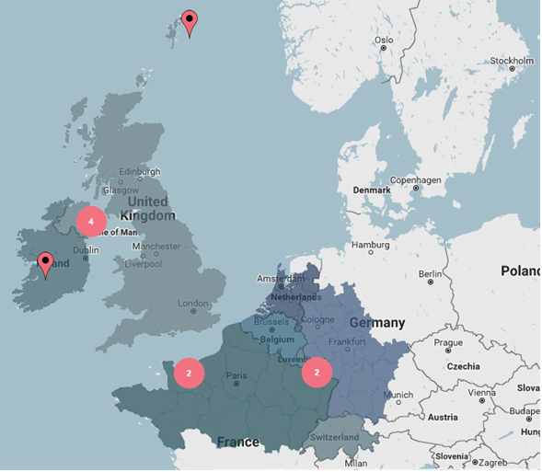
Where?
GenComm Project Partners’ Meeting #19
24th & 25th February 2022
Notes:
Renewable energy sources continue to increase their share of installed capacity worldwide. Their integration, in conjunction with increased energy efficiency and other low-carbon technologies, constitutes the best opportunity to achieve energy sustainability. They also constitute the best option to avert the risks that conventional non-renewable sources pose to health, geopolitics, the economy and the environment. In accordance with their commitment to the Paris Agreement of 2015, 175 parties have created national renewable energy action plans (NREAPs). Each NREAP aims to develop mixed energy systems that rely on a variety of renewable energy sources and energy carriers. These plans involve increasing renewable energy penetration targets for the electricity, heating and cooling and transport sectors. These three sectors alone account for 20%, 40% and 40% respectively of total end-use energy demand. And to shift from a hydrocarbon based economy to a renewable one, there is a need for clean sustainable energy carriers. Energy carriers have now been identified as the key enabling solution that allow renewable sources to supply different forms of energy demand across these sectors, and thus strengthen their technical and economic viability [2].
Hydrogen is one of these carriers that has attracted much support from across many countries across the globe. In fact, it has the potential to become one of the main energy carriers of the future as it can be easily produced using renewable energy, stored using commercially available technologies and used throughout the entire energy system. The use of hydrogen as an energy carrier however, has been hindered by specific challenges that need to be addressed.

Slide 6
Who?
Core Partners
Belfast Met
Energia
HyEnergy
National University of Ireland Galway
University of Luxemburg
IZES GmbH
Auxiliary Partners
ENSICAEN
INSA Rouen
VUB BURN
TK Renewables
Pure Energy Centre
Associate Partners
85 International Associates
GenComm Project Partners’ Meeting #19
24th & 25th February 2022
Notes:
Renewable energy sources continue to increase their share of installed capacity worldwide. Their integration, in conjunction with increased energy efficiency and other low-carbon technologies, constitutes the best opportunity to achieve energy sustainability. They also constitute the best option to avert the risks that conventional non-renewable sources pose to health, geopolitics, the economy and the environment. In accordance with their commitment to the Paris Agreement of 2015, 175 parties have created national renewable energy action plans (NREAPs). Each NREAP aims to develop mixed energy systems that rely on a variety of renewable energy sources and energy carriers. These plans involve increasing renewable energy penetration targets for the electricity, heating and cooling and transport sectors. These three sectors alone account for 20%, 40% and 40% respectively of total end-use energy demand. And to shift from a hydrocarbon based economy to a renewable one, there is a need for clean sustainable energy carriers. Energy carriers have now been identified as the key enabling solution that allow renewable sources to supply different forms of energy demand across these sectors, and thus strengthen their technical and economic viability [2].
Hydrogen is one of these carriers that has attracted much support from across many countries across the globe. In fact, it has the potential to become one of the main energy carriers of the future as it can be easily produced using renewable energy, stored using commercially available technologies and used throughout the entire energy system. The use of hydrogen as an energy carrier however, has been hindered by specific challenges that need to be addressed.

Slide 7
When?
GenComm Phase I
16th March 2017 – 30th December 2020 – extended to 31st October 2021
GenComm Phase II
Capitalisation Call: July 2021 - August 2023
Total budget €11.8M
GenComm Project Partners’ Meeting #19
24th & 25th February 2022

Slide 8
How?
H2 Energy Carrier
As we move from a hydrocarbon based economy to a renewable one, there is a need for clean sustainable energy carriers.
Energy carriers have now been identified as the key enabling solution that allow renewable sources to supply different forms of energy demand across these sectors, and thus strengthen their technical and economic viability.
Hydrogen is a key energy carrier. It has the potential to become one of the main energy carriers of the future as it can be easily produced using renewable energy, stored using commercially available technologies and used throughout the entire energy system. The use of hydrogen as an energy carrier however, has been hindered by specific challenges that need to be addressed.
GenComm Project Partners’ Meeting #19
24th & 25th February 2022
Notes:
Renewable energy sources continue to increase their share of installed capacity worldwide. Their integration, in conjunction with increased energy efficiency and other low-carbon technologies, constitutes the best opportunity to achieve energy sustainability. They also constitute the best option to avert the risks that conventional non-renewable sources pose to health, geopolitics, the economy and the environment. In accordance with their commitment to the Paris Agreement of 2015, 175 parties have created national renewable energy action plans (NREAPs). Each NREAP aims to develop mixed energy systems that rely on a variety of renewable energy sources and energy carriers. These plans involve increasing renewable energy penetration targets for the electricity, heating and cooling and transport sectors. These three sectors alone account for 20%, 40% and 40% respectively of total end-use energy demand. And to shift from a hydrocarbon based economy to a renewable one, there is a need for clean sustainable energy carriers. Energy carriers have now been identified as the key enabling solution that allow renewable sources to supply different forms of energy demand across these sectors, and thus strengthen their technical and economic viability [2].
Hydrogen is one of these carriers that has attracted much support from across many countries across the globe. In fact, it has the potential to become one of the main energy carriers of the future as it can be easily produced using renewable energy, stored using commercially available technologies and used throughout the entire energy system. The use of hydrogen as an energy carrier however, has been hindered by specific challenges that need to be addressed.

Slide 9
GenComm Deliverables
Curtailed renewable energy sources
Energy demands
Hydrogen could make sense for my community, organisation or company.
But how do I make it happen?
How do I find a hydrogen source or market?
Industry
Wind Energy
Solar Energy
Mobility
Stationary Energy
AD Plant
DST
Decision Support Tool
CH2F Community Hydrogen Forum
EST
Enabling Support Tool
GenComm Project Partners’ Meeting #19
24th & 25th February 2022

Slide 10
What’s Next?
Green H2 has emerged as a critical pillar to any aspiring net zero path. Globally, policy, affordability, and scalability are converging to create unprecedented momentum for the clean hydrogen economy
Continuous work on the commodification of Green Hydrogen
Additional international partnerships and projects. Including MARTH2, H2CAT, HALLIE, HyLight and others
Extend the reach of GenComm whilst also ensuring the richness through initiatives such as Hydrogen Ireland, linking in with The Clean Hydrogen Partnership and others
Develop the hydrogen tangential pathways supporting the Hydrogen revolution - to ensure comprehensive economic, social, commercial, academic and environmental pathways to sustainable success.
GenComm Project Partners’ Meeting #19
24th & 25th February 2022

Slide 11
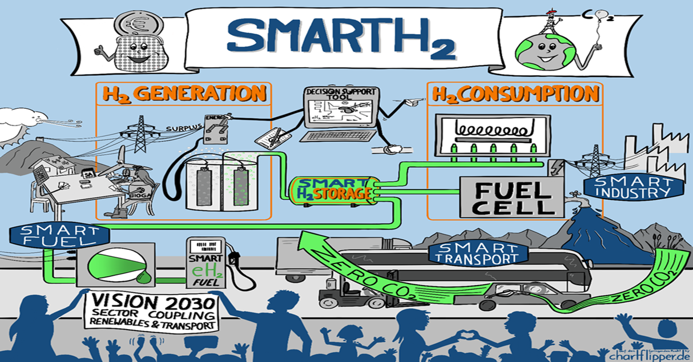
SMART H2
GenComm Project Partners’ Meeting #19 - 24th & 25th February 2022

Slide 12
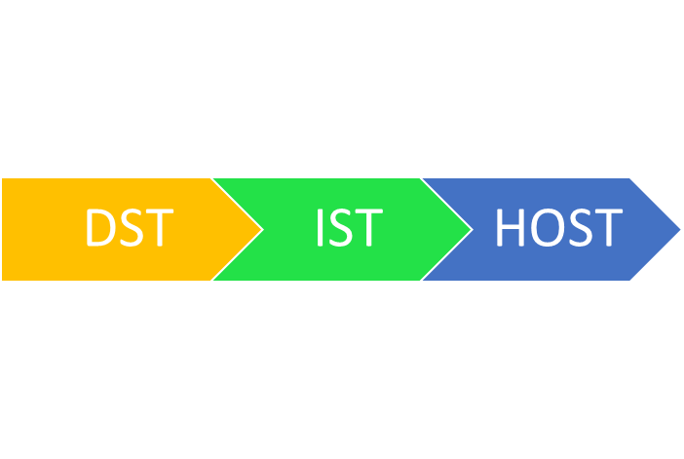
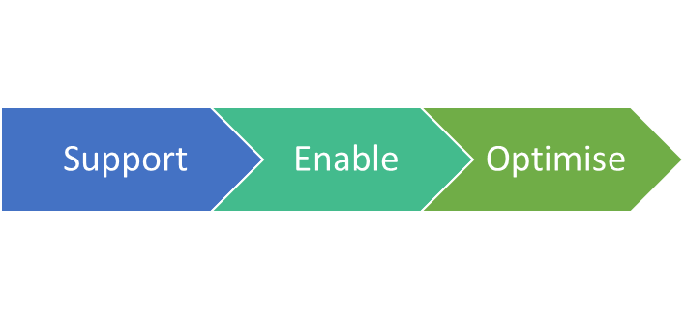
Hydrogen Optimisation Support Tool
Optimising hydrogen production, storage and use.
Actualising the CH2F to valorise and maximise the green energy outputs
Evaluation parameters of performance and benefits realisation
Validating P2X H2 technologies to be deployed in emerging scenarios
Developing long term strategies for the advancement in adoption of hydrogen technologies
Mapping Energy Navigation Routes for the transition of the EU energy system to the green destination
GenComm Project Partners’ Meeting #19 - 24th & 25th February 2022

Slide 13
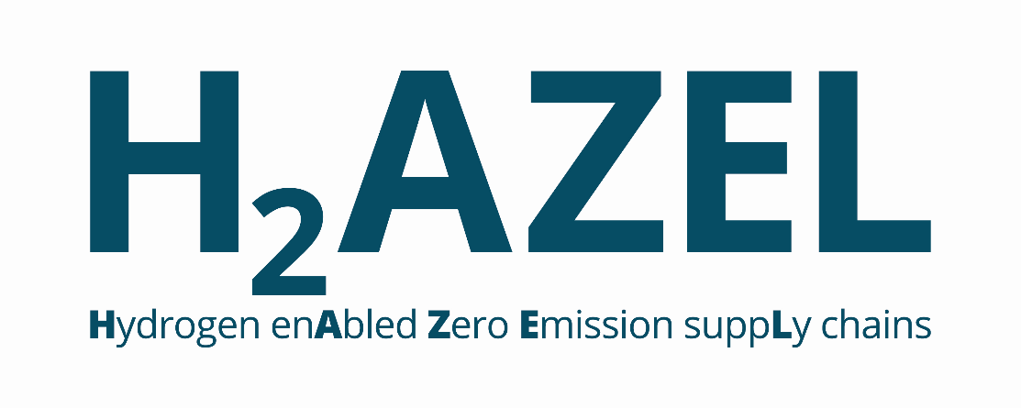
To decarbonise Europe, clean renewable power production must become the main source of energy.
Developing Power to X solutions for green hydrogen for hard to decarbonize industries
120% predicted increase in offshore wind capacity in Europe to 240 440 GW by 2050 presents a huge opportunity for a new European Green H2 Energy Equation.
GenComm Project Partners’ Meeting #19 - 24th & 25th February 2022

Slide 14
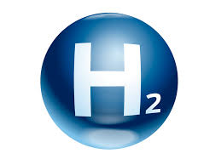
CAT
the pathway for increased H2 competitiveness
H2CAT will focus on:
• Production
• Applications & Usage
Sustainability
• Engineering and design
• Commercialising potential
• Collaboration
• ‘System scale’ skills development
• Reliability, safety and communications
GenComm Project Partners’ Meeting #19 - 24th & 25th February 2022

Slide 15
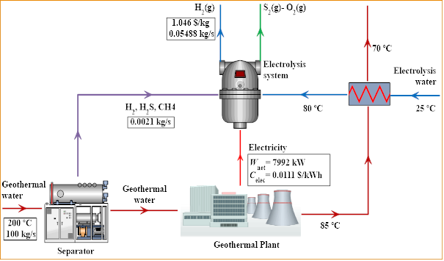
Geothermal
H2
 | Gray Hydrogen | Green Hydrogen via Wind Energy | Green Hydrogen via Solar Energy | Green Hydrogen via Geothermal Electricity | Green Hydrogen via Geothermal Electricity + Geothermal Heat | Green Hydrogen via Geothermal Electricity + Geothermal Heat + Non condensable Gases H₂ and H₂S
Hydrogen production cost (USD/kgH₂) | 1.00-2.27 | 2.65-5.00 | 3.40-6.35 | 1.11 | 1.08 | 1.04
GenComm Project Partners’ Meeting #19 - 24th & 25th February 2022

Slide 16
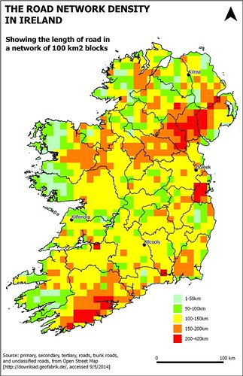
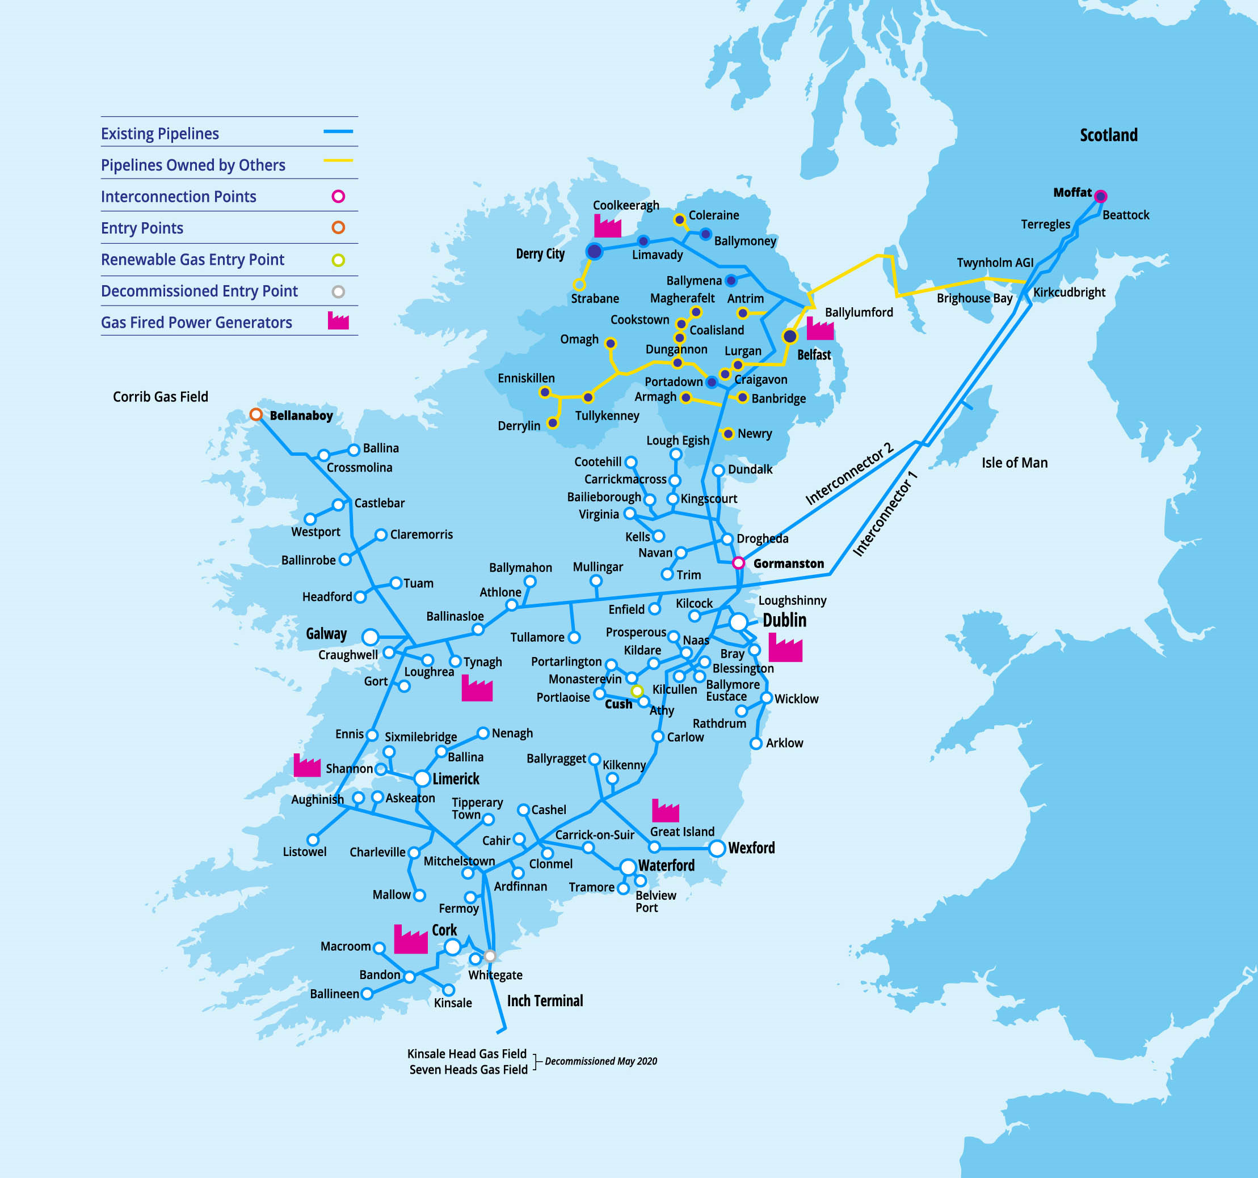
Irish Hydrogen Valley
GenComm Project Partners’ Meeting #19 - 24th & 25th February 2022

Slide 17
Reaching net zero by 2050 requires further rapid deployment of available technologies as well as widespread use of technologies that are not on the market yet.
Most of the global reductions in CO₂ emissions through 2030 in our pathway come from technologies readily available today.
But in 2050, almost half the reductions come from technologies that are currently at the demonstration or prototype phase.
Technological
Innovation
GenComm Project Partners’ Meeting #19 - 24th & 25th February 2022

Slide 18
Our Global Challenge
Stay ahead of the Green H2 curve
Accelerate the commodification pathway for green hydrogen integration into our energy mix
Infrastructure & Storage
Demand and Use
Stakeholder Engagement
Hydrogen Optimisation
Green H2 Supply

Slide 19
In Conclusion
GenComm is part of the wider global energy solution
We are all part of the new energy revolution
We are helping shape the energy future

Slide 20
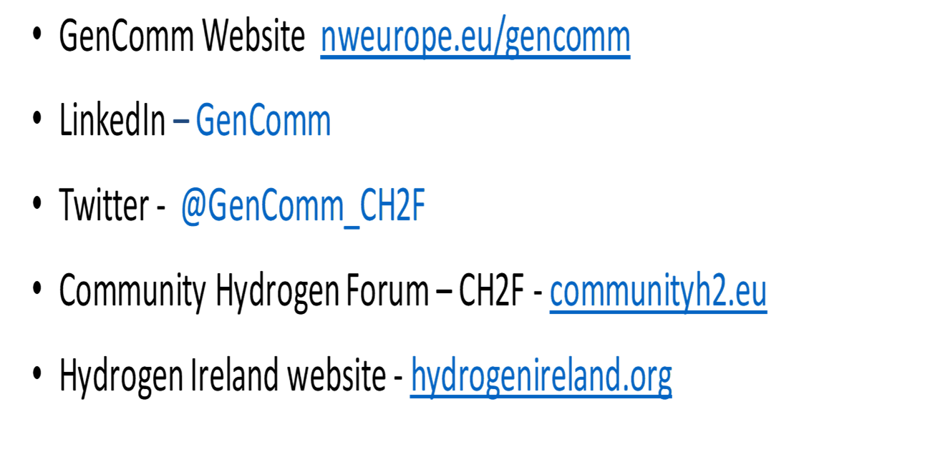
Thank You!
Place image in this area.

